Slide 2
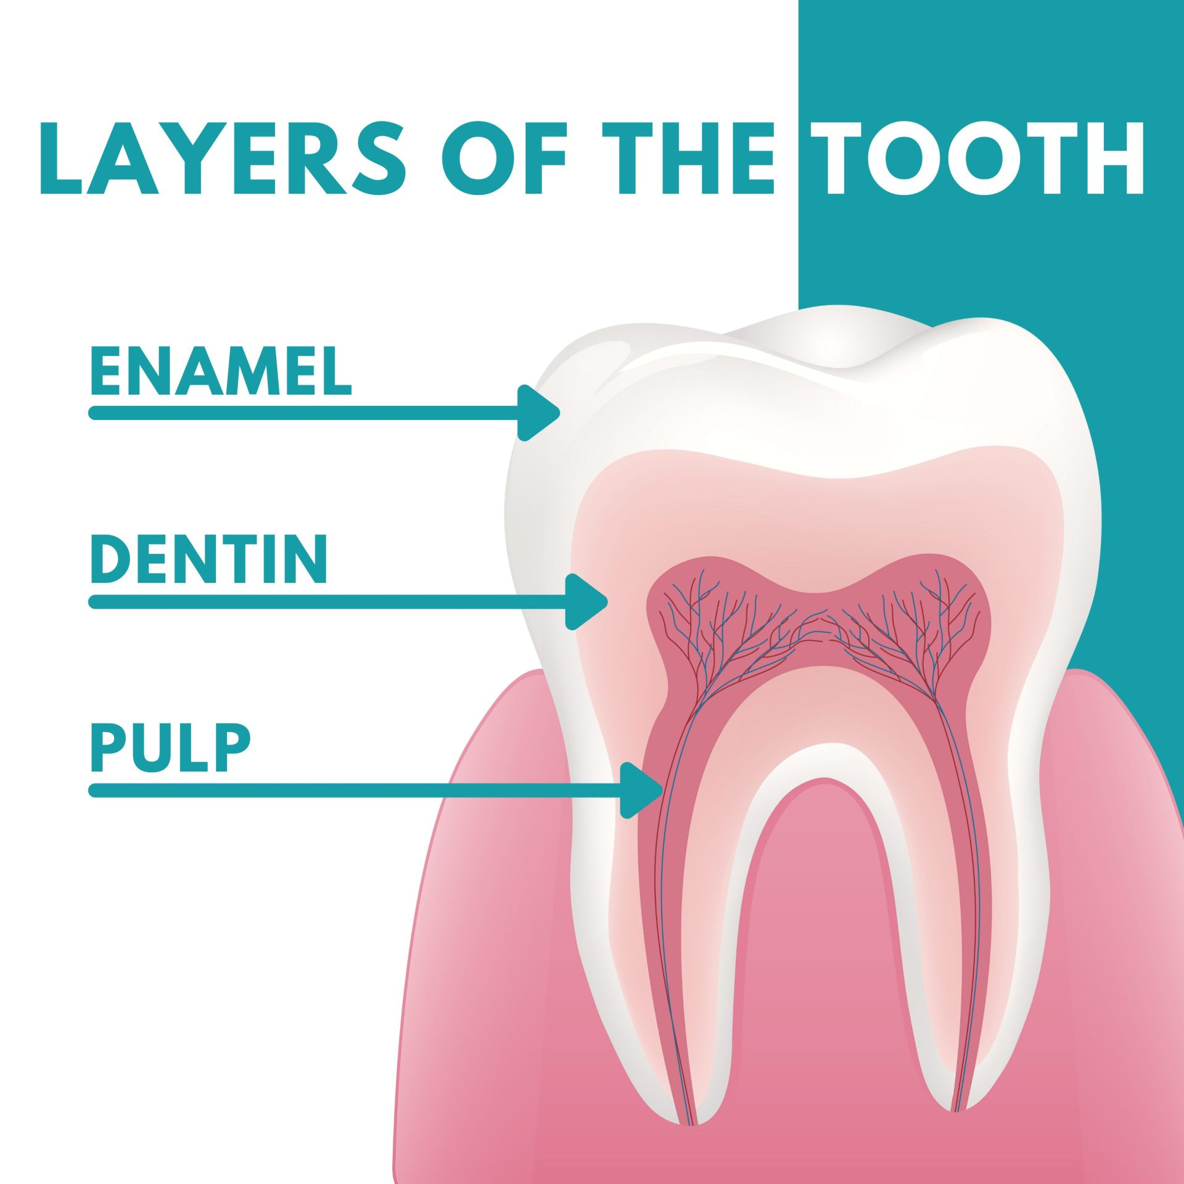

Slide 3
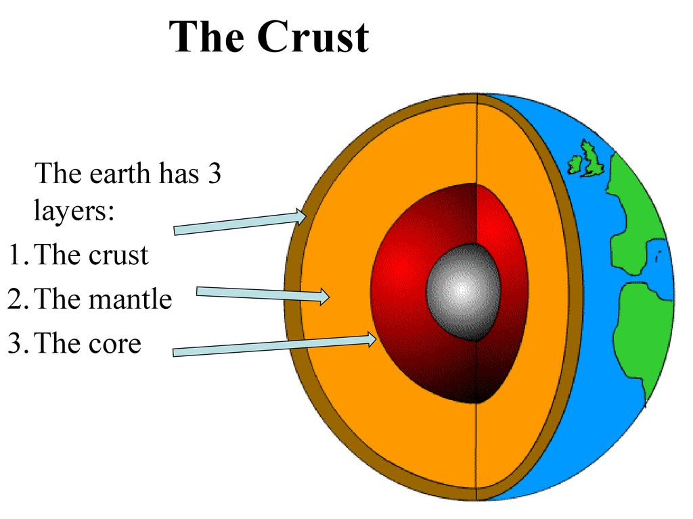

Slide 6
The message of Jesus Christ is God’s power to save (Rom. 1:16; 1 Cor. 15:1-2)
The message of Jesus Christ is God’s power to keep saved (1:15; 1 Cor. 15:1-2)
Action Item for You: Spend Time in the Gospels – Fill Yourself Up with Jesus Christ

Slide 7
The O.T. prophets foretold of God’s amazing plan of redemption (Rom. 1:2)
Some of God’s plans were not fully known until the N.T. (1 Pet. 1:10-12; Eph. 3:3-4)
No way man could have known of God’s plan without:
The O.T. prophets foretelling it and the N.T. prophets unfolding it
The Holy Spirit revealing it to all these men (1 Cor. 2:10-13; 2 Pet. 1:20-21)
God’s plan has been made known to all nations (16:26), in order to save all nations (Acts 10:34-35; Mark 16:15-16)
Action Item for You: Spend Time in the Old Testament – Find Those Connections to the New Testament

Slide 8
The N.T. is the law under which we live (Heb. 8:6-13)
The N.T. gives us “the commandment of the everlasting God” (cf. 1 Cor. 14:37)
The ultimate purpose = “For obedience to the faith”
Biblical faith is fully trusting God (Rom. 4:20-21)
Biblical faith is fully obeying God (Rom. 1:5; 6:17; 16:26)
True faith leads to a life of obedience which leads to a life in heaven (Rev. 14:12-13)
Action Item for You: Spend Time in Acts and the Epistles – Follow the Will of God

Slide 10
Believe Jesus is God’s Son – Mark 16:16
Repent of your sins and turn to God – 2 Peter 3:9
Confess your faith in Jesus Christ – Matthew 10:32
Be immersed into Christ – 1 Peter 3:21
God will forgive all of your sins – Acts 2:38
God will add you to His church – Acts 2:47
God will enroll you in heaven – Hebrews 12:23
Serve Him faithfully – 1 Corinthians 15:58

