Slide 1
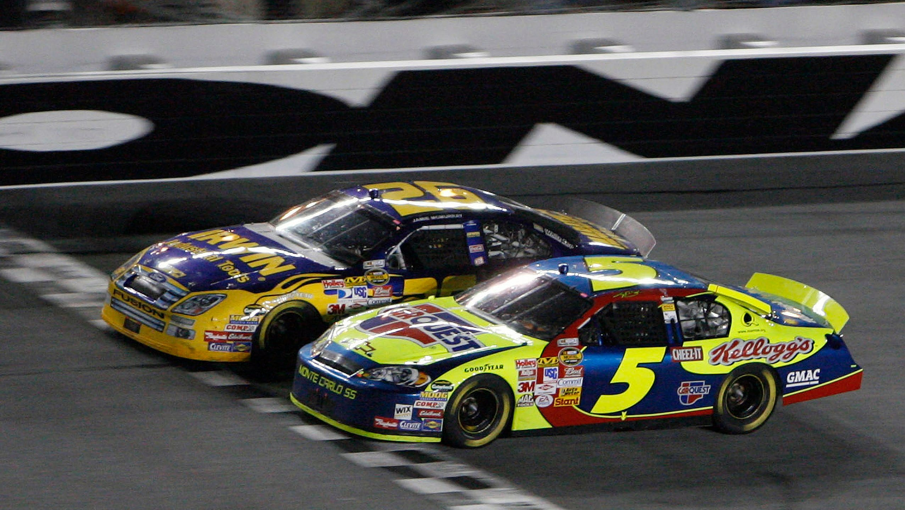
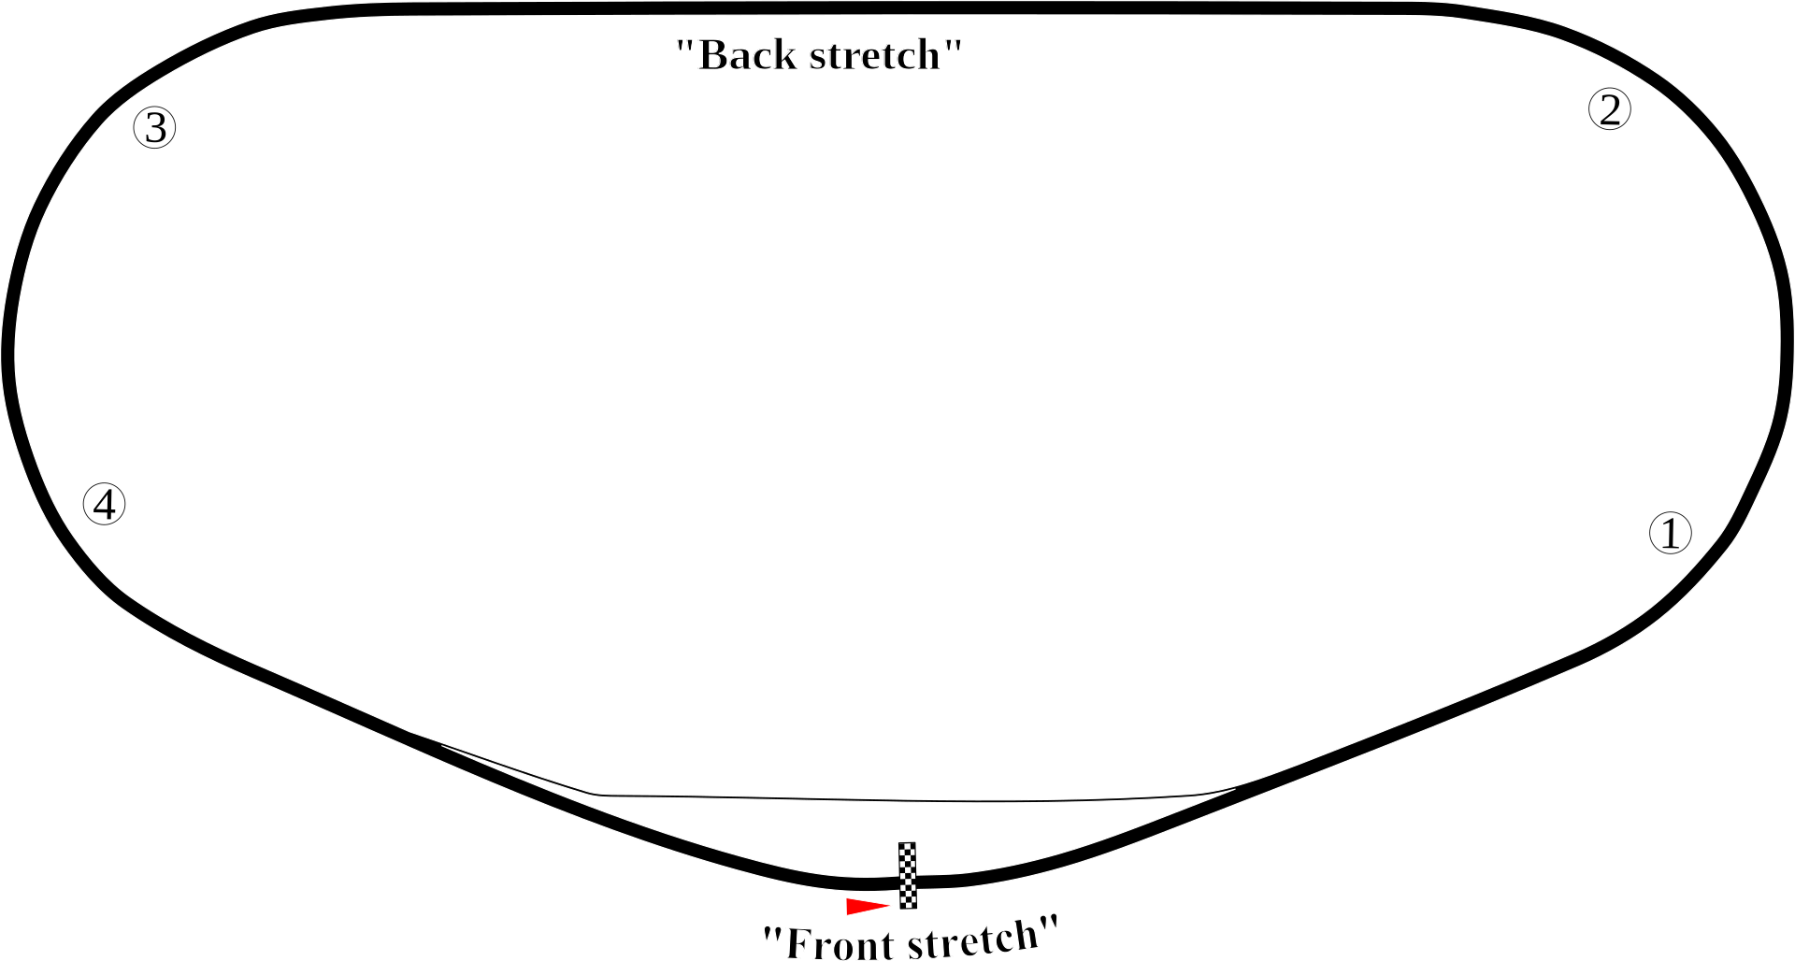
Pepsi 400 NASCAR Race
July 7, 2007
Daytona International Speedway
2.5-mile track
160 laps
Margin of victory:
0.005 seconds

Slide 2
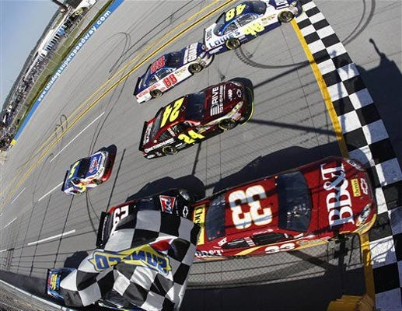
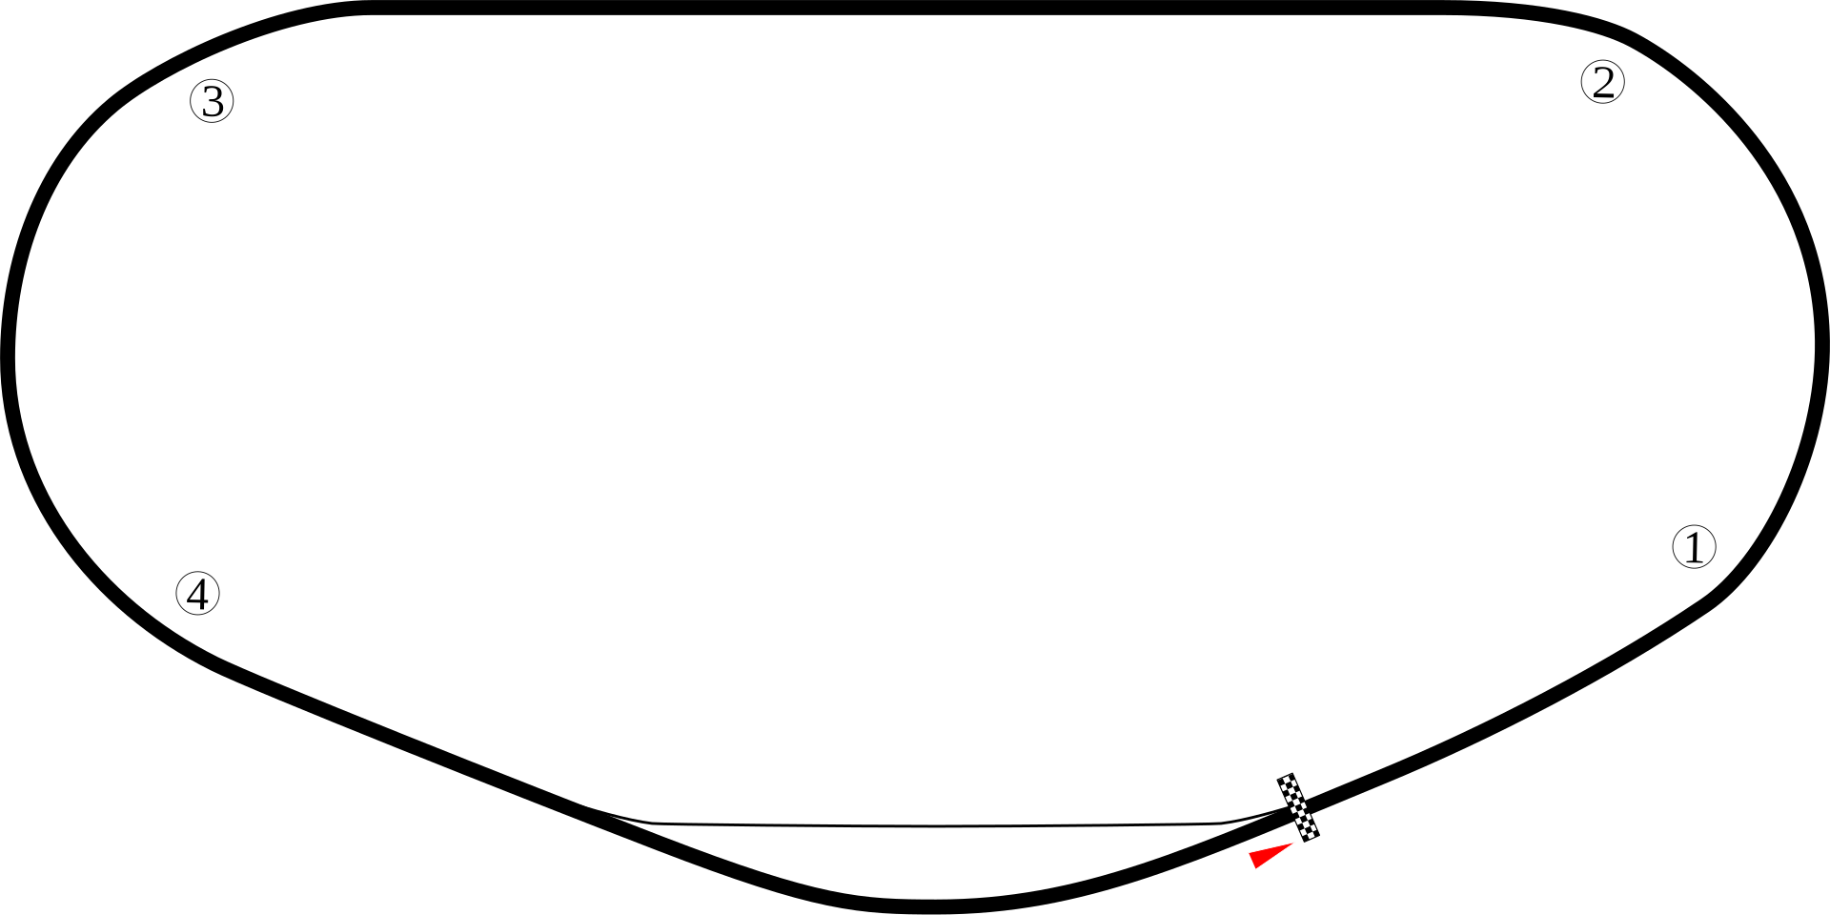
Aaron’s 499 NASCAR Race
April 17, 2011
Talladega Superspeedway
2.66-mile track
188 laps
Margin of victory:
0.002 seconds

Slide 3
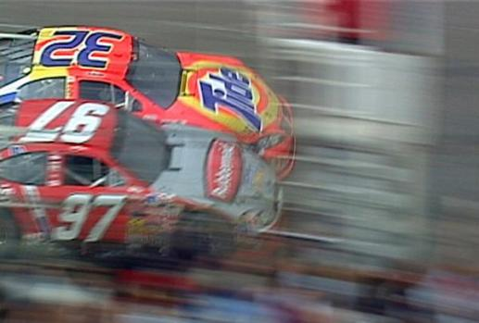
Carolina Dodge Dealers 400
March 16, 2003
Darlington Raceway
1.366-mile track
293 laps
Margin of victory:
0.002 seconds

Slide 4
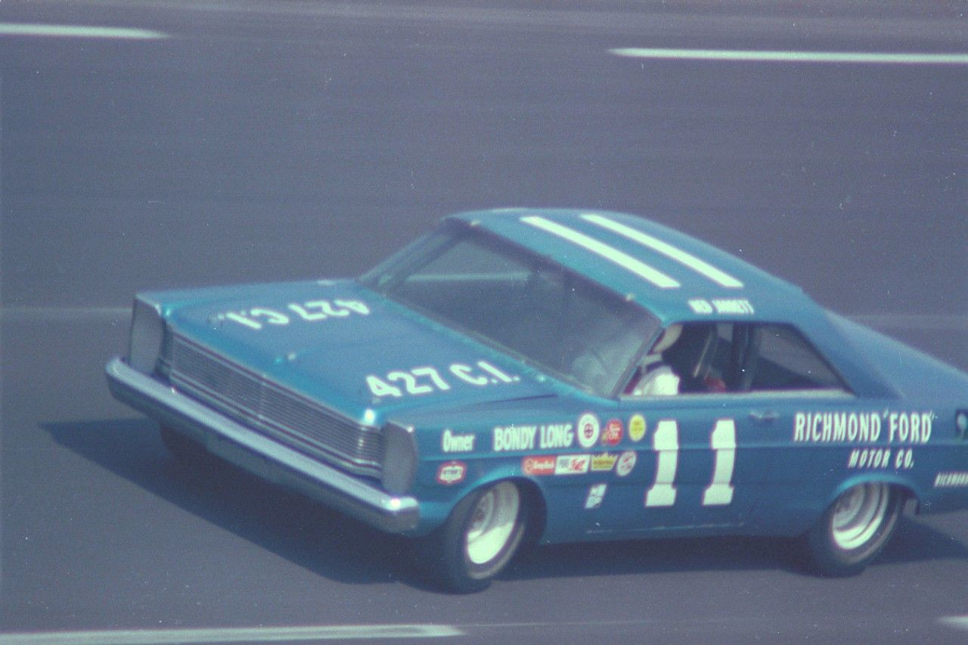
Southern 500 NASCAR Race
September 6, 1965
Darlington Raceway
1.375-mile track
364 laps
Margin of victory:
14 laps

Slide 6
First in Time (Mark 16:9; Rev. 2:5)
First in Sequence (Matt. 7:5; 1 Tim. 2:13)
First in Rank & Value
In regard to things (Mark 12:28-31; Luke 15:22)
In regard to people (Mark 10:43-44; 1 Tim. 1:15)
First in Degree (Matt. 6:33)
Means “ABOVE ALL things” – the central position the CHURCH is to have
EXCLUSIVE prominence – the HIGHEST PURPOSE in my life EVERY SINGLE DAY!

Slide 7
I don’t seek to expand those borders with the gospel (Mark 16:15)?
I don’t seek brethren who have wandered outside the borders (Jas. 5:19-20)?
I don’t defend those borders against attack (Phil. 1:16-17; 1 Pet. 3:15)?
I’m not more concerned about His borders than others (Acts 10:34-35)?

Slide 8
I don’t love its laws (2 Thess. 2:10; Psa. 119:97)?
I don’t seek after its laws (John 7:17; Matt. 5:6; Psa. 119:82)?
I don’t joyfully obey its laws (John 14:23; Matt. 7:21; 1 John 2:17)?
I don’t gladly avoid every violation of His law (1 Thess. 5:21-22; 1 Pet. 2:11)?
I’m not more concerned about His laws than other laws (Acts 4:19-20; 5:29)?

Slide 9
I don’t encourage one another (1 Thess. 5:11; Rom. 14:19; Heb. 3:13)?
I don’t serve one another (Gal. 5:13; 1 Pet. 4:10)?
I don’t practice hospitality toward one another (1 Pet. 4:9; Rom. 12:13)?
I don’t pray for one another (Jas. 5:16; 1 Thess. 1:2)?
I’m not more concerned about His citizens than others (Gal. 6:10; 1 Pet. 2:17)?

Slide 10
I don’t spend time with Him every day (Col. 3:15-16; Psa. 1:2; Josh. 1:8)?
I don’t love assembling and worshiping Him (Heb. 2:12; Col. 3:16; Psa. 122:1)?
I don’t cheerfully give back to Him what He has given to me (2 Cor. 9:6-8)?
I don’t eagerly hasten the possibility of seeing Him every day (Phil. 3:20; 2 Pet. 3:12)?
I’m not more concerned about pleasing my King than anyone else (Gal. 1:10; Jas. 4:4)?

Slide 11
Believe Jesus is God’s Son – John 8:24
Repent of your sins and turn to God – Luke 13:3
Confess your faith in Jesus Christ – Matthew 10:32
Be immersed into Christ – John 3:5
God will forgive all of your sins – Acts 2:38
God will add you to His church – Acts 2:47
God will enroll you in heaven – Hebrews 12:23
Put the Lord and His church first every day – Matthew 6:33

