Slide 1
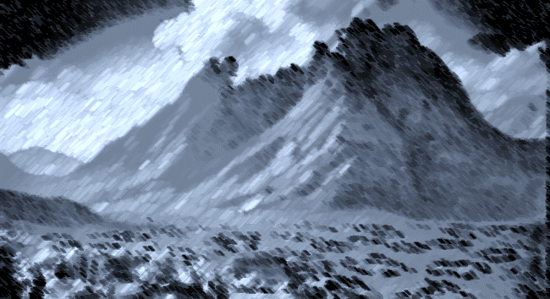
A Survey of Exodus and Leviticus
EXODUS CHAPTERS 28, 29, 39 & 40
LEVITICUS CHAPTERS 1-7, 8 - 10
22/13

Slide 2
Leviticus 11:45
For I am the LORD who brings you up out of the land of Egypt, to be your God. You shall therefore be holy, for I am holy.
Notes:
This slide was used before as we talked about the purpose of Leviticus. Exodus tells us the story of the birth of the great nation promised Abraham and Leviticus speaks to those people as a HOLY PEOPLE
Always Keep in mind the connection between God’s people of the OT and God’s people of the NT (the Christian, the saints within the church)
Last week we focused on the reasons for the shallow nature of Israel’s faith and we recognized that our faith can be shallow as well.
We can’t escape the reality that Israel took their eyes off of God and when they did, they were disobedient
The same is true for us as well. We have to remain pure to hear “well done thou good and faithful servant, enter into the glory of the Lord”
IN chapters 39 and 40, and we discussed this previously, the phrase “as the LORD has commanded Moses” is used 18 times
It doesn’t say that GOD RECOMMENDED
The context of Nadab and Abihu’s sin story
Exodus 34
After Moses’ 2nd trip up the mountain, it is time for Israel to move out
Exodus 28
God chooses Aaron and his sons to the priests and prescribes the uniforms
God prescribed an appearance that would distinguish his priests from the heathen nations that they were going into
Exodus 29, Leviticus 8 & 9
The consecration of Aaron and his sons as the priests
Exodus 40
The construction of the finished tabernacle
In chapters 1 through 7 of Leviticus, the feast rules are set into place
Leviticus 10
The sin of Nadab and Abihu

Slide 3
The Priests
Exodus 28:1-4 Aaron, Nadab, Abihu, Eleazar & Ithamar
Exodus 28:5-39 The Ephod, Engraved Onyx Stones, The Breastplate, Precious and Semi-precious Stones, The Urim & Thummim, The Tunic, The Turban, The Sash
Exodus 28:41 Anointed, Consecrated & Sanctified
Exodus 29 &
Leviticus 8 A sin offering, a burnt offering and a consecration offering for Aaron & his sons
7 days of consecration (Aaron & sons could not leave the tabernacle
Notes:
To Be a priest, a man had to be washed EX 29:4
To be a priest, a man had to put on priestly garments EX 29:5-6
To be a priest, a man had to be anointed EX 29:7
To be a priest, a man had to be sprinkled with blood EX 29:19-21
To be a priest, a man had to constantly offer sacrifices EX:29-22-46
We also see the blood placed on their ears, thumbs and big toes and we can consider that in doing this they were dedicating their ears to hearing God’s word, in dedicating their hands to do God’s work and in dedicating their feet to walk in God’s path.
In Exodus 28 –
They were anointed, they were consecrated and they were sanctified (ordained)
The people witnessed the events and it was a big deal

Slide 4
The Priests
Leviticus 9:1-22 After consecration, 8th day, a sin offering, a burnt offering, a grain offering and a peace offering on behalf of Aaron, Aaron’s sons and the Israelite people
Leviticus 9:23(b)- 24 Fire from heaven consumes the burnt offering
Notes:
It appears that the events of chapter 10 take place immediately upon the consecration of the tabernacle or at least very closed thereto. In chapter 10, after Nadab and Abihu’s death Moses forbids Aaron and his two remaining sons from leaving the tabernacle, lest they die. We will talk about that a little more when we get there but the events of dedicating the tabernacle and consecrating and ordaining the priests and this event of Nadab and Abihu’s sin seem to be scenes within the same act of the story
At the end of chapter 9, God’s approval with Israel for the way they are handling the events of the tabernacle and the priesthood is evident. This is Israel being a Holy Nation as God wished them to be.
Of course that is going to change quickly as we get into chapter 10 but before we get there lets take a quick look at the priests

Slide 5
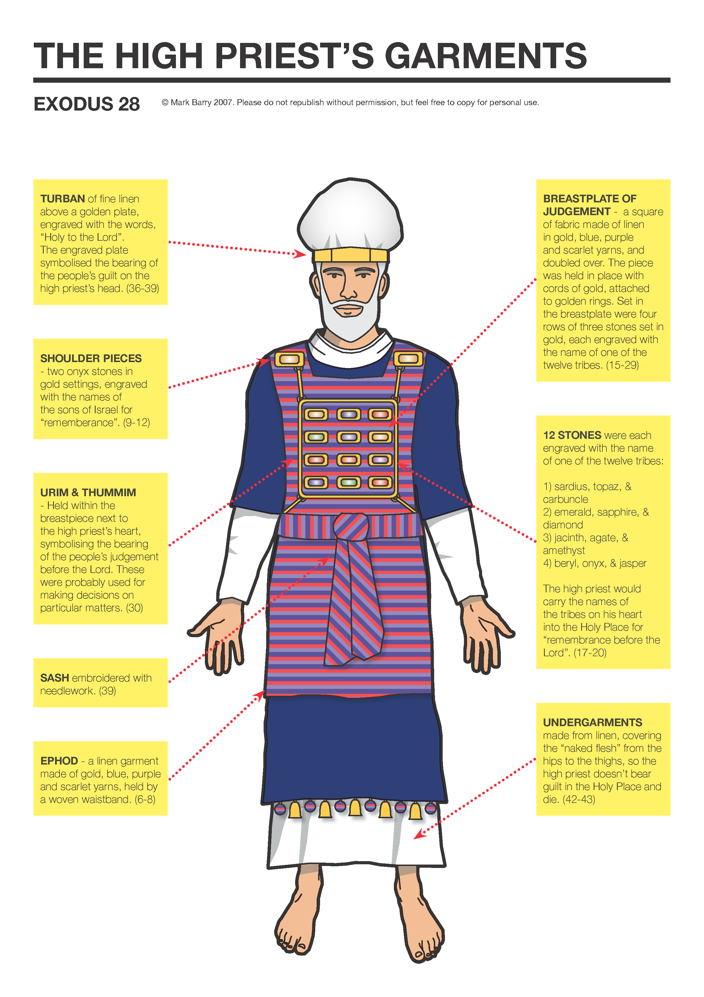
The
Priest Represented
Man
to God
Hebrews 8:1
1st Timothy 2:5
1st John 2:1
The
Priest Represented
God
to Man
John 14:6-9
1st Peter 2:4-5, 9-10
Notes:
Aaron had 4 sons and God chose them to be priests.
Nadab, Abihu, Eleazar & Ithamar
Aaron was chosen as High Priest which meant that he and he alone could go within the Most Holy Place
And there was a dress code when he went in as well as a dress code for all the priests who worked within the tabernacle
The breastplate and the Urim and the Thummim
Exodus 28:29 - "So Aaron shall bear the names of the sons of Israel on the breastplate of judgment over his heart, when he goes into the holy place, as a memorial before the LORD continually.
Every time the high priest entered the Holy Place he brought before YHWH the whole of Israel as a memorial. Bearing the names of all Israel could mean bearing their guilt or it could me interceding for them in prayer or it could be both.
URIM & THUMMIM (transliterated)
URIM means “lights” and THUMMIM means “perfections”
IN the possession of the high priest only because they were carried within the breastplate near the heart and only the high priest wore the breastplate
The Priest Represented Man to God
These scripture are for reference only, they are not to be read in class
Heb 8:1 Now this is the main point of the things we are saying: We have such a High Priest, who is seated at the right hand of the throne of the Majesty in the heavens,
1Ti 2:5 For there is one God and one Mediator between God and men, the Man Christ Jesus,
1Jn 2:1 My little children, these things I write to you, so that you may not sin. And if anyone sins, we have an Advocate with the Father, Jesus Christ the righteous.
The Priest Represented God to Man
John 14:6-9 is for reference and not to be read in class
Joh 14:6 Jesus said to him, "I am the way, the truth, and the life. No one comes to the Father except through Me.
Joh 14:7 "If you had known Me, you would have known My Father also; and from now on you know Him and have seen Him."
Joh 14:8 Philip said to Him, "Lord, show us the Father, and it is sufficient for us."
Joh 14:9 Jesus said to him, "Have I been with you so long, and yet you have not known Me, Philip? He who has seen Me has seen the Father; so how can you say, 'Show us the Father’?
1st Peter 2:4-5 & 9-10 is to be read in class
1Pe 2:4 Coming to Him as to a living stone, rejected indeed by men, but chosen by God and precious,
1Pe 2:5 you also, as living stones, are being built up a spiritual house, a holy priesthood, to offer up spiritual sacrifices acceptable to God through Jesus Christ.
1Pe 2:9 But you are a chosen generation, a royal priesthood, a holy nation, His own special people, that you may proclaim the praises of Him who called you out of darkness into His marvelous light;
1Pe 2:10 who once were not a people but are now the people of God, who had not obtained mercy but now have obtained mercy.
As I study this, I can’t help but to also think of
Ephesians 6:14 The breastplate of righteousness

Slide 6
Blaspheming God
Leviticus 24:10-23 God is obligated to punish sin
Nadab and Abihu
Leviticus 10:1 Profane Fire
Leviticus 10:2 Punishment was immediate
Leviticus 10:3-7 Moses instructs Aaron to keep his station and his peace
Leviticus 10:8 More Tabernacle Rules
Leviticus 10:19-20 Aaron and Moses sort things out
Notes:
First God gives us the story of a half Jew who got into a fight and cursed God
This is one of only 2 instances in Leviticus that is historical, with chapters 8,9 and 10 being the other
Bottom line – God’s laws apply to anyone within the camp – Jew, half-Jew or Gentile
God made an example out of this person
Lev 18:4 You shall observe My judgments and keep My ordinances, to walk in them: I am the LORD your God.
Lev 18:5 You shall therefore keep My statutes and My judgments, which if a man does, he shall live by them: I am the LORD.
Lev 19:37 'Therefore you shall observe all My statutes and all My judgments, and perform them: I am the LORD.’ “

Slide 7
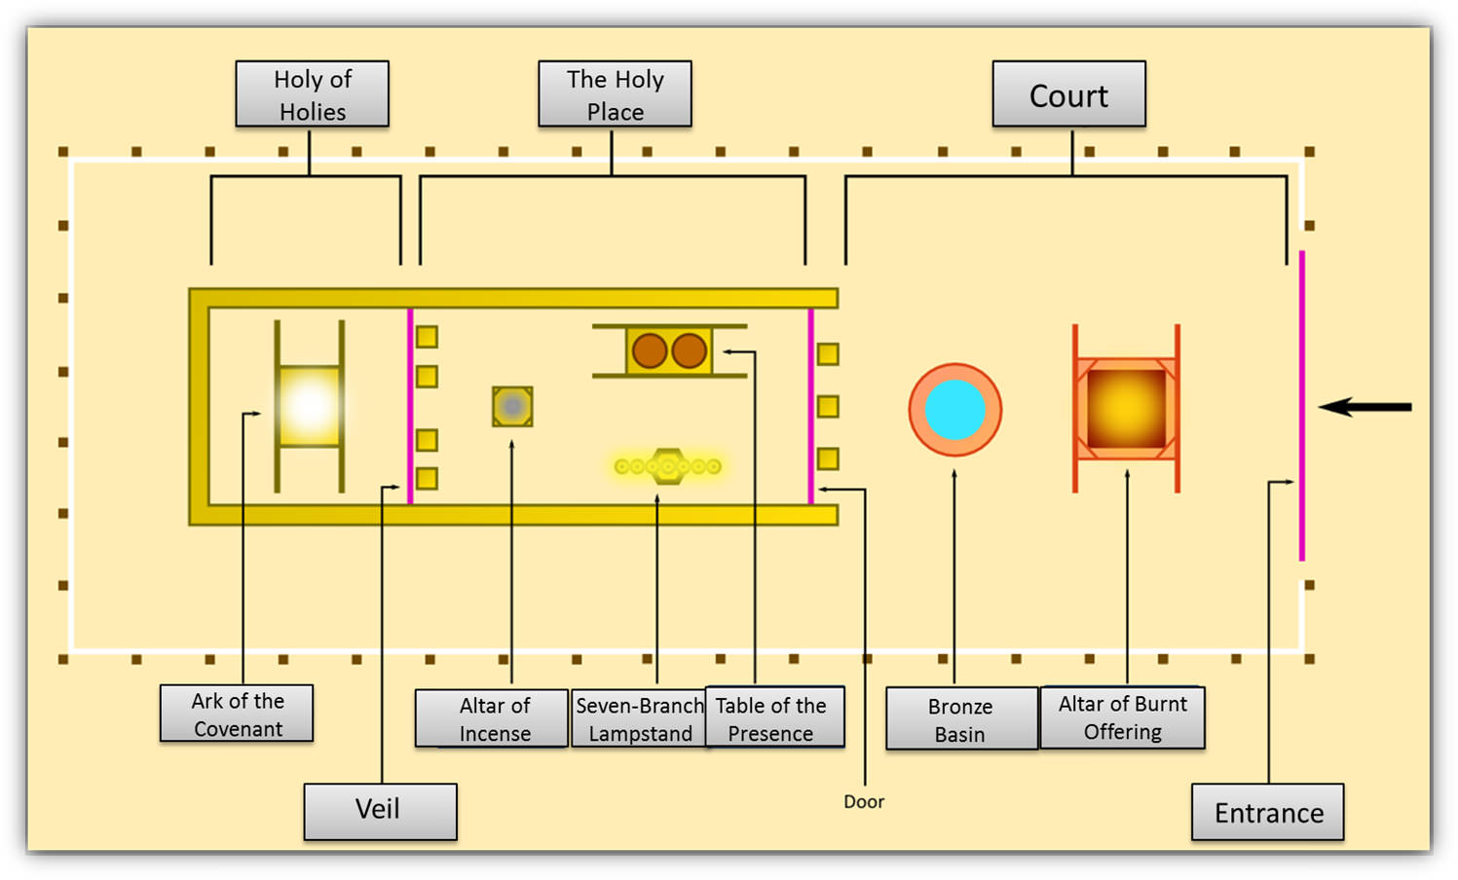
22/12
Notes:
God had just showed his approval of Israel’s actions by fire from Heaven (9:24)
Now God provides fire from Heaven to show his disapproval (10:2)
3 possibilities for the fire to be profane
It was fire from the wrong place. We know from Leviticus 16, when Aaron is given the instructions to offer the incense on the Day of Atonement that the fire to offer the incense comes from the fire that is burning on the alter of burnt offering.
We also know that Aaron and or his sons, Leviticus 27 and 30, were to tend the lamps that were in the holy place daily, twice per day and they were to offer incense when they did so.
It could have been improperly prepared incense (Exodus 30:34-38) has instructions for that
Drunkenness could have played a part. Look at verses 8 -10 of chapter 10. We do not know if drunkenness played a part or not but it is curious that this prohibition is inserted by Moses here in scripture. It seems more likely that if drunkenness was involved that this caused Nadab and Abihu to alter the plan, to ignore the commands, perhaps even to decide they had the authority to change the plan.
It seems the most likely that the profane fire was fire from somewhere other than the perpetual source of the fire, the altar within the court of the tabernacle.
Whatever the case, God did not approve it and regardless of how sincere Nadab and Abihu might have been, they sinned and paid for it with their lives
Exodus 30:7 Aaron and his sons could go into the Holy Place
Although Exodus 30:7-8 name Aaron as the person who goes into the Holy place to tend the lamps, Exodus 27:20-21 speak to Aaron and his sons tending the lamps that were never to go out
Lev 6:12 And the fire on the altar shall be kept burning on it; it shall not be put out. And the priest shall burn wood on it every morning, and lay the burnt offering in order on it; and he shall burn on it the fat of the peace offerings.
Lev 6:13 A fire shall always be burning on the altar; it shall never go out.
Exo 30:7 "Aaron shall burn on it sweet incense every morning; when he tends the lamps, he shall burn incense on it.
Exo 30:8 And when Aaron lights the lamps at twilight, he shall burn incense on it, a perpetual incense before the LORD throughout your generations.
Exo 30:9 You shall not offer strange incense on it, or a burnt offering, or a grain offering; nor shall you pour a drink offering on it.
Exo 30:10 And Aaron shall make atonement upon its horns once a year with the blood of the sin offering of atonement; once a year he shall make atonement upon it throughout your generations. It is most holy to the LORD."
Lev 16:1 Now the LORD spoke to Moses after the death of the two sons of Aaron, when they offered profane fire before the LORD, and died;
Lev 16:2 and the LORD said to Moses: "Tell Aaron your brother not to come at just any time into the Holy Place inside the veil, before the mercy seat which is on the ark, lest he die; for I will appear in the cloud above the mercy seat.
Lev 16:12 Then he shall take a censer full of burning coals of fire from the altar before the LORD, with his hands full of sweet incense beaten fine, and bring it inside the veil.
Lev 16:13 And he shall put the incense on the fire before the LORD, that the cloud of incense may cover the mercy seat that is on the Testimony, lest he die.
Aaron’s response to Moses regarding the sin of not consuming the sacrificed food portions
2 possibilities - (1) Perhaps because of his grief, he was concerned that his attitude did not allow him to partake in a way that would be pleasing to God.
We can understand this I think, we are instructed in 1st Corinthians to examine ourselves before we partake of the Lord’s Supper and to get our attitudes right
1Co 11:27 Therefore whoever eats this bread or drinks this cup of the Lord in an unworthy manner will be guilty of the body and blood of the Lord.
1Co 11:28 But let a man examine himself, and so let him eat of the bread and drink of the cup.
1Co 11:29 For he who eats and drinks in an unworthy manner eats and drinks judgment to himself, not discerning the Lord's body.
(2) Perhaps he thought that Nadab and Abihu’s sin from that day made it inappropriate to eat holy food on that day and his reaction is one of humility
Regardless, Moses accepted the explanation and calmed down

Slide 8
Lessons to be Learned
Leaders of God’s people are fallible Hebrews 5:1-10; 7:1-8:2
Obedience is essential to God Matthew 7:21-24; 1st Thessalonians 1:6-9
Innovation can be dangerous Revelation 22:18-19
God’s Worship is Holy Exodus 28:36-38; John 4:24
God’s Holiness requires punishment
to evildoers Romans 11:22
Notes:
Israel’s priests were fallible, they made mistakes, which showed the need for another high priest who was perfect and of course we know who that is. In Hebrews chapter 5, our Lord and savior Jesus Christ is referred to our high priest, after the order of Melchizadek, not as a descendant of Levi but as a priest who lived a perfect and sinless life on our behalf.
2. Surely by now we get the idea that obedience does matter
3. Innovation can be dangerous
If we get nothing else from this series on Exodus and Leviticus, please get this
What God set before us is pure and Holy. It is HIS word and we do not have the authority, much less the wisdom to add to taje away from.
The moment we, as individuals decide to selectively obey this book we sin
The moment we as a church, decide to selectively obey this book we are no longer the church that Jesus bought with his blood
4. God’s worship is holy. IF it is to God how can it not be?
5. Sin must be addressed. God made it clear that HE ad sin cannot coexist in the camp

