Slide 2

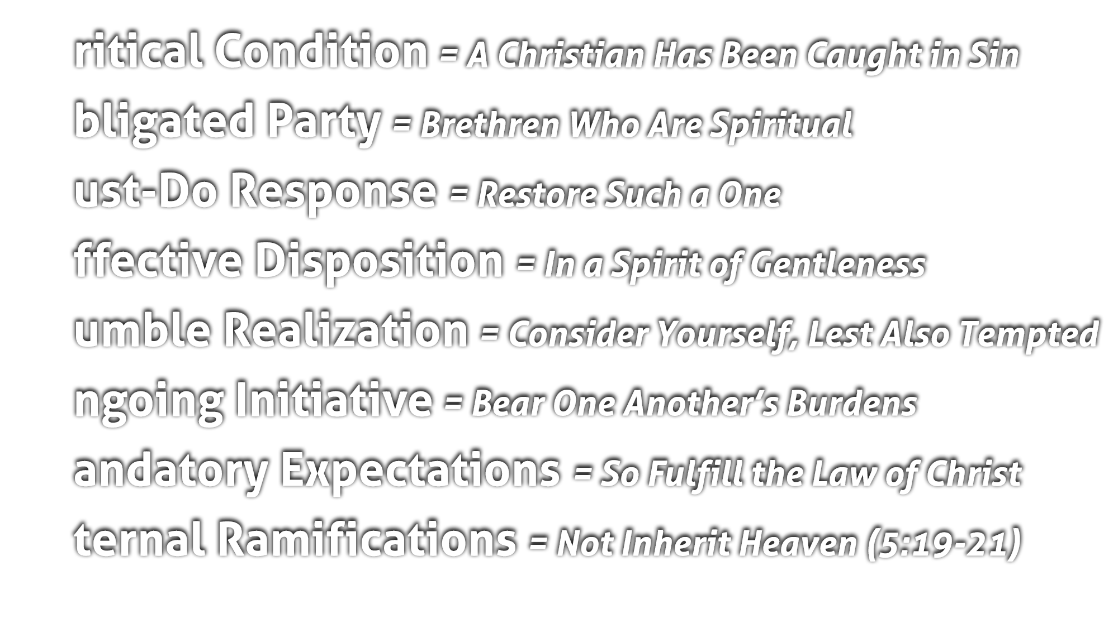
A brother can lapse into ongoing sin or deviate from the truth
(Jas. 5:19)
As a result, He is lost and not right with God
(Isa. 59:1-2; Eph. 2, 11-12)

Slide 3
“Spiritual” = “walk in the Spirit” (5:16), “live in the Spirit” (5:25), “are led by the Spirit” (5:18), bear “the fruit of the Spirit” (5:22-23), “sow to the Spirit” (6:8)
Those who are trying to live pleasing to God by abiding in His Word and seeking first His church (people), striving to follow the Golden Rule (Matt. 6:33; 7:12, 21-27)

Slide 4
Present imperative – a command involving continuous, ongoing efforts
Term used of a surgeon setting a broken bone
Term used of fishermen mending nets (Matt. 4:21)
Bringing back into his rightful place, his original working condition

Slide 5
Acting with kindness, sympathy, humility in the face of opposition
This is behaving like Jesus (Matt. 11:28-30; John 8:11)
Be direct, but encouraging (Eph. 4:15)

Slide 6
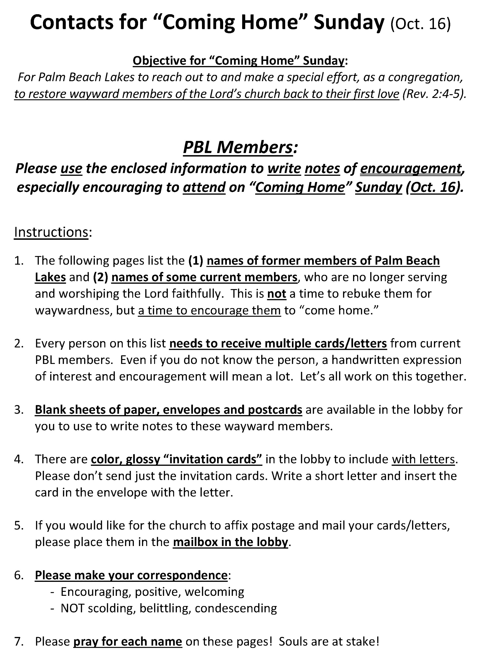

Slide 7
Keenly aware that you too could be the one needing to be restored
Keenly aware of the power of temptation to sin and the weakness of the flesh (Matt. 26:41; 1 Pet. 5:8-9; Jas. 4:7)

Slide 8
Present imperative – a command involving continuous, ongoing behavior
Burdens = something heavy, oppressive, crushing weight
Rather than wait, we must take the initiative (Rom. 15:1; 2 Cor. 11:28-29)

Slide 9
We are obligated, in this context, to the royal law (Gal. 5:14; Jas. 2:8)
If we do not seek to restore and bear, we break the law (AND SIN!)

Slide 10
Brethren who are lost in sin will be lost eternally (Rom. 6:23)
We must strive to “save a soul from death” (Jas. 5:19-21)

Slide 11
Believe that Jesus is God’s Son – John 1:12
Repent of your sins and turn to God – Acts 3:19
Confess your faith in Jesus Christ – Romans 10:10
Be immersed into Christ – Mark 16:16
  God will forgive all of your sins – Acts 2:38
  God will add you to His church – Acts 2:47
  God will register you in heaven – Hebrews 12:23
Walk faithfully with the Lord every day – 1 John 1:7
  If you’ve strayed, repent and turn away from your sins – Acts 8:22
  If you’ve strayed, confess your sins and ask for forgiveness – 1 John 1:9

