Slide 3
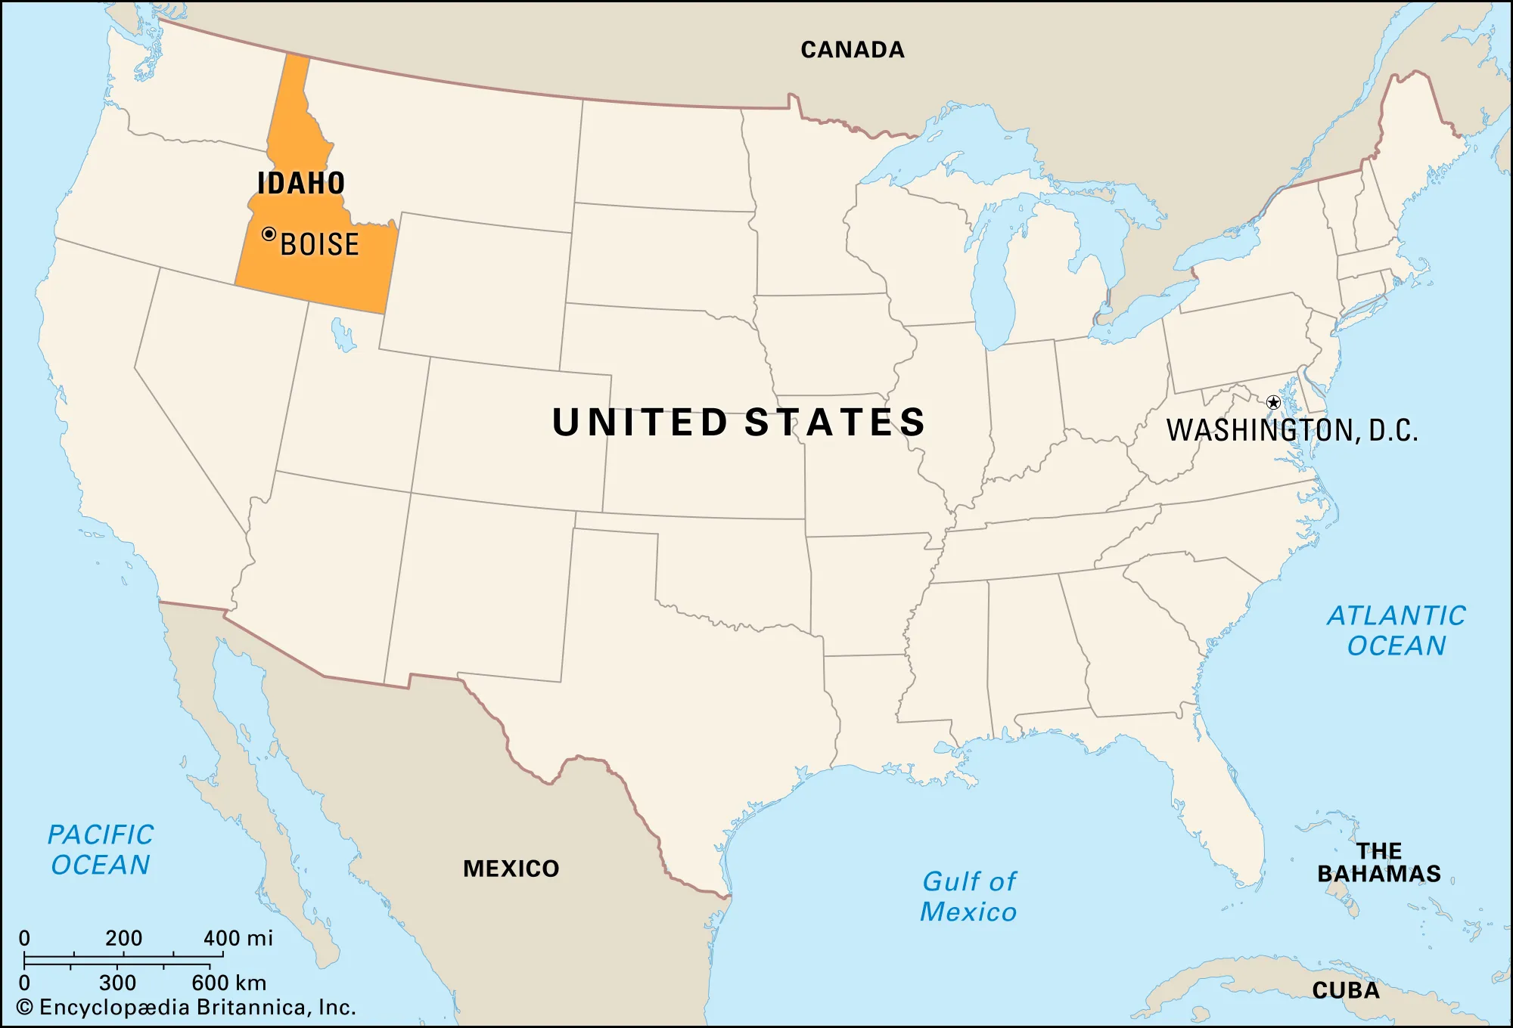

Slide 5
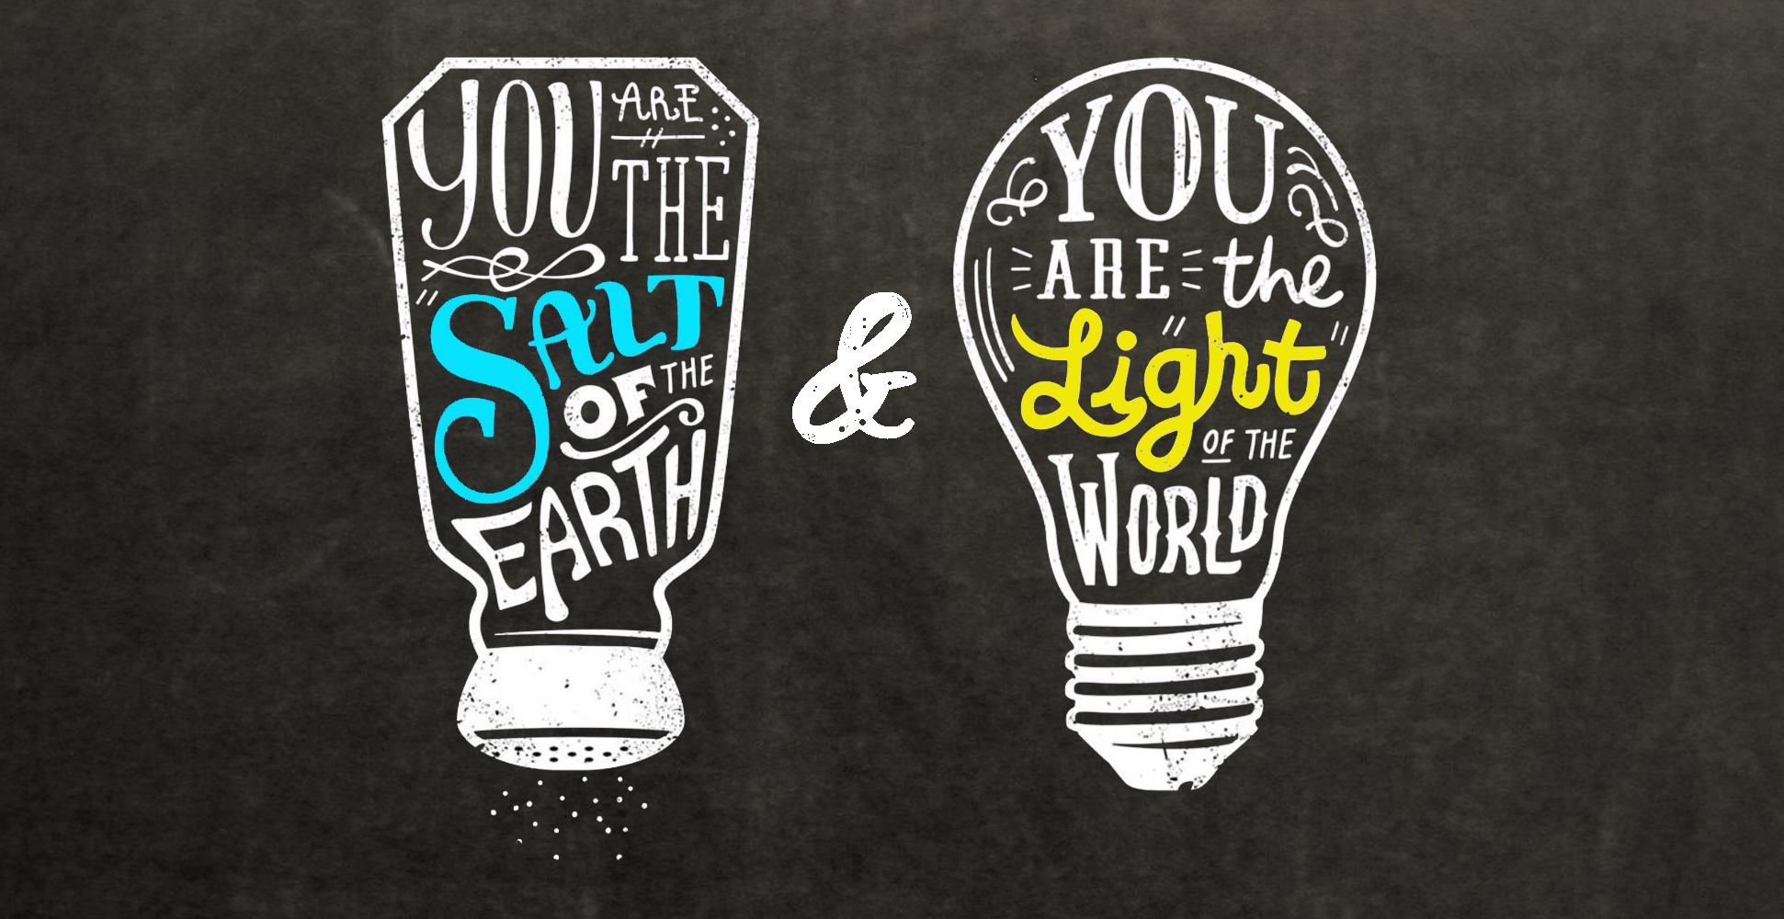

Slide 6
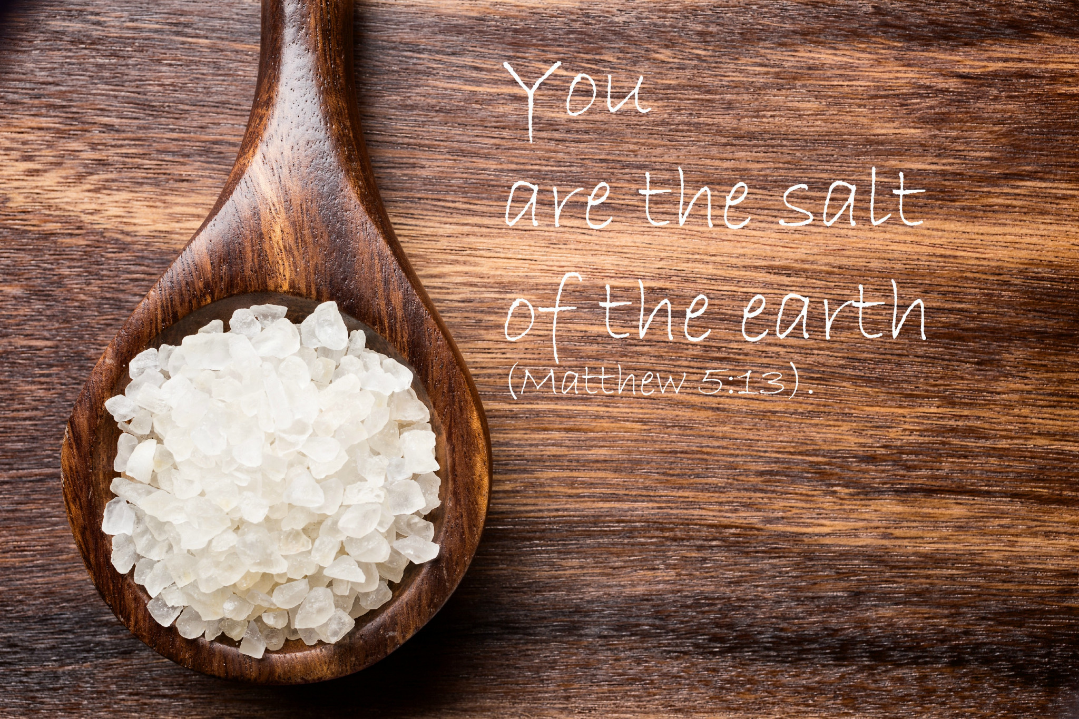

Slide 7
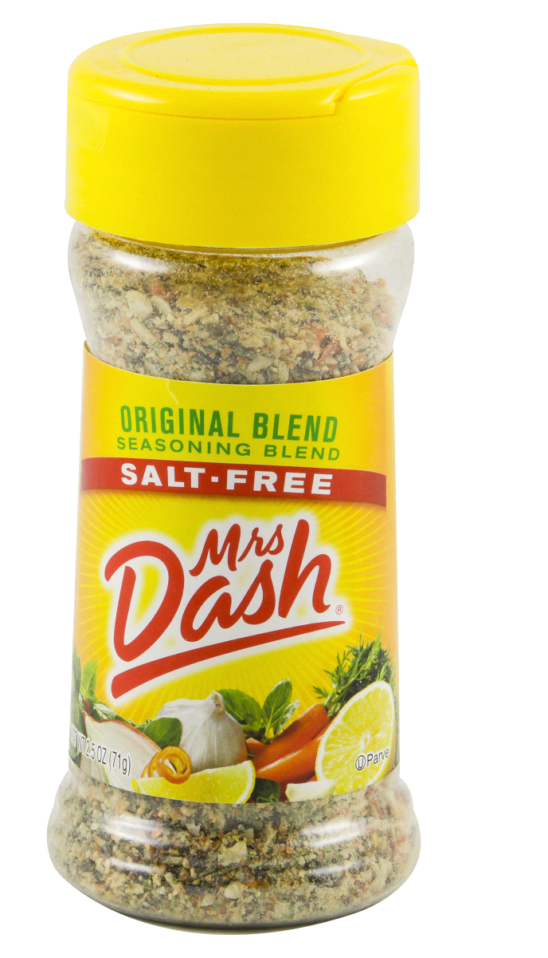
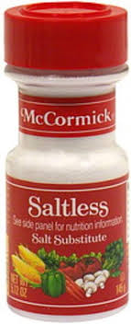
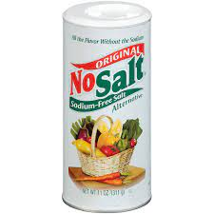

Slide 8
Salt cleanses
Salt preserves
Salt flavors
If salt loses its flavor…
Loses purpose
Loses mission

Slide 9
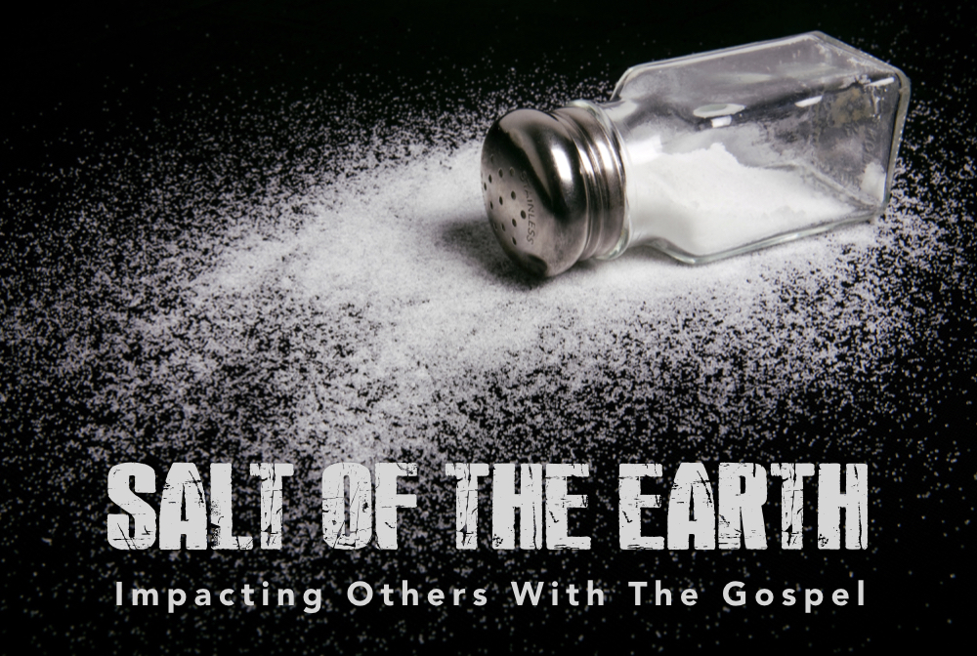

Slide 10
Way to God
God’s ways
Light shines
Light illuminates
Light reveals

Slide 11
People see your good deeds
People will praise God

