Slide 1
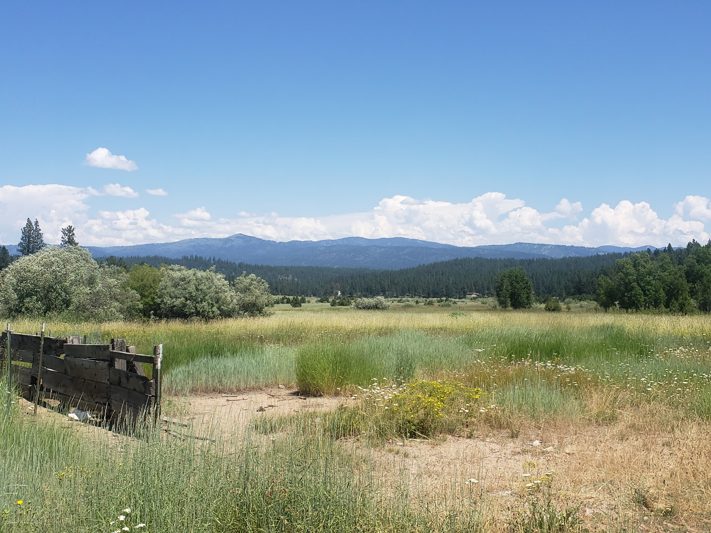
2022 Mission Trip
Parma, Idaho

Slide 2
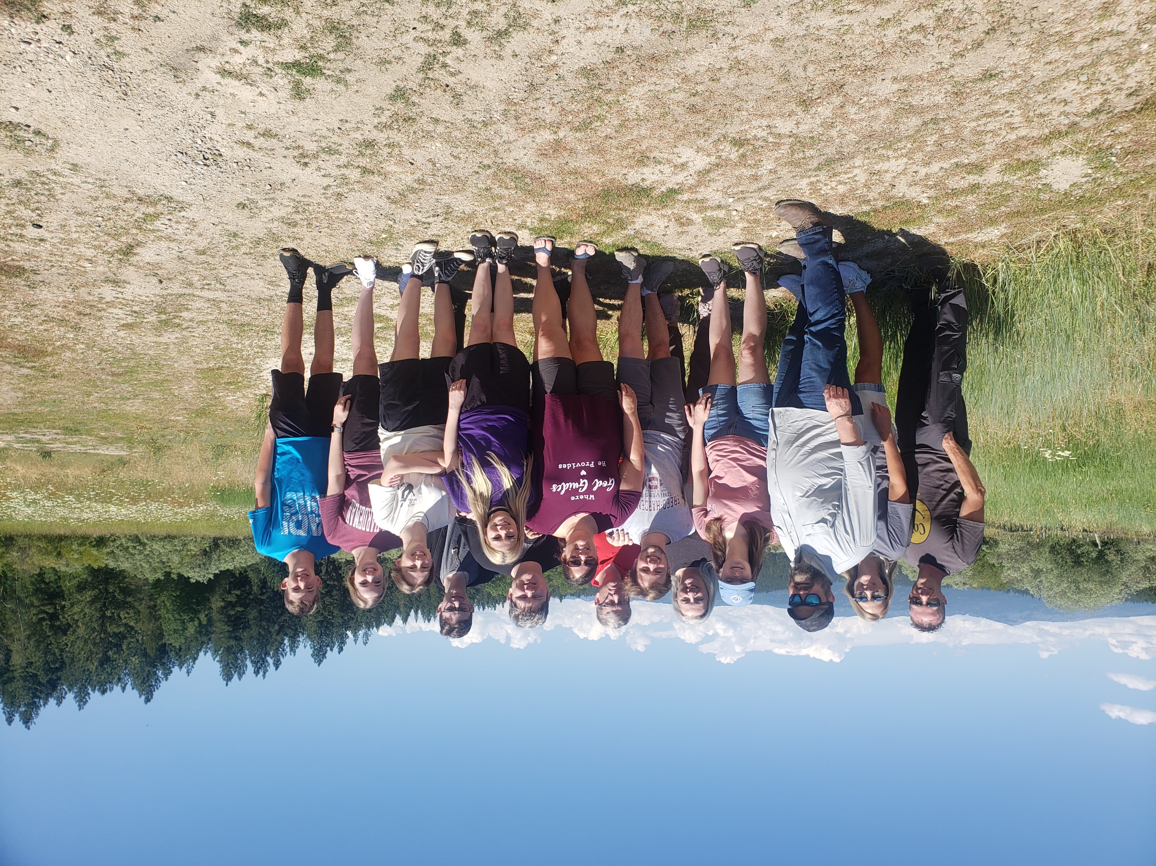

Slide 3
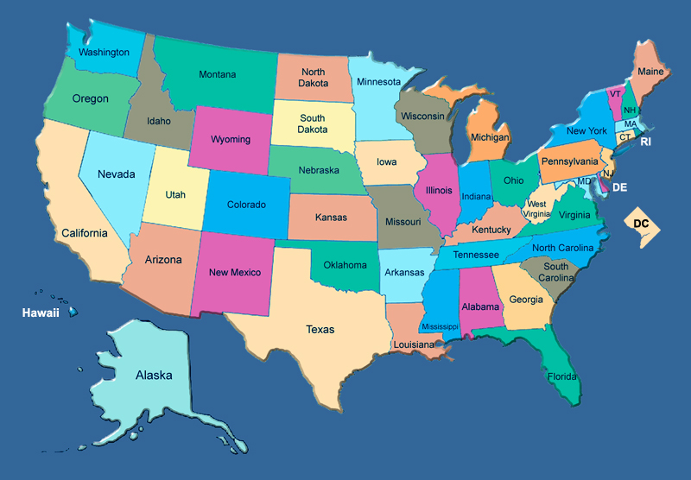
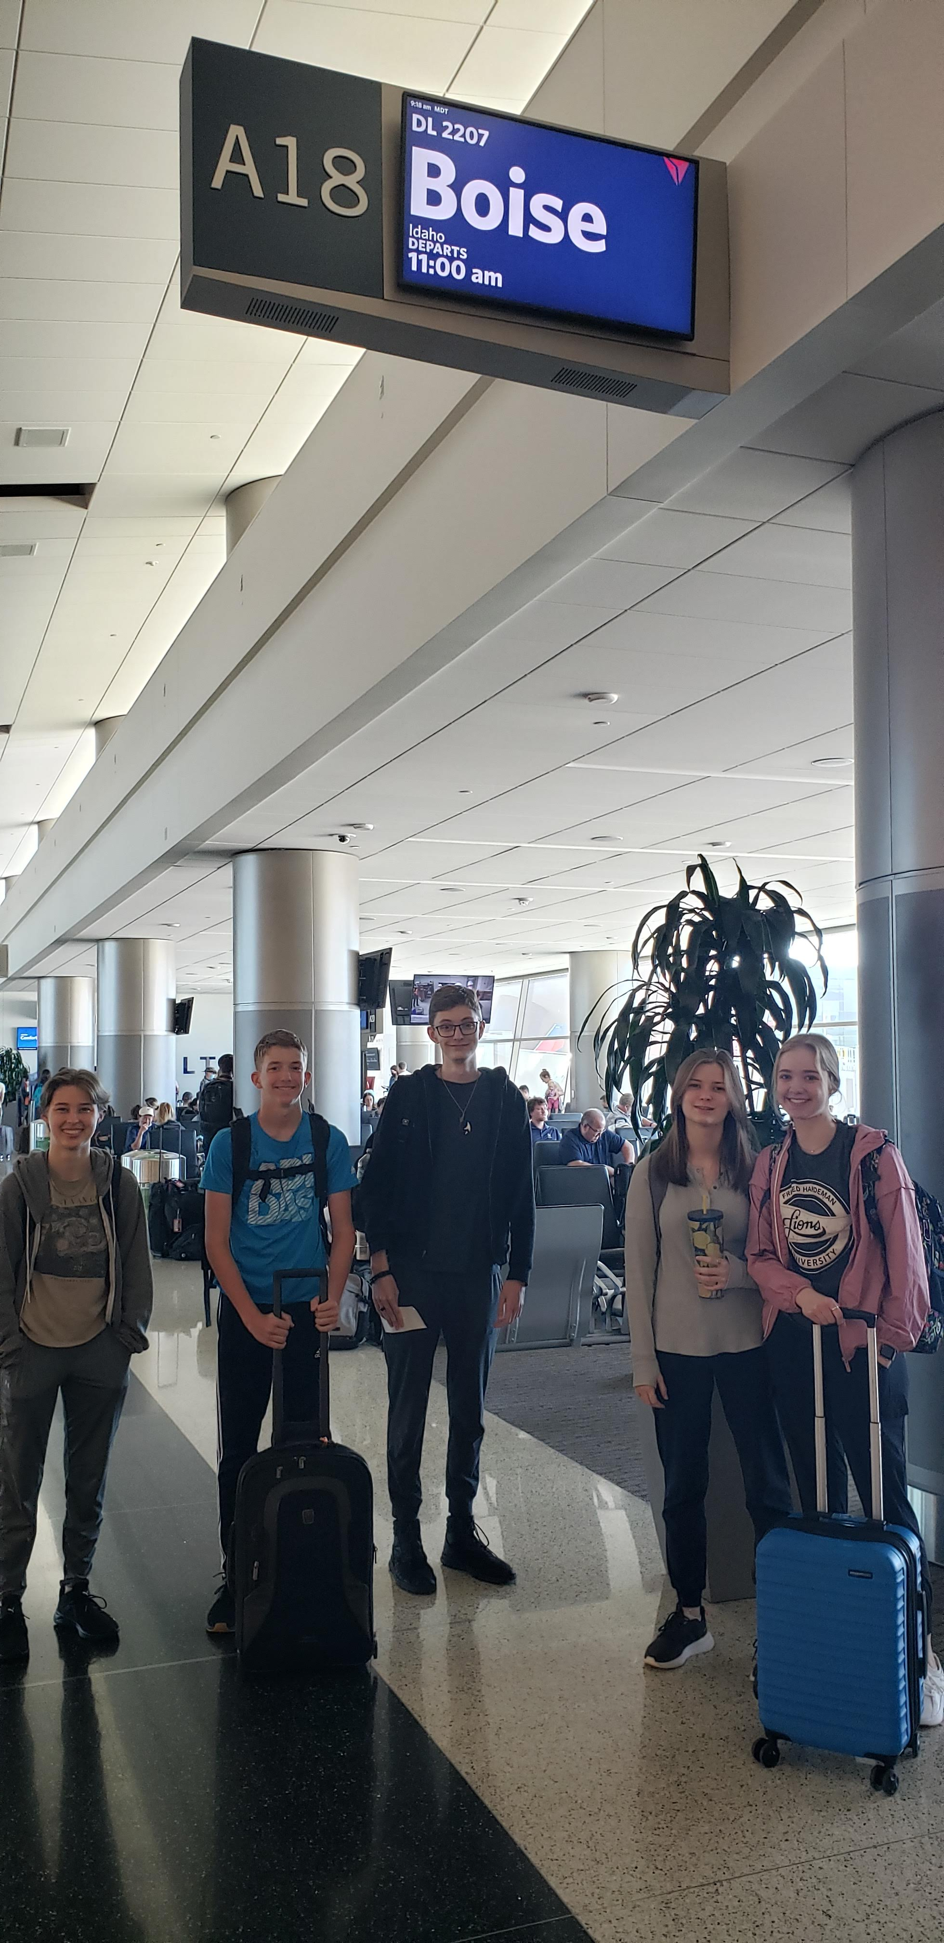
Travel
Boise
Salt Lake
Miami

Slide 4
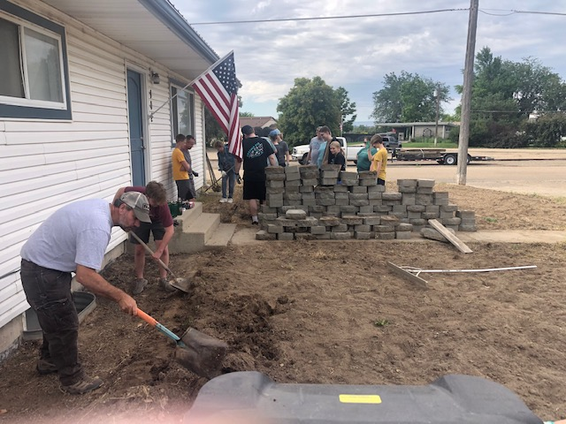
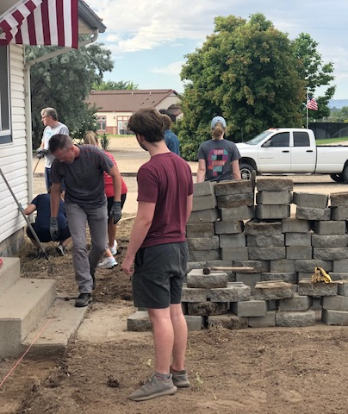
Phase One: Parsonage House

Slide 5
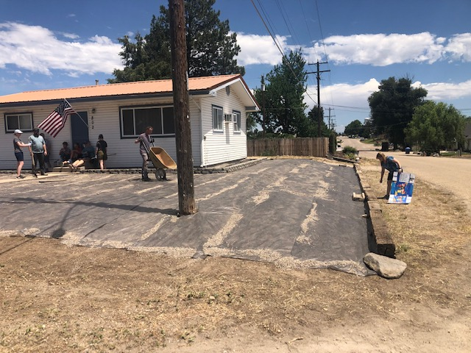
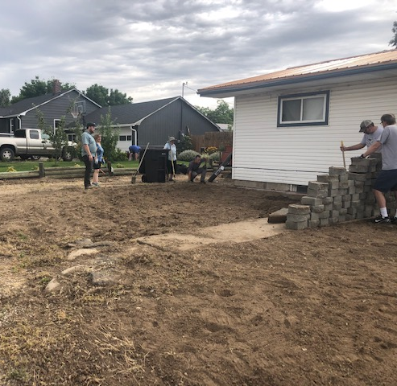
Phase One: Parsonage House

Slide 6
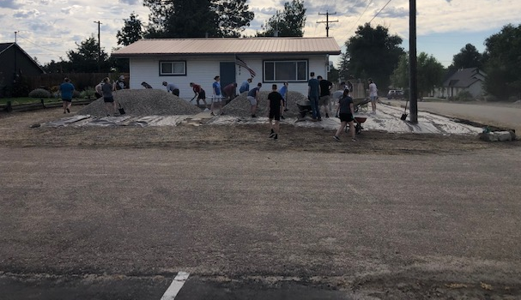
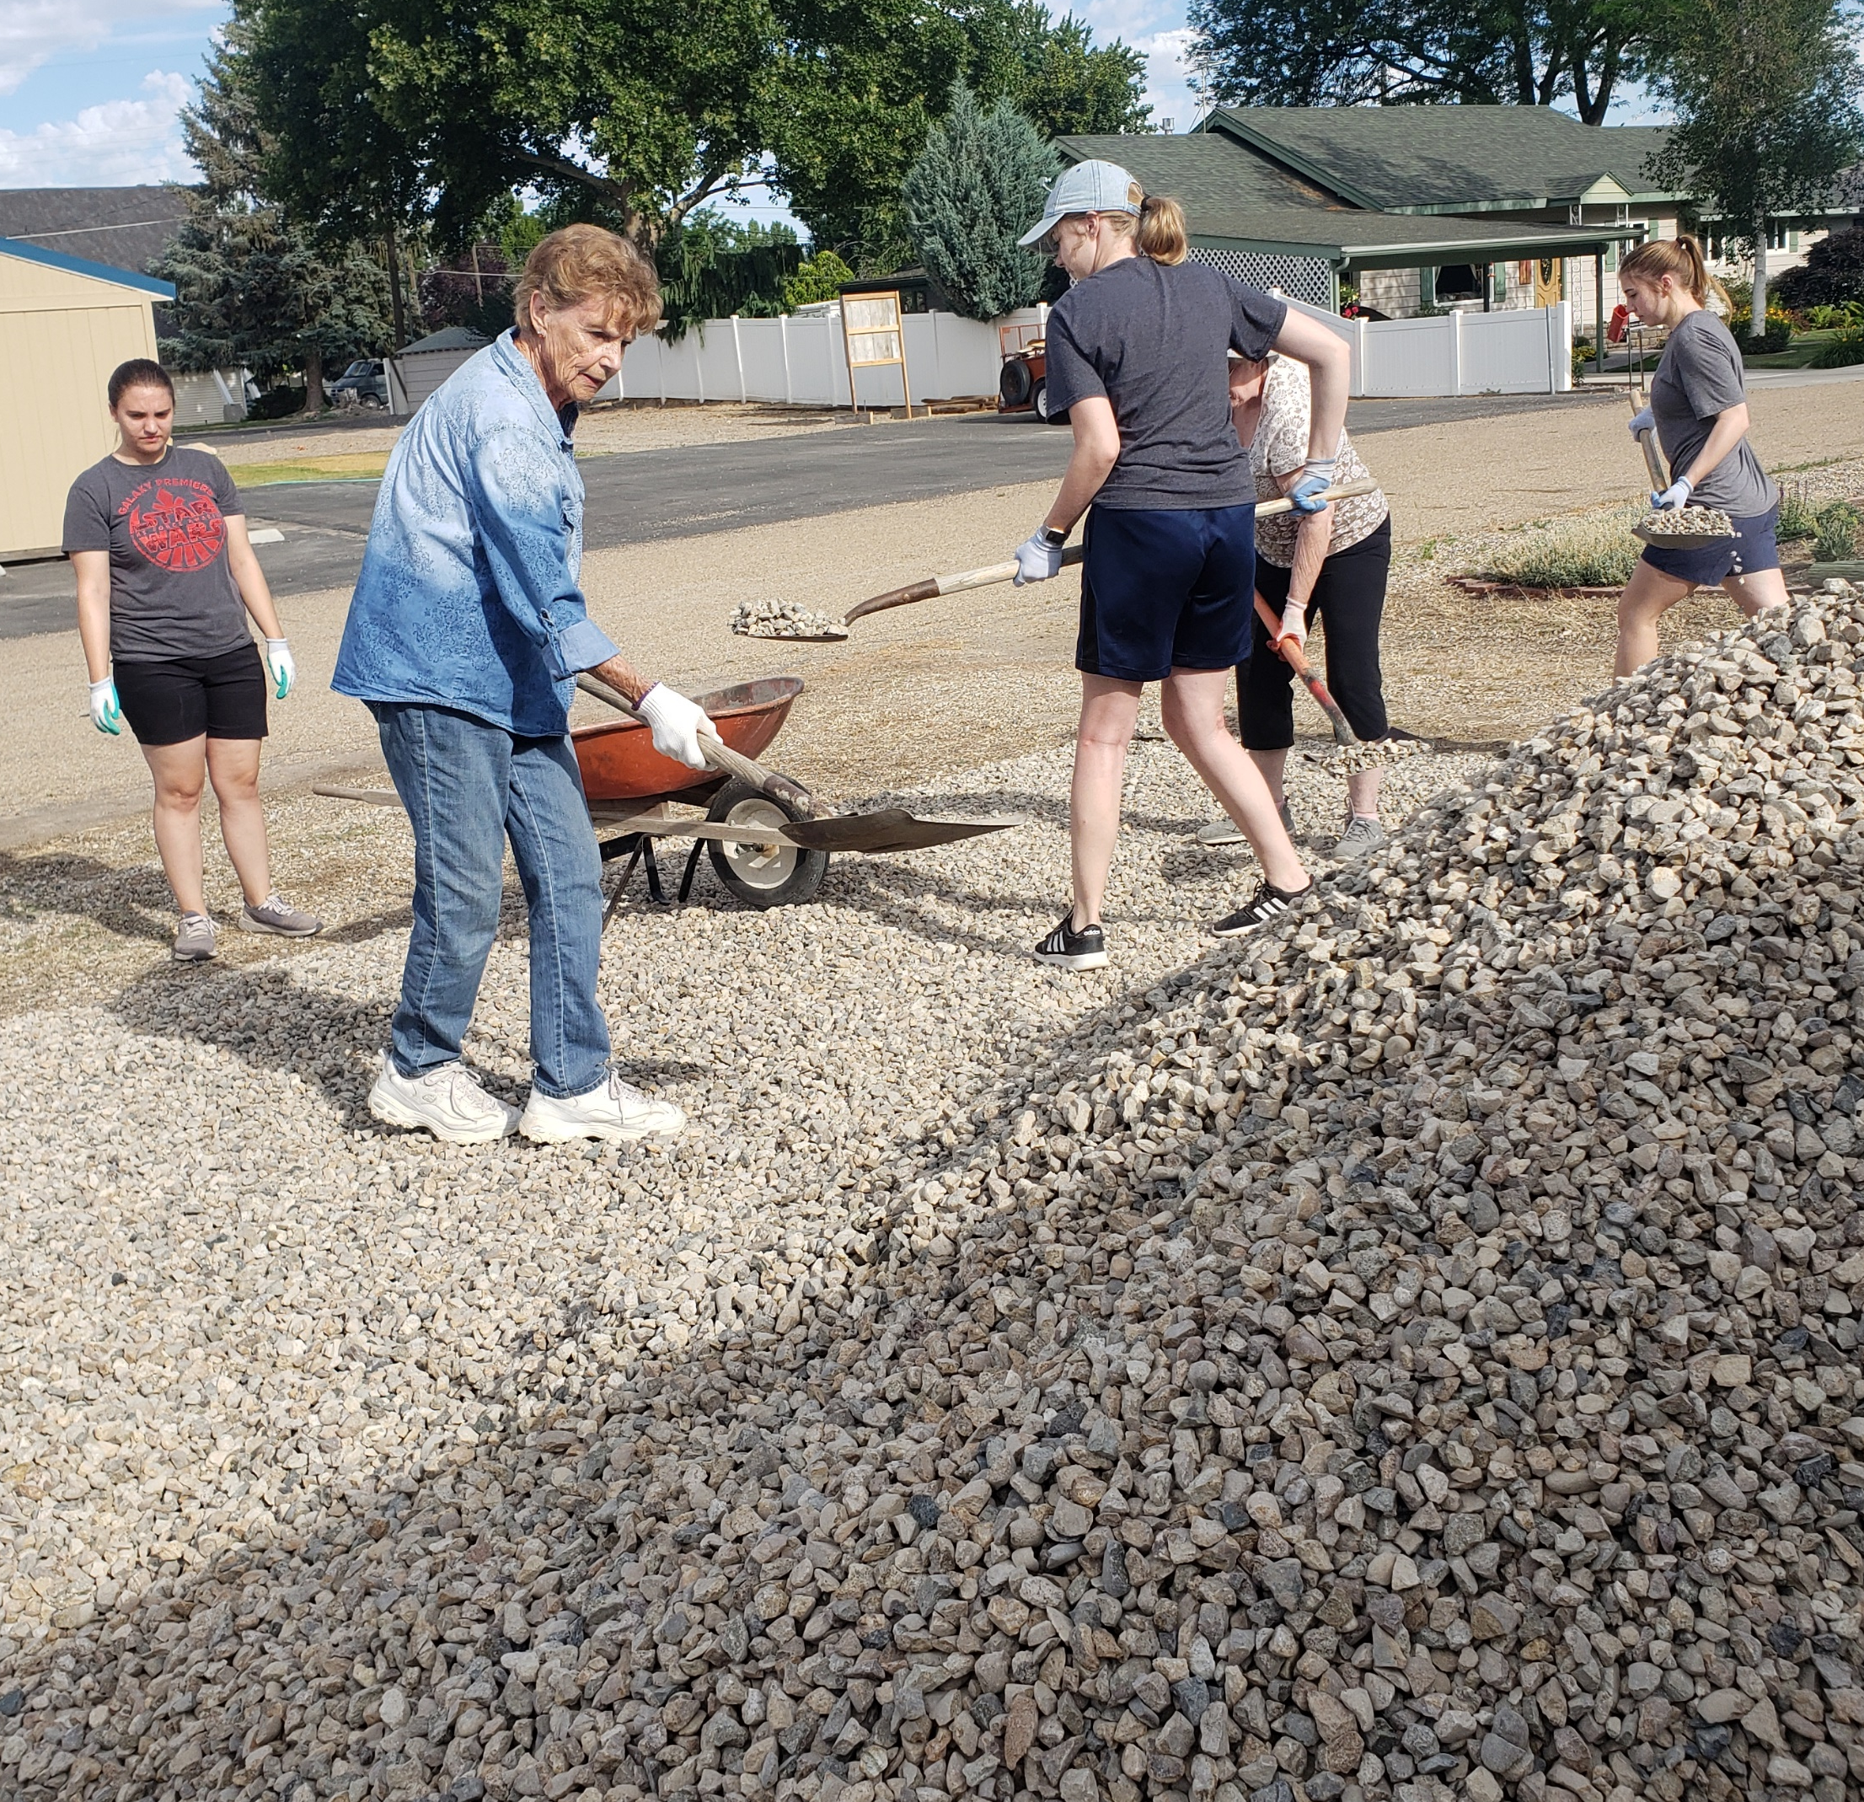
Phase One: Parsonage House

Slide 7
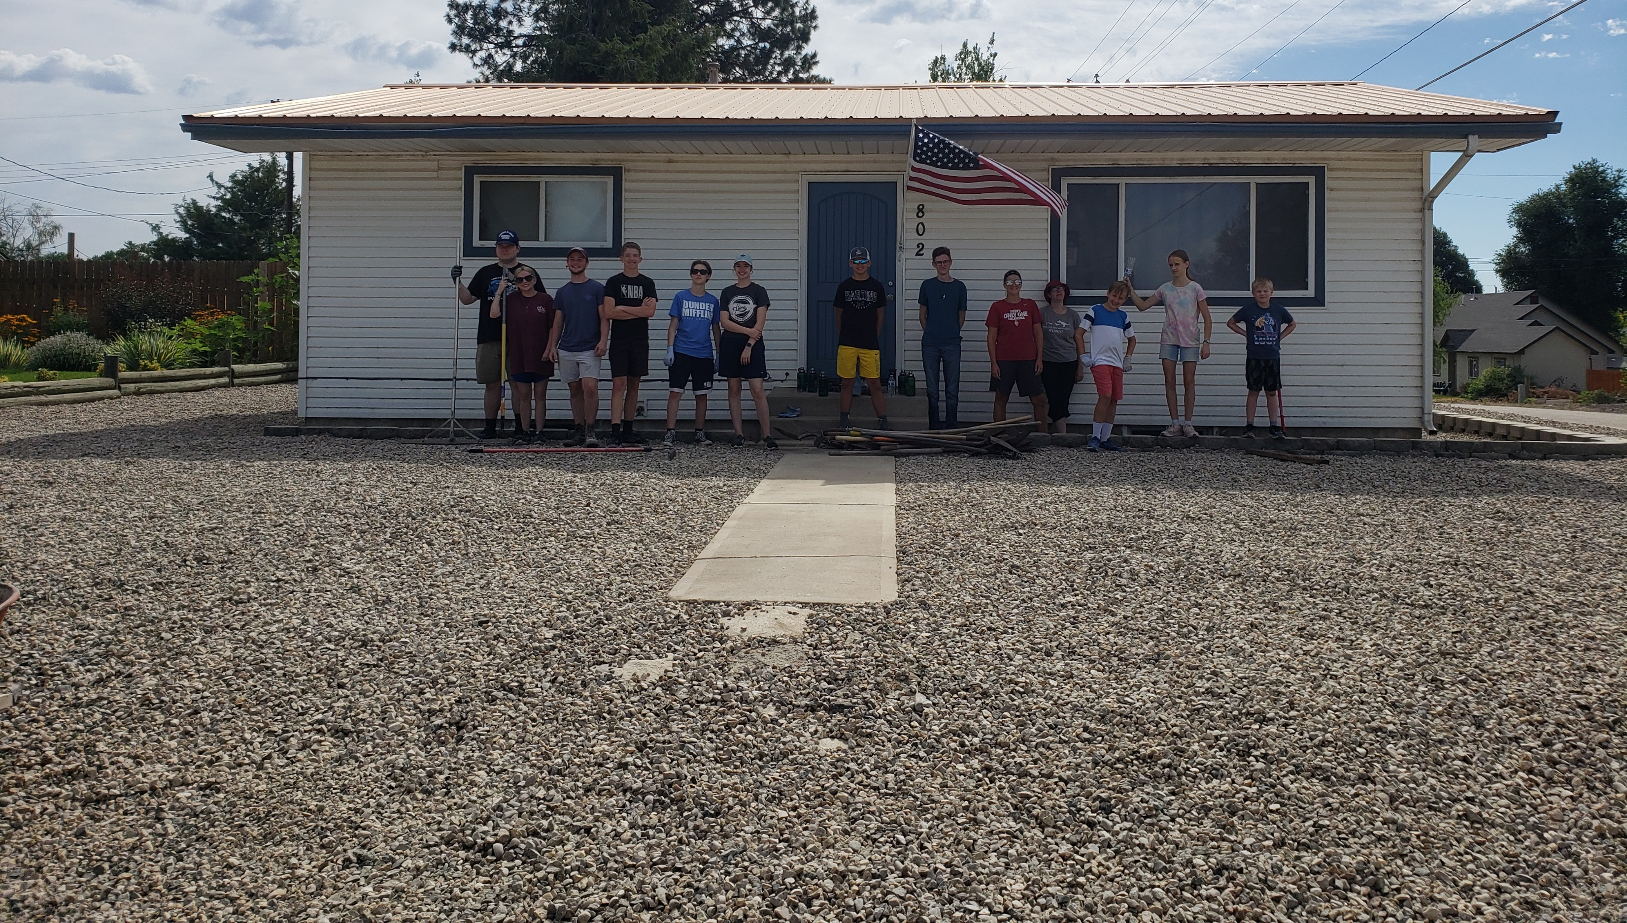
Phase One: Parsonage House

Slide 8
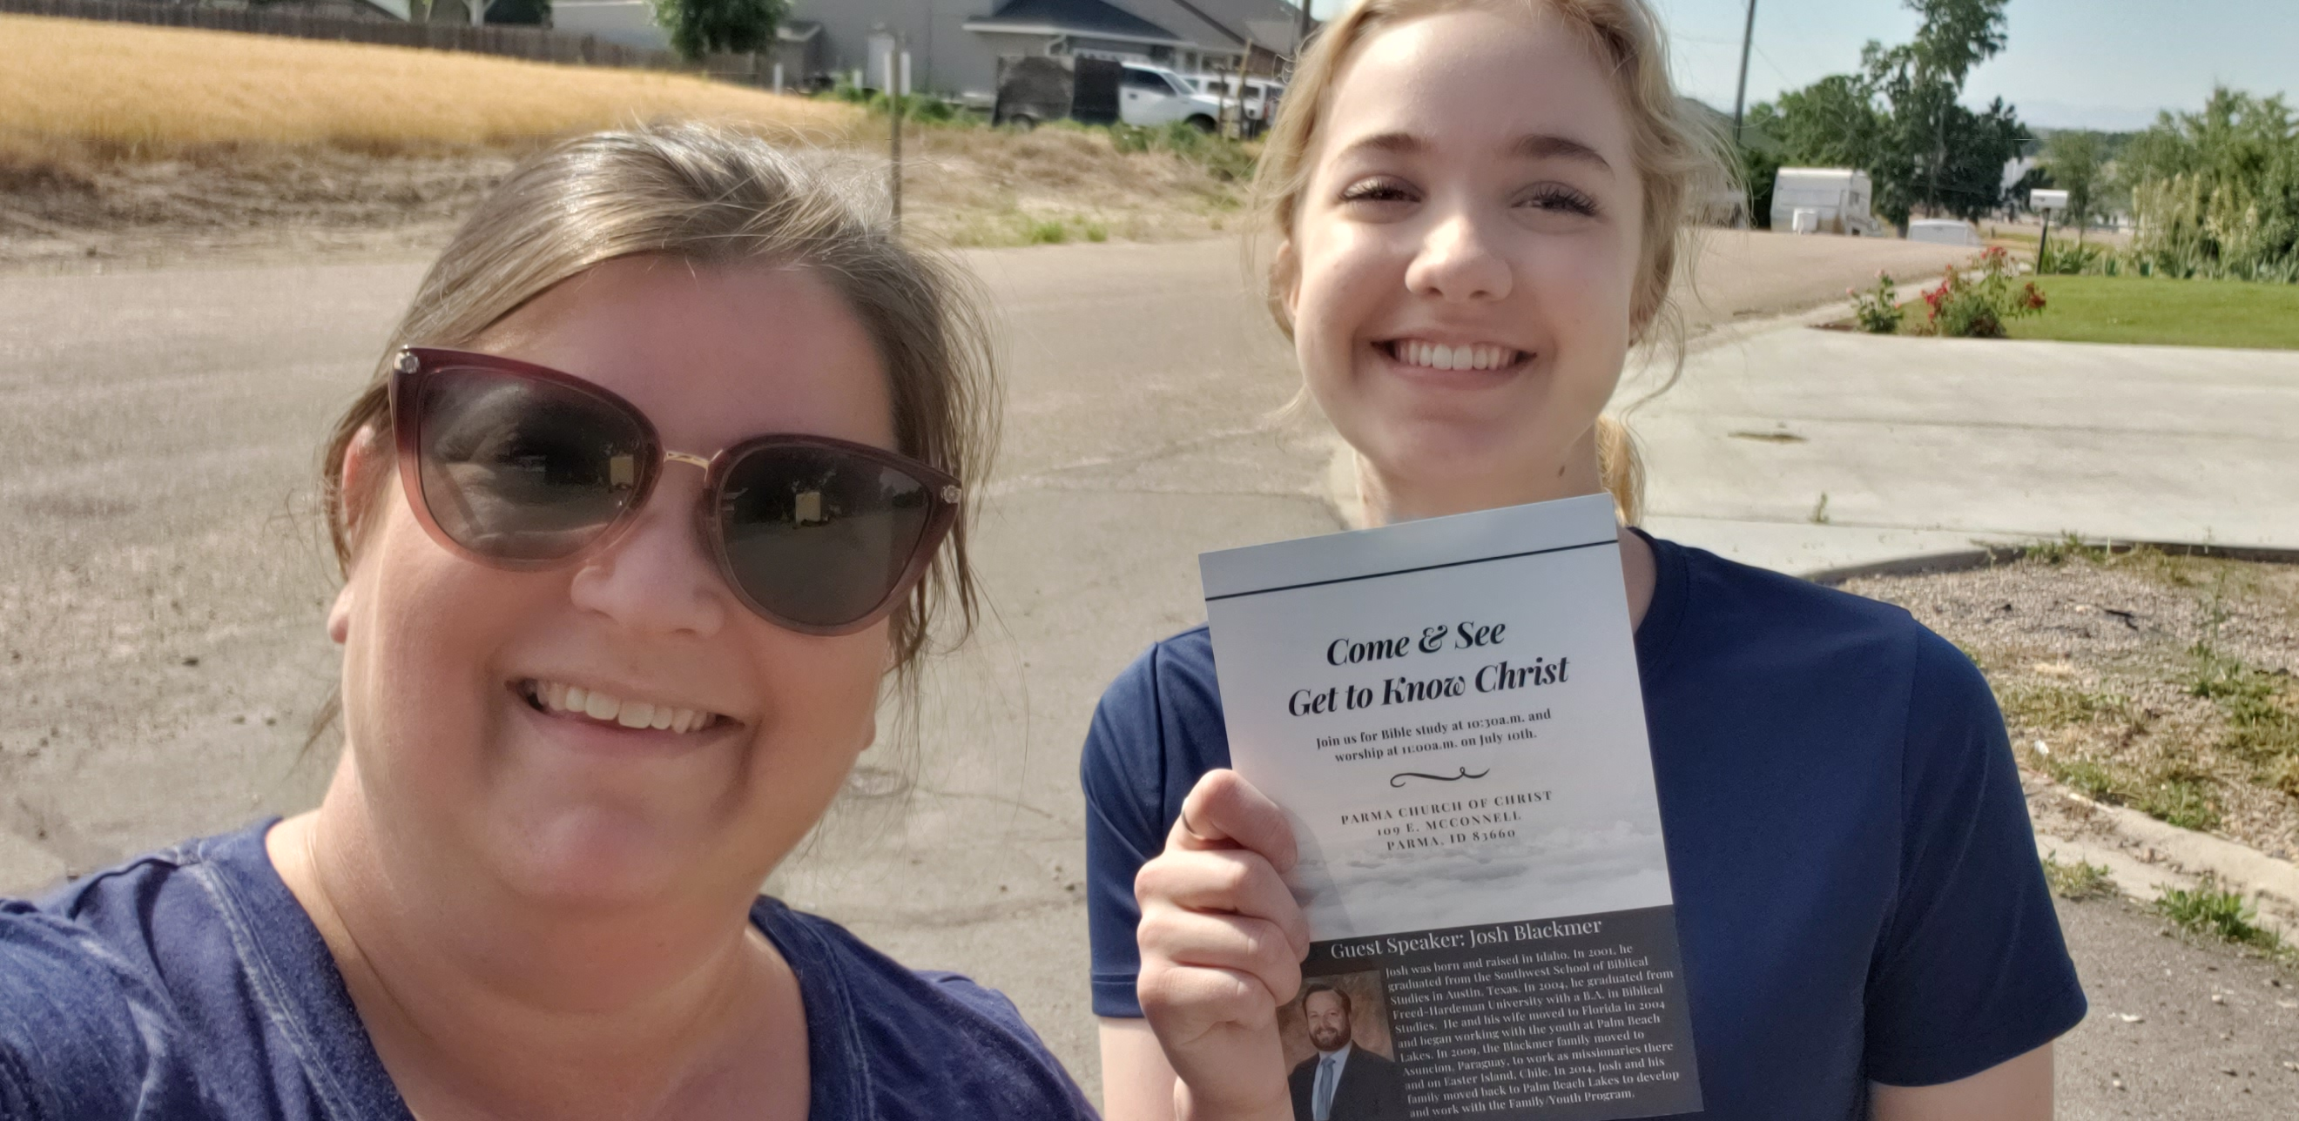
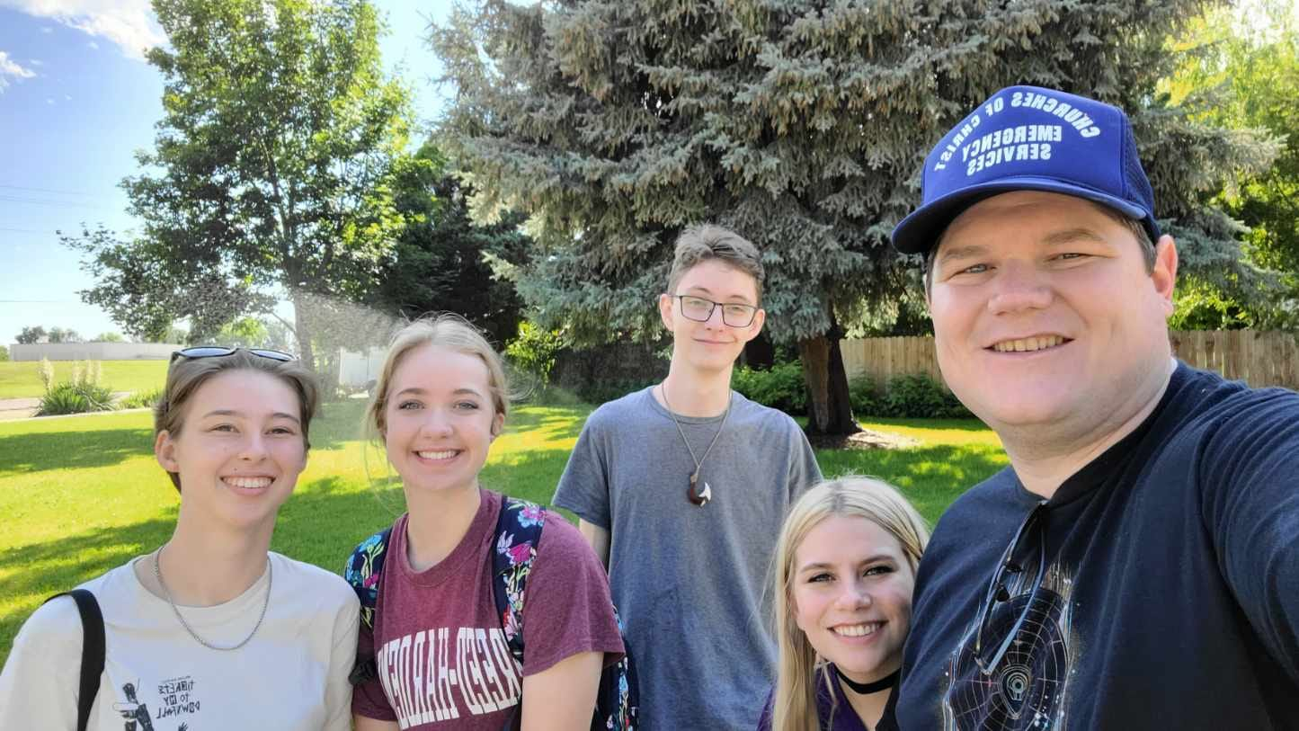
Phase Two: Handing Out Flyers

Slide 9
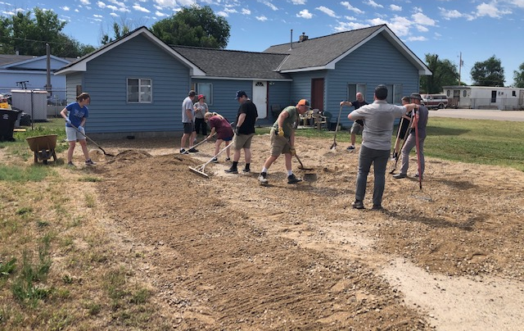
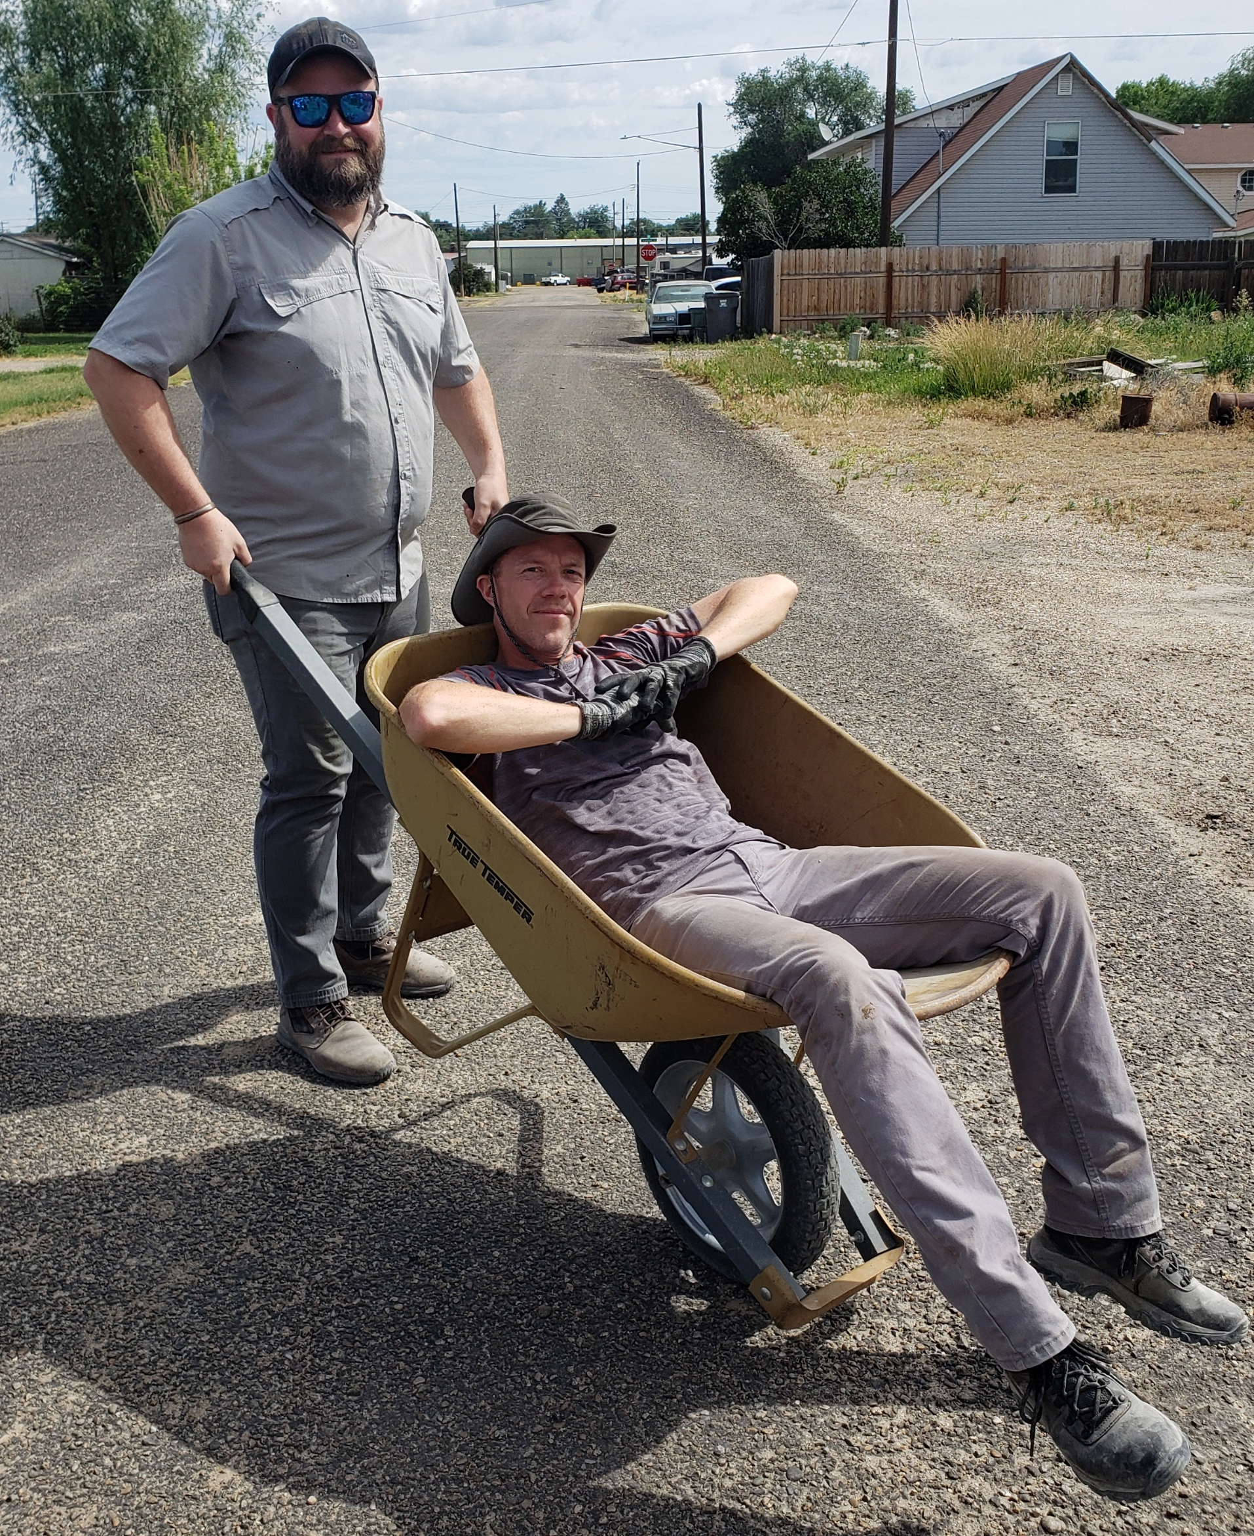
Phase Three: Benevolent Work

Slide 10
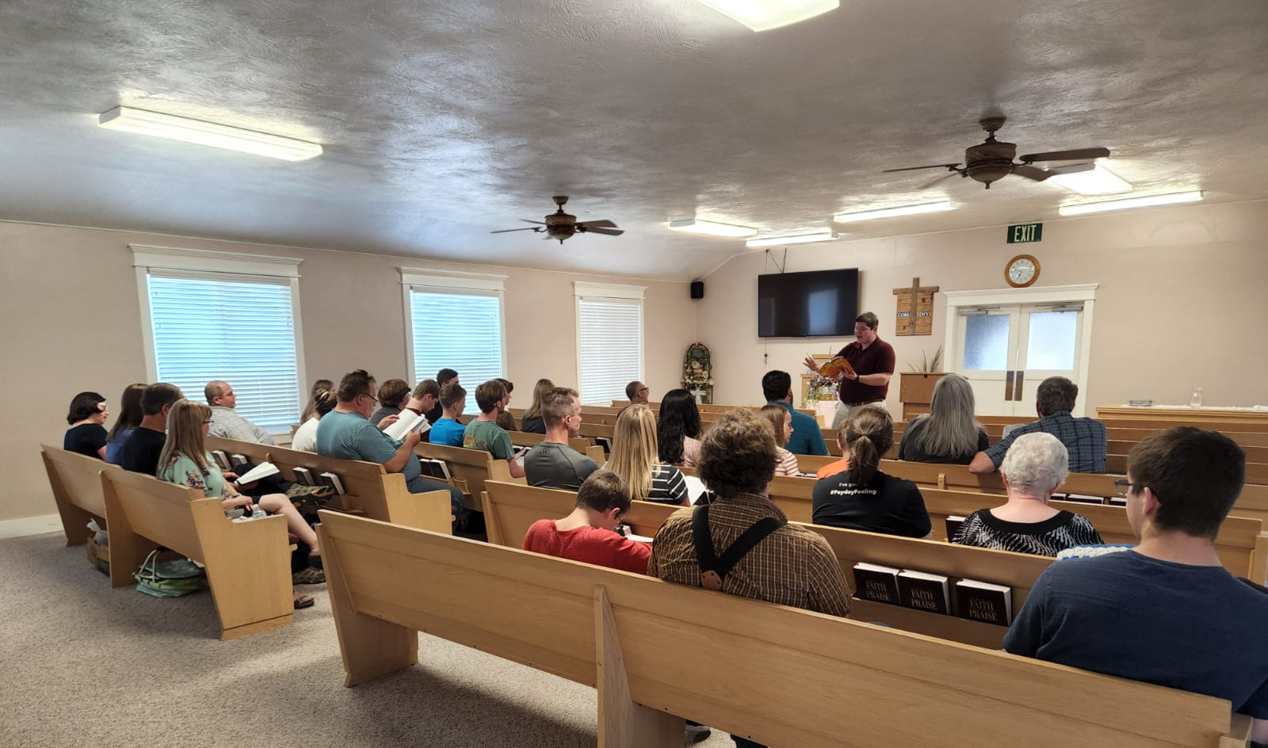
Phase Four: Area Wide Youth Event

Slide 11
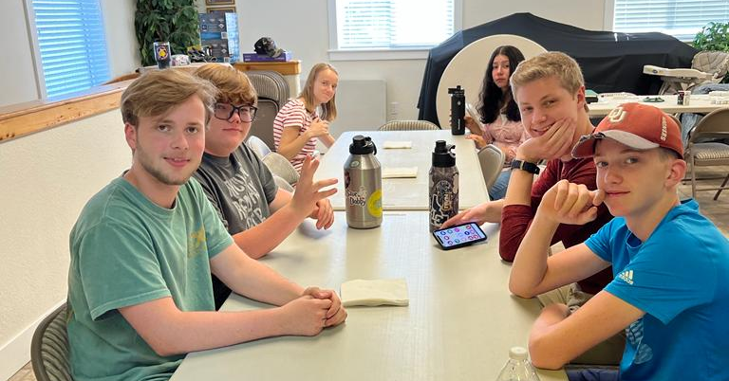
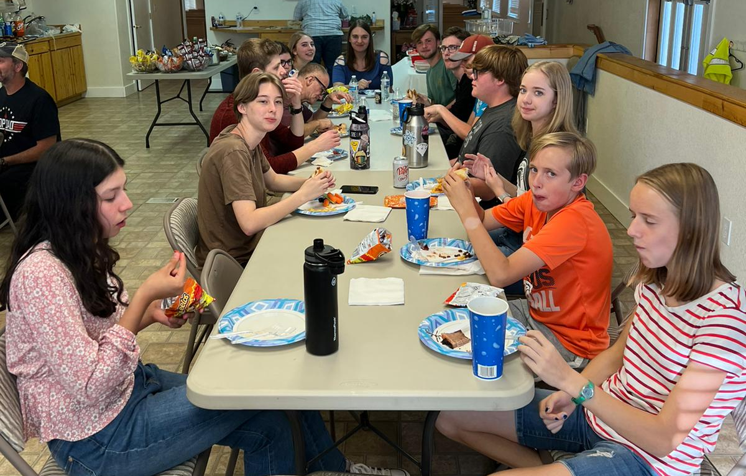
Phase Four: Area Wide Youth Event

Slide 12
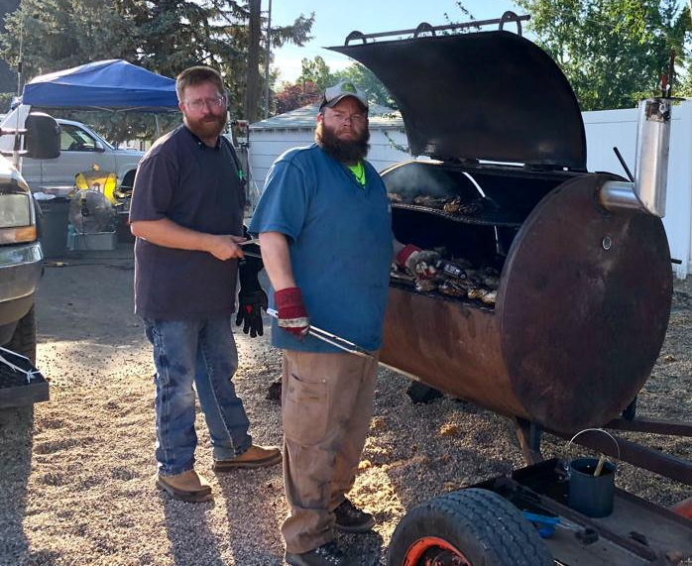
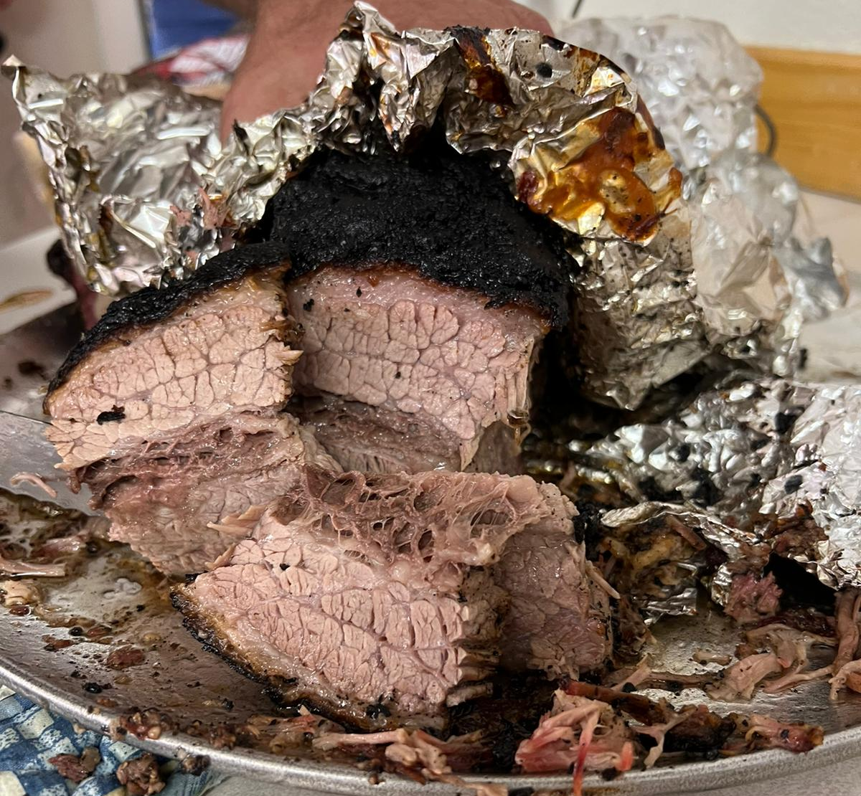
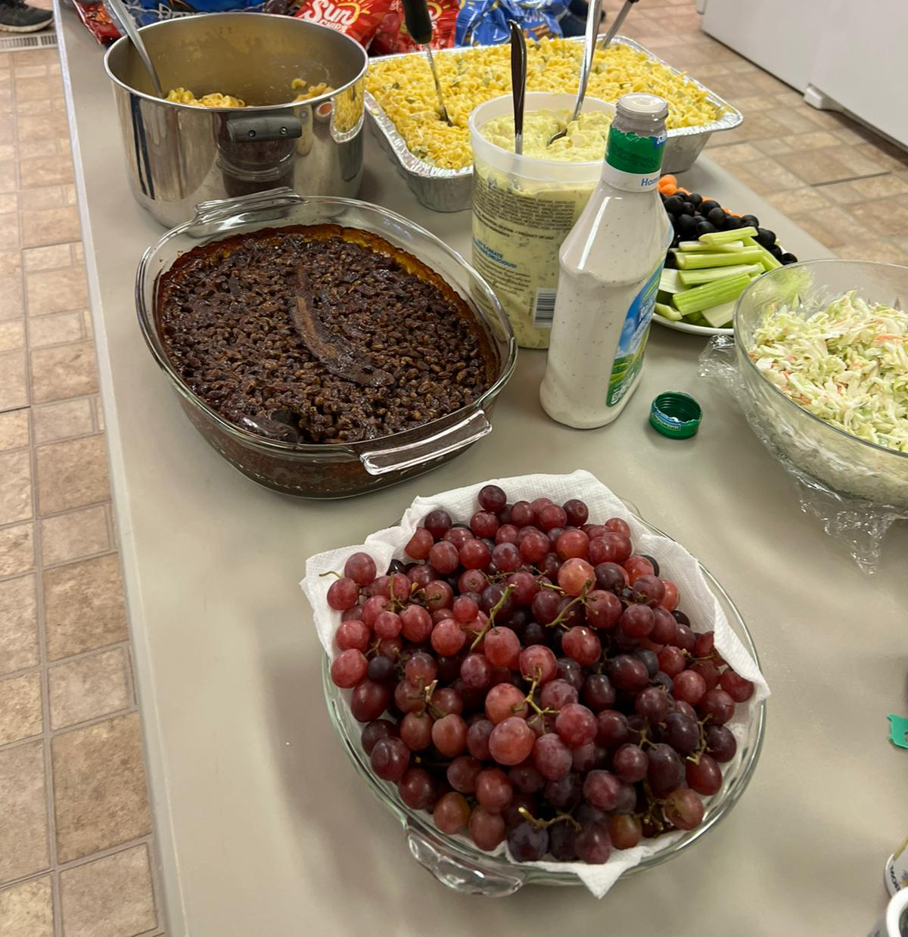
Phase Four: Area Wide Youth Event

Slide 13
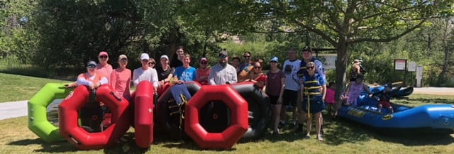
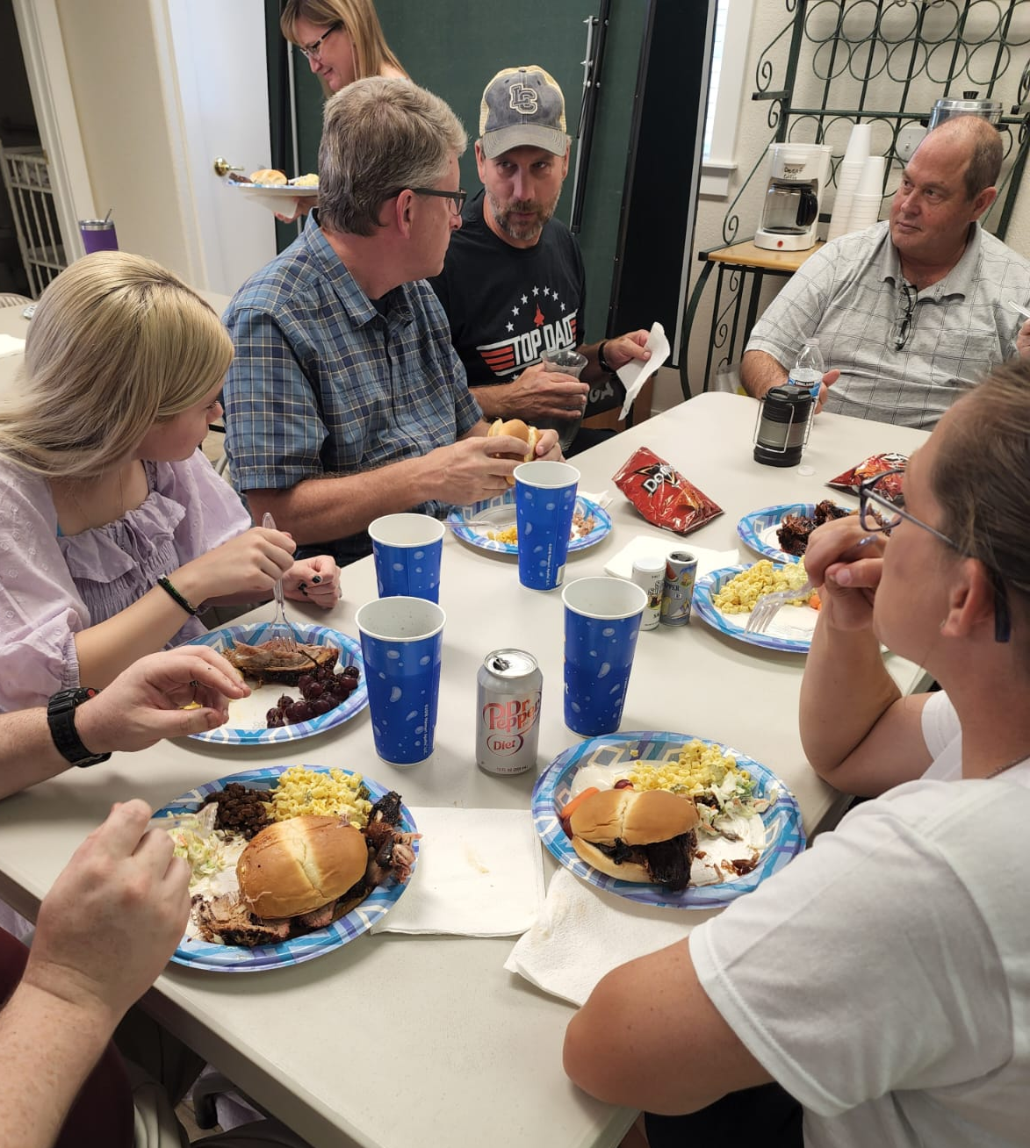
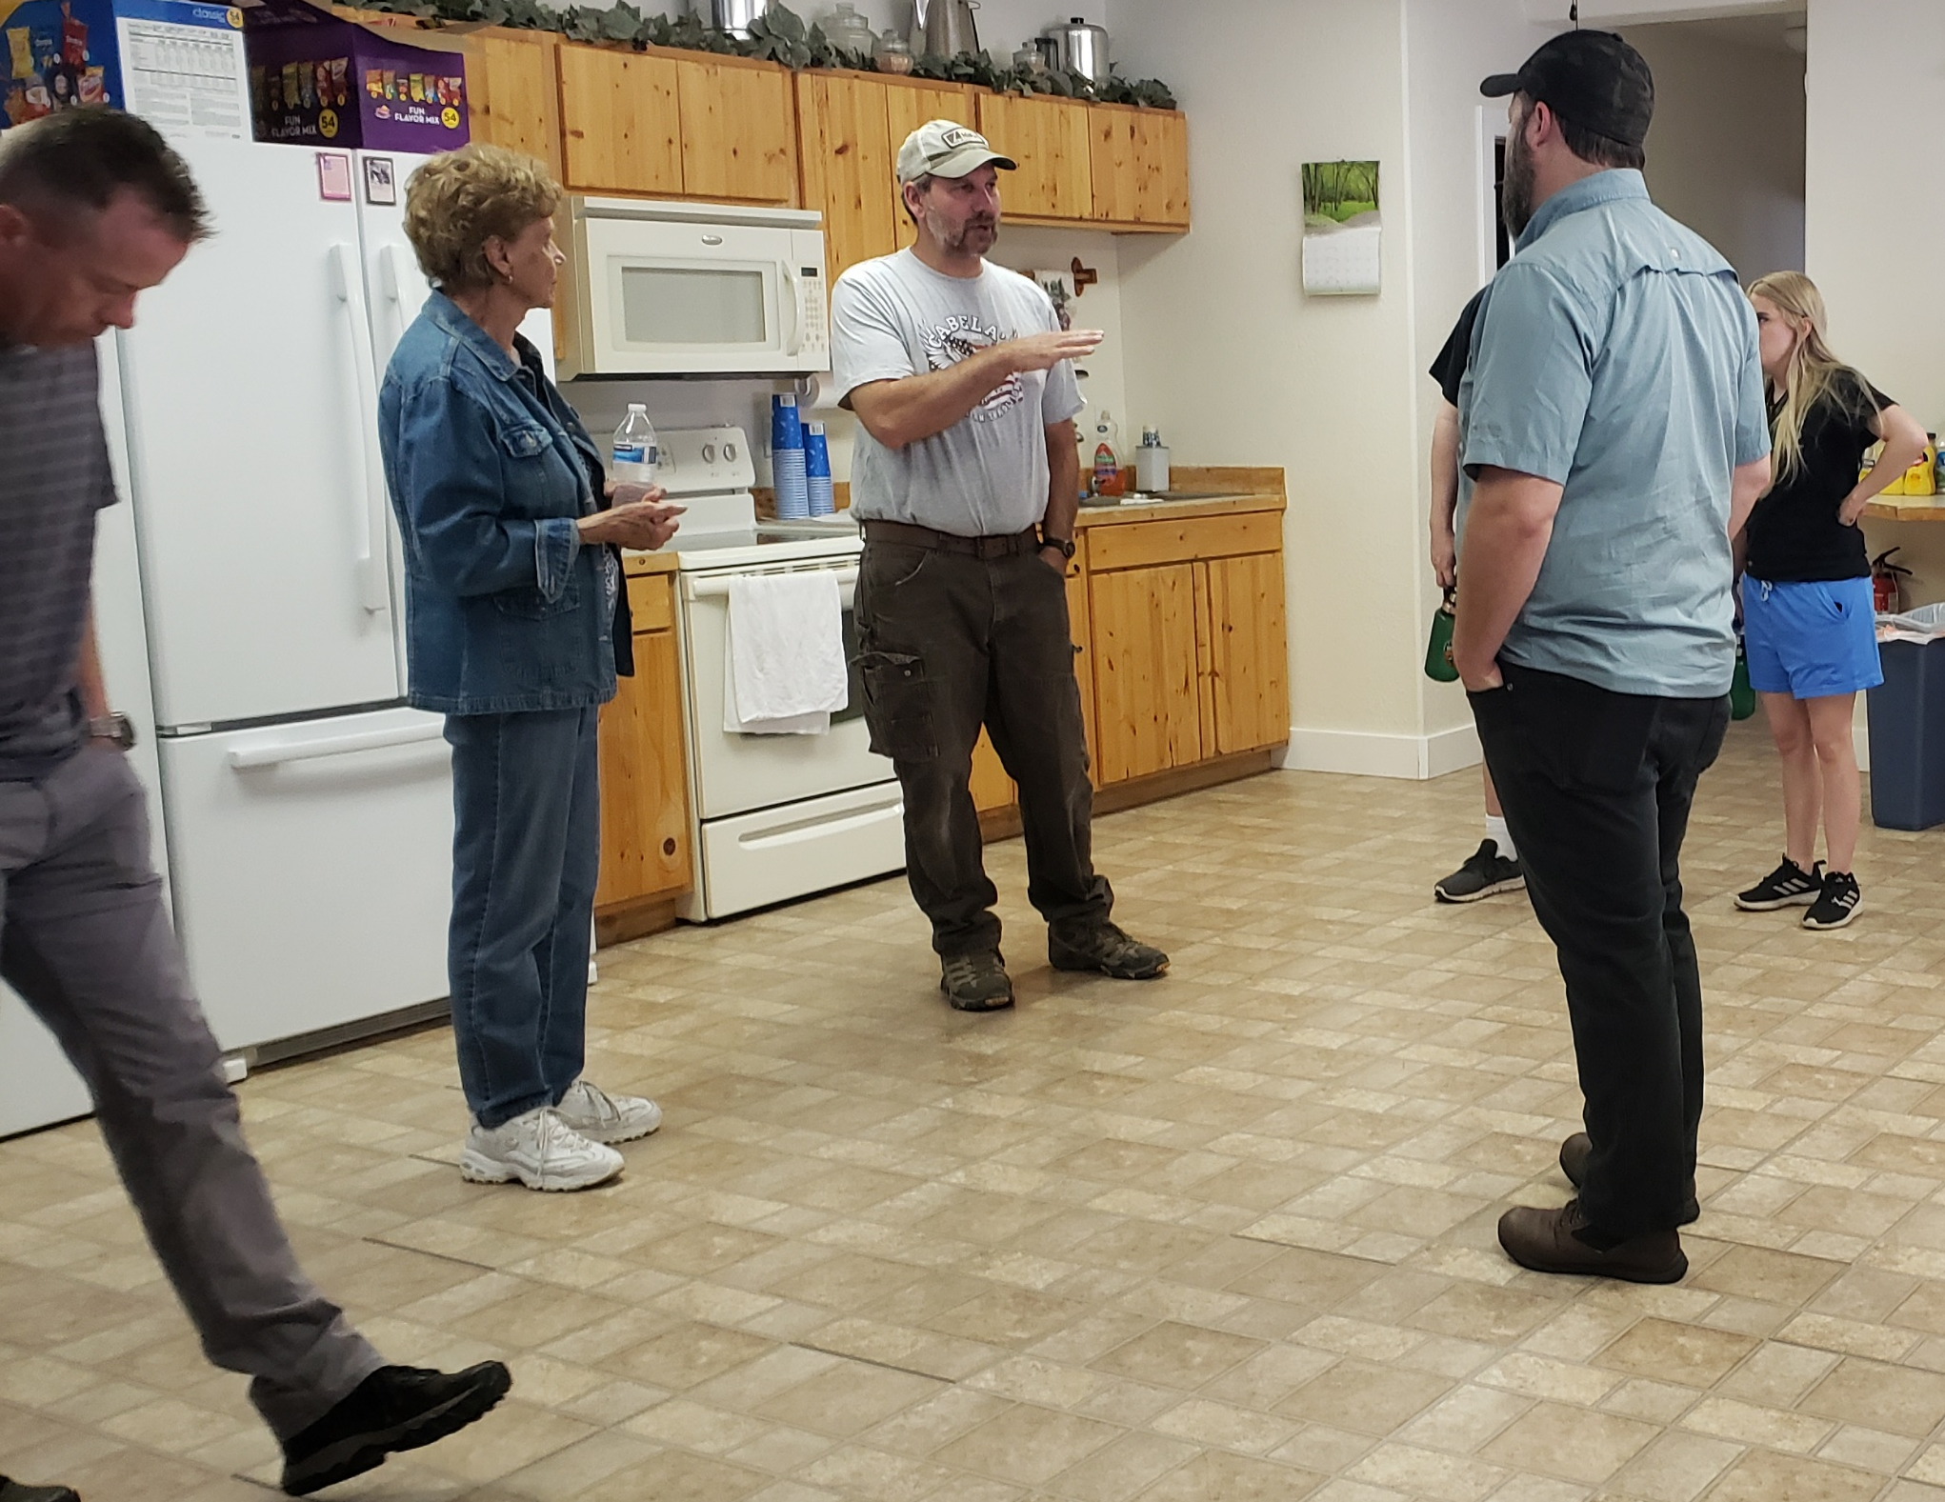
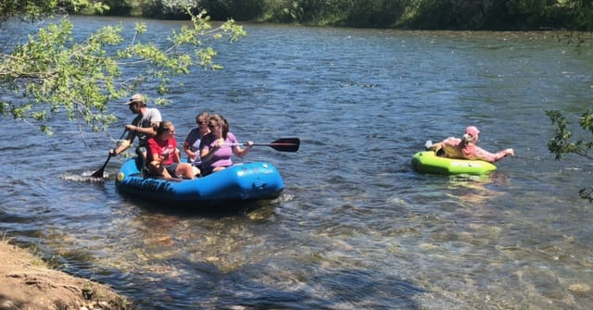
Encourage

Slide 14
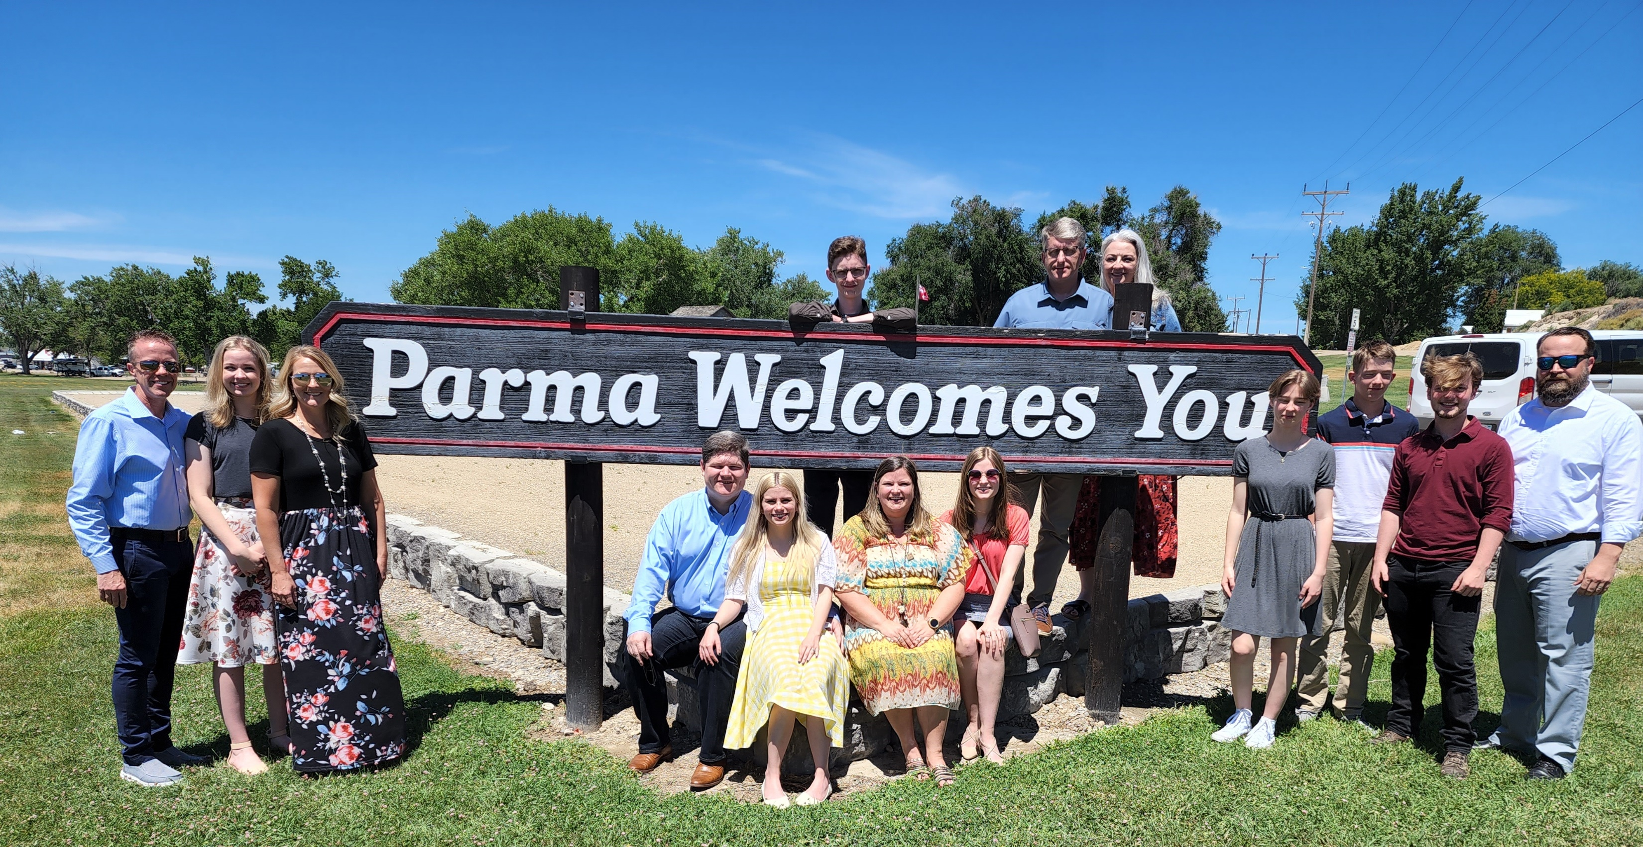
Encourage

Slide 15
“Come and see!”
"Come, see a man who told me all the things that I have done; this is not the Christ, is it?...From that city many of the Samaritans believed in Him because of the word of the woman who testified, "He told me all the things that I have done." So when the Samaritans came to Jesus, they were asking Him to stay with them; and He stayed there two days. Many more believed because of His word; and they were saying to the woman, "It is no longer because of what you said that we believe, for we have heard for ourselves and know that this One is indeed the Savior of the world.“ (John 4:29,39-42)

Slide 16
“Come and see!”
Do you believe Jesus is the Son of God? (John 8:24)
Would you confess His name before men? (Matthew 10:32-33)
Would you repent of your sins? (Luke 13:3)
Would you be immersed for the remission of your sins? (Mark 16:16)
Blessed are those who wash their robes, so that they may have the right to the tree of life, and may enter by the gates into the city… The Spirit and the bride say, "Come." And let the one who hears say, "Come." And let the one who is thirsty come; let the one who wishes take the water of life without cost. (Revelation 22:14, 17)

