Slide 1
You Are There Passover Week, 33 A.D.
Isaiah 53: 3-6

Slide 2
Isaiah 3-6
In Spirit and in Truth--Praying
3 He is despised and rejected by men, A Man of sorrows and acquainted with grief. And we hid, as it were, our faces from Him; He was despised, and we did not esteem Him.
4 Surely He has borne our griefs And carried our sorrows; Yet we esteemed Him stricken, Smitten by God, and afflicted.
5 But He was wounded for our transgressions, He was bruised for our iniquities; The chastisement for our peace was upon Him, And by His stripes we are healed.
6 All we like sheep have gone astray; We have turned, every one, to his own way; And the LORD has laid on Him the iniquity of us all.

Slide 3
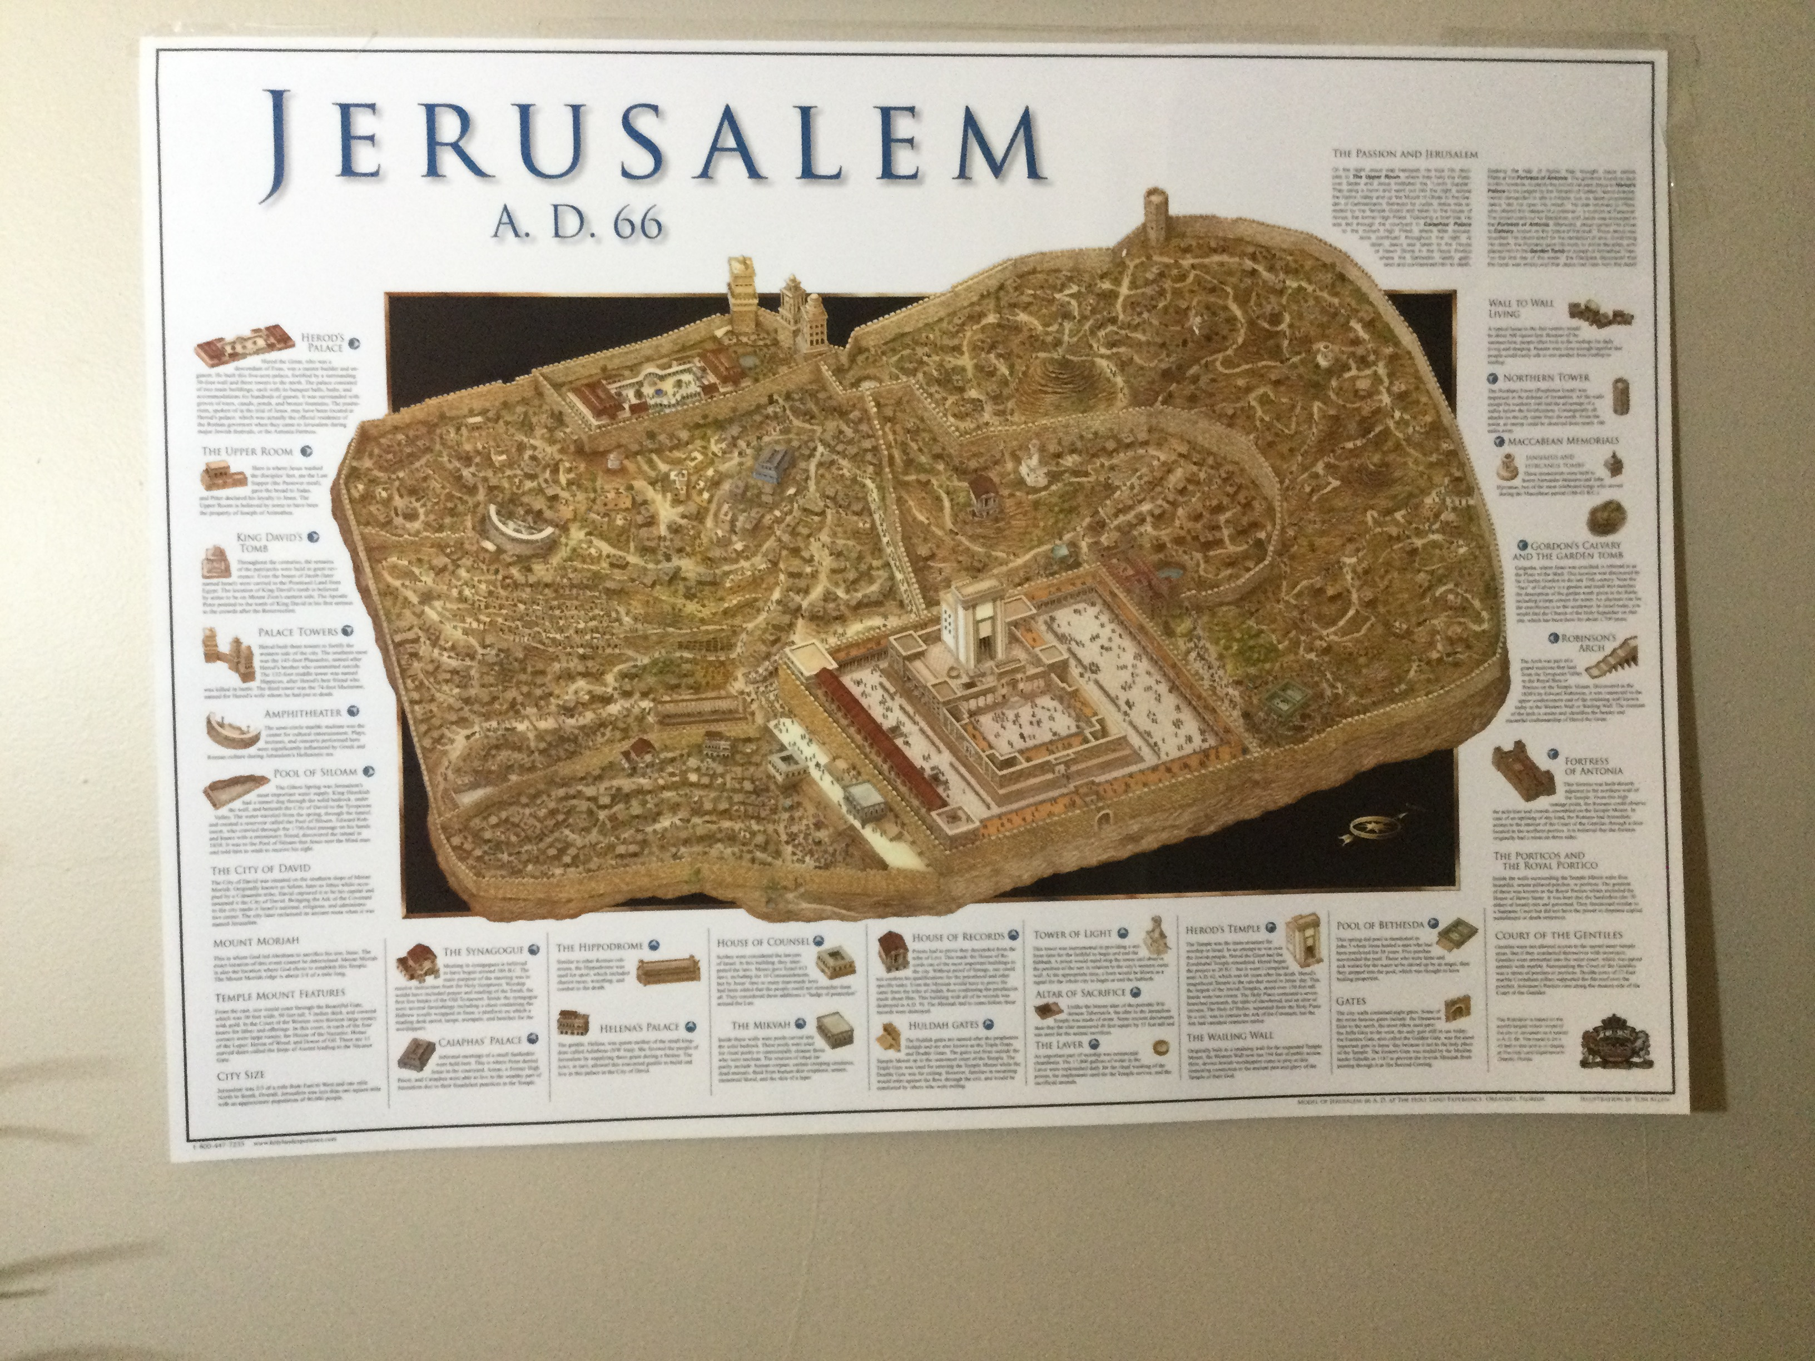

Slide 4
