Slide 2
Meridian, ID

Slide 3
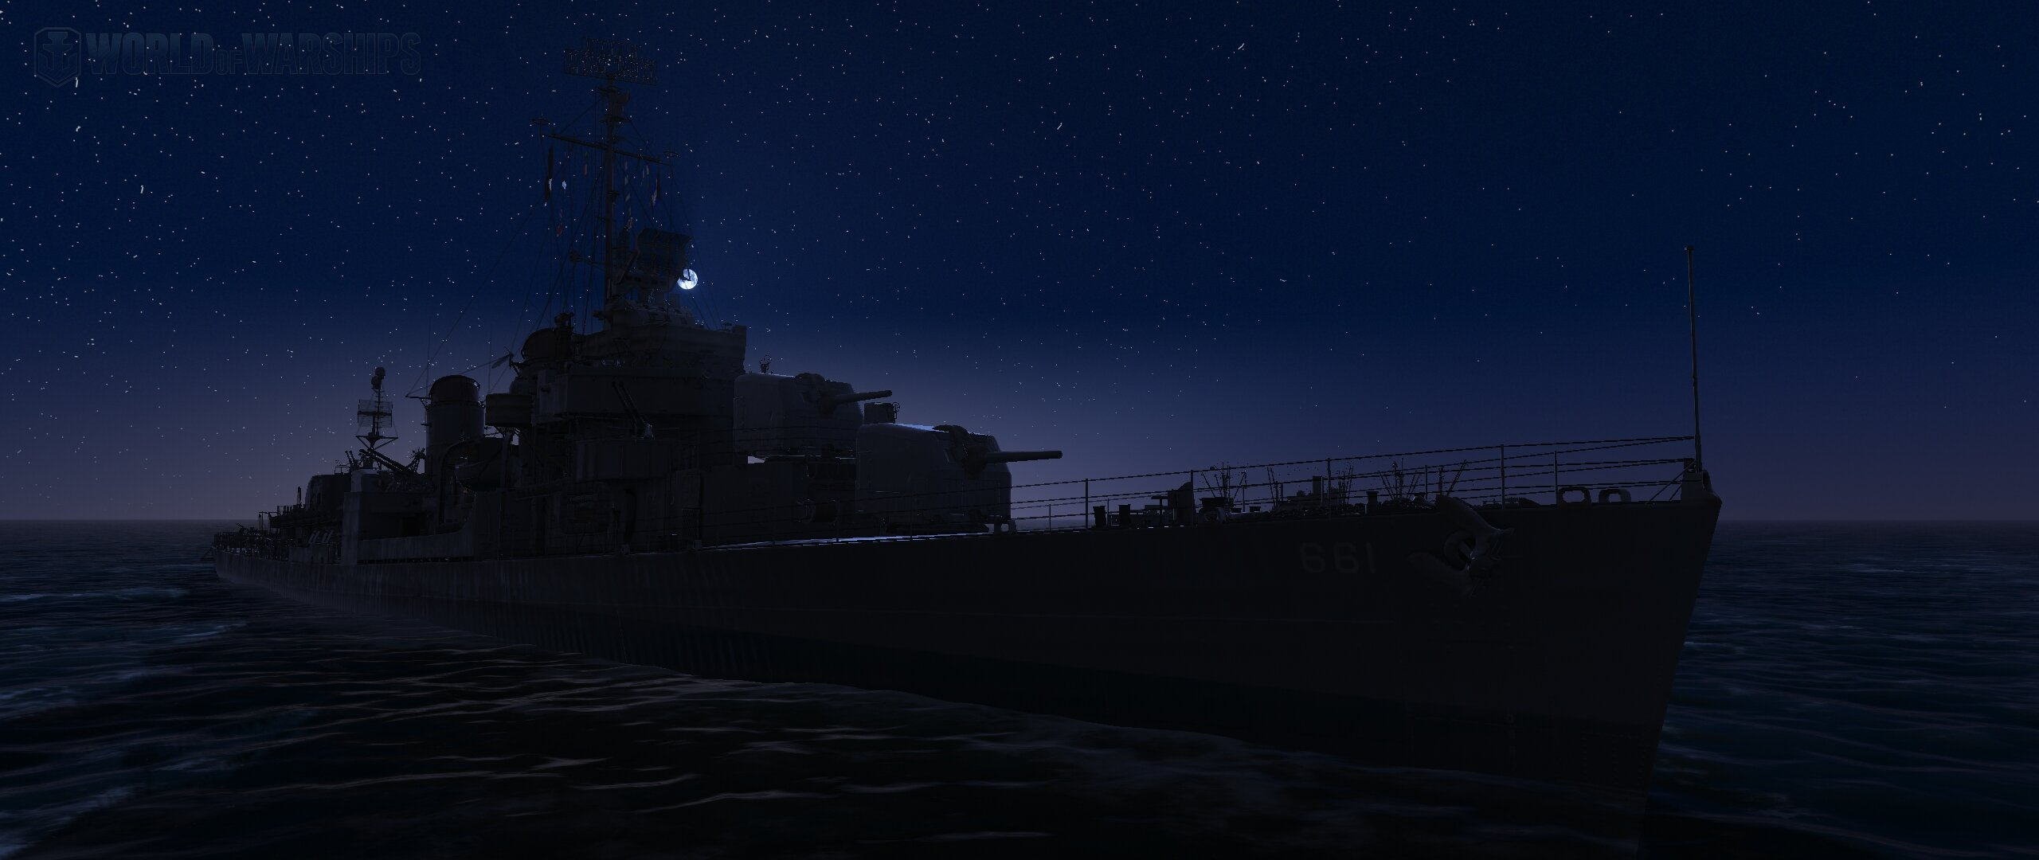

Slide 4
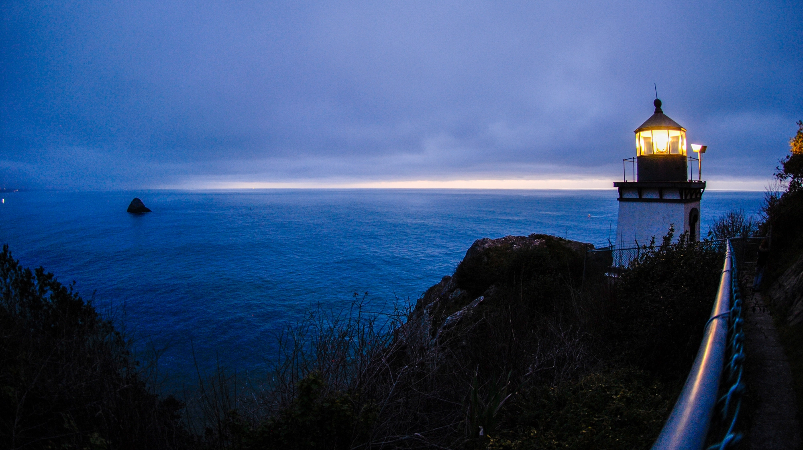

Slide 5
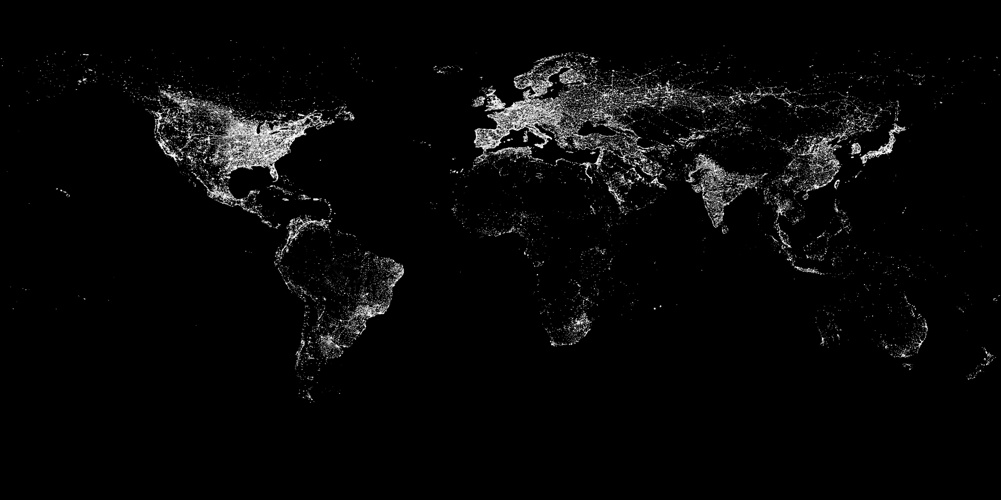

Slide 6
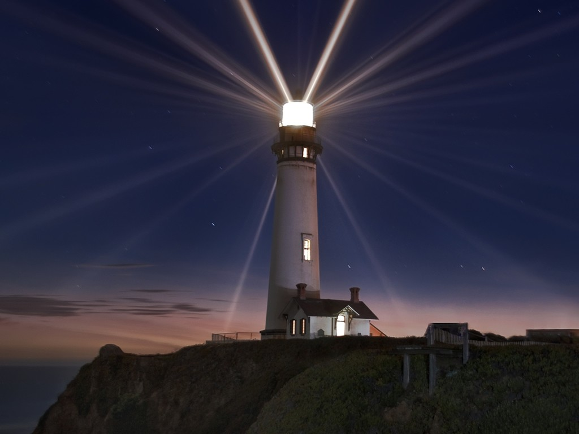

Slide 7
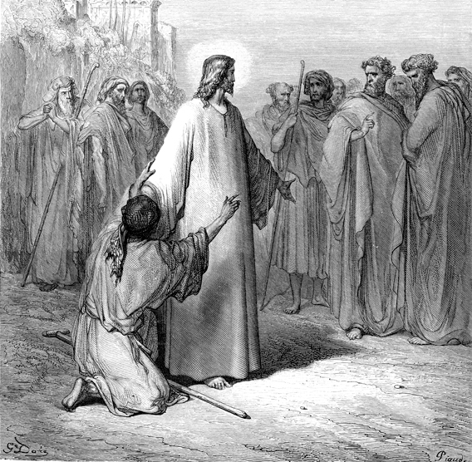
He’s powerless
People had taken action
No way to solve the problem

Slide 10
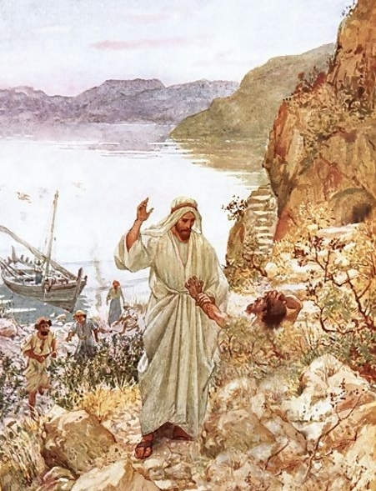
Satan is intelligent
Satan is working to oppose

Slide 11
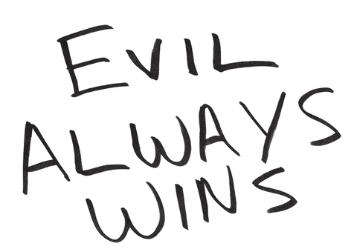

Slide 13
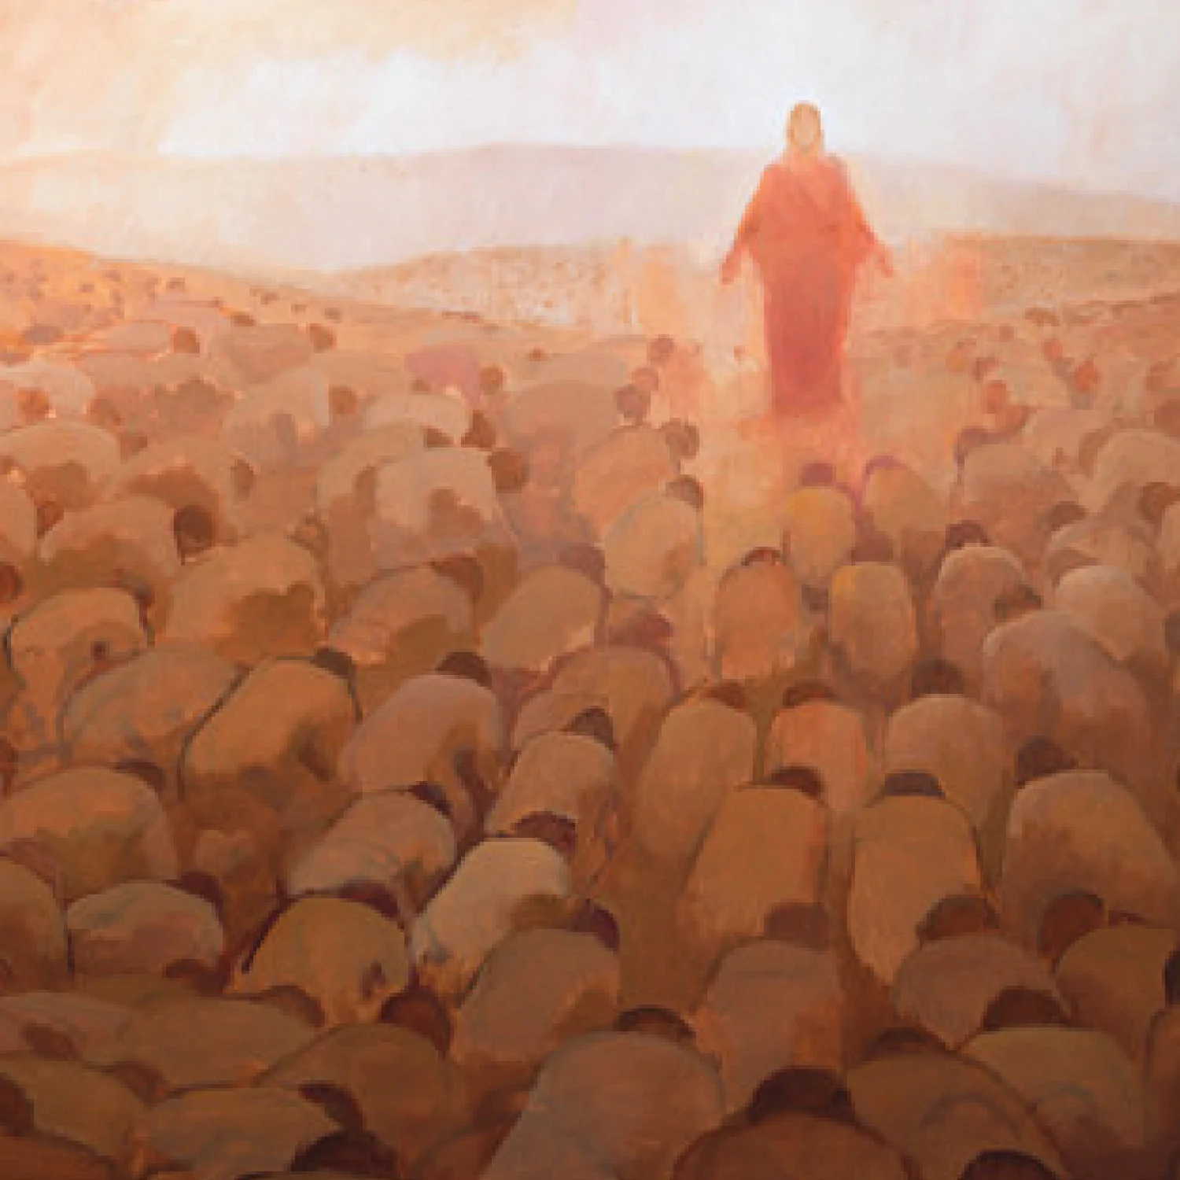

Slide 15
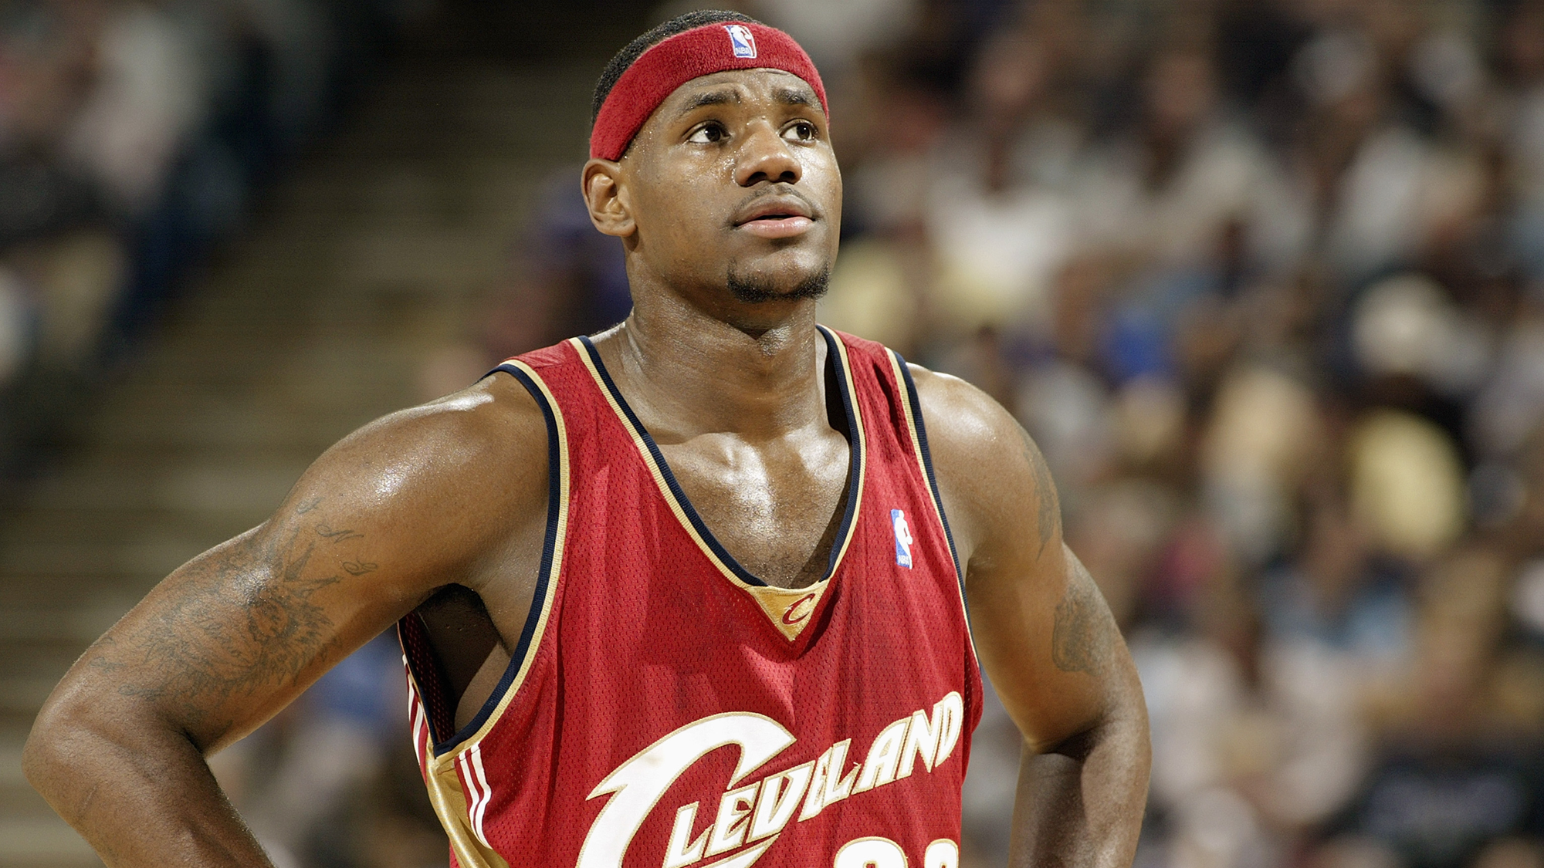

Slide 16
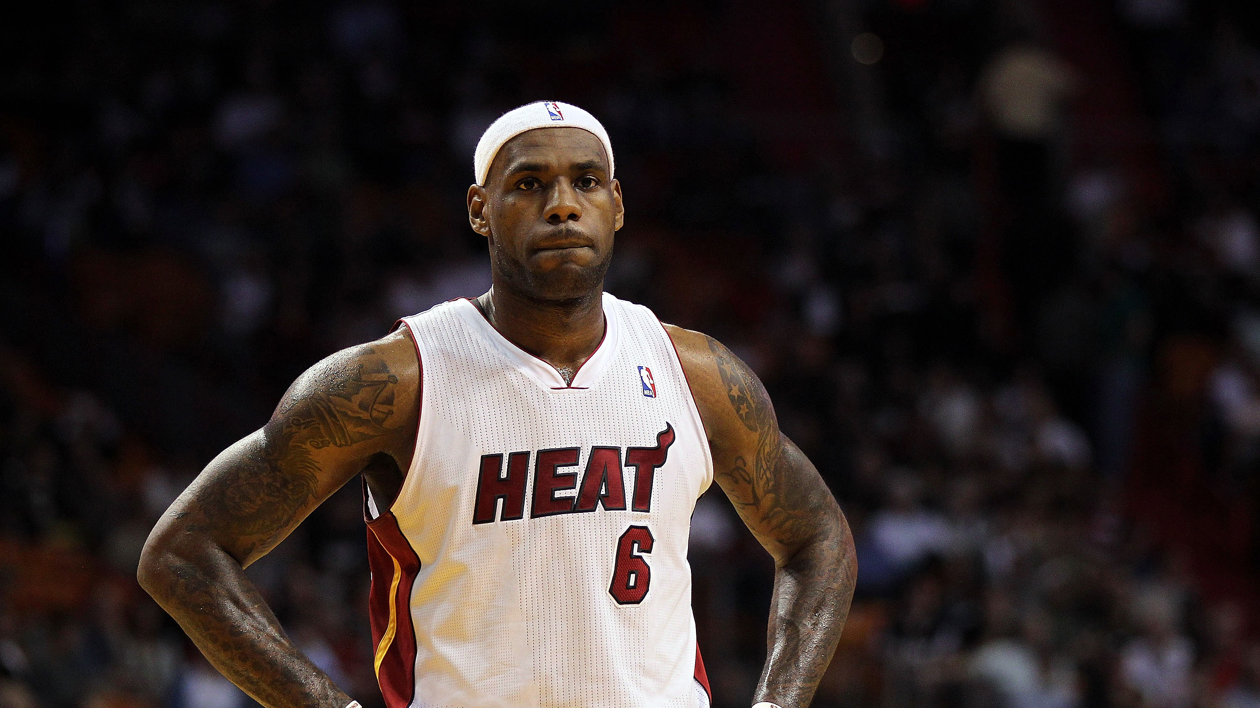

Slide 17
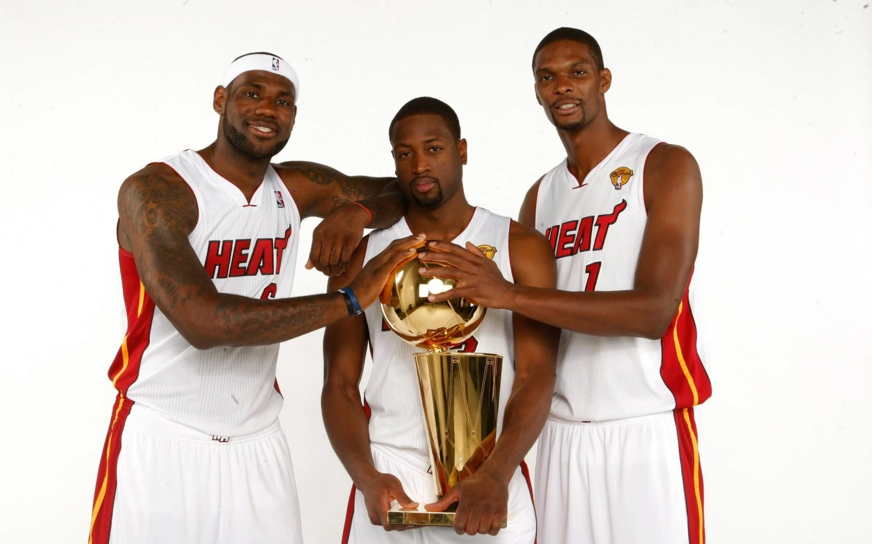

Slide 24
Don’t have to be “trained”
Don’t have to know all the answers
Don’t have to be successful
“GO!”…not “come”

Slide 26
“…let your light shine before others, so that they may see your good works and give glory to your Father in heaven” – Mt 5:16

