Slide 1
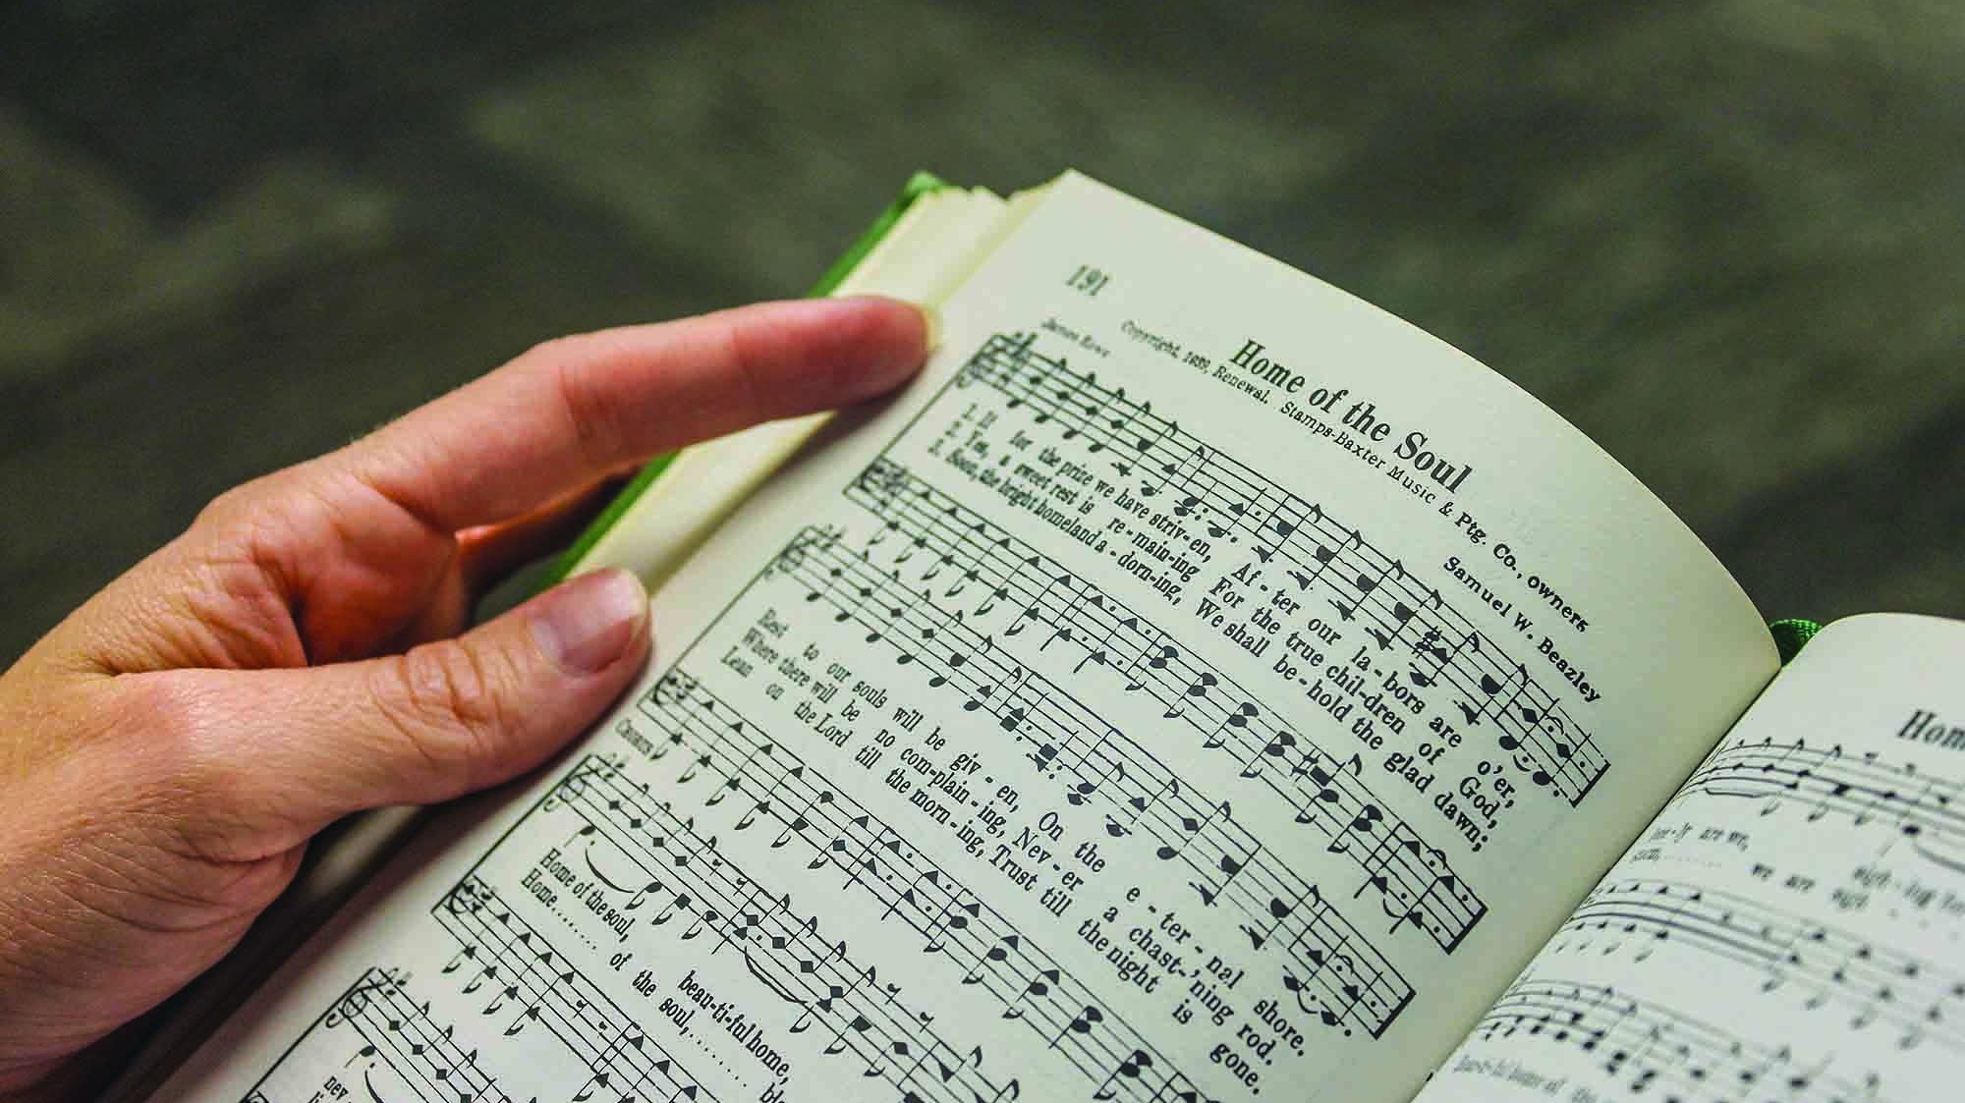
Congregational Singing

Slide 2
What is the Purpose?
Speak to One Another.
Give Thanks.
Teach.
Admonish.
Glorify God – Heb 2:12.

Slide 3
Why Should We Practice?
It is NOT about the sound.
A joyful NOISE – Ps 100.
The Heart – Eph 5:19.
The Spirit – 1 Cor 14:15.
It is about the effort.
Abraham made preparation for worship.
Temple Worship.
Best Animals.
Practiced musicians.

Slide 4
“So the number of them, with their brethren who were instructed in the songs of the Lord, all who were skillful…” – 1 Chr 25:7

Slide 5
Why Should We Practice?
It is about the words.
We cannot worship in truth if we don’t know the words.
The better we know them, the better we sing.

Slide 6
Singing Basics
Parts.
Soprano – Higher female voices.
Alto – Lower female voices.
Tenor – Higher male voice.
Bass – Lower male voice.

Slide 7
SHAPED NOTES
"DO"
is like a pyramid

Slide 8
SHAPED NOTES
"RE"
is shaped just like a bowl
DO

Slide 9
SHAPED NOTES
"MI"
a diamond in a ring
RE
DO

Slide 10
SHAPED NOTES
"FA"
a hill down which to roll
MI
RE
DO

Slide 11
SHAPED NOTES
"SOL"
the "O" in telephone
FA
MI
RE
DO

Slide 12
SHAPED NOTES
"LA"
a box to follow "SOL"
SOL
FA
MI
RE
DO

Slide 13
SHAPED NOTES
"TI"
a tasty ice cream cone
LA
SOL
FA
MI
RE
DO

Slide 14
SHAPED NOTES
And that brings us back to "DO"
DO
TI
LA
SOL
DO - RE - MI FA - SOL - LA - TI - DO
FA
MI
RE
DO

Slide 15
DO
SHAPED NOTES
TI
LA
SOL
FA
MI
RE
DO

Slide 16
How to INSTANTLY Improve Your Singing
Breathing.
Enunciate.
LISTEN!

Slide 17
Types of Songs
Psalms – Inspired songs of praise.
Hymns – Uninspired songs of praise.
Spiritual Songs – Songs that may not necessarily praise, but teach, encourage, or convict each other to good works.

Slide 18
Types of Songs
Praise.
Direction: God.
Focus: Glorification, Honor, and Adoration.
Ex. “Praise God from Whom All Blessings Flow” (528).
Thanksgiving.
Direction: God.
Focus: Recognition and Gratefulness.
Ex. “The Lord’s My Shepherd” (642).

Slide 19
Types of Songs
Supplication.
Direction: God.
Focus: Submission and Requests.
Ex. “Hear Me When I Call” (215).
Edification.
Direction: One Another.
Focus: Teach stories, lessons, and morals.
Ex. “Tell Me the Story of Jesus” (622).

Slide 20
Types of Songs
Exhortation.
Direction: One Another.
Focus: Urge toward action (invitation, evangelism, etc).
Ex. “How Long Has it Been?” (251).
Meditation.
Direction: Self.
Focus: Reflection and self-examination.
Ex. “When I Survey the Wondrous Cross” (742).

Slide 21
Practice!
Practice!
Practice!

