Slide 1
A Survey of Exodus and Leviticus
EXODUS CHAPTERS 14 - 17
22/4
Notes:
Over what has been a relatively short period of time, Moses has gone from burning bush foot-dragging to full fledged servant of God and leader of the Israelites.
In chapter 11 verse 3, Moses is described this way:
Exo 11:3 And the LORD gave the people favor in the sight of the Egyptians. Moreover the man Moses was very great in the land of Egypt, in the sight of Pharaoh's servants and in the sight of the people.
This would suggest that as the plagues played themselves out, the people saw God and recognized that Israel’s God was a true living God AND that their Egyptian gods were false gods. Notice also that this revelation of Moses’ greatness was limited to Pharoah’s servants and the people (NOT PHAROAH)
And so on the 15th day of the month of Abib, latter march to Mid April on our calendar, the Israelites left Egypt as God said they would
In chapter 12 verse 30, we read that there was a great cry in Egypt and that not a single household existed in Egypt that did not have one dead.
And so Israel plundered the Egyptians as God said they would. Later in chapter 12 we are told that the Israelites left from Rameses with about 600,000 men on foot plus children and women, flocks, herds and livestock, most estimates are about 2 million people

Slide 2
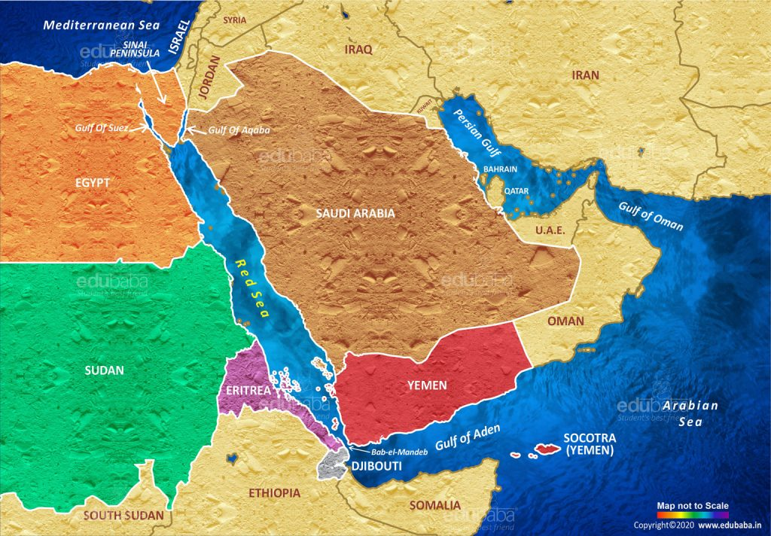
Notes:
Today/s middle east just for reference
Eastern Facing Arrow – The Land of Goshen; where the Israelites settled from back in Joseph’s day, Genesis Chapter 46
Shepherding was an abomination to the Egyptians per Genesis 46 (Joseph’s words) but Pharoah welcomed them to the best Egypt had to offer and agreed readily to allow them to settle in the land of Goshen.
Genesis 47
Gen 47:5 Then Pharaoh spoke to Joseph, saying, "Your father and your brothers have come to you.
Gen 47:6 The land of Egypt is before you. Have your father and brothers dwell in the best of the land; let them dwell in the land of Goshen.
Western Facing Arrow
Southern Sinai Peninsula – Mt Horeb / Sinai
God came to Moses on this mountain in the burning bush and started the journey that only a short time later would lead Moses and all of Israel back to this very same place. God spoke to Moses on this mountain through the bush and now speaks to him in the midst of clouds and fire that all of Israel can see (Exodus 19:16)

Slide 3
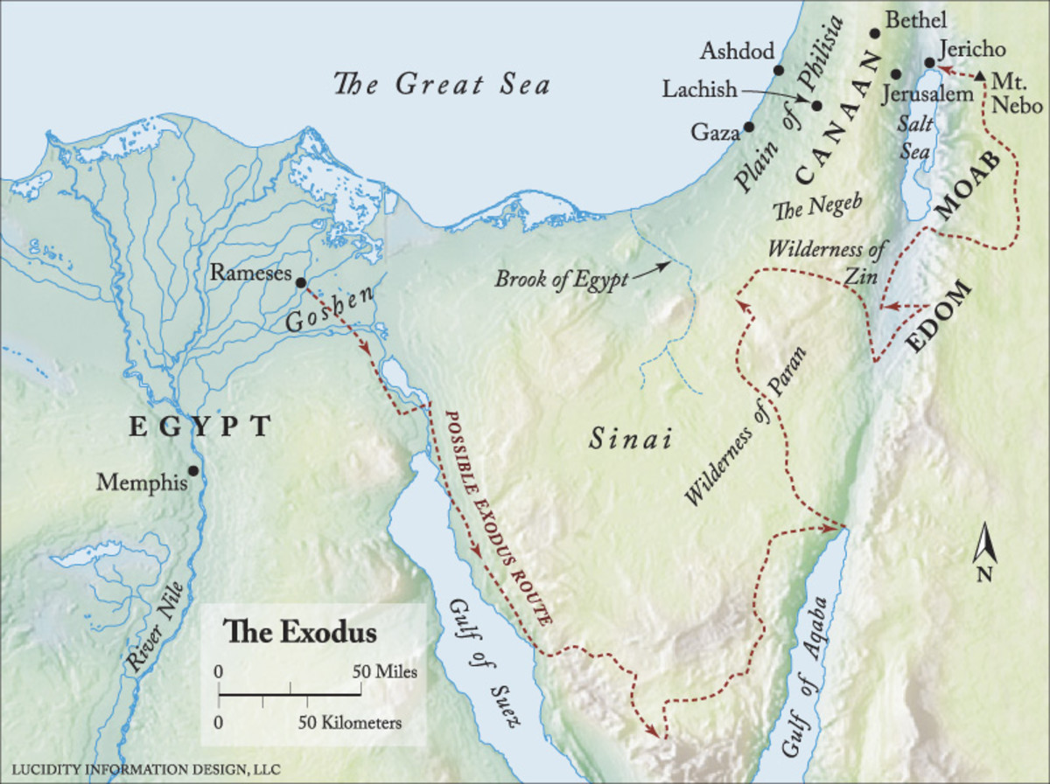
Philistines
Midian
Midian
Midian
22/3
Notes:
And so God said “walk this way
A majority of respected authorities on the exodus route believe the crossing was in the northern Guld of Suez area. Exactly where is speculative, but any of the lakes to the north of the gulf proper to the northern end of the gulf of Suez are in play. Crossing the gulf of Suez and wandering in the Sinai peninsula is the most fitting location .
One rabbit for a very short chase – explain the current day proposal that Mt Sinai is actually in modern day Saudi Arabia and that the crossing of the Red Sea took place in the Gulf od Agaba
Without getting into the technical reasons and geographical reasons and the time reasons of all of this too deeply
The travel time and distance to Kadesh don’t fit with the Saudi location nor foes the travel time of the trip to Sinai fit as well.. Although Midian was definitely in modern day Saudi Arabia, scholars agree that the extremely nomadic Midianites were also in the regions above and to the west of the gulf of Agaba.
FOR TEACHER ONLY – DO NOT USE IN CLASS
Lastly, Paul refers to Hagar as being Mt Sinai in Arabia (Galatians 4:25) Barnes refers to Arabia as Arabia Petraea and in the time of Paul, Arabia Petraea included all of the Sinai peninsula and into Jordan as well as a part of the Arabian peninsula. Bottom line, we are not 100% positive on the location of Mt Sinai, but it seems likely that we are in the correct area. BTW, Paul’s main point in Galatians 4:24-25 was not a geography lesson regarding Mt Sinai. Paul was comparing the bondage of the old law to the freedom of the new law, and he was using Abraham, Hagar, Sarah, Mt Sinai and Jerusalem to illustrate his point
We know where Ramses is without a doubt, we know where Goshen is. We know that to the north was area that was well patrolled and fortified and filled with Philistines

Slide 4
Chapter 14
Verse 2 – The lessons are not over, here comes Pharoah and his hard heart
Verse 7 – 600 choice chariots chasing, Josephus says 50K horsemen and 200k infantry
Verse 11 – Victims again!
Verse 21 – a strong east wind plows a road
Verse25 – the wheels come off – literally
Verse 28 – not a single Egyptian survivor
Verse 30 – Israel saw dead Egyptians was up on the shore
Verse 31 – Israel feared God
Notes:
Chapter 14
The Red Sea
As we have looked at all the lessons of the plagues and understand that God was teaching the Egyptians, the Israelites and Moses/Aaron this entire time. Chapter 14 explains that God wasn’t through teaching. There were more lessons to learn.
It would seem apparent that if you had just witnessed 10 plagues you would be of strong faith. Surely you would believe that your God could do anything but as soon as Isrtael sees the dust of Pharoah’s chariots, they wither
The angel of the Lord and the cloud went behind the Israelites and protected them.
A strong east wind but a north and south body of water. In this particular case God used a natural element to initiate the supernatural event of dividing the Red Sea. There was also an east wind in plague #8, the locusts and I don’t know if that plays in here or not. In this event, the wind blew, the cloud lined up to block the Egyptians and there was light on the Israelites side of the cloud and darkness on the Egyptian side of the cloud. The wind blew all night, presumably that’s how long it took all of Israel to cross the Red Sea, 2 million people plus all their possessions and their livestock.
We know that Egypt entered the red sea in the 4th watch of the night between 2A and 6A, we also know that they experienced much problems with chariot wheels coming off and bogging down. Everyone on the Egyptian side was within the wall of water when it came back down which took some time to get them all in place
Israel SAW the dead Egyptians on the shore – Israel saw, and Israel feared the Lord and believed Him and his servant Moses.

Slide 5
Chapter 15
Verse 1 – God’s triumph and glory is recognized
Verse 2,4-5,13-16 – Praise to God for being God and for what He has done & consequences
Verse 20 – Miriam the prophetess
Verse 23 – Grumble, grumble, grumble
Verse 25b & 26 – God reminds Israel there are conditions
Chapter 16
Verse 2 – 30 days after leaving Egypt, more complaining
Verse 3 – Too much drama, “Oh that we would have died”
Verse 8 – Moses reminds Israel that they are talking bad about God almighty
Verse 20 – Rules are not made to be broken
Verses 2,7,8,9,12 – Grumble, Complain & Murmur times 8
Notes:
In this lesson, the Israelites are finally free of Egypt. Going back to last week the last 2 verses, 30 and 31
Exo 14:30 Thus the LORD saved Israel that day from the hand of the Egyptians, and Israel saw the Egyptians dead on the seashore.
Exo 14:31 When Israel saw the great power which the LORD had used against the Egyptians, the people feared the LORD, and they believed in the LORD and in His servant Moses.
They believed ... At least for the moment ... We do the same thing though
Someone in our family has a serious illness, use cancer as an example and we wear out the knees in every pair of pants that we have praying to God to heal that cancer. We talk about how we need that person, we make deals with God, we promise to never take life for granted again and then – wonder of wonders – our loved one recovers ... And then what do we do.
We quit praying as much as we did when the stress was at its peak, we quit opening up the word and letting the Psalms wash over us, we lose some of our fire because we no longer have the singular purpose of begging our God look kindly upon us
And – we fall away...in small increments at first and then before we know it we are blaming God for the bad times and forgetting all the marvelous wonders he has shown us.
Chapter 15 of Exodus is a song that all the children of Israel sang. It is a song of triumph and of glory. From it we should recognize the importance of song to the Lord as well as to our soul. This tells us that worship (in general) and praise to God through song (in particular) is always an appropriate response to being saved
Throughout the Bible, music and specifically SONG has a special place, and this may be the oldest piece of song/poetry in the Bible.
In the 18 verses of song there are 2 stanzas. The first stanza (verses 1-12) alternates between Praise for who God is and Praise for what God has done and the 2nd stanza (verses 13-18) emphasize the results of what God has done and separate that between Israel and the other nations around them.
AS an example of this. Take verse 2, Praise to God for who he is
Exo 15:2 The LORD is my strength and song, And He has become my salvation; He is my God, and I will praise Him
AND verse 4 and 5, Praise to God for what he had done
Exo 15:4 Pharaoh's chariots and his army He has cast into the sea; ...
Exo 15:5 The depths have covered them; They sank to the bottom like a stone.
The first 12 verses go back and forth between the two sub-topics and then the last 5 verses focus on the impact to Israel (verse 13)
Exo 15:13 You in Your mercy have led forth The people whom You have redeemed; You have guided them in Your strength To Your holy habitation.
AND to the surrounding nations (verse 14-16)
Exo 15:14 "The people will hear and be afraid; Sorrow will take hold of the inhabitants of Philistia.
Exo 15:15 Then the chiefs of Edom will be dismayed; The mighty men of Moab, Trembling will take hold of them; All the inhabitants of Canaan will melt away.
Exo 15:16 Fear and dread will fall on them; By the greatness of Your arm, They will be as still as a stone, Till Your people pass over, O LORD, Till the people pass over Whom You have purchased.
And then back to Israel in verses 17 and 18
In verse 20, Miriam is referred to as a prophetess, one of a few, not the only one ... Deborah for example also noted as such. We don’t really know what prophesying that Miriam did, perhaps it was this song that is being referred to but if we remember the story in Numbers 12:1-3, in which Miriam and Aaron stage a mini-coup, that “they” (the 2 of them) said – “has not God spoken through us also” Speaking through Aaron is obvious because of the dialogue and signs given to Pharoah. For Miriam, not so much as we don’t really know to what extent that happened. Perhaps the revelation of this song is an instance of what Miriam refers to in Number 12.
If we stop the story here – where is Israel’s faith? It is on the top of the mountain – at its highest peak
Nothing can stop us
Nothing except a 3-day journey into the wilderness without water, that is.
Israel begins their trek, first to Sinai and then to the promised land and 2 things are emphasized
1 – Israel complains about everything, and they do it over and over again
2 – God provides for their every need. He does not punish them for their ingratitude but rather patiently endures their grumbling
Think about the journey so far, the leave the red sea on a spiritual high, they have seen things no one has ever seen. They have seen plagues and death, they have plundered the Egyptians was prophesied, they walked through the Red Sea, on dry land AFTER an east wind had plowed the water leaving a place wide enough for 2 million Jews to cross AFTER WHICH they watched the wheels come off Egypt’s chariots and then watched the water cover them up and then watch their bodies wash up on shore
And after all that, they are going to let a little bit of bitter water ruin their journey. Based on what they had seen did they really not think that God would sweeten the water to make it drinkable?
Exo 15:23 When they came to Marah, they could not drink the waters of Marah, for they were bitter; therefore, it was named Marah.
Exo 15:24 So the people grumbled at Moses, saying, "What shall we drink?"
Exo 15:25 Then he cried out to the LORD, and the LORD showed him a tree; and he threw it into the waters, and the waters became sweet. There He made for them a statute and regulation, and there He tested them.
Exo 15:26 And He said, "If you will give earnest heed to the voice of the LORD your God, and do what is right in His sight, and give ear to His commandments, and keep all His statutes, I will put none of the diseases on you which I have put on the Egyptians; for I, the LORD, am your healer."
God was testing his people, verse 25 tells us so. God wants to see what he has and he gives Israel a preview of the covenant that is to come shortly What lies ahead of the Israelites? Battles, conquest, the promised land – all within reach with God’s help.
30 days into the wilderness, we have our 2nd instance of Israelite murmuring. They are not yet to Mt Sinai.
Exo 16:3 The sons of Israel said to them, "Would that we had died by the LORD'S hand in the land of Egypt, when we sat by the pots of meat, when we ate bread to the full; for you have brought us out into this wilderness to kill this whole assembly with hunger."
Perhaps a little melodramatic but representative of how short out memory can be. But Israel has spent the biggest part of the last 215 years being slaves, but having all their needs supplied to them. No rights also means no decisions to make, no concerns about working their way out of a jam because there is no incentive to do so. They may have been slaves but Egypt needed their labor so they were only going to push so hard – at least until Moses showed up. Israel doesn’t understand the cost of their freedom.
Immediately God tells Moses, I will fix the food problem but this will also be a test – and he puts restrictions on how much may be gleaned. Is it surprising that they try to test God and take extra? It is NOT
We do exactly the same thing. We push and push to see how much we can get away with. And we do this instinctively from birth – do we not? And through this, we learn boundaries.
Verse 8 – A reminder
Exo 16:8 Moses said, "This will happen when the LORD gives you meat to eat in the evening, and bread to the full in the morning; for the LORD hears your grumblings which you grumble against Him. And what are we? Your grumblings are not against us but against the LORD."
ALSO – Moses says “what are we, that you grumble against us”
Perhaps referring to Aaron and maybe even Miriam as well. As the people continue to lash out to management, certainly Aaron and Miriam, simply by their blood relation to Moses are not going to get a pass and we know this is human nature. The point is thus – the people are lashing out to Moses because he is the face of the exodus, but in doing so, they are lashing out to God, first and foremost
And so God gives the people food, manna in the morning and quail in the evening. All that they had to do was collect it and follow instructions. Collect what you need and no more. ON Fridays, collect for two days.
What did God tell them if they gathered up too much?
And did it ruin?
Exo 16:20 But they did not listen to Moses, and some left part of it until morning, and it bred worms and became foul; and Moses was angry with them.
It is interesting to note that there is half of a verse (13a) about the quail and the rest of the food story focuses on the manna (about 23 verses). The word “manna” in Hebrew means “what is it?” Numbers 11:7-8 explains that the manna was a fine flake like thing that was as fine as frost. For the longest time, I always pictured it as a cracker that was ready to eat but this is incorrect, it was more of an ingredient than it was a finished product.
Num 11:7 Now the manna was like coriander seed, and its appearance like that of bdellium.
Num 11:8 The people would go about and gather it and grind it between two millstones or beat it in the mortar and boil it in the pot and make cakes with it; and its taste was as the taste of cakes baked with oil.
Coriander seed – the fruit part of the cilantro plant but does not taste like cilantro. May be used shole or ground into a flour, a little sweet, warm and aromatic
Bdellium – A transparent, gum like resin, probably from the balsam tree and if so, likely brown to amber in color. There is also a reference to the word meaning “pearls or pearl like”, which would put the color in the off white to pinkish white color.
They were to take only enough to eat in one day
They were top harvest it early in the morning before it melted
No harvesting on the sabbath
Consequences for disobedience
In the 16th chapter the word grumbled (NASB), murmured (KJV) or complained (NKJV) is used 8 times (NKJV “Complaint” 7 times not 8

Slide 6
Chapter 17
Verse 2 – Testing God through Moses
Verse 8 – The 1st military challenge against Israel and the 1st opportunity for Joshua
Verse 11 – Aaron and Hur keep Moses’ hands lifted up
Verse 14 – God will not let this sin by Amalek go unpunished
Deuteronomy 25:18 Amalekites attacked the rear of the Israelite convoy, women, children, sick
Ist Samuel 15:3 Saul disobeys God after God tells him to wipe out the Amalekites
Notes:
Chapter 17
Verse 2
Exo 17:2 Therefore the people quarreled with Moses and said, "Give us water that we may drink." And Moses said to them, "Why do you quarrel with me? Why do you test the LORD?"
Exo 17:3 But the people thirsted there for water; and they grumbled against Moses and said, "Why, now, have you brought us up from Egypt, to kill us and our children and our livestock with thirst?“
Exo 17:4 So Moses cried out to the LORD, saying, "What shall I do to this people? A little more and they will stone me."
Moses seems justified in his fear of the people
Of course we remember this water event and the striking of the rock and later we will have a striking that should be a talking to and we know where it landed Moses
And then comes Amalek.
This is the story of Joshua’s first military command and the story of Moses on a hilltoip, watching the battle and as long as Moses held his hands up, Israel prevailed but when he let his hands fall down, the Amalekites prevailed. Eventually of course, Aaron and Hur sat Moses on a rock and held his hands up for him so that Israel could and did win the battle.
This attack by the Amalekites infuriated God – read chapter 17:14
Why? Deuteronomy 25:18 gives is that answer when Moses recounts how Amalek came at Israel from a rearward position and attached the stragglers – it was cowardly
Who would have been at the rear – the women and children – the weak, the sick
The Amalekites were kin to the Israelites
Amalek was Esau’s grandson (Genesis 36:12)
They separated themselves from Edom and became the big boys in the northern end of the Sinai peninsula. It is most likely that they would have know of the Exodus, they would have know of the plagues, they would be cognizant of exactly who Israel was.
They attacked the rear and God did not appreciate it. They focused on the weak and it was foul play and God did not forgive them for it.
God told Samuel to tell Saul to utterly destroy the Amalekites – do not spare anyone – kill them all and take no plunder - We know the rest of that story as Saul disobeyed Samuel and let Agag live along with the best of the animals and did so by replacing Samuel’s (God’s) instructions with his own judgement
1st Samuel 15:10, God tells Samuel that he greatly regrets making Saul king.
In verse 19 of 1st Samuel 15, Samuel asks Saul why did he not obey God and Saul says “but I did obey – I went on the mission, I utterly destroyed the people, I brought back Agag the king and the people took the plunder, all the things that were supposed to be destroyed, they took those so they could sacrifice to God!” So ... What is the problem Samuel?
Do you have the nerve to stand before God and mock him in this way?
Is there any difference between Saul’s response and ours when we substitute our own opinion or judgement in place of God’s word. Well, I know that the Bible says this but I just feel that God is OK with me doing that.
In this battle we see the importance of leadership.
We see the importance of Godly leadership
We see the importance of conducting ourselves with honor, regardless of our circumstance
We see that God means what he says and consequences are not necessarily muted by time

Slide 7
Lessons For Us
The Bitter made Sweet
God will sweeten our lives if we let him. He will either change the circumstances or change our attitudes.
Naomi - (Ruth 1:20-21 & 4:13-17)
Romans 8:28
Our Daily Bread
Remember God’s blessing – Complain Less
Trust God’s Provisions – Complain Less
Obey God’s Commands – Complain Less
God gives DAILY bread and tomorrow God will give DAILY bread and the next day ...
Holding up one another’s hands
Behind every great leader is a support team.
Even if we are not a great leader, we can be great at holding up the hands of those that are. If we do, we will be blessed by God even though we may not be noticed by others.
Notes:
The Bitter made Sweet
God will sweeten our lives if we let him. He will either change the circumstances or change our attitudes.
Naomi - (Ruth 1:20-21 & 4:13-17)
Romans 8:28
Our Daily Bread
Remember God’s blessing – Complain Less
Trust God’s Provisions – Complain Less
Obey God’s Commands – Complain Less
God gives DAILY bread and tomorrow God will give DAILY bread and the next day ...
Holding up one another’s hands
Behind every great leader is a support team.
Even if we are not a great leader, we can be great at holding up the hands of those that are. If we do, we will be blessed by God even though we may not be noticed by others.

