Slide 1
A Survey of Exodus and Leviticus
EXODUS CHAPTERS 7 - 14
22/3

Slide 2
P1 Water to Blood (7:17)
Duplicated – Pharoah’s heart was not moved – Ho Hum
P2 Frogs (8:3,8)
Duplicated – Agrees to let the people go – Just kidding, heart hardened
P3 Lice (8:16,18-19)
Unable to Duplicate – Magicians knew the truth, but Pharoah’s heart hardened
P4 Flies (8:22-26)
No attempt to duplicate – Segregated to the Egyptians only – Pharoah waivers but has conditions – ultimately his heart remains hard
P5 Livestock (9:2,7)
No attempt to duplicate – Segregated to the Egyptians only – Pharoah verified the damage and immediately hardens his heart
Notes:
Pre-Plagues and Plagues
The first part of chapter 7, before we get to the plagues, is another humorous aside to me. Moses in chapter 5, Moses appeared before Pharoah but did not pull out any of the signs God gave him previously to use in front of the Jews. In chapter 7, after we have seen Pharoah turn up the heat on the working conditions, Moses goes back before him and uses the signs that God provided. God tells Moses once more time, that Pharoah will not heed the signs and that Pharoah’s resistance will be for the purpose of showing Egypt and the world, God’s power.
Moses and Aaron go before Pharoah. God tells Aaron to throw down his staff. The staff becomes a snake. Pharoah commands his magicians to do the same, they do and we have a room full of snakes. I read this and I always picture the Indiana Jones movie where he falls into the room full of snakes – snakes everywhere. But then, Aaron’s snakes eats all of Pharoah’s snakes. I find this very funny.
I can ‘t help but think about Moses’ fear of snakes and The scene from the first Indiana Jones movie in which Indy was lowered into the room and it was full of snakes – he also hated snakes.
As we look at the plagues, we see a rise in the severity and the obvious targeting specifically of the Egyptians. We see the incremental nature of God’s message, with each plague building on the one before. Each plague resonates deeply within the Egyptian’s psyche and we clearly see God’s intent – it is very clear, crystal clear, Job 1 is to convince the Egyptians to let Israel leave! And at the same time there is a message being broadcast to the surrounding nations and the world and to the Israelites.
P1 Water to blood, probably an easy trick with some type of formulated substance that colored and thickened the water. After all, these were Pharoah’s people, he knew they were or were not real (the magicians that is). How much did he want to know their secrets or their honesty?
P2 Frogs – how do we know which frogs were Moses’ and which were the magician’s – BUT – question ... Who had to get rid of the frogs? Chapter 8:7-8
P3 Lice. Magicians fail for the first time and tell Pharoah such. This bolsters my opinion that Pharoah knew that his magicians were professional liars. He knew the difference between a parlor trick and a miracle
P4 Flies. First time to impact only the Egyptians. How much irritation do we feel when a fly or 2 invades our picnic. This wasn’t one of 2 flies. Pharoah waivers and want to allow worship but within Egypt. Moses says NO, if we are to worship within the land, your people will see us, we will be an abomination b4 them and they will stone us to death – so no sir, not acceptable, we all go outside Egypt or we do not go at all. Pharoah capitulates a little more – Chapter 8:25 (Remember that God told Moses the Israelites would not only be allowed to leave, but they would also plunder the Egyptians on the way out.) what is our nature today, compromise? Take what you can get because it is better than what you have. What did we talk about last week – with God, we are either all in or we are out. God said HE would lead the people out of captivity, and HE will. There is not leaving in part – it is everyone or no one.
P5 Livestock – IN THE FIELD – this is important, a limitation on the loss by the Egyptians. Presumably, livestock in the barn or stalls would not be impacted. Livestock of the Israelites was not affected.

Slide 3
P6 Boils (9:8,11)
No attempt to duplicate – Pharoah’s heart was remained hard (as God said it would)
P7 Hail (and Fire) (9:16,23,31)
No attempt to duplicate – Pharoah admits that God is all powerful and that all Egypt are sinners and are evil and agrees to let Israel go – NOT – heart hardened again
P8 Locusts (10:7,10,12,15)
Pharoah’s servants challenge him to swallow pride and to put Egypt first – a limited exodus authorized without children - Pharoah’s heart hardened again
P9 Darkness (10:21,23-25)
First plague without a request/warning by Moses – Pharoah summoned Moses – limited exodus authorized - Ok for children to go but not livestock
Notes:
P6 Boils. Apparently, Egyptians only because of Chapter 9 verse 11 and notice the reference to the magicians again. They were still there, and it seems fair to speculate that they are quickly aware of the difference between what they do and what Moses does. It makes no difference however
P7 Hail. To appreciate this plague, it helps if you have lived in a part of the country that is prone to hail on a regular basis. It does hail in FL but not typically with the same rate of occurrence nor severity as it does in perhaps the parts of the country that we think of as tornado country. We see pictures on the news of large hail stones but being there in the middle of such an event is terrifying. Hailstones large enough to kill a person will also destroy crops, homes, equipment, anything touched. Again, only the Egyptians impacted, 9:26 indicates that no hail in Goshen.
Not just hail but also fire!
Pharoah cracks a bit more. What could be different about this plague – was it a cumulative effect or did the thunder, hail and fire have some type of impact that the others did not have? Where did this plague dome from – the heavens – is it more of a direct connection to God? Perhaps. Regardless, Pharoah cracks for the 2nd time and it is a more noticeable crack than after the P4 (flies)
Exodus 9:31, 32 – Now the flax and the barley were struck, for the barley was in the head and the flax was in bud. But the wheat and the spelt were not struck, for they are late crops. The time frame on this will be late January or early February based on our knowledge of the crops mentioned.
P8 A twist, after Moses meets with Pharoah and threatens locusts, Pharoah’s servants beg Pharoah to lose his pride and think of Egypt, the land is destroyed they say. Why keep this up, clearly you are no match for GOD! (10:7) I imagine them saying to Pharoah that the crops were just laid waste and we only have wheat and spelt spared because of the timing. We need to cut our losses NOW! This is a direct challenge to Pharoah’s judgement and to his authority by those servants. Pharoah asks Moses, who will be going, and Moses tells him that everyone will be going, and Pharoah turns on a dime and says, not so fast! Pharoah threatens Moses in verse 10 when he says – God had better be with you – think about what he just said, the God, whom I don’t know or recognize had better be with you because if you all go, I will see to it that you are stopped (paraphrased) Once again, Pharoah’s pride gets in the way and he says – you may go but not all of you, the men may go but everyone else stays!
Moses leaves that meeting and calls in the locusts. 10:15 describes it this way -
For they covered the face of the whole earth, so that the land was darkened; and they ate every herb of the land and all the fruit of the trees which the hail had left. SO there remained nothing green on the trees or the plants of the field throughout all the land of Egypt. Whatever the hail did not kill. The locusts ate.
A couple of notes here – Moses stretched out his staff of Egypt and God directed an East wind that blew all day and that same night. The next morning when the Egyptians woke up, the east wind brough the locusts. Does this sound familiar to us. Staff stretched out, wind from the East – a foreshadowing perhaps of the events at the Red Sea – staff stretched out, an East wind. Verse 14 says the worst that it has ever been in Egypt
The locusts were so thick covered the land with darkness – and we know what will come next – a plague of darkness – more on darkness later
Joel described the worst locust infestation to happen to the Israelites in Joel Chapter 1 and 2 and uses it to chastise Judah and get them to come back to God
Joe 1:4 What the chewing locust left, the swarming locust has eaten; What the swarming locust left, the crawling locust has eaten; And what the crawling locust left, the consuming locust has eaten.
Joe 1:6 For a nation has come up against My land, Strong, and without number; His teeth are the teeth of a lion, And he has the fangs of a fierce lion.
Joe 1:7 He has laid waste My vine, And ruined My fig tree; He has stripped it bare and thrown it away; Its branches are made white.
Joe 2:4 Their appearance is like the appearance of horses; And like swift steeds, so they run.
Joe 2:7 They run like mighty men, They climb the wall like men of war; Every one marches in formation, And they do not break ranks.
Joe 2:8 They do not push one another; Every one marches in his own column. Though they lunge between the weapons, They are not cut down.
Joe 2:9 They run to and fro in the city, They run on the wall; They climb into the houses, They enter at the windows like a thief.
Joe 2:10 The earth quakes before them, The heavens tremble; The sun and moon grow dark, And the stars diminish their brightness.
P9 Darkness with no warning but Israel had light. No one moved for 3 days, total darkness Moses and Aaron were summoned to Pharoah. Pharoah still can’t let go of his pride and sets conditions which are not acceptable. Remember God told Moses that he would leave with everything plus plunder the Egyptians Chapter verse 22. Notice that Noses ups the game in verse 25, when he says, that, Oh, by the way, not only will we not leave our flocks, BUT YOU will ALSO give us burnt offerings and sacrifices to take with us. Going without the livestock was not acceptable!
Plagues 7, 8 and 9 should have been especially meaningful to Pharoah – Egypt had many Gods associated with agriculture and God just took them all down. Egypt’s primary little G god was Ra – the Sun god. Ra, especially, had been taken down with locusts that darkened the entire earth and literal darkness, so much so that no one left their home
After this plague Pharoah tells Moses to leave and that he is not welcome any longer. He tells Moses to go and that if he sees Moses again , that he (Moses) shall surely die.

Slide 4
Chapter 11
Verse 1 – One more plague will be enough
Verse 4 – Firstborn children and animals will die
Verse 8 – Moses to Pharoah – “see ya!”
Chapter 12
First 28 verses spell out the details of the Passover
Verse 29 – The 10th and final plague; death of the firstborn
Verse 35 – Egypt plundered
Verse 37 – 600,000 men; probably 2 million men, women & children
Verse 40 – 430 Years
Chapter 13
Verse 2 - Consecrate the firstborn to God
Verse 2 – Remember this day
Verse 9 – God’s strong hand brought them out
Verse 17 – Long route, short route, God’s route
Notes:
Chapter 11:1-3, is a catch up to show the results of the 1st 9 plagues and to get the reader ready to see the results of the 10th and final plague. The first 3 verses are parenthetical. Moses must speak to the people and to speak to or to the servants of Pharoah. The last verse of chapter 10 indicates that Moses will not see Pharoah face to face again and the last verse of chapter 11 reads as does the verses at the end of the first 9 plagues – in other words God has allowed Pharoah to resist for purposes of a larger point to be made.
And yet, chapter 11 makes it clear that Phaorah will release the Israelites after this final event.
Verses 4 through 8 should be read as occurring as a part of the conversation happening at the end of chapter 10 or Moses could have dealt exclusively with Pharoah’s servants after the 9th plague. Moses and Pharoah could have been together in a public place along with the masses of the people and in response to Pharoah’s threat in chapter 10, Whatever the case it seems that the discourse in 11:4-8 is a part of the angry back and forth at the end of chapter 10
Read 11:4-8
Exo 11:4 So Moses said, “Thus says the LORD: ‘About midnight I will go out in the midst of Egypt,
Exo 11:5 and every firstborn in the land of Egypt shall die, from the firstborn of Pharaoh who sits on his throne, even to the firstborn of the slave girl who is behind the handmill, and all the firstborn of the cattle.
Exo 11:6 There shall be a great cry throughout all the land of Egypt, such as there has never been, nor ever will be again.
Exo 11:7 But not a dog shall growl against any of the people of Israel, either man or beast, that you may know that the LORD makes a distinction between Egypt and Israel.’
Exo 11:8 And all these your servants shall come down to me and bow down to me, saying, ‘Get out, you and all the people who follow you.’ And after that I will go out.” And he went out from Pharaoh in hot anger.
Whatever the case Moses explains that at midnight the firstborn of the family and the firstborn of the animals would die. This is significant for a couple of reasons, the original curse of Pharoah to the Israelites was to all male children and God’s rebuttal here is for only the firstborn but this will cause Pharoah to suffer exactly the same as everyone else. The Hebrew word used here is a noun in the masculine tense but according to the Hebrew sources I consulted it can be used to refer to men or tow women. I prefer to trust the translation as to “FIRSTBORN” regardless of sex, because of the statement in Chapter 12 verse 30, that says there was not a single house in all of Egypt where there was not one dead. What are the odds that every single home in Egypt has a firstborn male – not good, I would think. Regardless, what is the point – there was pain and suffering in Egypt and God kept his word, Pharoah had opportunities and ignored them.
Chapter 12
Verses 1 through 28 were probably penned later in Moses’ life and are chronological to the events in chapter 10 and the latter parts of chapter 11. It seems likely that Moses was prepping the Israelites to be able to leave quickly (even during the early plagues) and in verses 1 through 28 we have a reflection of that time and a summary of what they did
Remember back to the 9th plague that it was the only plague that was not pre-announced to Pharoah. We dealt with the locusts as Plague 8 and then what seemed to be quickly into the 9th plague, darkness and then again what seems to be quickly into the 10th plague.
I read plagues 8, 9 and 10 as back to back to back, rapid fire more or less, building on one another to a final crescendo. There is some deductive logic to my time frame. First of all Moses was 80 when he went back to Egypt, he died at age 120 and the Israelites wandered in the wilderness for 40 years. Even when referring to partial years as whole years and rounding up or rounding down, the entire process of the plagues couldn’t have been much longer than a year.
Plague 7 gives us a key to figuring some of this out because of the description of the plants destroyed – 7:31-32 tgell us that the flax and the barley were either in the fruit or almost in the fruit and were destroyed but the wheat and spelt were late crops and were therefore not impacted.
In 10:12, Moses tells us that Plague 8 (Locusts) would destroy every plant left by the hail. Flax and barley bloom in February and wheat and spelt a month or two later. At this point we don’t know that the wheat and the barley had time to bud but our knowledge of the jewish calendar today lets us deduce that late March to Mid-April was the date of the exodus and that especially these last few plagues may have been fairly continuous events.
We also know from scripture that the unleavened bread allowed them to travel because their kneading bowls were already packed (12:34)
The process of packing up doesn’t happen instantaneously for 2 million plus people – this had been in the works for a while – hence, probably not a lot of time between plagues but especially so as we near the end of them.
12:29-40, the EXODUS - in the middle of the night, in a hurry, no time to waste
Chapter 12 verse 36 says that Israel had gained favor in the eyes of the Egyptian people. We have seen this before regarding the mid-wives who were reluctant to carry out Pharoah’s order to kill all the male babies. The people seem to relate to the Israelites, perhaps it is their mis-treatment that strikes at the heart of the Egyptian people or perhaps they are tired of the plagues and are happy to give away the store just to get them to leave. Whatever the case, Israel plunders Egypt, just as God said they would
It is interesting to note also, that any foreigners who have cast their lot with the Israelites may not participate in the Passover unless the males have been circumcised. In Verse 49 – God says that there shall onbly be one law for the native born and for the stranger who dwells among you. We have mentioned this before when we discussed Moses’ reluctance – all in or all out – and certainly in this case, if you were a foreigner who had cast lots with the Israelites, you certainly want to be all in.
Midnight
EVERY Household in Egypt impacted
The people said here, take my money and my jewelry and everything I have and go!
About 600,000 men plus livestock plus families
430 years to the day
DO NOT REVIEW the timeline again for the 430 years, it is here for the teachers benefit only
Joseph was 30 years old when he rose to power. We know that after this event the 7 years of plenty came to pass as he had interpreted from Pharoah’s dream. 30 + 7. We also know in Genesis 45:6 that the famine had been going for at least 2 years when Joseph met with his brothers and revealed himself. We don’t know how long after Joseph because VP that the years of plenty started but it is likely that Joseph was 40 when Jacob came to Egypt. If Joseph lived another 70 years and then there arose a new king that did not know Joseph then at least there were at least 145 of the next 215 years that Israel was under cruel and rigorous hardship.
430 years (Exodus 12:40-41
Paul confirms the 430 years in Galatians 3:16-17
Josephus writes in The Antiquities of the Jews that the Israelites “left Egypt on the 15th day of the lunar month, 430 years after our forefather Abraham came into Canaan but only 215 years after Jacob moved into Egypt”
Abraham’s call to leave Haran, Abraham was 75 years old (Genesis 12:4)
Isaac born when Abraham was 100 (+ 25 years) (Genesis 21:5)
Jacob born when Isaac was 60 (+ 60 years) (Genesis 25:26)
Jacob was 130 when he entered Egypt (+ 130 years) (Genesis 47:9,28)
Total 215 years from the time Abraham was called until Jacob entered Egypt
Chapter 13
God continues with some housekeeping items. Consecrating the first born (animals and people). It was not unusual for the first-born child to be sacrificed in some cultures and certainly this was not the case with God’s people. If the firstborn animal was an unclean animal and could not be sacrificed, then it could be redeemed with a lamb. If the owner did not have a lamb to sacrifice, then the firstborn animal was to killed by breaking its neck.
The firstborn son was redeemed at a price of shekels of silver at one month of age.
God is clear that the Israelites are to remember this day and who was responsible. God was responsible and Moses records it with the image of God’s strong hand delivering the people.
God took Israel out of Egypt to avoid the Philistines to the north and did so expecting that they would have to fight their way through the Philistines. God says that they are not ready for that yet and he fears they would return to Egypt willingly. God is right, btw, and we see that in their attitude when they realize that Pharoah is chasing them down with 600 chariots.

Slide 5
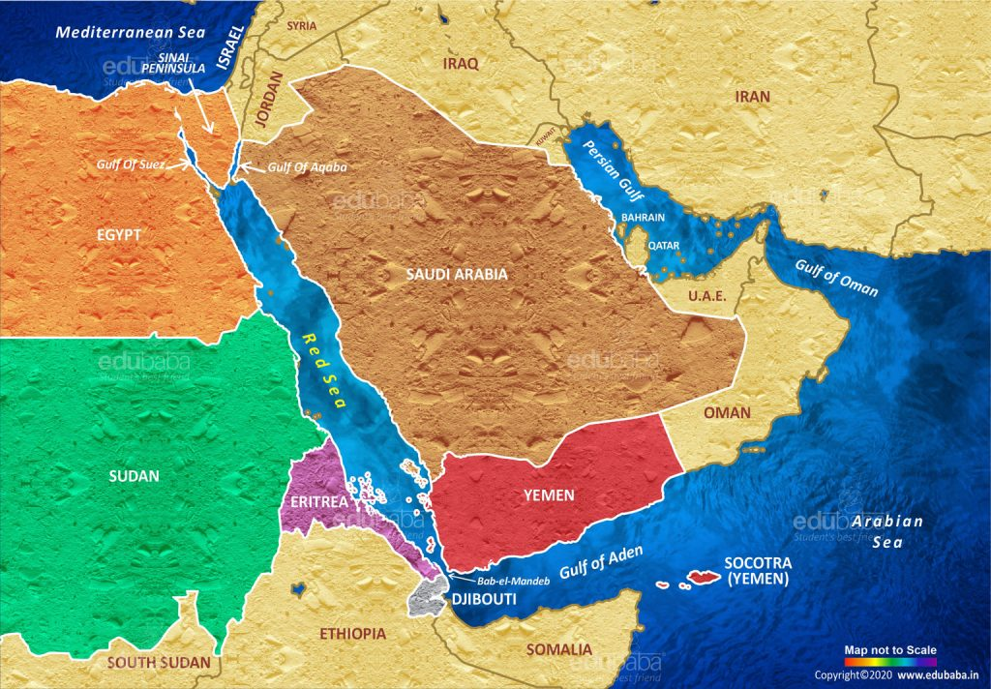
Notes:
Today/s middle east just for reference

Slide 6
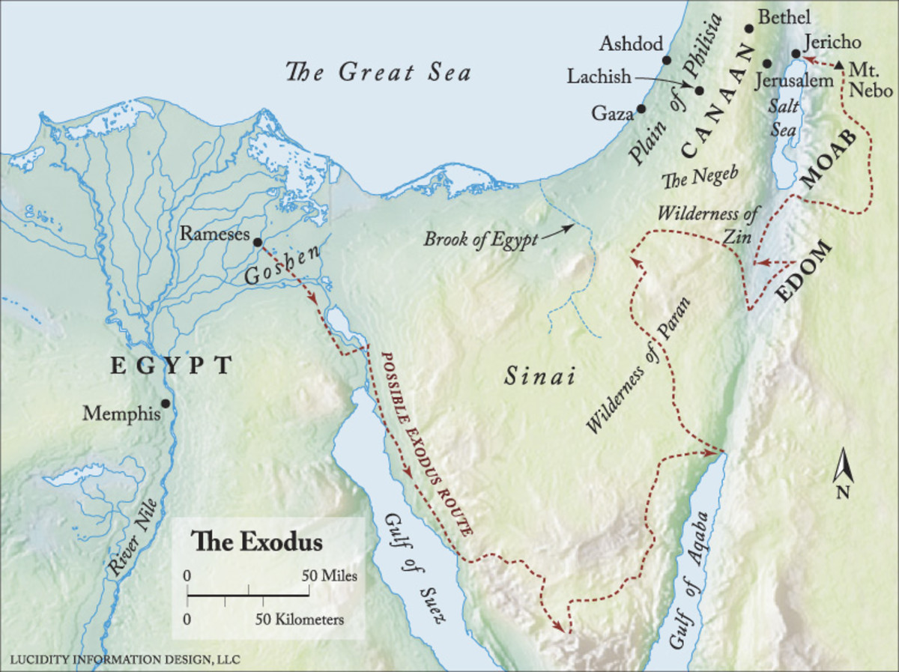
Philistines
22/3
Notes:
And so God said “walk this way
A majority of respected authorities on the exodus route believe the crossing was in the northern Guld of Suez area. Exactly where is speculative, but any of the lakes to the north of the gulf proper to the northern end of the gulf of Suez are in play. Crossing the gulf of Suez and wandering in the Sinai peninsula is the most fitting location . The travel time and distance to Kadesh Barnea fits the best. Although Midian was definitely in modern day Saudi Arabia, scholars agree that the extremely nomadic Midianites were also in the regions above and to the west of the gulf of Agaba. Lastly, Paul refers to Hagar as being Mt Sinai in Arabia (Galatians 4:25) Barnes refers to Arabia as Arabia Petraea and in the time of Paul, Arabia Petraea included all of the Sinai peninsula and into Jordan as well as a part of the Arabian peninsula. Bottom line, we are not 100% positive on the location of Mt Sinai, but it seems likely that we are in the correct area. BTW, Paul’s main point in Galatians 4:24-25 was not a geography lesson regarding Mt Sinai. Paul was comparing the bondage of the old law to the freedom of the new law, and he was using Abraham, Hagar, Sarah, Mt Sinai and Jerusalem to illustrate his point
We know where Ramses is without a doubt, we know where Goshen is. We know that to the north was area that was well patrolled and fortified and filled with Philistines

Slide 7
Chapter 14
Verse 2 – The lessons are not over, here comes Pharoah and his hard heart
Verse 7 – 600 choice chariots chasing, Josephus says 50K horsemen and 200k infantry
Verse 11 – Victims again!
Verse 21 – a strong east wind plows a road
Verse25 – the wheels come off – literally
Verse 28 – not a single Egyptian survivor
Verse 30 – Israel saw dead Egyptians was up on the shore
Verse 31 – Israel feared God
Notes:
Chapter 14
The Red Sea
As we have looked at all the lessons of the plagues and understand that God was teaching the Egyptians, the Israelites and Moses/Aaron this entire time. Chapter 14 explains that God wasn’t through teaching. There were more lessons to learn.
It would seem apparent that if you had just witnessed 10 plagues you would be of strong faith. Surely you would believe that your God could do anything but as soon as Isrtael sees the dust of Pharoah’s chariots, they wither
The angel of the Lord and the cloud went behind the Israelites and protected them.
A strong east wind but a north and south body of water. In this particular case God used a natural element to initiate the supernatural event of dividing the Red Sea. There was also an east wind in plague #8, the locusts and I don’t know if that plays in here or not. In this event, the wind blew, the cloud lined up to block the Egyptians and there was light on the Israelites side of the cloud and darkness on the Egyptian side of the cloud. The wind blew all night, presumably that’s how long it took all of Israel to cross the Red Sea, 2 million people plus all their possessions and their livestock.
We know that Egypt entered the red sea in the 4th watch of the night between 2A and 6A, we also know that they experienced much problems with chariot wheels coming off and bogging down. Everyone on the Egyptian side was within the wall of water when it came back down which took some time to get them all in place
Israel SAW the dead Egyptians on the shore – Israel saw, and Israel feared the Lord and believed Him and his servant Moses.

Slide 8
Lessons Learned
Exodus 11:3 Israel gained favor in the sight of the Egyptians
Acts 2:47 The Lord’s church praised God and had favor with all the people
Even against our enemies we need to conduct our business as a Godly people
We see the deterioration of Pharoah’s soul. In responding to God’s plagues, Pharoah bargained, resisted, deceived, appealed and threatened. This should be a warning to us all that if a sinful heart does not respond by faith to God, it will not be transformed by God’s grace
Jesus Christ – our Passover
The lamb was innocent – so was Jesus
The innocent lamb suffered for the guilty – so did Jesus
The lamb was a male without spot or blemish – so was Jesus
The blood of the lamb saved the Israelites on that night in Egypt – the blood of Jesus saves us
God may lead us by way of detours, dead ends and dry places but HE knows best, HE is faithful, and HE always keeps his promises. We have no right to question his leadership.
Notes:
Exodus 11:3 Israel gained favor in the sight of the Egyptians
Acts 2:47 The Lord’s church praised God and had favor with all the people
Even against our enemies we need to conduct our business as a Godly people
We see the deterioration of Pharoah’s soul. In responding to God’s plagues, Pharoah bargained, resisted, deceived, appealed and threatened. This should be a warning to us all that if a sinful heart does not respond by faith to God, it will not be transformed by God’s grace
Jesus Christ – our Passover
The lamb was innocent – so was Jesus
The innocent lamb suffered for the guilty – so did Jesus
The lamb was a male without spot or blemish – so was Jesus
The blood of the lamb saved the Israelites – the blood of Jesus saves us
God may lead us by way of detours, dead ends and dry places but HE knows best, HE is faithful, and HE always keeps his promises. We have no right to question his leadership.

