Slide 1
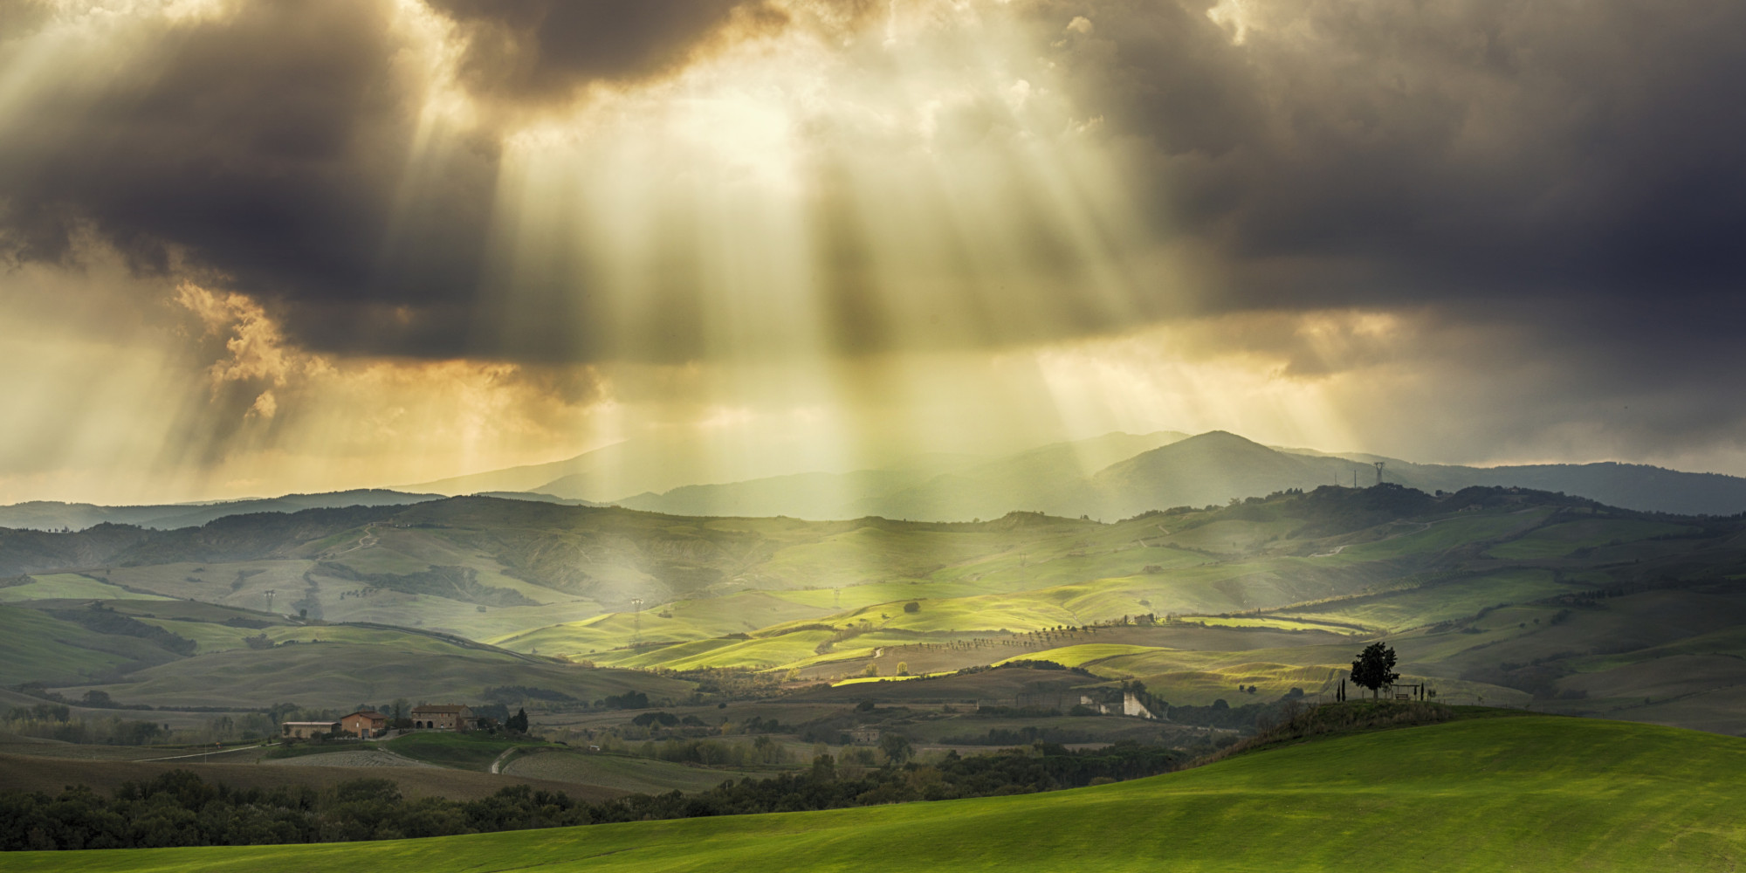
The Reason
of the Hope
1 Peter 3:15

Slide 2
A Few Truths About Comfort
We look for comfort.
We are creatures of habit.
We are willing to do something out of our comfort zone if the reward is good enough.
It is dificult to motivate someone to action when they are comfortable.

Slide 3
“If you should suffer for the sake of righteousness, you are blessed”

Slide 4
Blessed are those who suffer
Peter began this letter with, “In this you greatly rejoice, even though now for a little while, if necessary, you have been distressed by various trials” (1Pe 1:6)
In chapter two he gave us Jesus as an example.

Slide 5
For this finds favor, if for the sake of conscience toward God a person bears up under sorrows when suffering unjustly. For what credit is there if, when you sin and are harshly treated, you endure it with patience? But if when you do what is right and suffer for it you patiently endure it, this finds favor with God. For you have been called for this purpose, since Christ also suffered for you, leaving you an example for you to follow in His steps, Who committed no sin, nor was any deceit found in his mouth; and while being reviled, He did not revile in return; while suffering, He uttered no threats, but kept entrusting Himself to Him who judges righteously; and He Himself bore our sins in His body on the cross, so that we might die to sin and live to righteousness; for by His wounds you were healed.
(1 Peter 2:19-24)

Slide 6
Blessed are those who suffer
It´s normal that we will suffer. “Beloved, do not be surprised at the fiery ordeal among you, which comes upon you for your testing, as though some strange thing were happening to you; but to the degree that you share the sufferings of Christ, keep on rejoicing, so that also at the revelation of His glory you may rejoice with exultation” (1 Pe 4:12-13)
We Will find comfort during that suffering, “But if we are afflicted, it is for your comfort and salvation; or if we are comforted, it is for your comfort, which is effective in the patient enduring of the same sufferings which we also suffer; and our hope for you is firmly grounded, knowing that as you are sharers of our sufferings, so also you are sharers of our comfort” (2 Co 1:6-7)

Slide 7
Blessed are those who suffer
Some passages that help with this concept.
They took his advice; and after calling the apostles in, they flogged them and ordered them not to speak in the name of Jesus, and then released them. So they went on their way from the presence of the Council, rejoicing that they had been considered worthy to suffer shame for His name. And every day, in the temple and from house to house, they kept right on teaching and preaching Jesus as the Christ. (Acts 5:40-42)

Slide 8
Blessed are those who suffer
Some passages that help with this concept.
The Spirit Himself testifies with our spirit that we are children of God, and if children, heirs also, heirs of God and fellow heirs with Christ, if indeed we suffer with Him so that we may also be glorified with Him. For I consider that the sufferings of this present time are not worthy to be compared with the glory that is to be revealed to us.
(Romans 8:16-18)

Slide 9
Blessed are those who suffer
Some passages that help with this concept.
“All these died in faith, without receiving the promises, but having seen them and having welcomed them from a distance, and having confessed that they were strangers and exiles on the earth. For those who say such things make it clear that they are seeking a country of their own. And indeed if they had been thinking of that country from which they went out, they would have had opportunity to return. But as it is, they desire a better country, that is, a heavenly one. Therefore God is not ashamed to be called their God; for He has prepared a city for them”
(Hebrews 11:13-16)

Slide 10
“Always being ready to make a defense to everyone who asks you to give an account for the hope that is in you”

Slide 11
Always being ready
The word “hope” for some can mean can mean wish or expectation. There are many that wish to go to heaven. A Christian can have the ecpectation of heaven.
According to the New Testament hope is not anything you can see. “For in hope we have been saved, but hope that is seen is not hope; for who hopes for what he already sees? But if we hope for what we do not see, with perseverance we wait eagerly for it” (Romans 8:24-25)

Slide 12
Always being ready
We have been given the promise of heaven. “This is the promise which He Himself made to us: eternal life” (1 John 2:25)
This is something that we can explain to others. It is what 1 Peter 3:15 requires.
Again, we have this example in Christ. “Fixing our eyes on Jesus, the author and perfecter of faith, who for the joy set before Him endured the cross, despising the shame, and has sat down at the right hand of the throne of God” (Hebrews 12:2)

Slide 13
Always being ready
Paul gave Timothy some instructions about being ready.
“Until I come, give attention to the public reading of Scripture, to exhortation and teaching. Do not neglect the spiritual gift within you, which was bestowed on you through prophetic utterance with the laying on of hands by the presbytery. Take pains with these things; be absorbed in them, so that your progress will be evident to all. Pay close attention to yourself and to your teaching; persevere in these things, for as you do this you will ensure salvation both for yourself and for those who hear you”
(1 Timothy 4:13-16)

Slide 14
“Make a defense… yet with gentleness and reverence”

Slide 15
With Gentleness and Reverence
We should not be arrogant or combative.
We can have confidence and a living hope yet we should speak to others with humlity and respect.
“Conduct yourselves with wisdom toward outsiders, making the most of the opportunity. Let your speech always be with grace, as though seasoned with salt, so that you will know how you should respond to each person” (Colossians 4:5-6)

Slide 16
With Gentleness and Reverence
We need to remeber that our work is to help people escape this world. We should not be a hinderance.
“Keep yourselves in the love of God, waiting anxiously for the mercy of our Lord Jesus Christ to eternal life. And have mercy on some, who are doubting; save others, snatching them out of the fire; and on some have mercy with fear, hating even the garment polluted by the flesh” (Jude 1:21-23)

Slide 17
But even if you should suffer for the sake of righteousness, you are blessed. And do not fear their intimidation, and do not be troubled, but sanctify Christ as Lord in your hearts, always being ready to make a defense to everyone who asks you to give an account for the hope that is in you, yet with gentleness and reverence; and keep a good conscience so that in the thing in which you are slandered, those who revile your good behavior in Christ will be put to shame.
(1 Peter 3:14-16)

Slide 18
A Few Questions for Your Consideration
Where do you look for comfort?
Are our habits helping us or hindering us in our walk?
Has God promised us a reward worth enduring the suffering of this life?
Will we be motivated to action, or are we too comfortable?

