Slide 2
Soldiers of Christ—John the Baptist

Slide 3
Soldiers of Christ—John the Baptist
Prophet: KEY CHAPTER—The Baptism of Jesus:

Slide 4
Soldiers of Christ—John the Baptist
Prophet: KEY CHAPTER—The Baptism of Jesus: Matthew 3

Slide 5
Soldiers of Christ—John the Baptist
Prophet: KEY CHAPTER—The Baptism of Jesus: Matthew 3
Prophet: The Work of John the Baptist

Slide 6
Soldiers of Christ—John the Baptist
Prophet: KEY CHAPTER—The Baptism of Jesus: Matthew 3
Prophet: The Work of John the Baptist Forerunner of Jesus

Slide 7
Soldiers of Christ—John the Baptist
Prophet: KEY CHAPTER—The Baptism of Jesus: Matthew 3
Prophet: The Work of John the Baptist Forerunner of Jesus
Prophet: Reason John Was Called “the Baptist”

Slide 8
Soldiers of Christ—John the Baptist
Prophet: KEY CHAPTER—The Baptism of Jesus: Matthew 3
Prophet: The Work of John the Baptist Forerunner of Jesus
Prophet: Reason John Was Called “the Baptist” He Baptized (immersed) (Matt. 3:5-6)

Slide 9
Soldiers of Christ—John the Baptist
Prophet: KEY CHAPTER—The Baptism of Jesus: Matthew 3
Prophet: The Work of John the Baptist Forerunner of Jesus
Prophet: Reason John Was Called “the Baptist” He Baptized (immersed) (Matt. 3:5-6)
Priest: The Message of John

Slide 10
Soldiers of Christ—John the Baptist
Prophet: KEY CHAPTER—The Baptism of Jesus: Matthew 3
Prophet: The Work of John the Baptist Forerunner of Jesus
Prophet: Reason John Was Called “the Baptist” He Baptized (immersed) (Matt. 3:5-6)
Priest: The Message of John Repent, KINGdom is coming (Matt. 3:2)

Slide 11
Soldiers of Christ—John the Baptist
Prophet: KEY CHAPTER—The Baptism of Jesus: Matthew 3
Prophet: The Work of John the Baptist Forerunner of Jesus
Prophet: Reason John Was Called “the Baptist” He Baptized (immersed) (Matt. 3:5-6)
Priest: The Message of John Repent, KINGdom is coming (Matt. 3:2)
Prophet: Where Did John Preach

Slide 12
Soldiers of Christ—John the Baptist
Prophet: KEY CHAPTER—The Baptism of Jesus: Matthew 3
Prophet: The Work of John the Baptist Forerunner of Jesus
Prophet: Reason John Was Called “the Baptist” He Baptized (immersed) (Matt. 3:5-6)
Priest: The Message of John Repent, KINGdom is coming (Matt. 3:2)
Prophet: Where Did John Preach Wilderness of Judea (3:1)

Slide 13
Soldiers of Christ—John the Baptist
Prophet: KEY CHAPTER—The Baptism of Jesus: Matthew 3
Prophet: The Work of John the Baptist Forerunner of Jesus
Prophet: Reason John Was Called “the Baptist” He Baptized (immersed) (Matt. 3:5-6)
Priest: The Message of John Repent, KINGdom is coming (Matt. 3:2)
Prophet: Where Did John Preach Wilderness of Judea (3:1)
Priest: Clothing and Food of John

Slide 14
Soldiers of Christ—John the Baptist
Prophet: KEY CHAPTER—The Baptism of Jesus: Matthew 3
Prophet: The Work of John the Baptist Forerunner of Jesus
Prophet: Reason John Was Called “the Baptist” He Baptized (immersed) (Matt. 3:5-6)
Priest: The Message of John Repent, KINGdom is coming (Matt. 3:2)
Prophet: Where Did John Preach Wilderness of Judea (3:1)
Priest: Clothing and Food of John Camel’s Hair; Ate Locust and W. Honey

Slide 15
Soldiers of Christ—John the Baptist
Prophet: KEY CHAPTER—The Baptism of Jesus: Matthew 3
Prophet: The Work of John the Baptist Forerunner of Jesus
Prophet: Reason John Was Called “the Baptist” He Baptized (immersed) (Matt. 3:5-6)
Priest: The Message of John Repent, KINGdom is coming (Matt. 3:2)
Prophet: Where Did John Preach Wilderness of Judea (3:1)
Priest: Clothing and Food of John Camel’s Hair; Ate Locust and W. Honey
Prophet: Purpose of John’s Baptism

Slide 16
Soldiers of Christ—John the Baptist
Prophet: KEY CHAPTER—The Baptism of Jesus: Matthew 3
Prophet: The Work of John the Baptist Forerunner of Jesus
Prophet: Reason John Was Called “the Baptist” He Baptized (immersed) (Matt. 3:5-6)
Priest: The Message of John Repent, KINGdom is coming (Matt. 3:2)
Prophet: Where Did John Preach Wilderness of Judea (3:1)
Priest: Clothing and Food of John Camel’s Hair; Ate Locust and W. Honey
Prophet: Purpose of John’s Baptism For the Remission of Sins (Mark 1:4)

Slide 17
Soldiers of Christ—John the Baptist
Prophet: KEY CHAPTER—The Baptism of Jesus: Matthew 3
Prophet: The Work of John the Baptist Forerunner of Jesus
Prophet: Reason John Was Called “the Baptist” He Baptized (immersed) (Matt. 3:5-6)
Priest: The Message of John Repent, KINGdom is coming (Matt. 3:2)
Prophet: Where Did John Preach Wilderness of Judea (3:1)
Priest: Clothing and Food of John Camel’s Hair; Ate Locust and W. Honey
Prophet: Purpose of John’s Baptism For the Remission of Sins (Mark 1:4)
King: Impact of John’s Preaching

Slide 18
Soldiers of Christ—John the Baptist
Prophet: KEY CHAPTER—The Baptism of Jesus: Matthew 3
Prophet: The Work of John the Baptist Forerunner of Jesus
Prophet: Reason John Was Called “the Baptist” He Baptized (immersed) (Matt. 3:5-6)
Priest: The Message of John Repent, KINGdom is coming (Matt. 3:2)
Prophet: Where Did John Preach Wilderness of Judea (3:1)
Priest: Clothing and Food of John Camel’s Hair; Ate Locust and W. Honey
Prophet: Purpose of John’s Baptism For the Remission of Sins (Mark 1:4)
King: Impact of John’s Preaching Jerusalem, All Judea, and Region Around
Jordan Were Baptized (3:5)

Slide 19
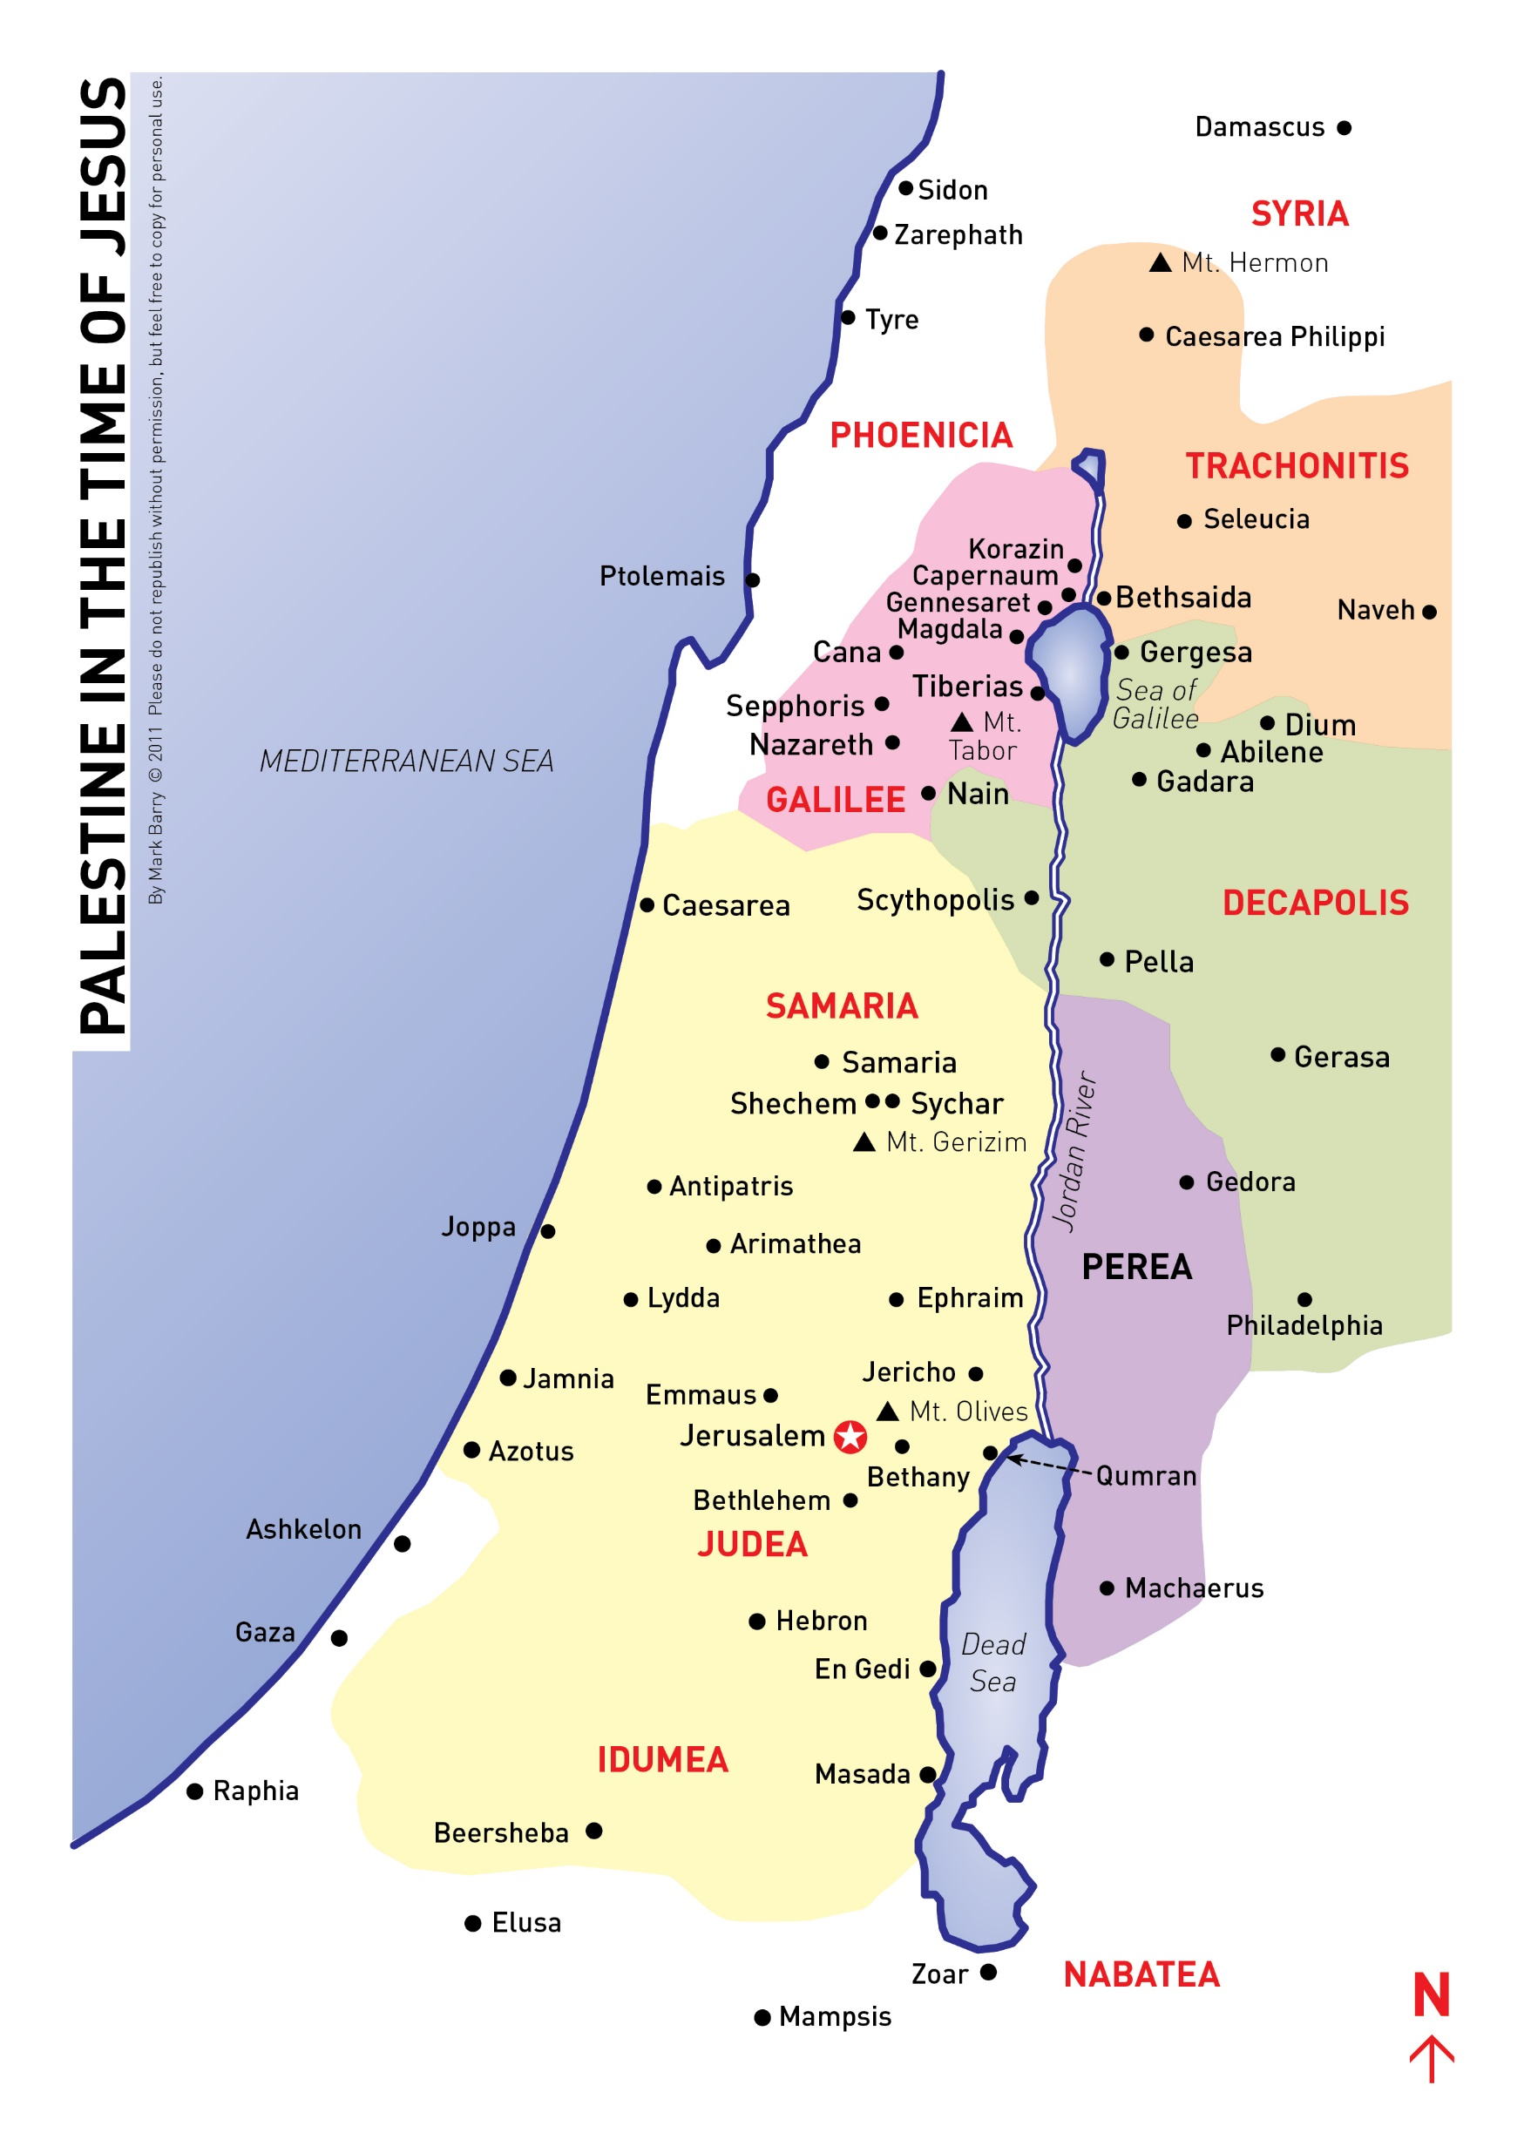
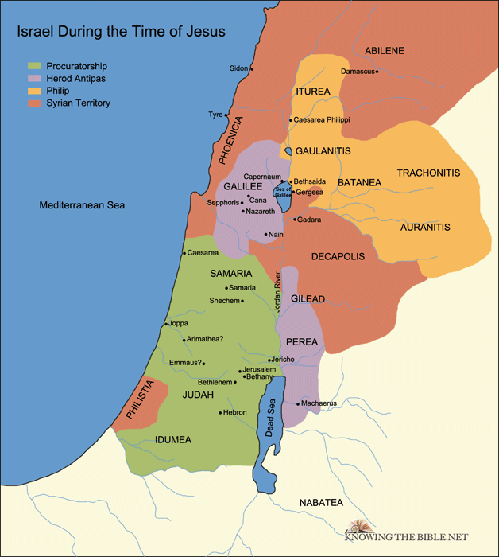
Soldiers of Christ—John the Baptist
Jerusalem, All Judea, and Region Around
Jordan Were Baptized by John (3:5)

Slide 20
Soldiers of Christ—John the Baptist
Prophet: KEY CHAPTER—The Baptism of Jesus: Matthew 3
Prophet: The Work of John the Baptist Forerunner of Jesus
Prophet: Reason John Was Called “the Baptist” He Baptized (immersed) (Matt. 3:5-6)
Priest: The Message of John Repent, KINGdom is coming (Matt. 3:2)
Prophet: Where Did John Preach Wilderness of Judea (3:1)
Priest: Clothing and Food of John Camel’s Hair; Ate Locust and W. Honey
Prophet: Purpose of John’s Baptism For the Remission of Sins (Mark 1:4)
King: Impact of John’s Preaching Jerusalem, All Judea, and Region Around
Jordan Were Baptized (3:5)
No Card: Why Did John Have This Impact

Slide 21
Soldiers of Christ—John the Baptist
Prophet: KEY CHAPTER—The Baptism of Jesus: Matthew 3
Prophet: The Work of John the Baptist Forerunner of Jesus
Prophet: Reason John Was Called “the Baptist” He Baptized (immersed) (Matt. 3:5-6)
Priest: The Message of John Repent, KINGdom is coming (Matt. 3:2)
Prophet: Where Did John Preach Wilderness of Judea (3:1)
Priest: Clothing and Food of John Camel’s Hair; Ate Locust and W. Honey
Prophet: Purpose of John’s Baptism For the Remission of Sins (Mark 1:4)
King: Impact of John’s Preaching Jerusalem, All Judea, and Region Around
Jordan Were Baptized (3:5)
No Card: Why Did John Have This Impact O.T. Prophecies (Isa. 40:3ff; Mal. 3:1; 4:5)

Slide 22
Soldiers of Christ—John the Baptist
Prophet: KEY CHAPTER—The Baptism of Jesus: Matthew 3
Prophet: The Work of John the Baptist Forerunner of Jesus
Prophet: Reason John Was Called “the Baptist” He Baptized (immersed) (Matt. 3:5-6)
Priest: The Message of John Repent, KINGdom is coming (Matt. 3:2)
Prophet: Where Did John Preach Wilderness of Judea (3:1)
Priest: Clothing and Food of John Camel’s Hair; Ate Locust and W. Honey
Prophet: Purpose of John’s Baptism For the Remission of Sins (Mark 1:4)
King: Impact of John’s Preaching Jerusalem, All Judea, and Region Around
Jordan Were Baptized (3:5)
No Card: Why Did John Have This Impact O.T. Prophecies (Isa. 40:3ff; Mal. 3:1; 4:5)
Prophet: KEY LOCATION: Jesus is _______, for John Prepared the Way for ______

Slide 23
Soldiers of Christ—John the Baptist
Prophet: KEY CHAPTER—The Baptism of Jesus: Matthew 3
Prophet: The Work of John the Baptist Forerunner of Jesus
Prophet: Reason John Was Called “the Baptist” He Baptized (immersed) (Matt. 3:5-6)
Priest: The Message of John Repent, KINGdom is coming (Matt. 3:2)
Prophet: Where Did John Preach Wilderness of Judea (3:1)
Priest: Clothing and Food of John Camel’s Hair; Ate Locust and W. Honey
Prophet: Purpose of John’s Baptism For the Remission of Sins (Mark 1:4)
King: Impact of John’s Preaching Jerusalem, All Judea, and Region Around
Jordan Were Baptized (3:5)
No Card: Why Did John Have This Impact O.T. Prophecies (Isa. 40:3ff; Mal. 3:1; 4:5)
Prophet: KEY LOCATION: Jesus is Jehovah, for John Prepared the Way for Jehovah (3:3)

Slide 24
Soldiers of Christ—John the Baptist and the Baptism of Jesus

Slide 25
Soldiers of Christ—John the Baptist and the Baptism of Jesus
King: KEY CHAPTER: John Prepares Way for Jesus

Slide 26
Soldiers of Christ—John the Baptist and the Baptism of Jesus
King: KEY CHAPTER: John Prepares Way for Jesus Luke 3

Slide 27
Soldiers of Christ—John the Baptist and the Baptism of Jesus
King: KEY CHAPTER: John Prepares Way for Jesus Luke 3
Prophet: Baptized Jesus

Slide 28
Soldiers of Christ—John the Baptist and the Baptism of Jesus
King: KEY CHAPTER: John Prepares Way for Jesus Luke 3
Prophet: Baptized Jesus John the Baptist

Slide 29
Soldiers of Christ—John the Baptist and the Baptism of Jesus
King: KEY CHAPTER: John Prepares Way for Jesus Luke 3
Prophet: Baptized Jesus John the Baptist
Prophet: Purpose of John’s Baptism

Slide 30
Soldiers of Christ—John the Baptist and the Baptism of Jesus
King: KEY CHAPTER: John Prepares Way for Jesus Luke 3
Prophet: Baptized Jesus John the Baptist
Prophet: Purpose of John’s Baptism For the Remission of Sins

Slide 31
Soldiers of Christ—John the Baptist and the Baptism of Jesus
King: KEY CHAPTER: John Prepares Way for Jesus Luke 3
Prophet: Baptized Jesus John the Baptist
Prophet: Purpose of John’s Baptism For the Remission of Sins
NO CARD: Refused to Baptize Jesus

Slide 32
Soldiers of Christ—John the Baptist and the Baptism of Jesus
King: KEY CHAPTER: John Prepares Way for Jesus Luke 3
Prophet: Baptized Jesus John the Baptist
Prophet: Purpose of John’s Baptism For the Remission of Sins
NO CARD: Refused to Baptize Jesus John the Baptist

Slide 33
Soldiers of Christ—John the Baptist and the Baptism of Jesus
King: KEY CHAPTER: John Prepares Way for Jesus Luke 3
Prophet: Baptized Jesus John the Baptist
Prophet: Purpose of John’s Baptism For the Remission of Sins
NO CARD: Refused to Baptize Jesus John the Baptist
NO CARD: Why John Refused

Slide 34
Soldiers of Christ—John the Baptist and the Baptism of Jesus
King: KEY CHAPTER: John Prepares Way for Jesus Luke 3
Prophet: Baptized Jesus John the Baptist
Prophet: Purpose of John’s Baptism For the Remission of Sins
NO CARD: Refused to Baptize Jesus John the Baptist
NO CARD: Why John Refused Jesus had no sin

Slide 35
Soldiers of Christ—John the Baptist and the Baptism of Jesus
King: KEY CHAPTER: John Prepares Way for Jesus Luke 3
Prophet: Baptized Jesus John the Baptist
Prophet: Purpose of John’s Baptism For the Remission of Sins
NO CARD: Refused to Baptize Jesus John the Baptist
NO CARD: Why John Refused Jesus had no sin
Prophet: Reason Jesus was Baptized

Slide 36
Soldiers of Christ—John the Baptist and the Baptism of Jesus
King: KEY CHAPTER: John Prepares Way for Jesus Luke 3
Prophet: Baptized Jesus John the Baptist
Prophet: Purpose of John’s Baptism For the Remission of Sins
NO CARD: Refused to Baptize Jesus John the Baptist
NO CARD: Why John Refused Jesus had no sin
Prophet: Reason Jesus was Baptized Fulfill all righteousness

Slide 37
Soldiers of Christ—John the Baptist and the Baptism of Jesus
King: KEY CHAPTER: John Prepares Way for Jesus Luke 3
Prophet: Baptized Jesus John the Baptist
Prophet: Purpose of John’s Baptism For the Remission of Sins
NO CARD: Refused to Baptize Jesus John the Baptist
NO CARD: Why John Refused Jesus had no sin
Prophet: Reason Jesus was Baptized Fulfill all righteousness
UNDERSTANDING BAPTISM

Slide 38
Soldiers of Christ—John the Baptist and the Baptism of Jesus
King: KEY CHAPTER: John Prepares Way for Jesus Luke 3
Prophet: Baptized Jesus John the Baptist
Prophet: Purpose of John’s Baptism For the Remission of Sins
NO CARD: Refused to Baptize Jesus John the Baptist
NO CARD: Why John Refused Jesus had no sin
Prophet: Reason Jesus was Baptized Fulfill all righteousness
UNDERSTANDING BAPTISM
John’s Baptism N.T. Baptism (Jesus)

Slide 39
Soldiers of Christ—John the Baptist and the Baptism of Jesus
King: KEY CHAPTER: John Prepares Way for Jesus Luke 3
Prophet: Baptized Jesus John the Baptist
Prophet: Purpose of John’s Baptism For the Remission of Sins
NO CARD: Refused to Baptize Jesus John the Baptist
NO CARD: Why John Refused Jesus had no sin
Prophet: Reason Jesus was Baptized Fulfill all righteousness
UNDERSTANDING BAPTISM
John’s Baptism N.T. Baptism (Jesus)
Element: Water

Slide 40
Soldiers of Christ—John the Baptist and the Baptism of Jesus
King: KEY CHAPTER: John Prepares Way for Jesus Luke 3
Prophet: Baptized Jesus John the Baptist
Prophet: Purpose of John’s Baptism For the Remission of Sins
NO CARD: Refused to Baptize Jesus John the Baptist
NO CARD: Why John Refused Jesus had no sin
Prophet: Reason Jesus was Baptized Fulfill all righteousness
UNDERSTANDING BAPTISM
John’s Baptism N.T. Baptism (Jesus)
Element: Water
“Mode”: Burial

Slide 41
Soldiers of Christ—John the Baptist and the Baptism of Jesus
King: KEY CHAPTER: John Prepares Way for Jesus Luke 3
Prophet: Baptized Jesus John the Baptist
Prophet: Purpose of John’s Baptism For the Remission of Sins
NO CARD: Refused to Baptize Jesus John the Baptist
NO CARD: Why John Refused Jesus had no sin
Prophet: Reason Jesus was Baptized Fulfill all righteousness
UNDERSTANDING BAPTISM
John’s Baptism N.T. Baptism (Jesus)
Element: Water
“Mode”: Burial
Subject: Believer in Jesus

Slide 42
Soldiers of Christ—John the Baptist and the Baptism of Jesus
King: KEY CHAPTER: John Prepares Way for Jesus Luke 3
Prophet: Baptized Jesus John the Baptist
Prophet: Purpose of John’s Baptism For the Remission of Sins
NO CARD: Refused to Baptize Jesus John the Baptist
NO CARD: Why John Refused Jesus had no sin
Prophet: Reason Jesus was Baptized Fulfill all righteousness
UNDERSTANDING BAPTISM
John’s Baptism N.T. Baptism (Jesus)
Element: Water
“Mode”: Burial
Subject: Believer in Jesus
Purpose: Remission of Sins

Slide 43
Soldiers of Christ—John the Baptist and the Baptism of Jesus
King: KEY CHAPTER: John Prepares Way for Jesus Luke 3
Prophet: Baptized Jesus John the Baptist
Prophet: Purpose of John’s Baptism For the Remission of Sins
NO CARD: Refused to Baptize Jesus John the Baptist
NO CARD: Why John Refused Jesus had no sin
Prophet: Reason Jesus was Baptized Fulfill all righteousness
UNDERSTANDING BAPTISM
John’s Baptism N.T. Baptism (Jesus)
Element: Water
“Mode”: Burial
Subject: Believer in Jesus
Purpose: Remission of Sins
Authority: In Jesus’ name

Slide 44
Soldiers of Christ—John the Baptist and the Baptism of Jesus
King: KEY CHAPTER: John Prepares Way for Jesus Luke 3
Prophet: Baptized Jesus John the Baptist
Prophet: Purpose of John’s Baptism For the Remission of Sins
NO CARD: Refused to Baptize Jesus John the Baptist
NO CARD: Why John Refused Jesus had no sin
Prophet: Reason Jesus was Baptized Fulfill all righteousness
UNDERSTANDING BAPTISM
John’s Baptism N.T. Baptism (Jesus)
Element: Water Yes Matt. 3:16
“Mode”: Burial Yes, (Gk. Word)
Subject: Believer in Jesus Yes, Acts 19:4
Purpose: Remission of Sins Yes, Mark 1:4
Authority: In Jesus’ name No

Slide 45
Soldiers of Christ—John the Baptist and the Baptism of Jesus
King: KEY CHAPTER: John Prepares Way for Jesus Luke 3
Prophet: Baptized Jesus John the Baptist
Prophet: Purpose of John’s Baptism For the Remission of Sins
NO CARD: Refused to Baptize Jesus John the Baptist
NO CARD: Why John Refused Jesus had no sin
Prophet: Reason Jesus was Baptized Fulfill all righteousness
UNDERSTANDING BAPTISM
John’s Baptism N.T. Baptism (Jesus)
Element: Water Yes Matt. 3:16 Yes, Acts 10:47-48
“Mode”: Burial Yes, (Gk. Word) Yes, Rom. 6:4
Subject: Believer in Jesus Yes, Acts 19:4 Yes, Mark 16:15-16
Purpose: Remission of Sins Yes, Mark 1:4 Yes, Acts 2:38
Authority: In Jesus’ name No Yes, Acts 2:38; 10:48

Slide 46
Soldiers of Christ—John the Baptist and the Baptism of Jesus
King: KEY CHAPTER: John Prepares Way for Jesus Luke 3
Prophet: Baptized Jesus John the Baptist
Prophet: Purpose of John’s Baptism For the Remission of Sins
NO CARD: Refused to Baptize Jesus John the Baptist
NO CARD: Why John Refused Jesus had no sin
Prophet: Reason Jesus was Baptized Fulfill all righteousness
UNDERSTANDING BAPTISM
John’s Baptism N.T. Baptism (Jesus)
Element: Water Yes Matt. 3:16 Yes, Acts 10:47-48
“Mode”: Burial Yes, (Gk. Word) Yes, Rom. 6:4
Subject: Believer in Jesus Yes, Acts 19:4 Yes, Mark 16:15-16
Purpose: Remission of Sins Yes, Mark 1:4 Yes, Acts 2:38
Authority: In Jesus’ name No Yes, Acts 2:38; 10:48
Can We Have John’s Baptism today

Slide 47
Soldiers of Christ—John the Baptist and the Baptism of Jesus
King: KEY CHAPTER: John Prepares Way for Jesus Luke 3
Prophet: Baptized Jesus John the Baptist
Prophet: Purpose of John’s Baptism For the Remission of Sins
NO CARD: Refused to Baptize Jesus John the Baptist
NO CARD: Why John Refused Jesus had no sin
Prophet: Reason Jesus was Baptized Fulfill all righteousness
UNDERSTANDING BAPTISM
John’s Baptism N.T. Baptism (Jesus)
Element: Water Yes Matt. 3:16 Yes, Acts 10:47-48
“Mode”: Burial Yes, (Gk. Word) Yes, Rom. 6:4
Subject: Believer in Jesus Yes, Acts 19:4 Yes, Mark 16:15-16
Purpose: Remission of Sins Yes, Mark 1:4 Yes, Acts 2:38
Authority: In Jesus’ name No Yes, Acts 2:38; 10:48
Can We Have John’s Baptism today? NO Because FOUR out of FIVE is Not Jesus’ Baptism

