Slide 2
Soldiers of Christ—John the Baptist

Slide 3
Soldiers of Christ—John the Baptist
Prophet: KEY CHAPTER—The Baptism of Jesus:

Slide 4
Soldiers of Christ—John the Baptist
Prophet: KEY CHAPTER—The Baptism of Jesus: Matthew 3

Slide 5
Soldiers of Christ—John the Baptist
Prophet: KEY CHAPTER—The Baptism of Jesus: Matthew 3
Prophet: The Work of John the Baptist

Slide 6
Soldiers of Christ—John the Baptist
Prophet: KEY CHAPTER—The Baptism of Jesus: Matthew 3
Prophet: The Work of John the Baptist Forerunner of Jesus

Slide 7
Soldiers of Christ—John the Baptist
Prophet: KEY CHAPTER—The Baptism of Jesus: Matthew 3
Prophet: The Work of John the Baptist Forerunner of Jesus
Prophet: Reason John Was Called “the Baptist”

Slide 8
Soldiers of Christ—John the Baptist
Prophet: KEY CHAPTER—The Baptism of Jesus: Matthew 3
Prophet: The Work of John the Baptist Forerunner of Jesus
Prophet: Reason John Was Called “the Baptist” He Baptized (immersed) (Matt. 3:5-6)

Slide 9
Soldiers of Christ—John the Baptist
Prophet: KEY CHAPTER—The Baptism of Jesus: Matthew 3
Prophet: The Work of John the Baptist Forerunner of Jesus
Prophet: Reason John Was Called “the Baptist” He Baptized (immersed) (Matt. 3:5-6)
Priest: The Message of John

Slide 10
Soldiers of Christ—John the Baptist
Prophet: KEY CHAPTER—The Baptism of Jesus: Matthew 3
Prophet: The Work of John the Baptist Forerunner of Jesus
Prophet: Reason John Was Called “the Baptist” He Baptized (immersed) (Matt. 3:5-6)
Priest: The Message of John Repent, KINGdom is coming (Matt. 3:2)

Slide 11
Soldiers of Christ—John the Baptist
Prophet: KEY CHAPTER—The Baptism of Jesus: Matthew 3
Prophet: The Work of John the Baptist Forerunner of Jesus
Prophet: Reason John Was Called “the Baptist” He Baptized (immersed) (Matt. 3:5-6)
Priest: The Message of John Repent, KINGdom is coming (Matt. 3:2)
Prophet: Where Did John Preach

Slide 12
Soldiers of Christ—John the Baptist
Prophet: KEY CHAPTER—The Baptism of Jesus: Matthew 3
Prophet: The Work of John the Baptist Forerunner of Jesus
Prophet: Reason John Was Called “the Baptist” He Baptized (immersed) (Matt. 3:5-6)
Priest: The Message of John Repent, KINGdom is coming (Matt. 3:2)
Prophet: Where Did John Preach Wilderness of Judea (3:1)

Slide 13
Soldiers of Christ—John the Baptist
Prophet: KEY CHAPTER—The Baptism of Jesus: Matthew 3
Prophet: The Work of John the Baptist Forerunner of Jesus
Prophet: Reason John Was Called “the Baptist” He Baptized (immersed) (Matt. 3:5-6)
Priest: The Message of John Repent, KINGdom is coming (Matt. 3:2)
Prophet: Where Did John Preach Wilderness of Judea (3:1)
Priest: Clothing and Food of John

Slide 14
Soldiers of Christ—John the Baptist
Prophet: KEY CHAPTER—The Baptism of Jesus: Matthew 3
Prophet: The Work of John the Baptist Forerunner of Jesus
Prophet: Reason John Was Called “the Baptist” He Baptized (immersed) (Matt. 3:5-6)
Priest: The Message of John Repent, KINGdom is coming (Matt. 3:2)
Prophet: Where Did John Preach Wilderness of Judea (3:1)
Priest: Clothing and Food of John Camel’s Hair; Ate Locust and W. Honey

Slide 15
Soldiers of Christ—John the Baptist
Prophet: KEY CHAPTER—The Baptism of Jesus: Matthew 3
Prophet: The Work of John the Baptist Forerunner of Jesus
Prophet: Reason John Was Called “the Baptist” He Baptized (immersed) (Matt. 3:5-6)
Priest: The Message of John Repent, KINGdom is coming (Matt. 3:2)
Prophet: Where Did John Preach Wilderness of Judea (3:1)
Priest: Clothing and Food of John Camel’s Hair; Ate Locust and W. Honey
Prophet: Purpose of John’s Baptism

Slide 16
Soldiers of Christ—John the Baptist
Prophet: KEY CHAPTER—The Baptism of Jesus: Matthew 3
Prophet: The Work of John the Baptist Forerunner of Jesus
Prophet: Reason John Was Called “the Baptist” He Baptized (immersed) (Matt. 3:5-6)
Priest: The Message of John Repent, KINGdom is coming (Matt. 3:2)
Prophet: Where Did John Preach Wilderness of Judea (3:1)
Priest: Clothing and Food of John Camel’s Hair; Ate Locust and W. Honey
Prophet: Purpose of John’s Baptism For the Remission of Sins (Mark 1:4)

Slide 17
Soldiers of Christ—John the Baptist
Prophet: KEY CHAPTER—The Baptism of Jesus: Matthew 3
Prophet: The Work of John the Baptist Forerunner of Jesus
Prophet: Reason John Was Called “the Baptist” He Baptized (immersed) (Matt. 3:5-6)
Priest: The Message of John Repent, KINGdom is coming (Matt. 3:2)
Prophet: Where Did John Preach Wilderness of Judea (3:1)
Priest: Clothing and Food of John Camel’s Hair; Ate Locust and W. Honey
Prophet: Purpose of John’s Baptism For the Remission of Sins (Mark 1:4)
King: Impact of John’s Preaching

Slide 18
Soldiers of Christ—John the Baptist
Prophet: KEY CHAPTER—The Baptism of Jesus: Matthew 3
Prophet: The Work of John the Baptist Forerunner of Jesus
Prophet: Reason John Was Called “the Baptist” He Baptized (immersed) (Matt. 3:5-6)
Priest: The Message of John Repent, KINGdom is coming (Matt. 3:2)
Prophet: Where Did John Preach Wilderness of Judea (3:1)
Priest: Clothing and Food of John Camel’s Hair; Ate Locust and W. Honey
Prophet: Purpose of John’s Baptism For the Remission of Sins (Mark 1:4)
King: Impact of John’s Preaching Jerusalem, All Judea, and Region Around
Jordan Were Baptized (3:5)

Slide 19
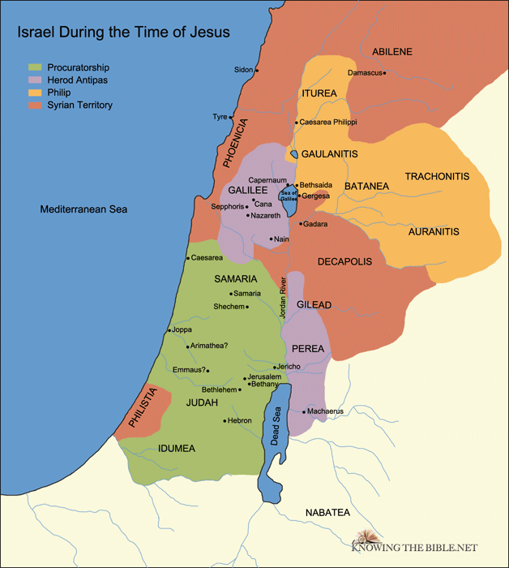
Soldiers of Christ—John the Baptist
Jerusalem, All Judea, and Region Around
Jordan Were Baptized by John (3:5)

Slide 20
Soldiers of Christ—John the Baptist
Prophet: KEY CHAPTER—The Baptism of Jesus: Matthew 3
Prophet: The Work of John the Baptist Forerunner of Jesus
Prophet: Reason John Was Called “the Baptist” He Baptized (immersed) (Matt. 3:5-6)
Priest: The Message of John Repent, KINGdom is coming (Matt. 3:2)
Prophet: Where Did John Preach Wilderness of Judea (3:1)
Priest: Clothing and Food of John Camel’s Hair; Ate Locust and W. Honey
Prophet: Purpose of John’s Baptism For the Remission of Sins (Mark 1:4)
King: Impact of John’s Preaching Jerusalem, All Judea, and Region Around
Jordan Were Baptized (3:5)
No Card: Why Did He Have This Impact

Slide 21
Soldiers of Christ—John the Baptist
Prophet: KEY CHAPTER—The Baptism of Jesus: Matthew 3
Prophet: The Work of John the Baptist Forerunner of Jesus
Prophet: Reason John Was Called “the Baptist” He Baptized (immersed) (Matt. 3:5-6)
Priest: The Message of John Repent, KINGdom is coming (Matt. 3:2)
Prophet: Where Did John Preach Wilderness of Judea (3:1)
Priest: Clothing and Food of John Camel’s Hair; Ate Locust and W. Honey
Prophet: Purpose of John’s Baptism For the Remission of Sins (Mark 1:4)
King: Impact of John’s Preaching Jerusalem, All Judea, and Region Around
Jordan Were Baptized (3:5)
No Card: Why Did He Have This Impact O.T. Prophecies (Isa. 40:3ff; Mal. 3:1; 4:5)

Slide 22
Soldiers of Christ—John the Baptist
Prophet: KEY CHAPTER—The Baptism of Jesus: Matthew 3
Prophet: The Work of John the Baptist Forerunner of Jesus
Prophet: Reason John Was Called “the Baptist” He Baptized (immersed) (Matt. 3:5-6)
Priest: The Message of John Repent, KINGdom is coming (Matt. 3:2)
Prophet: Where Did John Preach Wilderness of Judea (3:1)
Priest: Clothing and Food of John Camel’s Hair; Ate Locust and W. Honey
Prophet: Purpose of John’s Baptism For the Remission of Sins (Mark 1:4)
King: Impact of John’s Preaching Jerusalem, All Judea, and Region Around
Jordan Were Baptized (3:5)
No Card: Why Did He Have This Impact O.T. Prophecies (Isa. 40:3ff; Mal. 3:1; 4:5)
Prophet: KEY LOCATION: Jesus is _______, for John Prepared the Way for ______

Slide 23
Soldiers of Christ—John the Baptist
Prophet: KEY CHAPTER—The Baptism of Jesus: Matthew 3
Prophet: The Work of John the Baptist Forerunner of Jesus
Prophet: Reason John Was Called “the Baptist” He Baptized (immersed) (Matt. 3:5-6)
Priest: The Message of John Repent, KINGdom is coming (Matt. 3:2)
Prophet: Where Did John Preach Wilderness of Judea (3:1)
Priest: Clothing and Food of John Camel’s Hair; Ate Locust and W. Honey
Prophet: Purpose of John’s Baptism For the Remission of Sins (Mark 1:4)
King: Impact of John’s Preaching Jerusalem, All Judea, and Region Around
Jordan Were Baptized (3:5)
No Card: Why Did He Have This Impact O.T. Prophecies (Isa. 40:3ff; Mal. 3:1; 4:5)
Prophet: KEY LOCATION: Jesus is Jehovah, for John Prepared the Way for Jehovah (3:3)
NEXT WEEK: The Baptism of Jesus

Slide 24
Soldiers of Christ—John the Baptist
Prophet: KEY CHAPTER—The Baptism of Jesus: Matthew 3
Prophet: The Work of John the Baptist Forerunner of Jesus
Prophet: Reason John Was Called “the Baptist” He Baptized (immersed) (Matt. 3:5-6)
Priest: The Message of John Repent, KINGdom is coming (Matt. 3:2)
Prophet: Where Did John Preach Wilderness of Judea (3:1)
Priest: Clothing and Food of John Camel’s Hair; Ate Locust and W. Honey
Prophet: Purpose of John’s Baptism For the Remission of Sins (Mark 1:4)
King: Impact of John’s Preaching Jerusalem, All Judea, and Region Around
Jordan Were Baptized (3:5)
No Card: Why Did He Have This Impact O.T. Prophecies (Isa. 40:3ff; Mal. 3:1; 4:5)
Prophet: KEY LOCATION: Jesus is Jehovah, for John Prepared the Way for Jehovah (3:3)
NEXT WEEK: The Baptism of Jesus

