Slide 1
The Two Covenants Lesson Two—The Place & Purpose of the Old Testament Palm Beach Lakes
February-April 2022

Slide 2
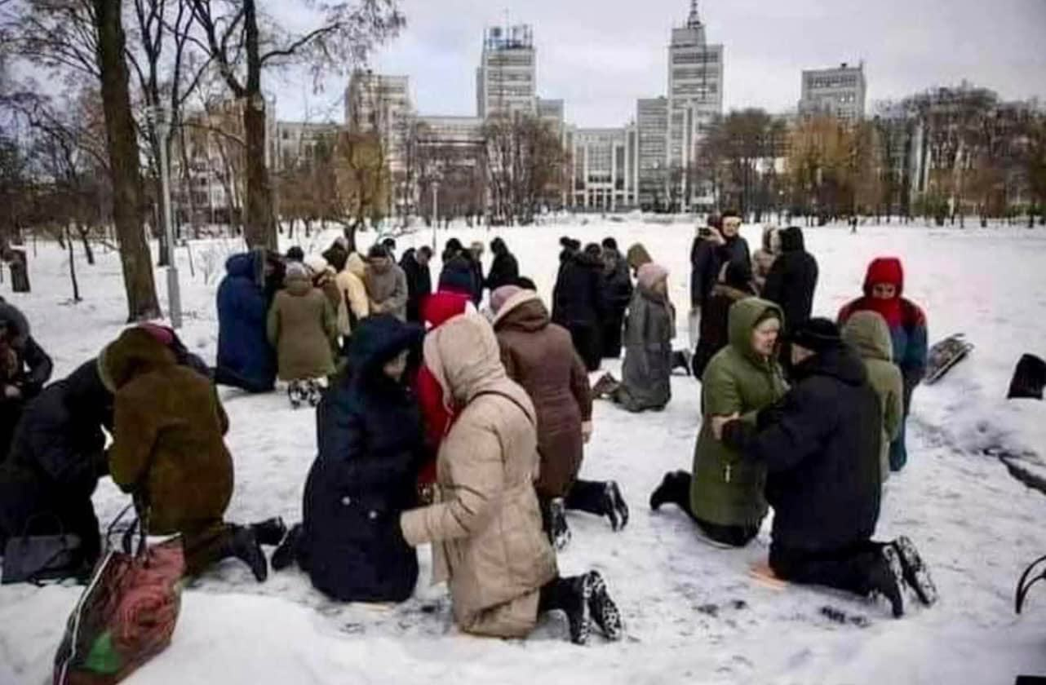
Believers Praying in the Ukraine
Z

Slide 3
Review of Lesson One

Slide 4
Review of Lesson One
Definition of a Covenant: Contract/Promise/Agreement

Slide 5
Review of Lesson One
Definition of a Covenant: Contract/Promise/Agreement
God made many covenants with men

Slide 6
Review of Lesson One
Definition of a Covenant: Contract/Promise/Agreement
God made many covenants with men
Covenant and testament are used interchangeably

Slide 7
Review of Lesson One
Definition of a Covenant: Contract/Promise/Agreement
God made many covenants with men
Covenant and testament are used interchangeably
Testament is found only 3 times in NKJV and 14 times in KJV

Slide 8
Review of Lesson One
Definition of a Covenant: Contract/Promise/Agreement
God made many covenants with men
Covenant and testament are used interchangeably
Testament is found only 3 times in NKJV and 14 times in KJV
Last week covered four points showing Bible clearly shows two major covenants—the Old Testament and the New Testament

Slide 9
Bible Clearly Speaks of Two Covenants
That first covenant in Deuteronomy 5:1-4 and 4:13
That first covenant was not intended to be permanent — Jer. 31:31
The second covenant is NOT the same as the first covenant
The first covenant was given “because of sin” – Gal. 3:19

Slide 10
Bible Clearly Speaks of Two Covenants
That first covenant in Deuteronomy 5:1-4 and 4:13
That first covenant was not intended to be permanent — Jer. 31:31
The second covenant is NOT the same as the first covenant
The first covenant was given “because of sin” – Gal. 3:19
The first covenant was holy and good, it showed what godliness was, but man’s weakness (flesh) showed its “fault – Rom . 8:3

Slide 11
Bible Clearly Speaks of Two Covenants
That first covenant in Deuteronomy 5:1-4 and 4:13
That first covenant was not intended to be permanent — Jer. 31:31
The second covenant is NOT the same as the first covenant
The first covenant was given “because of sin” – Gal. 3:19
The first covenant was holy and good, it showed what godliness was, but man’s weakness (flesh) showed its “fault – Rom . 8:3
The first covenant could not be altered by man — Deut. 4:2; 12:32

Slide 12
Bible Clearly Speaks of Two Covenants
That first covenant in Deuteronomy 5:1-4 and 4:13
That first covenant was not intended to be permanent — Jer. 31:31
The second covenant is NOT the same as the first covenant
The first covenant was given “because of sin” – Gal. 3:19
The first covenant was holy and good, it showed what godliness was, but man’s weakness (flesh) showed its “fault – Rom . 8:3
The first covenant could not be altered by man — Deut. 4:2; 12:32
The first covenant was altered/removed by God — Heb. 8:7

Slide 13
Bible Clearly Speaks of Two Covenants
That first covenant in Deuteronomy 5:1-4 and 4:13
That first covenant was not intended to be permanent — Jer. 31:31
The second covenant is NOT the same as the first covenant
The first covenant was given “because of sin” – Gal. 3:19
The first covenant was holy and good, it showed what godliness was, but man’s weakness (flesh) showed its “fault – Rom . 8:3
The first covenant could not be altered by man — Deut. 4:2; 12:32
The first covenant was altered/removed by God — Heb. 8:7
There is no way we can now enter heaven by using O.T. To be justified before God – Gal. 5:4

Slide 14
The Purpose of the Old Testament

Slide 15
The Purpose of the Old Testament
It was designed to bring us to Christ — Gal. 3:19; tutor — v. 24-25

Slide 16
The Purpose of the Old Testament
It was designed to bring us to Christ — Gal. 3:19; tutor — v. 24-25
It is written so that we can learn about the nature of God and to see examples of how He deals with men in various ways (Heb. 1:1)

Slide 17
The Purpose of the Old Testament
It was designed to bring us to Christ — Gal. 3:19; tutor — v. 24-25
It is written so that we can learn about the nature of God and to see examples of how He deals with men in various ways (Heb. 1:1)
These examples show us we cannot sin as they did—1 Cor. 10:6

Slide 18
The Purpose of the Old Testament
It was designed to bring us to Christ — Gal. 3:19; tutor — v. 24-25
It is written so that we can learn about the nature of God and to see examples of how He deals with men in various ways (Heb. 1:1)
These examples show us we cannot sin as they did—1 Cor. 10:6
The examples are written for our admonition—1 Cor. 10:11

Slide 19
The Purpose of the Old Testament
It was designed to bring us to Christ — Gal. 3:19; tutor — v. 24-25
It is written so that we can learn about the nature of God and to see examples of how He deals with men in various ways (Heb. 1:1)
These examples show us we cannot sin as they did—1 Cor. 10:6
The examples are written for our admonition—1 Cor. 10:11
All that was written before are for our learning and are designed to give us patience (endurance), comfort and hope—Rom. 15:4

Slide 20
The Purpose of the Old Testament
It was designed to bring us to Christ — Gal. 3:19; tutor — v. 24-25
It is written so that we can learn about the nature of God and to see examples of how He deals with men in various ways (Heb. 1:1)
These examples show us we cannot sin as they did—1 Cor. 10:6
The examples are written for our admonition—1 Cor. 10:11
All that was written before are for our learning and are designed to give us patience (endurance), comfort and hope—Rom. 15:4
They were a shadow to show things to come — Heb. 10:1

Slide 21
The Purpose of the Old Testament
It was designed to bring us to Christ — Gal. 3:19; tutor — v. 24-25
It is written so that we can learn about the nature of God and to see examples of how He deals with men in various ways (Heb. 1:1)
These examples show us we cannot sin as they did—1 Cor. 10:6
The examples are written for our admonition—1 Cor. 10:11
All that was written before are for our learning and are designed to give us patience (endurance), comfort and hope—Rom. 15:4
They were a shadow to show things to come — Heb. 10:1
They give us a “religious nomenclature” (terminology/vocabulary)

Slide 22
Some Nomenclature from the O.T.

Slide 23
Some Nomenclature from the O.T.
God’s use of prophets

Slide 24
Some Nomenclature from the O.T.
God’s use of prophets
God’s use of priests

Slide 25
Some Nomenclature from the O.T.
God’s use of prophets
God’s use of priests
Relationship between sin and blood sacrifice

Slide 26
Some Nomenclature from the O.T.
God’s use of prophets
God’s use of priests
Relationship between sin and blood sacrifice
God’s dealing with sin—Gen. 4; Gen 6; Gen. 19; Lev. 10:1-4

Slide 27
Some Nomenclature from the O.T.
God’s use of prophets
God’s use of priests
Relationship between sin and blood sacrifice
God’s dealing with sin—Gen. 4; Gen 6; Gen. 19; Lev. 10:1-4
Background of “the Lamb of God”

Slide 28
Some Nomenclature from the O.T.
God’s use of prophets
God’s use of priests
Relationship between sin and blood sacrifice
God’s dealing with sin—Gen. 4; Gen 6; Gen. 19; Lev. 10:1-4
Background of “the Lamb of God”
Importance of the boundaries of the Scripture

Slide 29
Some Nomenclature from the O.T.
God’s use of prophets
God’s use of priests
Relationship between sin and blood sacrifice
God’s dealing with sin—Gen. 4; Gen 6; Gen. 19; Lev. 10:1-4
Background of “the Lamb of God”
Importance of the boundaries of the Scripture
God’s longing for men to follow Him, His grace, His mercy

Slide 30
Some Nomenclature from the O.T.
God’s use of prophets
God’s use of priests
Relationship between sin and blood sacrifice
God’s dealing with sin—Gen. 4; Gen 6; Gen. 19; Lev. 10:1-4
Background of “the Lamb of God”
Importance of the boundaries of the Scripture
God’s longing for men to follow Him, His grace, His mercy
God’s trustworthiness as One who keeps His promises

Slide 31
Some Nomenclature from the O.T.
God’s use of prophets
God’s use of priests
Relationship between sin and blood sacrifice
God’s dealing with sin—Gen. 4; Gen 6; Gen. 19; Lev. 10:1-4
Background of “the Lamb of God”
Importance of the boundaries of the Scripture
God’s longing for men to follow Him, His grace, His mercy
God’s trustworthiness as One who keeps His promises
God’s active presence among the nations and the lives of saints

Slide 32
Some Nomenclature from the O.T.
God’s use of prophets
God’s use of priests
Relationship between sin and blood sacrifice
God’s dealing with sin—Gen. 4; Gen 6; Gen. 19; Lev. 10:1-4
Background of “the Lamb of God”
Importance of the boundaries of the Scripture
God’s longing for men to follow Him, His grace, His mercy
God’s trustworthiness as One who keeps His promises
God’s active presence among the nations and the lives of saints
This list is only a small beginning!

