Slide 1
The Two Covenants
Lesson One--Introduction
Palm Beach Lakes
February-April 2022

Slide 2
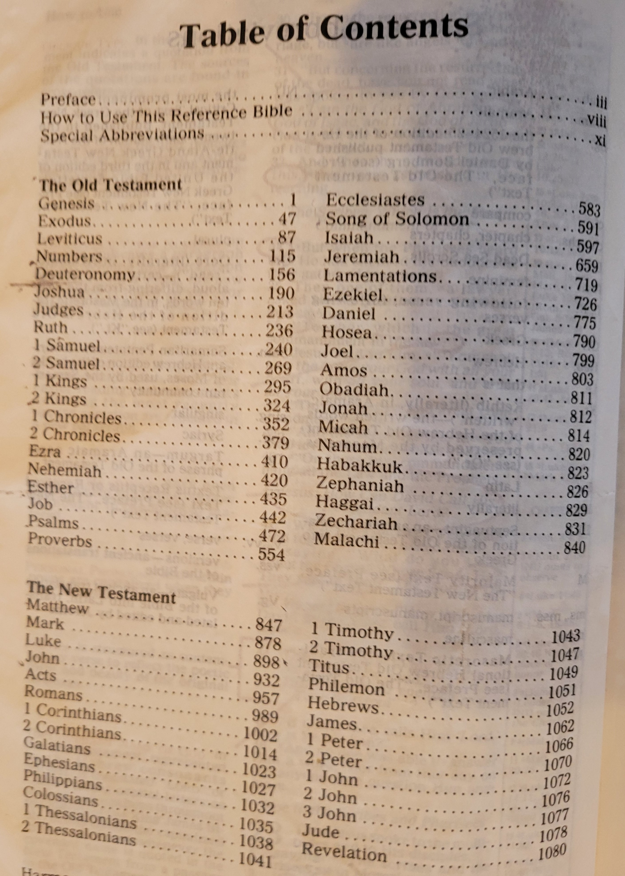
Introduction to the Bible

Slide 3
Introduction to the Bible
Main Parts
Books in the O.T.
Books in the N.T.
Years to Write the Bible
Number of Writers

Slide 4
Definition of Covenant/Testament

Slide 5
Definition of Covenant/Testament
      In this study—we look at how God relates to man since creation

Slide 6
Definition of Covenant/Testament
      In this study—we look at how God relates to man since creation
      The first time covenant is used in the Bible—Gen. 6-8

Slide 7
Definition of Covenant/Testament
      In this study—we look at how God relates to man since creation
      The first time covenant is used in the Bible—Gen. 6-8
      In this passage—A promise God made to Noah before he built the ark of his salvation and then the promise signified by the rainbow

Slide 8
Definition of Covenant/Testament
      In this study—we look at how God relates to man since creation
      The first time covenant is used in the Bible—Gen. 6-8
      In this passage—A promise God made to Noah before he built the ark of his salvation and then the promise signified by the rainbow
      A covenant is an agreement/promise/contract made regarding a relationship between individuals. i.e. “Last will and testament” and a covenant made in a marriage vow

Slide 9
Definition of Covenant/Testament
      In this study—we look at how God relates to man since creation
      The first time covenant is used in the Bible—Gen. 6-8
      In this passage—A promise God made to Noah before he built the ark of his salvation and then the promise signified by the rainbow
      A covenant is an agreement/promise/contract made regarding a relationship between individuals. i.e. “Last will and testament” and a covenant made in a marriage vow
      “Testament” (same Gk. Word as covenant) is not found in the O.T. and only three times in the N.T. (NKJV) AND 14 times in the KJV

Slide 10
Definition of Covenant/Testament
      In this study—we look at how God relates to man since creation
      The first time covenant is used in the Bible—Gen. 6-8
      In this passage—A promise God made to Noah before he built the ark of his salvation and then the promise signified by the rainbow
      A covenant is an agreement/promise/contract made regarding a relationship between individuals. i.e. “Last will and testament” and a covenant made in a marriage vow
      “Testament” (same Gk. Word as covenant) is not found in the O.T. and only three times in the N.T. (NKJV) AND 14 times in the KJV
      In this study we will use the words interchangeably

Slide 11
Bible Clearly Speaks of Two Covenants

Slide 12
Bible Clearly Speaks of Two Covenants
That first covenant in Deuteronomy 5:1-4 and 4:13

Slide 13
Bible Clearly Speaks of Two Covenants
That first covenant in Deuteronomy 5:1-4 and 4:13
That first covenant was not intended to be permanent — Jer. 31:31

Slide 14
Bible Clearly Speaks of Two Covenants
That first covenant in Deuteronomy 5:1-4 and 4:13
That first covenant was not intended to be permanent — Jer. 31:31
The second covenant is NOT the same as the first covenant

Slide 15
Bible Clearly Speaks of Two Covenants
That first covenant in Deuteronomy 5:1-4 and 4:13
That first covenant was not intended to be permanent — Jer. 31:31
The second covenant is NOT the same as the first covenant
The first covenant was given “because of sin” – Gal. 3:19

Slide 16
Bible Clearly Speaks of Two Covenants
That first covenant in Deuteronomy 5:1-4 and 4:13
That first covenant was not intended to be permanent — Jer. 31:31
The second covenant is NOT the same as the first covenant
The first covenant was given “because of sin” – Gal. 3:19
The first covenant was holy and good, it showed what godliness was, but man’s weakness (flesh) showed its “fault – Rom . 8:3

Slide 17
Bible Clearly Speaks of Two Covenants
That first covenant in Deuteronomy 5:1-4 and 4:13
That first covenant was not intended to be permanent — Jer. 31:31
The second covenant is NOT the same as the first covenant
The first covenant was given “because of sin” – Gal. 3:19
The first covenant was holy and good, it showed what godliness was, but man’s weakness (flesh) showed its “fault – Rom . 8:3
The first covenant could not be altered by man — Deut. 4:2; 12:32

Slide 18
Bible Clearly Speaks of Two Covenants
That first covenant in Deuteronomy 5:1-4 and 4:13
That first covenant was not intended to be permanent — Jer. 31:31
The second covenant is NOT the same as the first covenant
The first covenant was given “because of sin” – Gal. 3:19
The first covenant was holy and good, it showed what godliness was, but man’s weakness (flesh) showed its “fault – Rom . 8:3
The first covenant could not be altered by man — Deut. 4:2; 12:32
The first covenant was altered/removed by God — Heb. 8:7

Slide 19
Bible Clearly Speaks of Two Covenants
That first covenant in Deuteronomy 5:1-4 and 4:13
That first covenant was not intended to be permanent — Jer. 31:31
The second covenant is NOT the same as the first covenant
The first covenant was given “because of sin” – Gal. 3:19
The first covenant was holy and good, it showed what godliness was, but man’s weakness (flesh) showed its “fault – Rom . 8:3
The first covenant could not be altered by man — Deut. 4:2; 12:32
The first covenant was altered/removed by God — Heb. 8:7
There is no way we can now enter heaven by using O.T. be justified before God – Gal. 5:4

Slide 20
The Purpose of the Old Testament

Slide 21
The Purpose of the Old Testament
It was designed to bring us to Christ — Gal. 3:19; tutor — v. 24-25

Slide 22
The Purpose of the Old Testament
It was designed to bring us to Christ — Gal. 3:19; tutor — v. 24-25
It is written so that we can study the examples of events and learn about the nature of God – 1 Cor. 10

Slide 23
The Purpose of the Old Testament
It was designed to bring us to Christ — Gal. 3:19; tutor — v. 24-25
It is written so that we can study the examples of events and learn about the nature of God – 1 Cor. 10
These examples show us we cannot sin as they did—1 Cor. 10:6

Slide 24
The Purpose of the Old Testament
It was designed to bring us to Christ — Gal. 3:19; tutor — v. 24-25
It is written so that we can study the examples of events and learn about the nature of God – 1 Cor. 10
These examples show us we cannot sin as they did—1 Cor. 10:6
The examples are written for our admonition—1 Cor. 10:11

Slide 25
The Purpose of the Old Testament
It was designed to bring us to Christ — Gal. 3:19; tutor — v. 24-25
It is written so that we can study the examples of events and learn about the nature of God – 1 Cor. 10
These examples show us we cannot sin as they did—1 Cor. 10:6
The examples are written for our admonition—1 Cor. 10:11
All that was written before are for our learning and are designed to give us patience (endurance), comfort and hope—Rom. 15:4

Slide 26
The Purpose of the Old Testament
It was designed to bring us to Christ — Gal. 3:19; tutor — v. 24-25
It is written so that we can study the examples of events and learn about the nature of God – 1 Cor. 10
These examples show us we cannot sin as they did—1 Cor. 10:6
The examples are written for our admonition—1 Cor. 10:11
All that was written before are for our learning and are designed to give us patience (endurance), comfort and hope—Rom. 15:4
They were a shadow to show things to come — Heb. 10:1

Slide 27
The Purpose of the Old Testament
It was designed to bring us to Christ — Gal. 3:19; tutor — v. 24-25
It is written so that we can study the examples of events and learn about the nature of God – 1 Cor. 10
These examples show us we cannot sin as they did—1 Cor. 10:6
The examples are written for our admonition—1 Cor. 10:11
All that was written before are for our learning and are designed to give us patience (endurance), comfort and hope—Rom. 15:4
They were a shadow to show things to come — Heb. 10:1
They give us a “religious nomenclature”

