Slide 1
The reliability of the bible
Wednesday night bible class

Slide 2
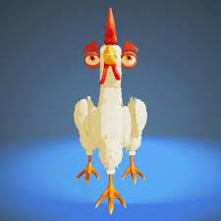

Slide 3
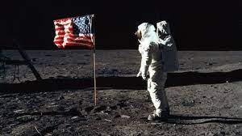
Reliability of the Bible
There are huge events in human history.

Slide 4
Reliability of the Bible
Studying the Bible
*Exegesis- Let the text reveal itself to you.
Don’t read anything into the text.
*Eisegesis- Coming to the Bible with
a biased cultural approach.
Reading something into the Bible
that is not there.

Slide 5

Reliability of the Bible
Is Jesus myth or reality?
Email t0 Apologetics Press. Jan. 16, 2007
“The real truth is that you, or no one else
can prove that there ever was a Jesus as described in
the new Testament. All you have is blind faith and
ZERO proof…Blind faith has made Christianity, believable Jesus nonsense… there is ZERO proof of a historical Jesus
Why keep lying that there is?”

Slide 6
Reliability of the Bible
The Washington Post
“Also important are the sources we don’t have. There are no eye witnessing accounts
of Jesus. All we have are later descriptions
of Jesus’ life events of non-eyewitnesses mostly of whom are obviously biased.”
Raphael Lataster- University of Sydney

Slide 7
Reliability of the Bible
Pretty big book
It is 66 books
This is where we find deep spiritual stories and important characters.

Slide 8
Reliability of the Bible
3 ways historians test ancient documents.
Internal evidence
Bibliographical
External

Slide 9
Reliability of the Bible
The Old Testament
Archeological findings
Precise detailed rewriting
Look at the teachings of Jesus

Slide 10
Reliability of the Bible
Critics use to say there was no evidence of
King David. He was just a myth.
* An ancient stone slab was found in 1944
that stone slab in northern Galilee that
references King David and The House of David.

Slide 11
Reliability of the Bible
Critics use to say there was no evidence of
A people called the Hittites. Hittites are
mentioned some 40 times in the Bible.
In 1906 an archeologist found the entire
Hittite capital city, the Hittite library, and
10,000 clay tablets of history. Documenting that the Hittite empire was real.

Slide 12
Can we trust the Old Testament
3 ways historians test ancient documents.
Internal evidence
Bibliographical
External

Slide 13
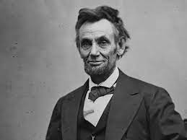
Can we trust the Old Testament
Who is this?

Slide 14
Can we trust the Old Testament
What evidence do have that
this is Abraham Lincoln?
Internal
Bibliographical
External

Slide 15
What about the Old Testament
-Even though it is there, there is difficulty
with OT bibliographical evidence.
The Masoretes
a. devised a way to make meticulous copies
b. devised an elaborate quality control system

Slide 16
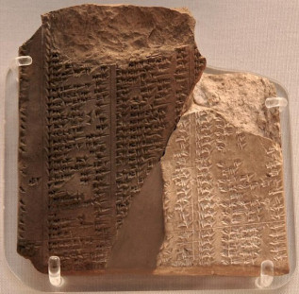
What about the Old Testament
External evidence
Assyrian Limmu
Lists Nadab the son of Jeroboam beginning his reign over Israel. “in the second year
of Asa king of Judah.” 1 Kings 15:25

Slide 17
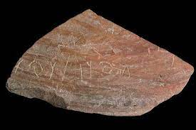
The Goliath stone
Archeologists found a piece of a stone
tablet inscribed with the name Goliath.
The time and the place coincided with
the story of Goliath from Gath.

Slide 18
What about the Old Testament
The prophecy of Tyre
In Ezekiel 2:1 the prophet noted that his
prophecies came in the fifth year of
King Jehoiachin's reign.
Tyre was a Phoenician city on the eastern
shore of the Mediterranean Sea.
It was an important city of trading
during the days of David and Solomon.

Slide 19
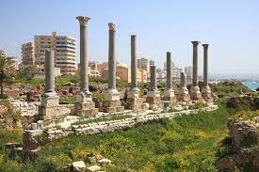
What about the Old Testament
The prophecy of Tyre
The city was in a state of spiritual decay.
Ezekiel 28:16-18.
The prophecy against Trye. 26:1-14, 19-21

Slide 20
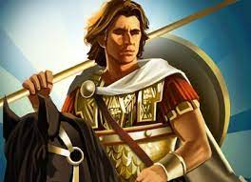
What about the Old Testament
The prophecy is fulfilled
Around 332 BC Alexander the Great took
aim at Tyre and destroyed it by building
a land bridge, or “mole” so his armies could
cross over and attack the city.
Hundreds of years after Ezekiel's prophecy.

Slide 21
Reliability of the Bible
What about the
New Testament?

Slide 22
Can we trust the New Testament?
Pretty big book
It is 27 books
This is where we find the death,
burial, and resurrection of
Jesus Christ.

Slide 23
Can we trust the New Testament?
Luke 1: 1-4
1 In as much as many have taken in hand to set in order a narrative of those things which have been fulfilled among us, just as those who from the beginning were eyewitnesses and ministers of the word delivered them to us, ³ it seemed good to me also, having had perfect understanding of all things from the very first, to write to you an orderly account, most excellent Theophilus, that you may know the certainty of those things in which you were instructed.

Slide 24
Can we trust the New Testament
Ancient Literature
Herodotus History: 109
Sophocles’ Plays: 193
Thucydides’ History: 96
Tacitus’ Annals: 33
Aristotle's works: 5
Plato’s works: 210
The Iliad: Less than 2000
New Testament Copies
23,000 +

Slide 25
Can we trust the New Testament?
3 ways historians test ancient
documents.
1. Internal Evidence Test
Luke 1:1-4, 2 Peter 1:16, 1 John 1

Slide 26



Can we trust the New Testament?
Fictional books

Slide 27
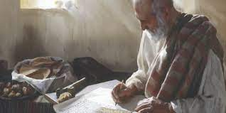
Can we trust the New Testament?
2. Bibliographical Test
Portion of the Gospel of John 120 AD
Over 23,000 New Testament manuscripts.

Slide 28
Can we trust the New Testament?
3. External Evidence Test
Writings outside the Bible
Jesus claimed to be God.
Writings that confirm His life.
That He did miracles.
Where He lived
Jesus died of crucifixion.

Slide 29
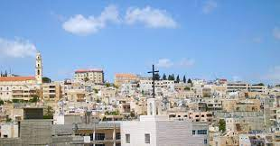
Can we trust the New Testament?
Archeological evidence
We know where Jesus was born
Bethlehem

Slide 30
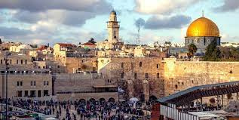
Can we trust the New Testament?
Archeological evidence
We know where Jesus was died
Jerusalem

Slide 31
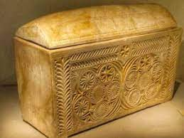
Can we trust the New Testament?
Archeological evidence
The ossuary of High Priest Caiaphas

Slide 32
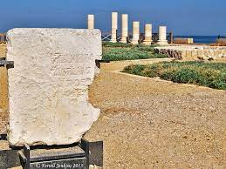
Can we trust the New Testament?
Archeological evidence
The Pontius Pilot Inscription

Slide 33
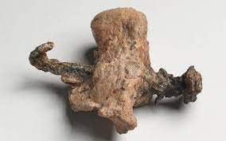
Can we trust the New Testament?
Archeological evidence
Crucified remains of a man
named Yehohanan.

Slide 34
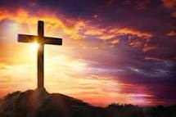
Jesus- His Resurrection
-Jesus lays out everything in detail. a. Calls Himself the messiah. b. Gives signs, performs miracles. c. Proclaims that His actions fulfill the Old Testament prophesies.

Slide 35
Jesus- His Resurrection
There are critics that do not believe in the resurrection of Jesus.
They follow the thought of the
1st century Sadducees.

Slide 36
Jesus- His Resurrection
The Swoon Theory
-Theory that suggests that Jesus did not die, but some how passed (or swooned) while He was on the cross and then found a way to escape the tomb.
Debunking the Swoon Theory
A.Jesus had six inch spikes driven into his hands and feet.
B.Blood and water came out when pierced. John 19:34
C.The Roman executioners thought he was dead and did not break His legs. John 19:33

Slide 37
Jesus- His Resurrection
Debunking the Swoon Theory
D. Pilate confirmed His death before burial.
He would not have allowed this error.
The stakes were high and public. Mark:15:44-45
E. Jesus was embalmed in about 75 pounds of spices and wrapped in bandages. John 19:39
F. Jesus was sealed in a tomb with a boulder that likely weighed 2,000 pounds. compellingtruth.org

Slide 38
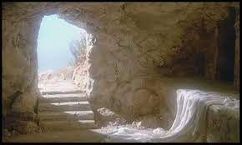
Jesus- His Resurrection
-The resurrection of Jesus Christ sets Christianity apart from any other religion.
- The resurrection gives us hope.
No other world religion can do so.

Slide 39
Jesus- His Resurrection
Acts 17:31 because He has appointed a day on which He will judge the world in righteousness by the Man He has ordained. He has given assurance of this to all by raising Him from the dead.

Slide 40
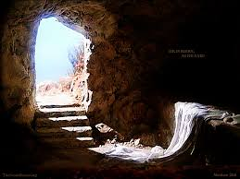
Jesus- His Resurrection
Fundamental facts
* Jesus was buried in a tomb owned by a member of the Sanhedrin, Joseph of
Arimathea. Important because it means the location of Jesus’ tomb was known in Jerusalem.

Slide 41
Jesus- His Resurrection
Fundamental facts
* As a member of the Jewish Sanhedrin,
Joseph is unlikely to be a Christian invention.
* No other burial story exists. All real sources confirms that Jesus was buried in tomb owned by Joseph of Arimathea.
* Jesus’ tomb was found empty by a group of His women followers.

Slide 42
Jesus- His Resurrection
* Mark’s account is very simple.
Contrast that to the apocryphal book, The Gospel of Peter
Written in the second half of the second century.

Slide 43
Jesus- His Resurrection
* The fact that women's testimony was less trustworthy in the
1st century society counts in favor of the truthfulness that tomb was empty.
-Josephus wrote that a Jewish woman’s testimony should not be admitted into a a Jewish court of Law.

Slide 44
Jesus- His Resurrection
* The Jewish claim that the disciples stole the body of Jesus shows that the body was missing.
- The early admission that the tomb was empty comes from opponents of the Christian movement.

Slide 45
Jesus- His Resurrection
Jesus appears to people
Sunday morning John 20:11-18
To the women Matt. 28:9-10
To Peter Luke 24:34, 1 Cor. 15:5
Road to Emmaus Luke 24: 13-31
Disciples (minus Thomas) Luke 24:36-39
One-week later John 20:26-29
To the Disciples 3 weeks later John 21: 1-14

Slide 46
Jesus- His Resurrection
Jesus appears to people
On a mountain in Galilee Matt. 28:16-20
More than 500 in Galilee 1 Cor. 15:6
James and all the apostles 1 Cor. 15:7
His ascension Luke 24:50-51
Paul Acts 9:3-6

Slide 47
Jesus- His Resurrection
Take- a ways
* Many more than 500 people saw Jesus after His resurrection.
* See eleven or twelve times in about 40 days.
* He could speak audibly, He could eat, appear as flesh and bone, and reason and instruct with intelligence.

Slide 48
Lesson 9 Jesus- His Resurrection
Jesus Christ Lived
A. The fact that Jesus Christ lived is practically universally accepted.
B. A host of hostiles witnesses testify to
His life.
C. The New Testament documents intrinsically detail His life.
D. The honest historian is forced to admit the documentation of His existence.
Kyle Butt, Apologetics Press

Slide 49
Lesson 9 Jesus- His Resurrection
Jesus Christ Died
A. Tacticus , the ancient Roman historian, documents the execution of Jesus.
“In the reign of Tiberius, by the governor of Judea, Pontius Pilot”.
B. Early Rabbis wrote that Jesus was put to death on Passover Eve.
C. Josephus wrote that Pilot condemned
Jesus Christ to the cross.
Kyle Butt, Apologetics Press

Slide 50
Jesus- His Resurrection
The Tomb Was Empty
A.In 165 AD Justin Martyr recorded a Jewish letter that was circulated, that the disciples of Jesus stole the body from the tomb.
B.All parties, friendly and hostile agree that the tomb was empty.
Kyle Butt, Apologetics Press

Slide 51
Jesus- His Resurrection
The Tomb Was Empty
C.When Peter stood up on the day of
Pentecost and preached, the Jewish leaders only had to produce the body of Jesus.
D.The Apostles knew the truth and boldly preached it in the city of Jerusalem.
E.Thousands of inhabitants of Jerusalem knew it and converted to Christianity.
Kyle Butt, Apologetics Press

Slide 52
Lesson 9 Jesus- His Resurrection
John Warwick Montgomery wrote:
It passes the bounds of credibility that the early Christians could have manufactured such a tale and preached it among those who might easily have refuted it simply by producing the body of Jesus.
Kyle Butt, Apologetics Press

Slide 53
Jesus- His Resurrection
The Tomb was Empty
F.The Apostles preached that Jesus physically rose from the dead.
* Acts 1:24
* Acts 2:24
* Acts 2:31
* 1 Cor. 15:3-4
Kyle Butt, Apologetics Press

Slide 54
Jesus- His Resurrection
From Wayne Jackson
While men may die out of religious deceptions, they do not willingly go to their deaths knowing they are perpetrating a hoax.

Slide 55
Jesus- His Resurrection
People’s reaction
- Beginning of the church. Acts 2:30-38
- That day about 3,000 were baptized.
- The church grew. Acts 2:47.
- The Apostle Paul. Acts 9.

Slide 56
Jesus- His Resurrection
Paul’s conversion supports the claims that the New Testament makes.
* He was beaten
* He was stoned
* He was shipwrecked 3 times
* He became a missionary for Jesus
* He wrote 13 of the 27 NT books.
* He died because of his belief that
Jesus was the Messiah and was resurrected.

