Slide 1
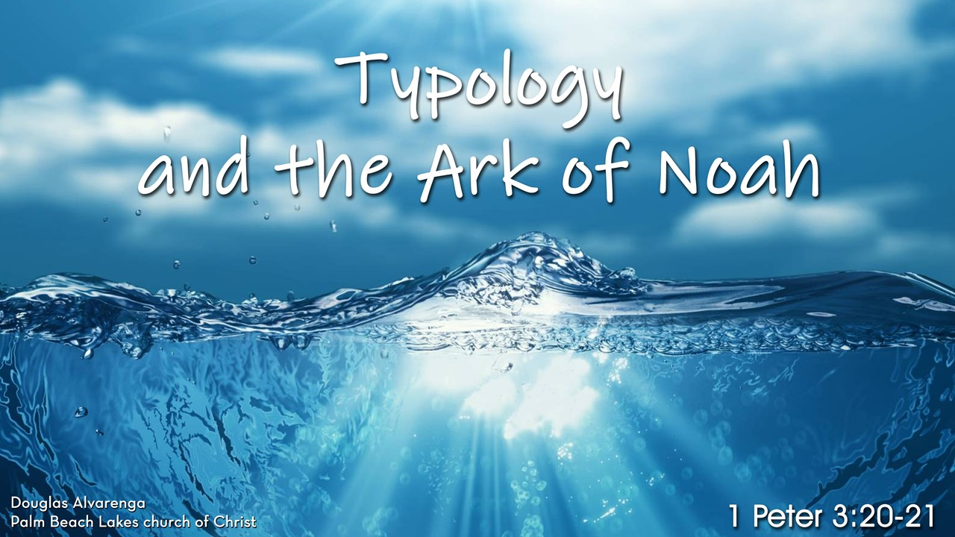

Slide 2
What Is Typology?
Branch of biblical interpretation in which an element found in the OT prefigures one found in the NT. The initial one is called the “type” and the fulfillment is designated the “antitype.”

Slide 3
What Is a Type?
A type is a picture, representation, or symbol of something yet to come.
A type is a shadow, copy or model of the real thing found in the New Testament.

Slide 4
A Type Can Be:
A Biblical place (Jerusalem, Zion).
A Biblical person (Adam, Melchizedek).
A Biblical event (Flood, Brazen Serpent).
An institution (Feasts, Covenant).
An office (Prophet, Priest, King) or
An object (Tabernacle, Altar, Incense).

Slide 5
What Is An Antitype?
An antitype is that which corresponds to the type, or the fulfilment of the type.
“The Real Thing!”

Slide 6


Shadow of an Apple Tree

Slide 7
Explicit Types
The Passover Lamb is a type of Christ (Exodus 12:1-13; 1 Corinthians 5:7).
Adam is a type of Christ (Romans 5:12-21; esp. v. 14).
Jonah in the belly of the fish was a type of the death, burial, and resurrection of Jesus (Jonah 1:17; Matthew 12:40).

Slide 8
Non-Explicit Types
Joseph a type of Christ
Crossing the Jordan River a type of Death
Moses 1st Miracle and Jesus’s 1st Miracle

Slide 9
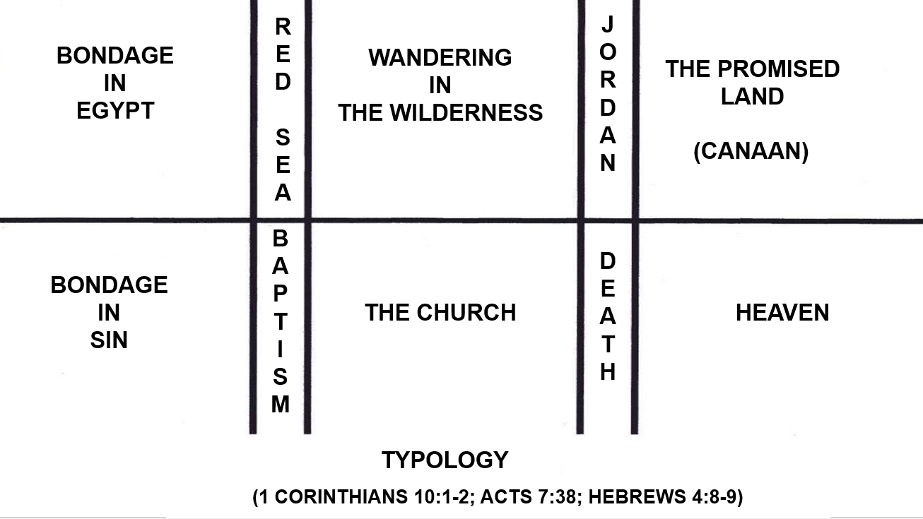

Slide 10
The Ark of Noah as a Type of the Church
Background Information

Slide 11
Three Different Interpretations
The Ark of Noah as a type of salvation in general.
The Ark of Noah as a type of Christ.
And the Ark of Noah as a type of the church.

Slide 12
People Who Have Seen the Ark of Noah as a Type of the Church
Maximus of Turin (5th century Bishop of Turin): “For as Noah’s ark preserved alive everyone whom it had taken in when the world was going under, so also Christ’s church will bring back unhurt everyone whom it embraces when the world goes up in flames.”

Slide 13
People Who Have Seen the Ark of Noah as a Type of the Church
Jerome (4th century, translator of the Latin Vulgate): “Noah’s ark was a type of the Church…”
Augustine (4th century): “The meaning must be that the ark of Noah is a picture of the church…”
Jonathan Edwards (18th century theologian): “The company in Noah’s Ark was upon many accounts a type of the church in Christ.”

Slide 14
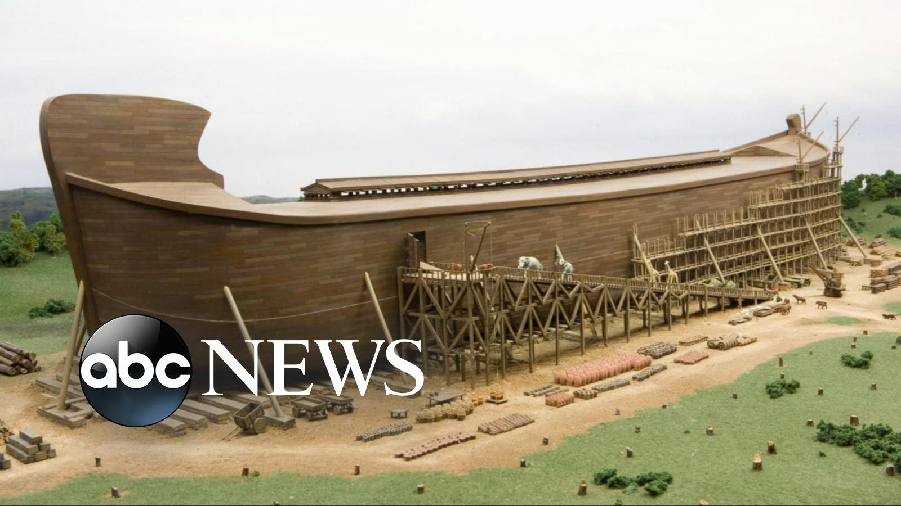

Slide 15
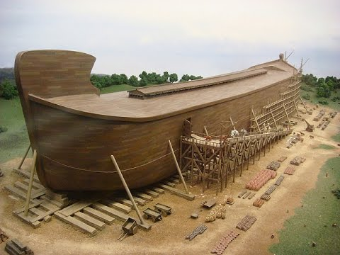

Slide 16
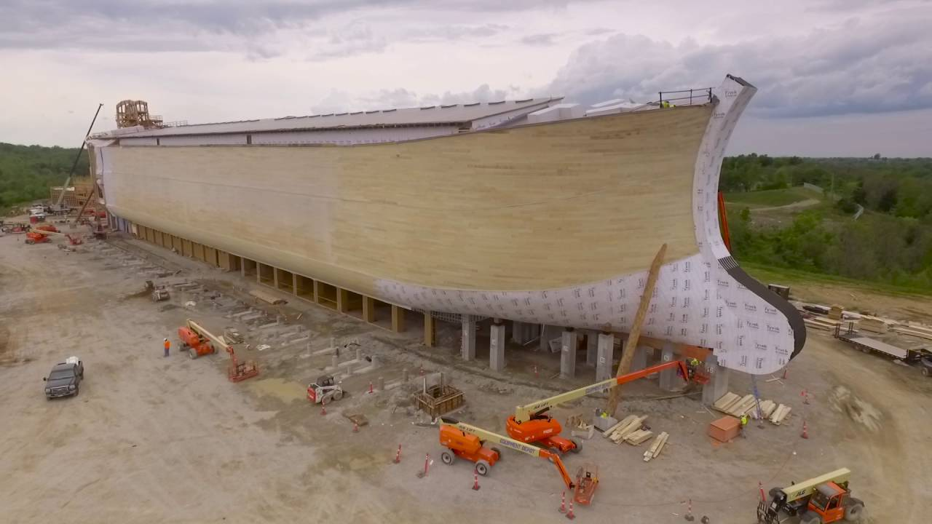

Slide 17
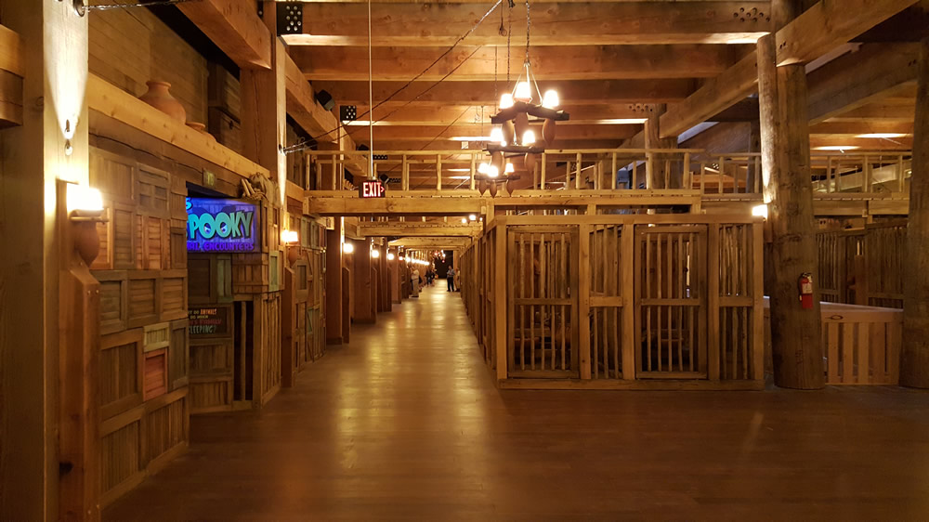

Slide 18
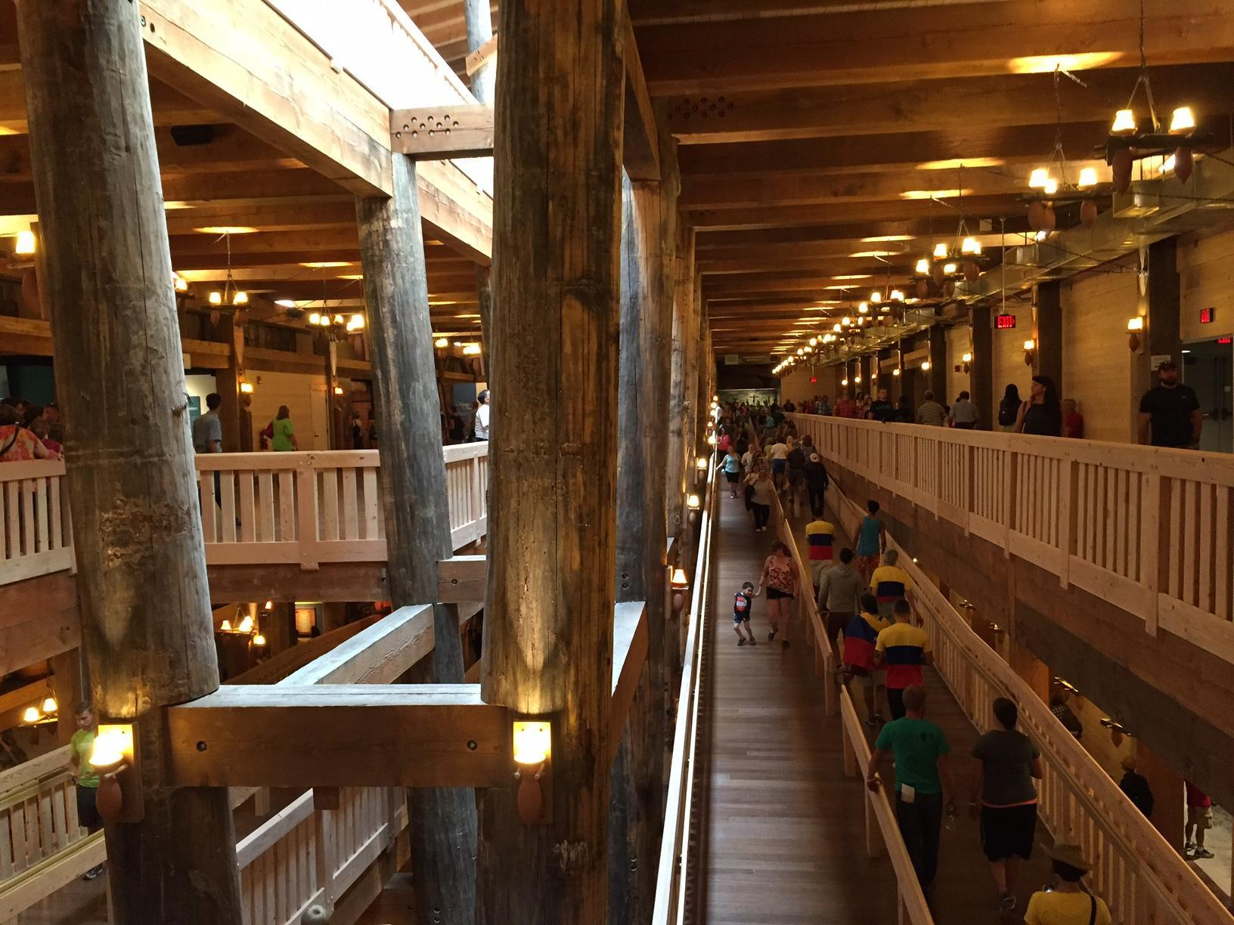

Slide 19
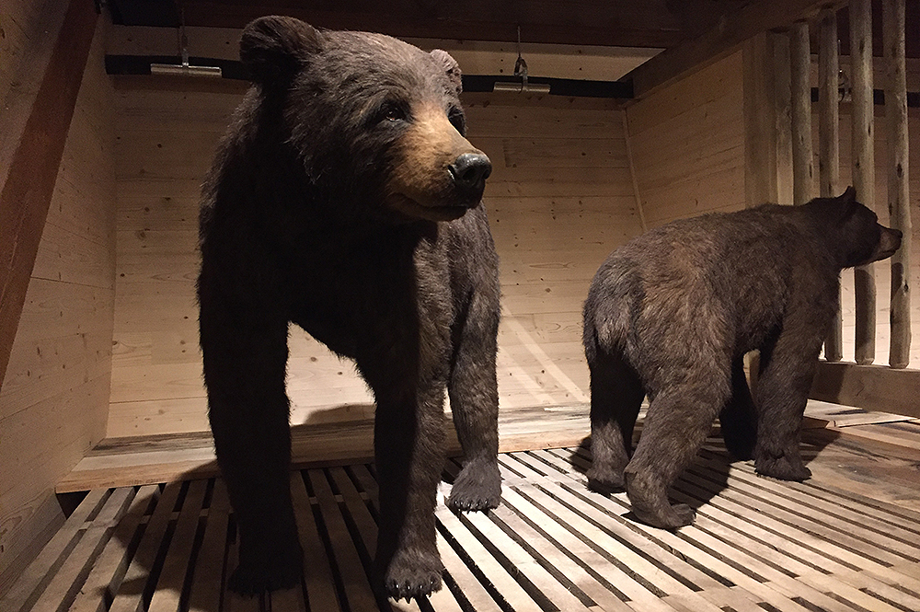

Slide 20
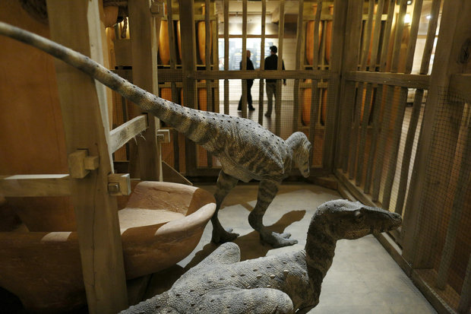

Slide 21
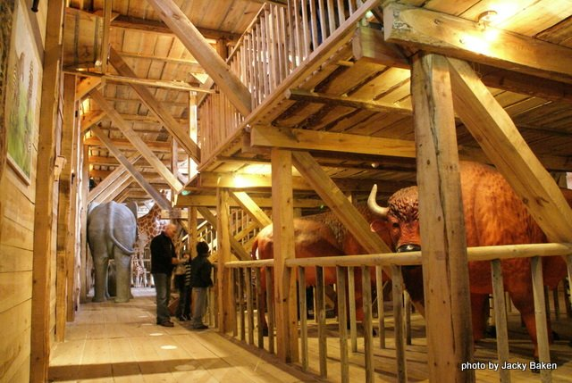

Slide 22
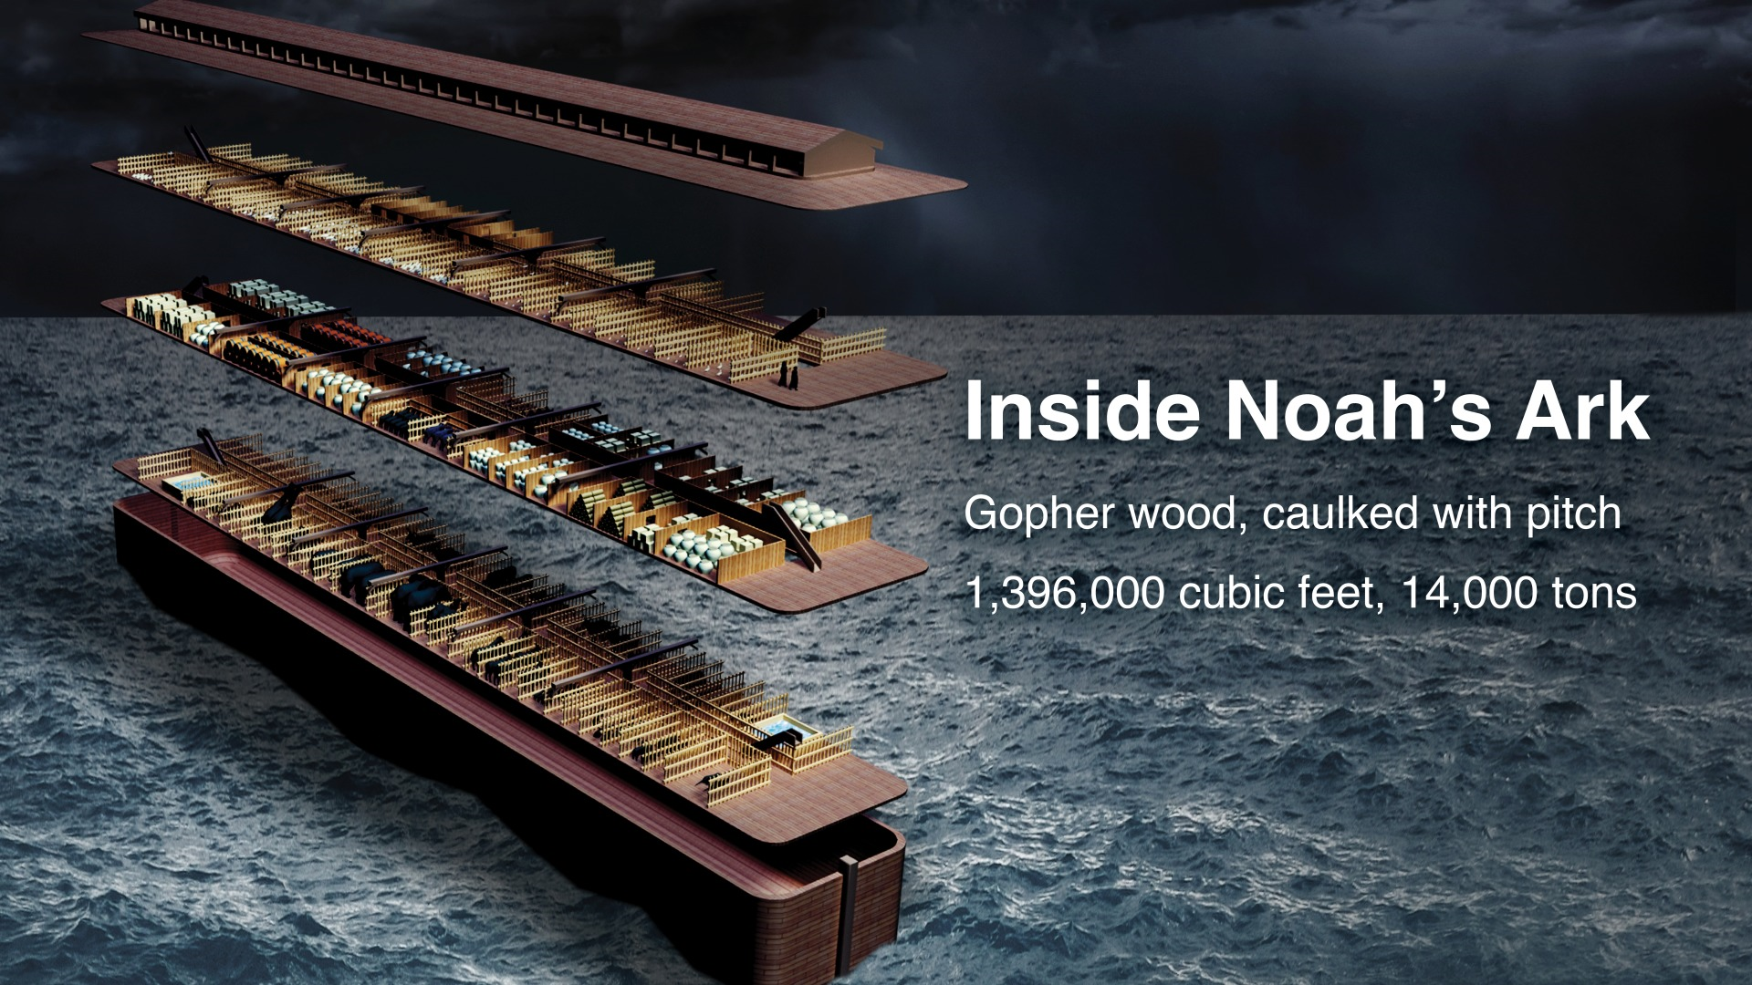

Slide 23
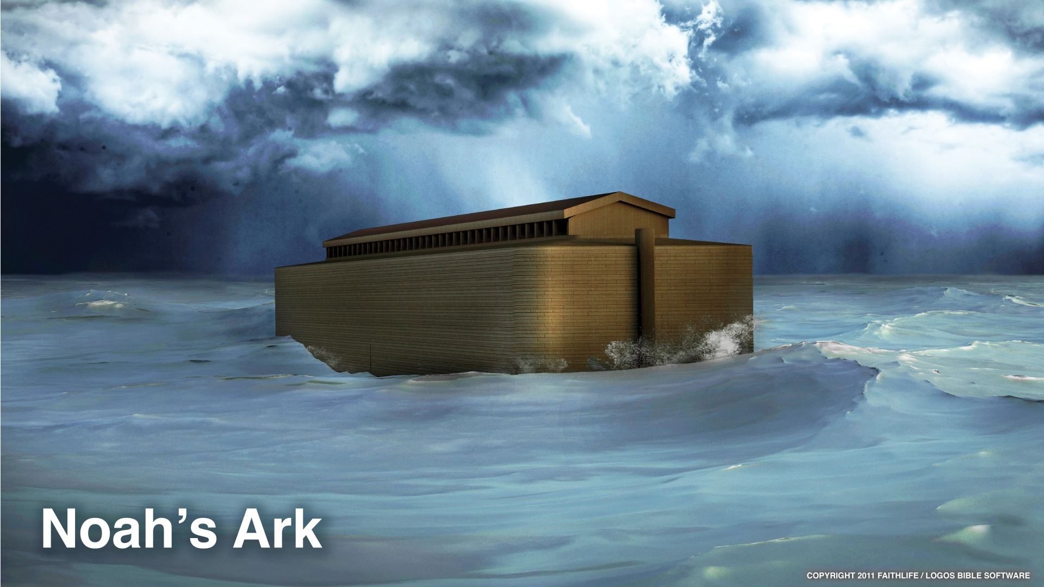

Slide 24
How is the Ark of Noah a Type of the Church?
Noah’s Ark only had ONE source of light, i.e. One window or skylight (Genesis 6:16) – So does the church!

Slide 25
What Is That Source of Light?
God and His Word! (Psalm 119:105, 130).
God is light (1 John 1:5) – whatever He teaches us in His Word is light (Proverbs 6:23).
God also send His Son to be the light of the world (John 1:4-9).

Slide 26
What’s Our Responsibility?
Our responsibility is to heed the Word of God (2 Peter 1:19).
  To heed means to pay attention to and obey (James 1:22; Matthew 7:21; Luke 6:46).
Our responsibility is to be the light of the world (Matthew 5:14-16; Philippians 2:15).
Therefore, we must walk as children of light! (Ephesians 5:8; 1 John 1:7).

Slide 27
How is the Ark of Noah a Type of the Church?
Noah’s Ark only had ONE door (Genesis 6:16) – So Does The Church!

Slide 28
One Door For The Ark
There was only one door in the ark and God was the only one who had control over it (Genesis 715-16; 8:15-16).
Only one way to get in and out of the Ark!

Slide 29
Jesus Is The Door of The Church
(John 10:9)
The Bible tells us Jesus is the way, the truth, and the life (John 14:6).
The Bible tells us only in Jesus’s name we have salvation (Acts 4:12).
The Bible tells us salvation is in Christ Jesus (2 Timothy 2:10).
And the Bible tells us Jesus is the Savior of the body (Ephesians 5:23).

Slide 30
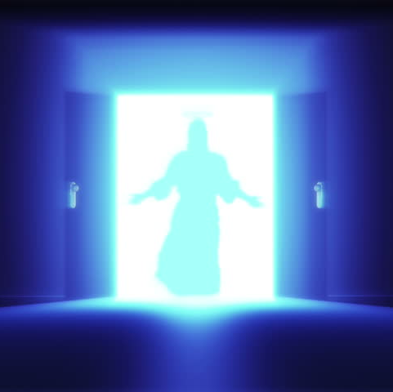
Jesus Is The Only Door!
Therefore, it is important to be a member of the church, which is Jesus’s body (Ephesians 1:22-23) and the only way to get IN the church is through Jesus!

Slide 31
How is the Ark of Noah a Type of the Church?
Noah’s Ark only had ONE family inside (Genesis 7:1, 7) – So does the church!

Slide 32
Only One Family in the Ark and in the Church
We are ALL members of the ONE family of God in Christ Jesus and heirs according to the promise! (Galatians 3:27-29).
We all have the privilege of becoming children of God (John 1:12) and being called children of God (1 John 3:1).
We are no longer strangers and aliens, but fellow citizens with the saints and members of the household of God (Ephesians 2:19).
We are all members of the household of faith (Galatians 6:10).
We are members of one another (Romans 12:5, 1 Corinthians 12:26-27).
And we live in the household of God, which is the church! (1 Timothy 3:14-15).

Slide 33
Our Responsibility
Our responsibility is to love one another as the family that we are! (John 13:34-35; 1 John 3:18; 4:11; Romans 12:9; 1 Peter 1:22).

Slide 34
How is the Ark of Noah a Type of the Church?
Noah’s Ark was the ONLY Ark (Genesis 6:14) and those that were saved were the ones that were inside the Ark! (Genesis 7:23).
Same with the Church!

Slide 35
There’s only ONE church and only those who are IN IT are saved!
There is only ONE church! (Ephesians 1:22-23; 4:4).
This teaches us that, though, God is an All-inclusive God (John 3:16; 1 Timothy 2:4; 2 Peter 3:9), yet, at the same time God is an EXCLUSIVE God!

Slide 36
Why Is God Exclusive?
Because there is only ONE body (Ephesians 4:4) and that body is the church (Ephesians 1:22-23).
Because Jesus only built ONE church (Matthew 16:18), not many churches. And…
Because Jesus died for HIS church (Acts 20:28), not many churches.

Slide 37
Therefore!
AGAIN, since there is only ONE church, we need to be members of that ONE church because Jesus is the savior of that ONE church! (Ephesians 5:23).
It is your responsibility to study the Bible so you can find that ONE church!

Slide 38
How is the Ark of Noah a Type of the Church?
Noah’s Ark and the people inside only had ONE means of salvation – WATER! (1 Peter 3:20)! Same with the Church!
(1 Peter 3:21).

Slide 39
Salvation Through Water!
The Ark and those who were INSIDE the Ark were saved through WATER! The water of the flood that is (1 Peter 3:20).
The water of the flood is the “Type” and the “Antitype” is BAPTISM! (1 Peter 3:21).

Slide 40
Salvation Through Water!
But Not Water Alone!
Noah and his family were not saved by water alone!
They were also saved by the grace of God, which was the original factor in their salvation (Genesis 6:8) and by an obedient faith (Genesis 6:14, 22; Hebrews 11:7; James 2:17, 24, 26).

Slide 41
Salvation Through Water!
But Not Water Alone!
Must hear the Gospel of Jesus (Romans 1:16; 10:17; 1 Corinthians 15:1-4).
Must believe in Jesus and His Gospel (John 8:24; Mark 16:15-16; John 3:18; Hebrews 11:6).
Must repent of sins (Luke 13:3, 5; Acts 11:18; 17:30; 2 Peter 3:9).
Must confess Jesus before men (Matthew 10:32-33; Romans 10:9-10; Acts 8:36-37).
Must be baptized to have sins forgiven (Mark 16:16; Acts 2:38; Romans 6:3-4; Galatians 3:27; 1 Peter 3:21).

Slide 42
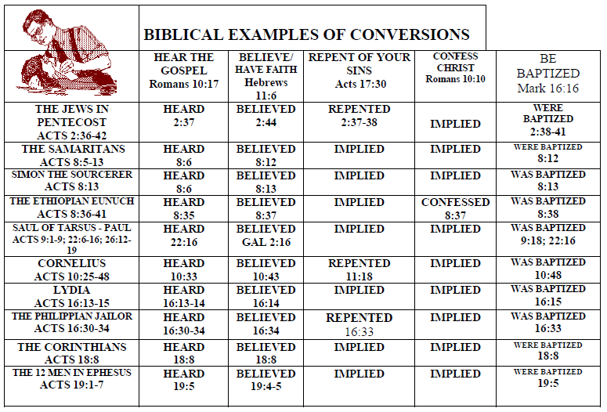

Slide 43
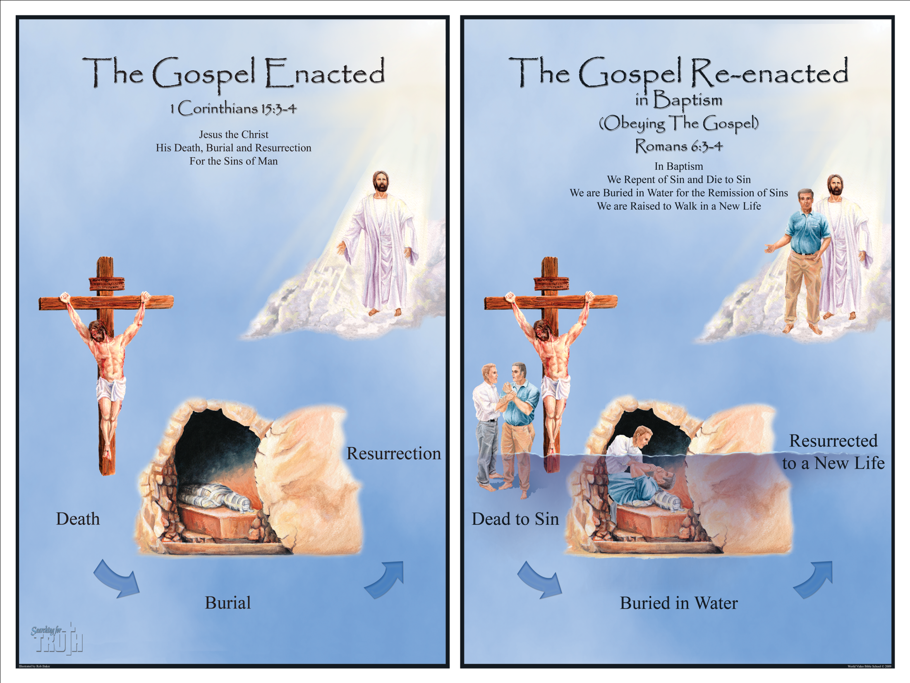

Slide 44
How is the Ark of Noah a Type of the Church?
There was work to be done in the Ark (Genesis 6:21) – Same in the church!

Slide 45
Christians Have Work To Do!
The Great Commission (Matthew 28:18-20; Mark 16:16; John 4:35).
We must live in a manner worthy of the Gospel (Philippians 1:27).
We must be zealous of good works (Titus 2:14).
We must stimulate one another to love and good works and that is done through our attendance to worship services (Hebrews 10:24-25).
We need to work out our salvation with fear and trembling (Philippians 2:12).
And we need to be steadfast, immovable, always abounding in the work of the Lord, knowing that our labor is not in vain IN the Lord (1 Corinthians 15:58).

Slide 46
We Will Be Rewarded for Our Work!
(Matthew 25:21; 2 Timothy 4:6-8; Revelation 22:12).

Slide 47
The Flood: A Destructive Event!
Just like there was ONE destruction to all outside the Ark, there will only be ONE destruction to all outside the Church!

Slide 48
Only One Destruction!
ALL the ones that did not enter the Ark were destroyed (Genesis 7:20-23).
ALL those who do not enter the church through obedience to the Gospel of Jesus will be destroyed with fire! (2 Thessalonians 1:6-10).
The old world was destroyed with water (2 Peter 3:5-6).
But this present world will be destroyed with fire (2 Peter 3:7, 10-12).

Slide 49
Last Type
Noah and his family only had ONE hope – So does the church!

Slide 50
Only ONE Hope!
The hope Noah and his family had was to live in a new world (Genesis 8:15-22).
We, too, as members of the church, have only ONE hope (Ephesians 4:4); and that hope is to make it to heaven, our promised land!
Our hope does not disappoint (Romans 5:5).
Our hope is a living hope (1 Peter 1:3).
Our hope includes an inheritance that is incorruptible, undefiled and that does not fade away, reserved for us in heaven (1 Peter 1:3-5).

Slide 51
Do You Want That Hope and Escape Destruction?
If you’re not a Christian, then you MUST obey the Gospel!
If you’re a Christian who’s not been faithful, then you MUST be restored!

