Slide 1
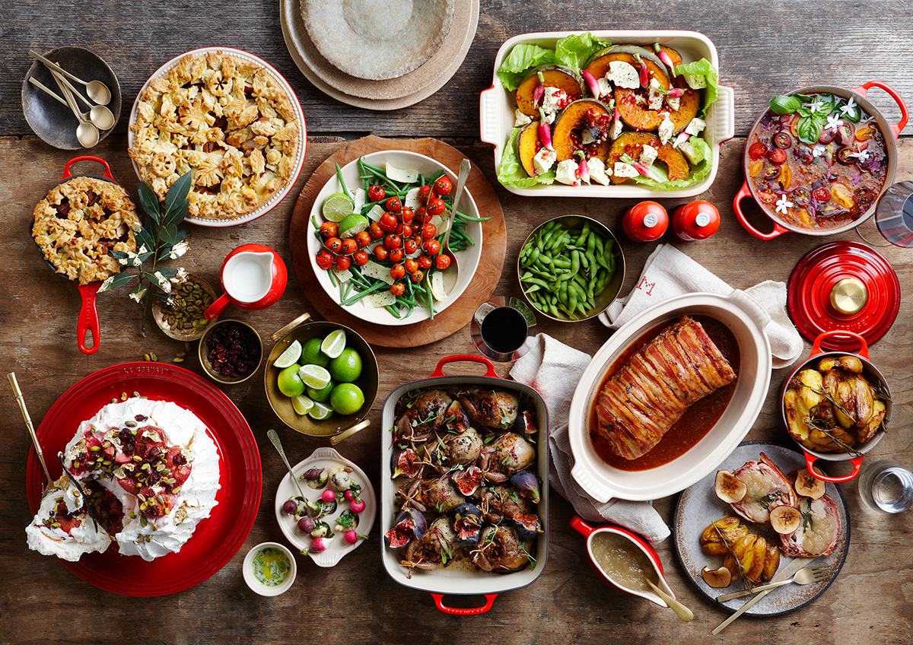
At the King’s Table
Notes:
Memories of sitting at the table.
The phrase “to sit at the table” means to be included

Slide 2
At David’s Table
“If I am still alive, will you not show me the lovingkindness of the LORD, that I may not die? "You shall not cut off your lovingkindness from my house forever, not even when the LORD cuts off every one of the enemies of David from the face of the earth." So Jonathan made a covenant with the house of David, saying, "May the LORD require it at the hands of David's enemies.”
1 Samuel 20:14-16
Notes:
King David, son of Jesse, is one that God has labeled “a man after my own heart” (1 Sam. 13:14; Acts 13:22).
"He raised up David to be their king, concerning whom He also testified and said, 'I HAVE FOUND DAVID the son of Jesse, A MAN AFTER MY HEART, who will do all My will. (Acts13:22)
Like God, David was one that showed kindness even to his enemies. When he had the chance to kill Saul, who had been persecuting him, his response was;
“Far be it from me because of the LORD that I should do this thing to my lord, the LORD'S anointed, to stretch out my hand against him, since he is the LORD'S anointed” (1 Sam. 24:6).

Slide 3
At David’s Table
Then David said, "Is there yet anyone left of the house of Saul, that I may show him kindness for Jonathan's sake?“
2 Samuel 9:1

Slide 4
At David’s Table
Now Jonathan, Saul's son, had a son crippled in his feet. He was five years old when the report of Saul and Jonathan came from Jezreel, and his nurse took him up and fled. And it happened that in her hurry to flee, he fell and became lame. And his name was Mephibosheth.
2 Samuel 4:4

Slide 5
At David’s Table
Mephibosheth, the son of Jonathan the son of Saul, came to David and fell on his face and prostrated himself. And David said, "Mephibosheth." And he said, "Here is your servant!" David said to him, "Do not fear, for I will surely show kindness to you for the sake of your father Jonathan, and will restore to you all the land of your grandfather Saul; and you shall eat at my table regularly.”
2 Samuel 9:6-7
Notes:
Despite who Mephibosheth was, David used his table to bless him, regularly.

Slide 6
Our Table
Above all, keep fervent in your love for one another, because love covers a multitude of sins. Be hospitable to one another without complaint. As each one has received a special gift, employ it in serving one another as good stewards of the manifold grace of God.
1 Peter 4:8-10

Slide 7
Our Table
Let love be without hypocrisy. Abhor what is evil; cling to what is good. Be devoted to one another in brotherly love; give preference to one another in honor; not lagging behind in diligence, fervent in spirit, serving the Lord; rejoicing in hope, persevering in tribulation, devoted to prayer, contributing to the needs of the saints, practicing hospitality.
Romans 12:9-13

Slide 8
Our Table
“So I sent for you immediately, and you have been kind enough to come. Now then, we are all here present before God to hear all that you have been commanded by the Lord.”
Acts 10:33

Slide 9
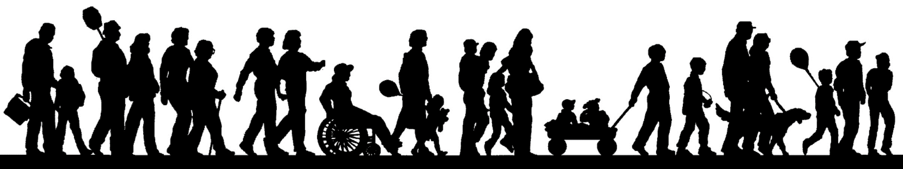
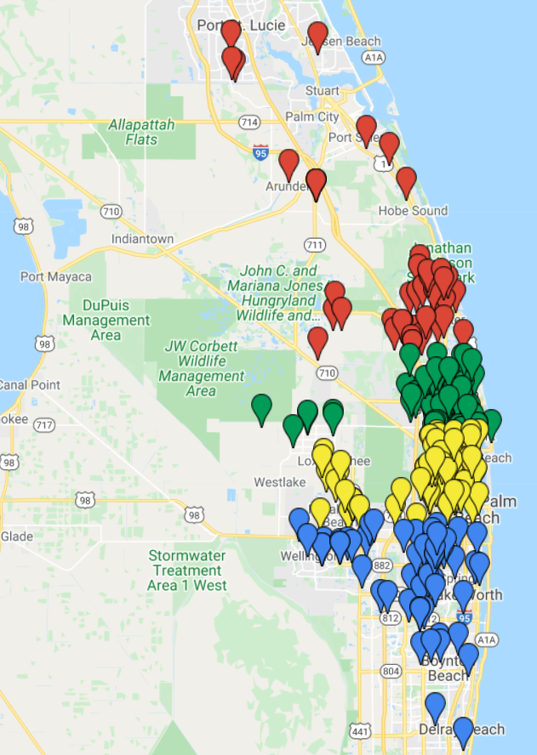

Family Groups
Group 1:
Donald Ross and North
Group 2:
Donald Ross to Blue Heron
Group 3:
Blue Heron to Southern
Group 4:
Southern and South
Notes:
930 Square miles, around the dots
We are spread out

Slide 10
Family Groups
Group 1:
March 22, Blackmer Home
Group 2:
March 15, Sproule Home
Group 3:
March 26, Fuller Home
Group 4:
March 4, Anderson Home
Notes:
Group 1:
March 22, Josh and Cara Blackmer Home
Group 2:
March 15, David and Traci Sproule Home
Group 3:
March 26, Dan and Loni Fuller Home
Group 4:
March 4, Andy and Letha Anderson Home

Slide 11
At the King’s Table
And although you were formerly alienated and hostile in mind, engaged in evil deeds, yet He has now reconciled you in His fleshly body through death, in order to present you before Him holy and blameless and beyond reproach
Colossians 1:21-22
Notes:
The King’s Table
The significance of Mephibosheth is that his household was hostile toward David but David had made a vow to one man.
Col 1:21-22 we are reconciled to God
He made a promise to Abraham (Gen 12:3)
“And in you all the families of the earth will be blessed”
Luke 14:16-24
Made to sit at the King’s table as sons Romans 8:15-17

Slide 12
At the King’s Table
Christ wants you at His table
Believe - Acts 16:31
Repent - Acts 17:30
Confess - Romans 10:9-10
Immersed - Acts 2:38

