Slide 1


Slide 2

Has not changed since the Lord gave it in the first century

Slide 3

19 Go therefore and make disciples of all the nations, baptizing them in the name of the Father and of the Son and of the Holy Spirit.

Slide 4


Mark 16:15 > “Go into all the world and preach the gospel to every creature………………….”

Slide 5
IT IS IMPORTANT TO THE LORD
Colossians 1:23> 23 if indeed you continue in the faith, grounded and steadfast, and are not moved away from the hope of the gospel which you heard, which was preached to every creature under heaven……….
Matthew 24:14> 14 And this gospel of the kingdom will be preached in all the world as a witness to all the nations, and then the end will come.

Slide 6

1 Peter 2:9> “……….that you may proclaim the praises of Him who called you out of darkness into His marvelous light.”

Slide 7
IT IS IMPORTANT FOR YOUR SPIRITUAL SOUL
1 Corinthians 9:16,17> 16 For if I preach the gospel, I have nothing to boast of, for necessity is laid upon me; yes, woe is me if I do not preach the gospel! 17 For if I do this willingly, I have a reward; but if against my will, I have been entrusted with a stewardship.
1 Timothy 4:16> 16 Take heed to yourself and to the doctrine. Continue in them, for in doing this you will save both yourself and those who hear you.

Slide 8
SAVE YOURSELF BY HAVING THIS ATTITUDE
I want to serve my Lord.
I get to be involved in the lives of others.
I get to tell the love of Christ to others.
I get to bring the unsearchable riches of Christ.
I get to bring others in touch with eternity.

Slide 9
IT IS IMPORTANT FOR THE SOULS OF OTHERS
Mark 8:36 For what will it profit a man if he gains the whole world, and loses his own soul? 37 Or what will a man give in exchange for his soul?
1 Timothy 2:3,4> 3 For this is good and acceptable in the sight of God our Savior, 4 who desires all men to be saved and to come to the knowledge of the truth.

Slide 10
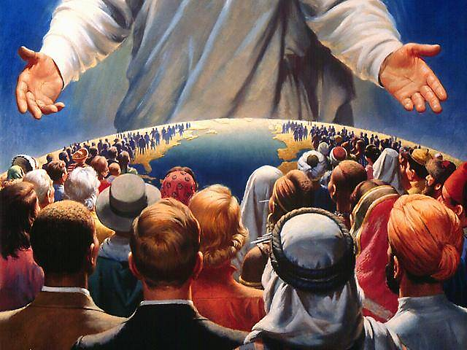
Matthew 11:28> 28 Come to Me, all you who labor and are heavy laden, and I will give you rest.

Slide 11
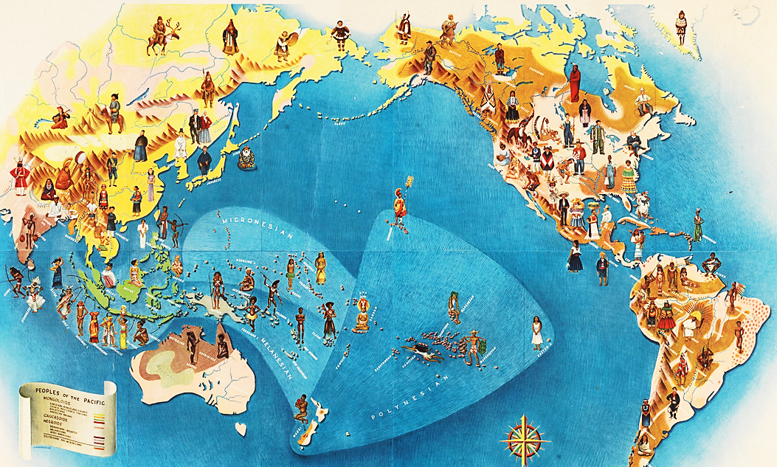

How can people call for help if they don't know who to trust?
How can they know who to trust if they haven't heard of the One who can be trusted?
How can they hear if nobody tells them?

