Slide 2
The SETTING of Their Giving Should Challenge Us
  “In great trial of affliction” (2 Cor. 8:2)
  “In deep, extreme poverty” (8:2)
The SPIRIT of Their Giving Should Challenge Us
  “The abundance of their joy” (8:2)
  “They were freely willing, of their own accord” (8:3)
  “Begging us with much urgency/urging” (8:4)
The SIZE of Their Giving Should Challenge Us
  “Their deep poverty abounded in the riches of their liberality” (8:2)
  “According to their ability, yes, beyond their ability” (8:3)
  “Gave not only as we had hoped/expected” (8:5)
The STRATEGY of Their Giving Should Challenge Us
  “Begging for the favor and participation in the ministering to the saints” (8:4)
  “They gave to please the will of God” (8:5)
The SECRET of Their Giving Should Challenge Us
  “They first gave themselves” (8:5)
  “To the Lord” (8:5)

Slide 3

January 30
Every dollar given on Mission Sunday
goes toward mission work.

Slide 4
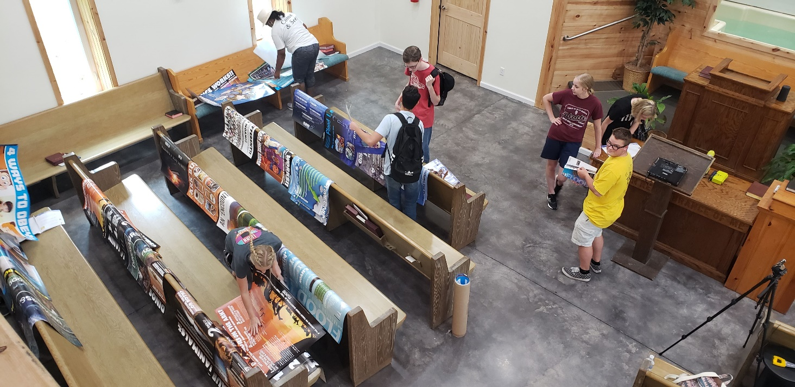

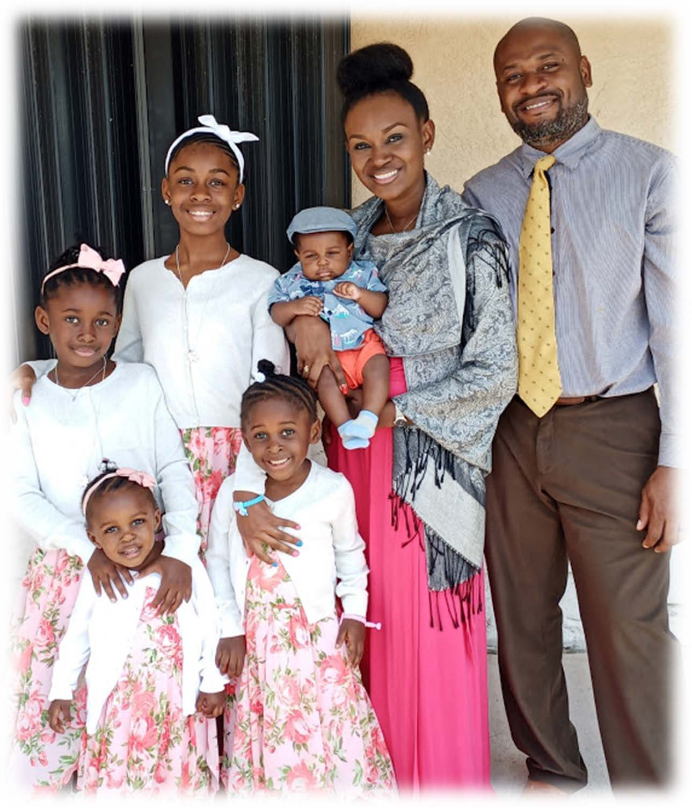
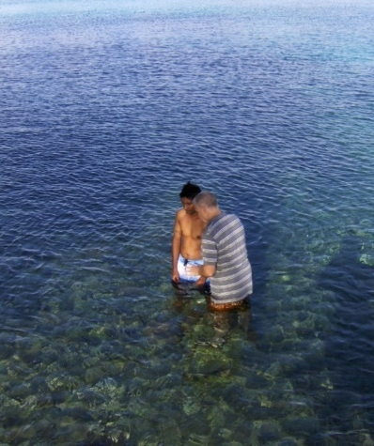
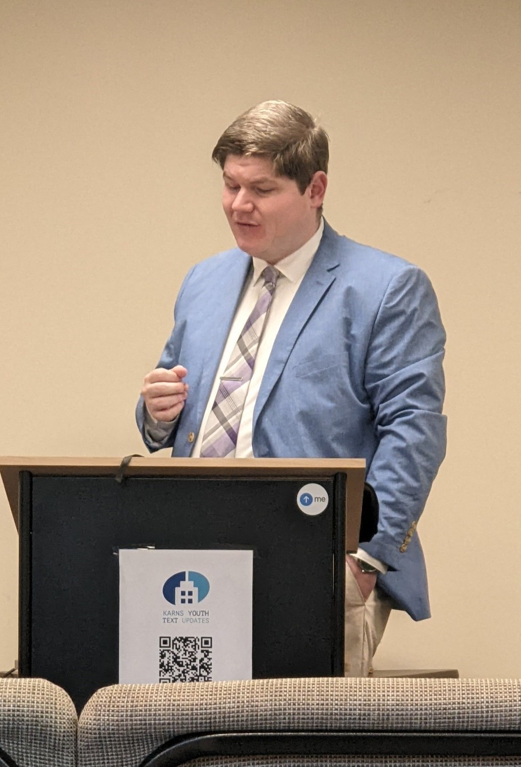

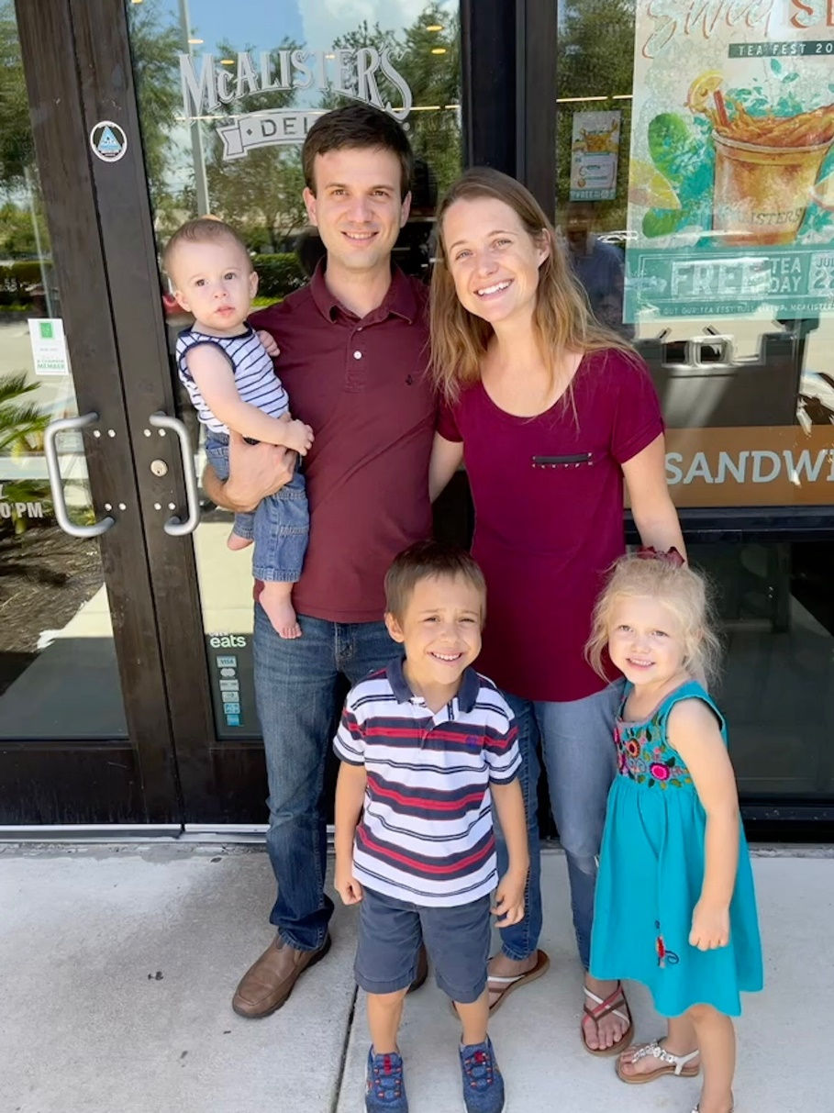
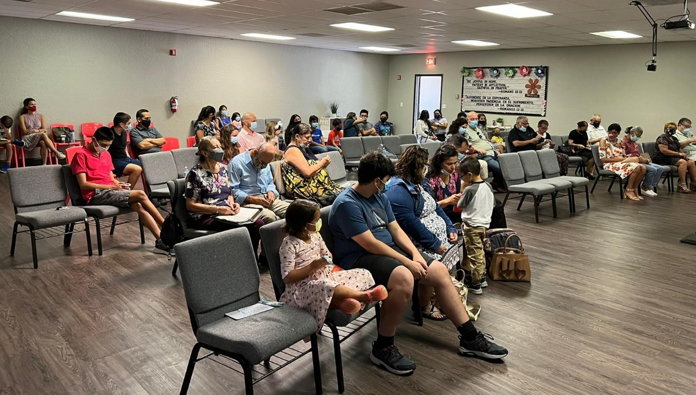
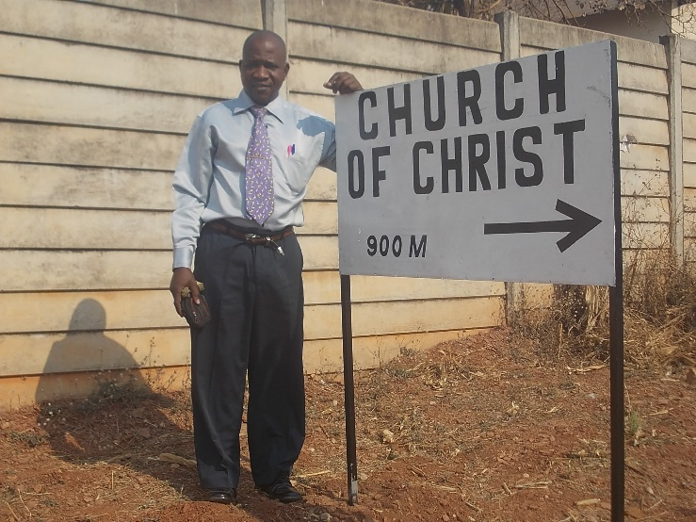
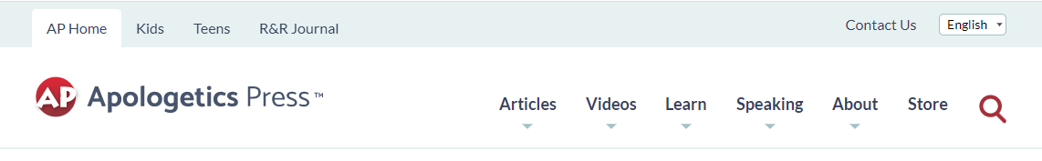
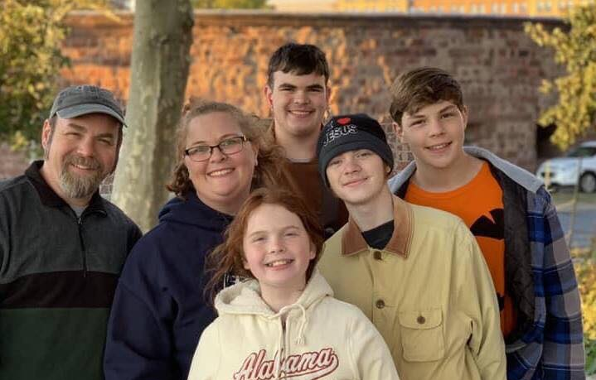
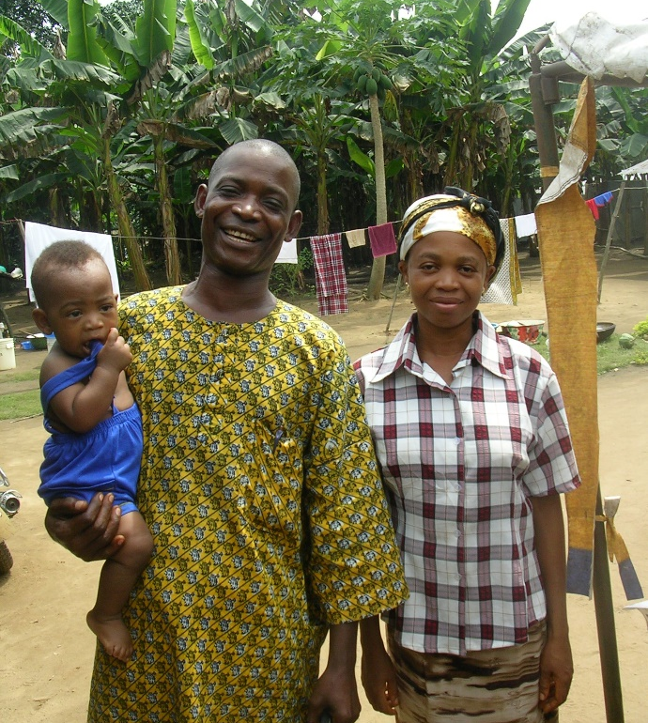
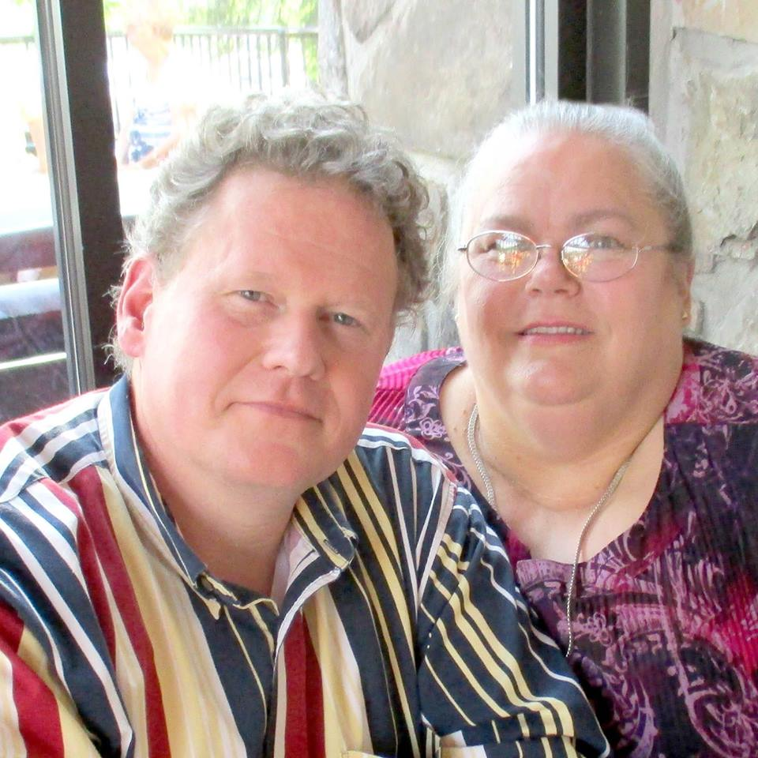
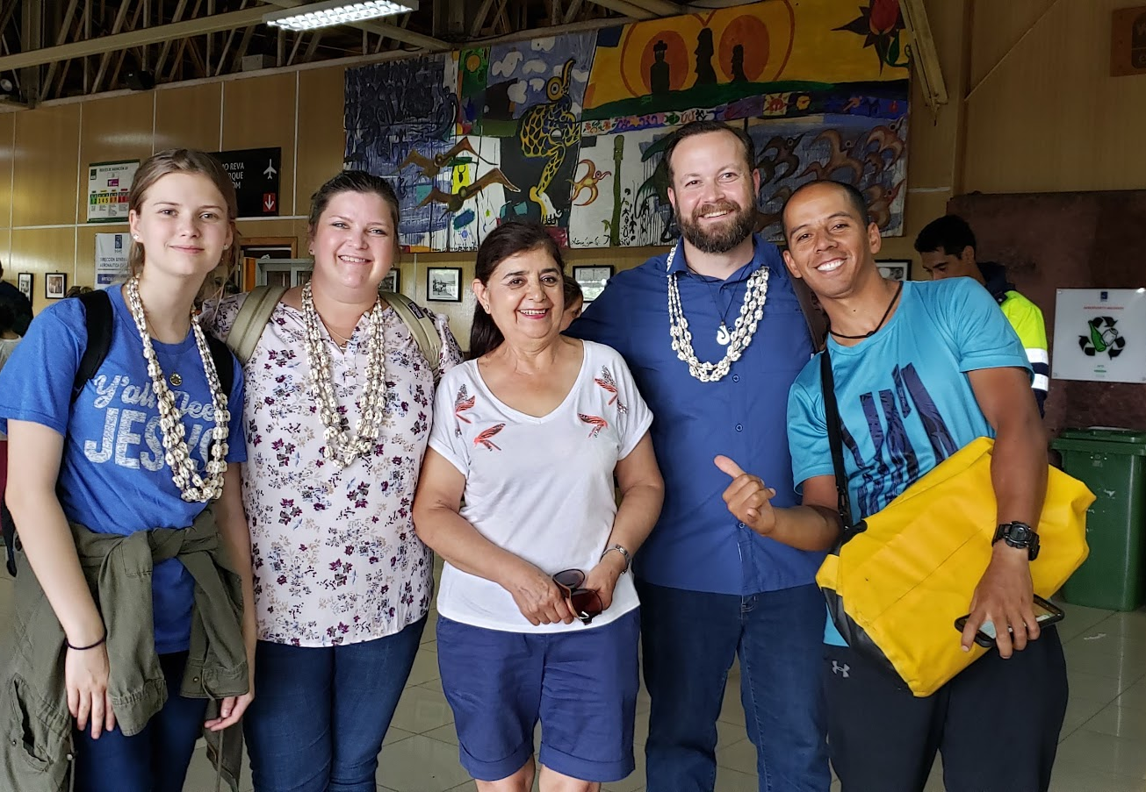
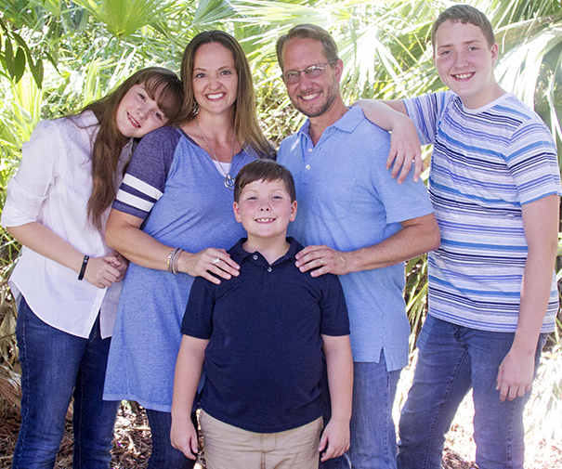
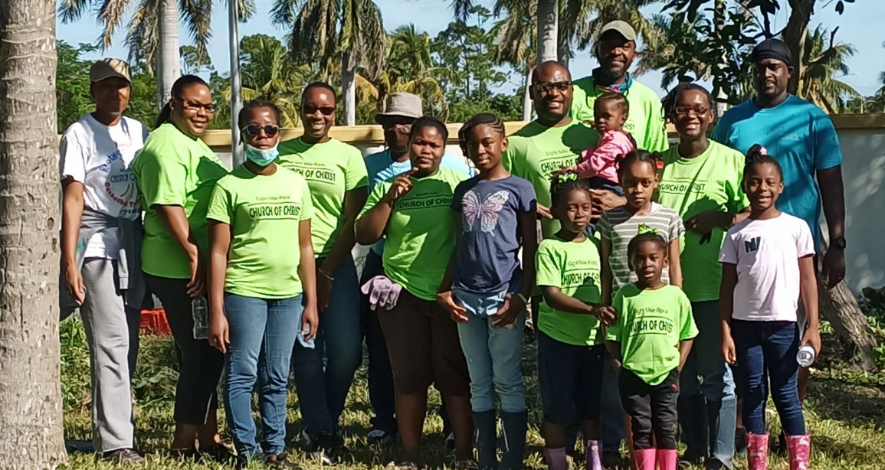
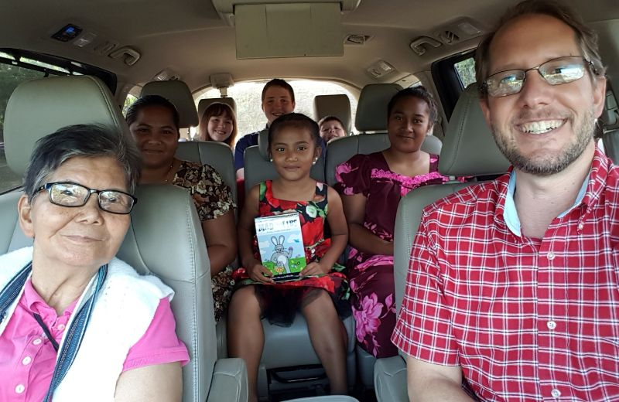
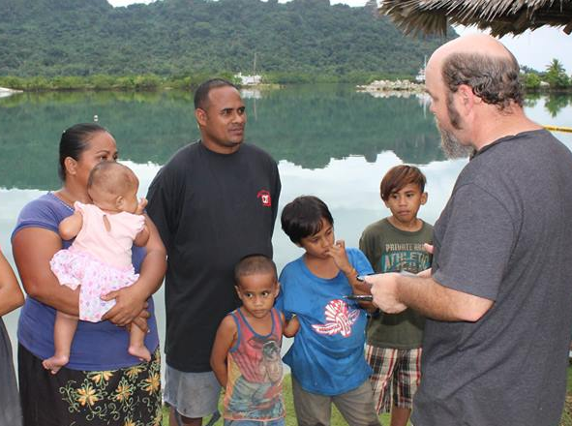
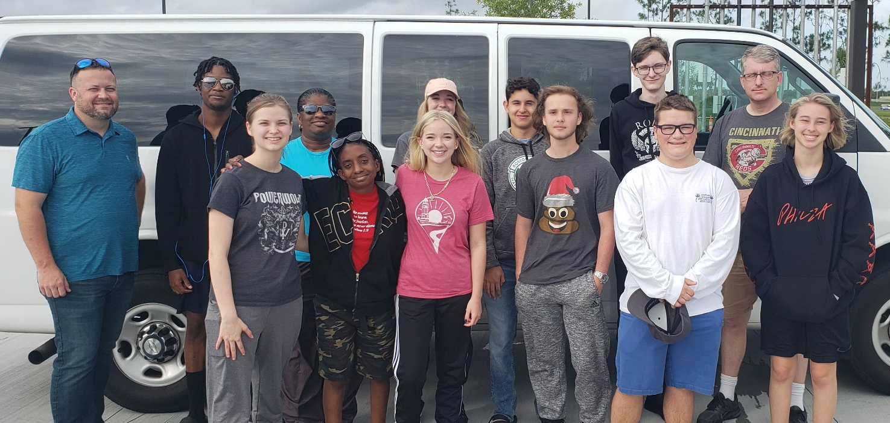
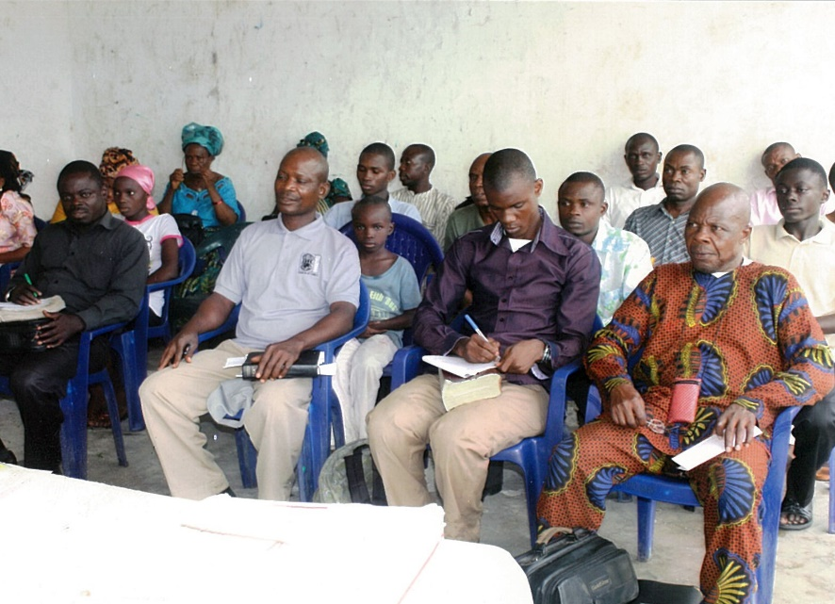
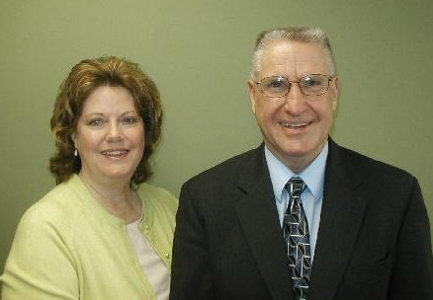
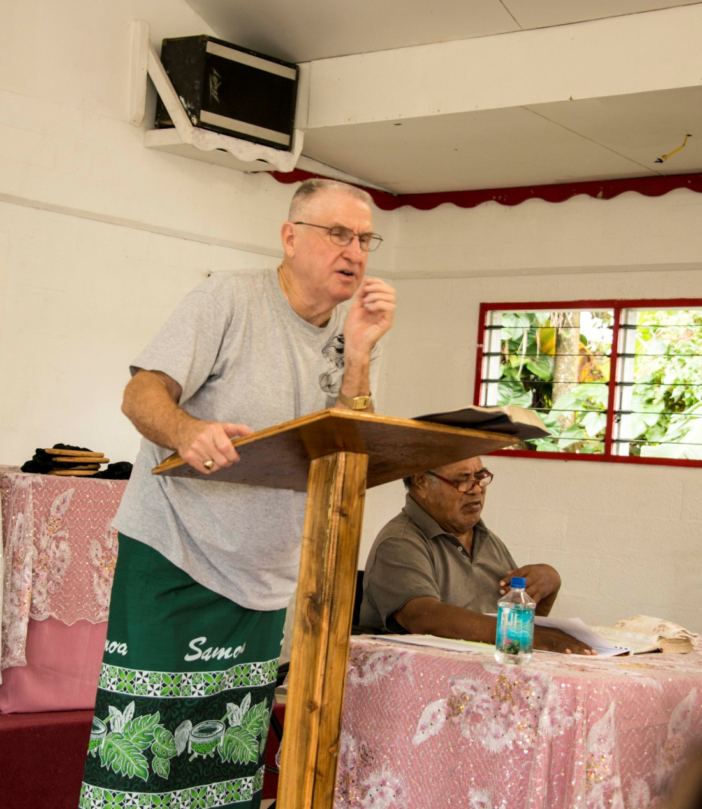

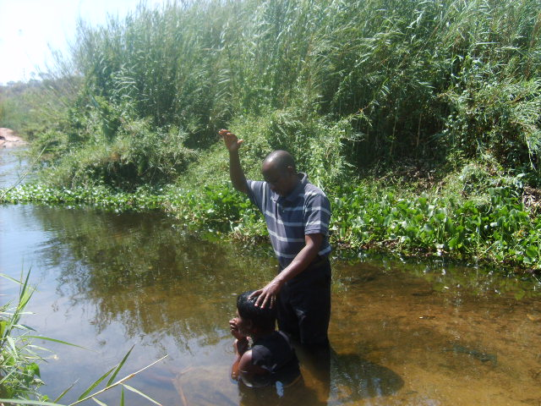
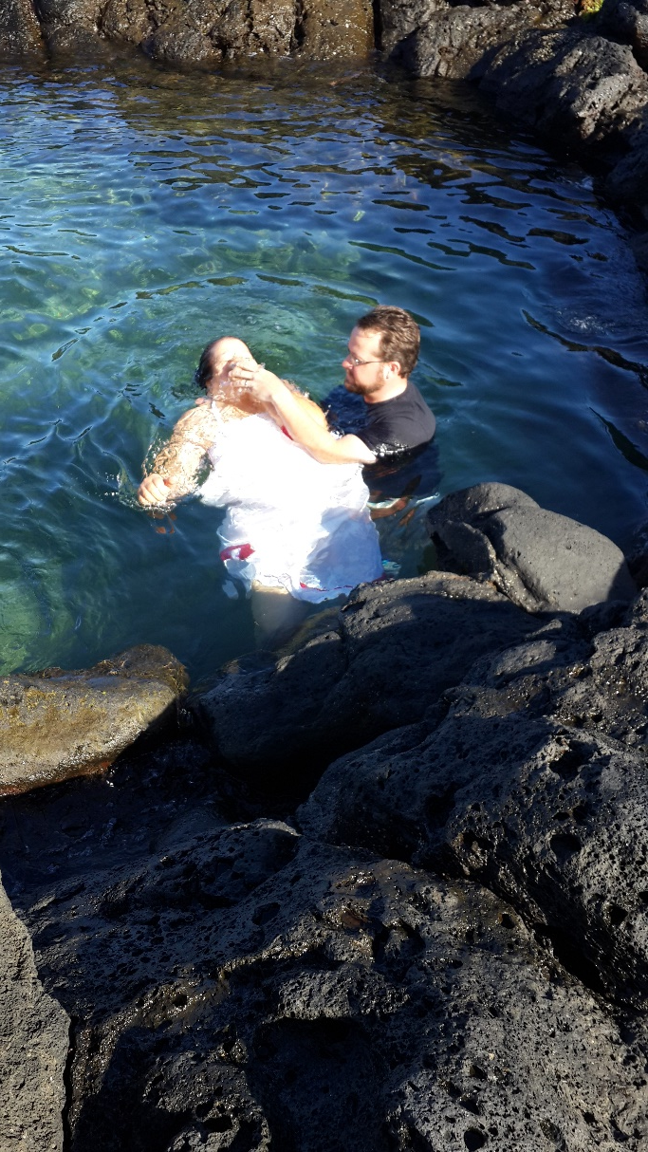
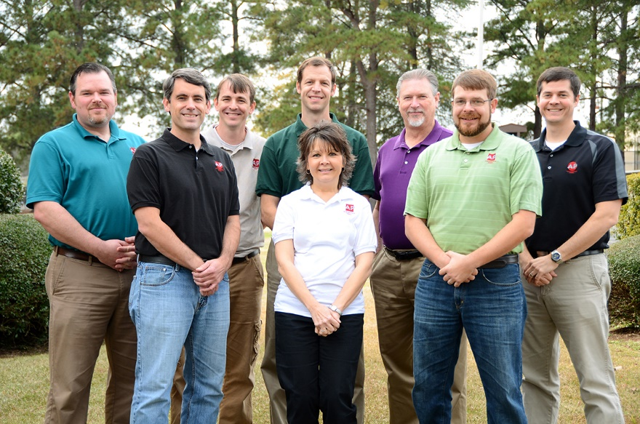
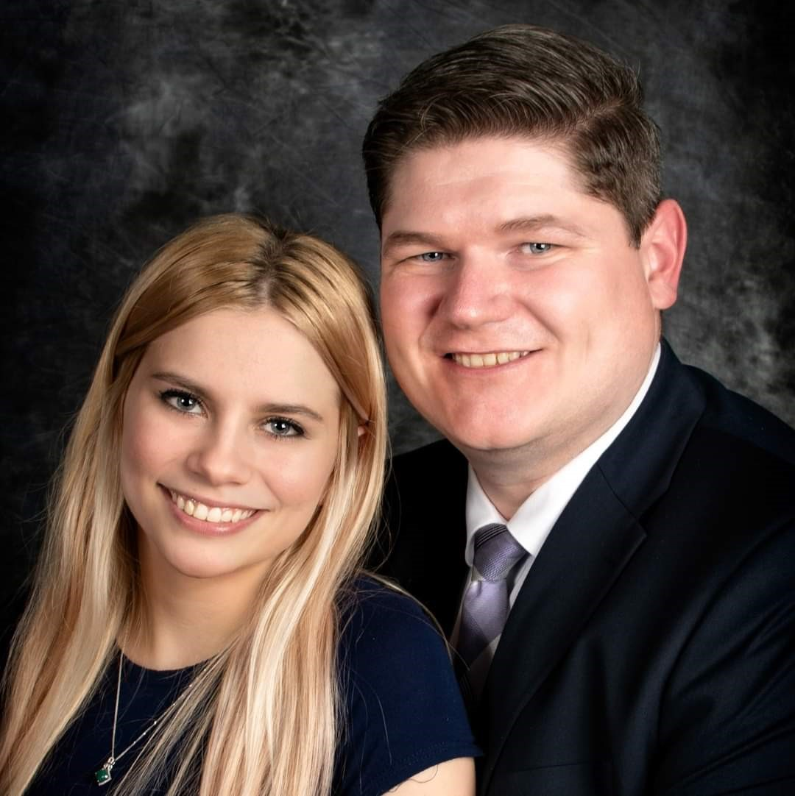
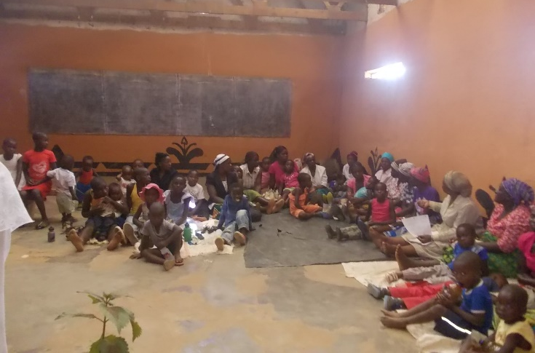


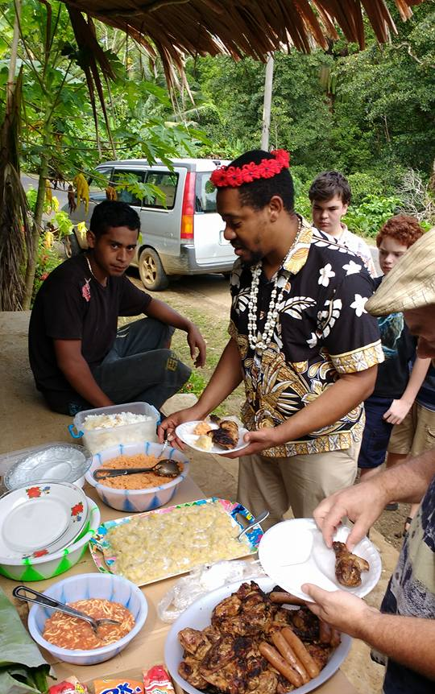


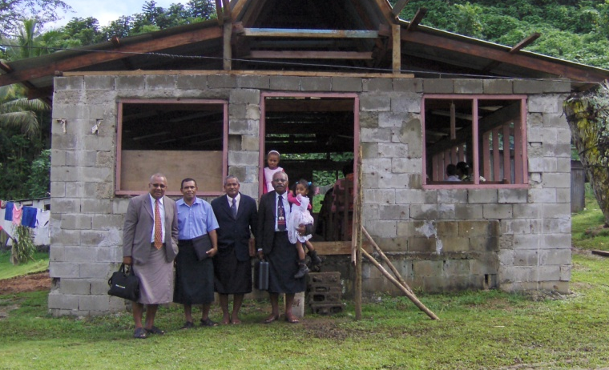
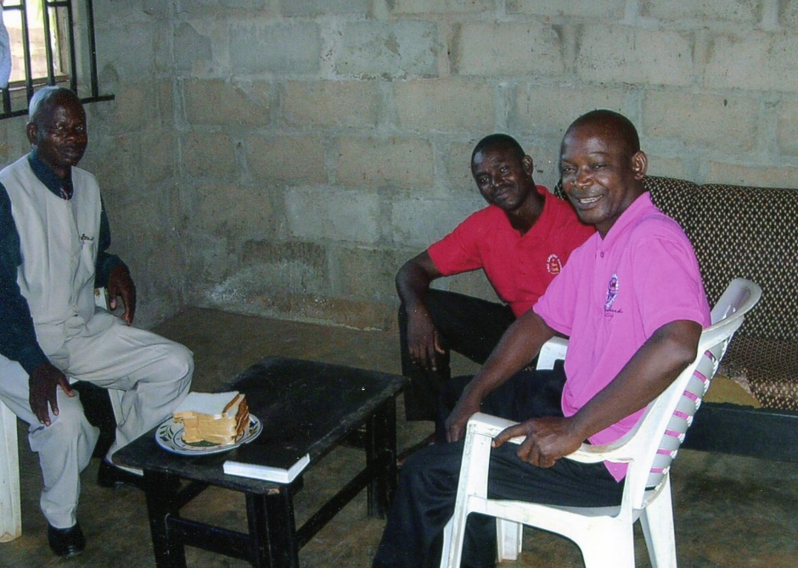
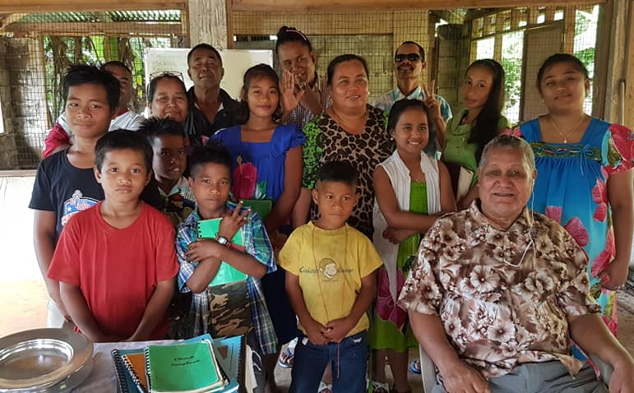
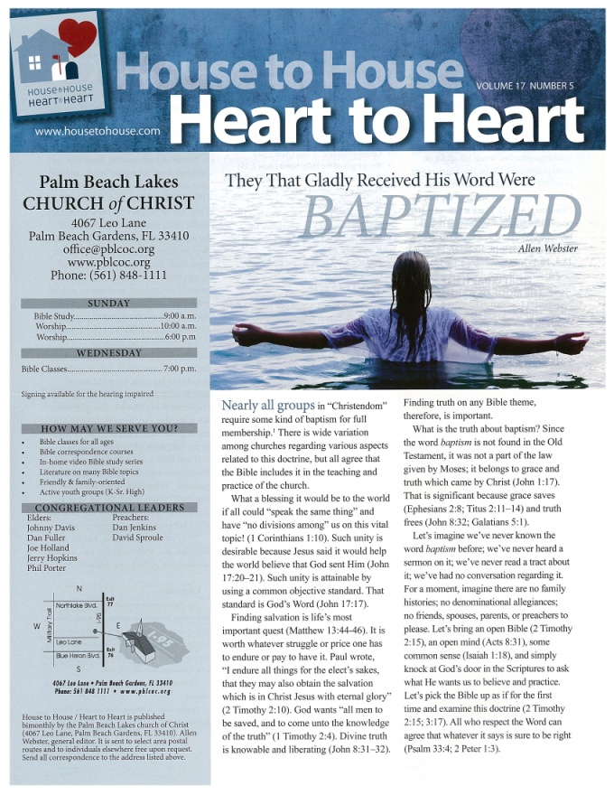
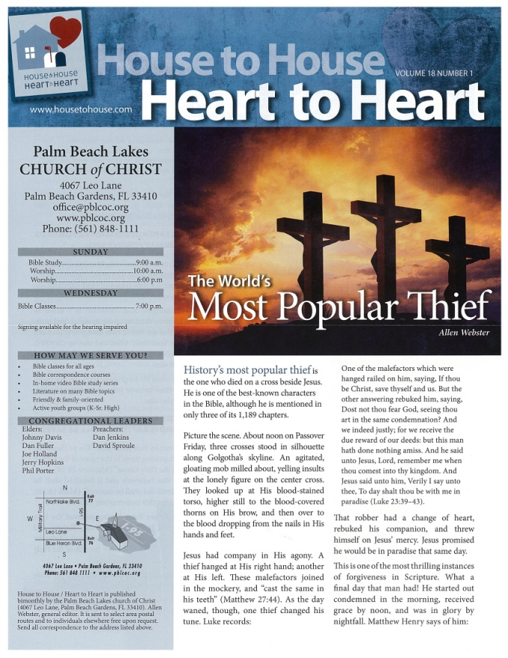
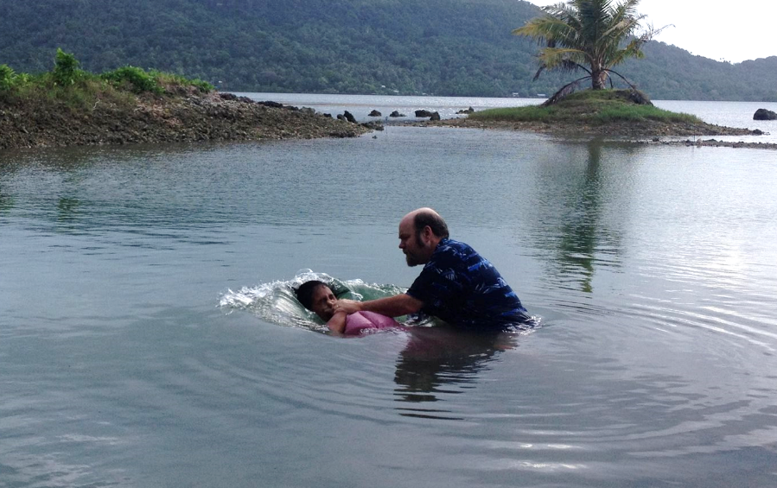
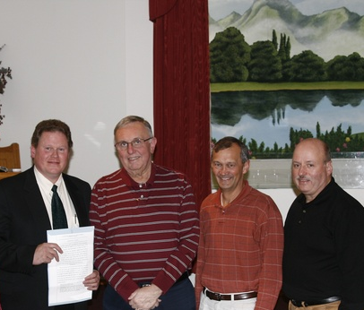
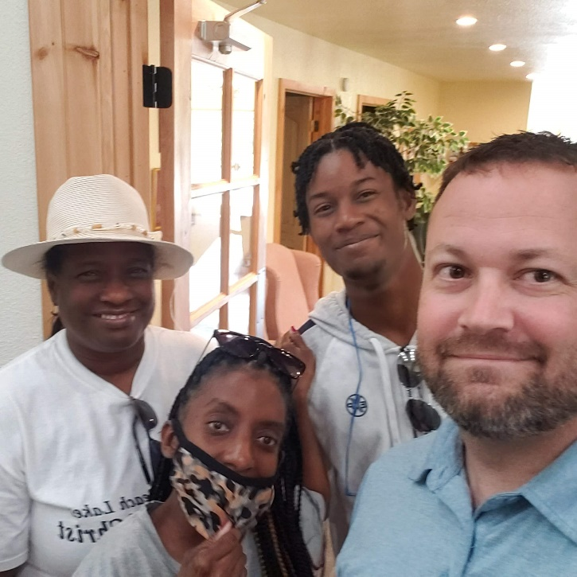
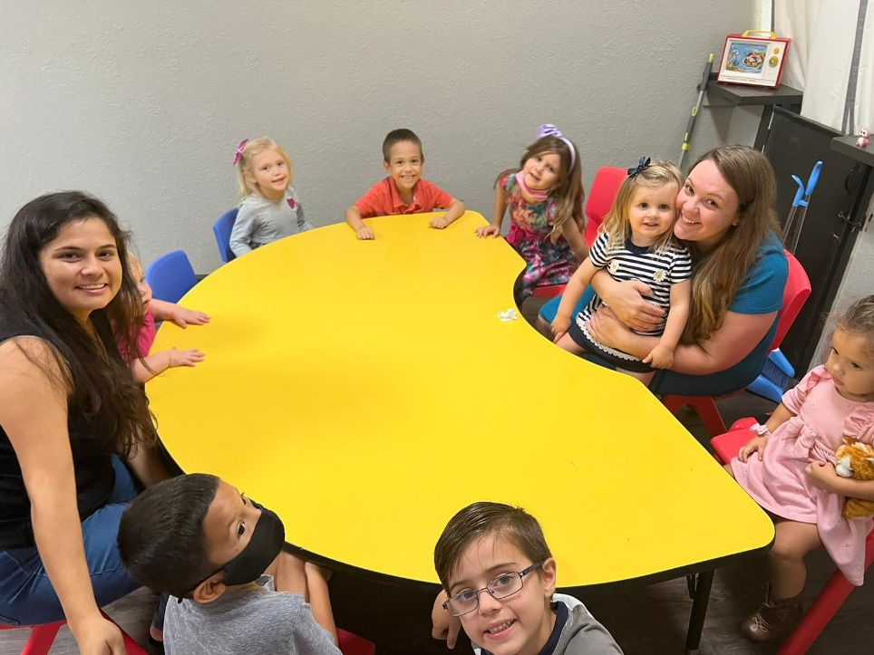
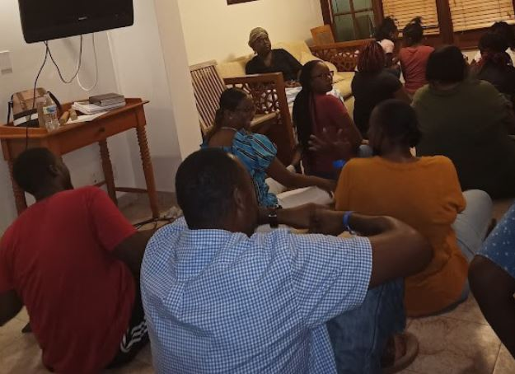
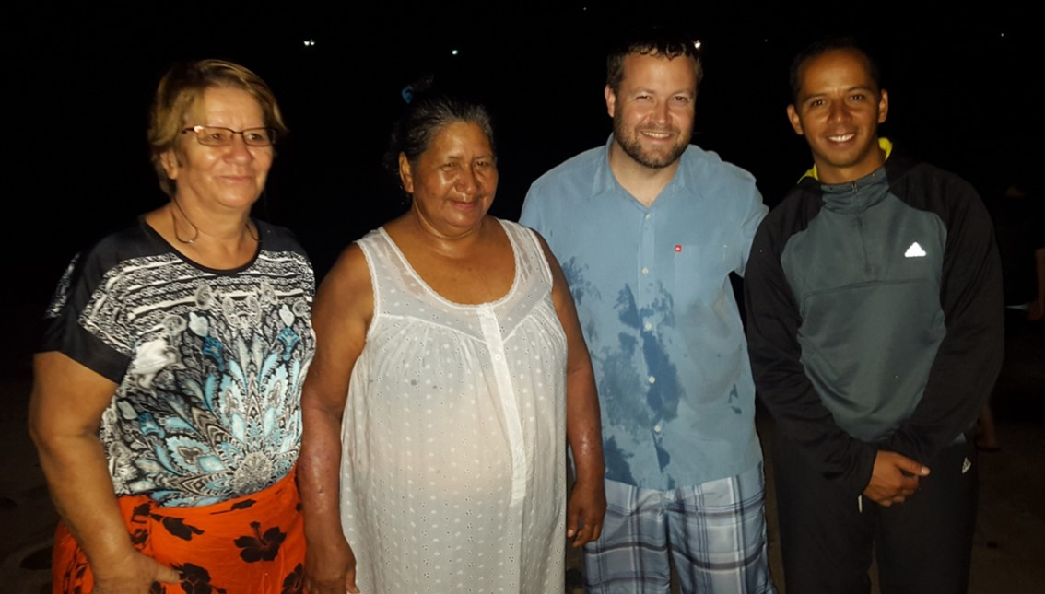
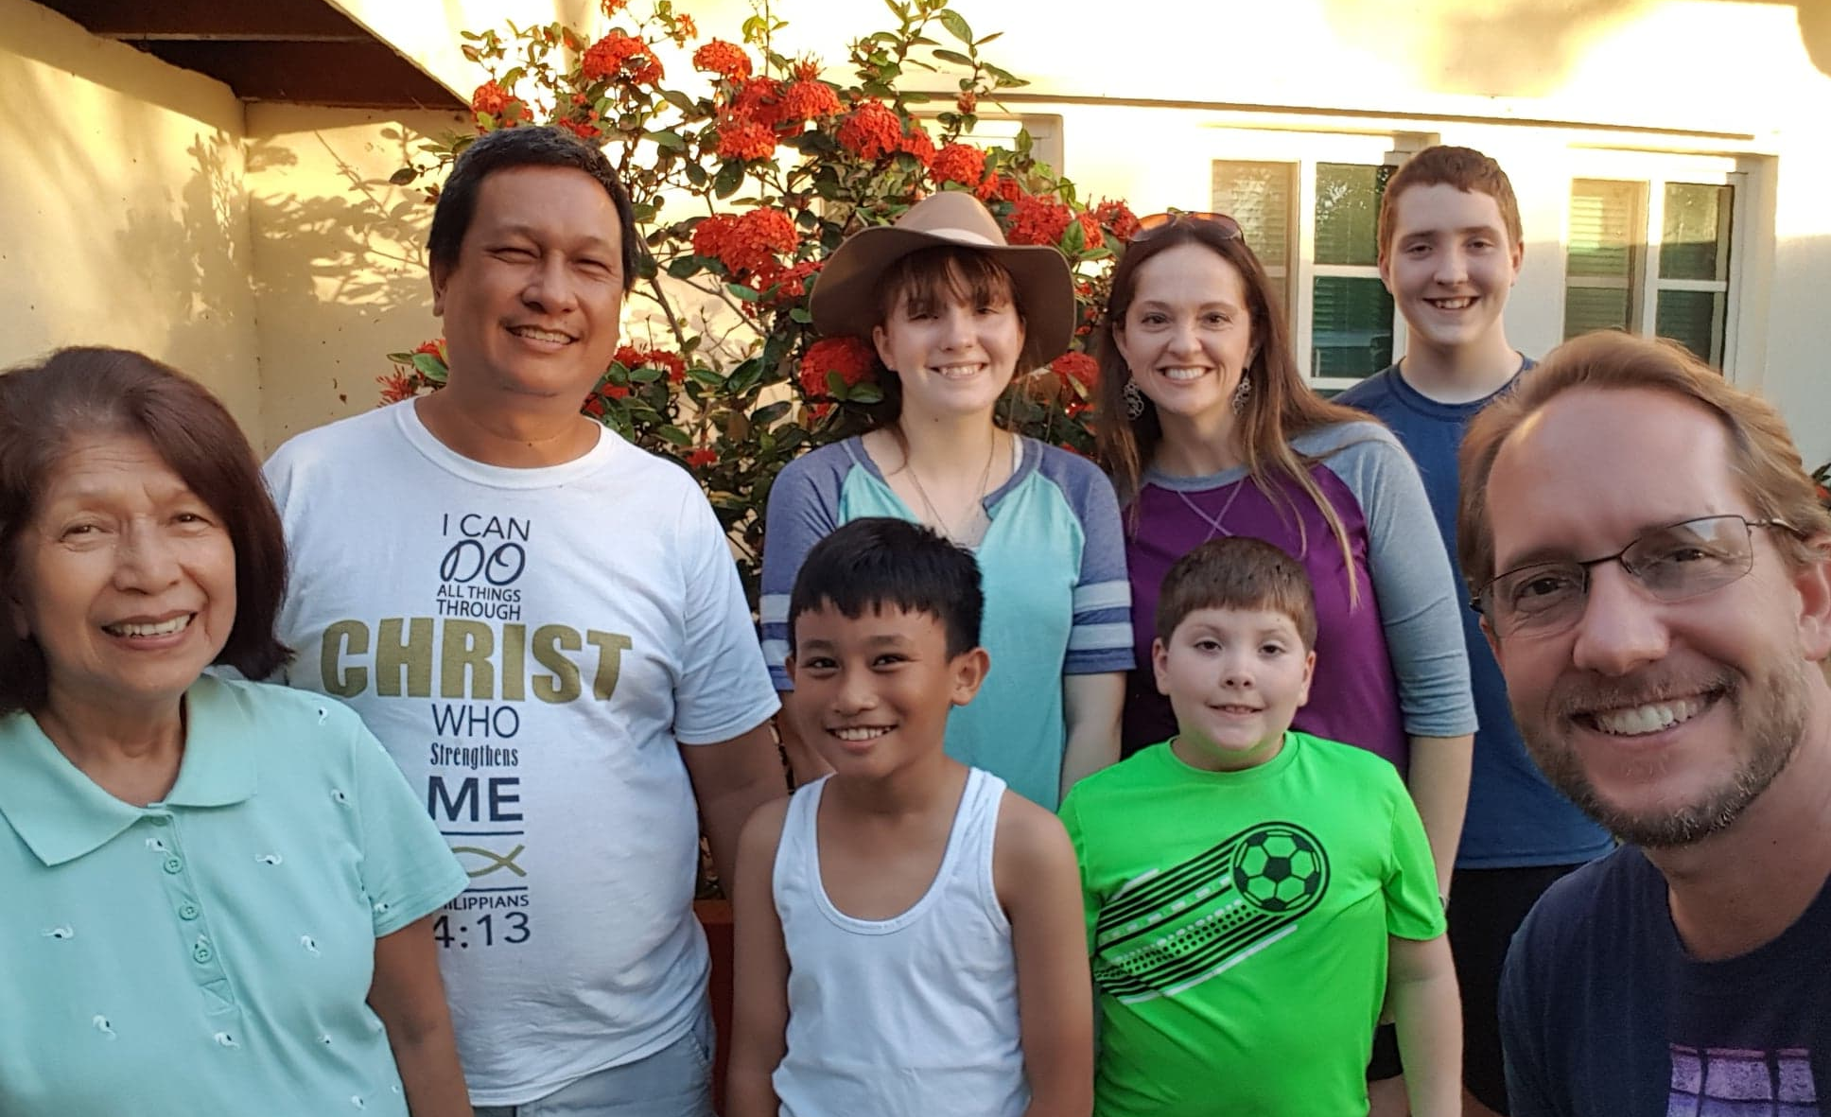
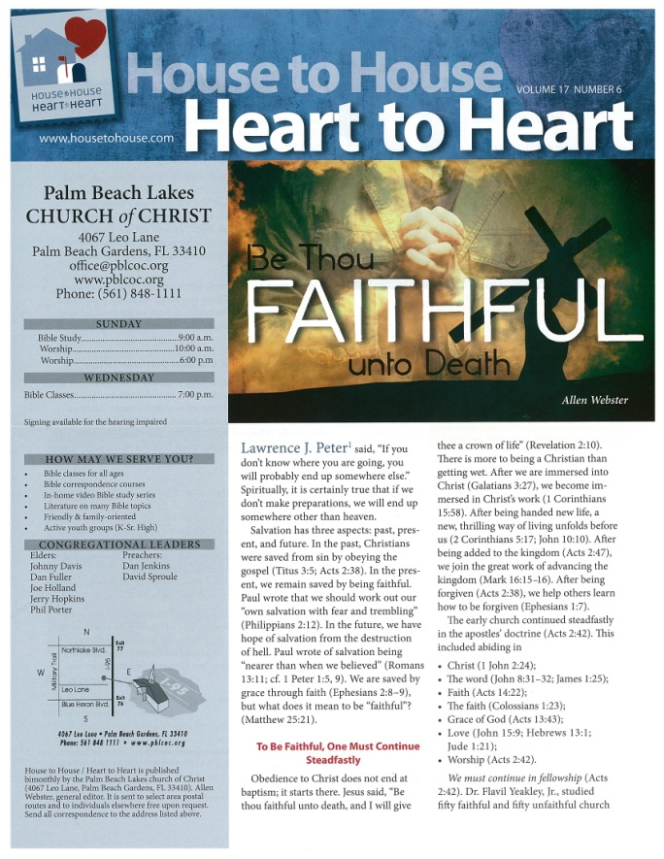
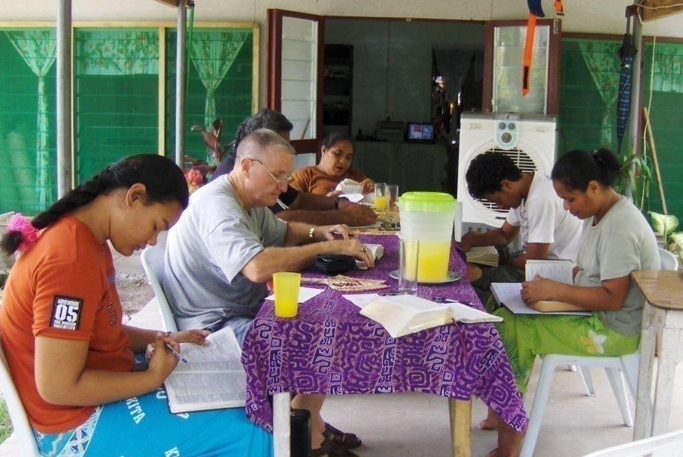
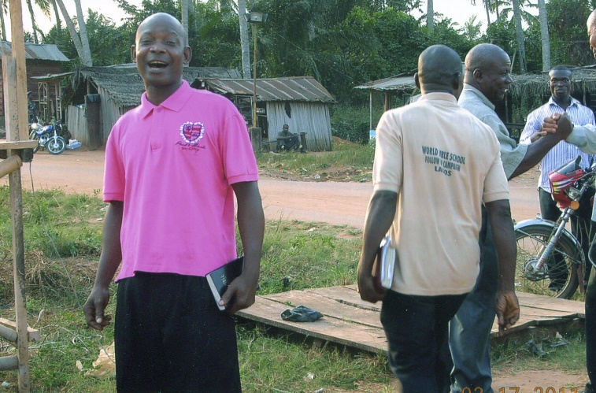
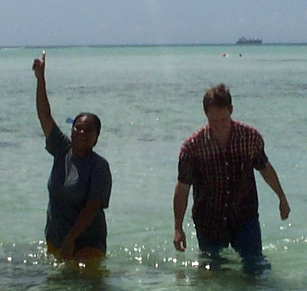
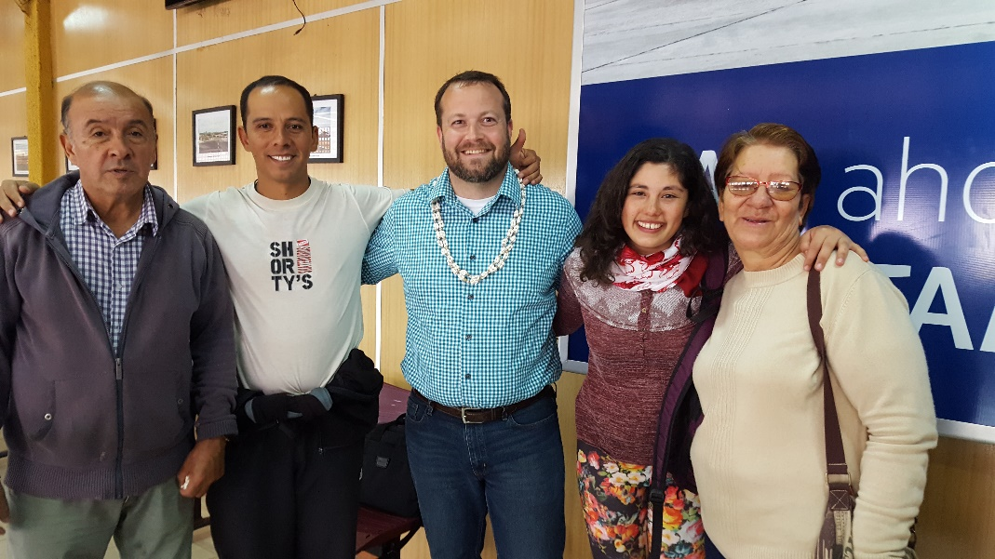
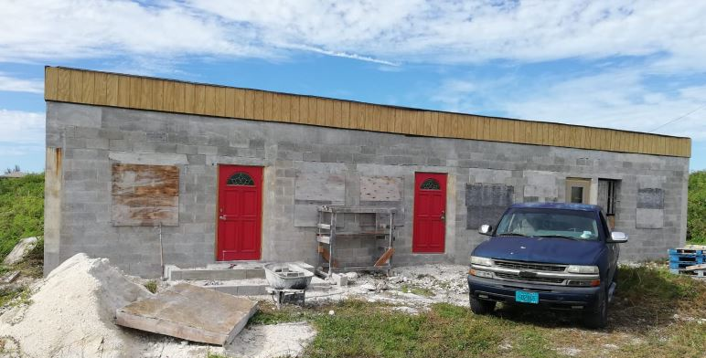
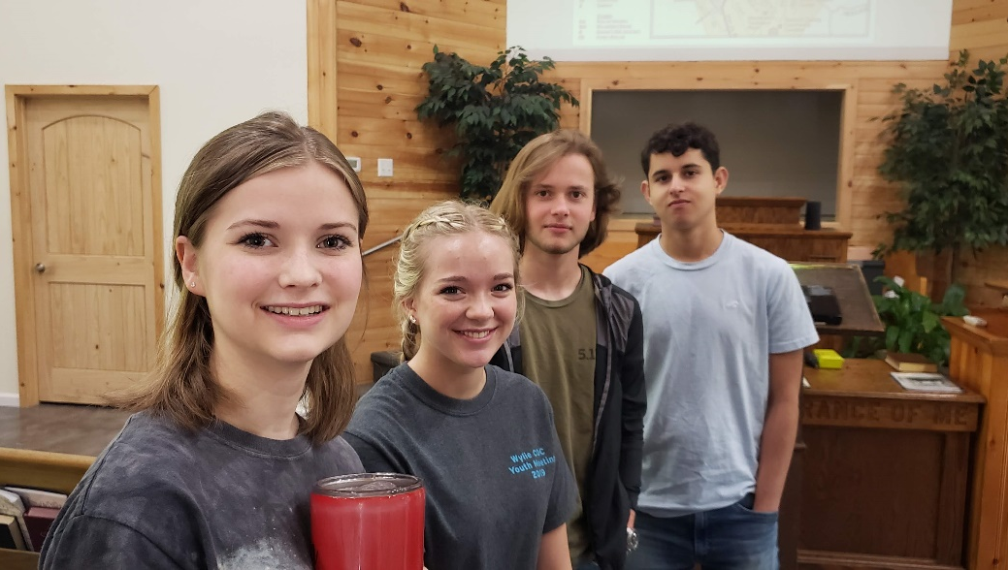
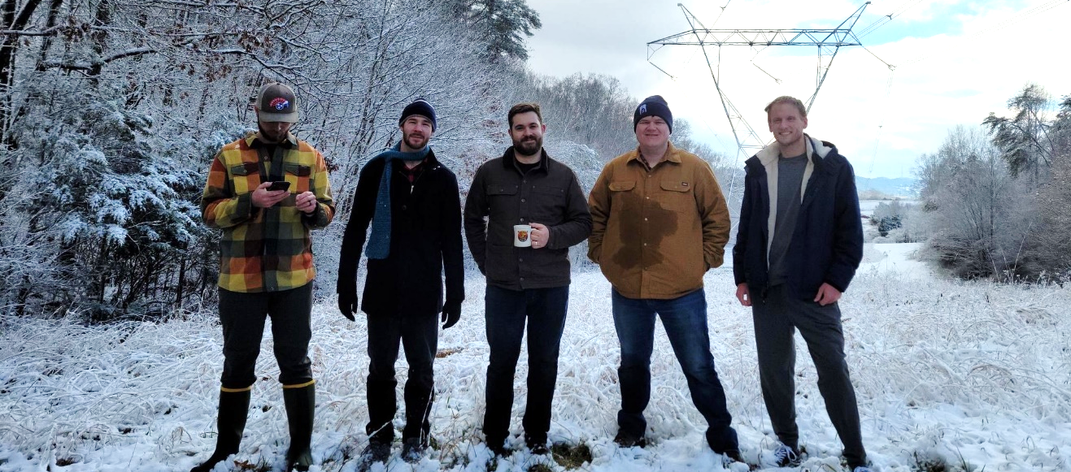
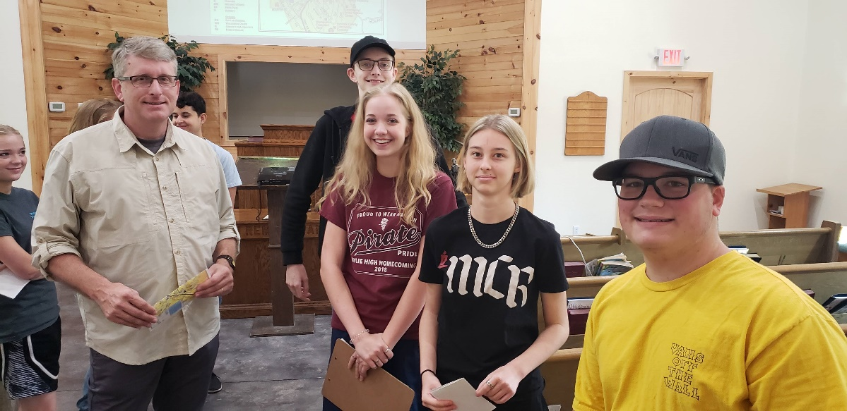
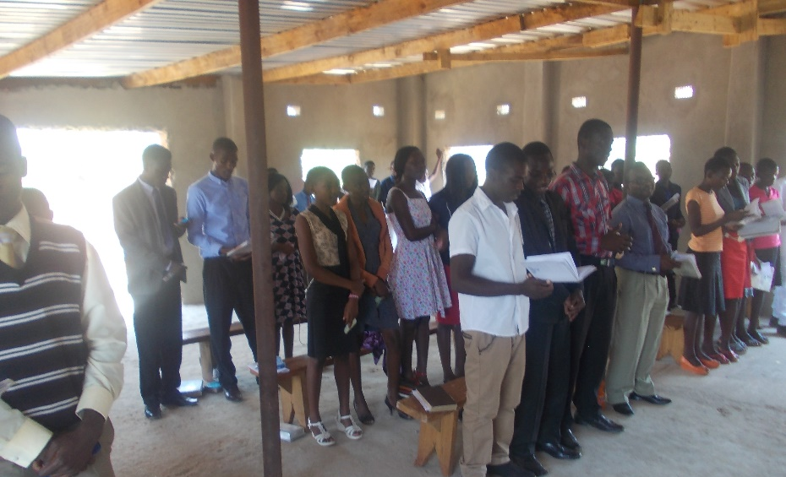
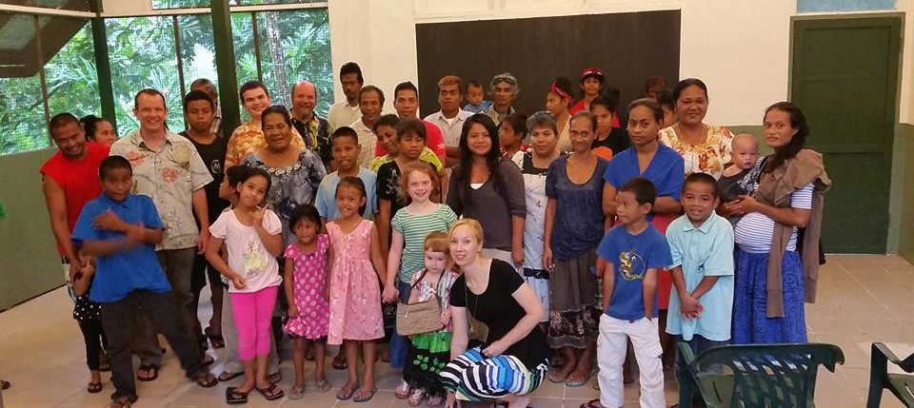
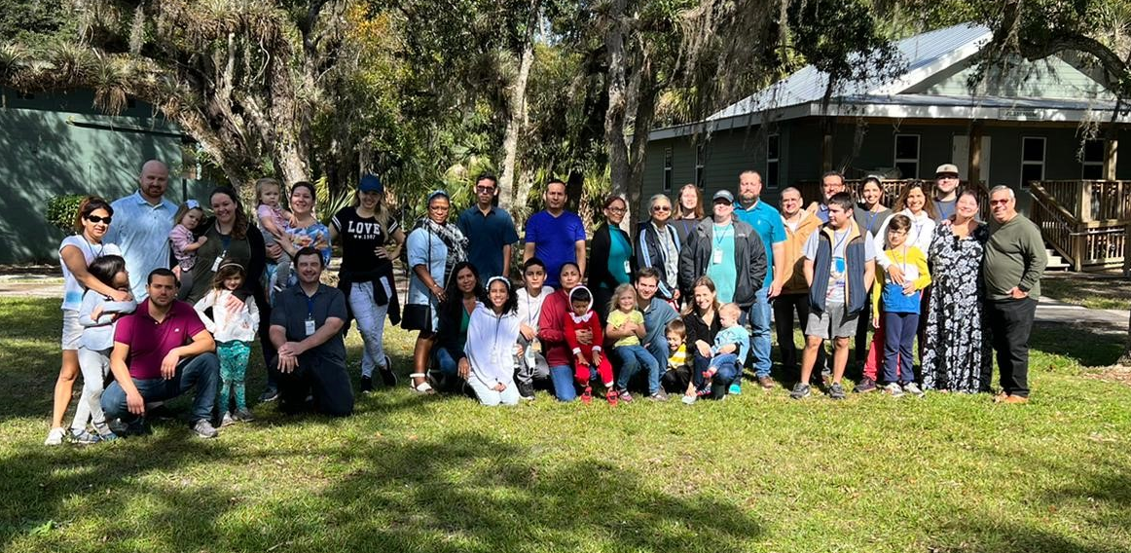




3,300 homes
EVERY month
Rotating Routes
Robert J. Lupo (SEIBS)
House to House/Heart to Heart
Easter
Island
Apologetics Press
Sr. High & Adult Mission Trip
$95,700
Tavaro Hanna (Bahamas)
Robert C. Lupo (Sneedville, TN)
Wayne Parker (Pacific)
Mauricio Yegros (Coral Springs)
Robert Martin (Pacific)
Joey Treat (Pacific)
Nnanna Aforji (Nigeria)
Tamuka Arunashe (Zimbabwe)

Slide 5


$109,200
Bibles for
Mission Fields
Robert J. Lupo (SEIBS)
House to House/Heart to Heart
Easter
Island
Apologetics Press
Sr. High & Adult Mission Trip
$95,700
Tavaro Hanna (Bahamas)
Robert C. Lupo (Sneedville, TN)
Wayne Parker (Pacific)
Mauricio Yegros (Coral Springs)
Robert Martin (Pacific)
Joey Treat (Pacific)
Nnanna Aforji (Nigeria)
Tamuka Arunashe (Zimbabwe)

Slide 6
$109,200
Bibles for
Mission Fields
Special Requests
for Mission Trips
PBL World Missions
Robert J. Lupo (SEIBS)
House to House/Heart to Heart
Easter
Island
Apologetics Press
Sr. High & Adult Mission Trip
$95,700
Tavaro Hanna (Bahamas)
Robert C. Lupo (Sneedville, TN)
Wayne Parker (Pacific)
Mauricio Yegros (Coral Springs)
Robert Martin (Pacific)
Joey Treat (Pacific)
Nnanna Aforji (Nigeria)
Tamuka Arunashe (Zimbabwe)

Slide 7



Josh Blackmer
Dan Jenkins
Mission Statement: Our mission is to labor with existing congregations and new works of the Lord’s church in evangelizing, edifying, and equipping the saints for greater service in domestic and foreign fields.
Assisting congregations in Florida and around the United States
  Workshops: Light the Fire, Leadership, Evangelism, Gospel Meeting
Assisting mission works on foreign soils

Slide 8
$124,200
Assist Spanish Congregation
$109,200
Bibles for
Mission Fields
Special Requests
for Mission Trips
PBL World Missions
Robert J. Lupo (SEIBS)
House to House/Heart to Heart
Easter
Island
Apologetics Press
Sr. High & Adult Mission Trip
$95,700
Tavaro Hanna (Bahamas)
Robert C. Lupo (Sneedville, TN)
Wayne Parker (Pacific)
Mauricio Yegros (Coral Springs)
Robert Martin (Pacific)
Joey Treat (Pacific)
Nnanna Aforji (Nigeria)
Tamuka Arunashe (Zimbabwe)

Slide 9






Slide 10
$124,200
Assist Spanish Congregation
“In Search of the
Lord’s Way” TV Program
$109,200
Bibles for
Mission Fields
Special Requests
for Mission Trips
PBL World Missions
Robert J. Lupo (SEIBS)
House to House/Heart to Heart
Easter
Island
Apologetics Press
Sr. High & Adult Mission Trip
$95,700
Tavaro Hanna (Bahamas)
Robert C. Lupo (Sneedville, TN)
Wayne Parker (Pacific)
Mauricio Yegros (Coral Springs)
Robert Martin (Pacific)
Joey Treat (Pacific)
Nnanna Aforji (Nigeria)
Tamuka Arunashe (Zimbabwe)

Slide 11



Sunday Mornings
at 7:00 a.m.
Reaching 100 million homes in America every week
Phil Sanders

Slide 12
$134,200
Targeted Local Evangelism
$124,200
Assist Spanish Congregation
“In Search of the
Lord’s Way” TV Program
$109,200
Bibles for
Mission Fields
Special Requests
for Mission Trips
PBL World Missions
Robert J. Lupo (SEIBS)
House to House/Heart to Heart
Easter
Island
Apologetics Press
Sr. High & Adult Mission Trip
$95,700
Tavaro Hanna (Bahamas)
Robert C. Lupo (Sneedville, TN)
Wayne Parker (Pacific)
Mauricio Yegros (Coral Springs)
Robert Martin (Pacific)
Joey Treat (Pacific)
Nnanna Aforji (Nigeria)
Tamuka Arunashe (Zimbabwe)

Slide 13



PALM BEACH LAKES CHURCH OF CHRIST
4067 Leo Lane
Palm Beach Gardens, FL 33410
I am a member at the Palm Beach Lakes church of Christ on Leo Lane, and I just wanted to invite you to come and worship with us. We are a friendly church that is just going back to the Bible. I hope you’ll come.
Name
Address
City, ST Zip

Slide 14
$134,200
Targeted Local Evangelism
PIBC Teacher’s Travel to Pacific
$124,200
Assist Spanish Congregation
“In Search of the
Lord’s Way” TV Program
$109,200
Bibles for
Mission Fields
Special Requests
for Mission Trips
PBL World Missions
Robert J. Lupo (SEIBS)
House to House/Heart to Heart
Easter
Island
Apologetics Press
Sr. High & Adult Mission Trip
$95,700
Tavaro Hanna (Bahamas)
Robert C. Lupo (Sneedville, TN)
Wayne Parker (Pacific)
Mauricio Yegros (Coral Springs)
Robert Martin (Pacific)
Joey Treat (Pacific)
Nnanna Aforji (Nigeria)
Tamuka Arunashe (Zimbabwe)

Slide 15

Training Christians for 25 years
Taking the school directly to the students
Our part: Assisting with travel expenses of teachers

Slide 16
$144,200
Christian Courier
$134,200
Targeted Local Evangelism
PIBC Teacher’s Travel to Pacific
$124,200
Assist Spanish Congregation
“In Search of the
Lord’s Way” TV Program
$109,200
Bibles for
Mission Fields
Special Requests
for Mission Trips
PBL World Missions
Robert J. Lupo (SEIBS)
House to House/Heart to Heart
Easter
Island
Apologetics Press
Sr. High & Adult Mission Trip
$95,700
Tavaro Hanna (Bahamas)
Robert C. Lupo (Sneedville, TN)
Wayne Parker (Pacific)
Mauricio Yegros (Coral Springs)
Robert Martin (Pacific)
Joey Treat (Pacific)
Nnanna Aforji (Nigeria)
Tamuka Arunashe (Zimbabwe)

Slide 17





CHRISTIAN COURIER

Slide 18
$144,200
Christian Courier
Truth for Today
$134,200
Targeted Local Evangelism
PIBC Teacher’s Travel to Pacific
$124,200
Assist Spanish Congregation
“In Search of the
Lord’s Way” TV Program
$109,200
Bibles for
Mission Fields
Special Requests
for Mission Trips
PBL World Missions
Robert J. Lupo (SEIBS)
House to House/Heart to Heart
Easter
Island
Apologetics Press
Sr. High & Adult Mission Trip
$95,700
Tavaro Hanna (Bahamas)
Robert C. Lupo (Sneedville, TN)
Wayne Parker (Pacific)
Mauricio Yegros (Coral Springs)
Robert Martin (Pacific)
Joey Treat (Pacific)
Nnanna Aforji (Nigeria)
Tamuka Arunashe (Zimbabwe)

Slide 19











Slide 20
$+++,+++
+
+
+
$144,200
Christian Courier
Truth for Today
$134,200
Targeted Local Evangelism
PIBC Teacher’s Travel to Pacific
$124,200
Assist Spanish Congregation
“In Search of the
Lord’s Way” TV Program
$109,200
Bibles for
Mission Fields
Special Requests
for Mission Trips
PBL World Missions
Robert J. Lupo (SEIBS)
House to House/Heart to Heart
Easter
Island
Apologetics Press
Sr. High & Adult Mission Trip
$95,700
Tavaro Hanna (Bahamas)
Robert C. Lupo (Sneedville, TN)
Wayne Parker (Pacific)
Mauricio Yegros (Coral Springs)
Robert Martin (Pacific)
Joey Treat (Pacific)
Nnanna Aforji (Nigeria)
Tamuka Arunashe (Zimbabwe)

Slide 22

Believe Jesus is God’s Son – John 8:24
Repent of your sins and turn to God – Acts 3:19
Confess your faith in Jesus Christ – Romans 10:9
Be immersed into Christ – Galatians 3:27
  God will forgive all of your sins – Acts 2:38
  God will add you to His church – Acts 2:47
  God will register you in heaven – Hebrews 12:23
Live faithfully to Christ – Revelation 2:10

Slide 23
$+++,+++
+
+
+
$144,200
Christian Courier
Truth for Today
$134,200
Targeted Local Evangelism
PIBC Teacher’s Travel to Pacific
$124,200
Assist Spanish Congregation
“In Search of the
Lord’s Way” TV Program
$109,200
Bibles for
Mission Fields
Special Requests
for Mission Trips
PBL World Missions
Robert J. Lupo (SEIBS)
House to House/Heart to Heart
Easter
Island
Apologetics Press
Sr. High & Adult Mission Trip
$95,700
Tavaro Hanna (Bahamas)
Robert C. Lupo (Sneedville, TN)
Wayne Parker (Pacific)
Mauricio Yegros (Coral Springs)
Robert Martin (Pacific)
Joey Treat (Pacific)
Nnanna Aforji (Nigeria)
Tamuka Arunashe (Zimbabwe)

Slide 24
$+++,+++
+
+
+
$144,200
Christian Courier
Truth for Today
$134,200
Targeted Local Evangelism
PIBC Teacher’s Travel to Pacific
$124,200
Assist Spanish Congregation
“In Search of the
Lord’s Way” TV Program
$109,200
Bibles for
Mission Fields
Special Requests
for Mission Trips
PBL World Missions
Robert J. Lupo (SEIBS)
House to House/Heart to Heart
Easter
Island
Apologetics Press
Sr. High & Adult Mission Trip
$95,700
Tavaro Hanna (Bahamas)
Robert C. Lupo (Sneedville, TN)
Wayne Parker (Pacific)
Mauricio Yegros (Coral Springs)
Robert Martin (Pacific)
Joey Treat (Pacific)
Nnanna Aforji (Nigeria)
Tamuka Arunashe (Zimbabwe)

