Slide 2
It presents peace as available to every man (Matt. 11:28-30; Rom. 5:1)
It pardons completely from all sin (Acts 2:38; Heb. 8:12)
It provides contentment in the Christian life (Phil. 4:11; 1 Tim. 6:6)
It places one into the Lord’s church family (Mark 10:29-30; Eph. 2:19-22)
It promises the hope of eternal life (Tit. 1:2; Rom. 6:23)

Slide 3
As jars of clay, we were created from dust (Gen. 2:7)
As jars of clay, we are subject to disease and death (Heb. 9:27; 2 Cor. 5:1)
As jars of clay, we are weak and often broken (Psa. 38:8; 6:6; Heb. 12:3)
As jars of clay, we sin and fall short of God’s glorious will (Rom. 3:23)
As jars of clay, we are insignificant compared to the treasure of the gospel (2 Cor. 4:7)

Slide 4
The treasure’s value is not diminished when deposited in a valueless vessel
The value of the treasure is inherent within the treasure
What is impossible with man is possible with God (Mark 10:27; Luke 1:37)
God’s power is abundantly extraordinary to accomplish His purpose (Isa. 55:11)
The true source of the power of the gospel resides in GOD, not man (Rom. 1:16)

Slide 6
Every dollar given on Mission Sunday
goes toward mission work.

Slide 7
18 Years of
Sacrificial Giving
2004 - 2021
Average Mission Sunday Each Year $138,151.38
Average Weekly Contribution $ 14,007.63

Slide 8
Some local evangelism involves MASS efforts
Radio and television programs & advertisements
Car magnets & plates
Electronic billboard on I-95
Some local evangelism involves TARGETED efforts
Direct mail campaigns: House to House/Heart to Heart; New Movers’ Mailers; Postcards; etc.
Some local evangelism involves PERSONAL efforts
Variety of Bible tracts & DVDs
Pocket-sized New Testaments and ESV Bibles
Variety of invitation cards, Discovery magazines, etc.
Some local evangelism involves ASSISTING sister congregations in this area

Slide 9
Sr. High Mission Trips to 18 congregations in 11 states
“In Search of the Lord’s Way” TV program hosted by Phil Sanders
Students in Schools of Preaching
Started supporting Robert J. Lupo in 2021
Robert C. Lupo in Sneedville, Tennessee

Slide 10
Supporting 15 missionaries in 26 countries on 4 continents
Supporting dozens of mission trips to 35+ countries on 6 continents
Assisting teachers in PIBC to travel to Pacific and teach with Robert Martin
Christian Courier – an online and print teaching resource
World Video Bible School – online and DVD teaching resources
Students & teachers in the Trinidad School of Preaching
Nigeria School of Preaching + Bibles for Nigeria missionary
Congregations in Paraguay & Puerto Rico
Truth for Today – assisting 32,000 preachers monthly around the world

Slide 11
Supporting Apologetics Press (since 1986, partnering since 2004)
Professional Staff: Dave Miller, Jeff Miller, Eric Lyons, Kyle Butt
Tremendously Talented Support Staff
Publications
Monthly journals: Reason & Revelation and Discovery (for Kids)
Books, Tracts, Videos, eBooks, Curriculum, VBS, Study Courses, etc.
Website (www.ApologeticsPress.org)
Taking the Gospel to Easter Island
Josh has made 16 trips to the island
4 souls have been converted and are growing (Piki, Uri, Andrea & Anita)
Josh has taken more than 500 Bibles to the island
Josh continues to work to strengthen and mature the members remotely every week
Funds set aside to hopefully one day have a full-time missionary there

Slide 12
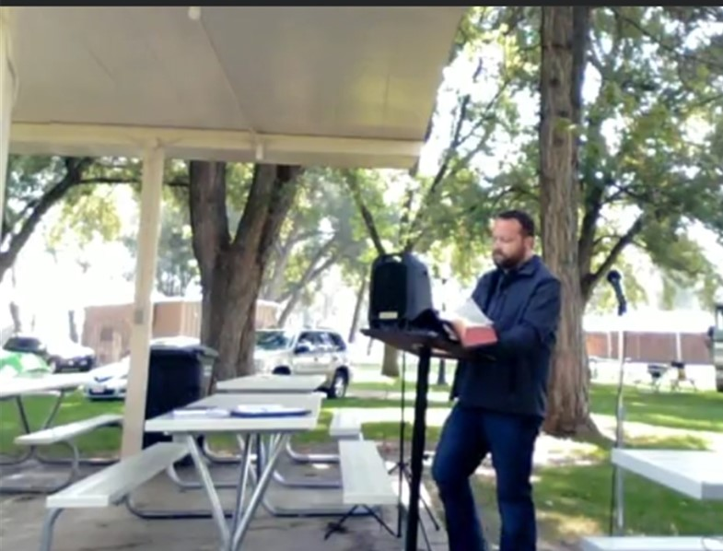
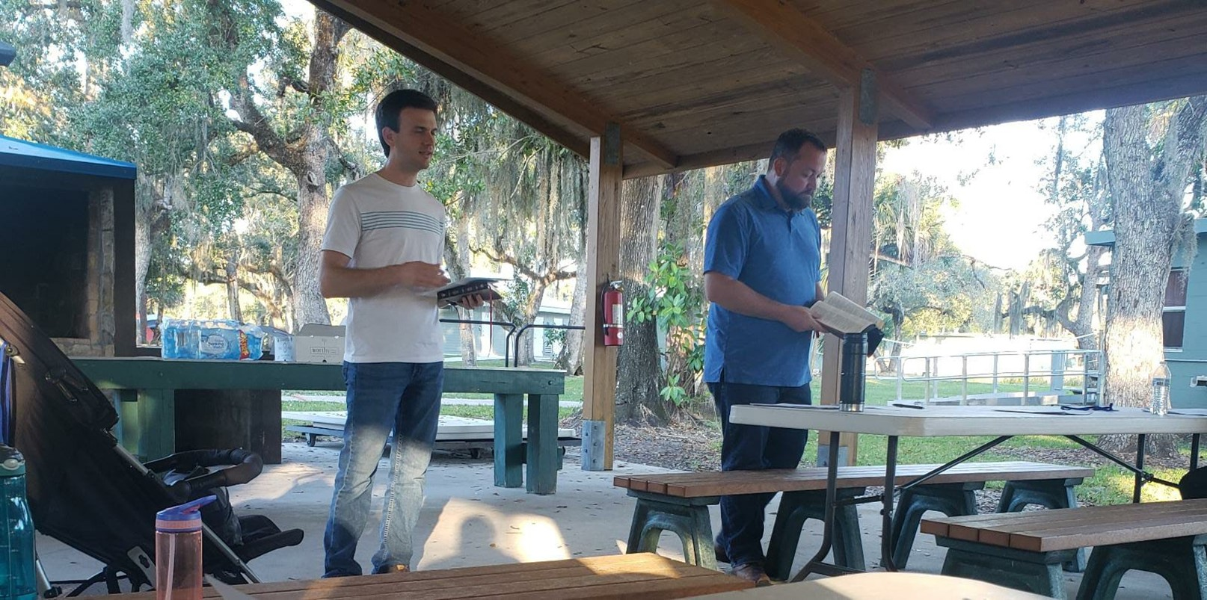
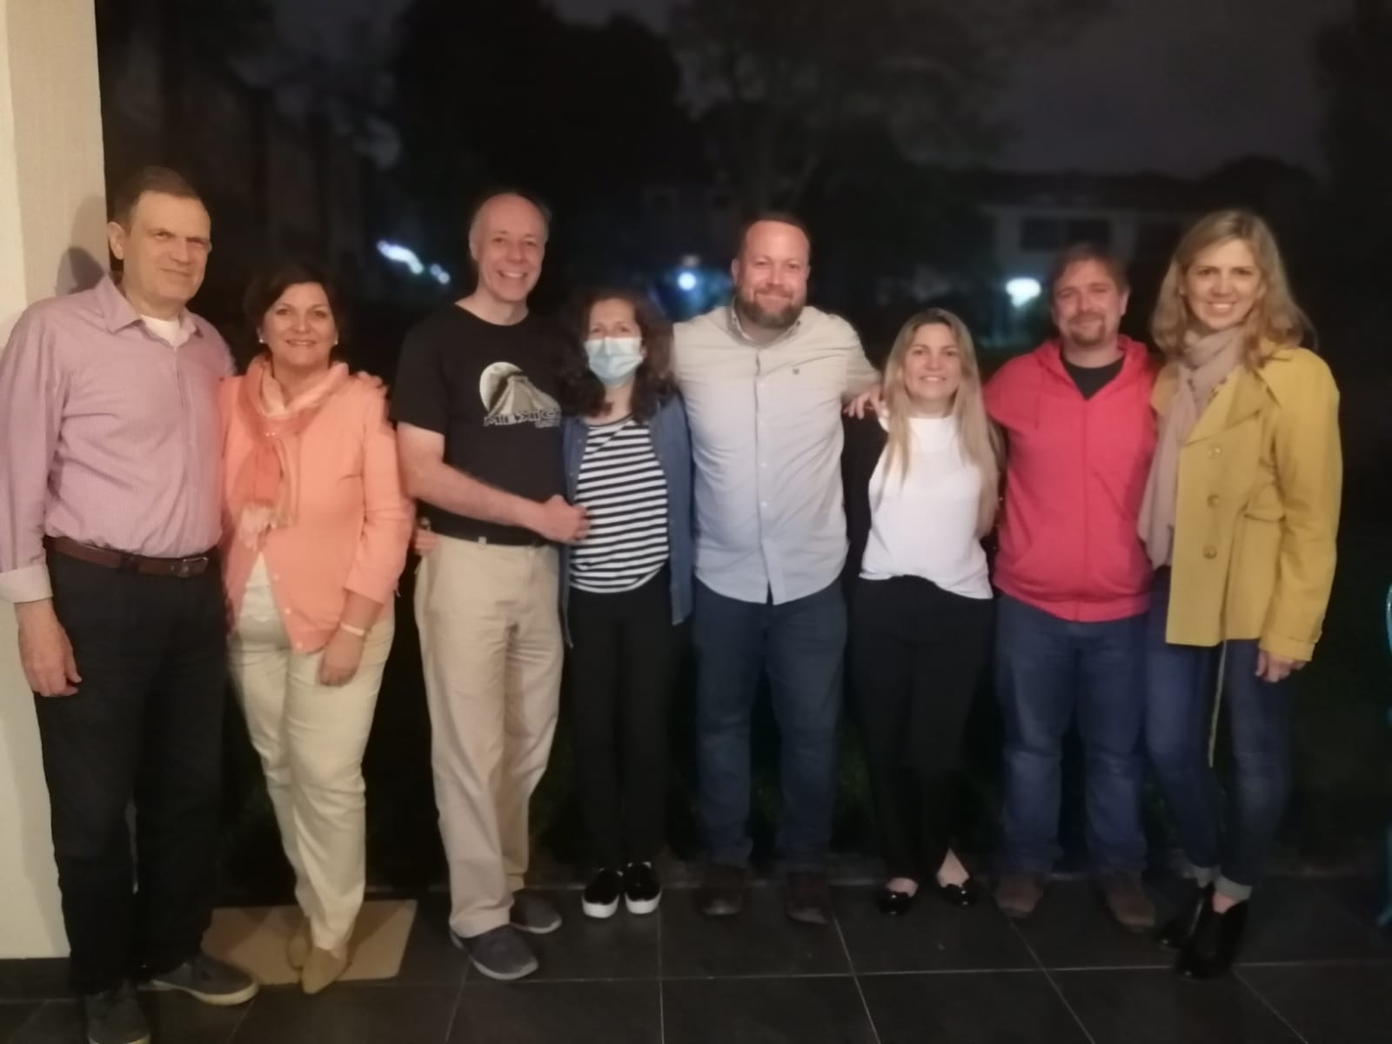
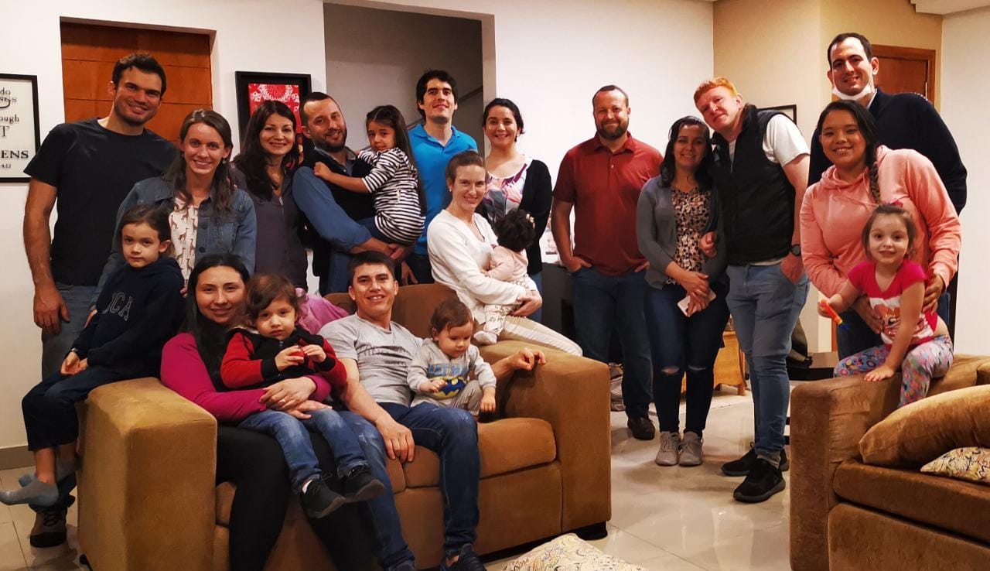
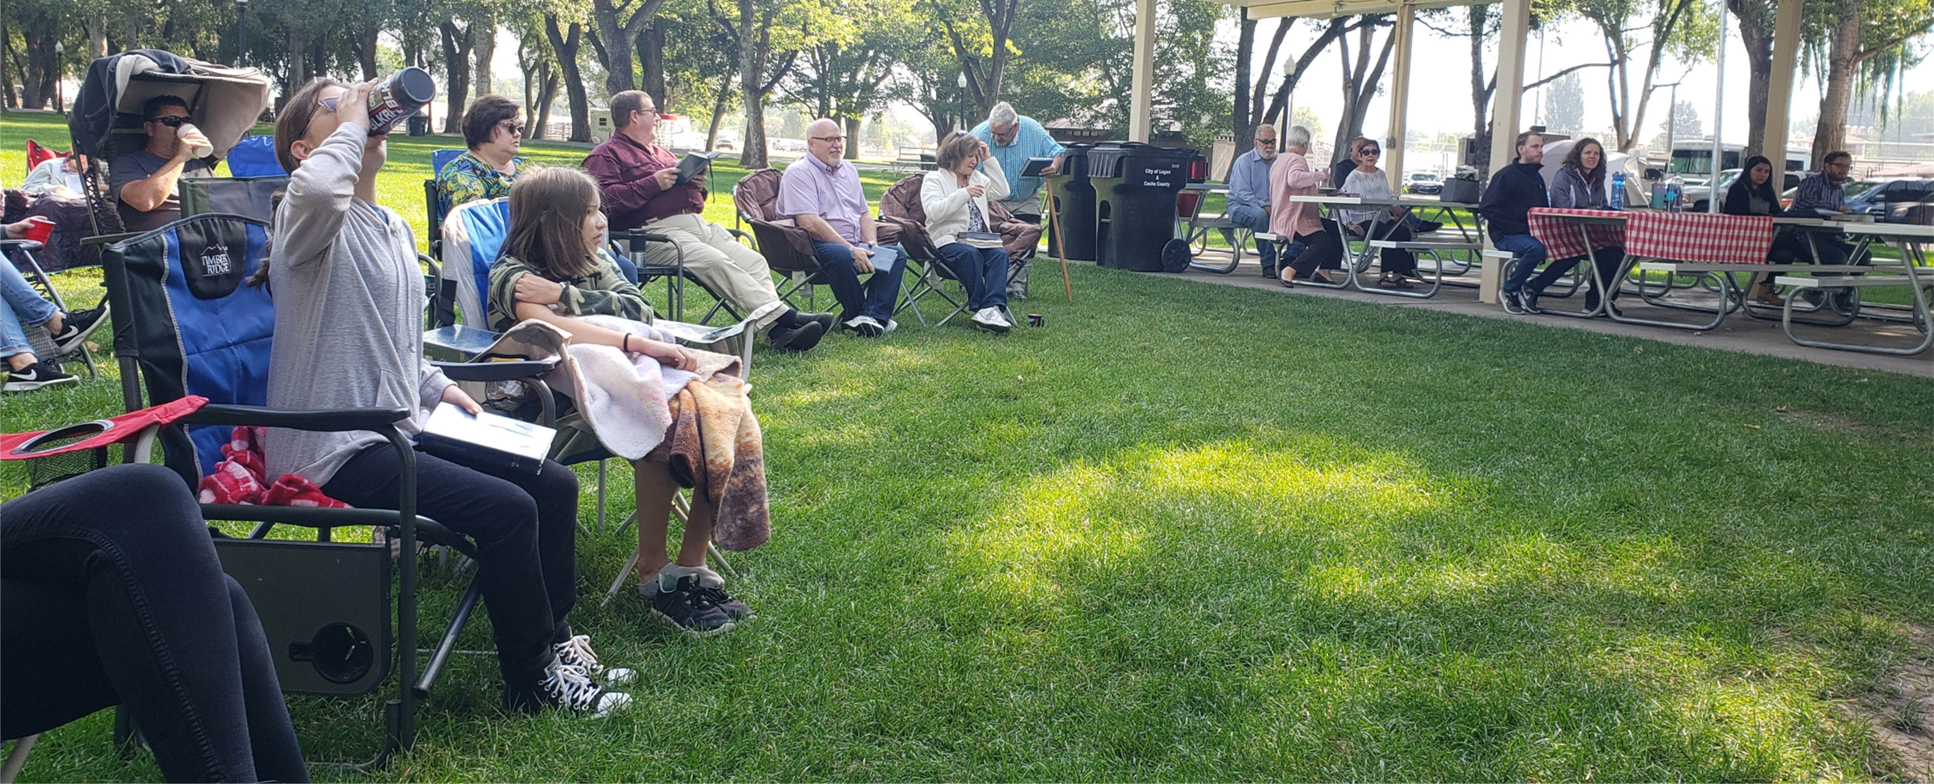
Beginning of Palm Beach Lakes World Missions in 2021
This is a growing effort, designed to evangelize, edify and equip congregations of the Lord’s church in various places

Slide 13
Mission Sunday ought to be a MAJOR highlight of OUR year:
We are reminded of the great treasure of the gospel
We are reminded that we are merely earthen vessels, jars of clay
We are reminded that God has given us a great task and the power is in HIM and HIS WORD to accomplish the task – BUT WE MUST WORK!

Slide 14
Believe Jesus is God’s Son – John 8:24
Repent of your sins and turn to God – Luke 13:3
Confess your faith in Jesus Christ – Matthew 10:32-33
Be immersed into Christ – John 3:5
God will forgive all of your sins – Acts 2:38
God will add you to His church – Acts 2:47
God will enroll you in heaven – Hebrews 12:23
Work faithfully for Him – 1 Corinthians 15:58

