Slide 2
Soldiers of Christ is a Bible study program that is DESIGNED TO BUILD AND STRENGTHEN FAITH
Without FAITH, it is impossible to PLEASE God – Heb. 11:7
FAITH is essential in order to obtain ETERNAL LIFE – John 3:16
We are SAVED by FAITH – Eph. 2:8; Acts 16:31
We must LIVE by FAITH – Gal. 2:20
The VICTORY that overcomes the world is our FAITH – 1 John 5:4
FAITH comes by hearing GOD’S WORD – Rom. 10:17
Thus, we must INCREASE our FAITH – Luke 17:5

Slide 3
The New Testament study of THE LIFE OF CHRIST will help you:
LEARN about JESUS
LOVE Jesus
IMITATE Jesus
FOLLOW Jesus
LONG to be WITH Jesus

Slide 4
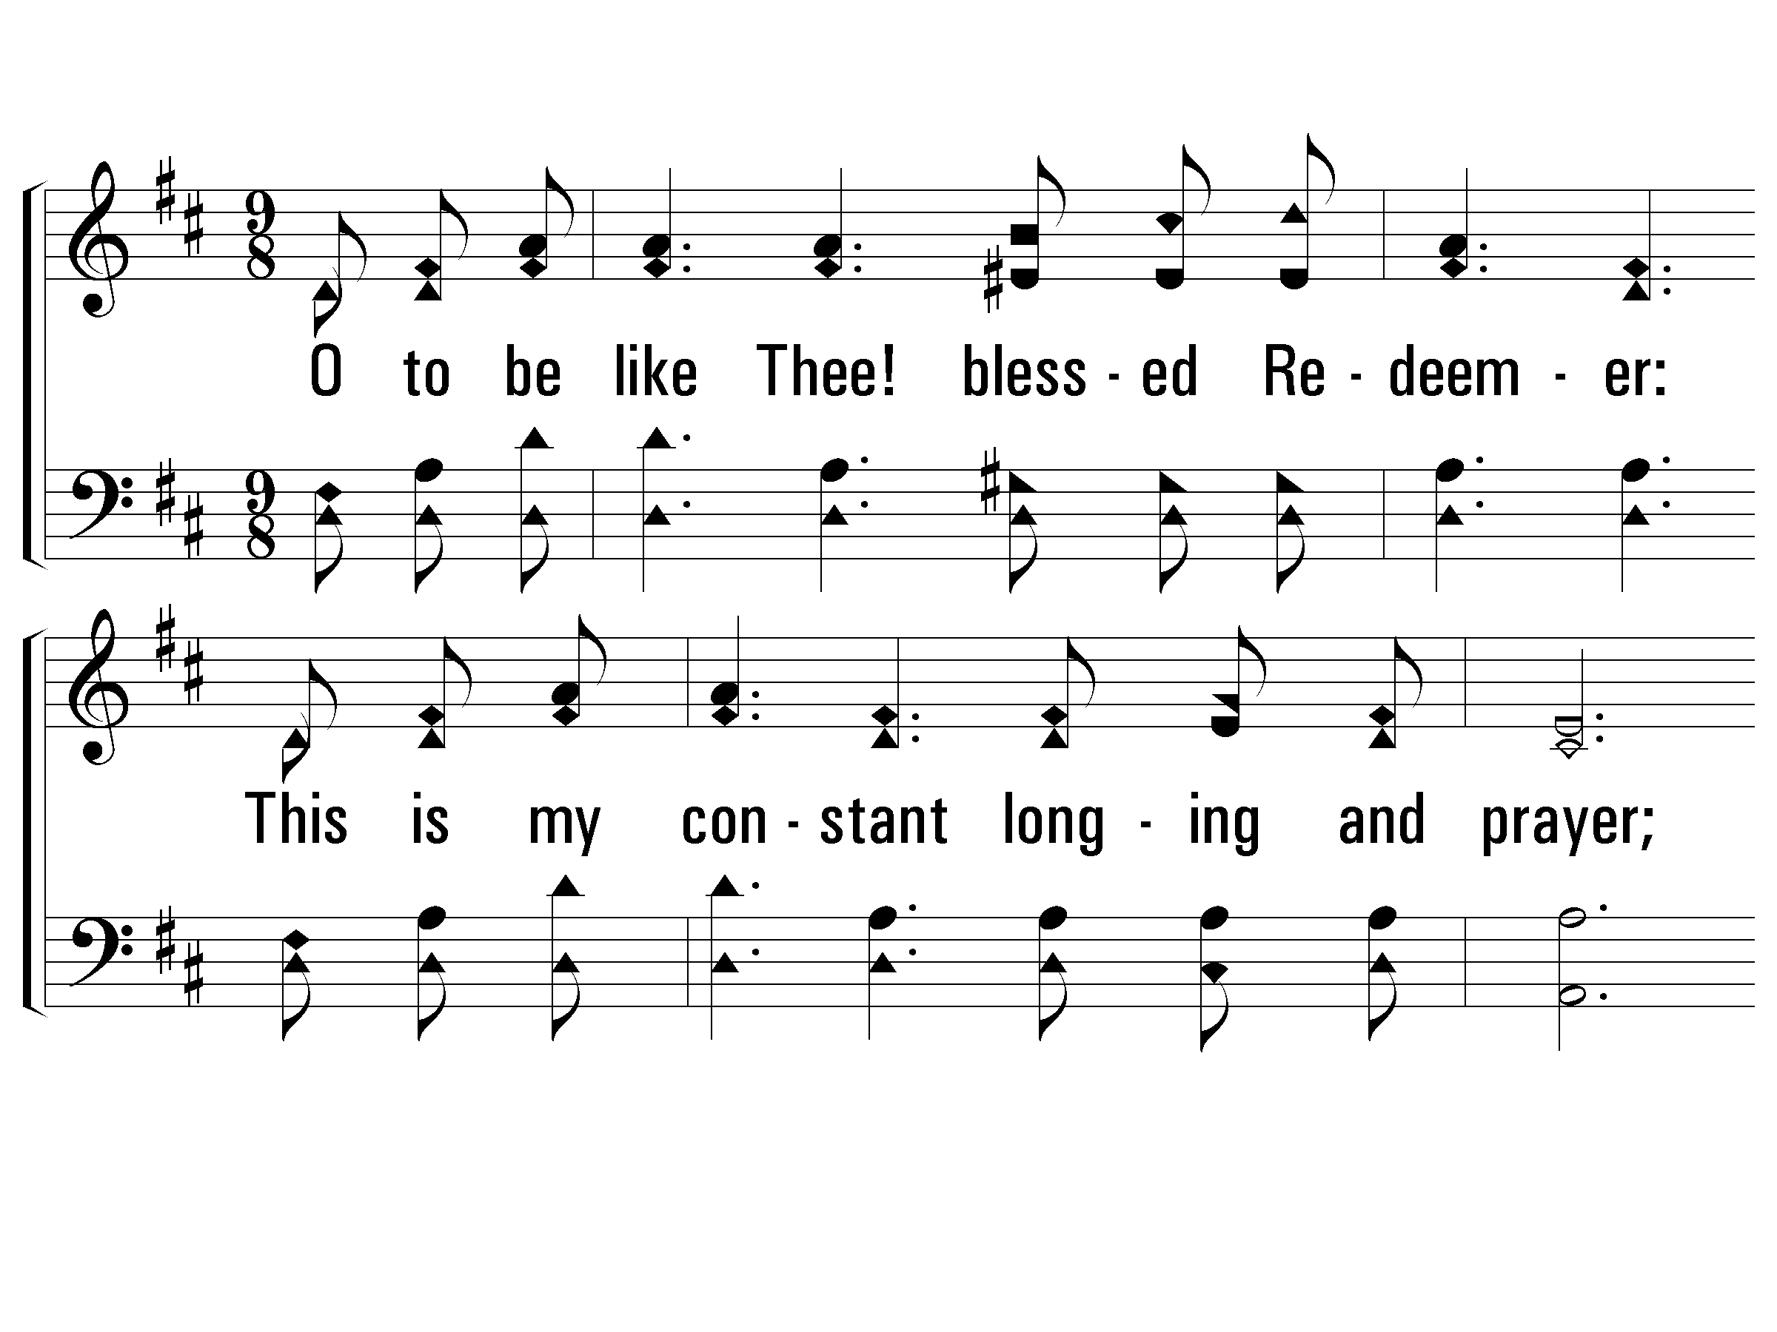
Verse 1
#499 – O to Be Like Thee!
1.
O to be like Thee! blessed Redeemer:
This is my constant longing and prayer;
Gladly I'll forfeit all of earth's treasures,
Jesus, Thy perfect likeness to wear.

Slide 5
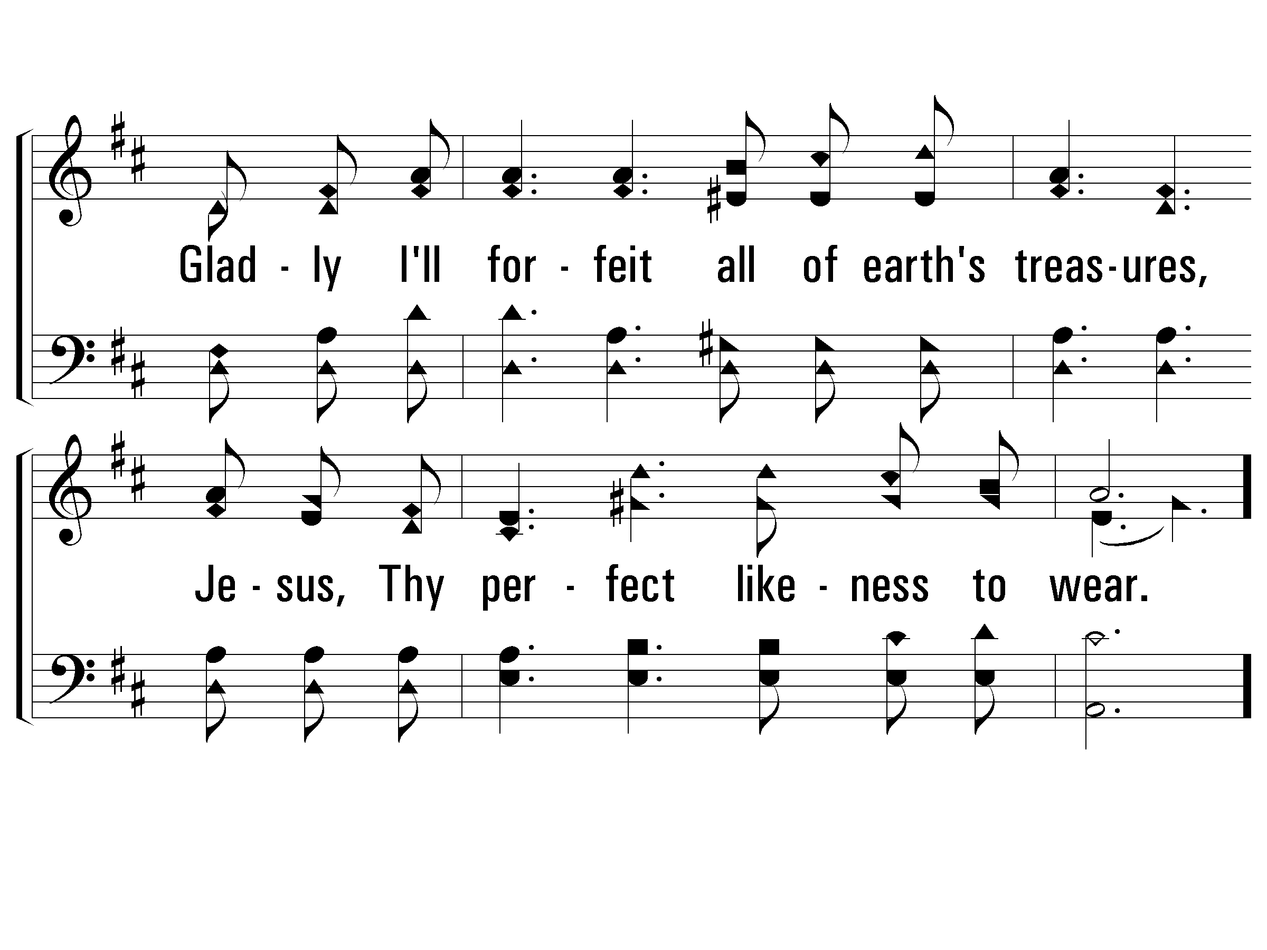
Verse 1
#499 – O to Be Like Thee!

Slide 6
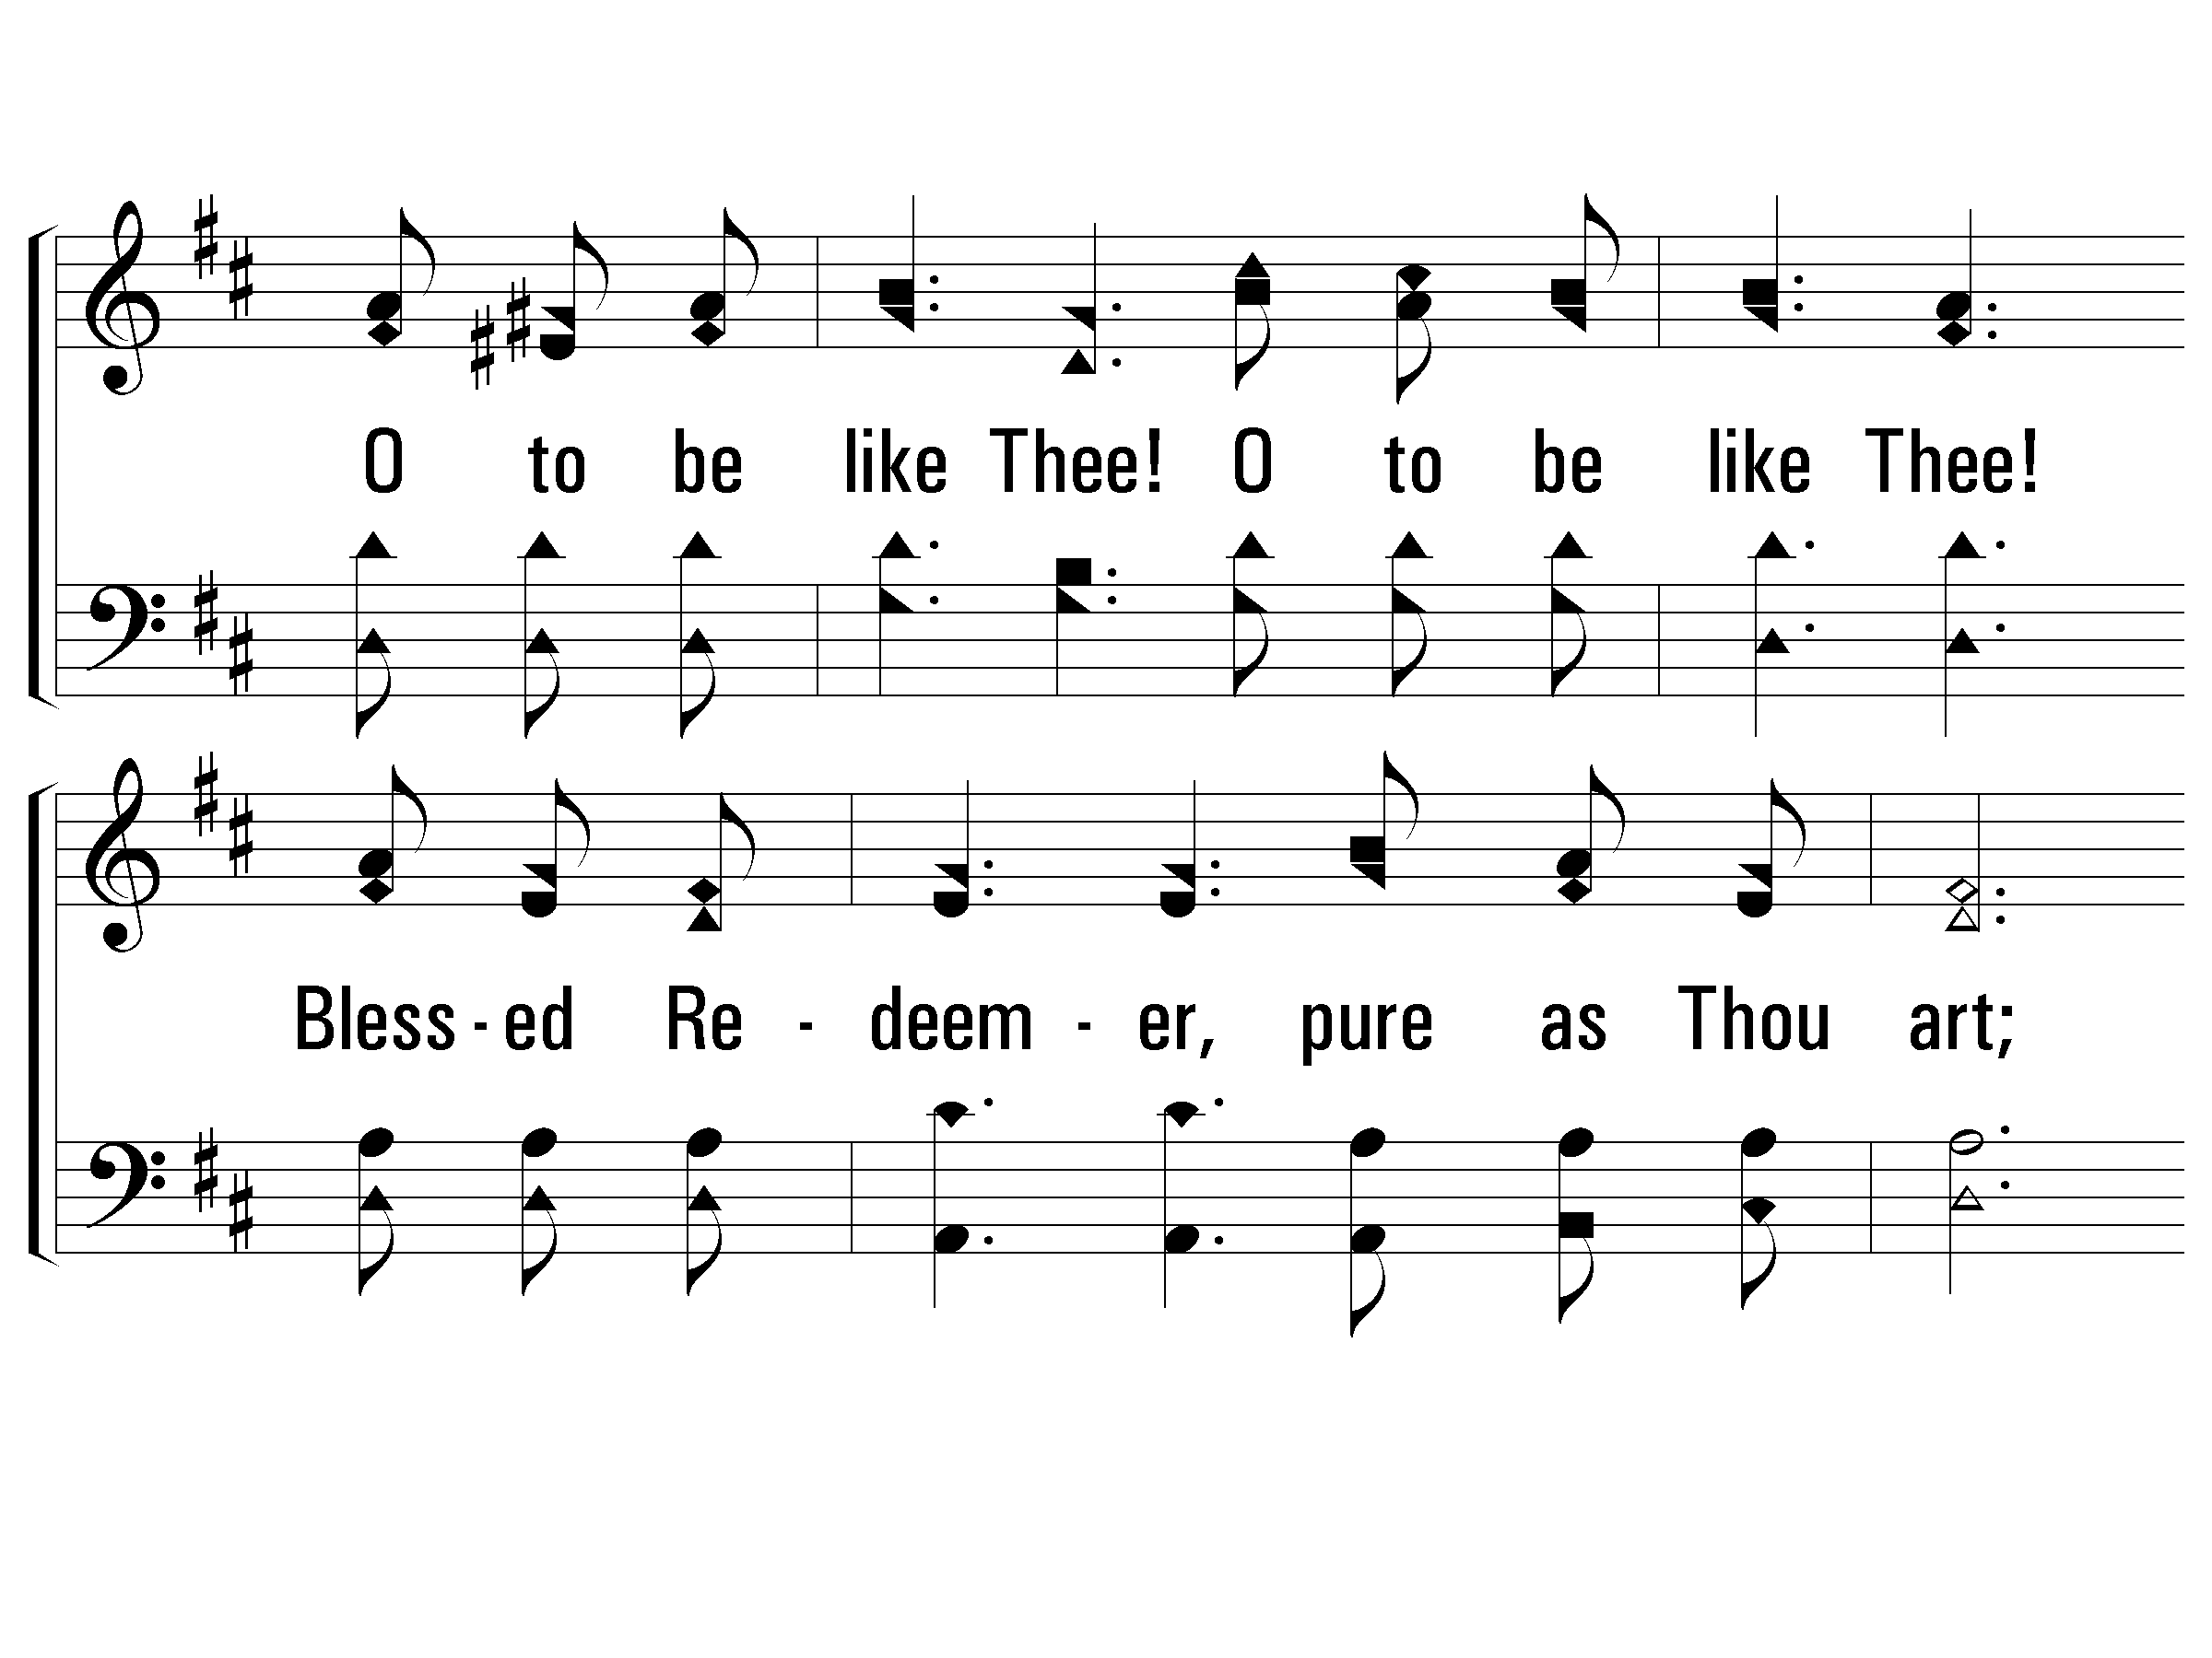
Chorus
#499 – O to Be Like Thee!
O to be like Thee!
O to be like Thee!
Blessed Redeemer, pure as Thou art;
Come in Thy sweetness, come in Thy fullness;
Stamp Thine own image deep on my heart.

Slide 7
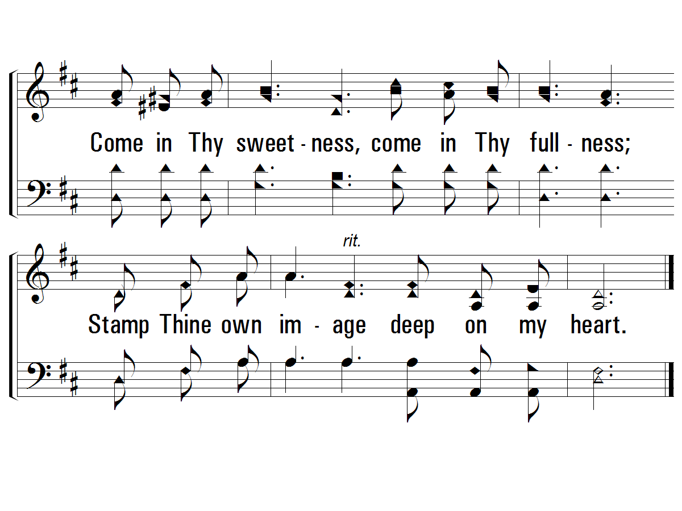
Chorus
#499 – O to Be Like Thee!

Slide 8
Every soldier of Christ needs a “Field Manual”
The “Field Manual” is an easy-access, convenient-size handbook
The “Field Manual” is designed to make learning easier
The Soldier of Christ needs his/her “Field Manual” EVERY Sunday night (bring it!)
Four Key Areas of Learning on each “Field Manual Card”
Key Bible Facts
Key Bible Chapters
Key Bible Locations
Key Memory Verses
Three Levels of Questions (different cards for each level)
Prophet (typically the easiest set of questions…shaded questions for young children)
Priest (typically a mid‐range set of questions)
King (typically the toughest set of questions)
Challenge yourself!

Slide 9
Written in QUESTION…ANSWER format
Bible references are provided as foundation for further study
Bible references are not deemed necessary to “get credit for the right answer”
The “Reference Card” is a summary of the Key Chapters, Key Locations and Memory Verses
There are Online Quizzes (PBLCOC website > Bible Study > Soldiers of Christ)
Quizzes for the Life of Christ will be added soon
“Dear Soldier, This is for your own personal growth, and your results will remain anonymous. You may take the quizzes in any order and as many times as you want or need.”
Challenge yourself!
Challenge family members!
Challenge each other!

Slide 10
Study the historical part of Jesus’ life through approx. 2nd year of His ministry
An overview of His life from birth until about the sending out of the twelve
Study the Miracles of Jesus
Study the Parables of Jesus
Study the historical part of Jesus’ life up until His last week
Study the Teachings of Jesus
Study the Final Week of the Life of Jesus
AFTER that…
Study the Book of Acts
Study the Epistles through Revelation
This will take several years! And it will be life-changing studies!

Slide 11
Overview of the Bible
Prophet
Greatest Book in the World
The Bible
Prophet
Two Main Parts of the Bible
Old Testament & New Testament
Prophet
Number of Books in the Bible
66
Prophet
Number of Books in the Old Testament
39
Prophet
Number of Books in the New Testament
27
Prophet
Number of Writers of Bible Books
About 40 Men
Prophet
Years of Writing the Bible
About 1,600
Prophet
Theme of the Bible
Jesus Christ
Three
-
Sentence Summary of the Bible
Someone is coming
Priest
.
Someone
is here
.
Someone
is coming again.
Priest
Three Dispensations of the Bible
Patriarchal (~2500 years
),
Mosaic
(~1500 years),
Christian
(~2000 years)
Priest
When OT Ended & NT Began
When Jesus Died on the Cross
(
Col. 2:14; Heb. 9:16
-
17)

Slide 12
Life of Christ: Up to His Last Week
Prophet
Name the Four Accounts of the Gospel
Matthew, Mark, Luke, John
Prophet
"Gospel" Means
Good News
Prophet
The Four Accounts of the Gospel
Tell
About
The Life of Jesus Christ

Slide 13
Overview of the Bible
Prophet | Greatest Book in the World | The Bible
Prophet | Two Main Parts of the Bible | Old Testament & New Testament
Prophet | Number of Books in the Bible | 66
Prophet | Number of Books in the Old Testament | 39
Prophet | Number of Books in the New Testament | 27
Prophet | Number of Writers of Bible Books | About 40 Men
Prophet | Years of Writing the Bible | About 1,600
Prophet | Theme of the Bible | Jesus Christ
Priest | Three-Sentence Summary of the Bible | Someone is coming. Someone is here. Someone is coming again.
Priest | Three Dispensations of the Bible | Patriarchal (~2500 years), Mosaic (~1500 years), Christian (~2000 years)
Priest | When OT Ended & NT Began | When Jesus Died on the Cross (Col. 2:14; Heb. 9:16-17)

Slide 14
Life of Christ: Up to His Last Week
Prophet | Name the Four Accounts of the Gospel | Matthew, Mark, Luke, John
Prophet | "Gospel" Means | Good News
Prophet | The Four Accounts of the Gospel Tell About | The Life of Jesus Christ

