Slide 1
Survey of Genesis
Lesson Eight
Palm Beach Lakes
September-November 2021

Slide 2
Who Could Have Known Adam?
130
235
325
395
460
612
677
864
930
Flood
Creation
ADAM---------------------------------------------------------- 930 YEARS
SETH---------------------------------------------------------- 912 YEARS
ENOSH------------------------------------------------------ 905 YEARS
CAINAN----------------------------------------------------- 919 YEARS
MAHALAEL------------------------------------------------ 895 YEARS
JARED-----------------------------------------------------------962 YEARS
ENOCH-365 YEARS
Nine Generations from Adam to Noah’s Father
METHUSALAH---------------------------------------------------969 YEARS
LAMECH-------------------------------------777 YEARS

Slide 3
Who Could Have Known Adam?
130
235
325
395
460
612
677
864
930
Flood
Creation
ADAM---------------------------------------------------------- 930 YEARS
SETH---------------------------------------------------------- 912 YEARS
ENOSH------------------------------------------------------ 905 YEARS
CAINAN----------------------------------------------------- 919 YEARS
MAHALAEL------------------------------------------------ 895 YEARS
JARED-----------------------------------------------------------962 YEARS
ENOCH-365 YEARS
METHUSALAH---------------------------------------------------969 YEARS
LAMECH-------------------------------------777 YEARS
NOAH ------------- 600 YEARS to FLOOD

Slide 4
Who Could Noah Have Known?
130
235
325
395
460
612
677
864
930
Flood
Creation
ADAM-----------------------------------930YEARS
SETH----------------------------------912 YEARS
ENOSH-----------------------------------905 YEARS
84 years
CAINAN-----------------------------------919 YEARS
179 years
MAHALAEL-----------------------------------895 YEARS
234 years
JARED-----------------------------------962 YEARS
366 years
ENOCH--365 YEARS
0 years
METHUSALAH----------------------------969 YEARS
600 years
595 years
LAMECH-------------------------777 YEARS
NOAH COULD
HAVE KNOWN
NOAH ---------------600 YEARS to Flood

Slide 5
Who Could Noah Have Known?
100
200
300
400
500
Flood
Isaac
NOAH--------------------------------------------------------350 YEARS AFTER FLOOD

Slide 6
Who Could Have Known Noah?
100
200
300
400
500
Flood
Isaac
NOAH--------------------------------------------------------350 YEARS AFTER FLOOD
SHEM--------------------------------------------------------------------------------------------------498 YEARS AFTER FLOOD
ARPHAXAD------------------------------------------------------------------------------------------------438 YEARS
SALAH-----------------------------------------------------------------------------------------------------433 YEARS
EBER-------------------------------------------------------------------------------------------------------------464 YEARS
PELEG-----------------------------------------239 YEARS
Every Generation from Noah to Abraham
REU--------------------------------------------239 YEARS
SERUG----------148 YEARS
NAHOR--------------------------------205 YEARS
TERAH---------------------------------205 YEARS
ABRAHAM-----------------175 YEARS

Slide 7
Who Could Have Known Noah?
100
200
300
400
500
Flood
Isaac
NOAH--------------------------------------------------------350 YEARS AFTER FLOOD
SHEM--------------------------------------------------------------------------------------------------498 YEARS AFTER FLOOD
ARPHAXAD------------------------------------------------------------------------------------------------438 YEARS
SALAH-----------------------------------------------------------------------------------------------------433 YEARS
EBER-------------------------------------------------------------------------------------------------------------464 YEARS
PELEG-----------------------------------------239 YEARS
Abraham Could have know Noah for 58 yrs. Shem for all his life
REU--------------------------------------------239 YEARS
SERUG----------148 YEARS
NAHOR--------------------------------205 YEARS
TERAH---------------------------------205 YEARS
ABRAHAM-----------------175 YEARS

Slide 8
Genesis—Chapter Twelve
Abraham is the central figure of the Old Testament

Slide 9
Genesis—Chapter Twelve
Abraham is the central figure of the Old Testament
Mentioned 312 in Bible (in 17 O.T. books and 11 N.T. books)

Slide 10
Genesis—Chapter Twelve
Abraham is the central figure of the Old Testament
Mentioned 312 in Bible (in 17 O.T. books and 11 N.T. books)
The Threefold Promise made to Abraham, Isaac and Jacob

Slide 11
Genesis—Chapter Twelve
Abraham is the central figure of the Old Testament
Mentioned 312 in Bible (in 17 O.T. books and 11 N.T. books)
The Threefold Promise made to Abraham, Isaac and Jacob
Promise to Abraham (12:3-4; 18:18; 22:17-18); to Isaac (26:4); and Jacob (28:14)

Slide 12
Genesis—Chapter Twelve
Abraham is the central figure of the Old Testament
Mentioned 312 in Bible (in 17 O.T. books and 11 N.T. books)
The Threefold Promise made to Abraham, Isaac and Jacob
Promise to Abraham (12:3-4; 18:18; 22:17-18); to Isaac (26:4); and Jacob (28:14)
1. A GREAT nation
2. In a GREAT land
3. A GREAT seed to bless all nations (seed=Jesus, Gal. 3:16)

Slide 13
Overview of the Life of Abram/Abraham

Slide 14
Overview of the Life of Abram/Abraham
Abraham, His call to leave Ur, Threefold Promises, Haran

Slide 15
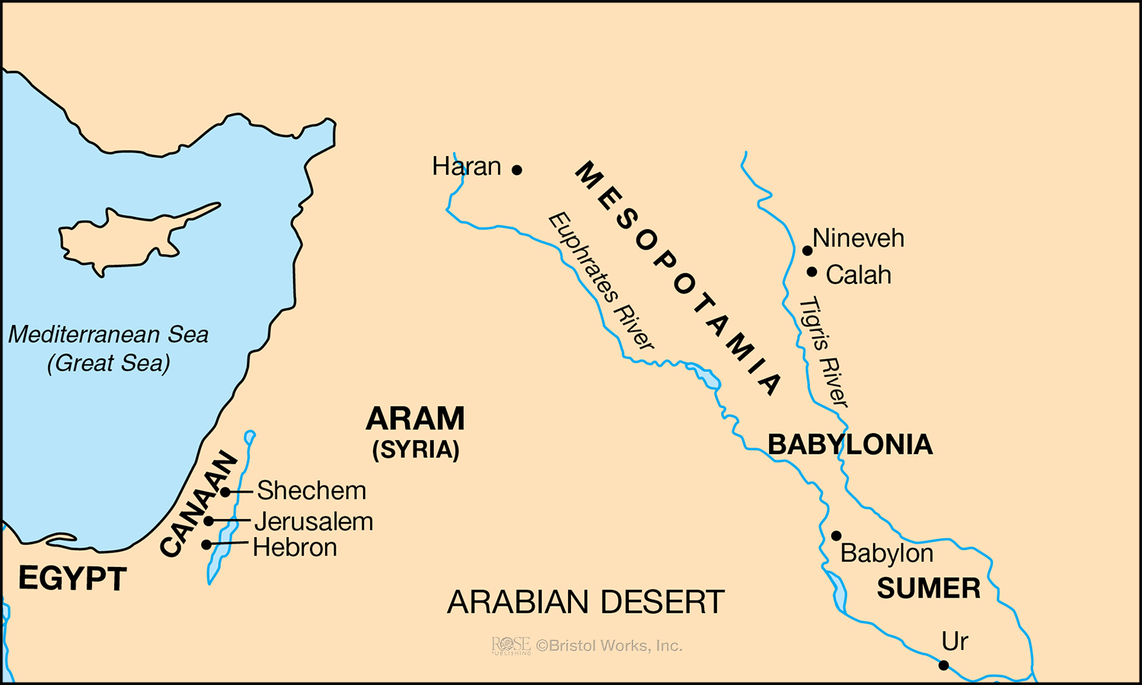
Who Could Have Known Noah/Shem
Journey of Abraham—From Ur to Haran
Genesis—Chapter Twelve
400
500
Ur
100
200
300
Flood
Haran
Abraham is the central figure of the Old Testament
Mentioned 312 in Bible (in 17 O.T. books and 11 N.T. books)
NOAH—350 YEARS AFTER FLOOD
SHEM—500 YEARS A.F.
ARPHAXAD-----------------------------------438 YEARS
SALAH-----------------------------------433 YEARS
The God of glory appeared to our father Abraham when he was in Mesopotamia, before he dwelt in Haran, and said, “Get out of your country and from your relatives, and come to a land that I will show you” Acts 7:2-3
EBER-----------------------------------464 YEARS
30
PELEG------------------------239 YEARS
REU--239 YEARS
SERUG--------148 YEARS
NAHOR-------------------205 YEARS
TERAH-------------------205 YEARS
ABRAHAM----------175 YEARS
Ur

Slide 16
Overview of the Life of Abram/Abraham
Abraham, His call to leave Ur, Threefold Promises, Haran
Sojourn in Promised Land, boundary of Promised Land

Slide 17
Who Could Have Known Noah/Shem
Journey of Abraham—From Ur to Canaan
Genesis—Chapter Twelve
400
500
Ur
100
200
300
Flood
Haran
Abraham is the central figure of the Old Testament
Mentioned 312 in Bible (in 17 O.T. books and 11 N.T. books)
NOAH—350 YEARS AFTER FLOOD
SHEM—500 YEARS A.F.
ARPHAXAD-----------------------------------438 YEARS
SALAH-----------------------------------433 YEARS
EBER-----------------------------------464 YEARS
30
PELEG------------------------239 YEARS
REU--239 YEARS
SERUG--------148 YEARS
NAHOR-------------------205 YEARS
TERAH-------------------205 YEARS
ABRAHAM----------175 YEARS
Ur

Slide 18
Overview of the Life of Abram/Abraham
Abraham, His call to leave Ur, Threefold Promises, Haran
Sojourn in Promised Land, boundary of Promised Land
18 On the same day the LORD made a covenant with Abram, saying: "To your descendants I have given this land, from the river of Egypt to the great river, the River Euphrates—
19 the Kenites, the Kenezzites, the Kadmonites,
20 the Hittites, the Perizzites, the Rephaim,
21 the Amorites, the Canaanites, the Girgashites, and the Jebusites." Gen. 20:18-21

Slide 19
Who Could Have Known Noah/Shem
Journey of Abraham—From Ur to Canaan
Genesis—Chapter Twelve
400
500
Ur
100
200
300
Flood
Haran
Abraham is the central figure of the Old Testament
Mentioned 312 in Bible (in 17 O.T. books and 11 N.T. books)
NOAH—350 YEARS AFTER FLOOD
SHEM—500 YEARS A.F.
ARPHAXAD-----------------------------------438 YEARS
SALAH-----------------------------------433 YEARS
EBER-----------------------------------464 YEARS
30
PELEG------------------------239 YEARS
REU--239 YEARS
SERUG--------148 YEARS
NAHOR-------------------205 YEARS
TERAH-------------------205 YEARS
ABRAHAM----------175 YEARS
Ur

Slide 20
Overview of the Life of Abram/Abraham
Abraham, His call to leave Ur, Threefold Promises, Haran
Sojourn in Promised Land, boundary of the Promised Land
Famine and the trip to Egypt, trouble with Pharoah (Gen. 12)

Slide 21
Overview of the Life of Abram/Abraham
Abraham, His call to leave Ur, Threefold Promises, Haran
Sojourn in Promised Land, boundary of the Promised Land
Famine and the trip to Egypt, trouble with Pharoah (Gen. 12)
Rescue of Lot, meeting Melchizedek (Gen. 14)

Slide 22
Overview of the Life of Abram/Abraham
Abraham, His call to leave Ur, Threefold Promises, Haran
Sojourn in Promised Land, boundary of the Promised Land
Famine and the trip to Egypt, trouble with Pharoah (Gen. 12)
Rescue of Lot, meeting Melchizedek (Gen. 14)
Birth of Ishmael by Hagar (Gen. 16)

Slide 23
Overview of the Life of Abram/Abraham
Abraham, His call to leave Ur, Threefold Promises, Haran
Sojourn in Promised Land, boundary of the Promised Land
Famine and the trip to Egypt, trouble with Pharoah (Gen. 12)
Rescue of Lot, meeting Melchizedek (Gen. 14)
Birth of Ishmael by Hagar (Gen. 16)
Circumcision and Promise of Isaac (laughter) (Gen. 17)

Slide 24
Overview of the Life of Abram/Abraham
Abraham, His call to leave Ur, Threefold Promises, Haran
Sojourn in Promised Land, boundary of the Promised Land
Famine and the trip to Egypt, trouble with Pharoah (Gen. 12)
Rescue of Lot, meeting Melchizedek (Gen. 14)
Birth of Ishmael by Hagar (Gen. 16)
Circumcision and Promise of Isaac (laughter) (Gen. 17)
Judgment against sinful Sodom

Slide 25
Overview of the Life of Abram/Abraham
Abraham, His call to leave Ur, Threefold Promises, Haran
Sojourn in Promised Land, boundary of the Promised Land
Famine and the trip to Egypt, trouble with Pharoah (Gen. 12)
Rescue of Lot, meeting Melchizedek (Gen. 14)
Birth of Ishmael by Hagar (Gen. 16)
Circumcision and Promise of Isaac (laughter) (Gen. 17)
Judgment against sinful Sodom
Birth of Isaac

Slide 26
Who Could Have Known Noah/Shem
400
500
Ur
100
200
300
Flood
NOAH—350 YEARS AFTER FLOOD
SHEM—500 YEARS A.F.
ARPHAXAD-----------------------------------438 YEARS
SALAH-----------------------------------433 YEARS
EBER-----------------------------------464 YEARS
PELEG------------------------239 YEARS
REU--239 YEARS
SERUG--------148 YEARS
NAHOR-------------------205 YEARS
TERAH-------------------205 YEARS
ABRAHAM----------175 YEARS
ISAAC---------180 YEARS

