Slide 1
Survey of Genesis Lesson Seven Palm Beach Lakes
September-November 2021

Slide 2
Wrong Teachings in Chapter Nine
Chapter Nine discusses the curse of Canaan, not the curse of Ham
I focused on Bible maps and not on the text
Some descendants of Ham settled in Africa: Israelites in bondage in land of Ham (Psa. 78:51; 105:23, 27; 106:22)
The Hebrew word kush is translated Ethiopia 20 times in O.T.
However, the concept of curse on all descendants of Ham is not Biblical, the curse was on Canaan. I was wrong in what I taught.
The Bible shows the fulfilment on curse of Canaan in that the his descendants (10:15-18) were the Canaanite nations subjugated by the Jews, the descendants of Shem (Israel) in days of Joshua. Canaan’s sons served Shem’s sons. This is the curse of Canaan.

Slide 3
Who Could Have Known Adam?
130
235
325
395
460
612
677
864
930
Flood
Creation
ADAM---------------------------------------------------------- 930 YEARS
SETH---------------------------------------------------------- 912 YEARS
ENOSH------------------------------------------------------ 905 YEARS
CAINAN----------------------------------------------------- 919 YEARS
MAHALAEL------------------------------------------------ 895 YEARS
JARED-----------------------------------------------------------962 YEARS
ENOCH-365 YEARS
METHUSALAH---------------------------------------------------969 YEARS
LAMECH-------------------------------------777 YEARS

Slide 4
Who Could Have Known Adam?
130
235
325
395
460
612
677
864
930
Flood
Creation
ADAM---------------------------------------------------------- 930 YEARS
SETH---------------------------------------------------------- 912 YEARS
ENOSH------------------------------------------------------ 905 YEARS
CAINAN----------------------------------------------------- 919 YEARS
MAHALAEL------------------------------------------------ 895 YEARS
JARED-----------------------------------------------------------962 YEARS
ENOCH-365 YEARS
METHUSALAH---------------------------------------------------969 YEARS
LAMECH-------------------------------------777 YEARS
NOAH ------------- 600 YEARS to FLOOD

Slide 5
Who Could Noah Have Known?
130
235
325
395
460
612
677
864
930
Flood
Creation
ADAM-----------------------------------930YEARS
SETH----------------------------------912 YEARS
ENOSH-----------------------------------905 YEARS
84 years
CAINAN-----------------------------------919 YEARS
179 years
MAHALAEL-----------------------------------895 YEARS
234 years
JARED-----------------------------------962 YEARS
366 years
ENOCH--365 YEARS
0 years
METHUSALAH----------------------------969 YEARS
600 years
595 years
LAMECH-------------------------777 YEARS
NOAH COULD
HAVE KNOWN
NOAH ---------------600 YEARS to Flood

Slide 6
Genesis—Chapters Ten/Eleven
Chapter Ten shows descendants of Noah and the beginning of nations
Chapter Eleven shows tower of Babel and the beginning of language here

Slide 7
Genesis—Chapter Eleven
The Tower of Babel divided people into nations (10:5,31-32)
God’s command before the tower
And God blessed Noah and his sons, and said unto them, “Be fruitful, and multiply, and replenish the earth.” Gen. 9:1
The tower was not built to reach God’s heaven (cf. Deut. 1:28)
The reason was to keep from being scattered
And they said, "Come, let us build ourselves a city, and a tower whose top is in the heavens; let us make a name for ourselves, lest we be scattered abroad over the earth.” Gen. 11:4

Slide 8
Who Could Noah Have Known?
100
200
300
400
500
Flood
Isaac
NOAH--------------------------------------------------------350 YEARS AFTER FLOOD

Slide 9
Who Could Noah Have Known?
100
200
300
400
500
Flood
Isaac
NOAH--------------------------------------------------------350 YEARS AFTER FLOOD
SHEM--------------------------------------------------------------------------------------------------498 YEARS AFTER FLOOD
ARPHAXAD------------------------------------------------------------------------------------------------438 YEARS
SALAH-----------------------------------------------------------------------------------------------------433 YEARS
EBER-------------------------------------------------------------------------------------------------------------464 YEARS
PELEG-----------------------------------------239 YEARS
REU--------------------------------------------239 YEARS
SERUG----------148 YEARS
NAHOR--------------------------------205 YEARS
TERAH---------------------------------205 YEARS
ABRAHAM-----------------175 YEARS

Slide 10
Genesis—Chapter Twelve
Abraham is the central figure of the Old Testament
Mentioned 312 in Bible (in 17 O.T. books and 11 N.T. books)
The Threefold Promise made to Abraham, Isaac and Jacob
- To Abraham (12:3-4; 18:18; 22:17-18); Isaac (26:4); and Jacob (28:14)
- A GREAT nation
- In a GREAT land
- A GREAT seed to bless all nations (seed is Jesus, Gal. 3:16)
Overview of the Life of Abram/Abraham

Slide 11
Overview of the Life of Abram/Abraham
Abraham, His call to leave Ur, Threefold Promises, Haran
Sojourn in Promised Land
Famine and the trip to Egypt
Sodom, Lot, Melchizedek
Birth of Ishmael by Hagar
Birth of Isaac
Sacrifice of Isaac

Slide 12
Overview of the Life of Abram/Abraham
Abraham, His call to leave Ur, Threefold Promises, Haran

Slide 13
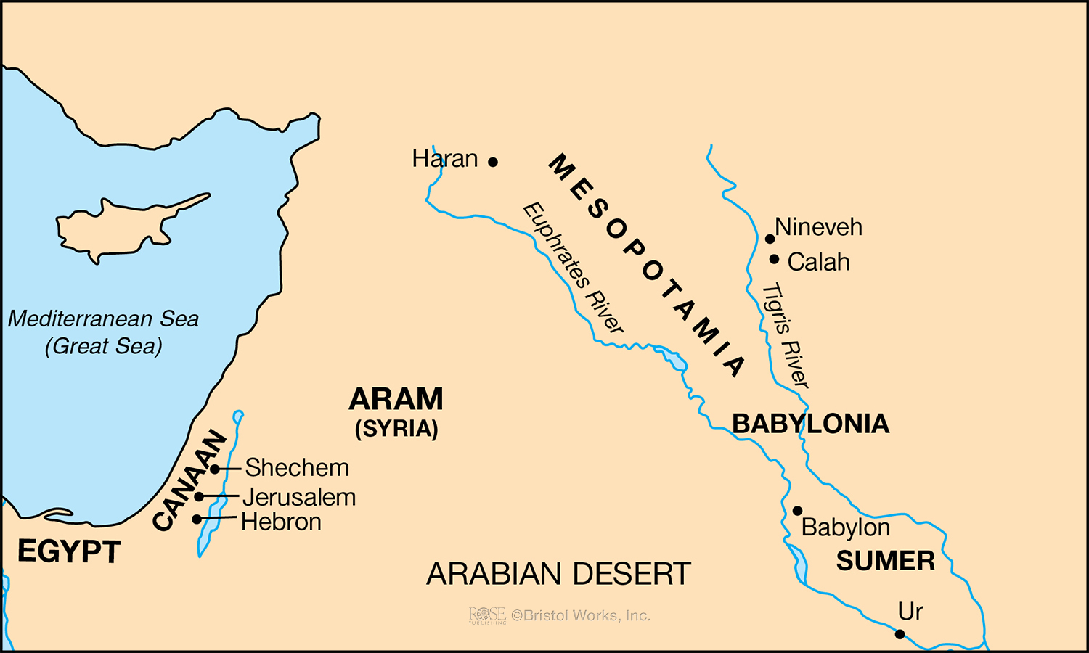
Who Could Have Known Noah/Shem
Journey of Abraham—From Ur to Haran
Genesis—Chapter Twelve
400
500
Ur
100
200
300
Flood
Haran
Abraham is the central figure of the Old Testament
Mentioned 312 in Bible (in 17 O.T. books and 11 N.T. books)
NOAH—350 YEARS AFTER FLOOD
SHEM—500 YEARS A.F.
ARPHAXAD-----------------------------------438 YEARS
SALAH-----------------------------------433 YEARS
The God of glory appeared to our father Abraham when he was in Mesopotamia, before he dwelt in Haran, and said, “Get out of your country and from your relatives, and come to a land that I will show you” Acts 7:2-3
EBER-----------------------------------464 YEARS
30
PELEG------------------------239 YEARS
REU--239 YEARS
SERUG--------148 YEARS
NAHOR-------------------205 YEARS
TERAH-------------------205 YEARS
ABRAHAM----------175 YEARS
Ur

Slide 14
Who Could Have Known Noah/Shem
Journey of Abraham—From Ur to Canaan
Genesis—Chapter Twelve
400
500
Ur
100
200
300
Flood
Haran
Abraham is the central figure of the Old Testament
Mentioned 312 in Bible (in 17 O.T. books and 11 N.T. books)
The God of glory appeared to our father Abraham when he was in Mesopotamia, before he dwelt in Haran, and said, “Get out of your country and from your relatives, and come to a land that I will show you” Acts 7:2-3
NOAH—350 YEARS AFTER FLOOD
SHEM—500 YEARS A.F.
ARPHAXAD-----------------------------------438 YEARS
SALAH-----------------------------------433 YEARS
EBER-----------------------------------464 YEARS
30
PELEG------------------------239 YEARS
REU--239 YEARS
SERUG--------148 YEARS
NAHOR-------------------205 YEARS
TERAH-------------------205 YEARS
ABRAHAM----------175 YEARS
Ur

Slide 15
Overview of the Life of Abram/Abraham
Abraham, His call to leave Ur, Threefold Promises, Haran
Sojourn in Promised Land
Famine and the trip to Egypt
Sodom, Lot, Melchizedek
Birth of Ishmael by Hagar
Birth of Isaac
Sacrifice of Isaac

Slide 16
Who Could Have Known Noah/Shem
400
500
Ur
100
200
300
Flood
NOAH—350 YEARS AFTER FLOOD
SHEM—500 YEARS A.F.
ARPHAXAD-----------------------------------438 YEARS
SALAH-----------------------------------433 YEARS
EBER-----------------------------------464 YEARS
30
PELEG------------------------239 YEARS
REU--239 YEARS
SERUG--------148 YEARS
NAHOR-------------------205 YEARS
TERAH-------------------205 YEARS
ABRAHAM----------175 YEARS
ISAAC---------180 YEARS

