Slide 2
I am living in “the time of trouble” (27:5)
There are “evildoers” who “come against me” (27:2)
There are “adversaries” who oppose me (27:2)
There is “an army” encamped “against me” (27:3)
There is a “war” raging “against me” (27:3)
There are “enemies all around me” (27:6)
There are “enemies” who obstruct my “path” (27:11)
There are “adversaries” who “desire” to harm me (27:12)
There are “false witnesses” rising “against me” to slander me (27:12)

Slide 3
It would be natural to “fear” (27:1)
It would be natural to “be afraid” (27:1)
However, “my heart shall not fear” (27:3)
In the face of fear and doubt:
  I can and will “be confident” (27:3)
  I can and will “certainly believe” and “remain confident” (27:13)

Slide 4
The Lord is “my light” (27:1), in a world of darkness (Mic. 7:8)
  He will “teach me” and “lead me” safely with His Word (27:11)
The Lord is “my salvation” (27:1, 9), from the dangers of sin (Psa. 79:9)
  He will “hear” me, “have mercy” on me and “answer me” (27:7)
The Lord is my “stronghold” (27:1), which the enemy cannot penetrate (18:1-2; 46:1)
  He will “hide me” in His “secret place” and “set me high upon a rock” (27:6)
  He will cause my enemies to “stumble and fall” (27:2) and not me
The Lord is “my help” (27:9), every time and every place I need Him (Psa. 46:1-11)
  He will “lift up my head above my enemies” (27:6)
  He will “not hide His face from me” (27:9)
  He will “not leave me nor forsake me” (27:9-10)
  He will “take care of me” and “take me in” (27:10)
  He will “deliver” me from my enemies (27:12)

Slide 5
“I will seek to dwell in the house of the Lord” and worship Him (27:4)
I will “gaze upon the beauty of the Lord” (27:4)
I will “inquire in His temple” (27:4)
“I will offer sacrifices with shouts of joy” (27:6)
“I will sing praises to the Lord” (27:6)
I will “cry with my voice” and pray unto my Father in heaven (27:7)
I will obey Him and “seek” His “face,” by seeking His presence and approval (27:8)
I will trust in His providence (27:9-10)
I will listen to Him and walk in His “way” and follow on His “path” (27:11)
I will “believe” that I will “see the goodness of the Lord” in this life (27:13)
I will “wait on [and for] the Lord” (27:14) and trust His timing and His ways
I will “be strong” and “take courage” in and from “the Lord” (27:14)

Slide 6
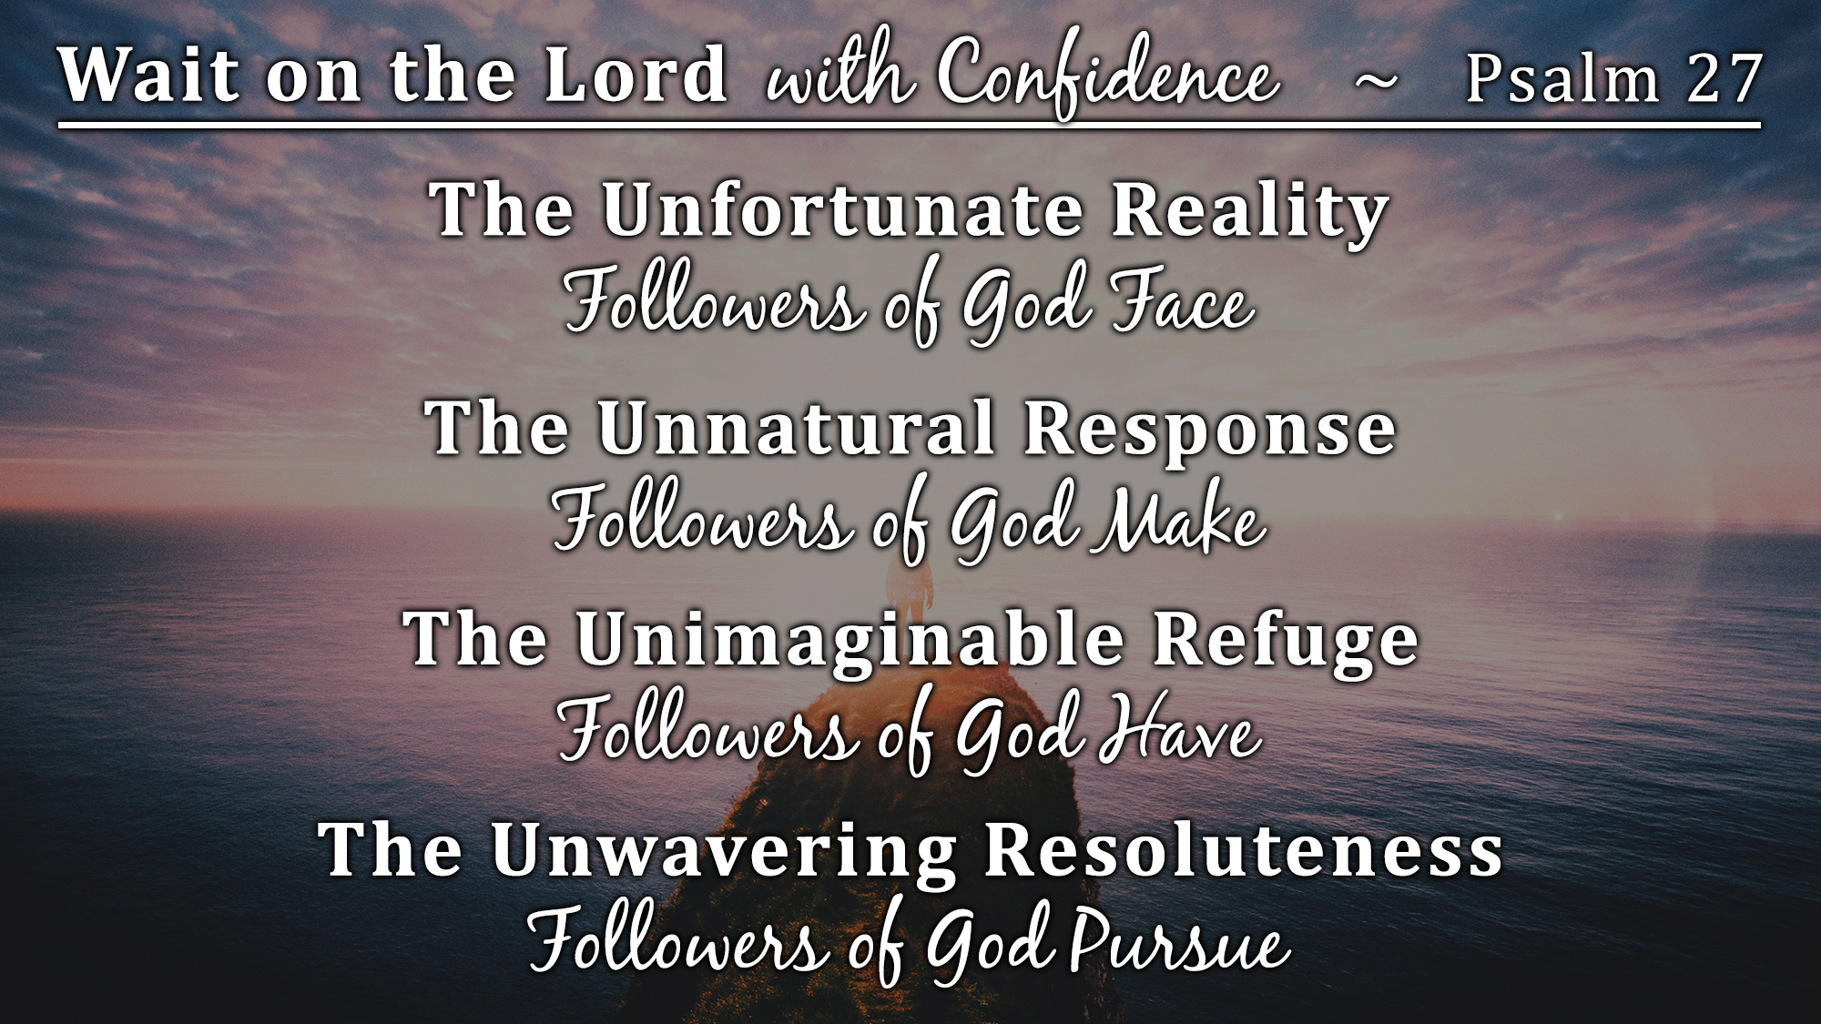

Slide 7
Believe Jesus is God’s Son – John 8:24
Repent of your sins and turn to God – Luke 13:3
Confess your faith in Jesus Christ – Matthew 10:32-33
Be immersed into Christ – Mark 16:16
  God will forgive all of your sins – Acts 2:38
  God will add you to His church – Acts 2:47
  God will register you in heaven – Hebrews 12:23
Confidently walk in His path until He returns – 1 John 1:7

