Slide 1
Survey of Genesis
Lesson Seven
Palm Beach Lakes
September-November 2021

Slide 2
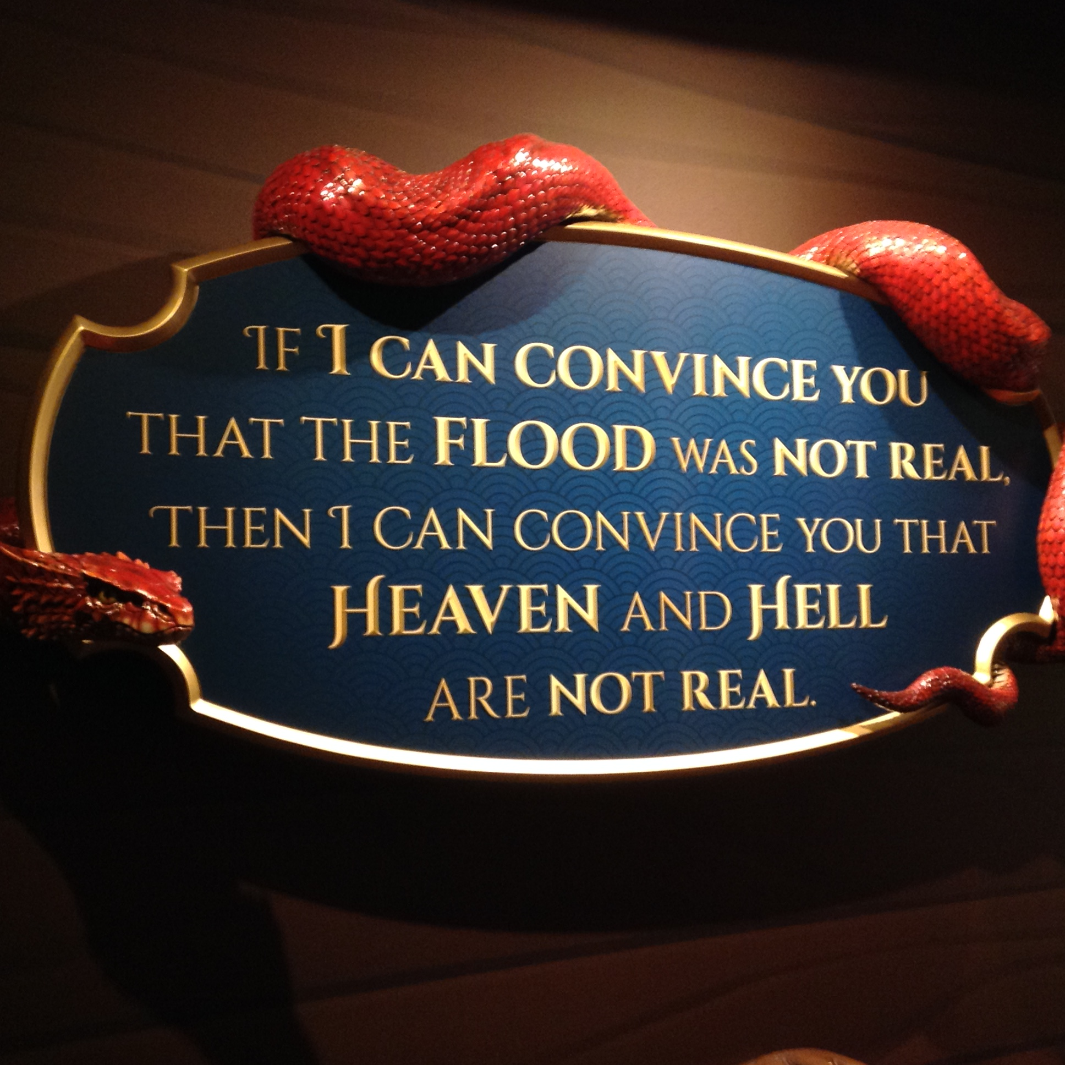

Slide 3
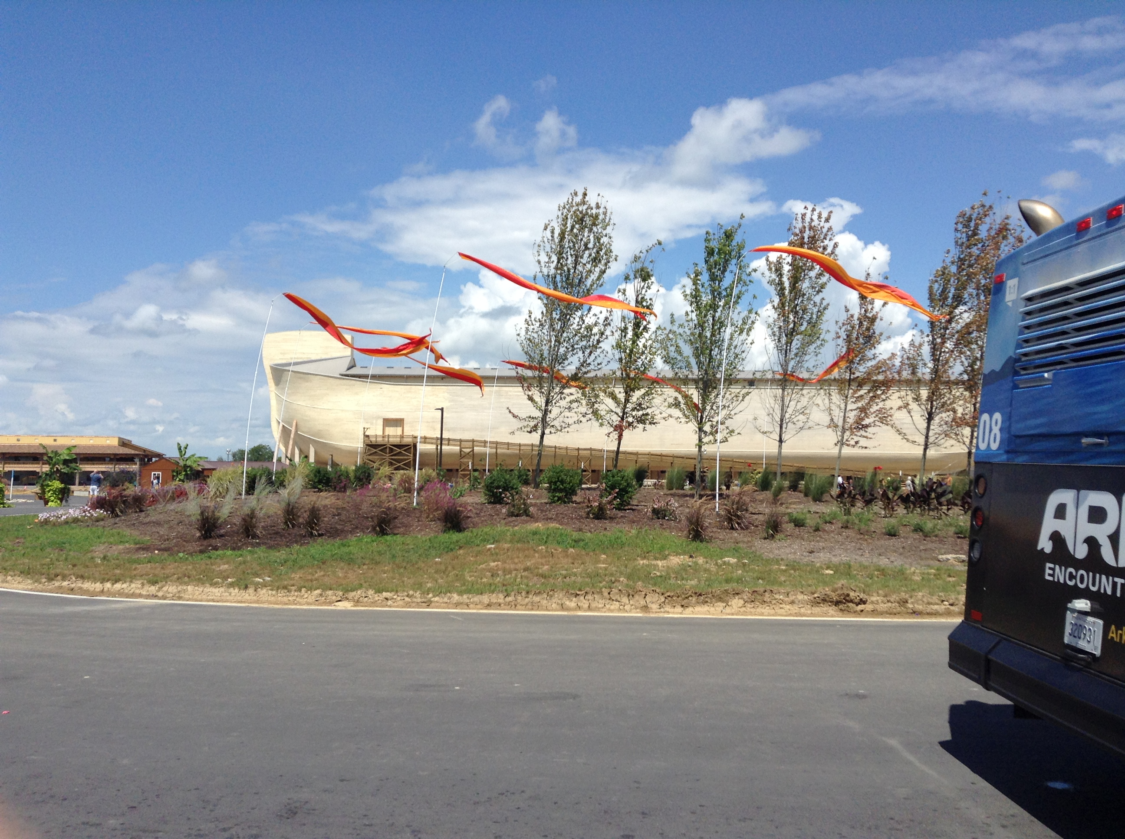

Slide 4
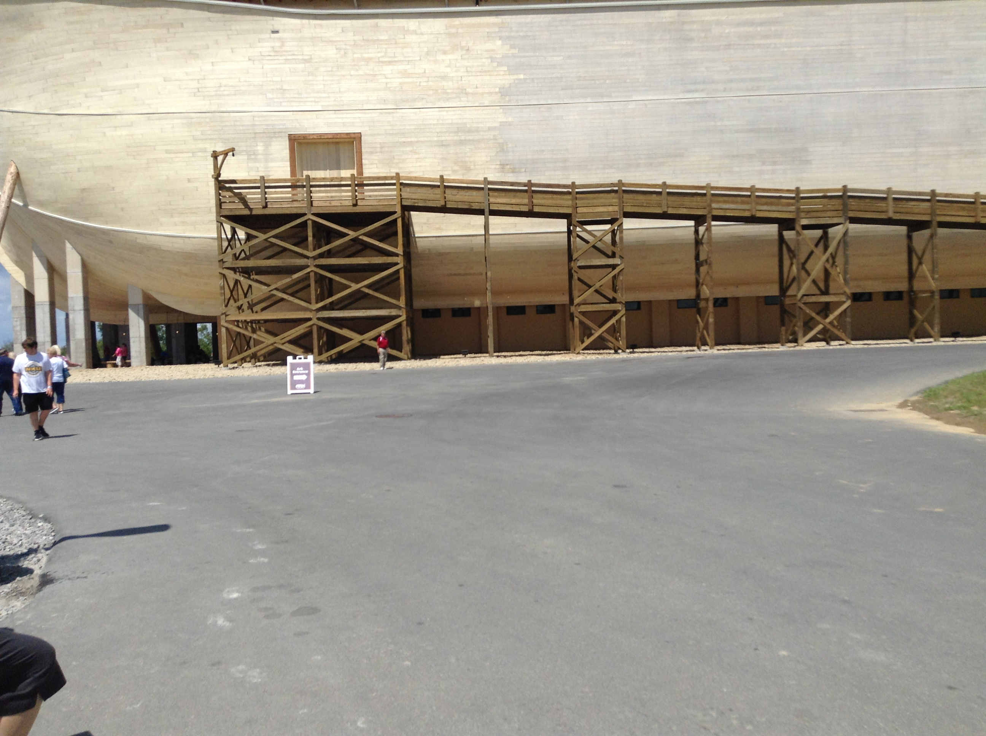

Slide 6
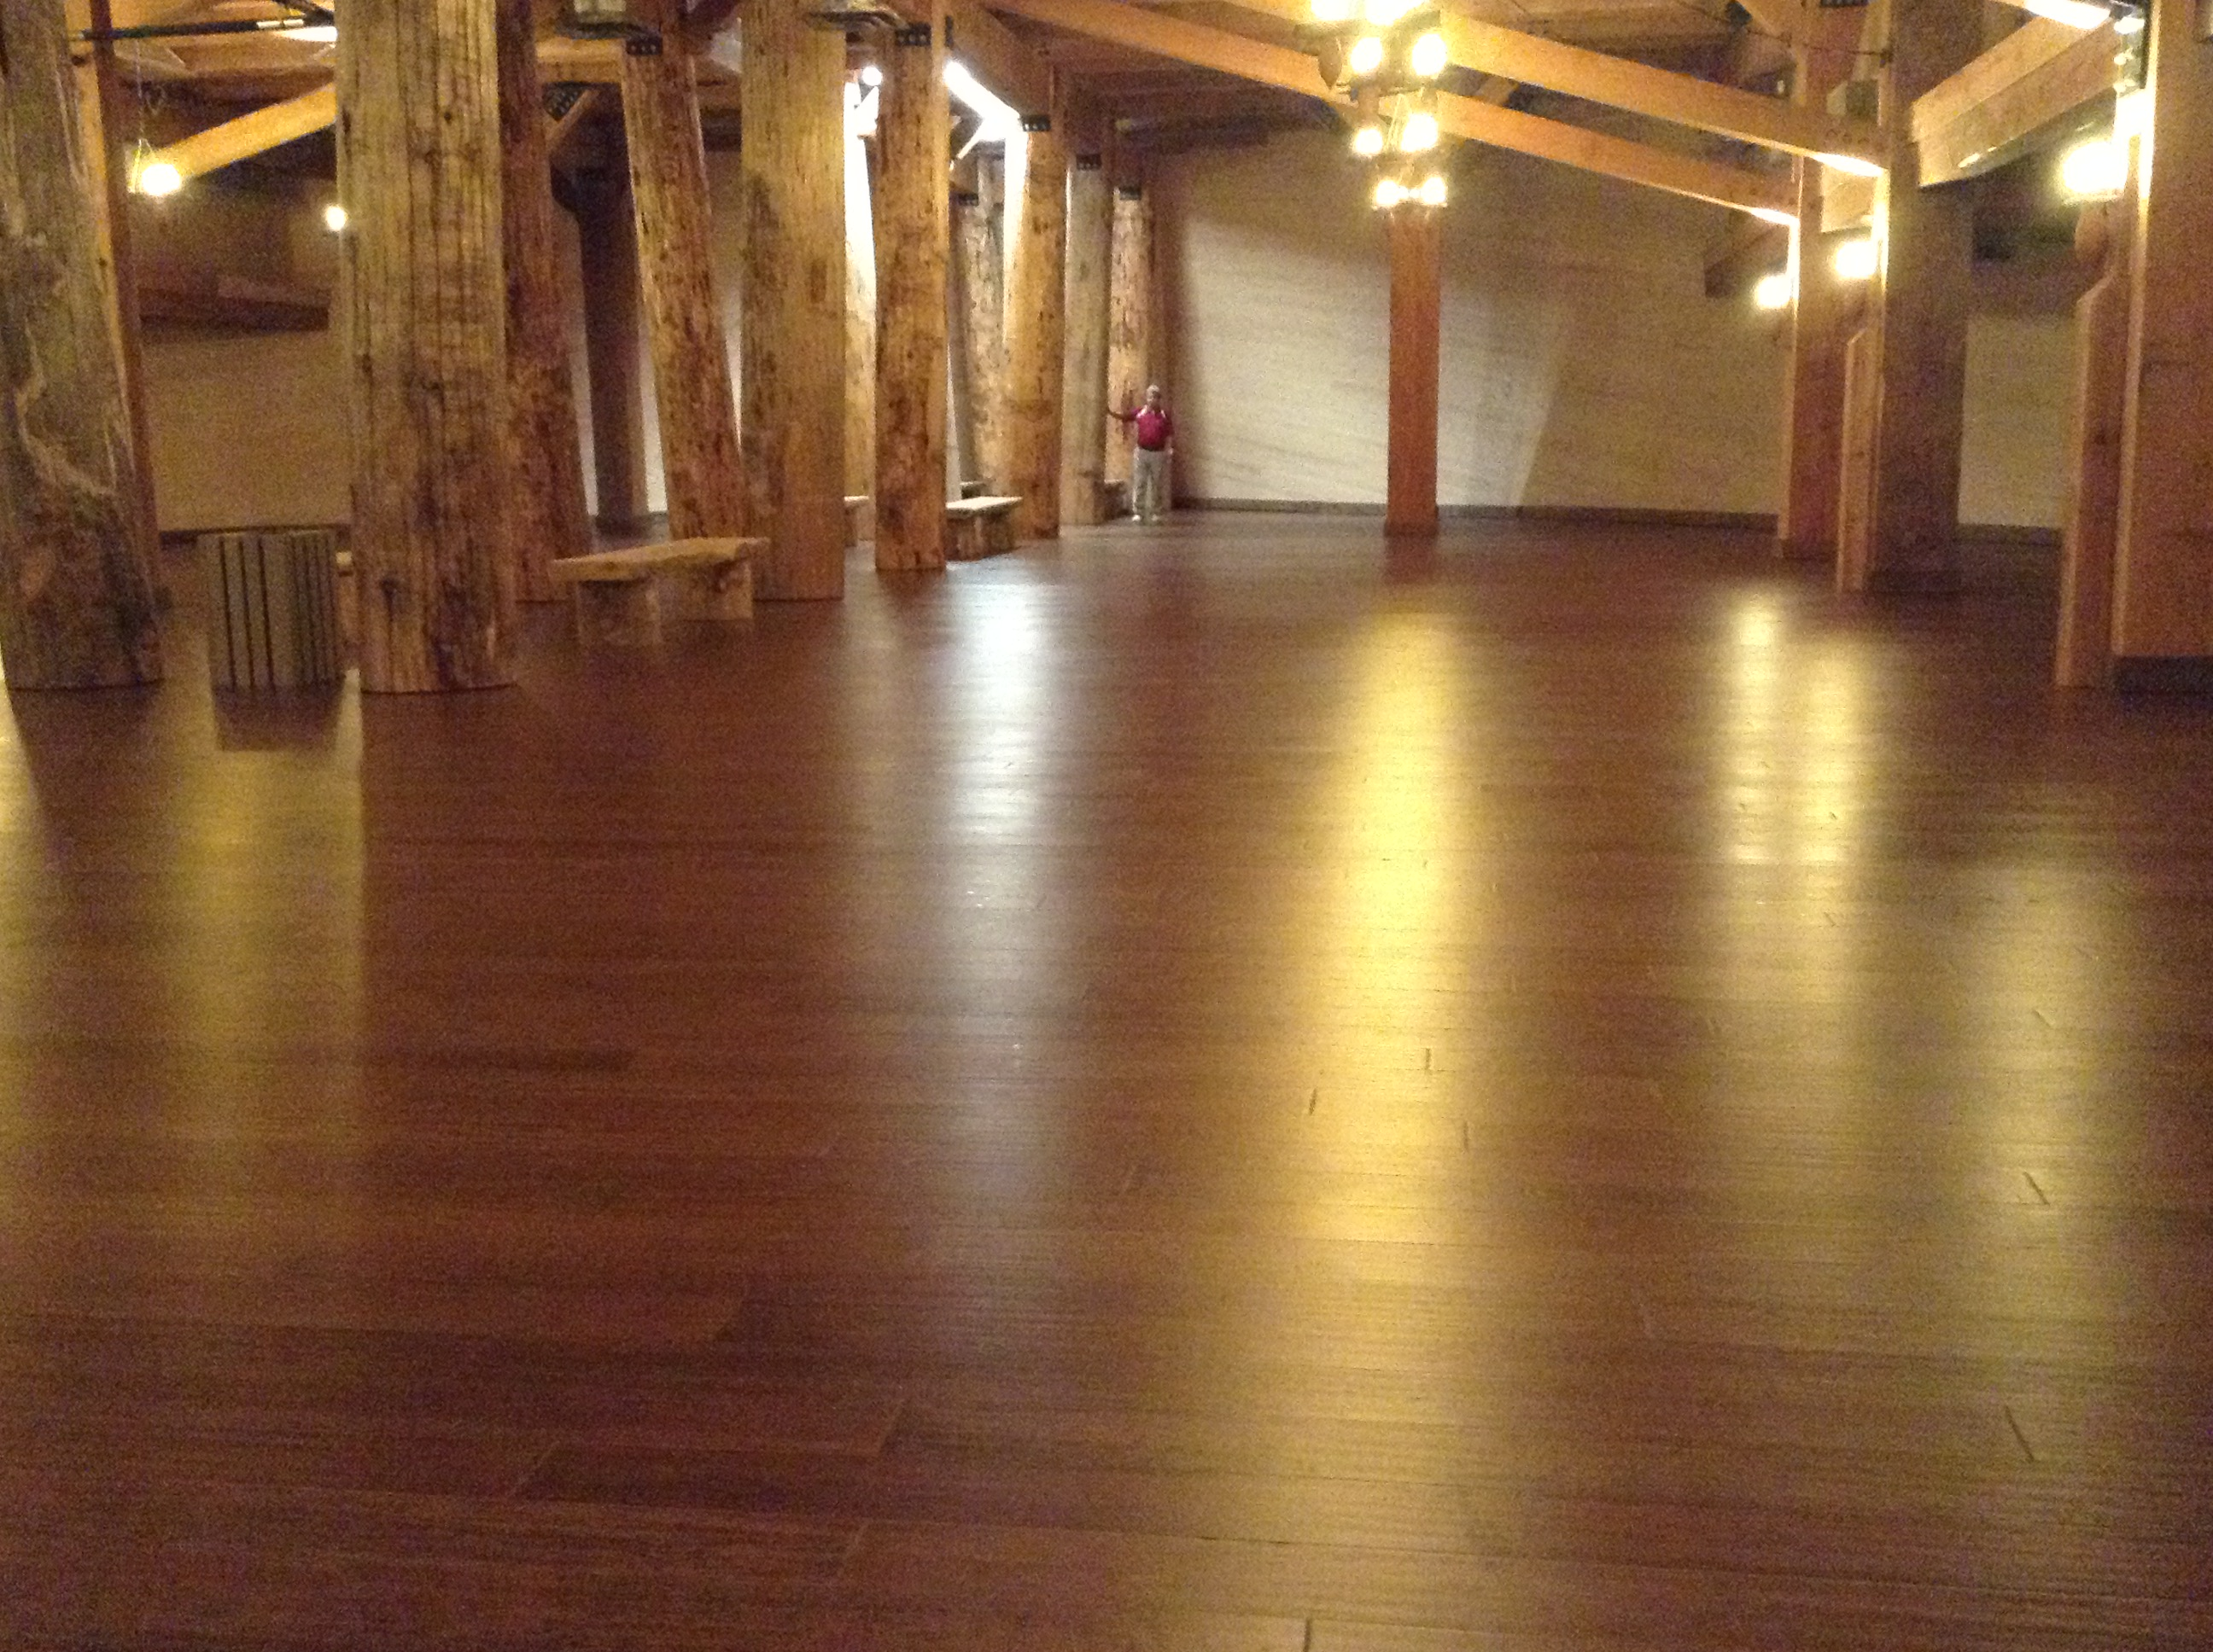

Slide 8
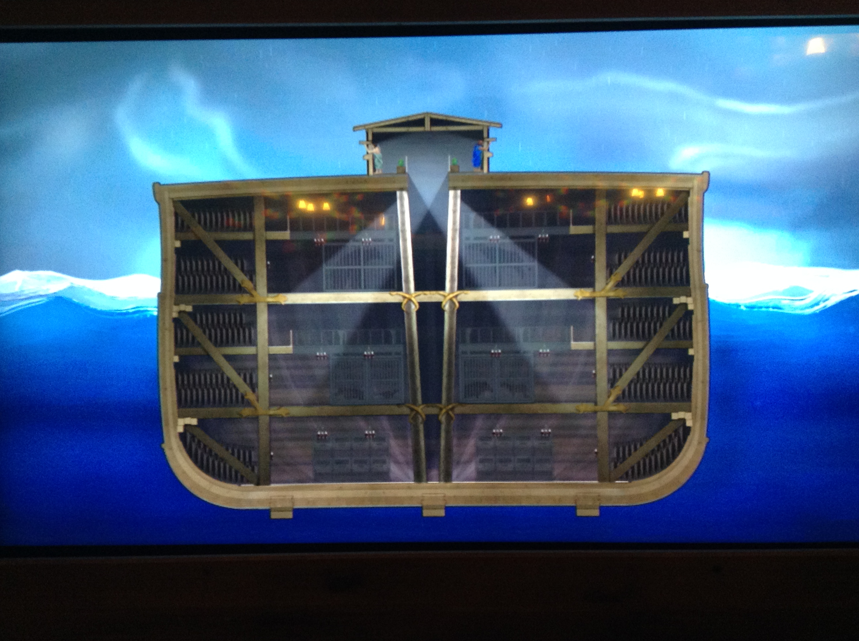

Slide 9
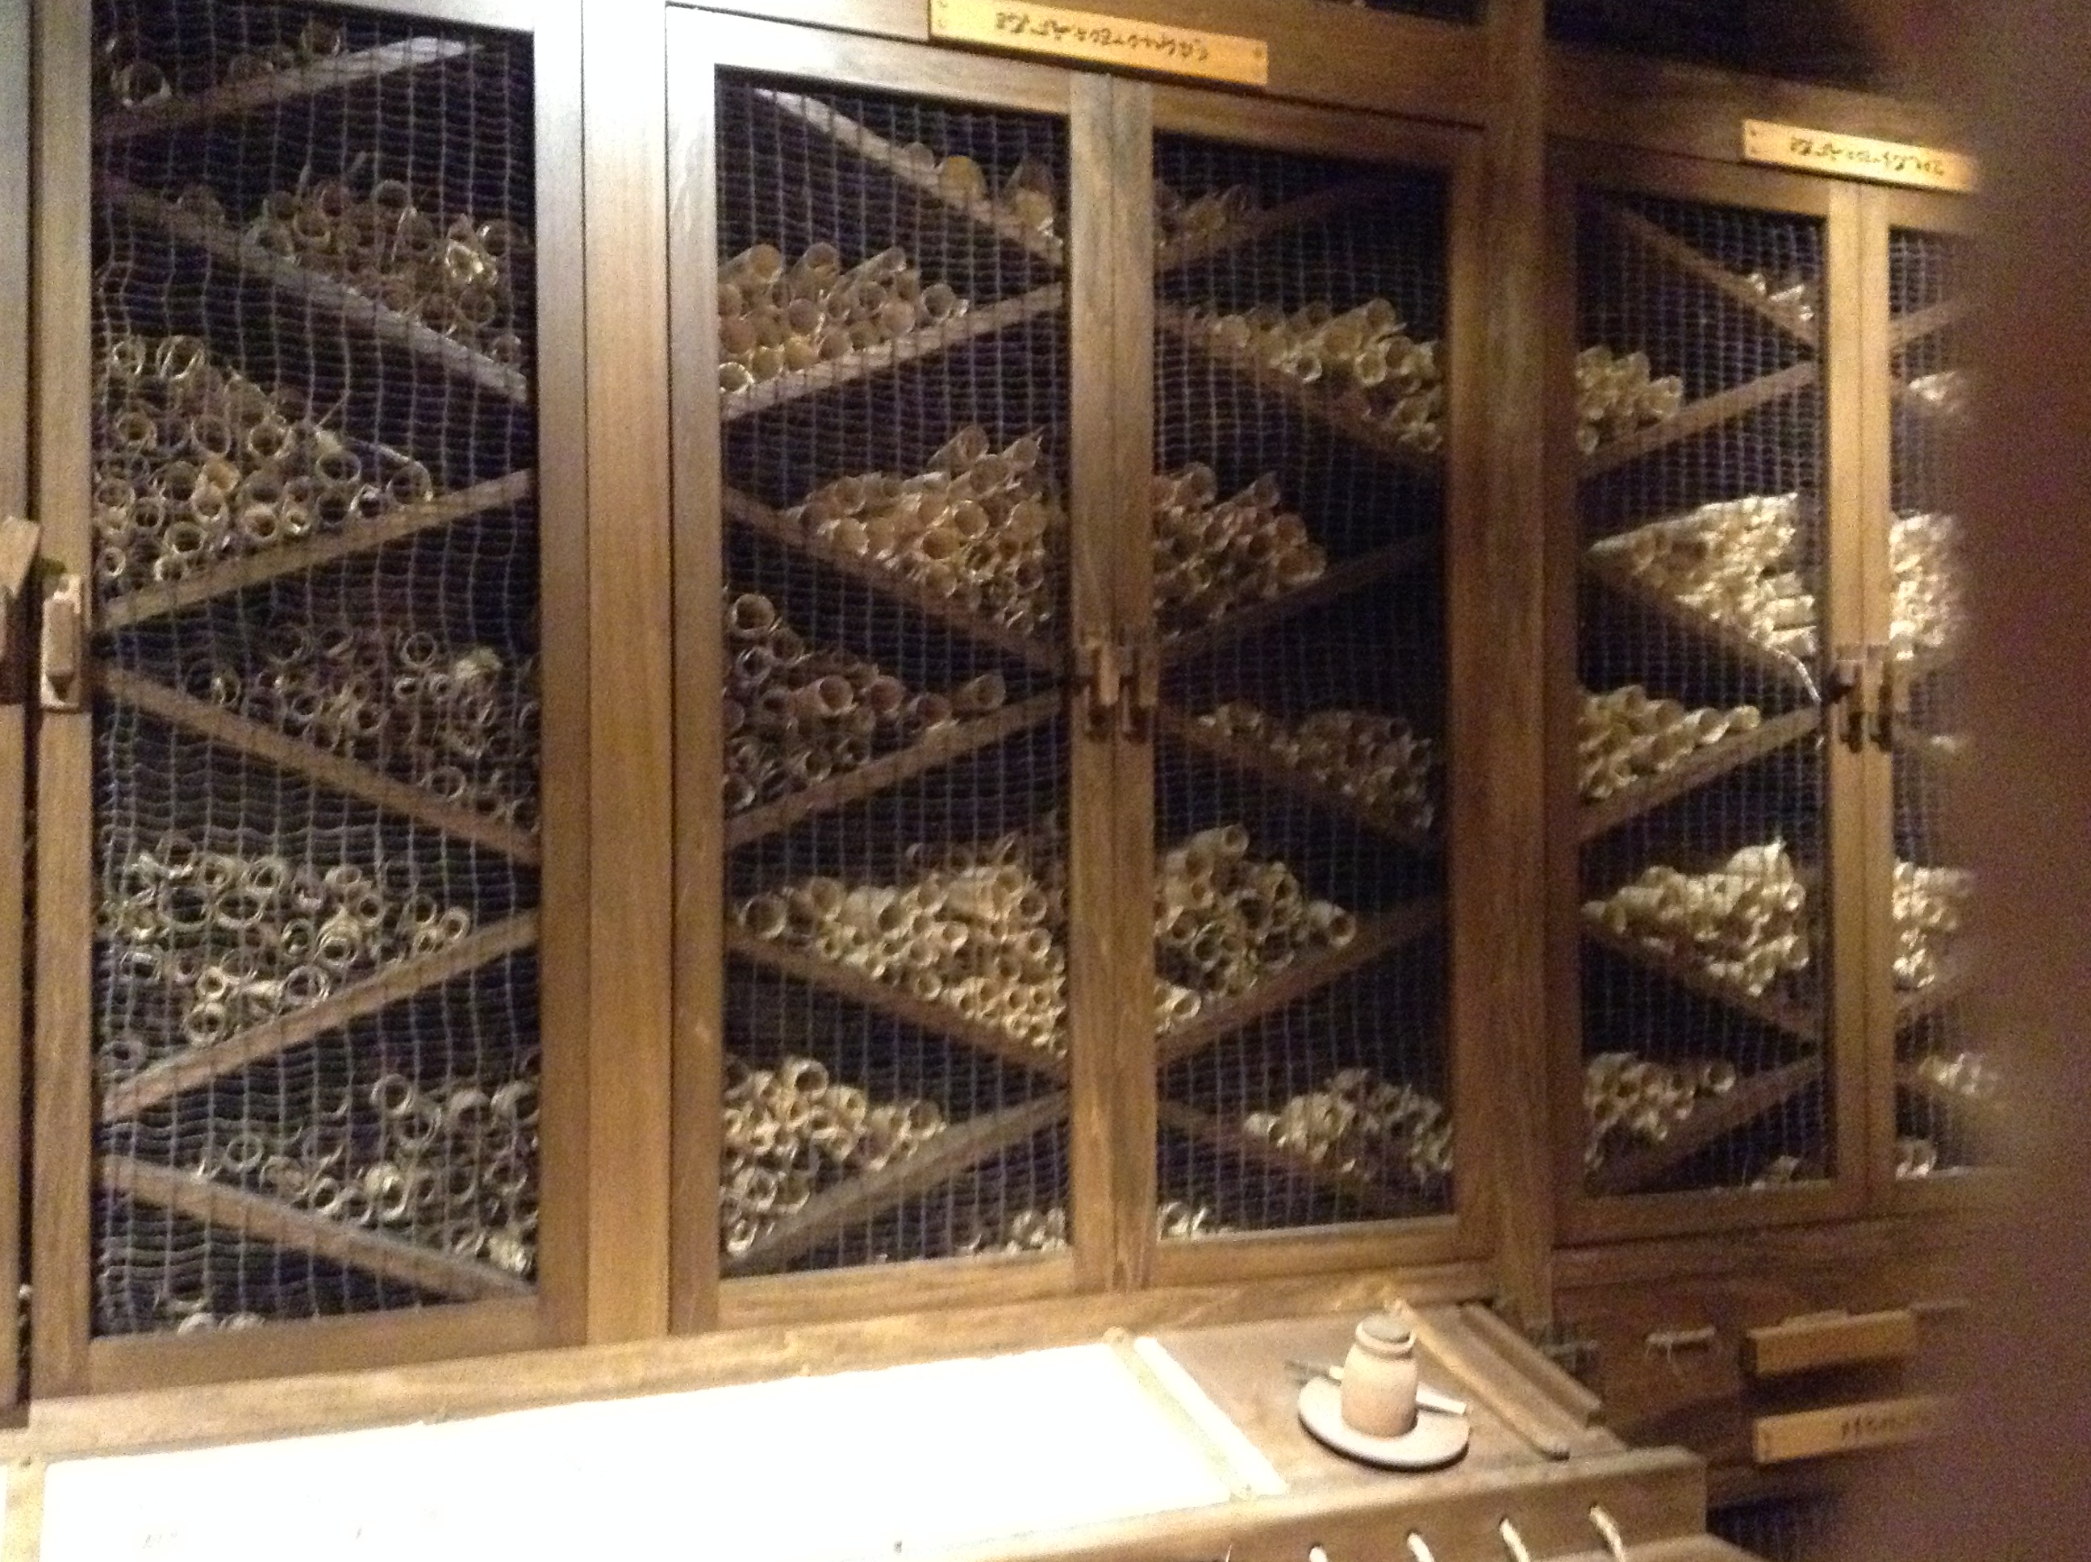

Slide 10
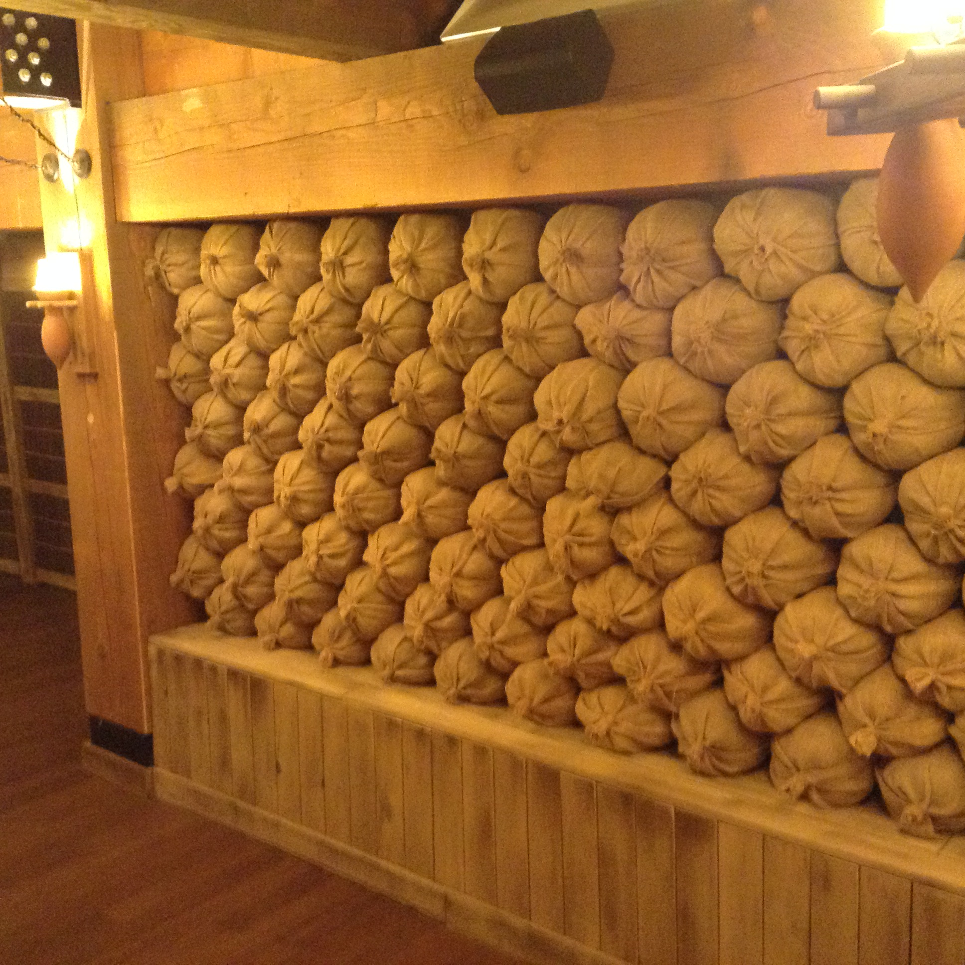

Slide 11
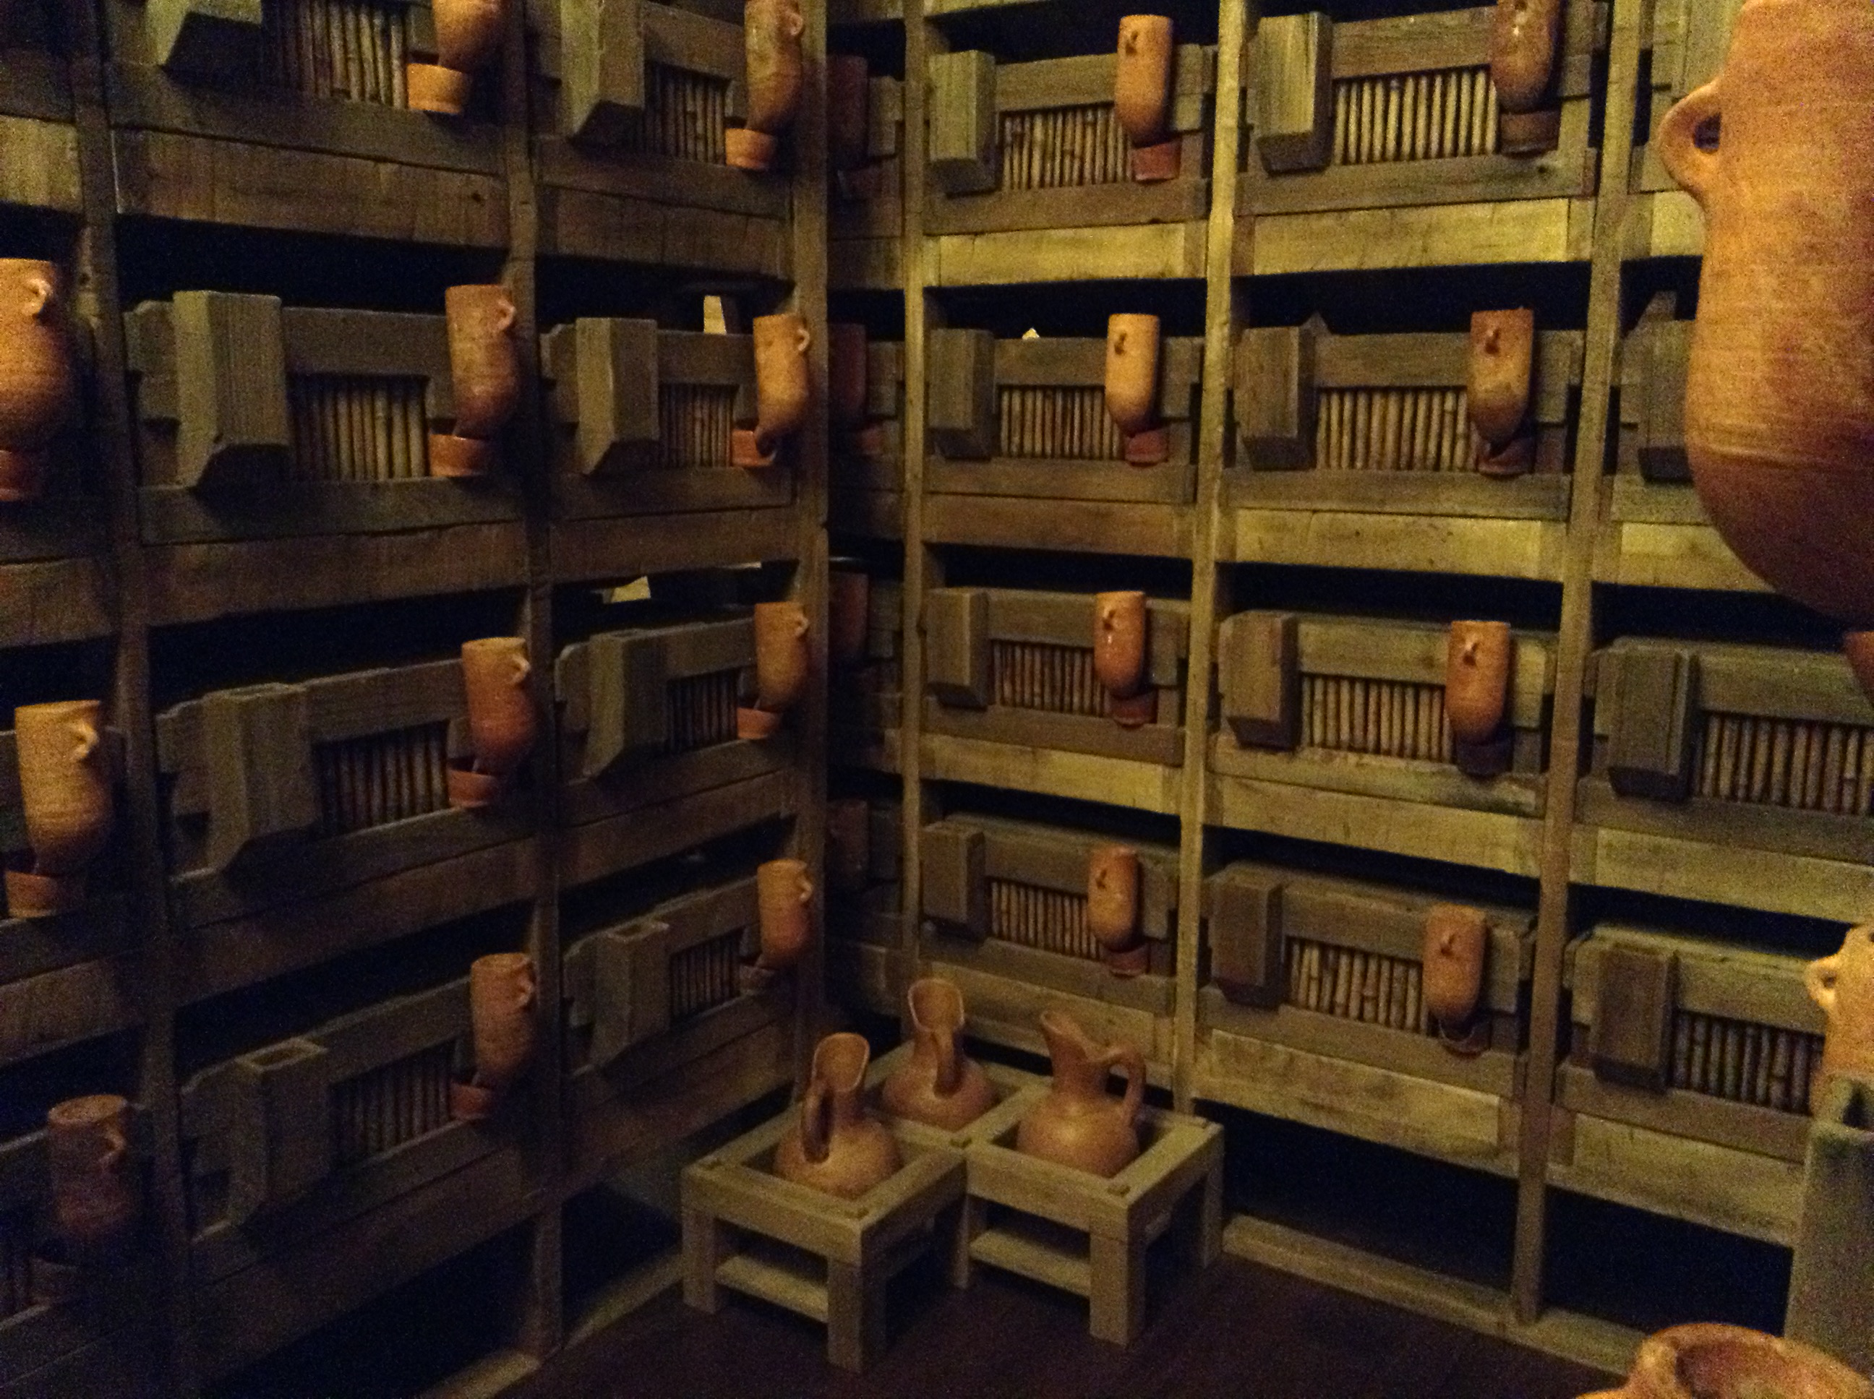

Slide 12
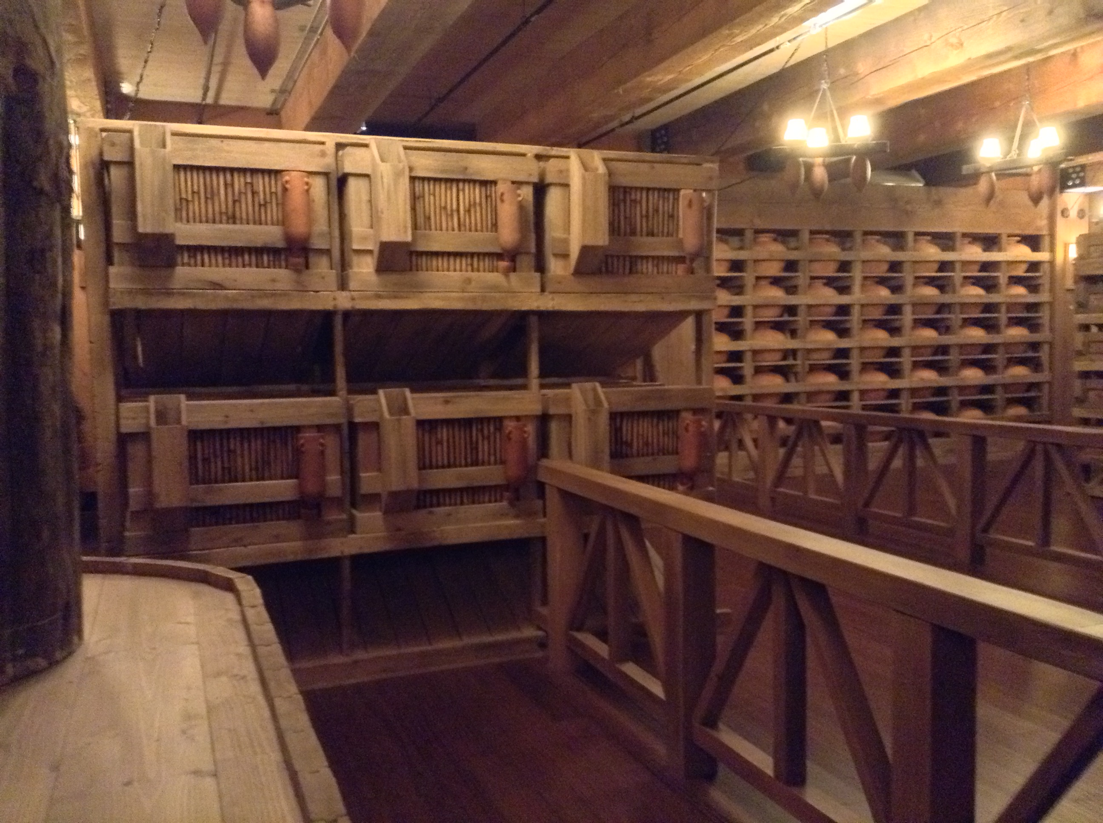

Slide 13
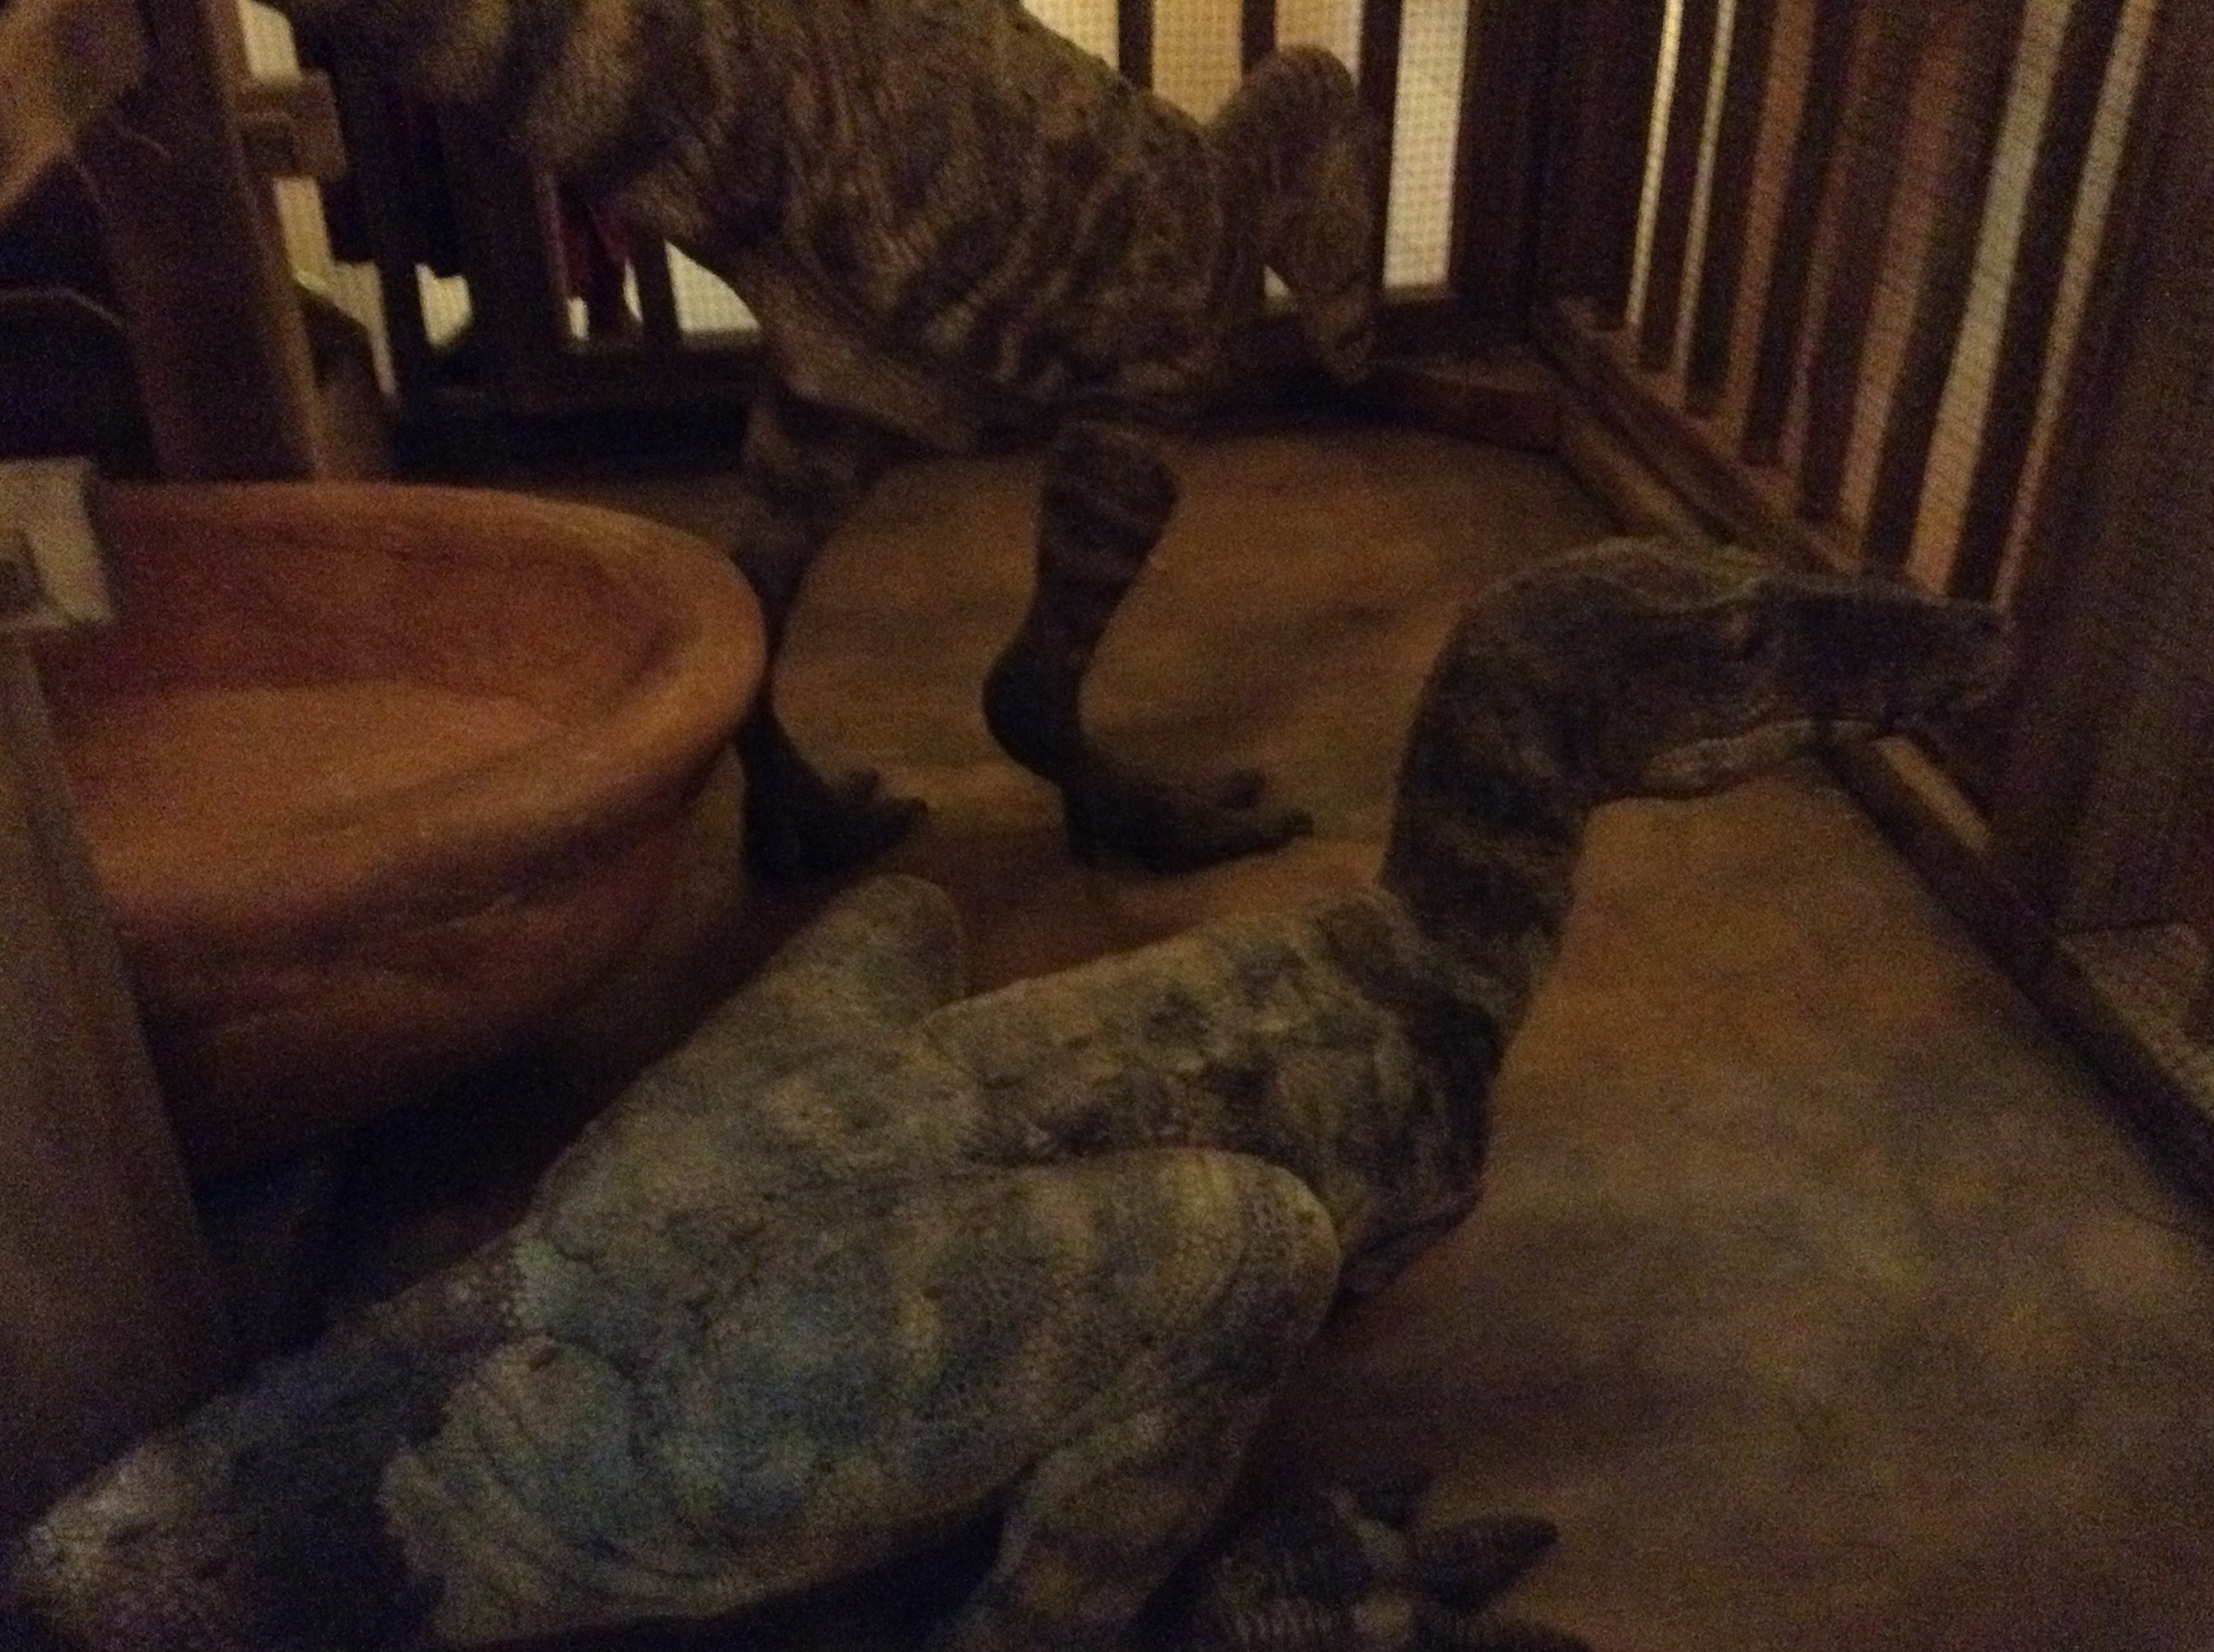

Slide 14
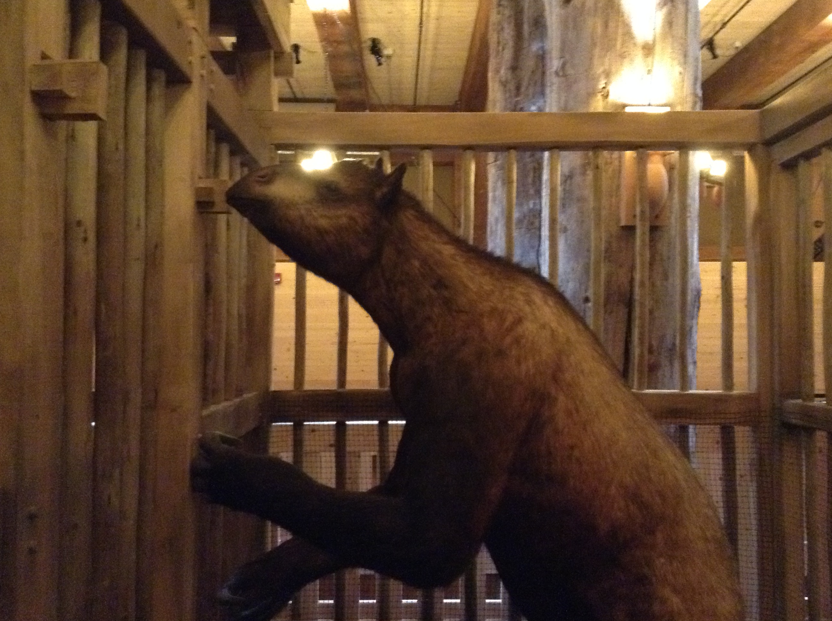

Slide 15
The Genealogy of Adam to Noah

Slide 16
Who Could Have Known Adam?
Flood
Creation
-----------------------------1656 Years From the Creation to the Flood--------------------------------

Slide 17
Who Could Noah Have Known?
130
235
325
395
460
612
677
864
930
Flood
Creation
ADAM-----------------------------------------------------------930 YEARS
SETH-----------------------------------------------------------912 YEARS
ENOSH-------------------------------------------------------905 YEARS
84 years
CAINAN------------------------------------------------------919 YEARS
179 years
MAHALAEL------------------------------------------------895 YEARS
234 years
JARED-----------------------------------------------------------962 YEARS
366 years
ENOCH--365 YEARS
0 years
METHUSALAH---------------------------------------------------969 YEARS
600 years
595 years
LAMECH-------------------------------------777 YEARS
NOAH COULD
HAVE KNOWN
NOAH ---------------600 YEARS to Flood

Slide 18
Genesis—Chapter Eleven
The Tower of Babel divided people into nations (10:5,31-32)

Slide 19
Genesis—Chapter Eleven
The Tower of Babel divided people into nations (10:5,31-32)
God’s command before the tower
And God blessed Noah and his sons, and said unto them, “Be fruitful, and multiply, and replenish the earth.” Gen. 9:1

Slide 20
Genesis—Chapter Eleven
The Tower of Babel divided people into nations (10:5,31-32)
God’s command before the tower
And God blessed Noah and his sons, and said unto them, “Be fruitful, and multiply, and replenish the earth.” Gen. 9:1
The tower was not built to reach God’s heaven (cf. Deut. 1:28)

Slide 21
Genesis—Chapter Eleven
The Tower of Babel divided people into nations (10:5,31-32)
God’s command before the tower
And God blessed Noah and his sons, and said unto them, “Be fruitful, and multiply, and replenish the earth.” Gen. 9:1
The tower was not built to reach God’s heaven (cf. Deut. 1:28)
The reason was to keep from being scattered
And they said, "Come, let us build ourselves a city, and a tower whose top is in the heavens; let us make a name for ourselves, lest we be scattered abroad over the earth.” Gen. 11:4

Slide 22
Who Could Have Known Noah/Shem
100
200
300
400
500
Flood
NOAH-----------------------------------------LIVED FOR 350 YEARS AFTER FLOOD
SHEM--------------------------------------------------------------------------------------LIVED FOR 500 YEARS AFTER FLOOD
ARPHAXAD------------------------------------------------------------------------------------------------438 YEARS
SALAH-----------------------------------------------------------------------------------------------------433 YEARS
EBER-------------------------------------------------------------------------------------------------------------464 YEARS
30
PELEG-----------------------------------------239 YEARS
REU--------------------------------------------239 YEARS
SERUG----------148 YEARS
NAHOR--------------------------------205 YEARS
TERAH---------------------------------205 YEARS
ABRAHAM-----------------175 YEARS

Slide 23
Genesis—Chapter Twelve
Abraham is the central figure of the Old Testament
Mentioned 312 in Bible (in 17 O.T. books and 11 N.T. books)

Slide 24
Who Could Have Known Noah/Shem
100
200
300
400
500
Flood
NOAH-----------------------------------------LIVED FOR 350 YEARS AFTER FLOOD
SHEM---------------------------------------------------------------------------------------------------------LIVED FOR 500 YEARS
ARPHAXAD------------------------------------------------------------------------------------------------438 YEARS
SALAH-----------------------------------------------------------------------------------------------------433 YEARS
EBER-------------------------------------------------------------------------------------------------------------464 YEARS
30
PELEG-----------------------------------------239 YEARS
REU--------------------------------------------239 YEARS
SERUG----------148 YEARS
NAHOR--------------------------------205 YEARS
TERAH---------------------------------205 YEARS
ABRAHAM-----------------175 YEARS
ISAAC------------------------180 YEARS

