Slide 1
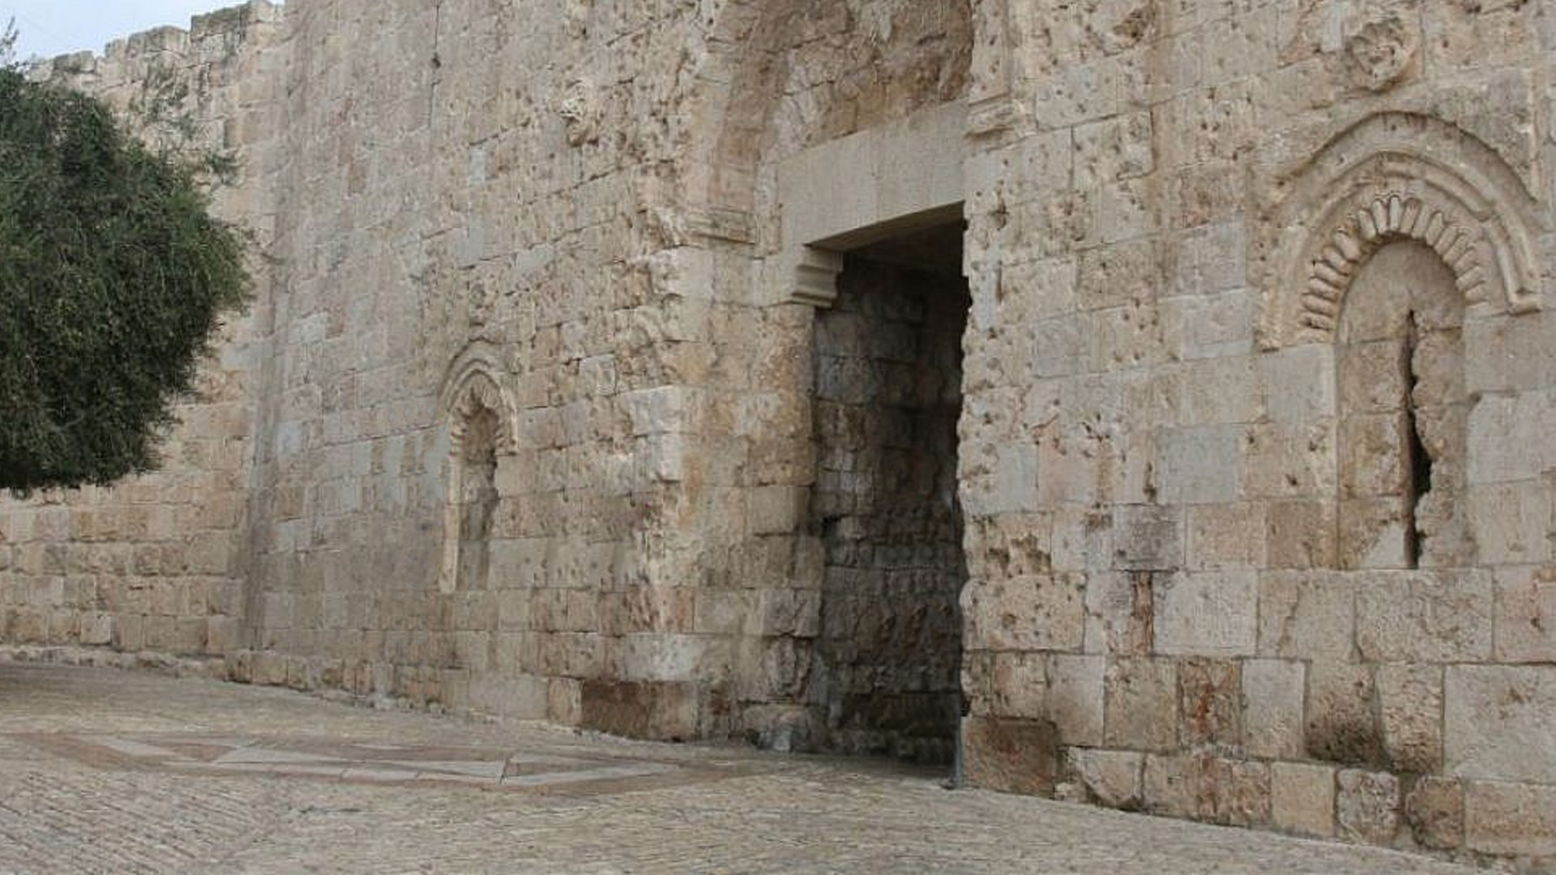

Slide 2
As a Christian, I have the best news ever = JESUS!
Jesus Christ came and lived for me (2 Cor. 8:9; Phil. 2:6-8)
Jesus Christ came and died for me (Eph. 5:2; 1 John 4:9)
Jesus Christ came and opened heaven for me (Heb. 10:19-22; Eph. 2:14-22)
The good news that I have is of “first importance” (1 Cor. 15:1-4)
I need to be ready to give this good news at all times to all people (Ro. 1:15)
I must never be ashamed of the good news of Jesus Christ (Rom. 1:16)
My neighbor needs to hear the good news that I have heard!

Slide 3
I cannot give you the church, but I can tell you about it and point you to it
That’s what John the Baptist did (Matt. 3:2)
That’s what Jesus did (Matt. 4:17, 23; 9:35)
That’s what the 12 apostles Jesus sent out did (Matt. 10:7)
That’s what the 70 disciples Jesus sent out did (Luke 10:9)
That’s what the early Christians did (Acts 8:12; 19:8; 20:25; 28:23, 31)
I can tell you that I found the one church of the Bible (Eph. 4:4 + 1:22-23)
The one that was established and detailed in the New Testament (Acts-Rev)
The one that follows the pattern of the New Testament (2 Tim. 1:13)
The one that Jesus died for (Matt. 16:18-19; Acts 20:28)
The one that Jesus loves (Eph. 5:2, 25)
The one that Jesus will return to take to heaven (1 Cor. 15:24; Heb. 12:23)
My neighbor needs to be able to rejoice to find Christ’s church (Matt. 13:44)

Slide 4
I cannot give you my salvation, but I can tell you how to get it (1 Cor. 15:1-4; 2 Cor. 2:14-17)
I should be eager to show God’s plan of salvation (Acts 8:4, 30; 1 Cor. 9:19-22)
My neighbor needs to be saved the way the Bible teaches
Salvation comes from knowing what Jesus did for me and why
Salvation comes from knowing what Jesus expects of me and why
Salvation comes from loving and obeying the Lord (1 John 5:2-3; Heb. 5:9)

Slide 5
Paul utilized his resources:
He wrote letters (13 of them)
He encouraged to read other letters (Col. 4:16)
He utilized books, maybe loaning some (2 Tim. 4:13)
He utilized various preachers and friends (Tit. 1:5; Acts 19:22; 1 Cor. 4:17)
We have loads of resources available to us:
PBL website
Apologetics Press
ChristianCourier.com
Bible tracts
Books
Bibles

Slide 6
You need to believe that Jesus is God’s Son – John 20:30-31
You need to repent of your sins and turn to God – 2 Peter 3:9
You need to confess your faith in Jesus Christ – Romans 10:9
You need to be immersed into Christ – Romans 6:3
God will forgive all of your sins – Acts 2:38
God will add you to His church – Acts 2:47
God will register you in heaven – Hebrews 12:23
You need to walk faithfully with the Lord – 1 John 1:7

