Slide 1
The Christian and Influence
Matthew 5:13-16

Slide 2
Consider Your Influence
We should be all about influence Matthew 5:13-16
The Lord's work consists of influencing people in God's direction Colossians 1:28
Influence comes down to a matter of communication both verbal and non-verbal.
Sometimes we are guilty of neglecting the power of influence.
Notes:
Mat 5:13-16 "You are the salt of the earth; but if the salt has become tasteless, how can it be made salty again? It is no longer good for anything, except to be thrown out and trampled under foot by men. (14) "You are the light of the world. A city set on a hill cannot be hidden; (15) nor does anyone light a lamp and put it under a basket, but on the lampstand, and it gives light to all who are in the house. (16) "Let your light shine before men in such a way that they may see your good works, and glorify your Father who is in heaven.
Col 1:28 We proclaim Him, admonishing every man and teaching every man with all wisdom, so that we may present every man complete in Christ.

Slide 3
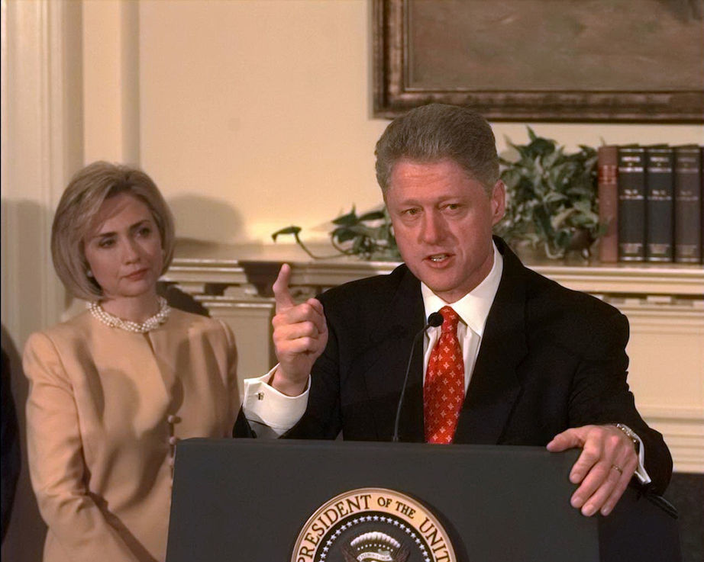
Does Character Matter?

Slide 4
Examine Self Before Influencing Others Character
Most significant change starts with self — an "inside out" approach to influencing others is best.
We know this but we forget Matthew 7:3-5
Ralph Waldo Emerson, "What you are stands over you the while, and thunders so that I cannot hear what you say to the contrary.”
Paul said it this way 1 Corinthians 9:24-27
We must model the conduct we wish to encourage in others Acts 20:34,35; 1 Corinthians 11:1
We must be examples 1 Timothy 4:12
Notes:
Mat 7:3-5 "Why do you look at the speck that is in your brother's eye, but do not notice the log that is in your own eye? (4) "Or how can you say to your brother, 'Let me take the speck out of your eye,' and behold, the log is in your own eye? (5) "You hypocrite, first take the log out of your own eye, and then you will see clearly to take the speck out of your brother's eye.
1Co 9:27 but I discipline my body and make it my slave, so that, after I have preached to others, I myself will not be disqualified.
Act 20:34-35 "You yourselves know that these hands ministered to my own needs and to the men who were with me. (35) "In everything I showed you that by working hard in this manner you must help the weak and remember the words of the Lord Jesus, that He Himself said, 'It is more blessed to give than to receive.'"
1Co 11:1 Be imitators of me, just as I also am of Christ.
1Ti 4:12 Let no one look down on your youthfulness, but rather in speech, conduct, love, faith and purity, show yourself an example of those who believe.

Slide 5
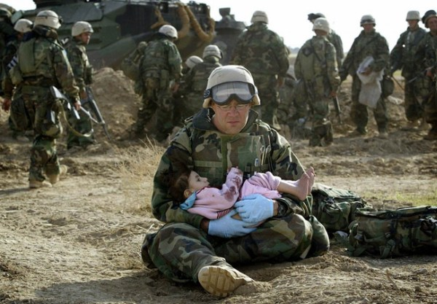
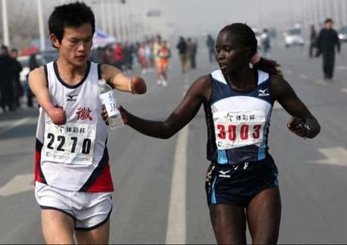
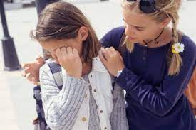
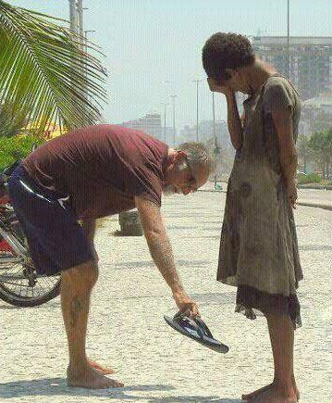
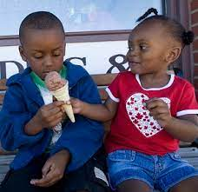
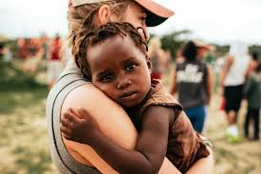
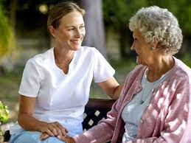
Does Compassion Matter?

Slide 6
We Should Understand Before We Advise Compassion
It is true that in some cases we have to earn the right to be heard by showing ourselves to be genuinely concerned about the other person.
Sympathy is to feel or share what others feel.
Empathy is to understand the situation of others Philippians 2:1-2
Understanding needs to go before being understood Philippians 2:4
How good are we at listening?
Jesus the Master Teacher saw people with His perfect understanding and compassion. Matthew 9:36
Notes:
Php 2:1-2 Therefore if there is any encouragement in Christ, if there is any consolation of love, if there is any fellowship of the Spirit, if any affection and compassion, (2) make my joy complete by being of the same mind, maintaining the same love, united in spirit, intent on one purpose.
Php 2:4 do not merely look out for your own personal interests, but also for the interests of others.
Mat 9:36 Seeing the people, He felt compassion for them, because they were distressed and dispirited like sheep without a shepherd.

Slide 7
Does Communication Matter?
“Give me a _______! Give me a _______! _______ me off a piece of that Kit Kat bar.”- Kit Kat
“Melts in your _______, not in your ________.” - M&Ms
“A ________ is forever.” - De Beers
“The ________ of champions.” - Wheaties
“America ______ on Dunkin.” - Dunkin Donuts
“Can you ______ me now?” - Verizon

Slide 8
A Good Example is Not Enough Communication
Character and compassion are not enough to communicate the truth of the gospel, it takes words Ephesians. 1:13; Acts 11:13,14; Romans 10:17
The gospel is of no benefit if it is not made clear Colossians 4:3-4; Ephesians 6:19-20
We must strive to balance courage and consideration. We must be courteous as well as candid. Colossians 4:5-6
We must communicate. We cannot afford to sacrifice clarity for courtesy.
We must be what we ought to be and genuinely seek to understand others. We must “admonish/warn" and "teach" Colossians 1:28
Notes:
Eph 1:13 In Him, you also, after listening to the message of truth, the gospel of your salvation—having also believed, you were sealed in Him with the Holy Spirit of promise,
Act 11:13-14 "And he reported to us how he had seen the angel standing in his house, and saying, 'Send to Joppa and have Simon, who is also called Peter, brought here; (14) and he will speak words to you by which you will be saved, you and all your household.'
Rom 10:17 So faith comes from hearing, and hearing by the word of Christ.
Col 4:3-4 praying at the same time for us as well, that God will open up to us a door for the word, so that we may speak forth the mystery of Christ, for which I have also been imprisoned; (4) that I may make it clear in the way I ought to speak.
Eph 6:19-20 and pray on my behalf, that utterance may be given to me in the opening of my mouth, to make known with boldness the mystery of the gospel, (20) for which I am an ambassador in chains; that in proclaiming it I may speak boldly, as I ought to speak.
Col 4:5-6 Conduct yourselves with wisdom toward outsiders, making the most of the opportunity. (6) Let your speech always be with grace, as though seasoned with salt, so that you will know how you should respond to each person.
Col 1:28 We proclaim Him, admonishing every man and teaching every man with all wisdom, so that we may present every man complete in Christ.

Slide 9
Our Influence Applied
Aristotle taught that there three basic forms of influence:
Ethos — what we are (character).
Pathos — understanding/concern for people (compassion).
Logos — what we say (communication).
These three build on one another and are related in an organic way each needing the other that precede it.
We will not succeed using just one.
Logos is empty without ethos and powerless without pathos.
Ethos and pathos are insufficient without logos.
We need to strive for a full, mature ability to influence others for good. 1 Timothy 4:15-16
Notes:
1Ti 4:15-16 Take pains with these things; be absorbed in them, so that your progress will be evident to all. (16) Pay close attention to yourself and to your teaching; persevere in these things, for as you do this you will ensure salvation both for yourself and for those who hear you.

