Slide 1
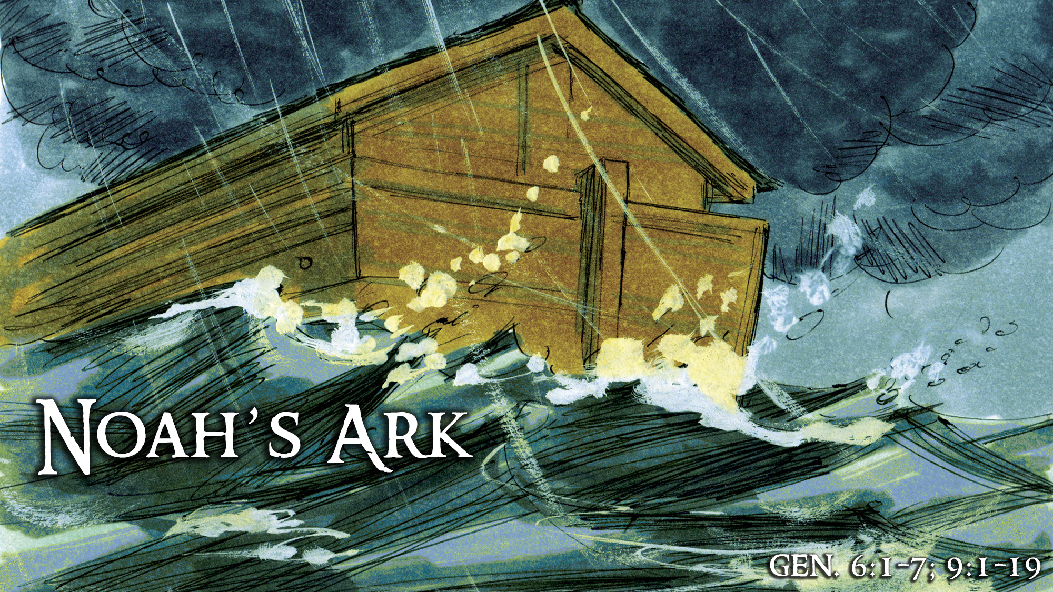

Slide 5
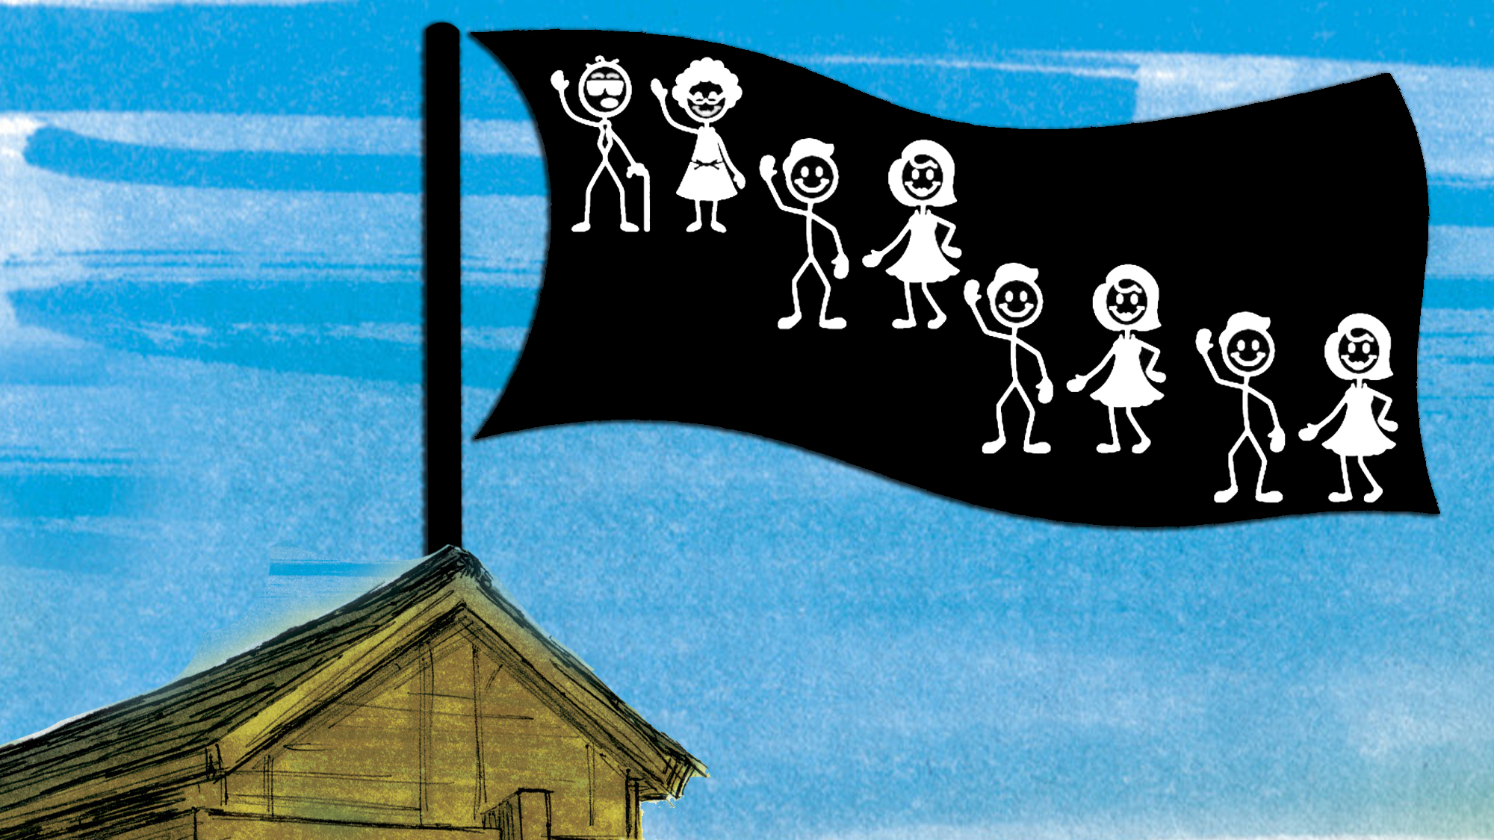

Slide 9
Homosexuality “seems” to be in full acceptance today
In our NATION
In our COURTS
In our WORKPLACES
In our SCHOOLS
In our ENTERTAINMENT
We are surrounded by widespread acceptance today

Slide 10
1987 Article in Guide Magazine by two gay men, Marshall Kirk and Hunter Madsen (writing under the pen-name of Erastes Pill), entitled, “The Overhauling of Straight America.”
Step-by-step guide to bringing about complete cultural change, transforming beliefs on the issue of homosexuality (laying out a 6-point plan)
The conclusion of the article: “The Time Is Now. We have sketched out here a blueprint for transforming the social values of straight America…”
The very first sentence of the article: “The first order of business is desensitization of the American public concerning gays and gay rights. To desensitize the public is to help it view homosexuality with indifference instead of with keen emotion…
They continued: “If only you can get them to think that it is just another thing, with a shrug of their shoulders, then your battle for legal and social rights is virtually won…A large-scale media campaign will be required in order to change the image of gays in America. And any campaign to accomplish this turnaround should do six things.”

Slide 11
1987 Article: “The Overhauling of Straight America”
Step-by-step guide to bringing about complete cultural change, transforming beliefs on the issue of homosexuality (laying out a 6-point plan)
Point #1: Talk About Gays and Gayness As Loudly and As Often As Possible
Almost any behavior begins to look normal if you are exposed to enough of it…
Open and frank talk makes the subject seem less furtive, alien, and sinful, more above-board.
The main thing is to talk about gayness until the issue becomes thoroughly tiresome…
Gay rights should be reduced to an abstract social question as much as possible. First let the camel get his nose inside the tent—only later his unsightly derriere…
When conservative churches condemn gays, there are only two things we can do:
(1) we can use talk to muddy the moral waters;
(2) we can undermine the moral authority of homophobic churches by portraying them as antiquated backwaters…

Slide 12
1987 Article: “The Overhauling of Straight America”
Step-by-step guide to bringing about complete cultural change, transforming beliefs on the issue of homosexuality (laying out a 6-point plan)
Point #2: Portray Gays As Victims, Not As Aggressive Challengers
In any campaign to win over the public, gays must be cast as victims in need of protection so that straights will be inclined by reflex to assume the role of protector…
We must forego the temptation to strut our “gay pride” publicly when it conflicts with the Gay Victim image.
The mainstream should be told that gays are victims of fate, in the sense that most never had a choice to accept or reject their sexual preference…
The second message would portray gays as victims of society. The straight majority does not recognize the suffering it brings to the lives of gays and must be shown…

Slide 13
1987 Article: “The Overhauling of Straight America”
Step-by-step guide to bringing about complete cultural change, transforming beliefs on the issue of homosexuality (laying out a 6-point plan)
Point #3: Give Protectors A Just Cause
Our campaign should…take anti-discrimination as its theme.
The right to free speech, freedom of beliefs, freedom of association, due process and equal protection of laws-these should be the concerns brought to mind by our campaign.

Slide 14
1987 Article: “The Overhauling of Straight America”
Step-by-step guide to bringing about complete cultural change, transforming beliefs on the issue of homosexuality (laying out a 6-point plan)
Point #4: Make Gays Look Good
In order to make a Gay Victim sympathetic to straights you have to portray him as Everyman…the campaign should paint gays as superior pillars of society.
The honor roll of prominent gay or bisexual men and women is truly eye popping…
In no time, a skillful and clever media campaign could have the gay community looking like the veritable fairy godmother to Western Civilization.
We shouldn’t overlook the Celebrity Endorsement. The celebrities can be straight…or gay.

Slide 15
1987 Article: “The Overhauling of Straight America”
Step-by-step guide to bringing about complete cultural change, transforming beliefs on the issue of homosexuality (laying out a 6-point plan)
Point #5: Make the Victimizers Look Bad
At a later stage of the media campaign for gay rights—long after other gay ads have become commonplace—it will be time to get tough with remaining opponents. To be blunt, they must be vilified.
Our goal is here is twofold. First, we seek to replace the mainstream’s self-righteous pride about its homophobia with shame and guilt. Second, we intend to make the antigays look so nasty that average Americans will want to dissociate themselves from such types.
Point #6: Solicit Funds from Corporate America
Any massive campaign of this kind would require unprecedented expenditures…
The appeal should be directed both at gays and at straights who care about social justice.

Slide 16
They have fulfilled their agenda
1995 – Lesbian author Patricia Nell Warren wrote: “Whoever captures the kids owns the future.”
October 1-3, 1999 – Conference sponsored by Gay, Lesbian and Straight Education Network (GLSEN), which works to “end the damaging effects of anti-gay bias in America’s K-12 schools.”
GLSEN’s Executive Director, Kevin Jennings, said that his organization would be “shameless” in promoting pro-homosexual programs to all 15,000 schools in the country.
GLSEN’s Director of Communications, James Anderson, said, “If we do our jobs right, we’re going to raise a generation of kids who don’t believe [the claims of] the religious right.”
Research indicates a major shift in support for same-sex marriage in America:
1988 – 11% of Americans supported same-sex marriage
2004 – 31% of Americans supported same-sex marriage
2010 – 46% of Americans supported same-sex marriage
2018 – 67% of Americans supported same-sex marriage
2021 – 70% of Americans support same-sex marriage

Slide 17
THE BIBLE IS:
God’s Word, Every Word of It (2 Tim. 3:16-17; 2 Pet. 1:20-21)
Complete (Jude 3) and Lacking Nothing (2 Pet. 1:3)
Unchanging Truth (Psa. 119:89; 1 Pet. 1:25; Rev. 22:18-19)
Always Right (Hos. 14:9; Psa. 19:7-11; Isa. 55:10-11)
Our Standard for Living (Col. 3:17; Matt. 7:21-27)
The Standard of Judgment (John 12:48; 2 Cor. 5:10)
All That Matters (Psalm 119; Gal. 1:6-9; Deut. 5:32; 28:14; Josh. 1:7-8)
Nothing to Be Ashamed Of (Rom. 1:16; Acts 4:29-31; Eph. 6:19-20)

Slide 18
God Created Man and Woman As Heterosexual Beings
“So God created man in His own image; in the image of God He created him; male and female He created them. Then God blessed them, and God said to them, ‘Be fruitful and multiply; fill the earth and subdue it…’” (Gen. 1:27-28).
“And the LORD God said, ‘It is not good that man should be alone; I will make him a helper comparable to him.’…He made into a woman, and He brought her to the man. And Adam said: ‘This is now bone of my bones And flesh of my flesh; She shall be called Woman, Because she was taken out of Man.’ Therefore a man shall leave his father and mother and be joined to his wife, and they shall become one flesh” (Gen. 2:18-24).
“And He answered and said to them, ‘Have you not read that He who made them at the beginning “made them male and female,” and said, “For this reason a man shall leave his father and mother and be joined to his wife, and the two shall become one flesh”? So then, they are no longer two but one flesh. Therefore what God has joined together, let not man separate” (Matt. 19:4-6).

Slide 19
God Declares (Even Commands) in Very Clear Terms to Not Engage in Homosexuality
“You shall not lie with a male as with a woman” (Lev. 18:22)
“Do not defile yourselves with any of these things” (Lev. 18:24)
“You shall not commit any of these” (Lev. 18:26)
“Do not commit any of these” (Lev. 18:30)
“Do not defile yourselves by them” (Lev. 18:30)
“A man” is not to “lie with a male as he lies with a woman” (Lev. 20:13)
Do not “practice such things” or “approve of those who practice them” (Rom. 1:32)
“Flee sexual immorality” (1 Cor. 6:18)
Do not be “homosexuals” or “sodomites” (1 Cor. 6:9-10)
“Let [fornication] not even be named among you” (Eph. 5:3)
“Put to death your members which are on the earth: fornication” (Col. 3:5)
“Abstain from sexual immorality” (1 Thess. 4:3)
“Abstain from fleshly lusts that war against the soul” (1 Pet. 2:11)

Slide 20
God Uses Precise and Potent Words to Describe Homosexuality
“Sin” (Gen. 18:20)
“Very grievous sin” (Gen. 18:20)
“Wicked” (Gen. 18:23, 25)
“So wickedly” (Gen. 19:7)
“Filthy conduct of the wicked” (2 Pet. 2:7)
“Lawless deeds” (2 Pet. 2:8)
“Unrighteous” (2 Pet. 2:9)
“Indulged in gross immorality” (Jude 7, NASB)
“Gone after strangle flesh” (Jude 7)
“An abomination” (Lev. 18:22)
“Defiled” (Lev. 18:24-25)

Slide 21
God Uses Precise and Potent Words to Describe Homosexuality
“Abomination” (Lev. 18:26)
“Abominable customs” (Lev. 18:30)
“A detestable act” (Lev. 20:13, NASB)
“Perverted” (Judg. 19:22)
“Vile passions” (Rom. 1:26)
“Exchanged the natural use” (Rom. 1:26)
“Against nature” (Rom. 1:26)
“Abandoned the natural function” (Rom. 1:27, NASB)
“Burned in their lust” (Rom. 1:27)
“Committing what is shameful” (Rom. 1:27)
“Error” (Rom. 1:27)

Slide 22
God Uses Precise and Potent Words to Describe Homosexuality
“Did not like to retain God” (Rom. 1:28)
“Things which are not fitting” (Rom. 1:28)
“Unrighteous” (1 Cor. 6:9)
“Lawless” (1 Tim. 1:9)
“Insubordinate/Disobedient” (1 Tim. 1:9)
“Ungodly” (1 Tim. 1:9)
“Sinner” (1 Tim. 1:9)
“Unholy” (1 Tim. 1:9)
“Profane” (1 Tim. 1:9)
“Contrary to the sound doctrine” (1 Tim. 1:10)
“Not fitting for the saints” (Eph. 5:3)

Slide 23
God Announces Severe Consequences of Homosexuality
“Punishment” (Gen. 19:15)
“Brimstone and fire” (Gen. 19:24)
“Turning into ashes” (2 Pet. 2:6)
“Condemned them to destruction” (2 Pet. 2:6)
“Keep under punishment for the day of judgment” (2 Pet. 2:9)
“Reserved in everlasting chains” (Jude 6)
“Under darkness for the judgment of the great day” (Jude 6)
“I am casting out” (Lev. 18:24)
“Punishment of its iniquity” (Lev. 18:25)
“Shall be cut off” (Lev. 18:29)
“Surely be put to death” (Lev. 20:13)
“Their blood shall be upon them” (Lev. 20:13)

Slide 24
God Announces Severe Consequences of Homosexuality
“God gave them up” (Rom. 1:26)
“Receiving in themselves the penalty of their error which was due” (Rom. 1:27)
“God gave them over” (Rom. 1:28)
“Deserving of death” (Rom. 1:32)
“Not inherit the kingdom of God” (1 Cor. 6:9)
Not “inherit the kingdom of God” (1 Cor. 6:10)
“Will not inherit the kingdom of God” (Gal. 5:19-21)
“No inheritance in the kingdom of Christ and God” (Eph. 5:5)
“Fornicators God will judge” (Heb. 13:4)
“Suffering the vengeance of eternal fire” (Jude 7)
“The wrath of God” (Col. 3:6)

Slide 25
God Gives Hope
There are numerous examples of practicing homosexuals who changed their ways
God provides a way of escape (1 Cor. 10:13)
God offers the blessing of full forgiveness to those who turn to Him:
“Repent of the uncleanness, fornication and lewdness” (2 Cor. 12:21)
“Such were some of you” (1 Cor. 6:11)
“But you were washed…sanctified…justified” (1 Cor. 6:11)
God offers the blessing of the inheritance of His kingdom (1 Cor. 6:9-11)

Slide 26
God punished sin – “wickedness…evil” (Gen. 6:1-7)
God preserved heterosexuals (Gen. 6:18; 7:7, 13; 8:16, 18; 1 Pet. 3:20)
God promised to never flood the earth again (Gen. 9:11, 15)
God provided a sign of a rainbow to remind us (Gen. 9:12-17):
The seriousness of sin
The salvation through God
The surety of His promise

Slide 27
Be a faithful Christian – emulate and demonstrate Christ (Gal. 2:20)
Understand the difference between temptation and engaging (Jas. 1:12-15)
Be a positive and steady influence for good in the lives of others (Mt. 5:13-16)
Be an example of genuine, faithful, enthusiastic Christian living for others to follow (1 Tim. 4:12)
Practice the Golden Rule (Luke 6:31)
Be kind (Eph. 5:32)
“Speak the truth in love” (Eph. 4:15)

Slide 28
Do not be ashamed of God’s truth or to speak it (Rom. 1:14-16)
Do not compromise God’s truth (Gal. 1:6-9)
Do not get discouraged when truth is dismissed and overrun (2 Tim. 3:1-17)
Stand up for the truth (Phil. 1:17; Eph. 6:10-18)
“Love the truth” (2 Thess. 2:10), knowing only IT can save!
“Expose” the “unfruitful works of darkness” with God’s truth (Eph. 5:11)
Strive to “live soberly, righteously and godly” (Titus 2:11-12)
Censor what goes into your heart (Matt. 15:19; Jas. 1:27)

Slide 29
Pray fervently & without ceasing that God will help us (1 Th. 5:17; 1 Ti. 2:1-3)
Immerse yourself in God’s Word (Psa. 119:9-11, 97, 103-106; Heb. 4:12)
Parents must teach their children in the ways of the Lord (Eph. 6:4; Dt. 6:6-9)
Elders must feed the flock (Acts 20:28)
Preachers must preach the truth and stand for righteousness (2 Tim. 4:1-5)
Pray some more!

