Slide 2
David Sproule
Palm Beach Lakes church of Christ
THE WORLD
VACATION BIBLE SCHOOL

Slide 3
Time changes things, doesn’t it?

Slide 4
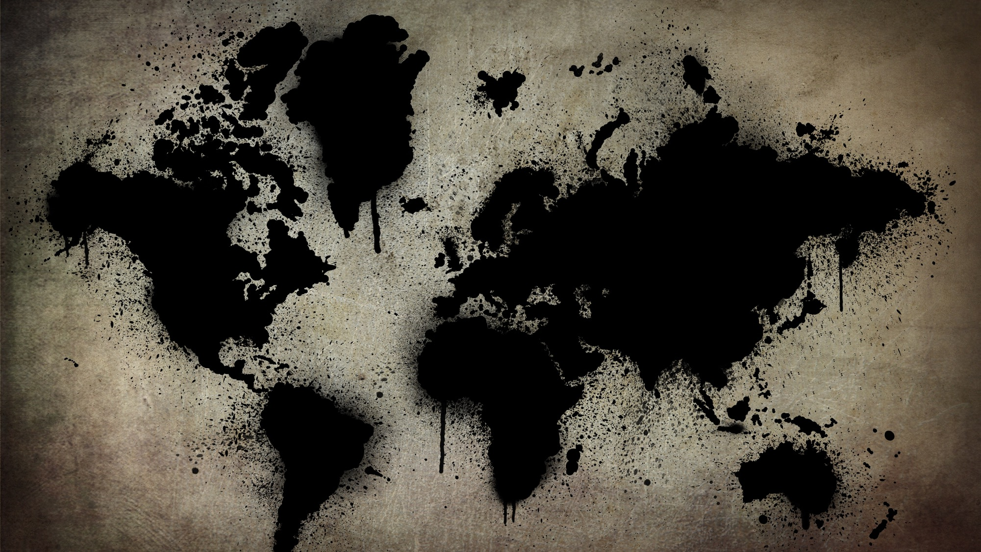
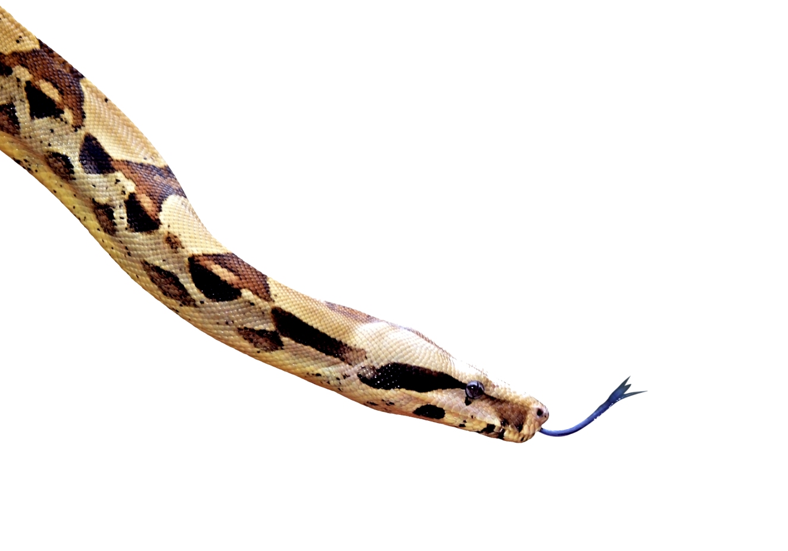
I. “THE SPIRITUAL CONDITION OF THE WORLD”
1. A SERPENT – GENESIS 1-3
“Then God saw everything that He had made, and indeed it was very good.” – Genesis 1:31
“There is none righteous, no, not one…for all have sinned and fall short of the glory of God.” – Romans 3:10, 23
“Therefore, just as through one man sin entered the world, and death through sin, and thus death spread to all men, because all sinned.” – Romans 5:12

Slide 5
I. “THE SPIRITUAL CONDITION OF THE WORLD”
1. A SERPENT – GENESIS 1-3
“Then God saw everything that He had made, and indeed it was very good.” – Genesis 1:31
Sowing doubt – vs. 1
Lying – vs. 4
Twisting the truth – vs. 5

Slide 6
“ For all that is in the world—the lust of the flesh, the lust of the eyes, and the pride of life—is not of the Father but is of the world.” 1 John 2:16

Slide 7
Lust of the flesh lust of the eyes pride of life

Slide 8
I. “THE SPIRITUAL CONDITION OF THE WORLD”
2. A SACRIFICE – GENESIS 4:1-16
COMPROMISE – Genesis 4:3
COMPARISON – Genesis 4:4b-5a
CHOICE – Genesis 4:8
CONSEQUENCES – Genesis 4:9-16

Slide 9
I. “THE SPIRITUAL CONDITION OF THE WORLD”
3. A SELECTION – GENESIS 4:16-6:4
CAIN’S LINEAGE – Genesis 4:19,23-24
SETH’S LINEAGE – Genesis 4:26
GENESIS 6:1-2 – The Turning Point...

Slide 10
I. “THE SPIRITUAL CONDITION OF THE WORLD”
4. A SYNOPSIS – GENESIS 6:5-12
“The wickedness of man was great in the Earth” – vs. 5
“Every intent of the thoughts of his heart was only evil continually ” – vs. 5
“The Earth was also corrupt before God and the earth was filled with violence” – vs. 11
“It was corrupt; for all flesh had corrupted their way on the Earth” – vs. 12

Slide 11
II. ”GOD’S
INITIAL
SOLUTION”
SODOM & GOMORRAH: Genesis 18-19
DAVID: 2 Samuel 11-12
THE ISRAELITES: Hebrews 3:7-11
MANKIND, IN GENERAL: 2 Thessalonians 1:8-9; 2 Pet. 3:9
“And the Lord said, ‘My Spirit shall not strive with man forever, for he is indeed flesh; yet his days shall be one hundred and twenty years.’”
Genesis 6:3

Slide 12
III. “APPLICATION”
A MORE MODERN EXAMPLE
“For 185 years, American culture was friendly toward Christianity.”
Dr. Dave Miller, “The Silencing of God”

Slide 13
1. THE DECLARATION OF INDEPENDENCE
“Nature’s God”
“all men are created equal” and “endowed by their Creator”
“appealing to the Supreme Judge of the world”
“with a firm reliance on the protection of divine Providence”

Slide 14
2. THE FEDERAL CONSTITUTION
“The Christian religion is inherently assumed and implicitly present in the Constitution. In fact, the United States Constitution contains a direct reference to Jesus Christ!”

Slide 15
EVIDENCE WITHIN THE CONSTITUTION:
“Congress shall make no law respecting an establishment of religion, or prohibiting the free exercise thereof...”
“[A]ll men have an equal, natural, and unalienable Right to the free Exercise of Religion according to the dictates of conscience, and that no particular religious sect or society of Christians ought to be favored or established by law in preference to others.” – George Mason (“Father of the Bill of Rights”), proposed this wording for the First Amendment

Slide 16
EVIDENCE WITHIN THE CONSTITUTION:
“Congress shall make no law respecting an establishment of religion, or prohibiting the free exercise thereof...”
“If any Bill shall not be returned by the President within ten Days (Sundays excepted) after it shall have been presented to him, the Same shall be a Law, in like Manner as if he had signed it...”
“Done in Convention of September in the Year of our Lord one thousand seven hundred and Eighty seven and of the Independence of the United States of America the Twelfth...”

Slide 17
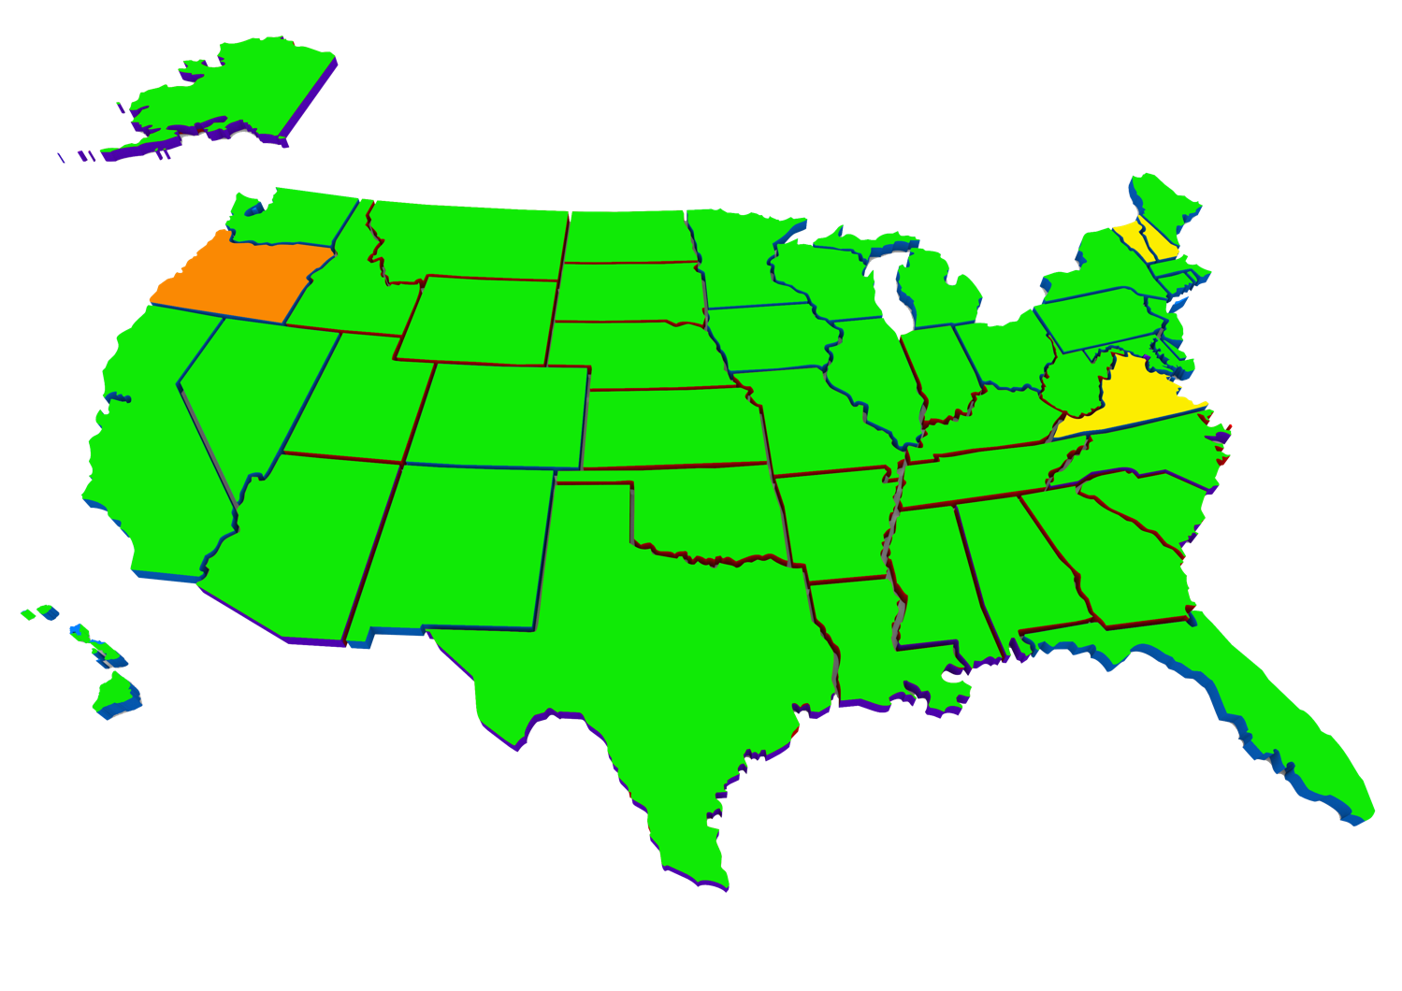
Of the 50 state constitutions, 47 have “preambles,” and 46 of those preambles make explicit, even passionate, appeals to the God of the Bible!
COLORADO’S PREAMBLE:
“We the people of Colorado, with profound reverence for the Supreme Ruler of the Universe, in order to form a more independent and perfect government; establish justice; insure tranquility; provide for the common defense; promote the general welfare and secure the blessings of liberty to ourselves and our posterity, do ordain and establish this Constitution for the State of Colorado.”
GREEN=States with preambles that directly reference the God of the Bible
ORANGE=State that has a preamble that DOESN’T mention the God of the Bible
YELLOW=States that do not HAVE preambles to their constitution

Slide 18
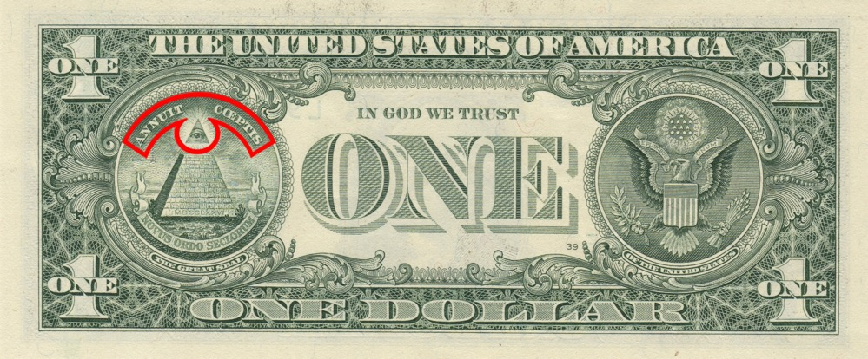
Our National Seal
“In God We Trust”
The “Eye of Providence” (at the top of the pyramid)
“Annuit Coeptis” (Latin for “He [God] favors our undertakings”)

Slide 19
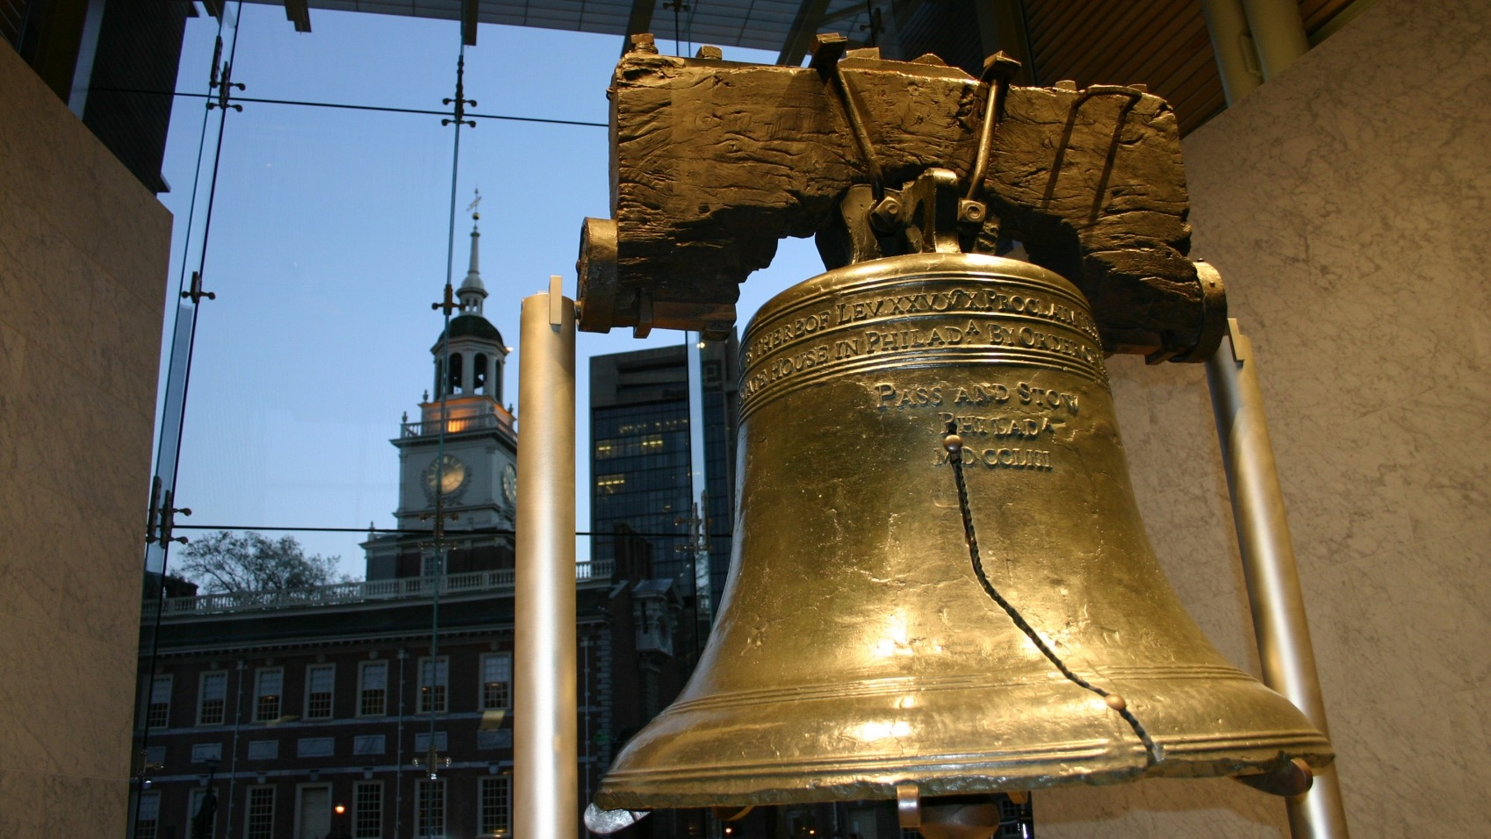
The Liberty Bell
“Proclaim liberty throughout all the land, unto all the inhabitants thereof...”
Leviticus 25:10

Slide 20
The Statue of Liberty
“Proclaim liberty throughout all the land, unto all the inhabitants thereof...”
Leviticus 25:10

Slide 21
WHAT IS HAPPENING IN AMERICAN CULTURE?
God is being systematically removed from the fabric of American culture
Christian morality is under heavy attack and immorality is rampant (atheism, abortion, homosexuality, etc.).
Evolution is taught as fact in public education, and God/the Bible/prayer are being pushed out.

Slide 22
THREE SIMILARITIES:
SPIRITUAL CORRUPTION – Genesis 6:5-12
IMMINENT DESTRUCTION – 2 Peter 3:1-10
GOD’S TEMPORARY TOLERATION –
2 Peter 3:9

Slide 23
“Therefore, since all these things will be dissolved, what manner of persons ought you to be in holy conduct and godliness, looking for and hastening the coming of the day of God.... Therefore, beloved, looking forward to these things, be diligent to be found by Him in peace, without spot and blameless; and consider that the longsuffering of our Lord is salvation....” 2 Peter 3:11-15

Slide 24
THE WORLD
VACATION BIBLE SCHOOL

