Slide 1
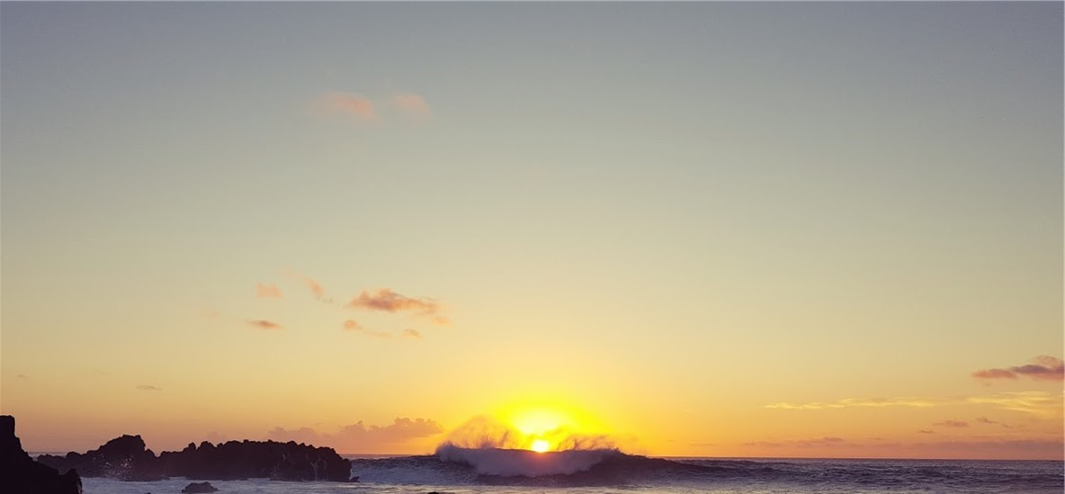
Wait on the Lord
Josh Blackmer
Palm Beach Lakes church of Christ
2 Kings 6:24-30
Notes:
It was evident that Elisha had been preaching that message to the disdain of the one sent to kill him.
Earlier in the same chapter God had saved the city of Dothan through Elisha, “Those that are with are more than those who are with them.”
Maybe an expectation that Elisha would do something similar in this case.
It was taught though out the Psalms and the prophets

Slide 2
Wait on the Lord
Wait for the Lord; be strong, and let your heart take courage; yes, wait for the Lord!
Psalm 27:14

Slide 3
Wait on the Lord
Rest in the Lord and wait patiently for Him; do not fret because of him who prospers in his way, because of the man who carries out wicked schemes. Cease from anger and forsake wrath; do not fret; it leads only to evildoing. For evildoers will be cut off, but those who wait for the Lord, they will inherit the land.
Psalm 37:7-9

Slide 4
Wait on the Lord
I wait for the Lord, my soul does wait, and in His word do I hope. My soul waits for the Lord more than the watchmen for the morning; indeed, more than the watchmen for the morning.
Psalm 130:5-6

Slide 5
Wait on the Lord
The Lord is good to those who wait for Him, to the person who seeks Him. It is good that he waits silently for the salvation of the Lord.
Lamentations 3:25-26

Slide 6
Wait on the Lord
Do you not know? Have you not heard? The everlasting God, the Lord, the Creator of the ends of the earth does not become weary or tired. His understanding is inscrutable. He gives strength to the weary, and to him who lacks might He increases power. Though youths grow weary and tired, and vigorous young men stumble badly, yet those who wait for the Lord will gain new strength; they will mount up with wings like eagles, they will run and not get tired, they will walk and not become weary.
Isaiah 40:28-31

Slide 7
Wait on the Lord
Though the fig tree should not blossom and there be no fruit on the vines, Though the yield of the olive should fail and the fields produce no food, Though the flock should be cut off from the fold and there be no cattle in the stalls, Yet I will exult in the LORD, I will rejoice in the God of my salvation. The Lord GOD is my strength, and He has made my feet like hinds' feet, And makes me walk on my high places.
Habakkuk 3:17-19

Slide 8
Wait on the Lord
Remember All
  God is faithful in His promises (Deut. 7:9)
  God is faithful in nature (Job 12:7-10; Mat. 6:25-30)
  God is faithful with us (2 Thess. 3:3; 1 John 1:9; 1 Cor. 10:13)
Notes:
"Know therefore that the LORD your God, He is God, the faithful God, who keeps His covenant and His lovingkindness to a thousandth generation with those who love Him and keep His commandments;(Deu 7:9)
"But now ask the beasts, and let them teach you; And the birds of the heavens, and let them tell you. "Or speak to the earth, and let it teach you; And let the fish of the sea declare to you. "Who among all these does not know That the hand of the LORD has done this, In whose hand is the life of every living thing, And the breath of all mankind?(Job 12:7-10)
"For this reason I say to you, do not be worried about your life, as to what you will eat or what you will drink; nor for your body, as to what you will put on. Is not life more than food, and the body more than clothing? "Look at the birds of the air, that they do not sow, nor reap nor gather into barns, and yet your heavenly Father feeds them. Are you not worth much more than they? "And who of you by being worried can add a single hour to his life? "And why are you worried about clothing? Observe how the lilies of the field grow; they do not toil nor do they spin, yet I say to you that not even Solomon in all his glory clothed himself like one of these. "But if God so clothes the grass of the field, which is alive today and tomorrow is thrown into the furnace, will He not much more clothe you? You of little faith!(Mat 6:25-30)
But the Lord is faithful, and He will strengthen and protect you from the evil one.(2Th 3:3)
If we confess our sins, He is faithful and righteous to forgive us our sins and to cleanse us from all unrighteousness.(1Jn 1:9)
No temptation has overtaken you but such as is common to man; and God is faithful, who will not allow you to be tempted beyond what you are able, but with the temptation will provide the way of escape also, so that you will be able to endure it. (1Co 10:13)

Slide 9
Wait on the Lord
Surrender All
  It’s what happens at baptism (Rom 6:4-6)
  It’s the cost of true disciple ship (Matthew 16:24-25)
  It’s exampled by those before us (Galatians 2:20; 2 Tim.4:5-8)
Notes:
Therefore we have been buried with Him through baptism into death, so that as Christ was raised from the dead through the glory of the Father, so we too might walk in newness of life. For if we have become united with Him in the likeness of His death, certainly we shall also be in the likeness of His resurrection, knowing this, that our old self was crucified with Him, in order that our body of sin might be done away with, so that we would no longer be slaves to sin;(Rom 6:4-6)
Then Jesus said to His disciples, "If anyone wishes to come after Me, he must deny himself, and take up his cross and follow Me. "For whoever wishes to save his life will lose it; but whoever loses his life for My sake will find it.(Mat 16:24-25)
"I have been crucified with Christ; and it is no longer I who live, but Christ lives in me; and the life which I now live in the flesh I live by faith in the Son of God, who loved me and gave Himself up for me.(Gal 2:20)
But you, be sober in all things, endure hardship, do the work of an evangelist, fulfill your ministry. For I am already being poured out as a drink offering, and the time of my departure has come. I have fought the good fight, I have finished the course, I have kept the faith; in the future there is laid up for me the crown of righteousness, which the Lord, the righteous Judge, will award to me on that day; and not only to me, but also to all who have loved His appearing.(2Ti 4:5-8)

Slide 10
Wait on the Lord
Prepare All
  It’s our response to His goodness (1 Peter 2:9-10; 3:14-15)
  It’s what keeps us focused (Mat. 6:33-34; Phil. 3:12-14)
  It’s what is expected of us (Luke 12:35-38)
Notes:
But you are A CHOSEN RACE, A royal PRIESTHOOD, A HOLY NATION, A PEOPLE FOR God's OWN POSSESSION, so that you may proclaim the excellencies of Him who has called you out of darkness into His marvelous light; for you once were NOT A PEOPLE, but now you are THE PEOPLE OF GOD; you had NOT RECEIVED MERCY, but now you have RECEIVED MERCY.(1Pe 2:9-10)
But even if you should suffer for the sake of righteousness, you are blessed. AND DO NOT FEAR THEIR INTIMIDATION, AND DO NOT BE TROUBLED, but sanctify Christ as Lord in your hearts, always being ready to make a defense to everyone who asks you to give an account for the hope that is in you, yet with gentleness and reverence;(1Pe 3:14-15)
"But seek first His kingdom and His righteousness, and all these things will be added to you. "So do not worry about tomorrow; for tomorrow will care for itself. Each day has enough trouble of its own.(Mat 6:33-34)
Not that I have already obtained it or have already become perfect, but I press on so that I may lay hold of that for which also I was laid hold of by Christ Jesus. Brethren, I do not regard myself as having laid hold of it yet; but one thing I do: forgetting what lies behind and reaching forward to what lies ahead, I press on toward the goal for the prize of the upward call of God in Christ Jesus.(Php 3:12-14)
"Be dressed in readiness, and keep your lamps lit. "Be like men who are waiting for their master when he returns from the wedding feast, so that they may immediately open the door to him when he comes and knocks. "Blessed are those slaves whom the master will find on the alert when he comes; truly I say to you, that he will gird himself to serve, and have them recline at the table, and will come up and wait on them. "Whether he comes in the second watch, or even in the third, and finds them so, blessed are those slaves.(Luk 12:35-38)

Slide 11
The Lord Is Waiting on You
Notes:
'Behold, I stand at the door and knock; if anyone hears My voice and opens the door, I will come in to him and will dine with him, and he with Me. 'He who overcomes, I will grant to him to sit down with Me on My throne, as I also overcame and sat down with My Father on His throne. (Rev 3:20-21)
When the Lamb broke the fifth seal, I saw underneath the altar the souls of those who had been slain because of the word of God, and because of the testimony which they had maintained; and they cried out with a loud voice, saying, "How long, O Lord, holy and true, will You refrain from judging and avenging our blood on those who dwell on the earth?" And there was given to each of them a white robe; and they were told that they should rest for a little while longer, until the number of their fellow servants and their brethren who were to be killed even as they had been, would be completed also. (Rev 6:9-11)
"And behold, I am coming quickly, and My reward is with Me, to give to every one according to his work. (Rev 22:12)

