Slide 1
Daniel Had a Dream
Daniel 8:15-19

Slide 2
The Text—Daniel 8:15-19
In Spirit and in Truth--Praying
15 Then it happened, when I, Daniel, had seen the vision and was seeking the meaning, that suddenly there stood before me one having the appearance of a man.
16 And I heard a man's voice between the banks of the Ulai, who called, and said, "Gabriel, make this man understand the vision."
17 So he came near where I stood, and when he came I was afraid and fell on my face; but he said to me, "Understand, son of man, that the vision refers to the time of the end."
18 Now, as he was speaking with me, I was in a deep sleep with my face to the ground; but he touched me, and stood me upright.
19 And he said, "Look, I am making known to you what shall happen in the latter time of the indignation; for at the appointed time the end shall be.”

Slide 3
Background of Explaining the Vision
In Spirit and in Truth--Praying
Daniel in Babylon, Jerusalem destroyed and 70 years captivity begun
King Belshazzar He reigned about four years, this vision seen in 4th year
The Medes and Persians were ascending in power
He is the king who saw the handwriting on wall and died the same night
This message showed what was about to happen
Daniel’s vision seen just before start of Medo-Persian reign of 200+ years

Slide 4
The Dream
In Spirit and in Truth--Praying
First Part:
- A river (Ulai)
- A ram
- Two horns, smaller one became greater
- Became great

Slide 5
The Dream
In Spirit and in Truth--Praying
First Part:
- A river (Ulai)
- A ram
- Two horns, smaller one became greater
- Became great
Second Part:
- A goat with one horn
- Ran across the earth, feet not touching ground
- Attacked the ram, broke both horns, the ram and trampled on it, four new horns
- Out of one of these horn, another horn grew

Slide 6
The Dream
In Spirit and in Truth--Praying
First Part:
- A river (Ulai)
- A ram
- Two horns, smaller one became greater
- Became great
Second Part:
- A goat with one horn
- Ran across the earth, feet not touching ground
- Attacked the ram, broke both horns, the ram and trampled on it, four new horns
- Out of one of these horn, another horn grew
Third Part:
- This new little horn grew
- Came to destroy the “Glorious Land” (Canaan)
- Because of sin, daily sacrifices in temple for 2,300 “days,” then worship resumed

Slide 7
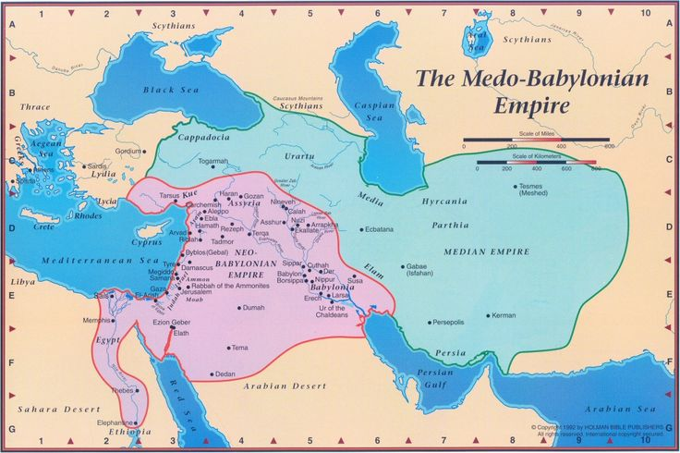
Background of Explaining the Vision
In Spirit and in Truth--Praying
The Ram With Two Horns
The Ram With Two Horns

Slide 8
The Dream
In Spirit and in Truth--Praying
First Part:
- A river (Ulai)
- A ram
- Two horns, smaller one became greater
- Became great
Second Part:
- A goat with one horn
- Ran across the earth, feet not touching ground
- Attacked the ram, broke both horns, of the ram--trampled on it, four new horns
- Out of one of these horn, another horn grew

Slide 9
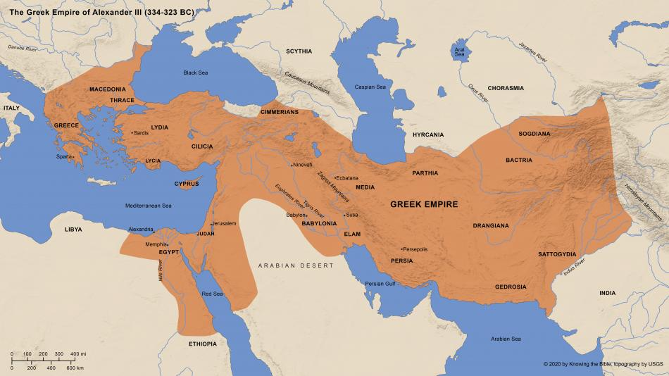
Introduction—Number One!
In Spirit and in Truth--Praying
The “Unigoat: From the West

Slide 10
The Dream
In Spirit and in Truth--Praying
First Part:
- A river (Ulai)
- A ram
- Two horns, smaller one became greater
- Became great
Second Part:
- A goat with one horn
- Ran across the earth, feet not touching ground
- Attacked the ram, broke both horns, the ram and trampled on it—four new horns
- Out of one of these horn, another horn grew
Third Part:
- This new little horn grew
- Came to destroy the “Glorious Land” (Canaan)
- Because of sin, daily sacrifices in temple for 2,300 “days,” then worship resumed

Slide 11
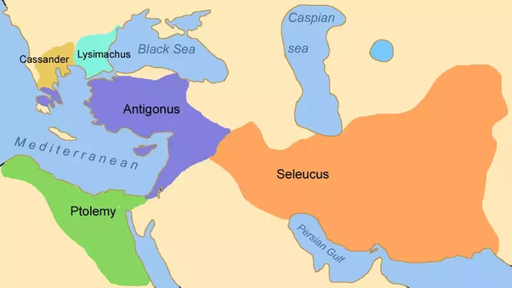
Introduction—Number One!
In Spirit and in Truth--Praying

Slide 12
The Horn Which Stopped the Daily Sacrifice
In Spirit and in Truth--Praying
Only two of four divisions impact the Jews
The North=Seleucids
The South=Ptolemys
About 200 B.C. the Rule of the Antiochus

Slide 13
The Horn Which Stopped the Daily Sacrifice
In Spirit and in Truth--Praying
Only two of four divisions impact the Jews
The North=Seleucids
The South=Ptolemys
About 200 B.C. the Rule of the Antiochus
In 168 B. C. Antiiochus Epiphanes desecrates temple worship
In 165 B. C. Jews rebellion (the Maccabees) family leads
Daily sacrifice restored after 2,300 evening and morning sacrifices

Slide 14
Path to Finding God
Believe Mark 16:16
Repent Luke 13:3
Confess Faith in Him Rom. 10:9
Be Baptized Into Him, sins washed away Acts 22:16
You are Now a Member of His Flock—His Glorious Church
Now be faithful until you die Rev. 2:10

