Slide 1
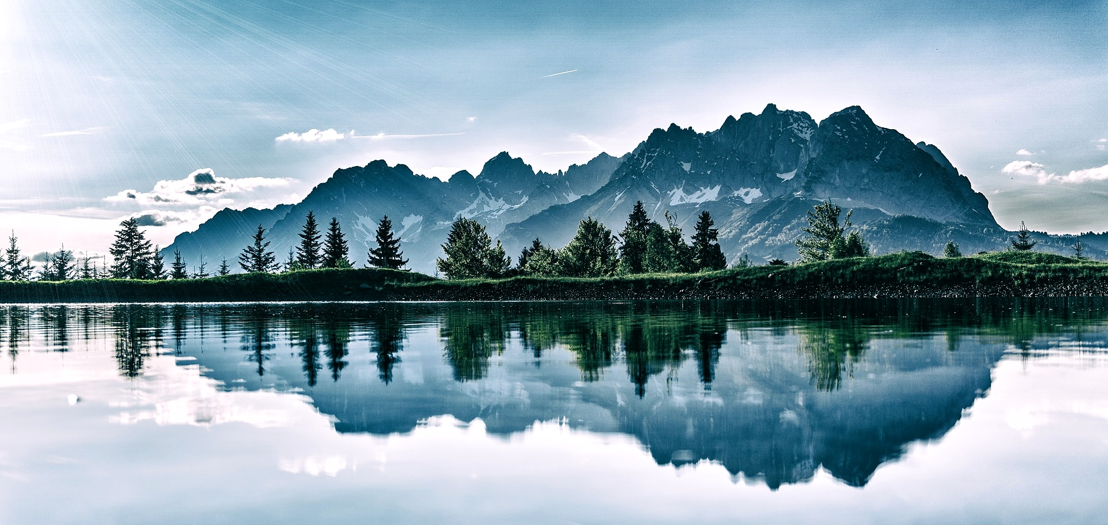
Stand in Confidence
Josh Blackmer
Palm Beach Lakes church of Christ
Psalm 122

Slide 2
My Help Comes From the Lord

Slide 3
I will lift up my eyes to the mountains; From where shall my help come? My help comes from the LORD, Who made heaven and earth.
Psalm 121:1-2

Slide 4
Cry For Help
Heed the sound of my cry for help, my King and my God, For to You I pray. (Psalm 5:2)
Help, LORD, for the godly man ceases to be… (Psalm 12:1)
Make haste to help me, O Lord, my salvation! (Psalm 38:22)
In my distress I called upon the LORD. (Psalm18:6)

Slide 5
Confidence in the Lord
Psalm 121
Your foot will not slip (3)
He will Keep you (3-5)
He will not slumber (4)
Shade from the Sun and Moon (5-6)
Protect you from all evil (7)
Guard your going out and coming in (8)

Slide 6
Stand in Confidence
Hananiah, Mishael and Azariah - Daniel 3
Daniel was told not to pray – Daniel 6
Rebuilding the Temple - Ezra 3-6
Rebuilding the Wall - Nehemiah 3-6
Jewish opposition to the church - Acts 4, 7, 17
Roman opposition to the church - Acts 19
Opposition by the apostate church

Slide 7
Stand in Confidence
Hebrews 10:32-39; 11:32-38
Romans 8:31-39 (Psalm 44:22)
Galatians 5:1 “It was for freedom that Christ set us free; therefore keep standing firm and do not be subject again to a yoke of slavery.”
1 Corinthians 16:13 “Be on the alert, stand firm in the faith, act like men, be strong.”

Slide 8
I will lift up my eyes to the mountains; From where shall my help come? My help comes from the LORD, Who made heaven and earth.
Psalm 121:1-2

