Slide 2
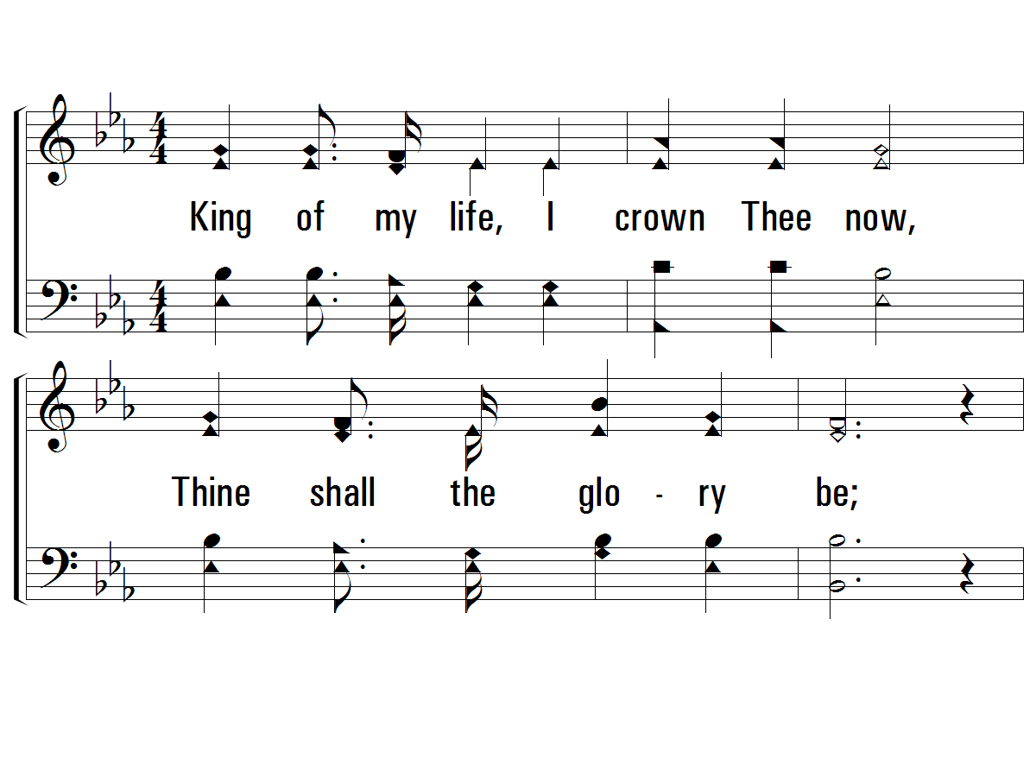
Verse 1
#384 – Lead Me to Calvary
1.
King of my life, I crown Thee now,
Thine shall the glory be;
Lest I forget Thy thorn crowned brow,
Lead me to Calvary.

Slide 3
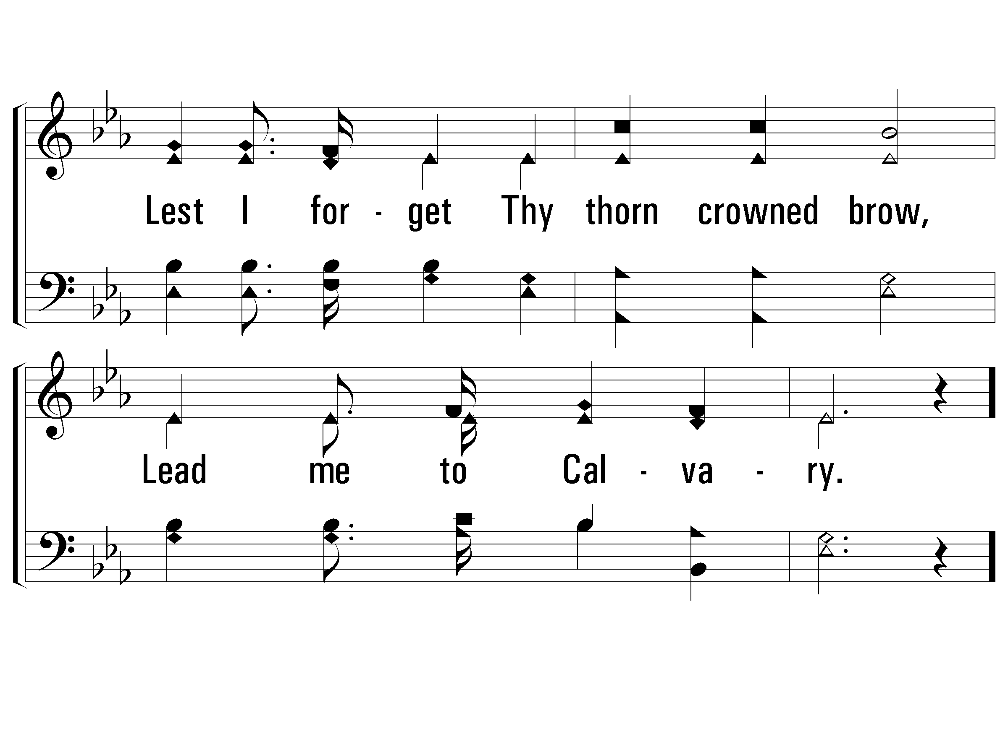
Verse 1
#384 – Lead Me to Calvary

Slide 4
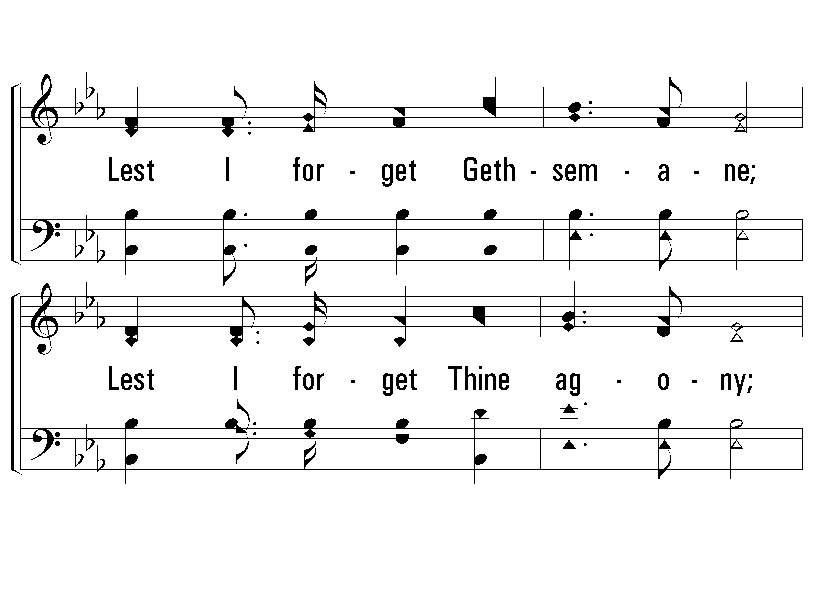
Chorus
#384 – Lead Me to Calvary
Lest I forget Gethsemane;
Lest I forget Thine agony;
Lest I forget Thy love for me,
Lead me to Ca-vary.

Slide 5
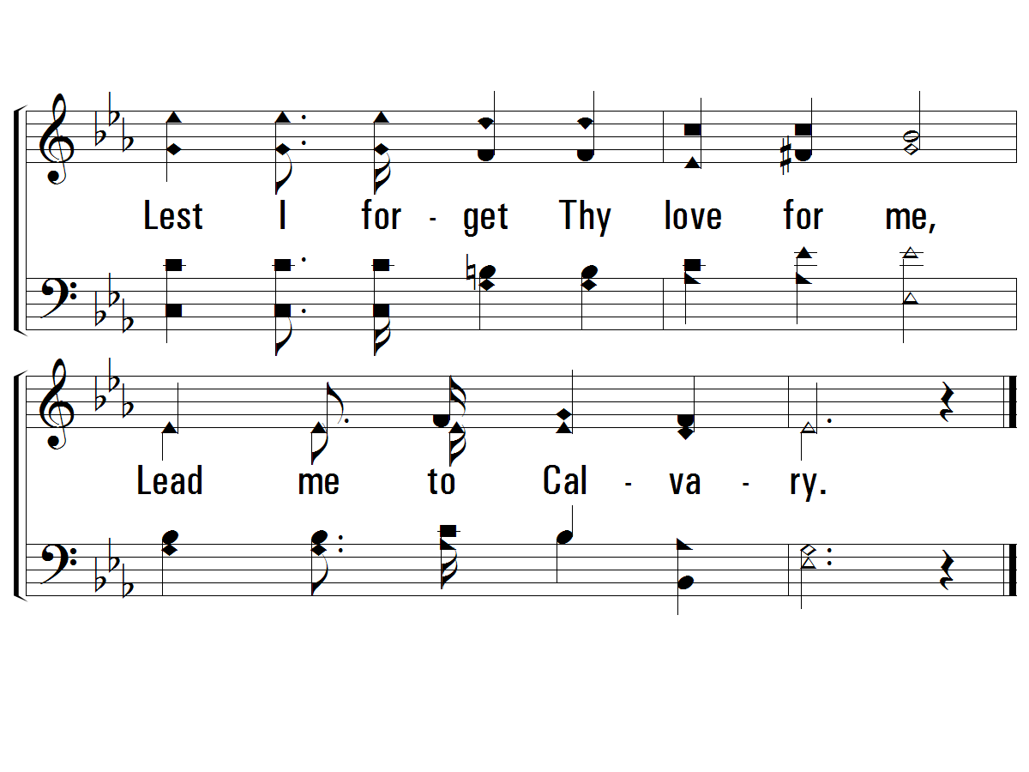
Chorus
#384 – Lead Me to Calvary

Slide 6
Jesus Predicted His Suffering and Death

Slide 7
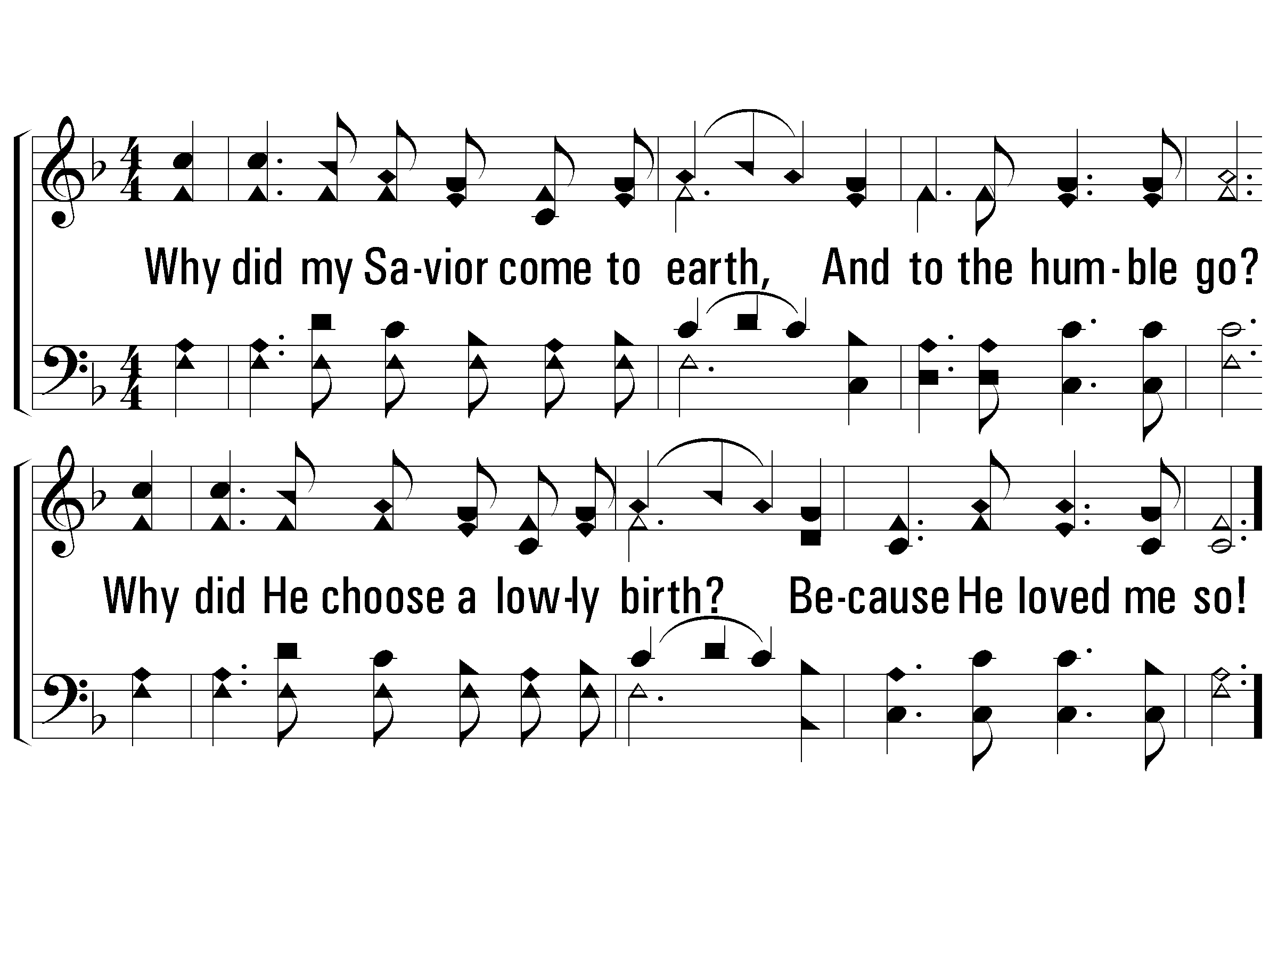
Verse 1
#784 – Why Did My Savior Come to Earth?
1.
Why did my Savior come to earth,
And to the humble go?
Why did He choose a lowly birth?
Be-cause He loved me so!

Slide 8
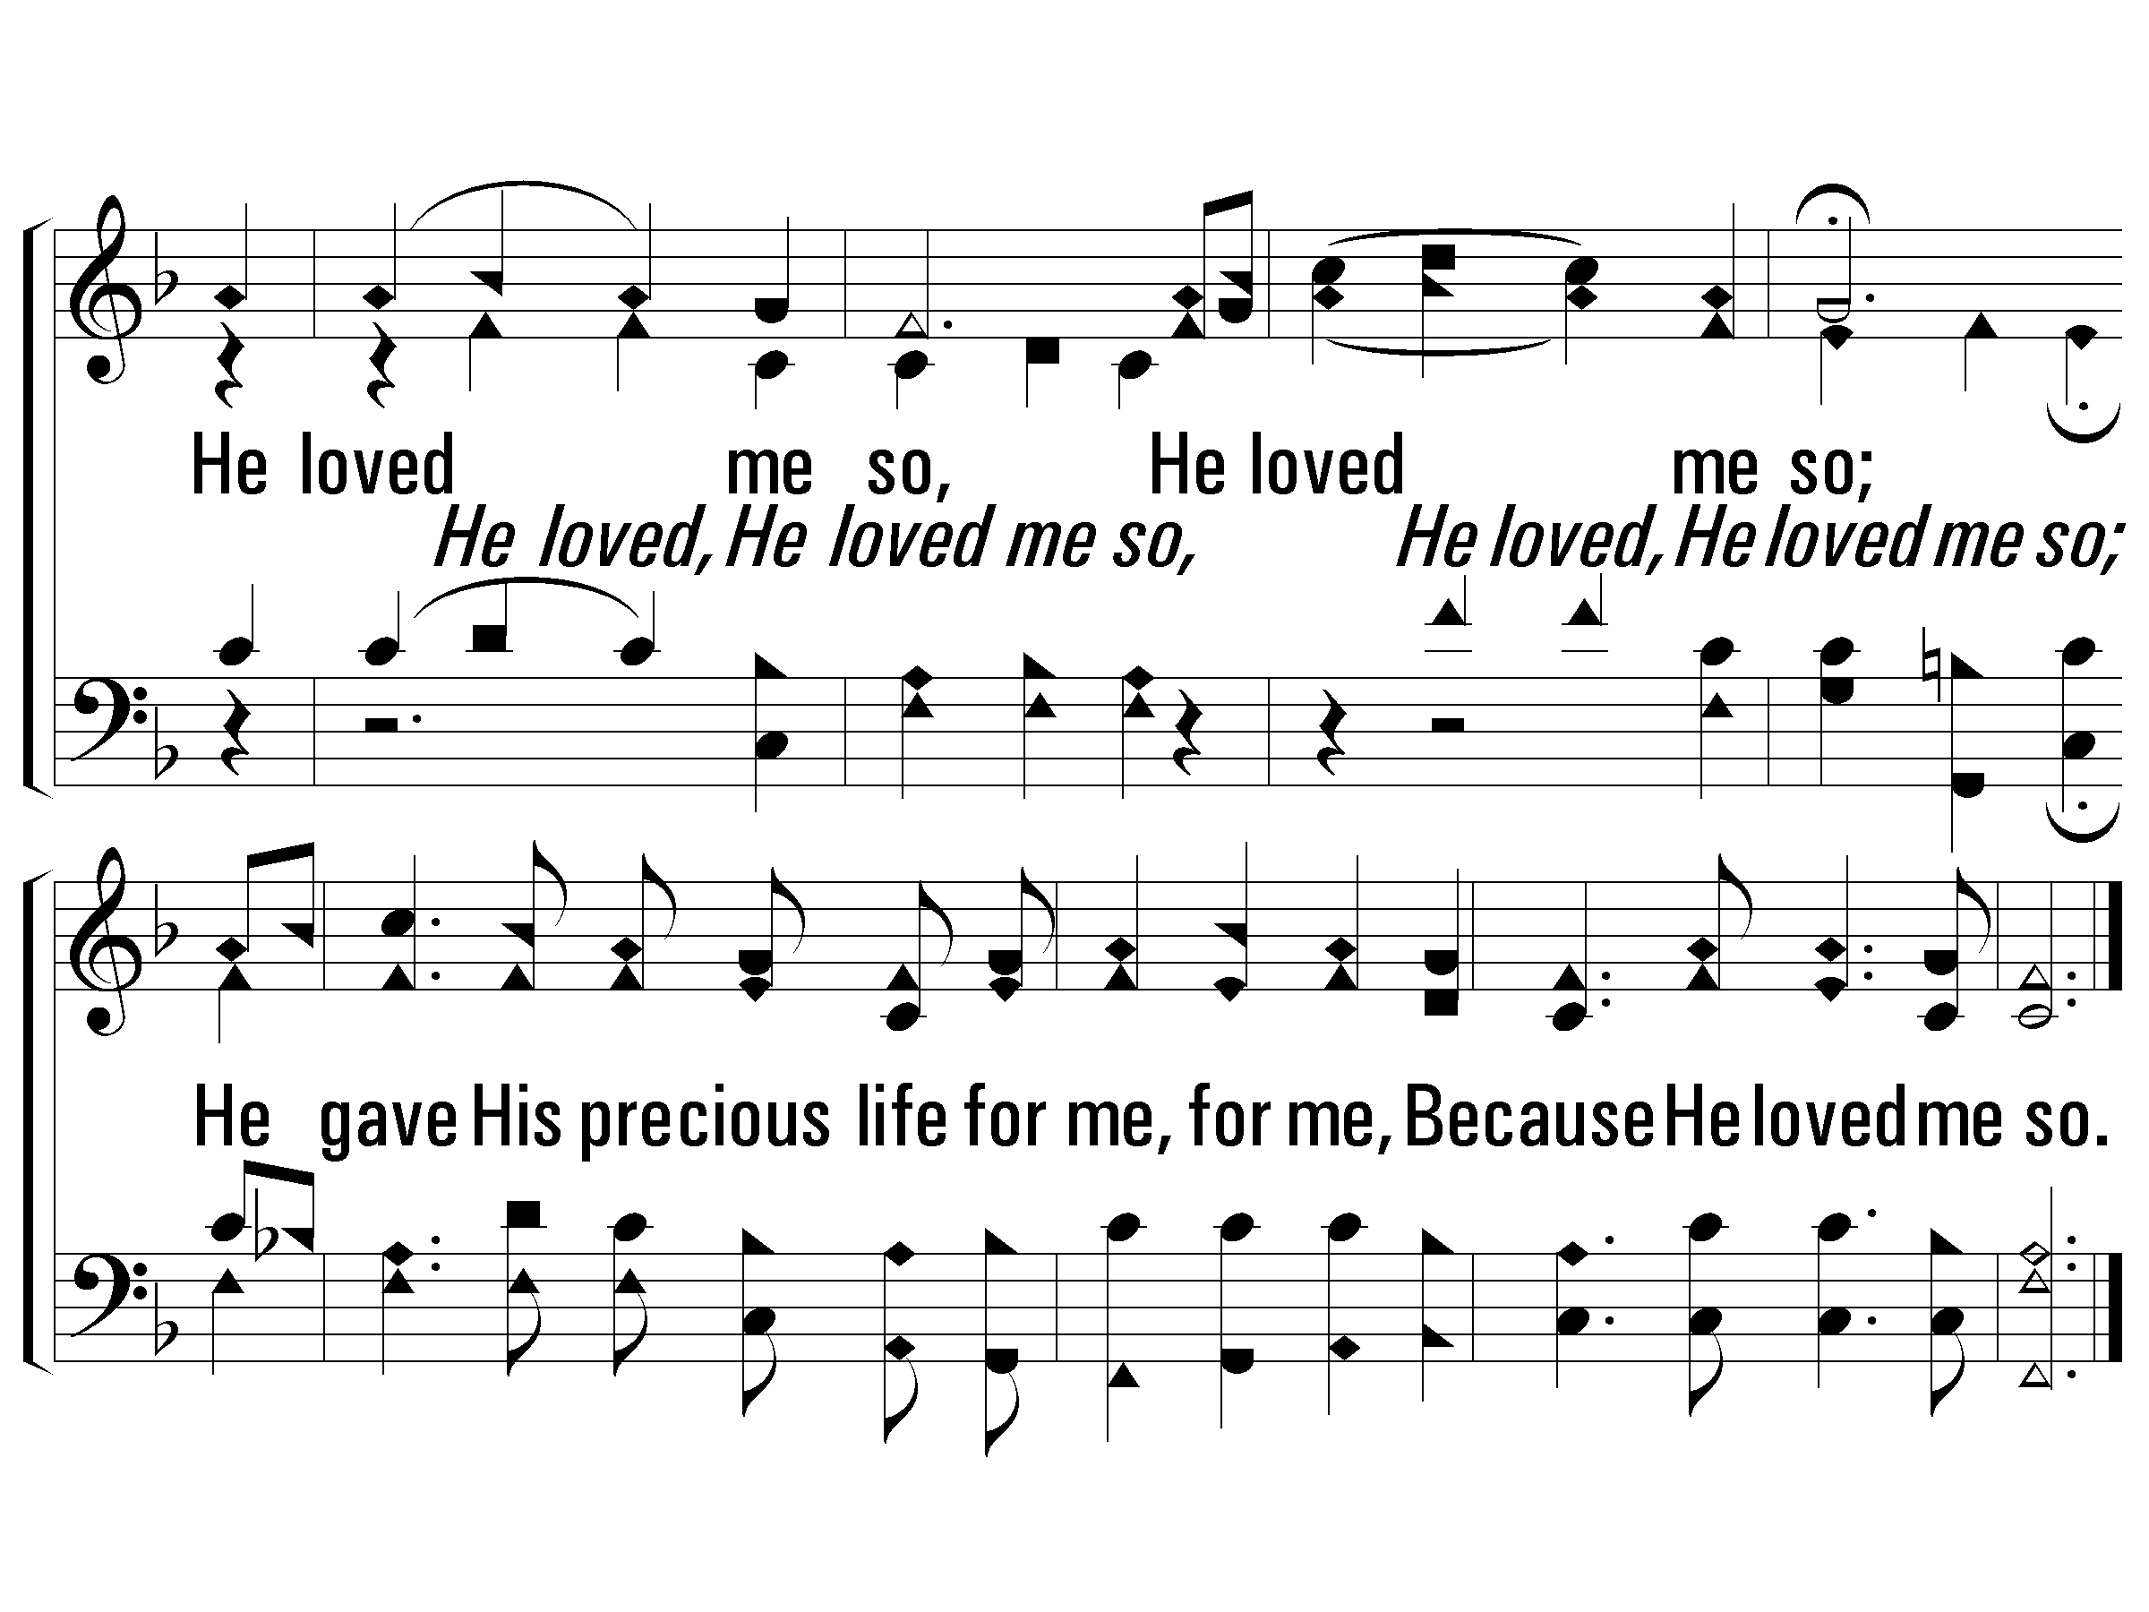
Chorus
#784 – Why Did My Savior Come to Earth?
He loved me so,
He loved me so;
He gave His precious life for me, for me,
Because He loved me so. l

Slide 9
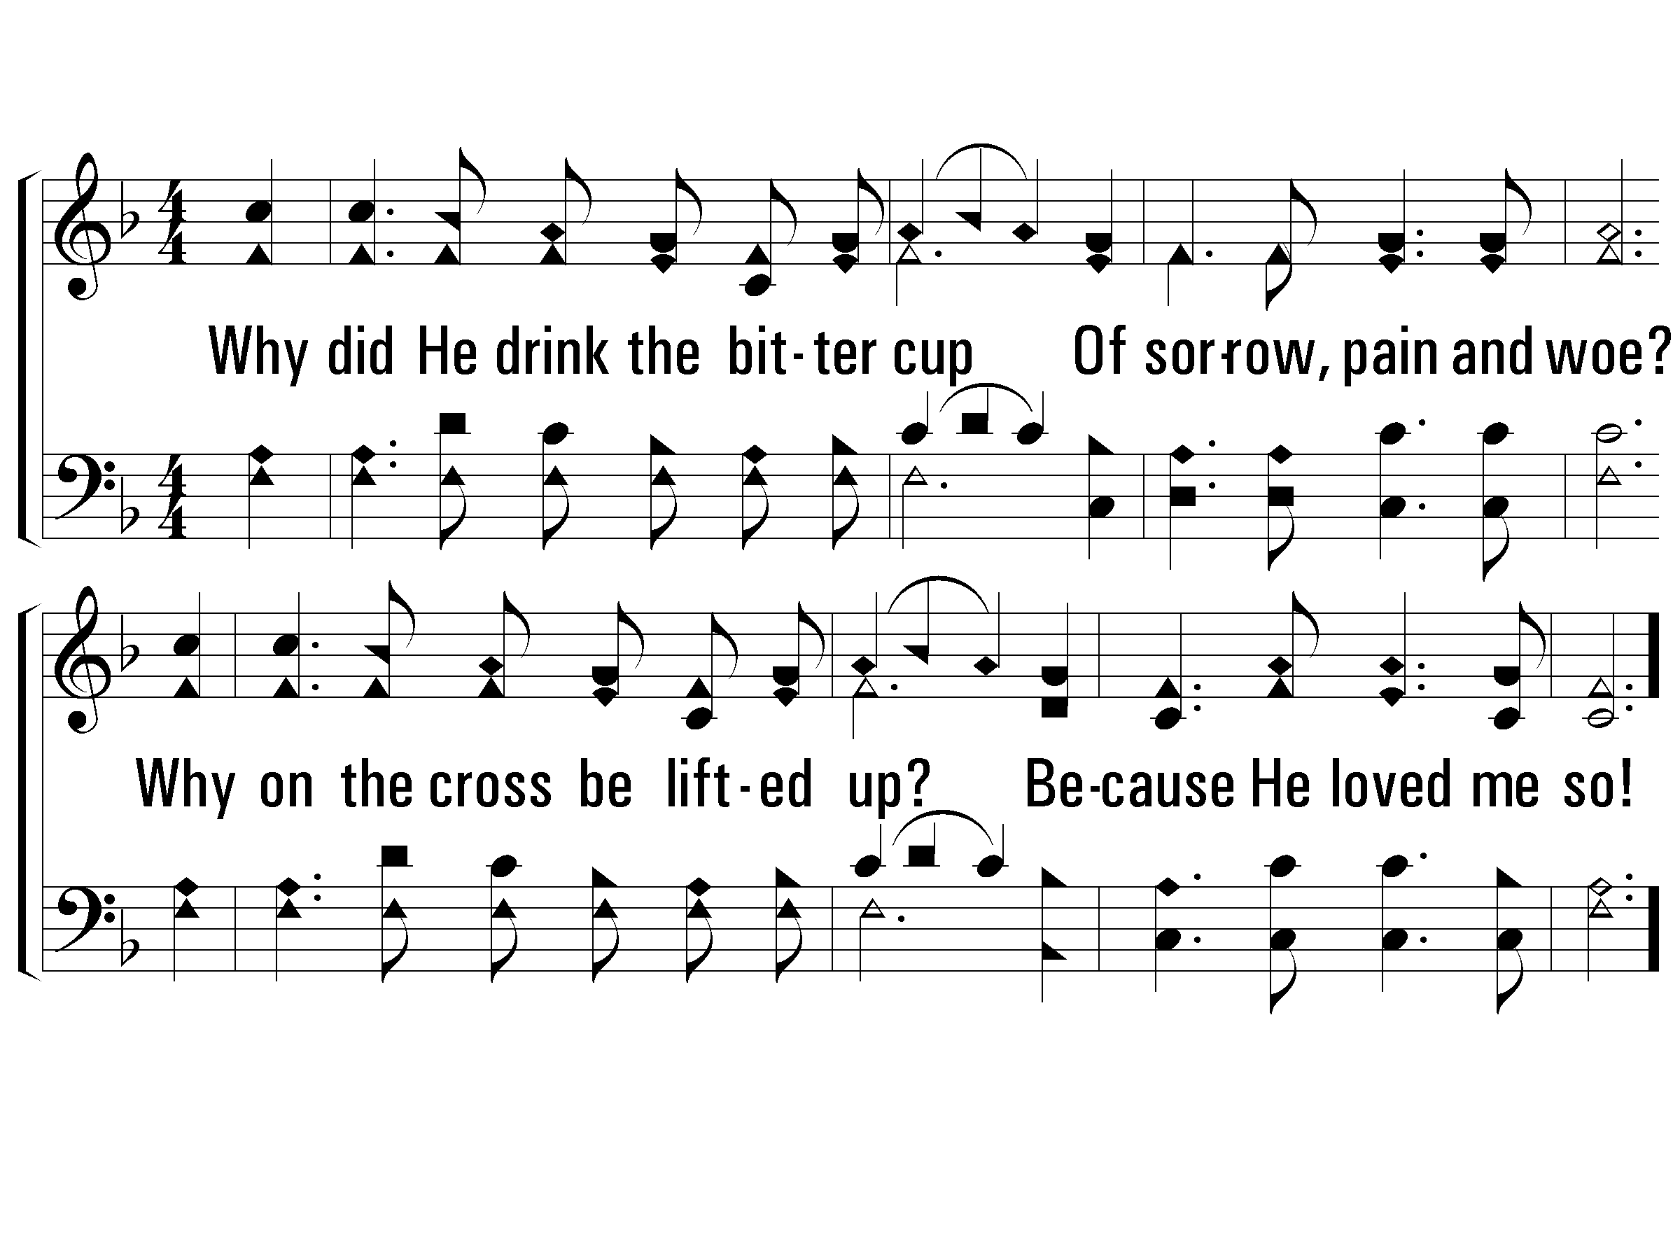
Verse 2
#784 – Why Did My Savior Come to Earth?
2.
Why did He drink the bitter cup
Of sorrow, pain and woe?
Why on the cross be lifted up?
Because He loved me so!

Slide 10
Chorus
#784 – Why Did My Savior Come to Earth?
He loved me so,
He loved me so;
He gave His precious life for me, for me,
Because He loved me so. l

Slide 11
Jesus Predicted His Suffering and Death
Jesus Identified His Betrayer
Jesus Predicted Peter’s Denial

Slide 12
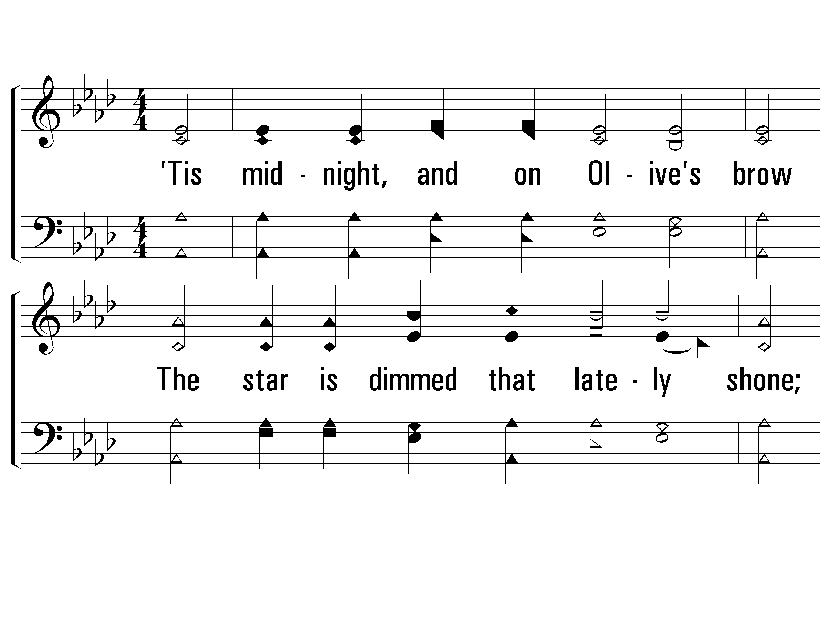
Verse 1
#709 – ‘Tis Midnight, and on Olive’s Brow
1.
'Tis midnight, and on Olive's brow
The star is dimmed that lately shone;
'Tis midnight; in the garden, now
The suffering Savior prays alone.

Slide 13
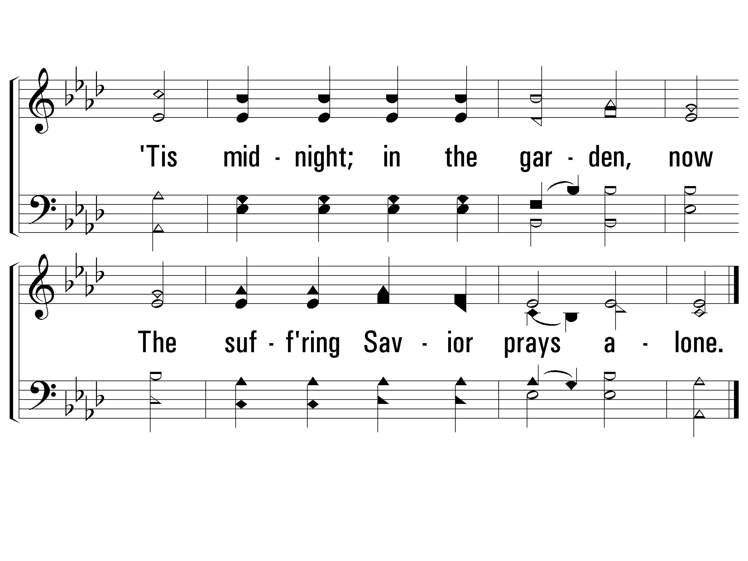
Verse 1
#709 – ‘Tis Midnight, and on Olive’s Brow

Slide 14
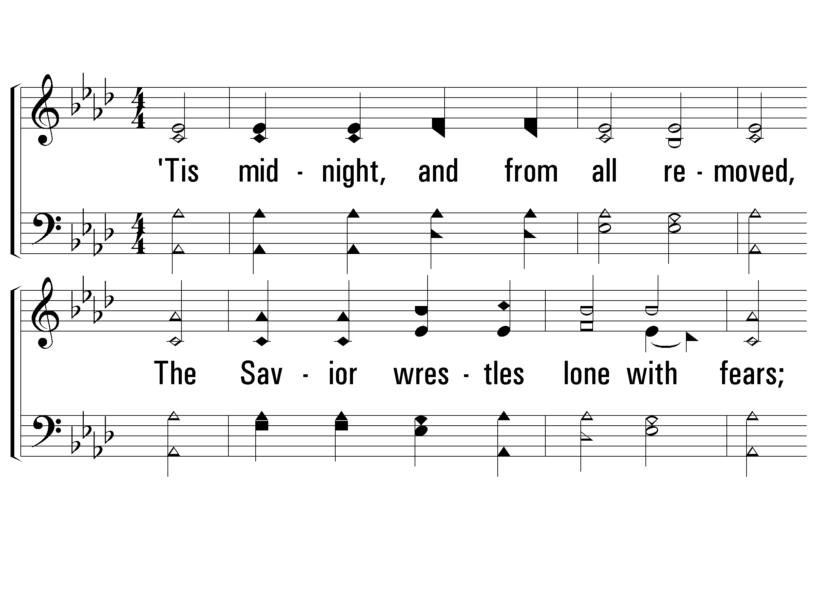
Verse 2
#709 – ‘Tis Midnight, and on Olive’s Brow
2.
'Tis midnight, and from all removed,
The Savior wrestles lone with fears;
Even that disciple whom He loved
Heeds not his Master's grief and tears.

Slide 15
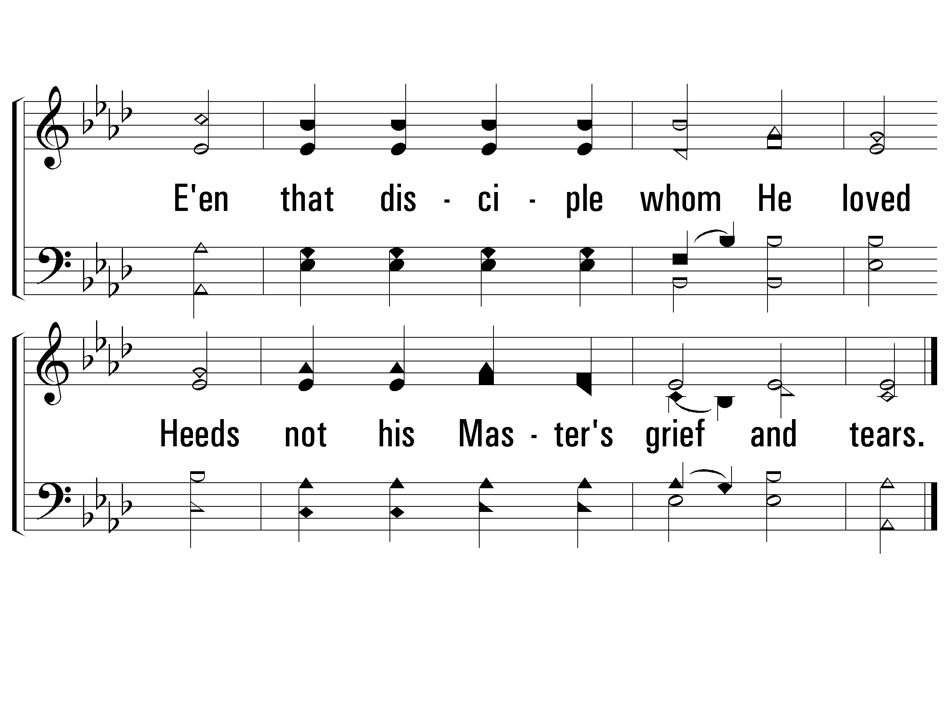
Verse 2
#709 – ‘Tis Midnight, and on Olive’s Brow

Slide 16
Jesus Predicted His Suffering and Death
Jesus Identified His Betrayer
Jesus Predicted Peter’s Denial
Jesus Instituted the Lord’s Supper
Jesus Prayed and Agonized in Gethsemane

Slide 17
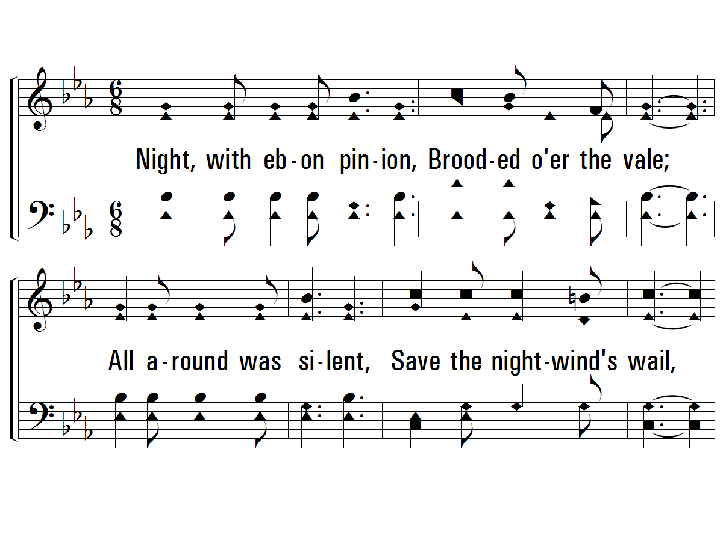
Verse 1
#452 – Night, with Ebon Pinion
1.
Night, with ebon pinion,
Brooded over the vale;
All around was silent,
Save the night-wind's wail,
When Christ, the Man of Sorrows,
In tears and sweat and blood,
Prostrate in the garden,
Raised His voice to God.

Slide 18
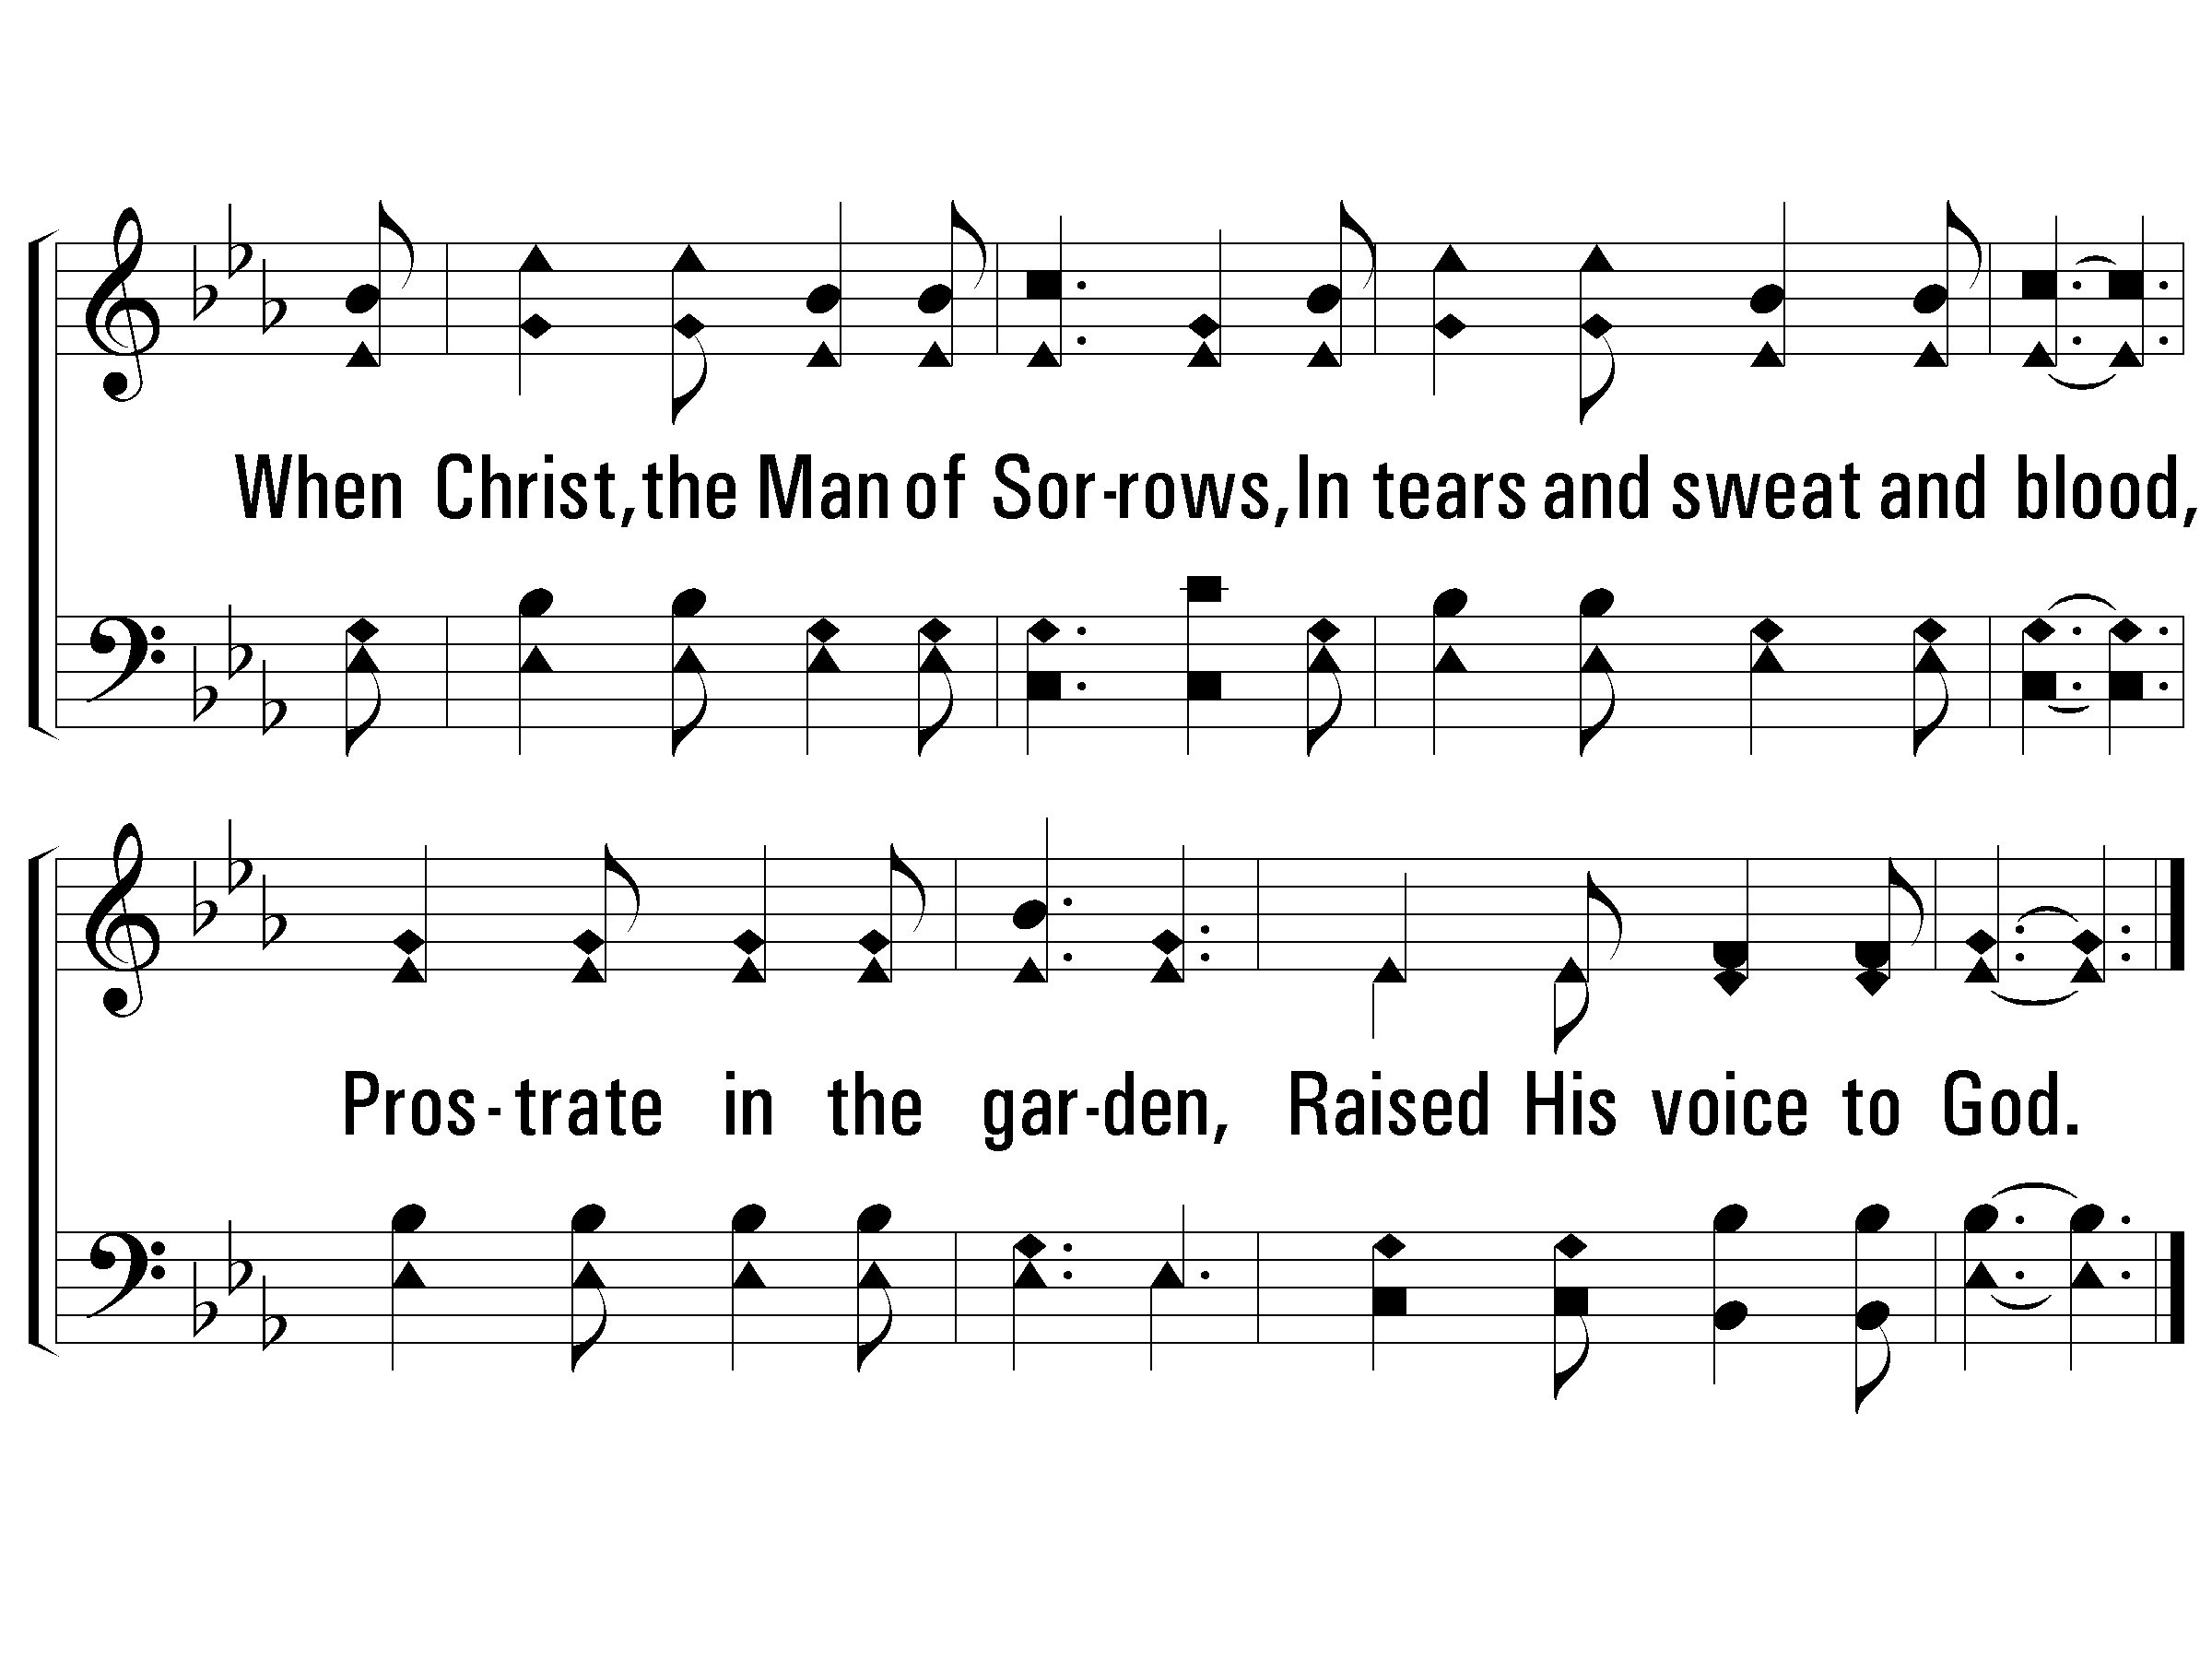
Verse 1
#452 – Night, with Ebon Pinion

Slide 19
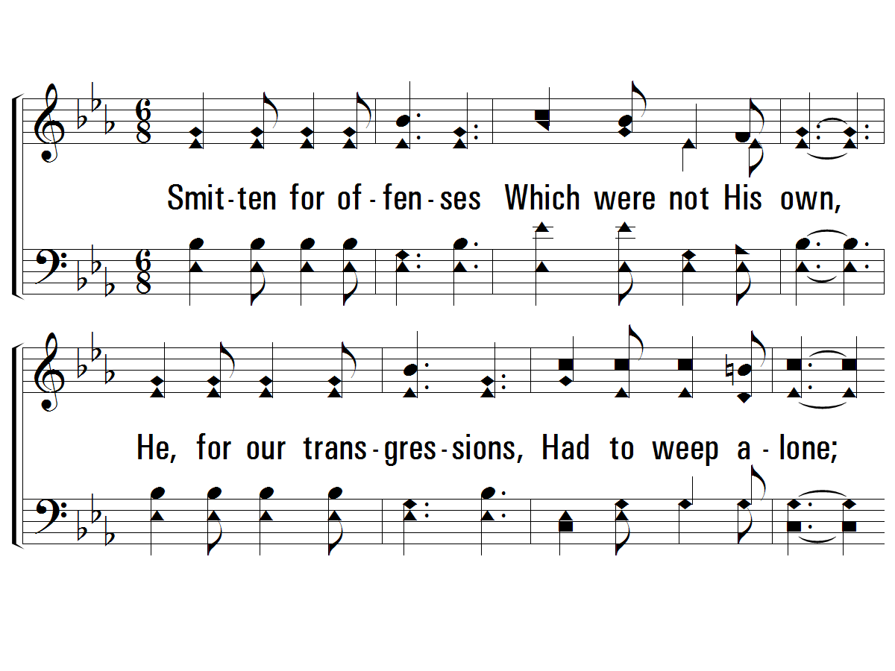
Verse 2
#452 – Night, with Ebon Pinion
2.
Smitten for offenses
Which were not His own,
He, for our transgressions,
Had to weep alone;
No friend with words to comfort,
Nor hand to help was there,
When the Meek and Lowly
Humbly bowed in prayer.

Slide 20
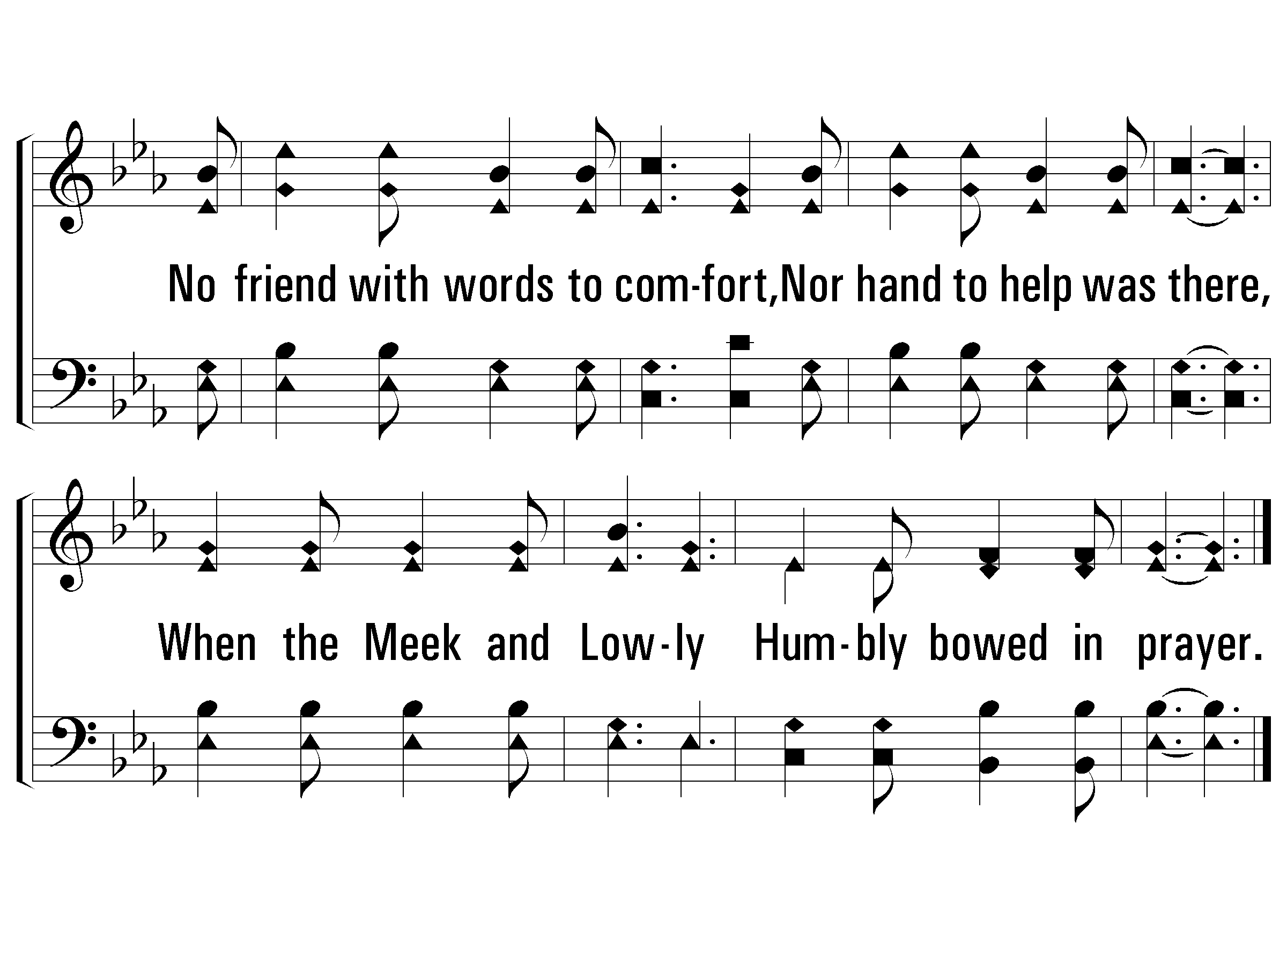
Verse 2
#452 – Night, with Ebon Pinion

Slide 21
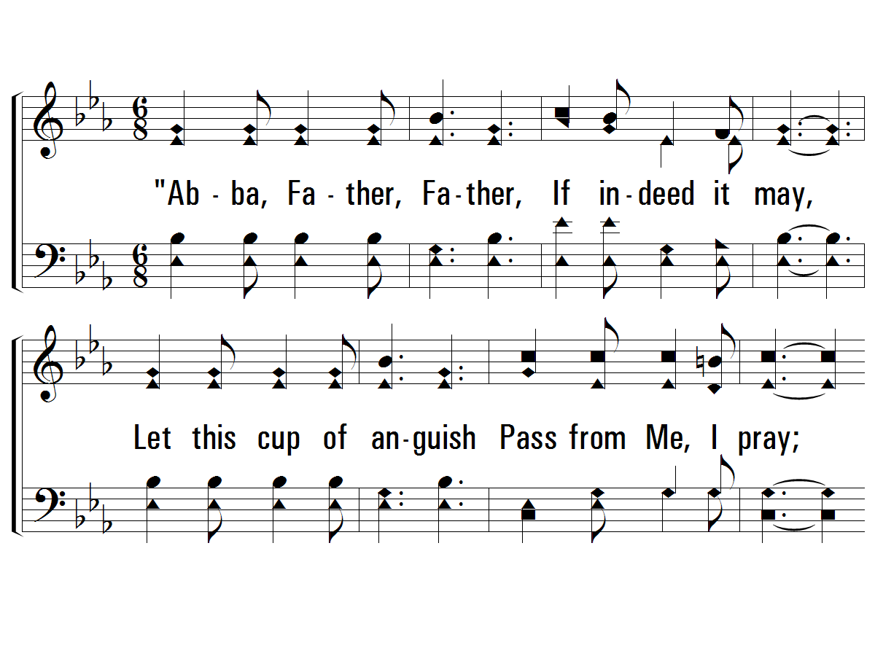
Verse 3
#452 – Night, with Ebon Pinion
3.
"Abba, Father, Father,
If indeed it may,
Let this cup of anguish
Pass from Me, I pray;
Yet, if it must be suffered,
By Me, Thine only Son,
Abba, Father, Father,
Let Thy will be done."

Slide 22
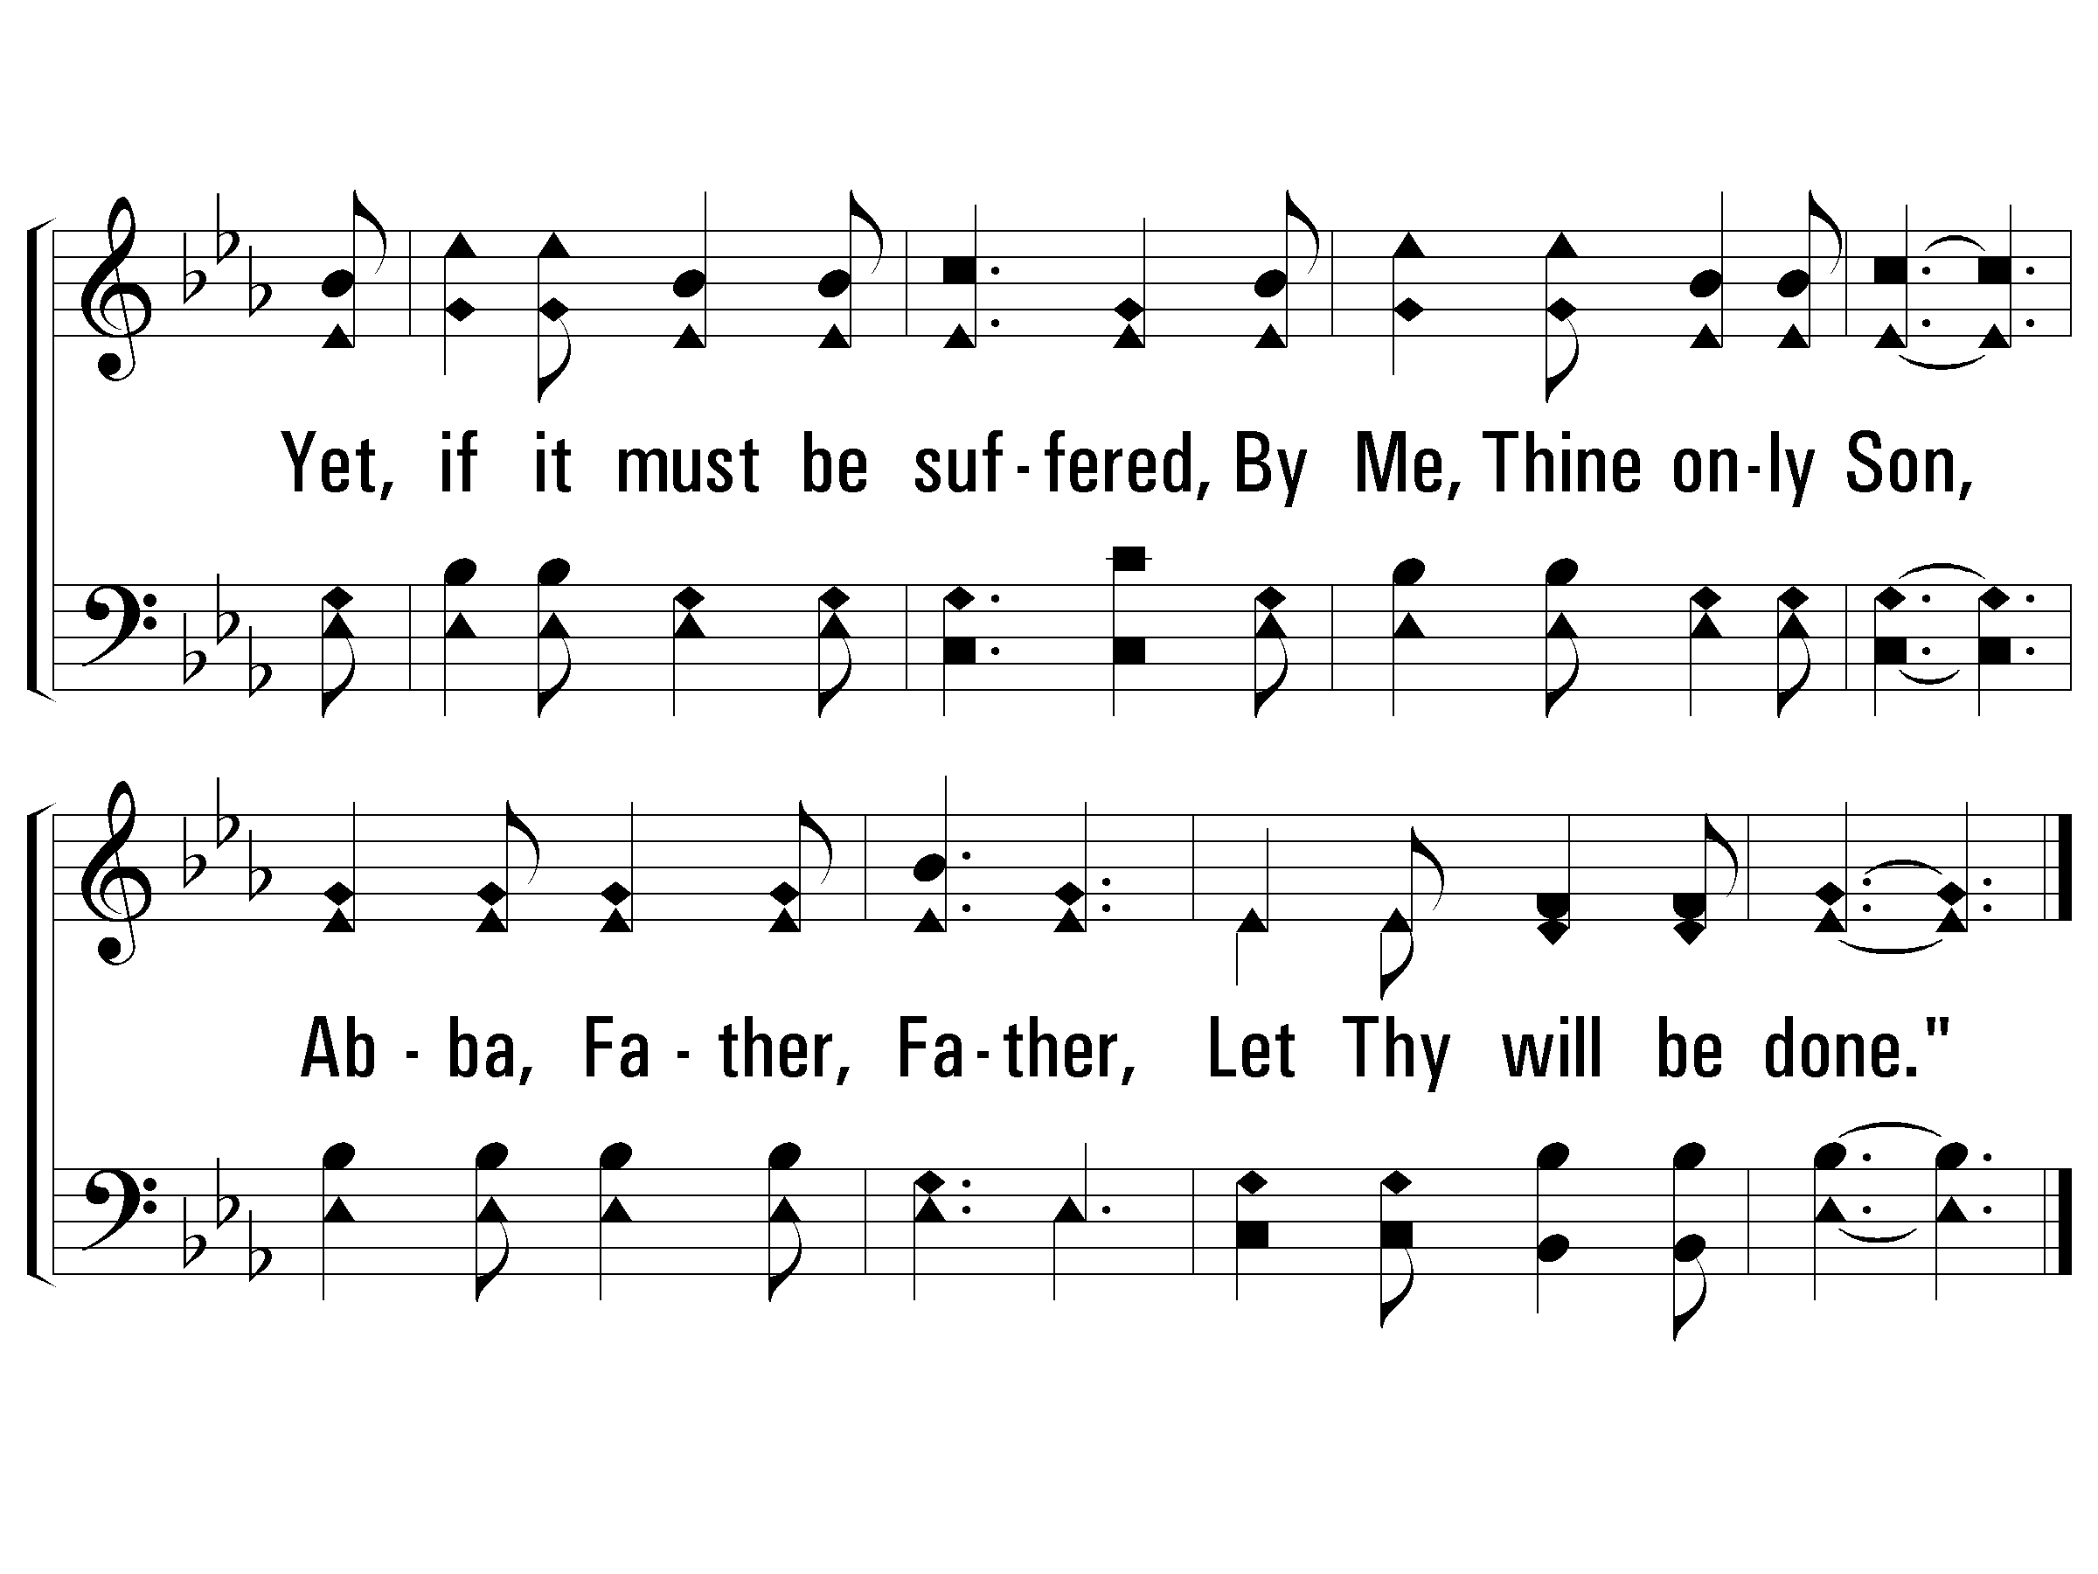
Verse 3
#452 – Night, with Ebon Pinion

Slide 23
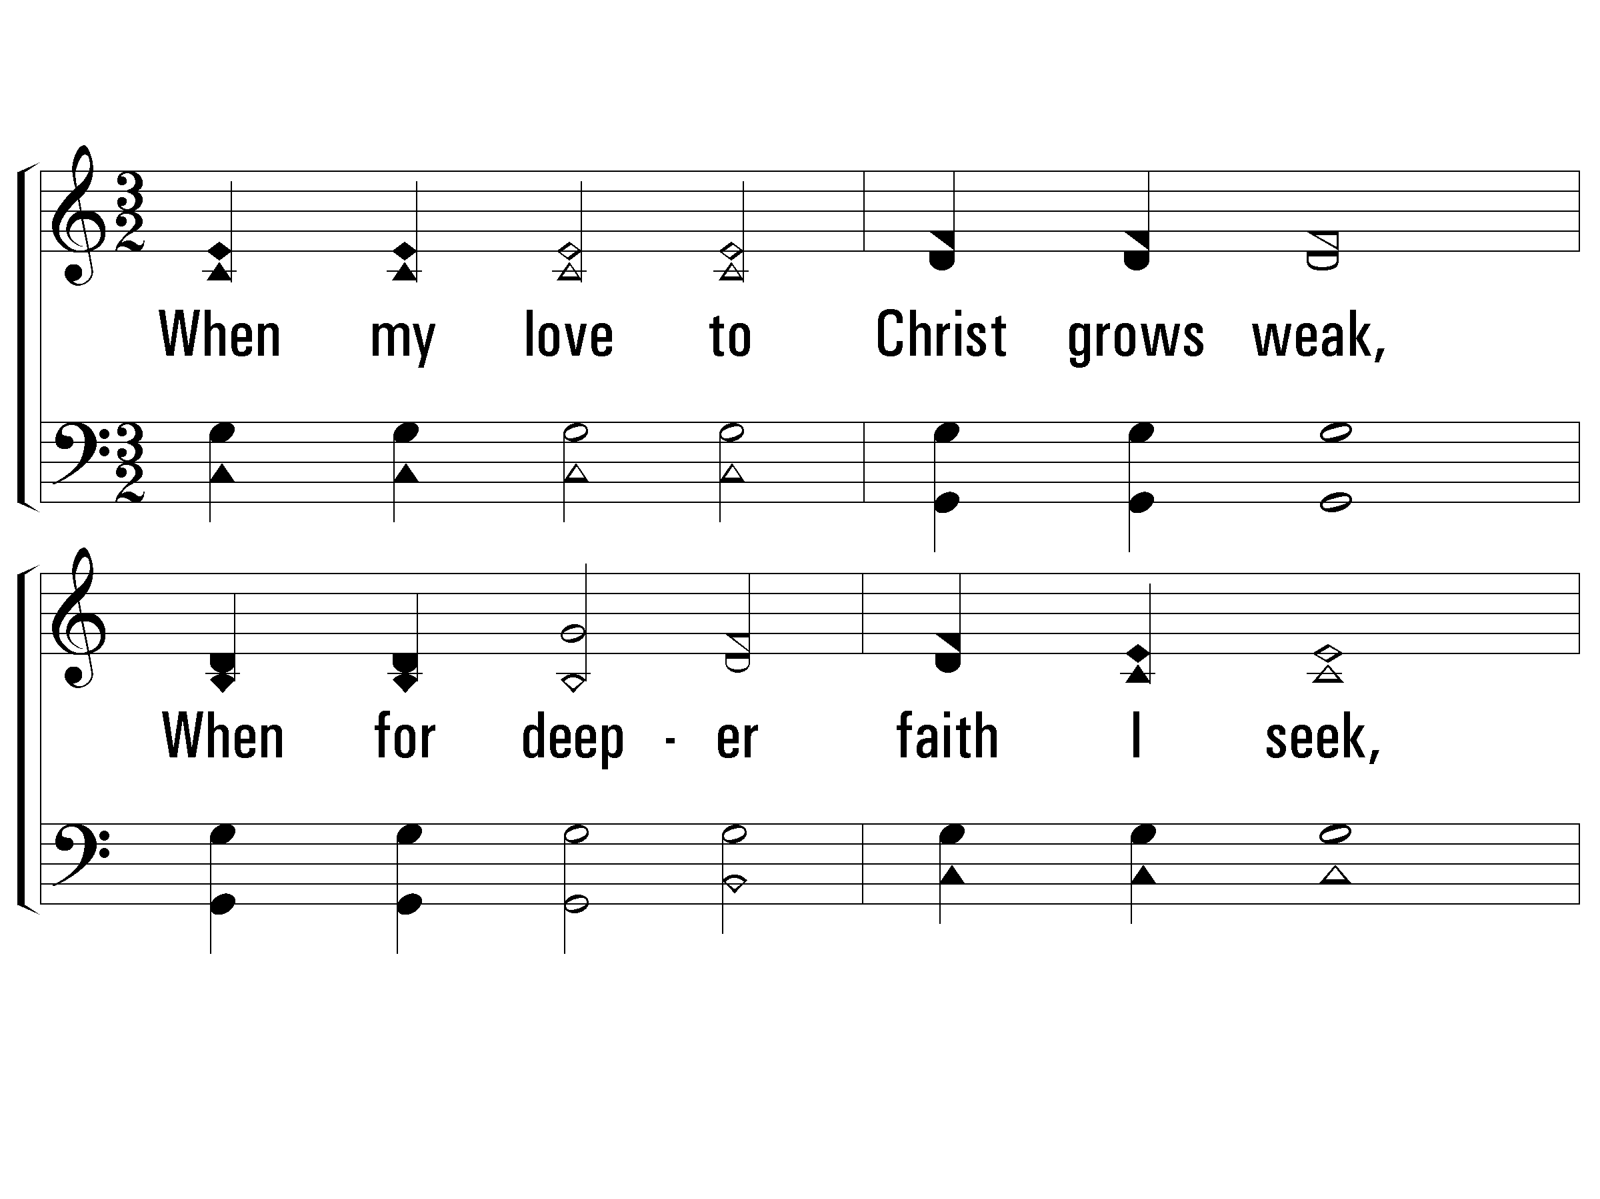
Verse 1
#752 – When My Love to Christ Grows Weak
1.
When my love to Christ grows weak,
When for deeper faith I seek,
Then in thought I go to thee,
Garden of Gethsemane!

Slide 24
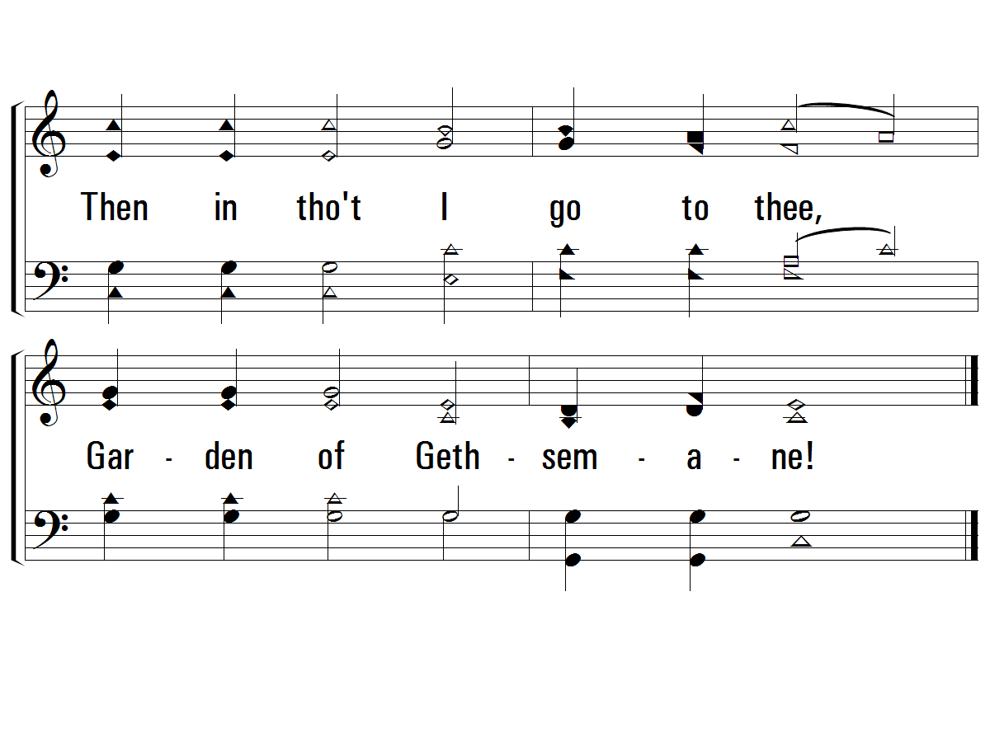
Verse 1
#752 – When My Love to Christ Grows Weak

Slide 25
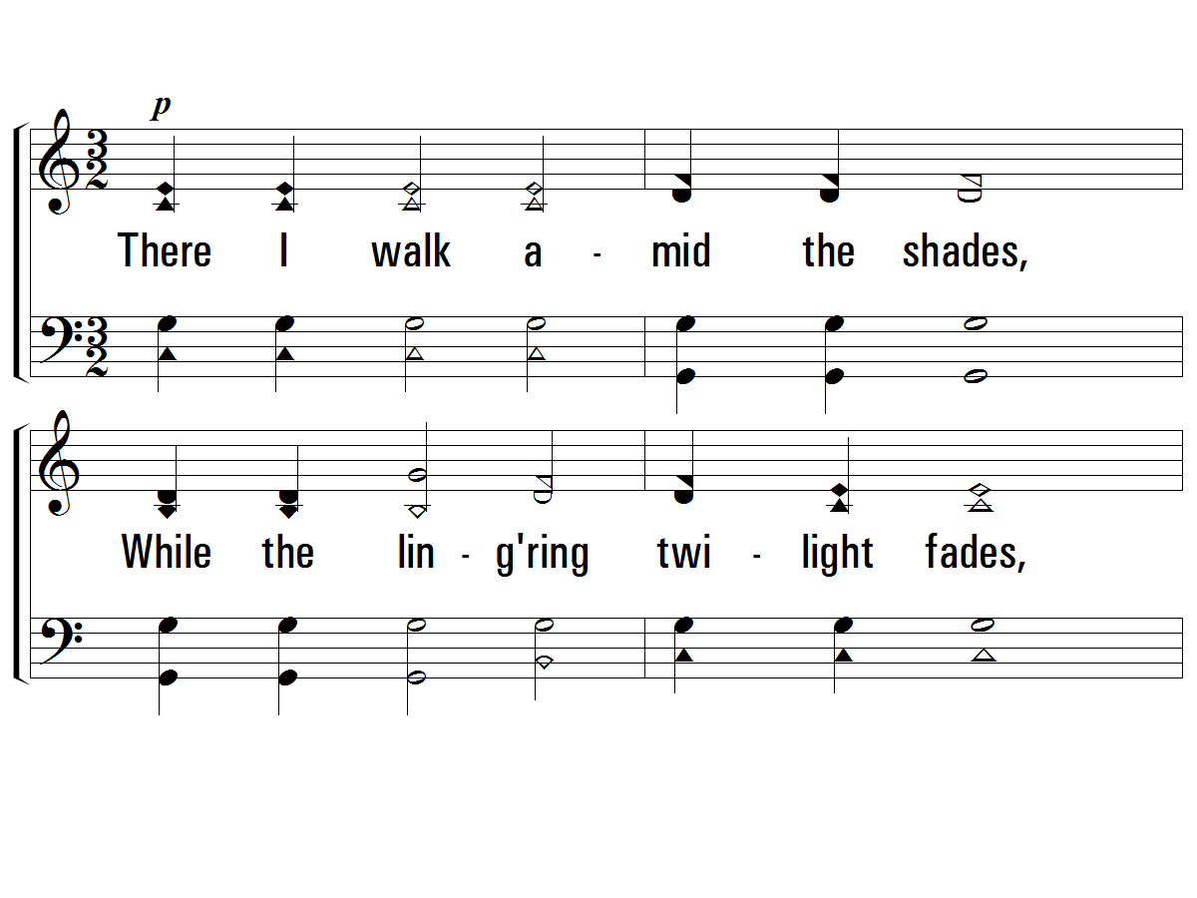
Verse 2
#752 – When My Love to Christ Grows Weak
2.
There I walk amid the shades,
While the lingering twilight fades,
See that suffering, friendless One,
Weeping, praying there alone.

Slide 26
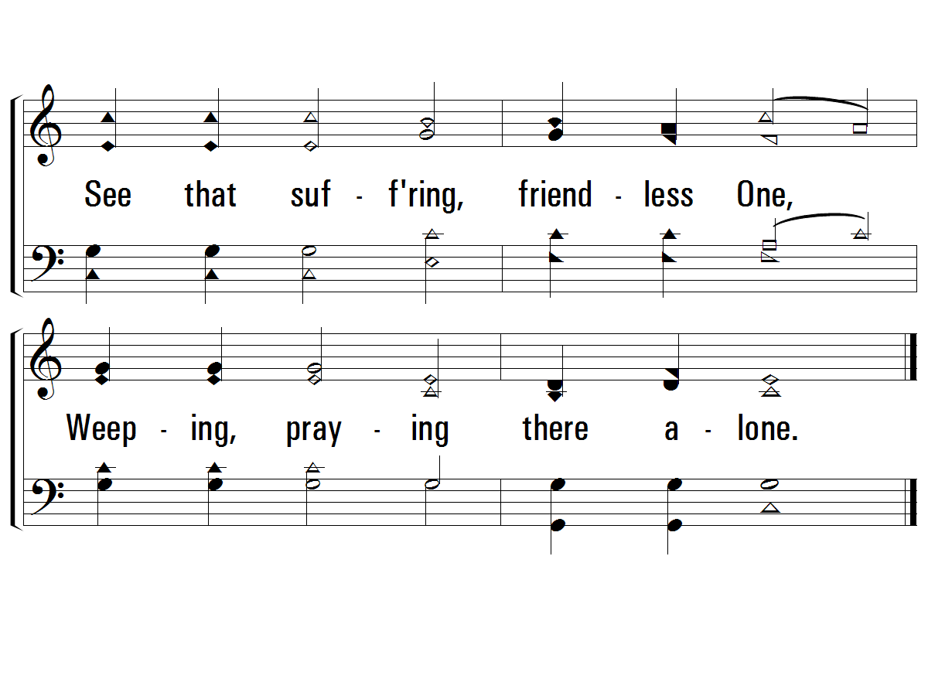
Verse 2
#752 – When My Love to Christ Grows Weak

Slide 27
Jesus Predicted His Suffering and Death
Jesus Identified His Betrayer
Jesus Predicted Peter’s Denial
Jesus Instituted the Lord’s Supper
Jesus Prayed and Agonized in Gethsemane
Jesus Was Betrayed and Arrested
Jesus Endured Six Unlawful Trials
  1st Jewish Trial (Annas)
  2nd Jewish Trial (Caiaphas)
  3rd Jewish Trial (Sanhedrin)
  1st Civil Trial (Pilate)
  2nd Civil Trial (Herod)
  3rd Civil Trial (Pilate)

Slide 28
Jesus Predicted His Suffering and Death
Jesus Identified His Betrayer
Jesus Predicted Peter’s Denial
Jesus Instituted the Lord’s Supper
Jesus Prayed and Agonized in Gethsemane
Jesus Was Betrayed and Arrested
Jesus Endured Six Unlawful Trials
Jesus Was Scourged

Slide 29
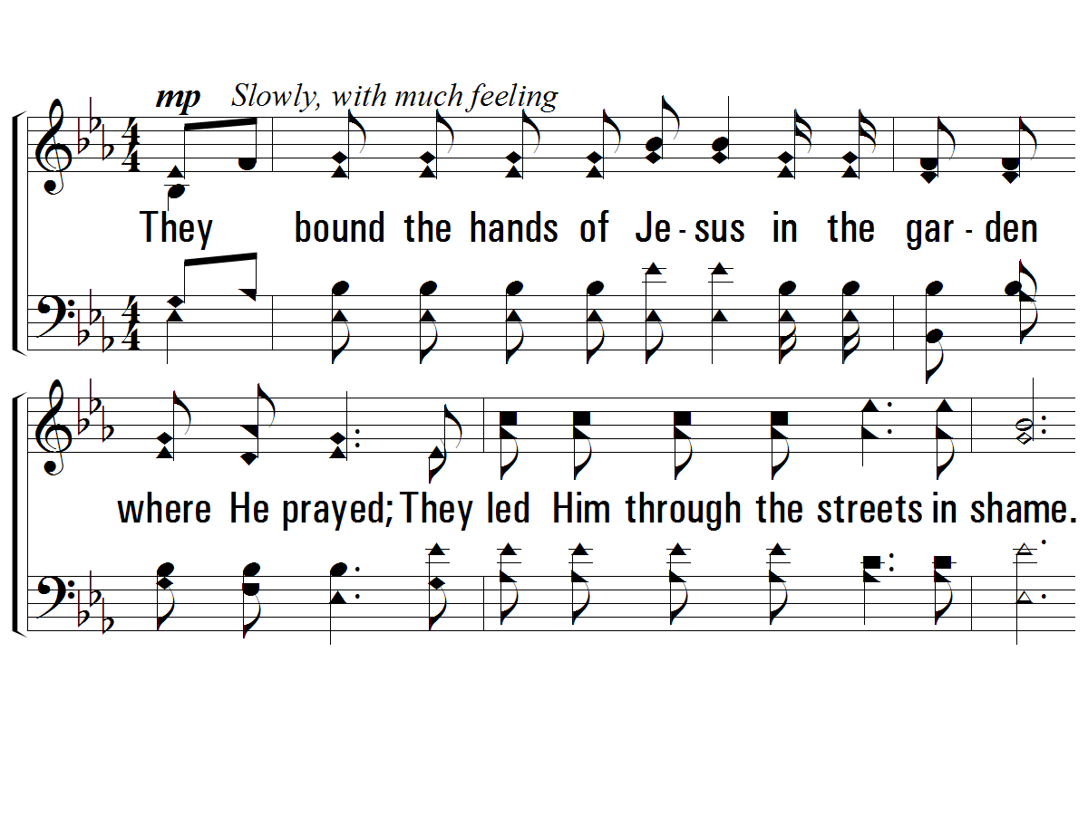
Verse 1
#621 – Ten Thousand Angels
1.
They bound the hands of Jesus in the garden where He prayed;
They led Him through the streets in shame.
They spat upon the Savior so pure and free from sin;
They said "Crucify Him; He's to blame."

Slide 30
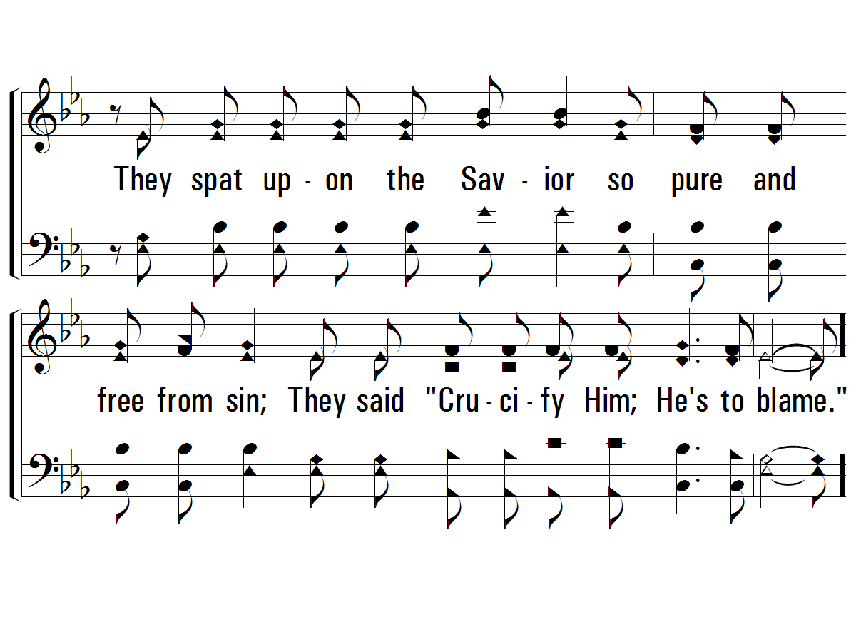
Verse 1
#621 – Ten Thousand Angels

Slide 31
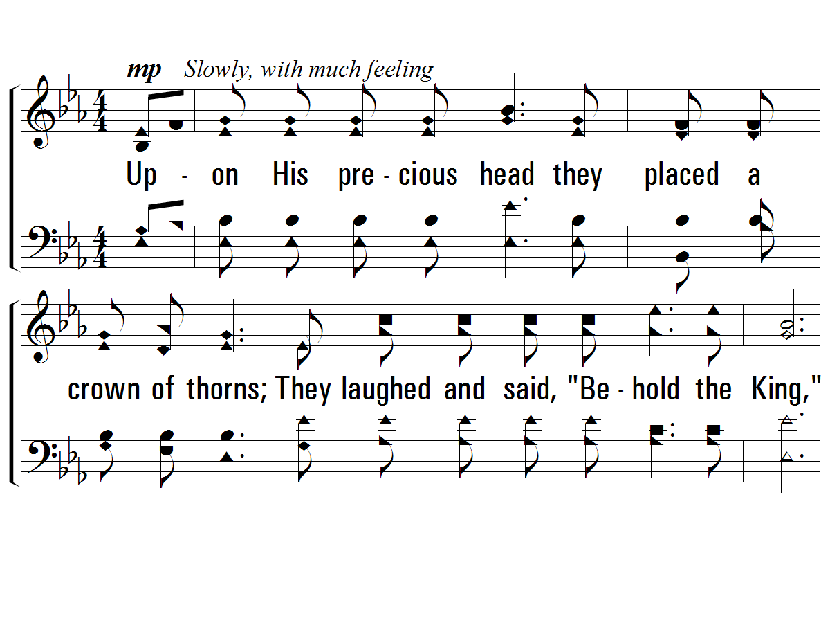
Verse 2
#621 – Ten Thousand Angels
2.
Upon His precious head they placed a crown of thorns;
They laughed and said, "Be-hold the King,"
They struck Him and they cursed Him and mocked His holy name.
All alone He suffered everything.

Slide 32
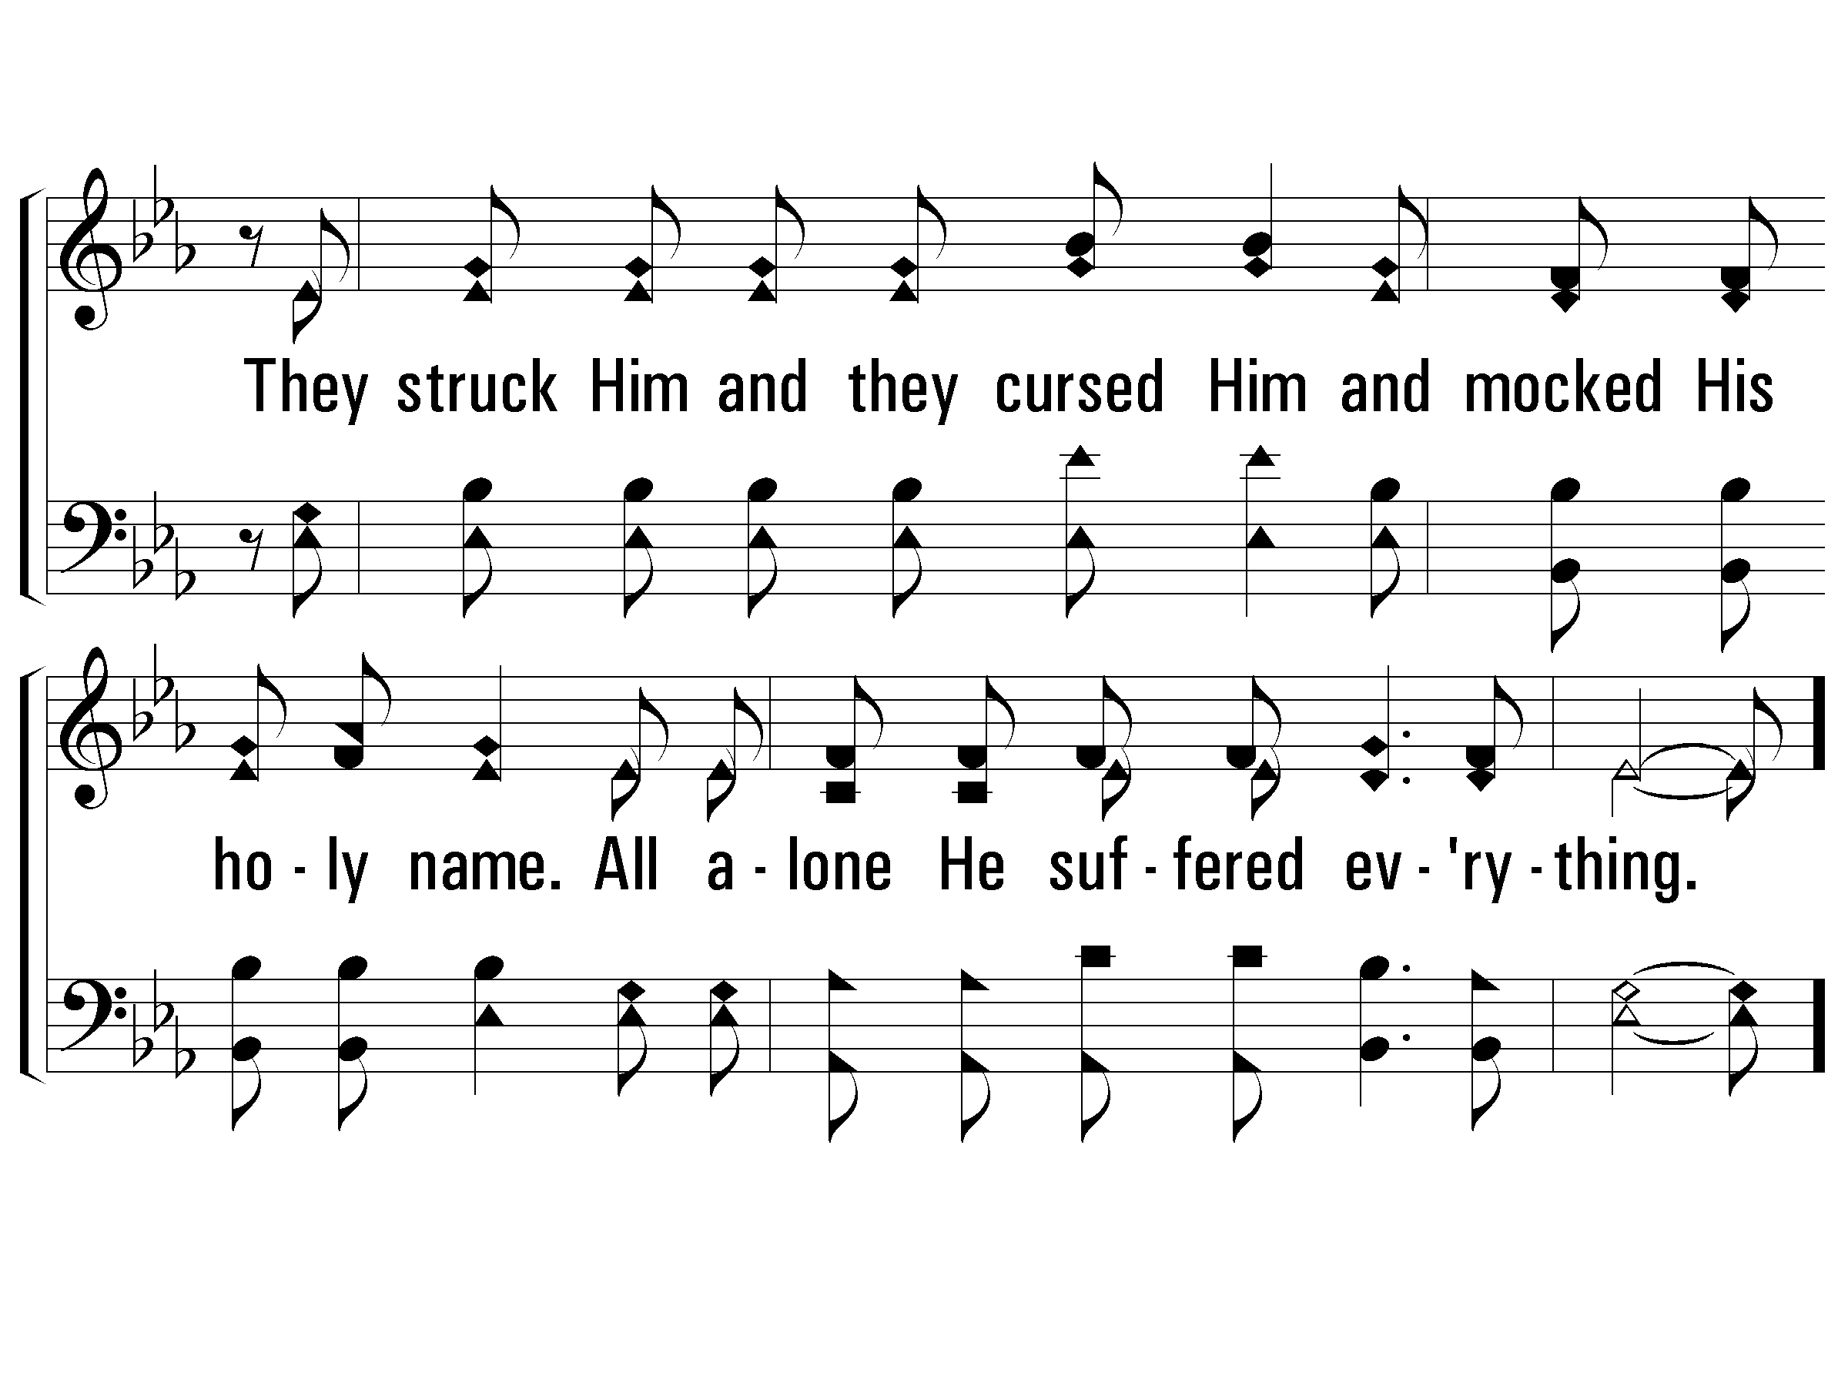
Verse 2
#621 – Ten Thousand Angels

Slide 33
Jesus Predicted His Suffering and Death
Jesus Identified His Betrayer
Jesus Predicted Peter’s Denial
Jesus Instituted the Lord’s Supper
Jesus Prayed and Agonized in Gethsemane
Jesus Was Betrayed and Arrested
Jesus Endured Six Unlawful Trials
Jesus Was Scourged
Jesus Carried His Own Cross
Jesus Was Crucified
  His First Three Hours on the Cross

Slide 34
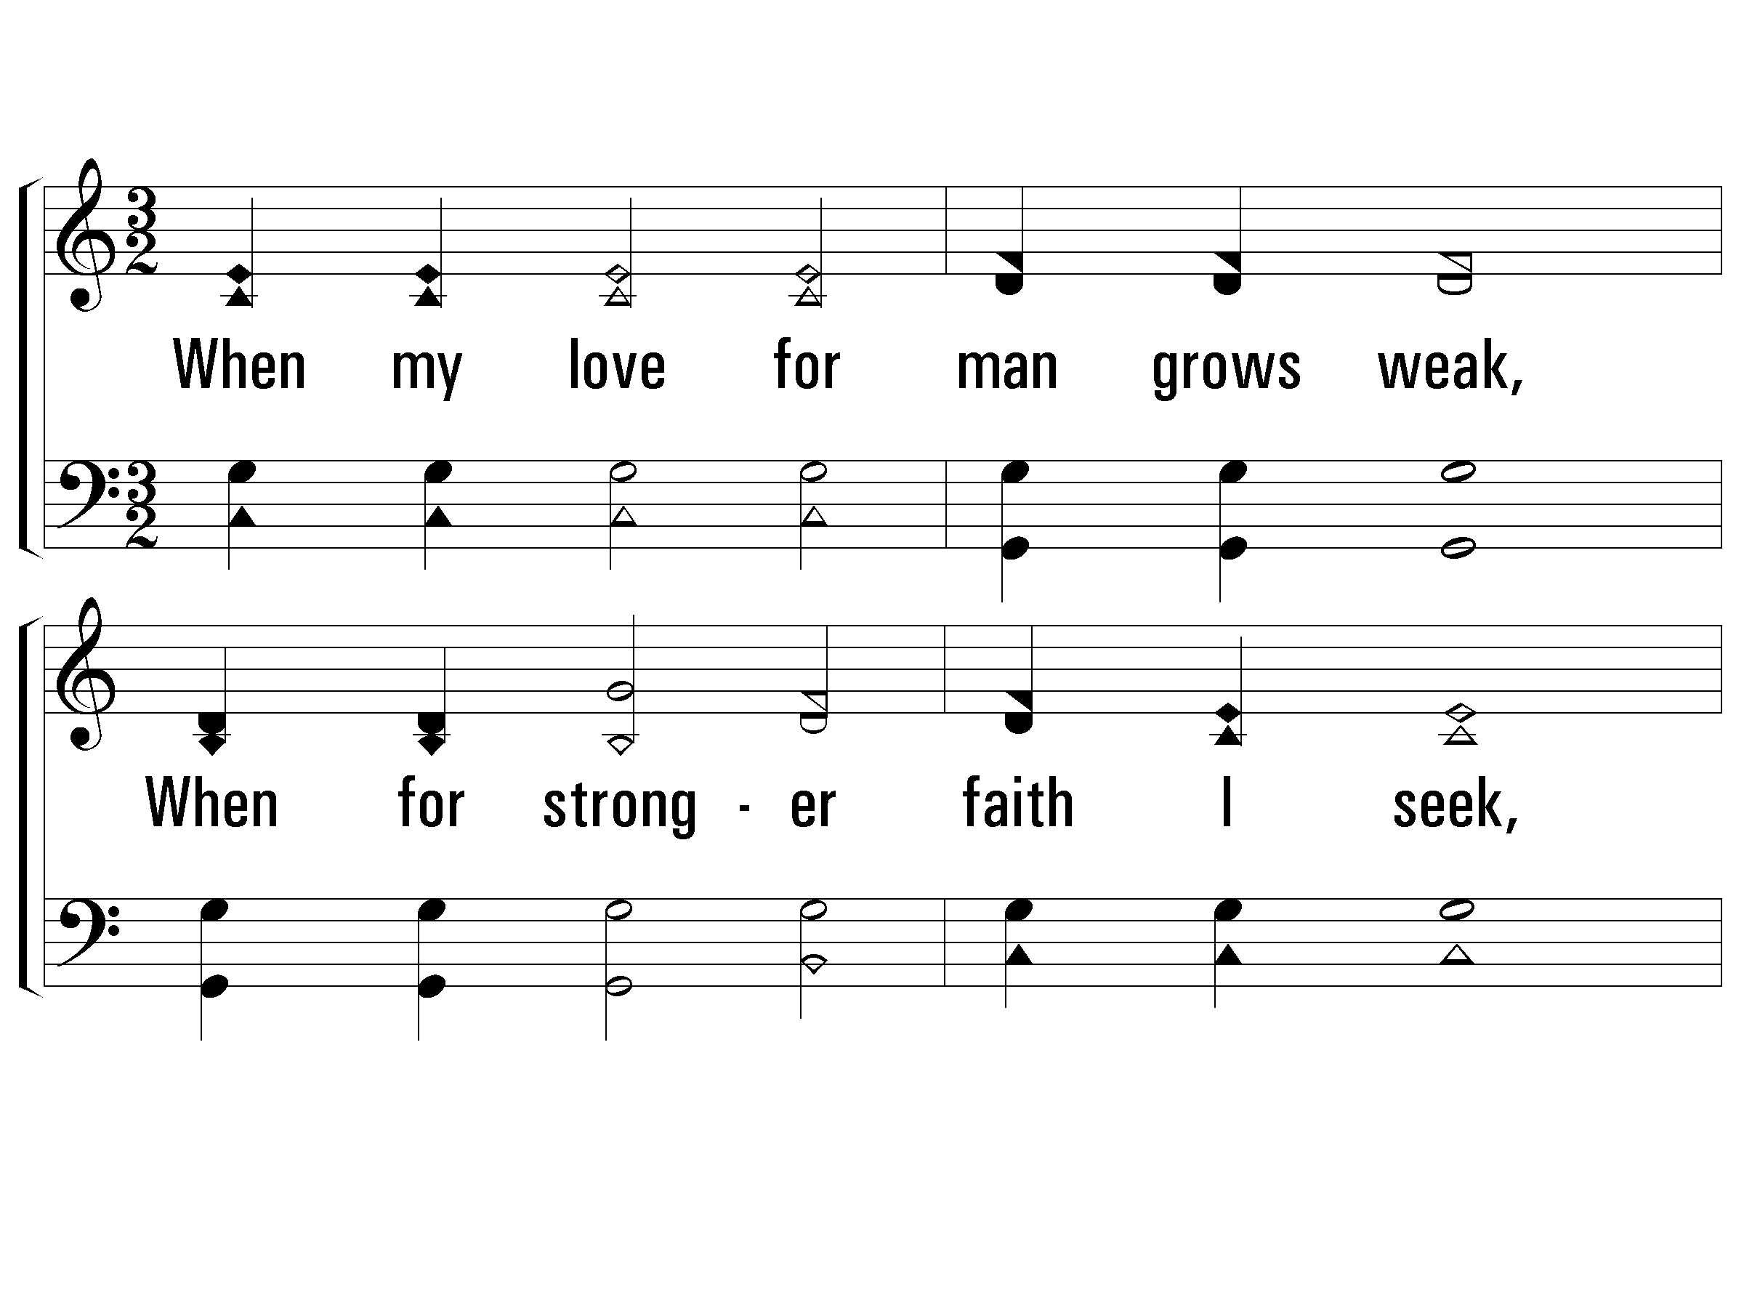
Verse 3
#752 – When My Love to Christ Grows Weak
3.
When my love for man grows weak,
When for stronger faith I seek,
Hill of Calvary! I go
To thy scenes of fear and woe.

Slide 35
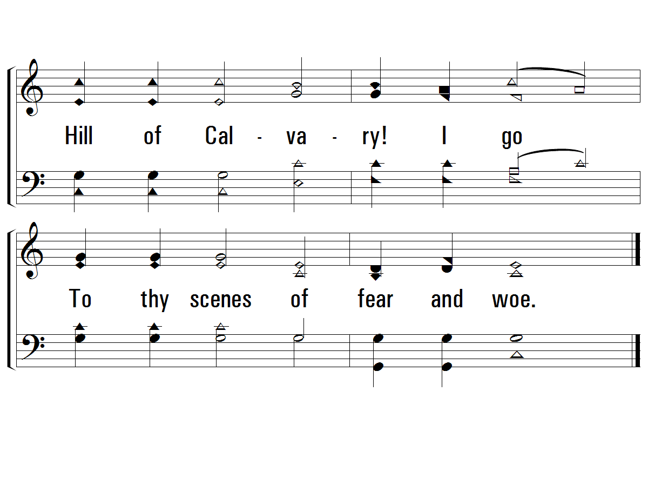
Verse 3
#752 – When My Love to Christ Grows Weak

Slide 36
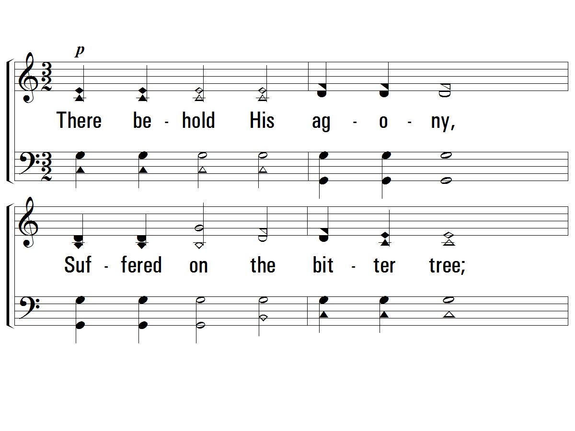
Verse 4
#752 – When My Love to Christ Grows Weak
4.
There behold His agony,
Suffered on the bitter tree;
See His anguish, see His faith
Love triumphant still in death.

Slide 37
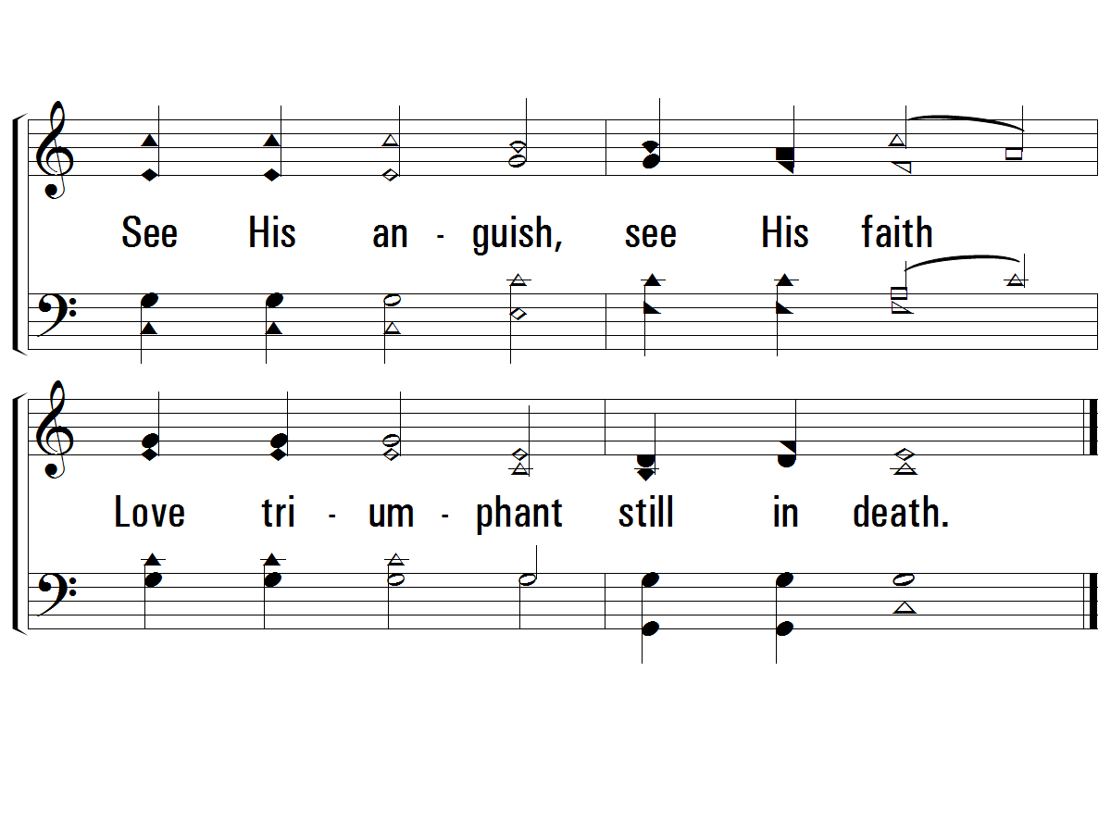
Verse 4
#752 – When My Love to Christ Grows Weak

Slide 38
Jesus Predicted His Suffering and Death
Jesus Identified His Betrayer
Jesus Predicted Peter’s Denial
Jesus Instituted the Lord’s Supper
Jesus Prayed and Agonized in Gethsemane
Jesus Was Betrayed and Arrested
Jesus Endured Six Unlawful Trials
Jesus Was Scourged
Jesus Carried His Own Cross
Jesus Was Crucified
  His First Three Hours on the Cross
  His Final Three Hours on the Cross

Slide 39
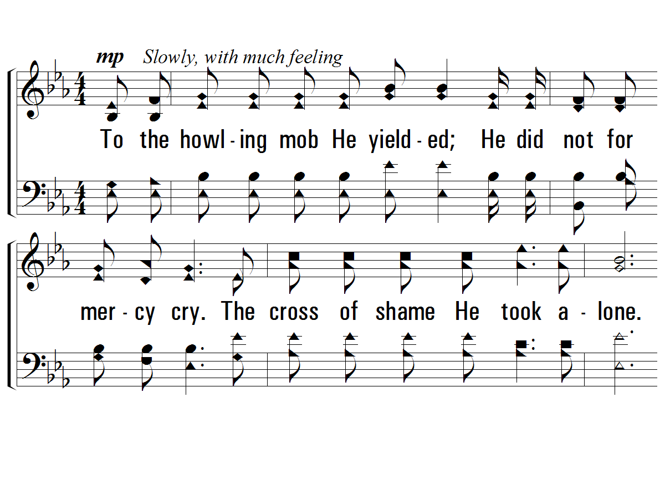
Verse 4
#621 – Ten Thousand Angels
4.
To the howling mob He yielded;
He did not for mercy cry.
The cross of shame He took alone.
And when He cried, "It's finished,"
He gave Himself to die;
Salvation's wondrous plan was done.

Slide 40
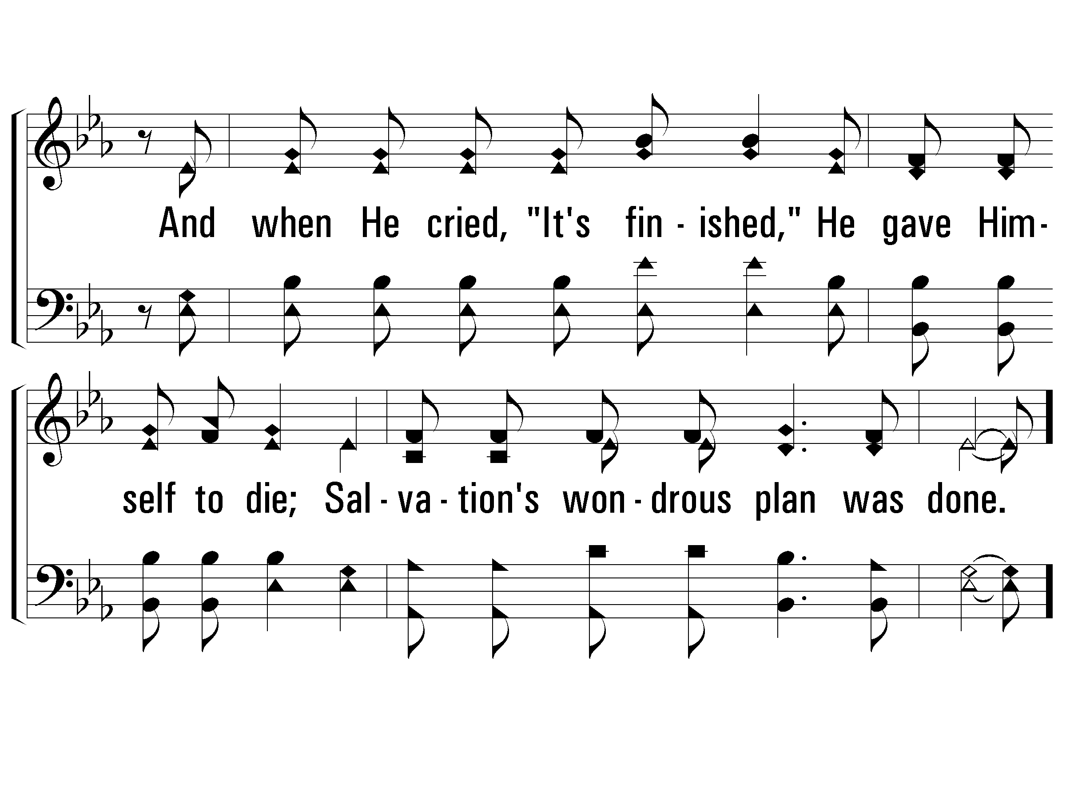
Verse 4
#621 – Ten Thousand Angels

Slide 41
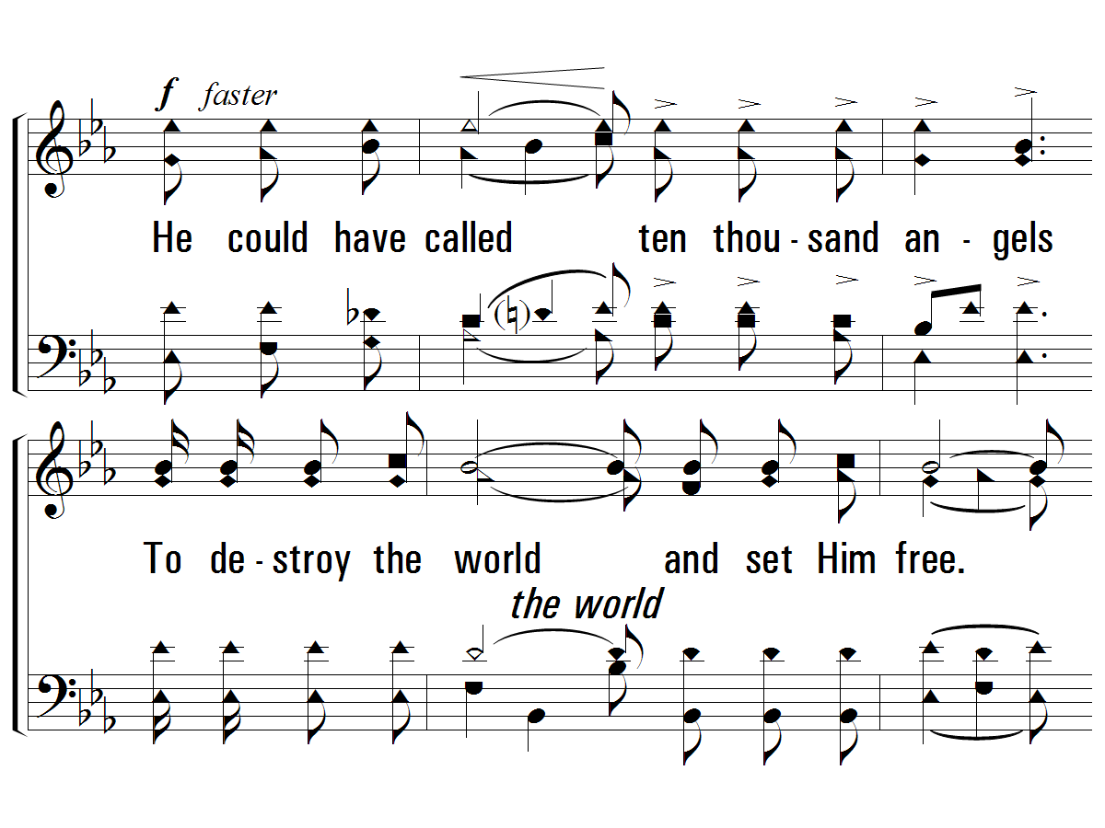
Chorus
#621 – Ten Thousand Angels
He could have called ten thousand angels
To destroy the world and set Him free.
He could have called, ten thousand angels,
But He died alone, for you and me.

Slide 42
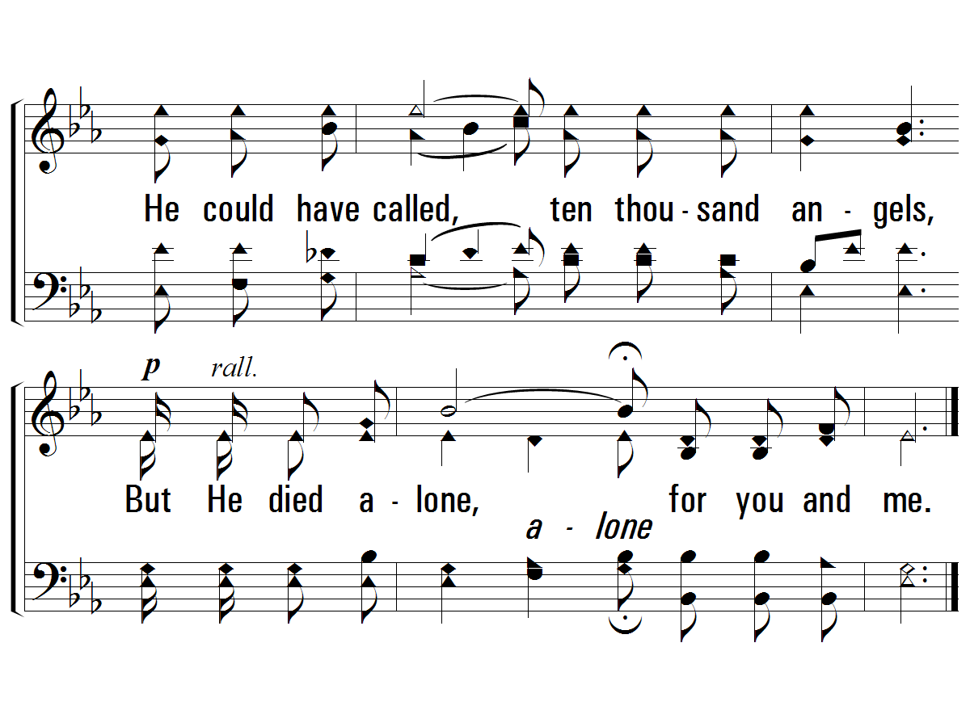
Chorus
#621 – Ten Thousand Angels

Slide 43
Jesus Predicted His Suffering and Death
Jesus Identified His Betrayer
Jesus Predicted Peter’s Denial
Jesus Instituted the Lord’s Supper
Jesus Prayed and Agonized in Gethsemane
Jesus Was Betrayed and Arrested
Jesus Endured Six Unlawful Trials
Jesus Was Scourged
Jesus Carried His Own Cross
Jesus Was Crucified

Slide 44
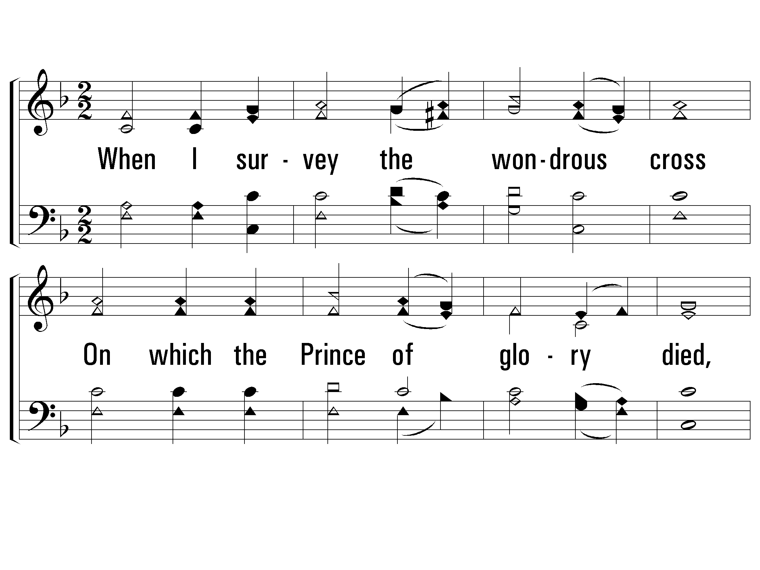
Verse 1
#742 – When I Survey the Wondrous Cross
1.
When I survey the wondrous cross
On which the Prince of glory died,
My richest gain I count but loss
And pour contempt on all my pride.

Slide 45
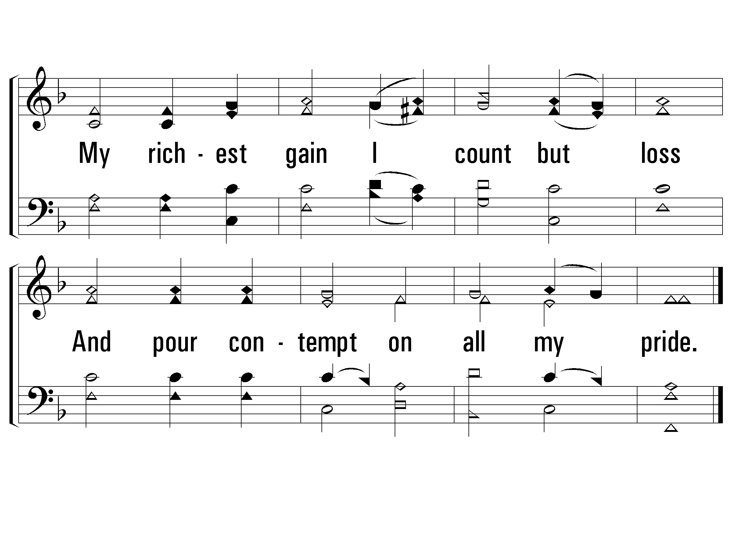
Verse 1
#742 – When I Survey the Wondrous Cross

Slide 46
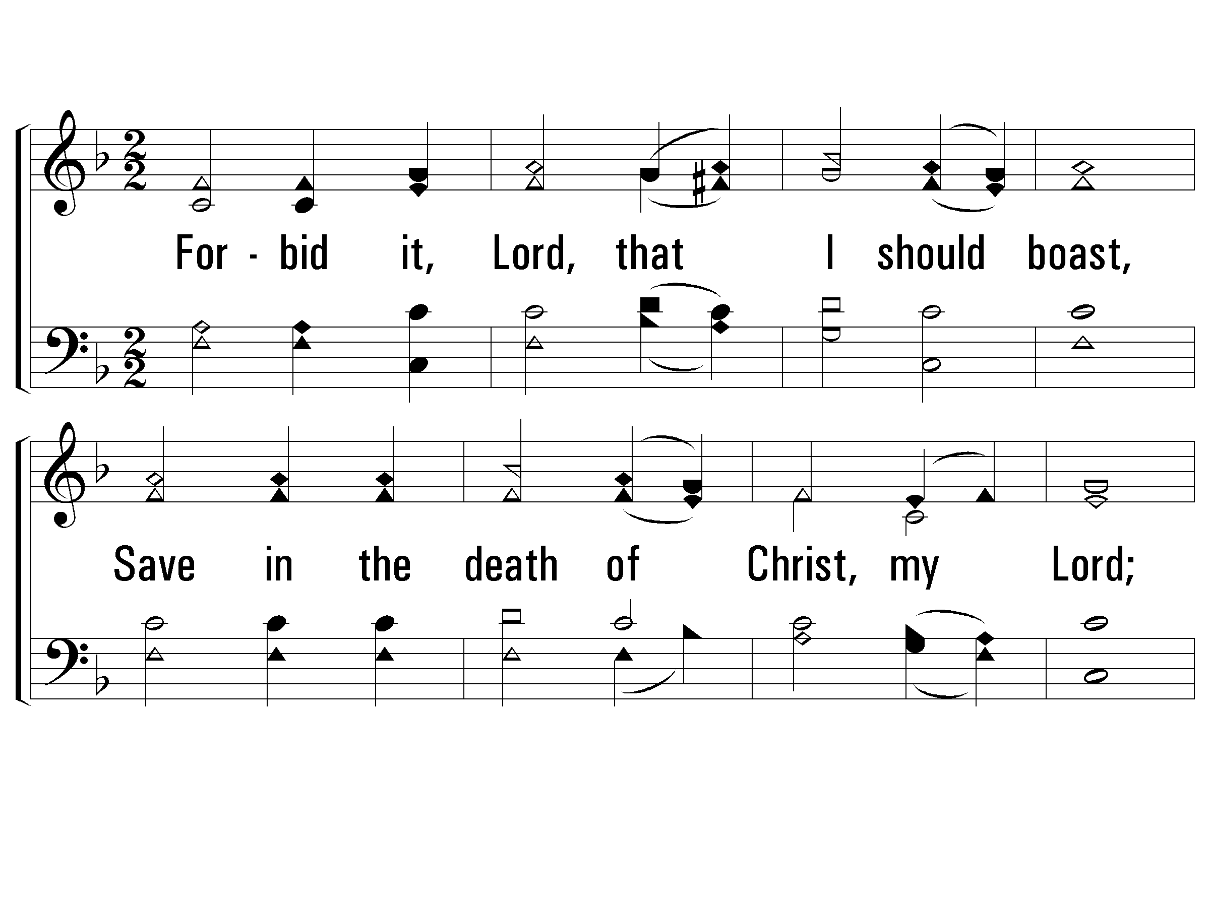
Verse 2
#742 – When I Survey the Wondrous Cross
2.
Forbid it, Lord, that I should boast,
Save in the death of Christ, my Lord;
All the vain things that charm me most
I sacrifice them to His blood.

Slide 47
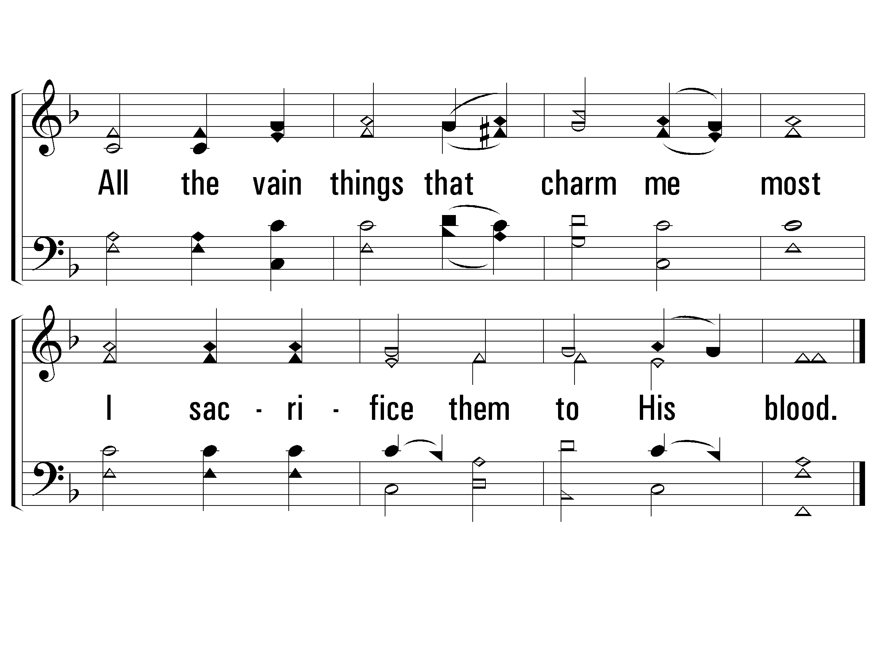
Verse 2
#742 – When I Survey the Wondrous Cross

Slide 48
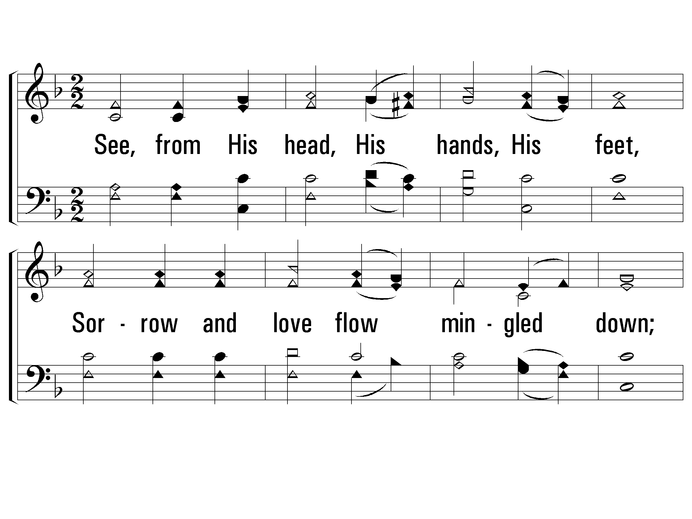
Verse 3
#742 – When I Survey the Wondrous Cross
3.
See, from His head, His hands, His feet,
Sorrow and love flow mingled down;
Did e'er such love and sorrow meet,
Or thorns compose so rich a crown?

Slide 49
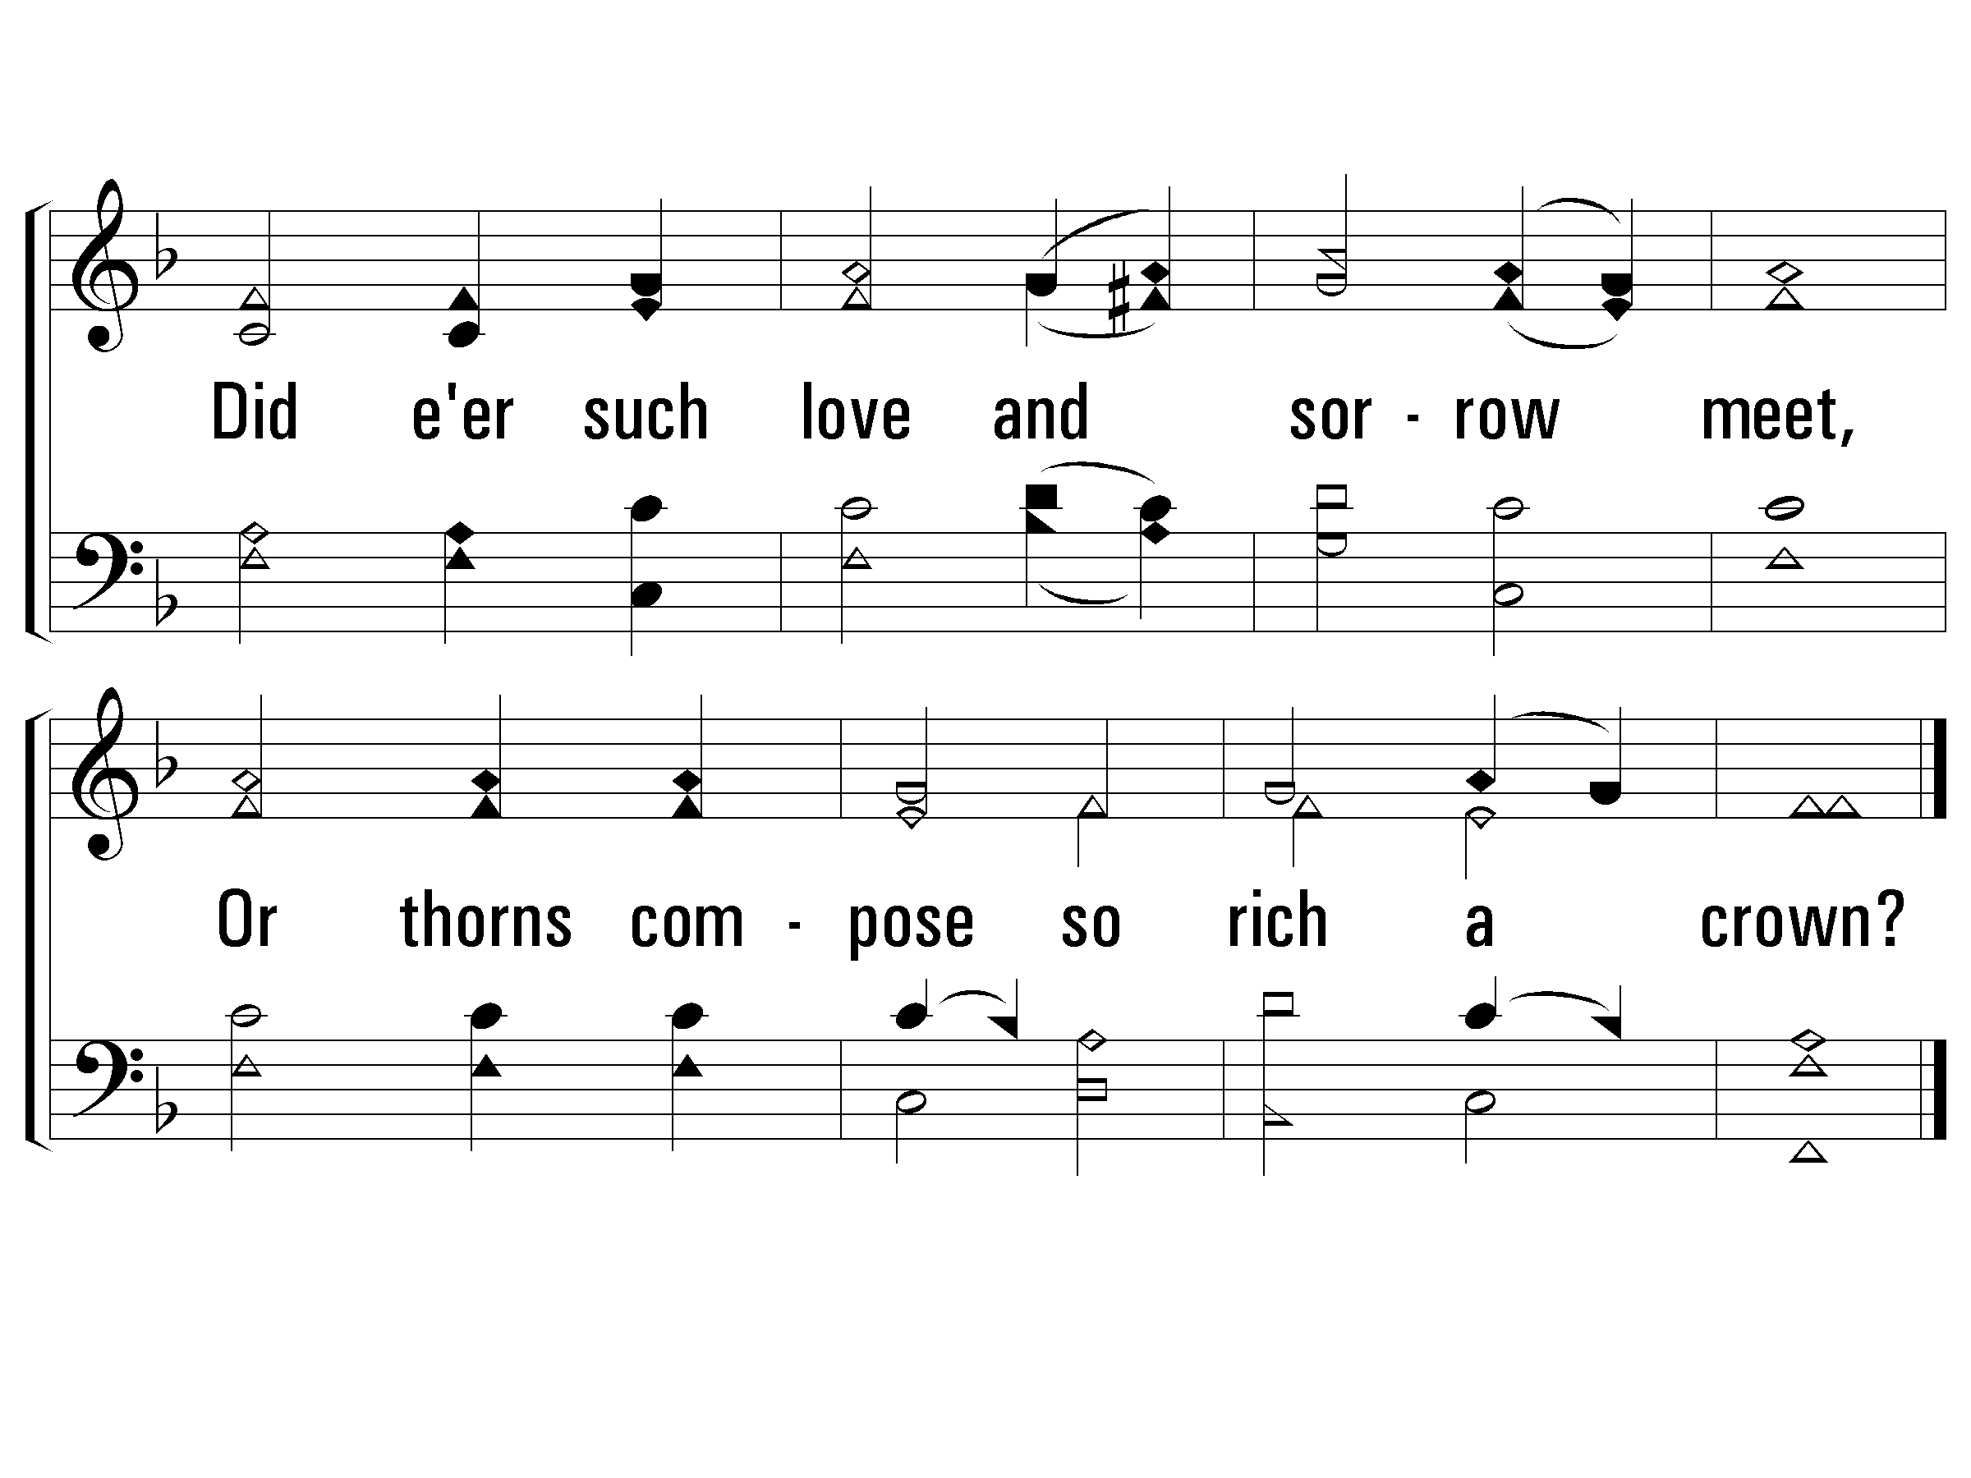
Verse 3
#742 – When I Survey the Wondrous Cross

Slide 50
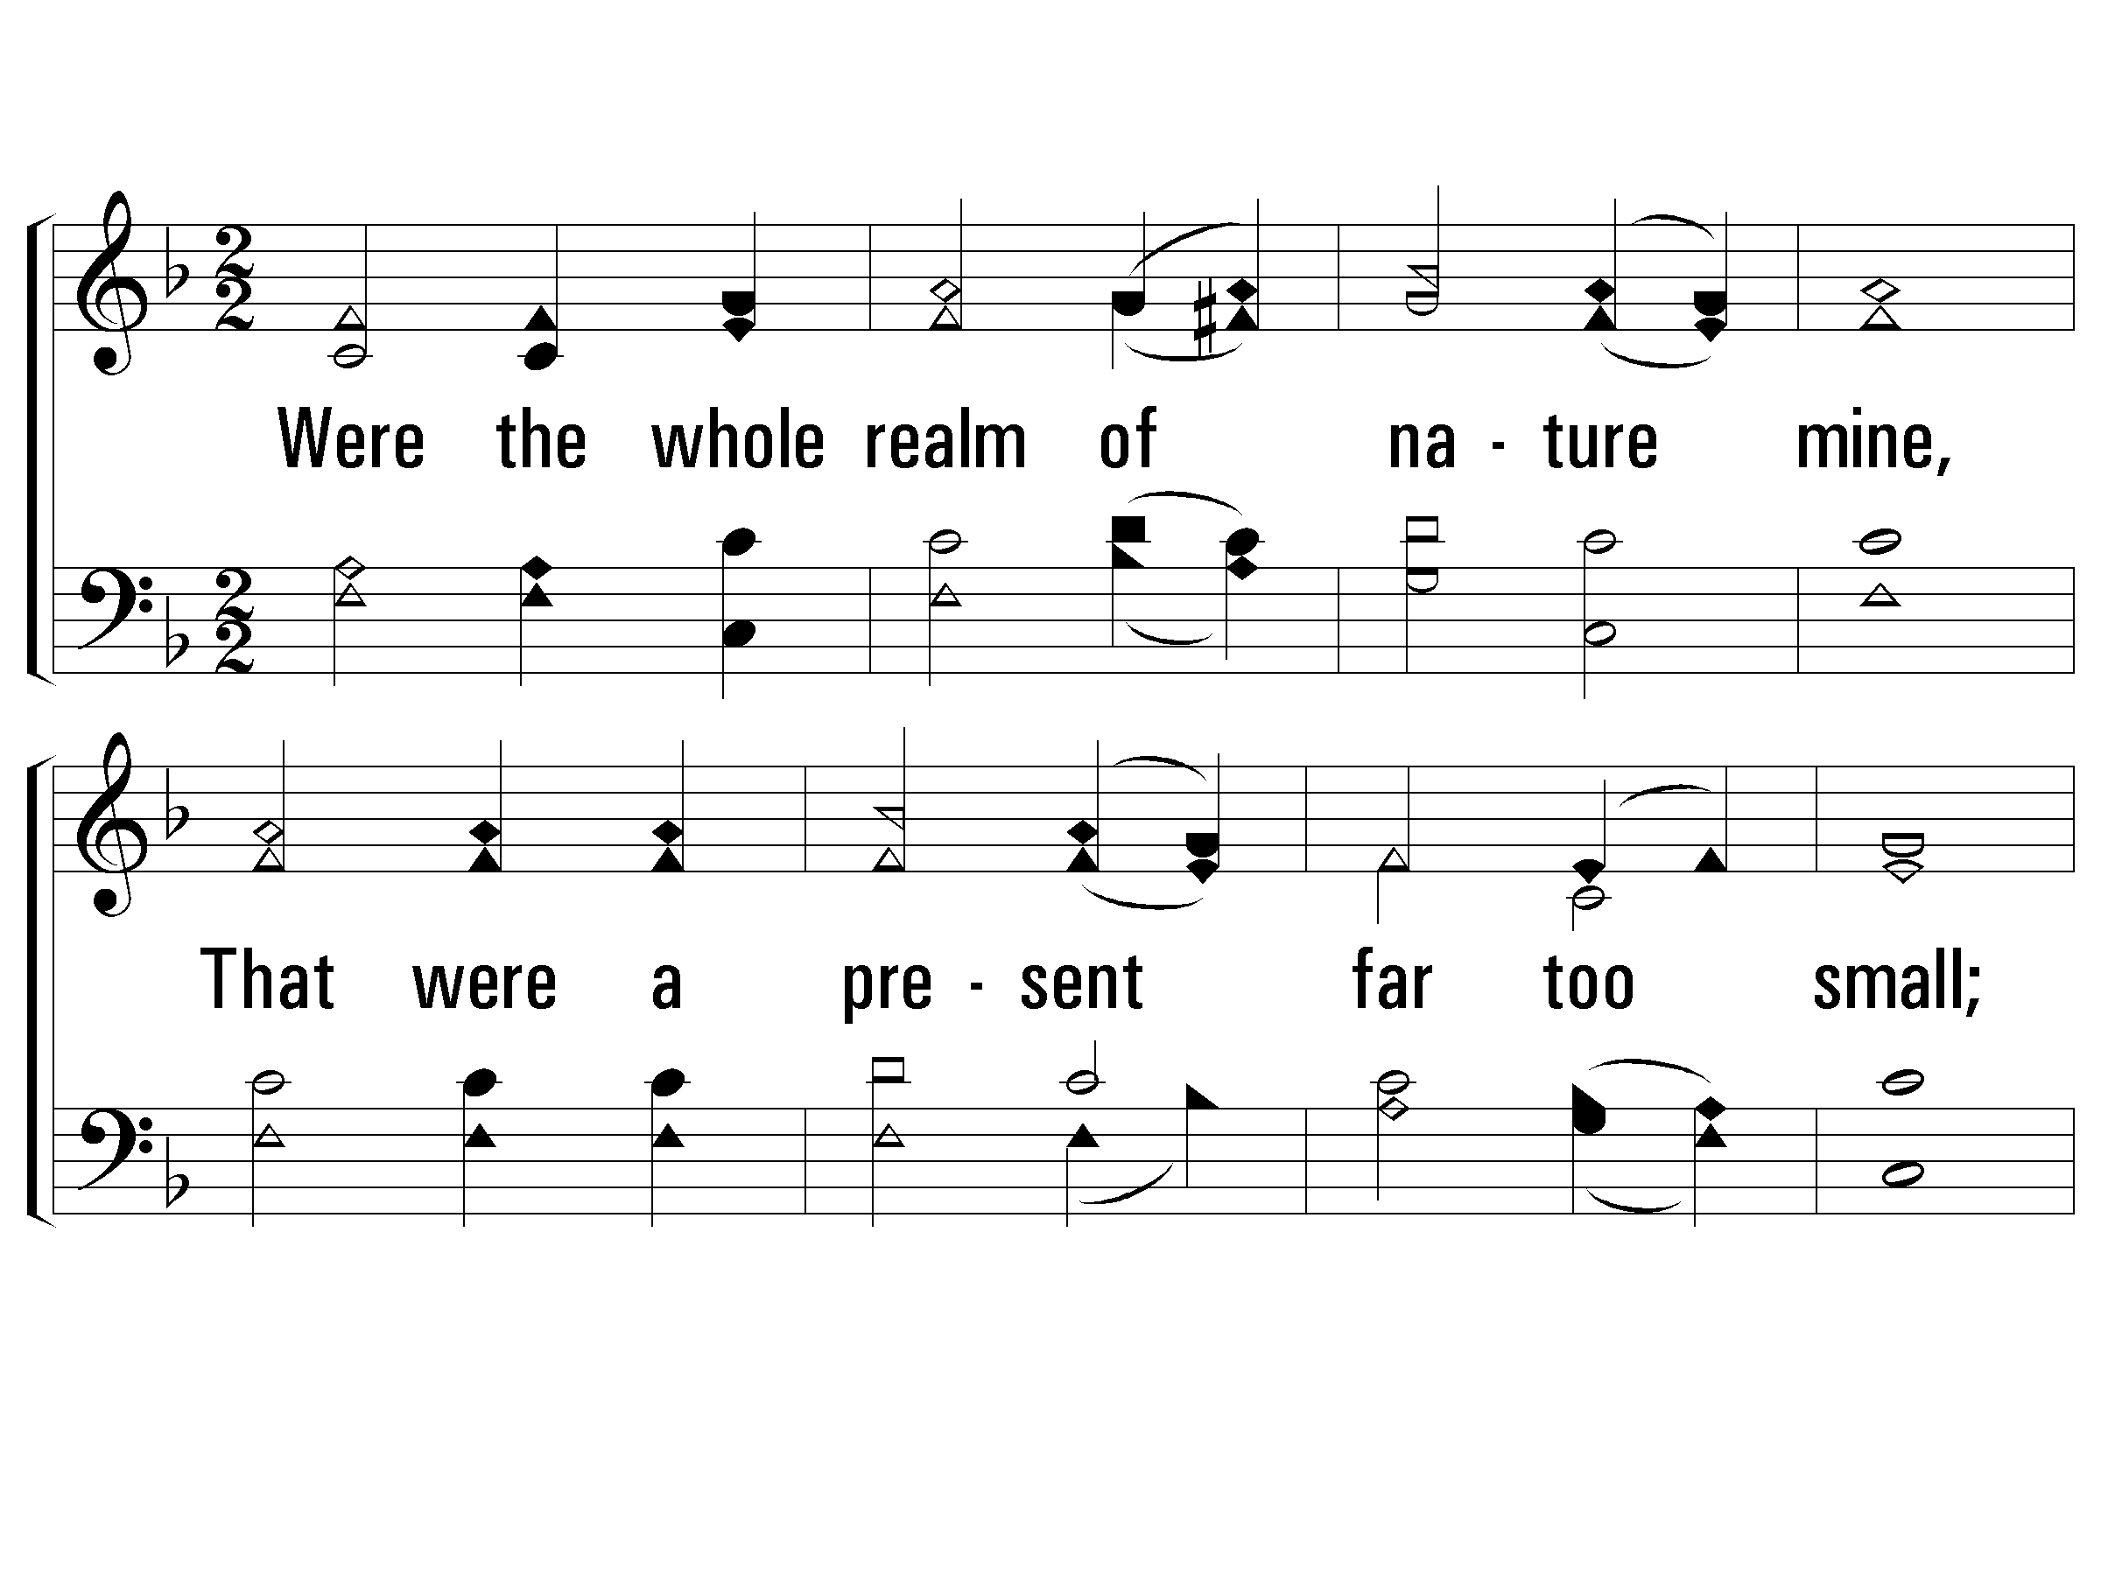
Verse 5
#742 – When I Survey the Wondrous Cross
5.
Were the whole realm of nature mine,
That were a present far too small;
Love so amazing, so divine,
Demands my soul, my life, my all.

Slide 51
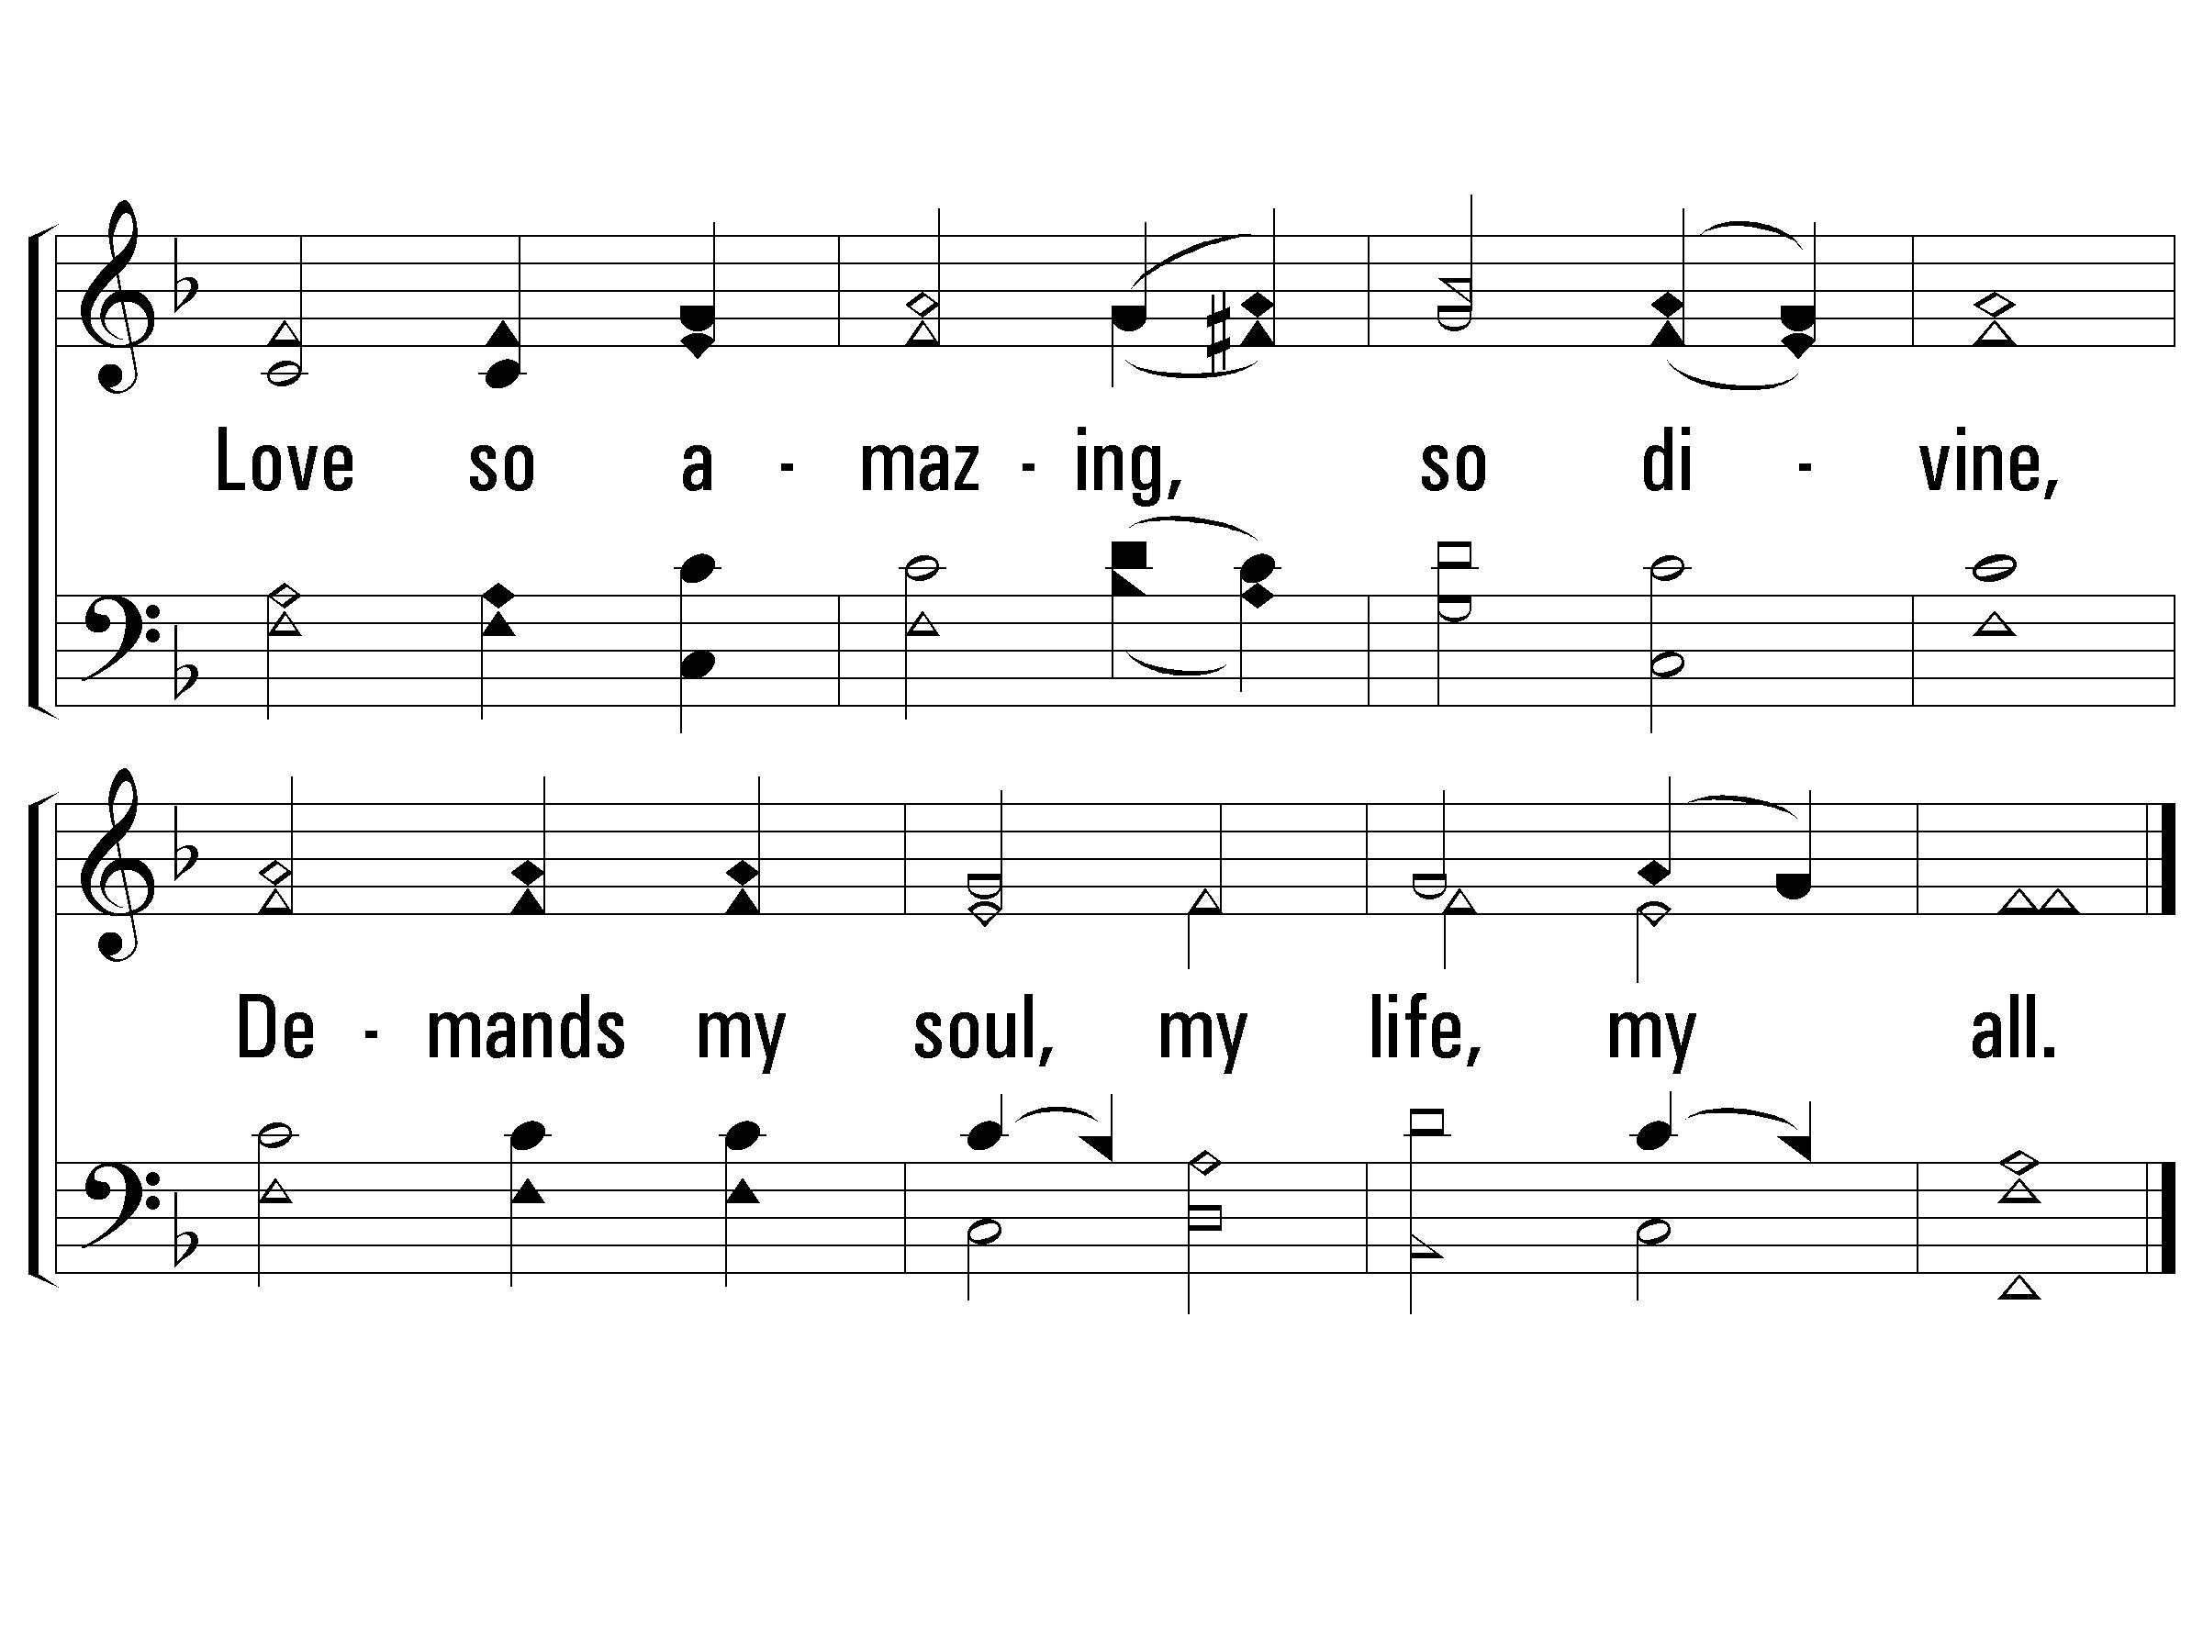
Verse 5
#742 – When I Survey the Wondrous Cross

