Slide 1


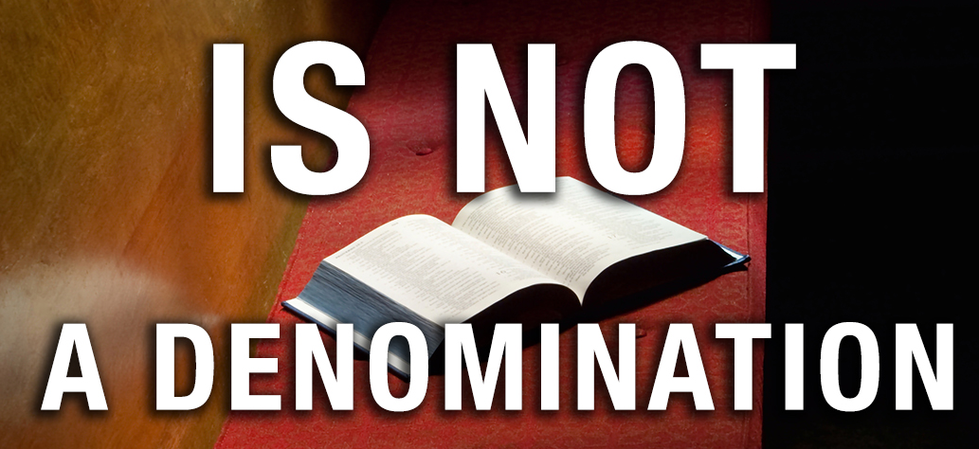


Slide 2
Denominationalism is DEVISED of the human mind, not Divine (1:11-12)
  “Each of YOU is saying” (cf. Gal. 1:6)
  They were all SAYING something different = human origin, not Divine
  They were all WEARING different names = human origin, not Divine
Denominationalism is DIVISION that is not recognized by God (1:10, 13)
  God calls for “NO divisions” (1:10)
  Yet, they had “DIVIDED” Christ (1:13)
Denominationalism is DISREGARD for the will, authority & words of Christ (1:10)
  Paul’s plea is that of Christ Himself (1 Cor. 14:37)
  Paul’s plea is made by the authority of Christ (cf. Acts 4:12; Col. 3:17)
  Paul’s plea is for the doctrine of Christ (cf. 1 Tim. 1:3; 6:3)
  Paul’s plea is in harmony with the prayer of Christ (John 17:20-21)

Slide 3
The church of Christ COMMENCED by the crucifixion of CHRIST (1:13)
  Paul did not start the church because Paul was NOT crucified for it
  Christ started the church because He was crucified for it (Acts 20:28; Eph. 5:25)
  The church of Christ is PRE-denominational!

Slide 4
The church of Christ COMMENCED by the crucifixion of CHRIST (1:13)
The church of Christ CONFORMS only to the will, authority and words of CHRIST (1:10)
  The church of Christ seeks only the will of Christ (cf. Heb. 11:6)
  The church of Christ submits only to the authority of Christ (cf. Eph. 5:23)
  The church of Christ speaks only the words of Christ (cf. 1 Pet. 4:11)
  The church of Christ sticks only to the mind and decisions of Christ (cf. Phil. 1:27)
  The only way for “ALL” to “speak the same thing” is for ALL to speak what the Bible speaks!
    And NOT adding to, taking from or modifying Christ’s doctrine (Rev. 22:18-19; Gal. 1:8-9)
    And NOT accepting any teaching that is contrary to Christ’s doctrine (2 John 9-11)
  If the church deviates from Christ’s one doctrine, it ceases to be His church (Rev. 2:16)!

Slide 5
The church of Christ COMMENCED by the crucifixion of CHRIST (1:13)
The church of Christ CONFORMS only to the will, authority and words of CHRIST (1:10)
The church of Christ CALLS itself only by the name of CHRIST (1:13)
  The church of Christ (collectively) wears no other name but His name (cf. Rom. 16:16)
    It is a mark of ownership – the church belongs to Him!
  The followers of Christ (individually) wear no other name but His name (cf. 1 Pet. 4:16)
    It is a mark of ownership – I belong to Him – I am a CHRISTIAN!
  Why would a church or a follower wear any other name?

Slide 6
The church of Christ COMMENCED by the crucifixion of CHRIST (1:13)
The church of Christ CONFORMS only to the will, authority and words of CHRIST (1:10)
The church of Christ CALLS itself only by the name of CHRIST (1:13)
The church of Christ CLINGS to the one means of entrance into CHRIST (1:13)
  In order to be “of Paul,” two requirements:
    (1) PAUL crucified for you
    (2) YOU baptized in the name of Paul
  In order to be “of Christ,” two requirements:
    (1) HIS part: CHRIST crucified for you
    (2) YOUR part: YOU baptized in His name
  You MUST be baptized “in the name of Christ” to enter Christ and be saved (cf. Acts 2:38)

