Slide 1
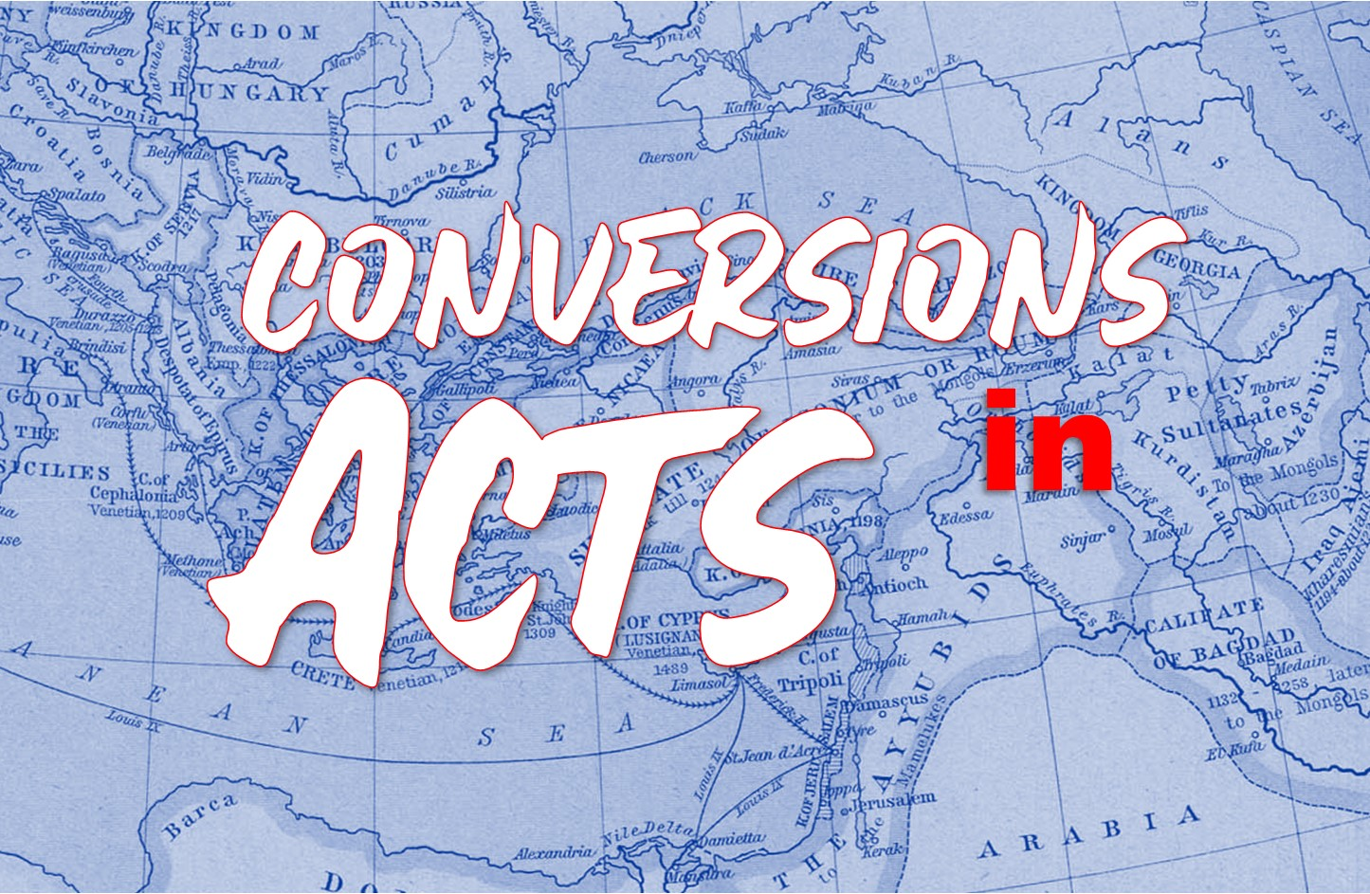

Slide 2

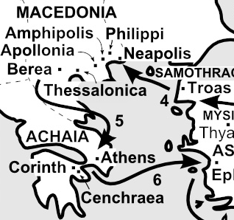
Conversion of the Corinthians
Acts 18:1-11
Paul’s arrival in Corinth v.1-3
His Work in Corinth v.4-11
  He goes to the synagogue v.4
  When Silas and Timothy arrive, Paul preaches “full time” v.5
  Rejection by some of the Jews v.6-7
  The gospel bears fruit in Corinth v.8
  After a message from the Lord, Paul stays for a year and a half v.9-11

Slide 3
“Not Sent to Baptize”
Context
The church at Corinth was divided - 1Co 1:10-11
People had favorite preachers - 1Co 1:12-13
Paul’s rhetorical questions
Implications of those questions

Slide 4
“Not Sent to Baptize”
Paul’s Comments
"I thank God that I baptized none of you except..."- 1Co 1:14
"For Christ sent me not to baptize, but to preach the gospel..." - 1Co 1:17

Slide 5
“Not Sent to Baptize”
Conclusion
The conversion of the Corinthians confirms what we have seen in previous examples of conversions in the book of Acts.
The conversion of the Corinthians also stands out because of the impact the gospel had in their lives.

