Slide 1
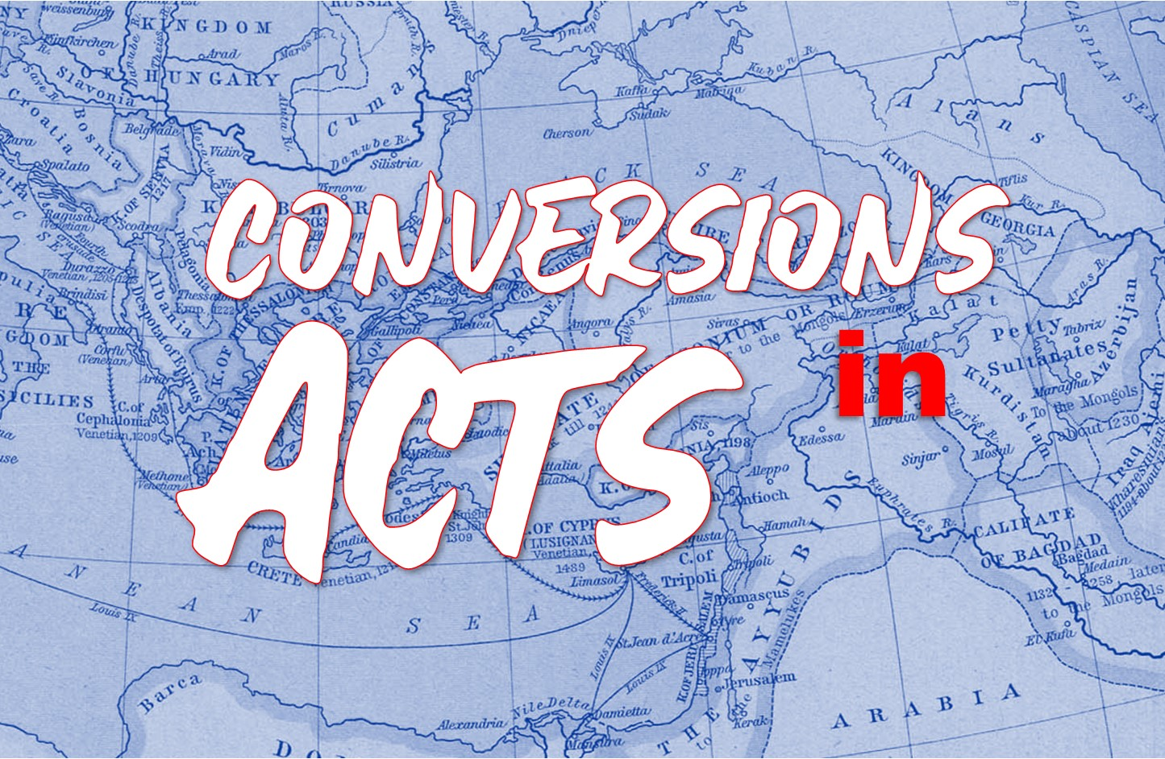

Slide 2
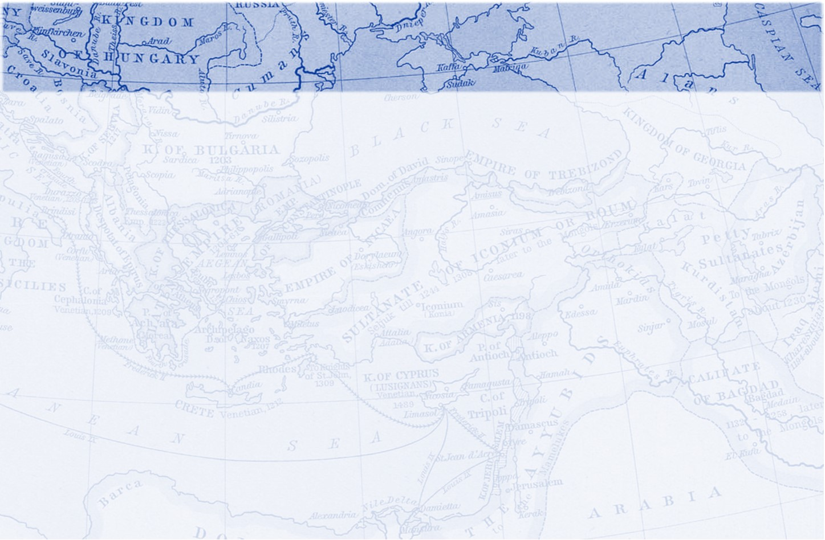
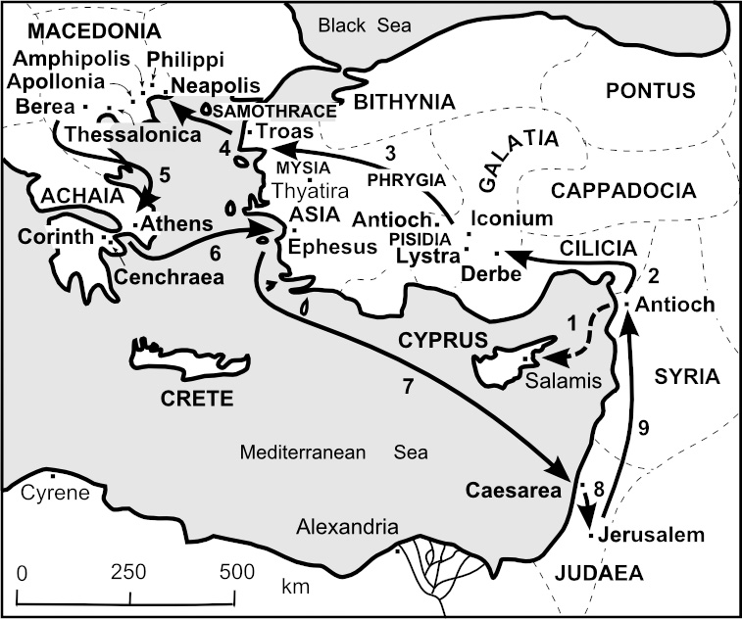
Paul and Silas In Thessalonica
Acts 17:1-9
Paul’s custom
Explaining and giving evidence
But the Jews
Jason
Notes:
Explaining and Giving Evidence
1 Thes 1:5
1 Thes 2:9
More converts were Gentile 1 Thes 1:9
Kd;l

Slide 3
Paul and Silas in Berea
Acts 17:10-15
They went to the synagogue
More noble
But the Jews
Left for Athens
Notes:
To the Synagogue, Paul's custom
The Law produced faith
Jews made the 60 mile journey to thwart Paul's efforts
1 Thes 1:8

Slide 4
Paul in Athens
Acts 17:16-21
City full of Idols
Synagogue and Gentiles
Philosophers
Something new
Notes:
Epicureans- modest sustainable pleasure
Stoics- not controlled by pleasure or fear, understanding ones role in nature

Slide 5
Paul Addresses the Areopagus
Acts 17:22-34
To an unknown God
God the creator
God the sustainer
God the judge
The Response
Notes:
Demon fearing
Easier to find a god in Athens than a man.
The God you don’t know, couldn’t argue against that
God the creator
1 Cor 1:21
Acts 14:16-17; Rom 1:18-25
Pride in their conclusion that there was no afterlife

Slide 6
Paul Addresses the Areopagus
8 Truths Paul Taught
The true God made the world and everything in it.
The unknown God is Lord of heaven and earth.
God does not live in temples made with hands.
God does not need anything from us, but gives life, breath, and all things.
All nations made from one blood.
In God we live, move, and have our very being.
God commands all men everywhere to repent.
God has appointed a day of judgement.
Notes:
Demon fearing
Easier to find a god in Athens than a man.
The God you don’t know, couldn’t argue against that
God the creator
1 Cor 1:21
Acts 14:16-17; Rom 1:18-25
Pride in their conclusion that there was no afterlife

