Slide 2
God uses the word “turn” in that way 6 times in this chapter
God yearns for man to change direction and do right (18:21-22; Acts 17:30)
God gives man the information needed to turn (Acts 26:16-18; 2:36-38)
Do we have the same heart?
  Do we long for all people to turn from their sinful ways?
  God’s heart must be our heart!

Slide 3
God uses the word “sin” and its synonyms 27 times in this chapter
God yearns to remember not one single wrongdoing (18:22; Psa. 86:5)
God gives man the information to know what sin is and how to be saved
(1 Tim. 2:3-7; Mark 16:15-16)
Do we have the same heart?
  Do we long for all people to be forgiven of their sins?
  God’s heart must be our heart!

Slide 4
God uses the word “live” or “alive” 13 times in this chapter
God finds no pleasure in man being eternally separated from Him in hell (18:23, 32; 33:11; 2 Pet. 3:9)
God gives man the information needed to live with Him (John 3:16-17; 12:48; Matt. 7:21)
Do we have the same heart?
  Do we long for all people to live in heaven eternally?
  God’s heart must be our heart!

Slide 5

January 31
Every dollar given on Mission Sunday
goes toward mission work.

Slide 6
This will NOT be projected
Must have $73,950 to cover our base/committed works
Nnanna Aforji (Nigeria) – supported him since 1994
Tamuka Arunashe (Zimbabwe) – since 1994 (horrible inflation; basic necessities not available; political
Robert Martin (Pacific) – since 1989
Joey Treat (Guam) – since 2004 – moved to Guam in 2019 to begin working with three congregations
Wayne Parker (Pacific) – began supporting 2017 (in Pohnpei)
Mauricio Yegros (Hispanics in Coral Springs) – since May 2013
Tavaro Hanna (Eight Mile Rock, Grand Bahama) – since 2017
Robert C. Lupo (Sneedville, TN)
Apologetics Press – since 1986 (oversight since 2004)
  Website, new publications, “Defending the Faith Study Bible,” speaking around the country, etc.
Sr. High & Adult Summer Mission Trip
  Combining Sr. High w/ adults – limited # adults can go, must complete application – see Josh
Josh Blackmer to Easter Island – TWO trips in 2020
House to House/Heart to Heart
  Monthly publication to Approx. 3300 homes each month
  Routes will rotate each month on a quarterly basis, each home receiving 4 issues in the year

Slide 7

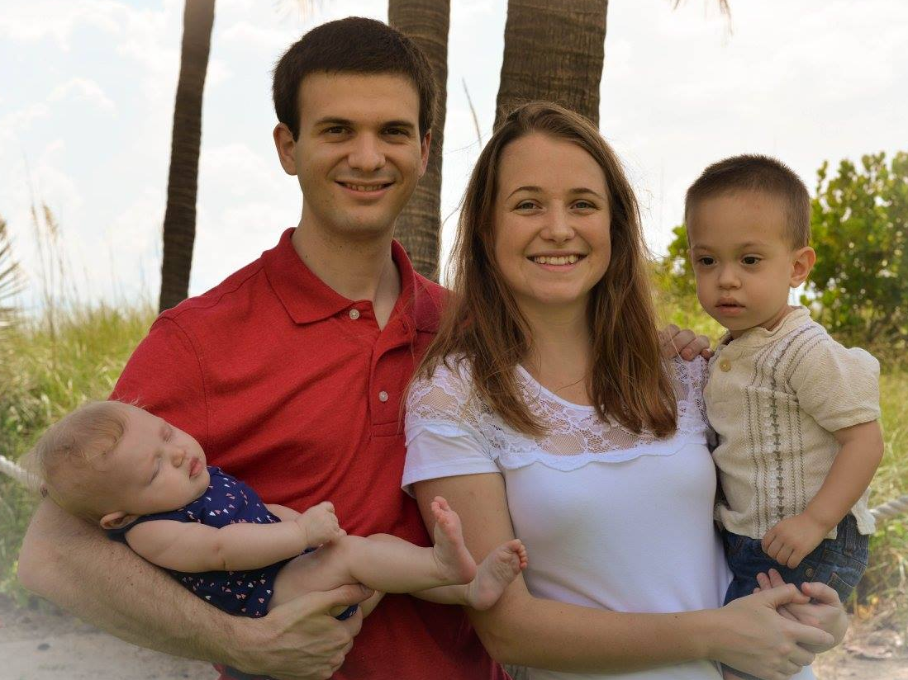
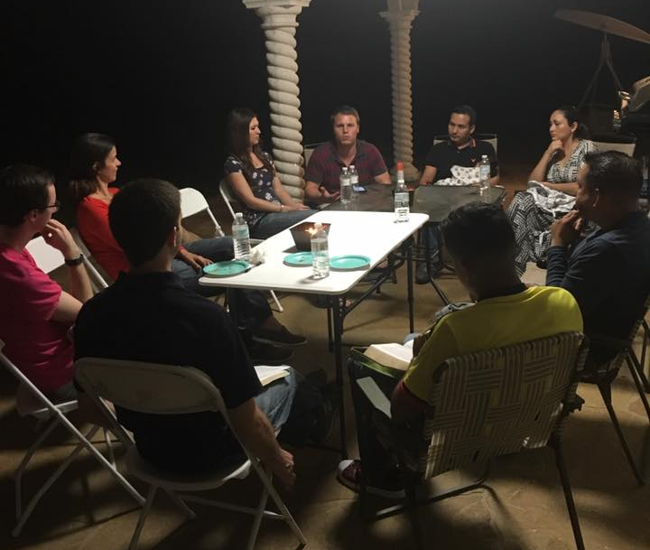
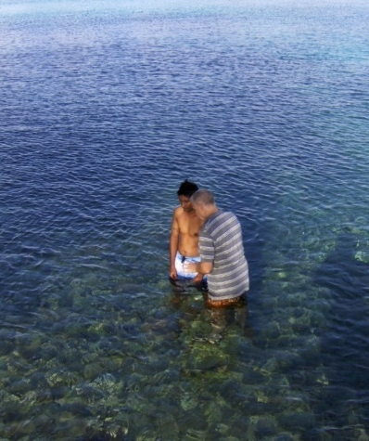

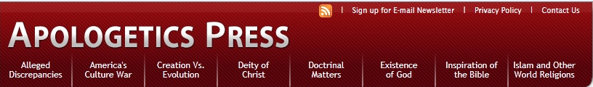
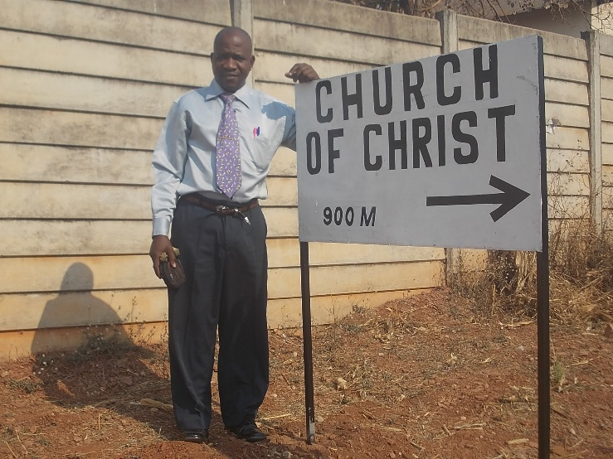
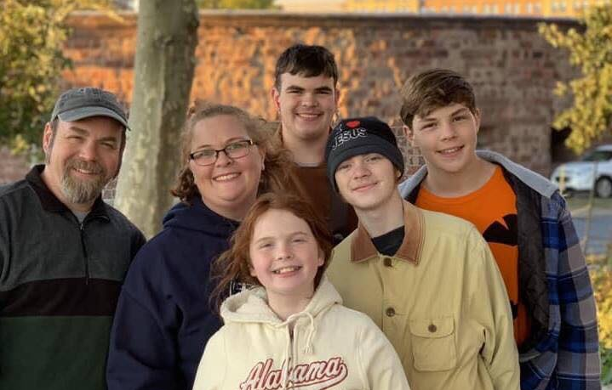
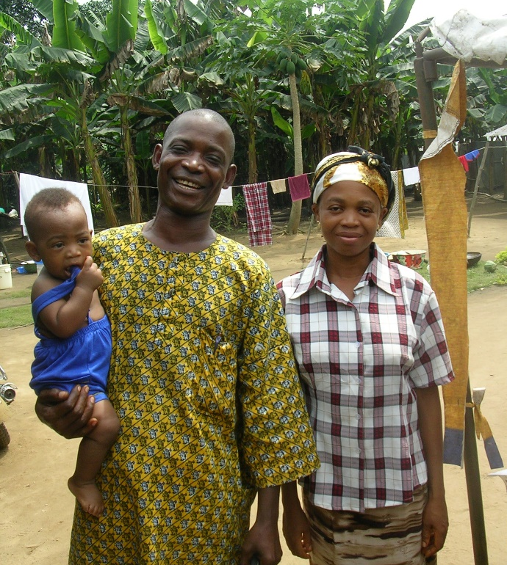
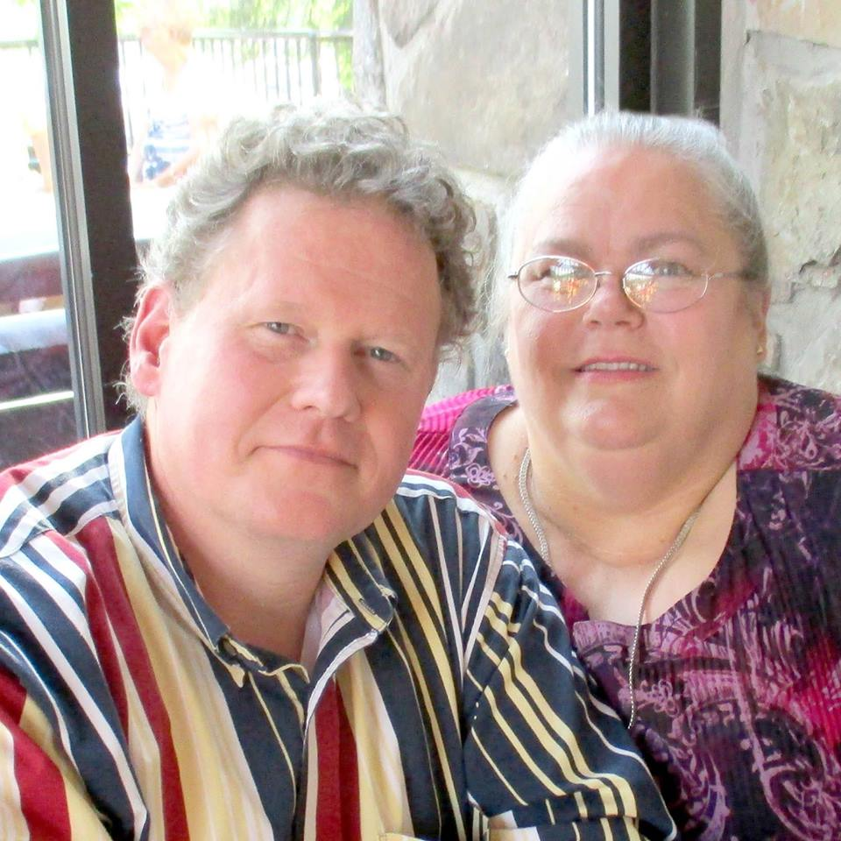
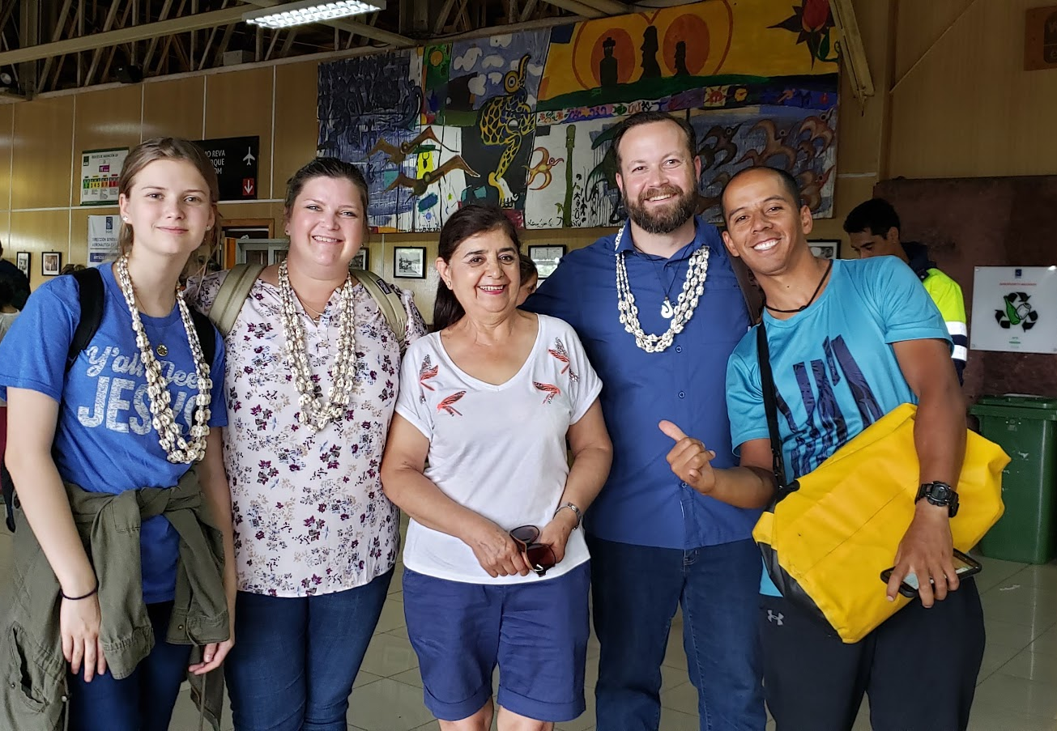
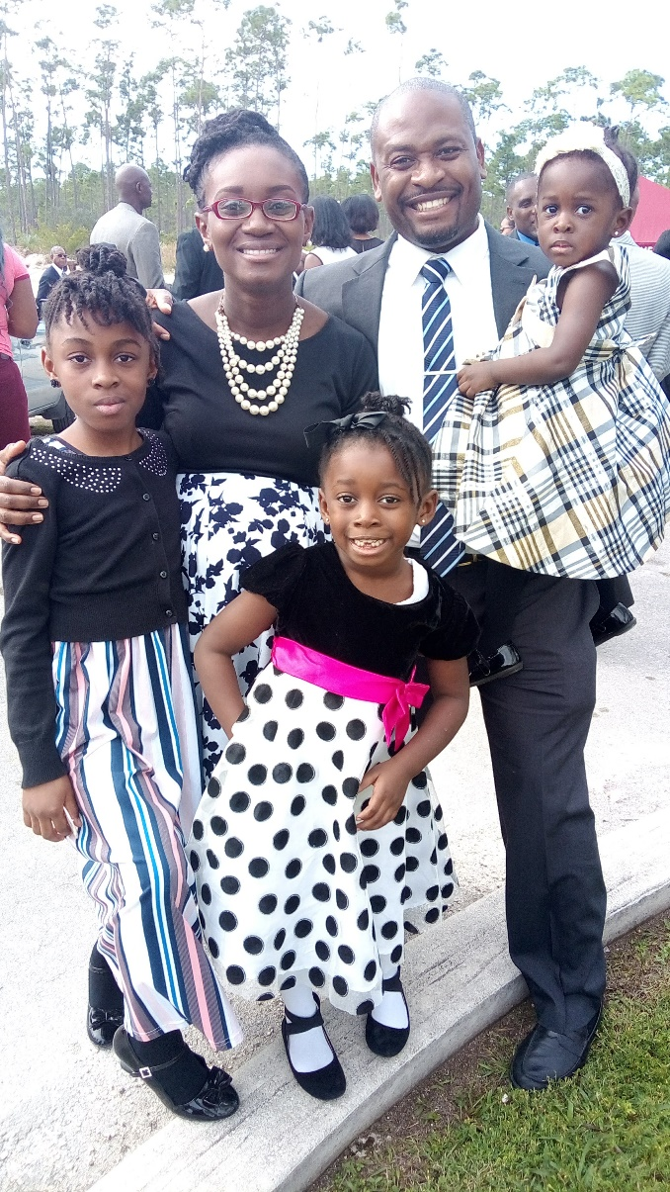

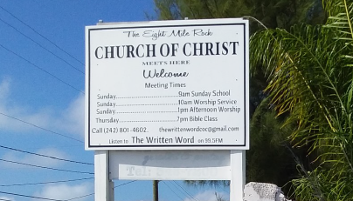
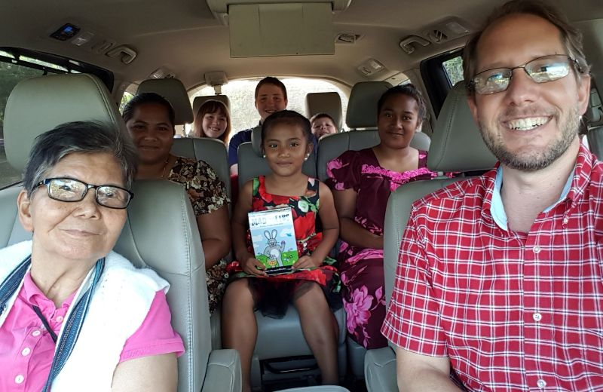
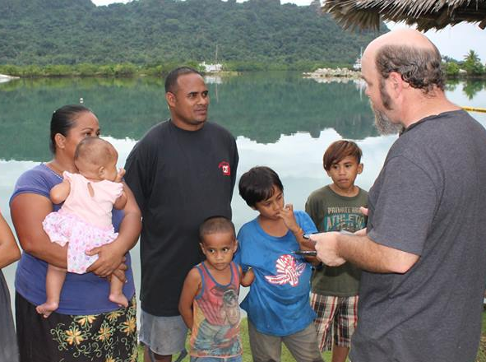
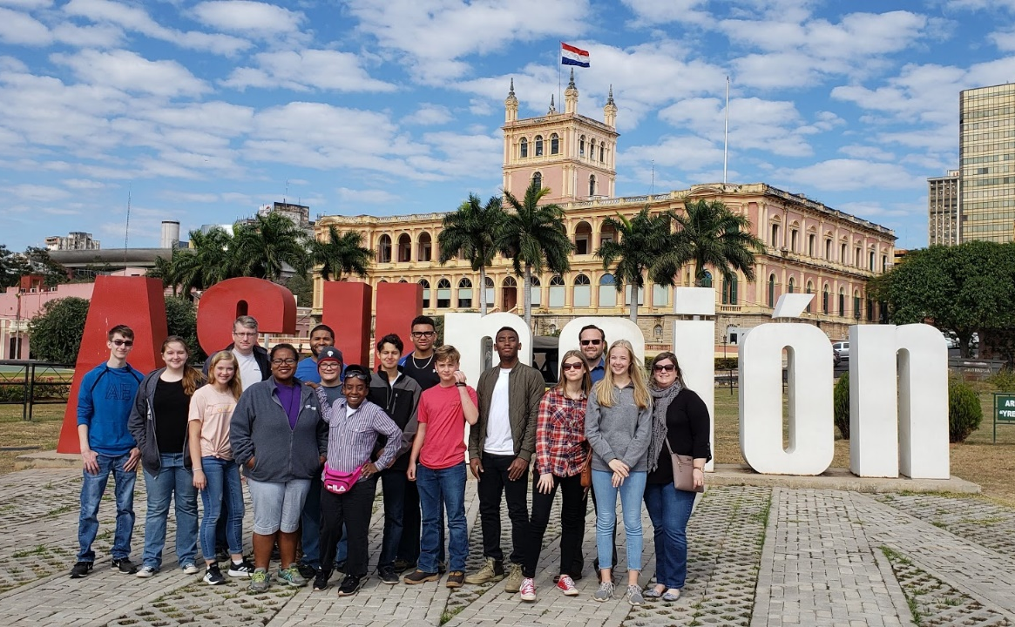
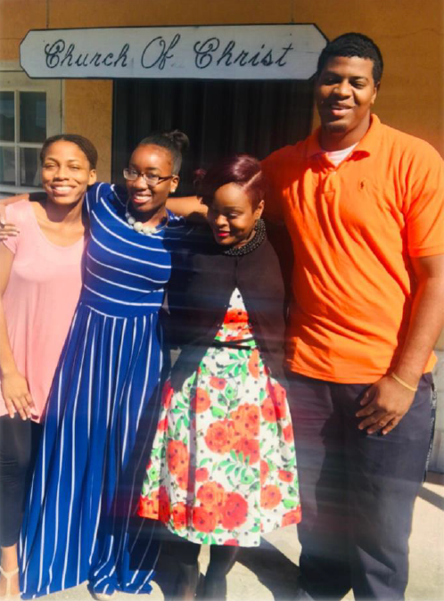
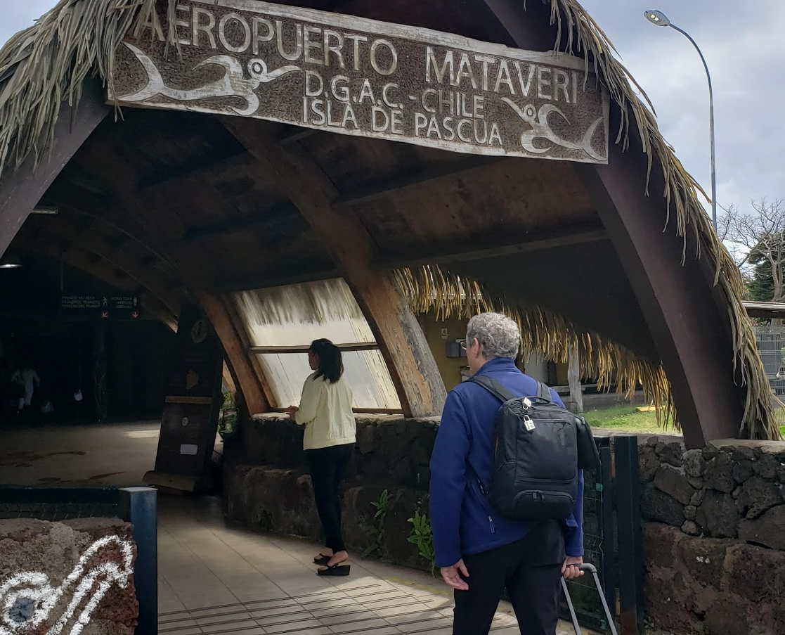
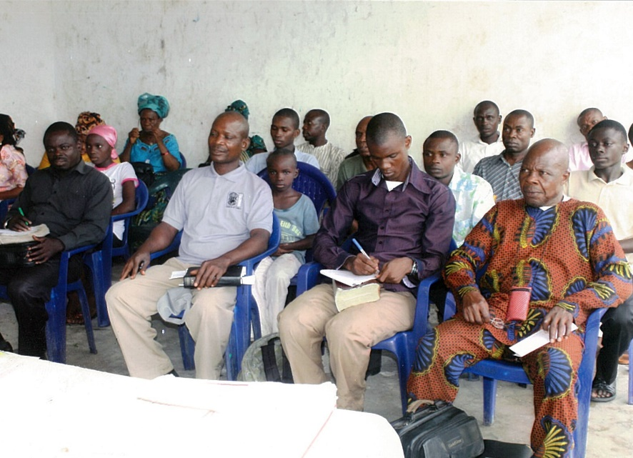
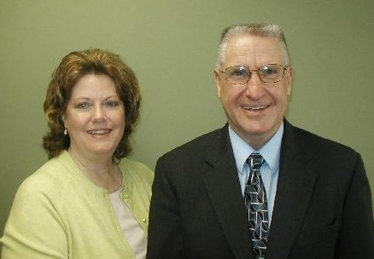
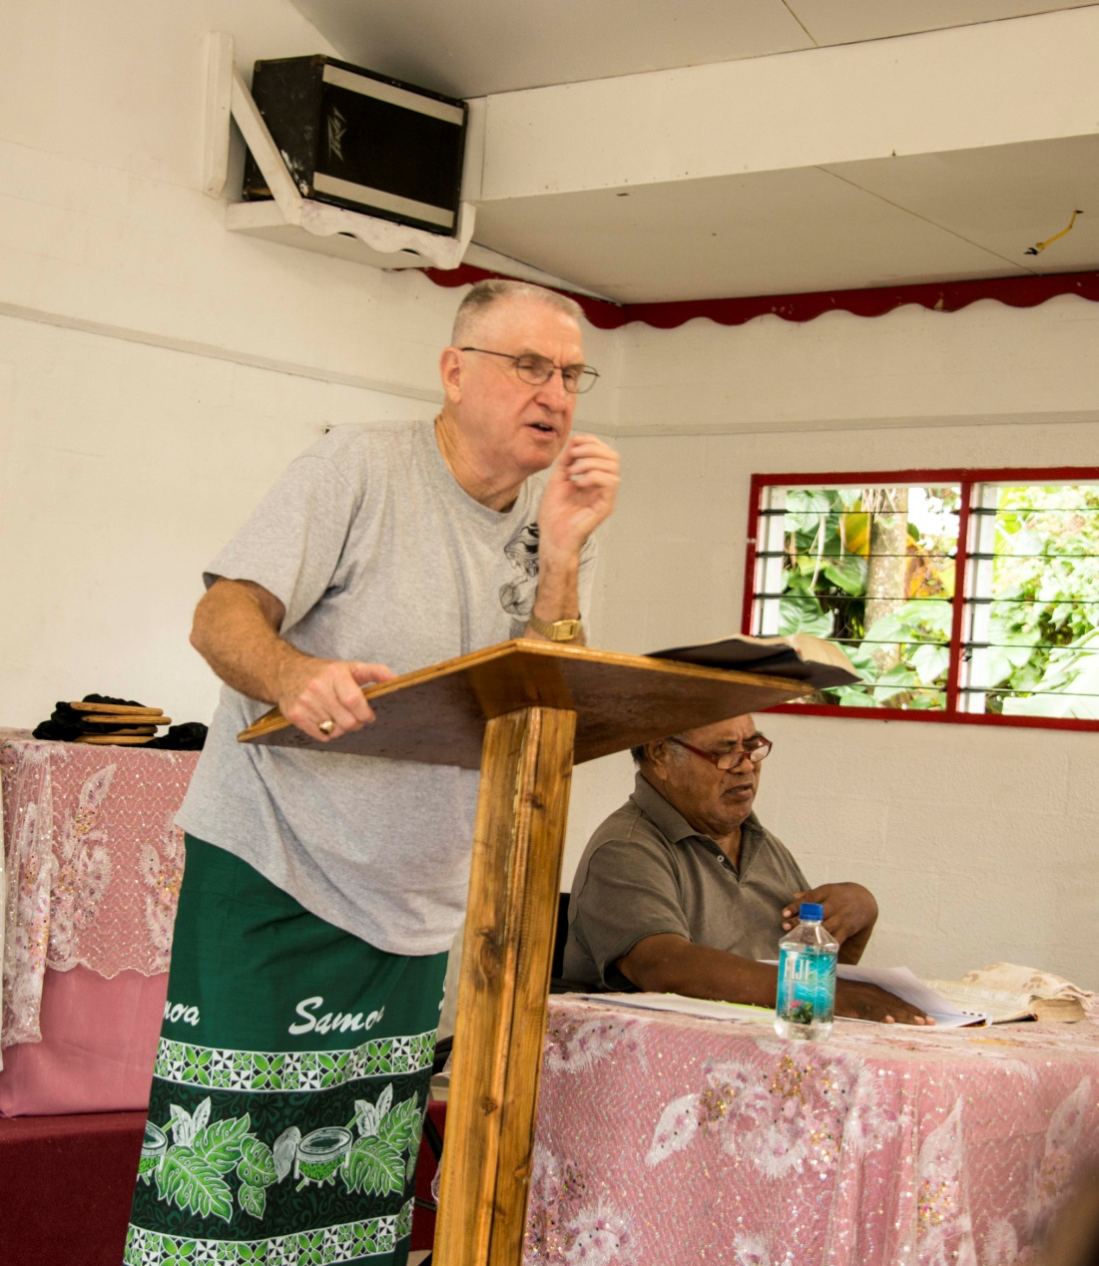
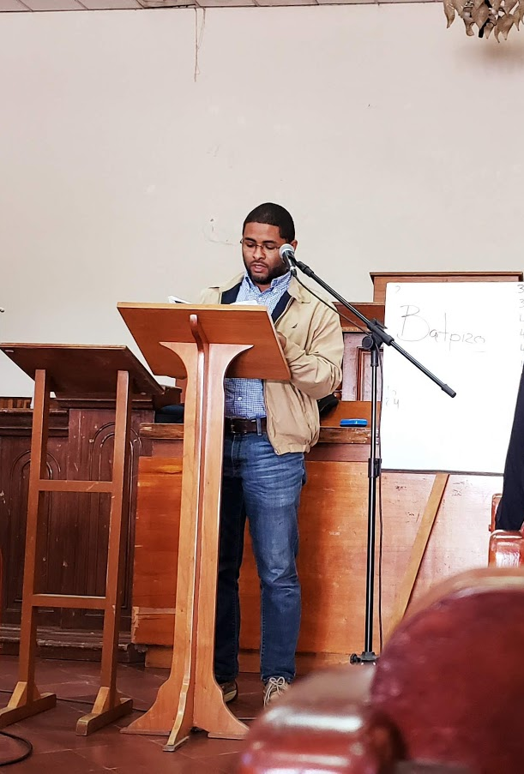
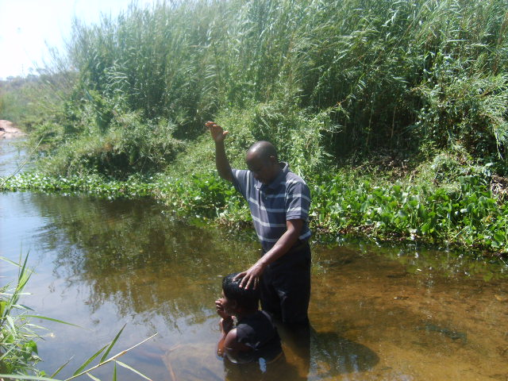
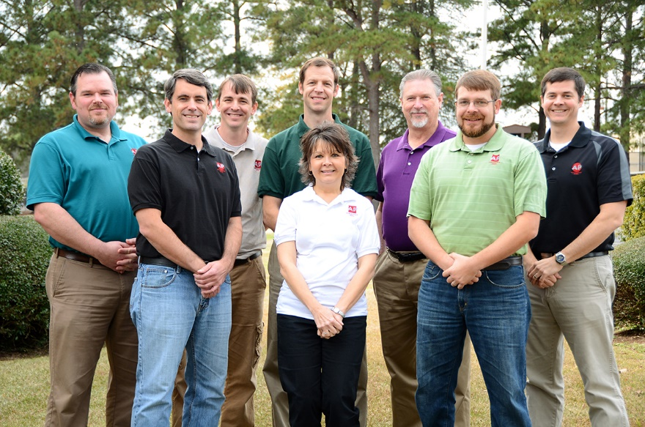
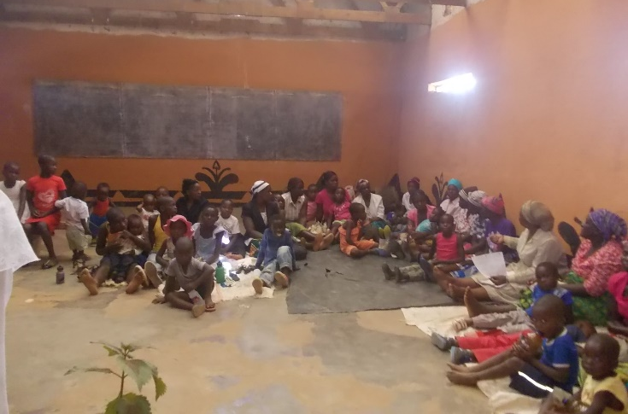
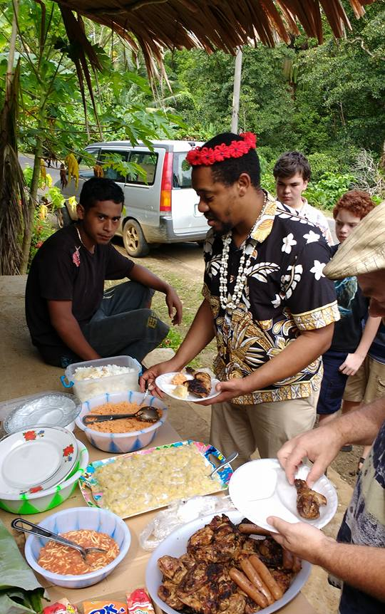

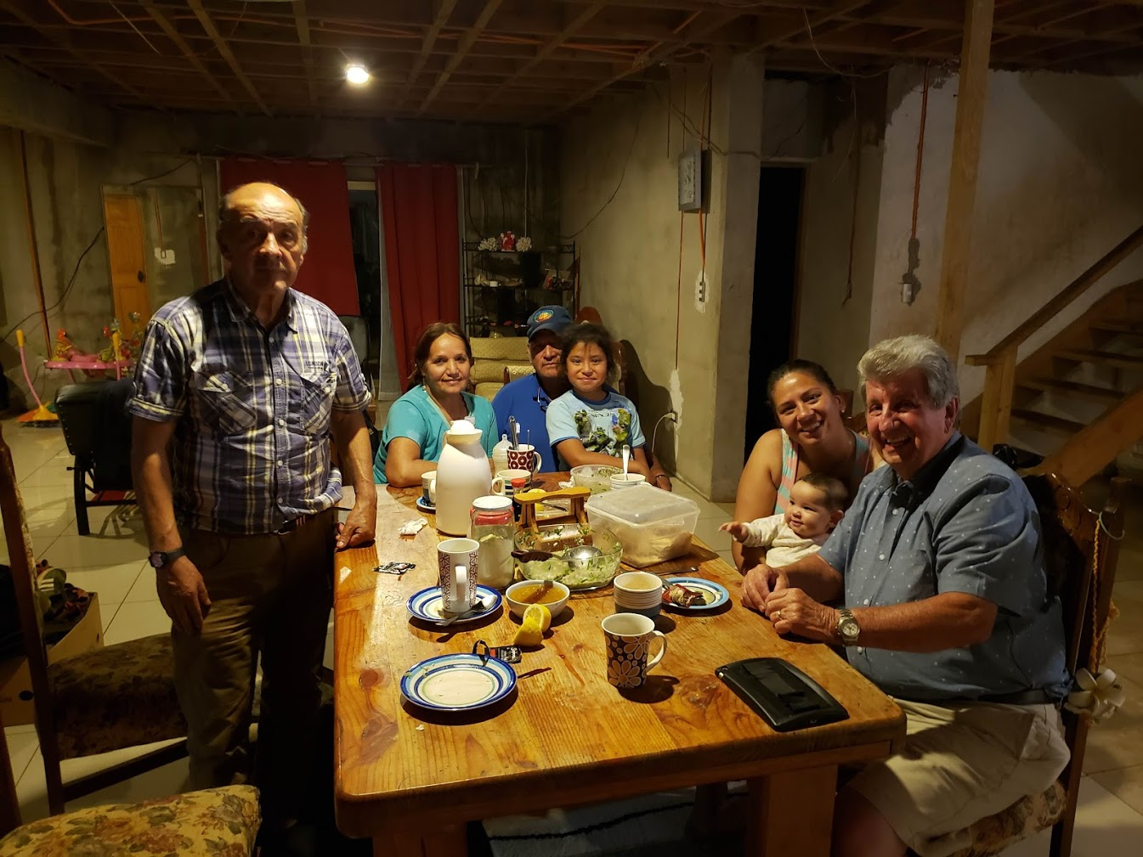


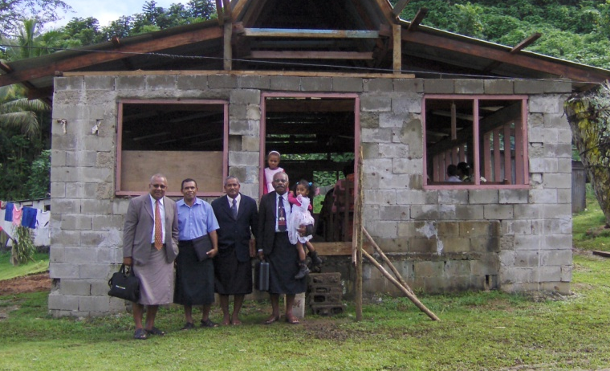

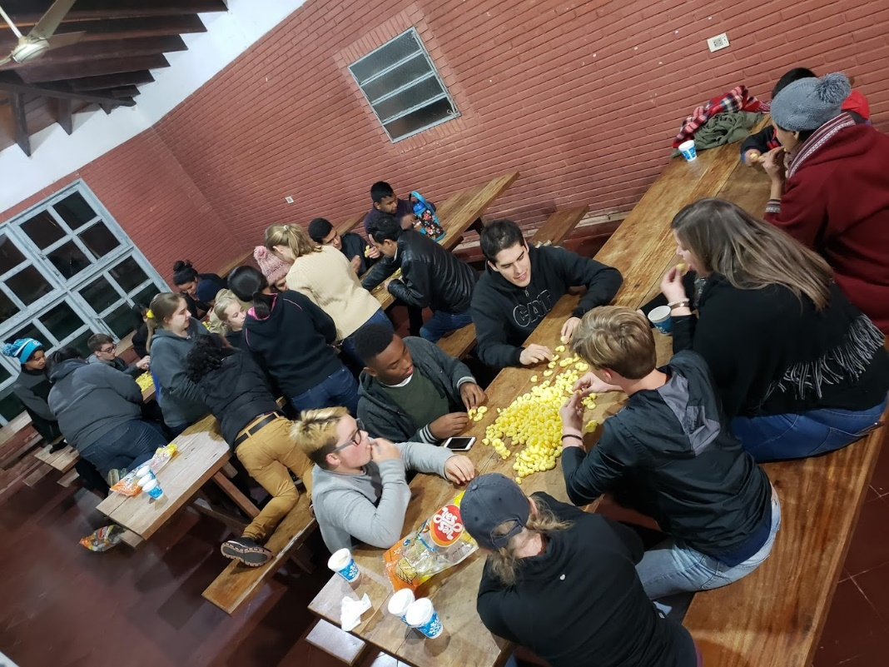
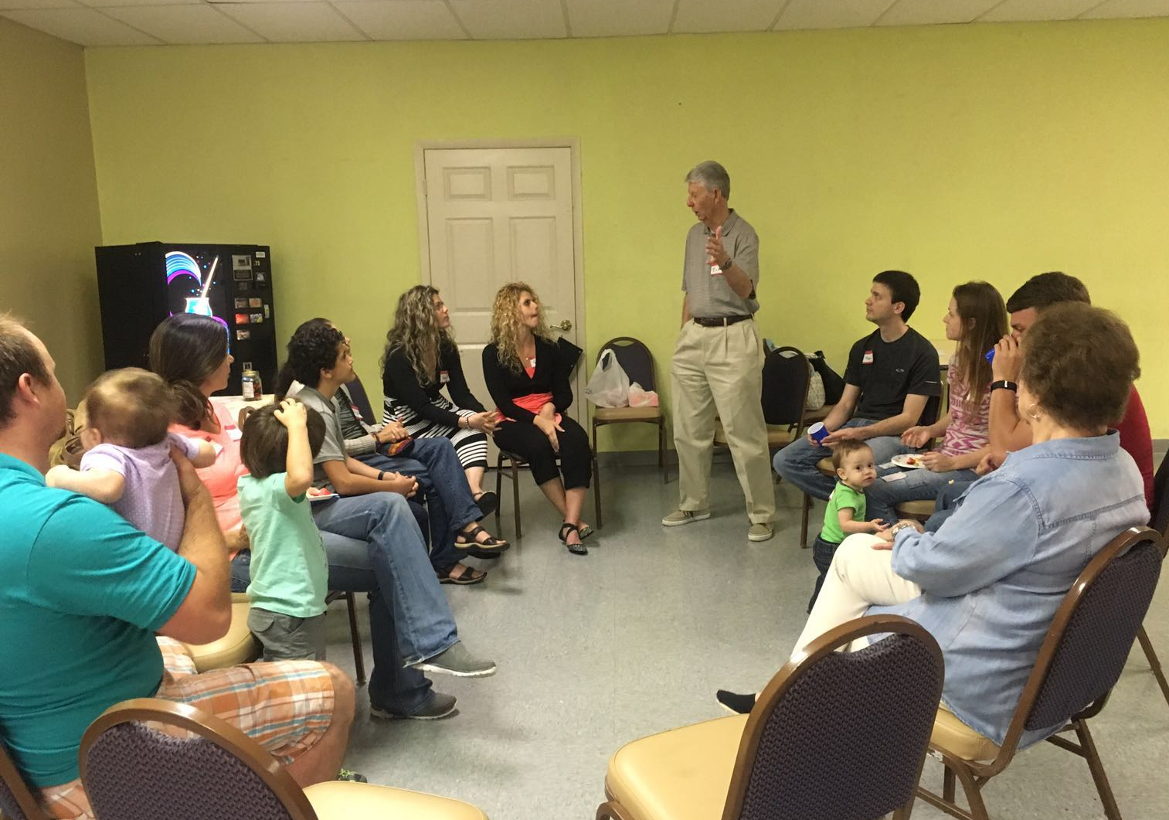
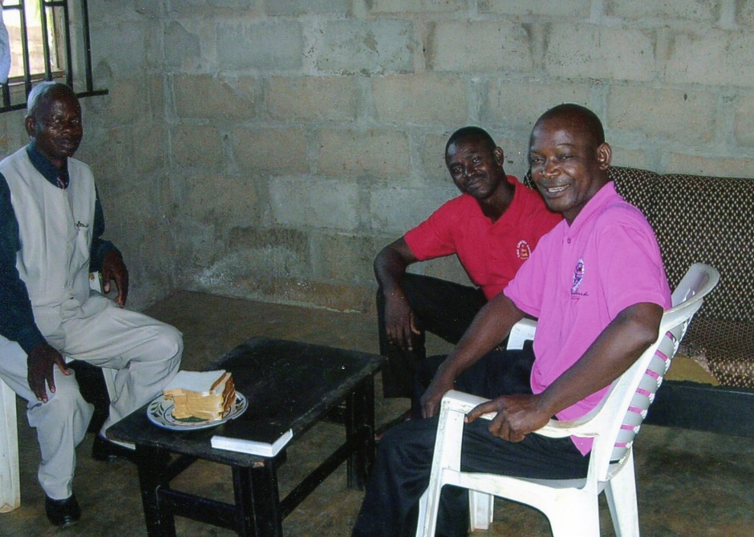
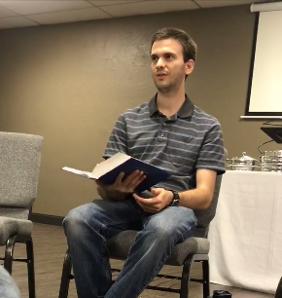
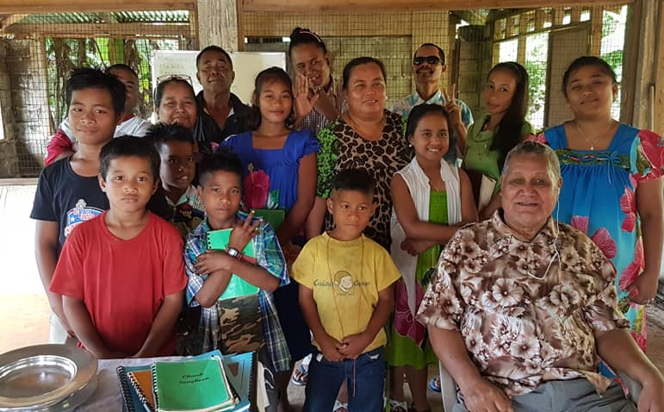
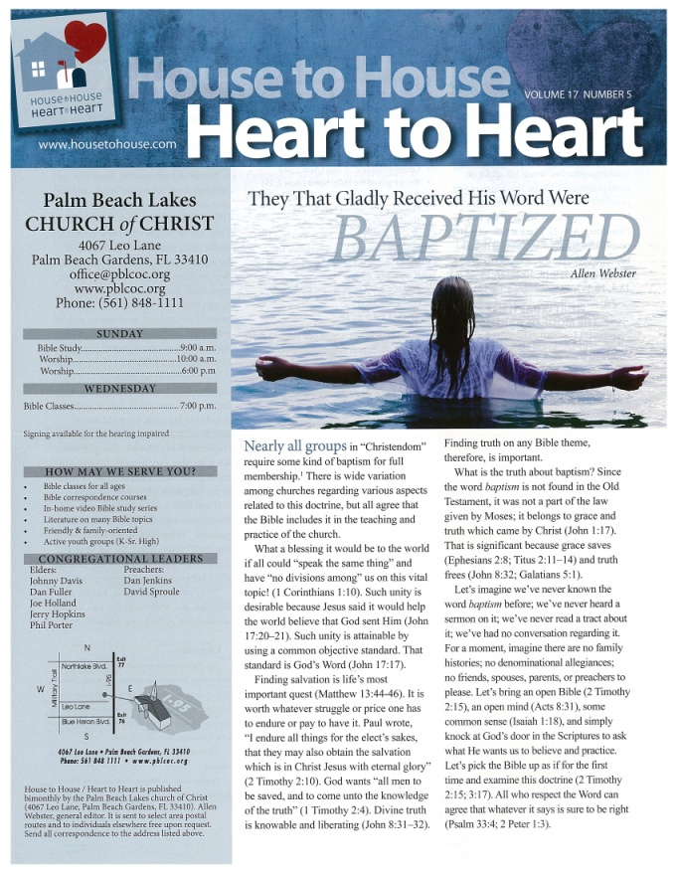
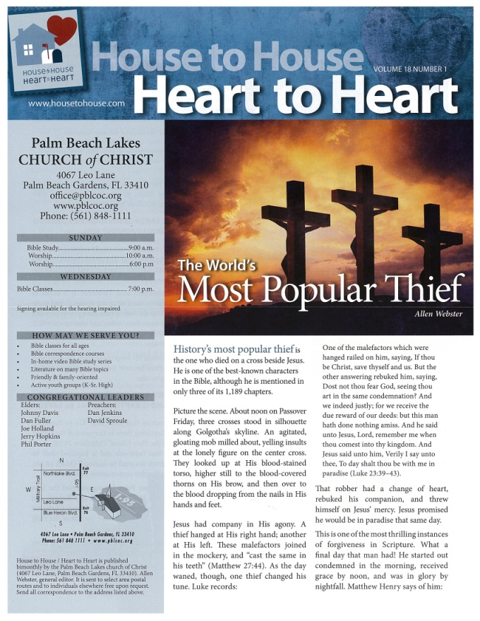
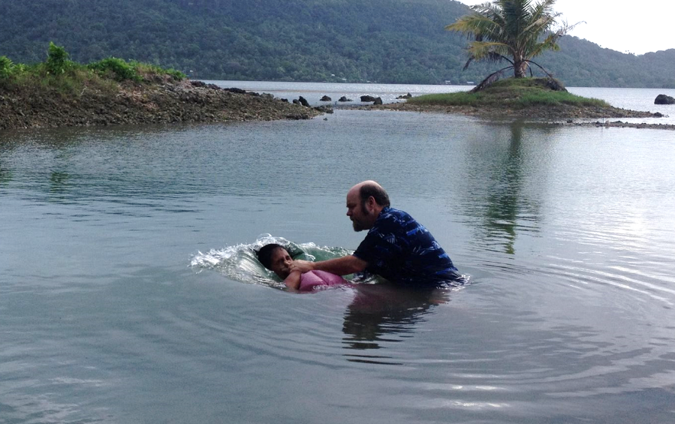
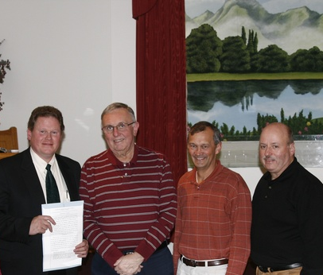
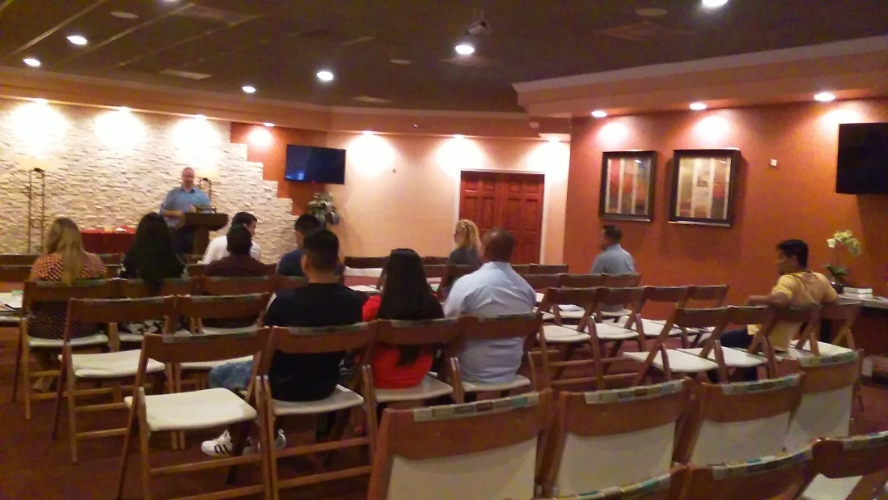
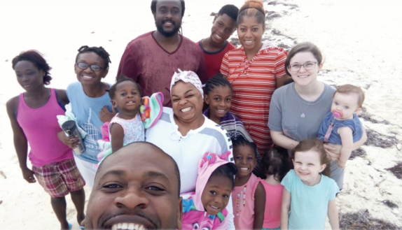
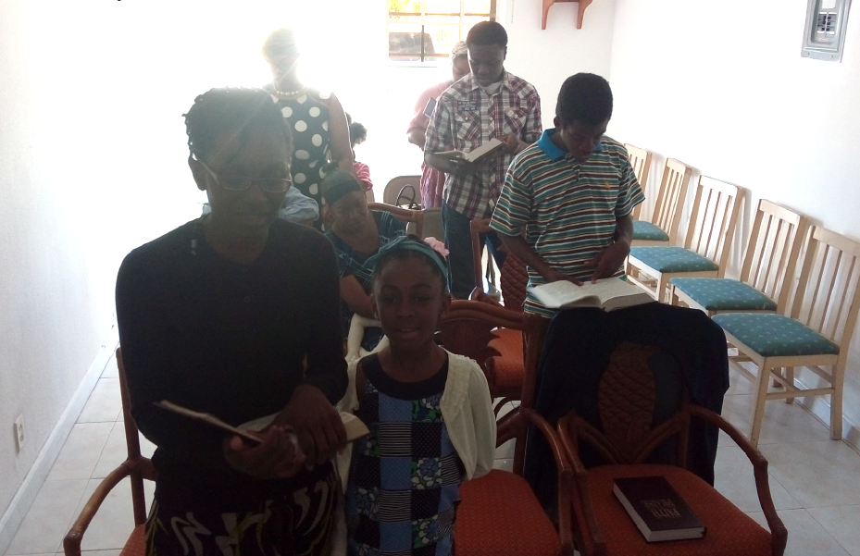
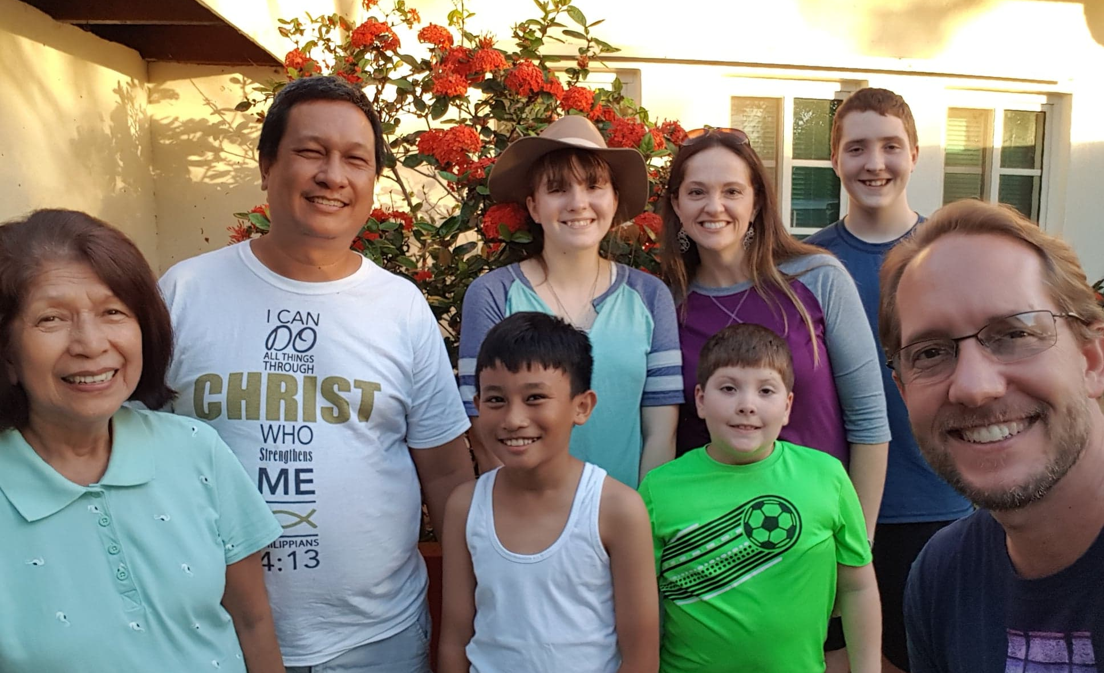

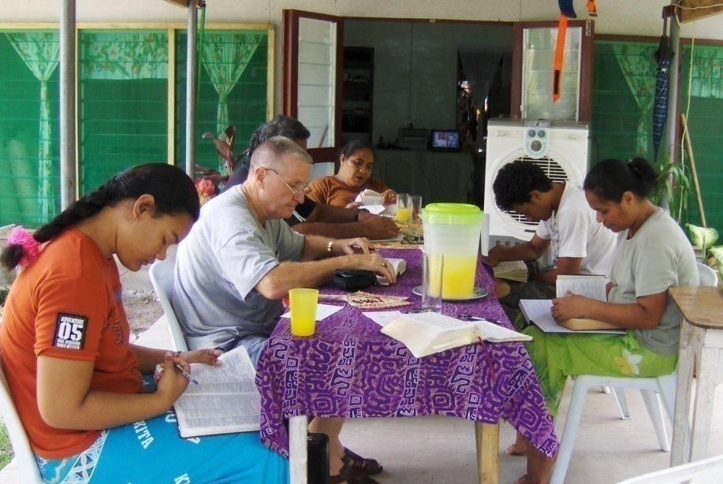
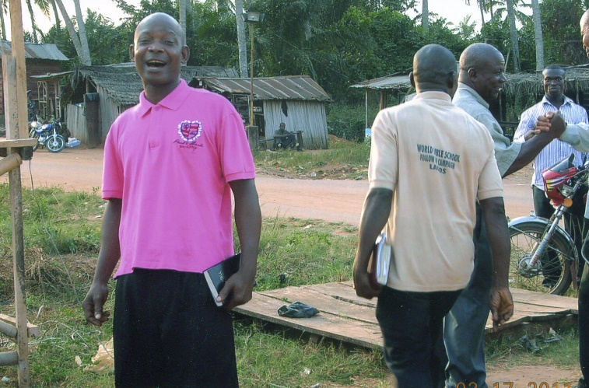
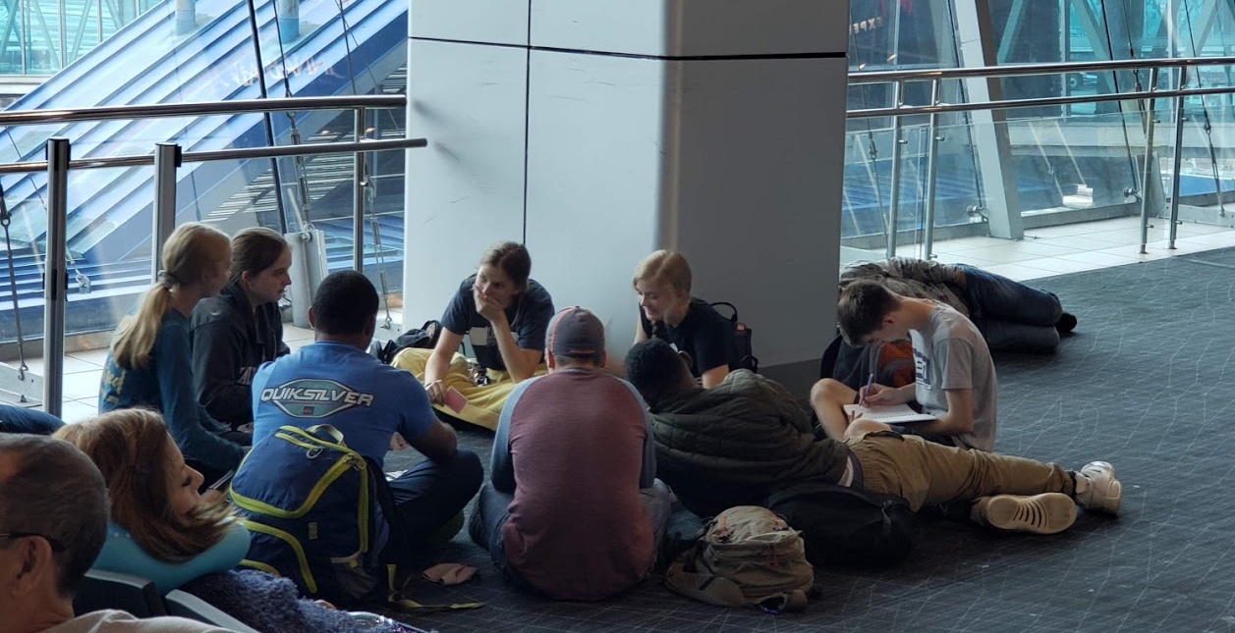
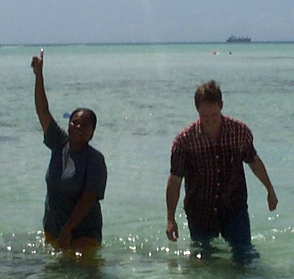
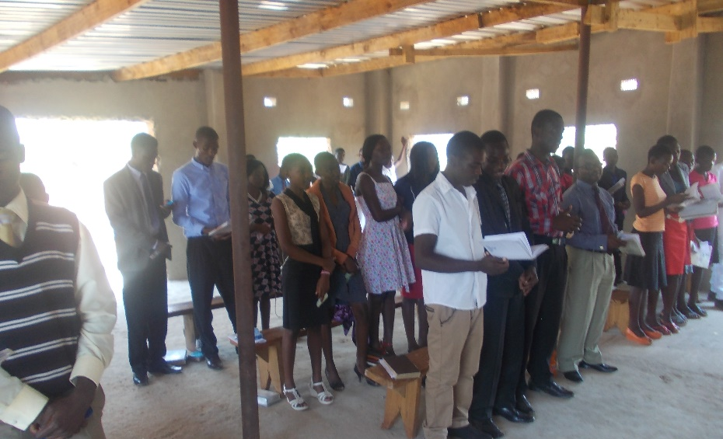
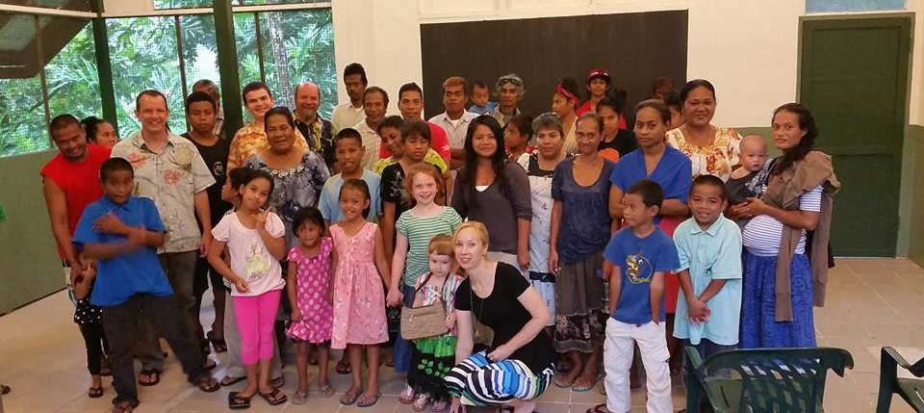
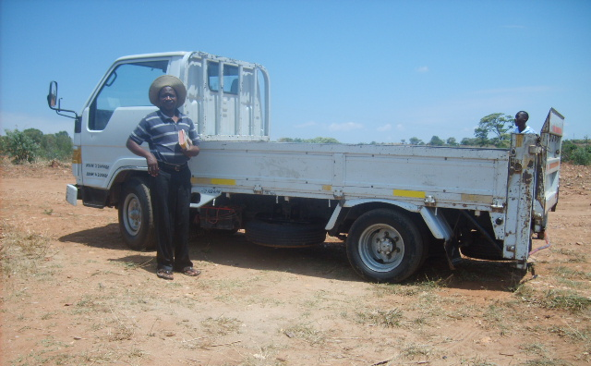
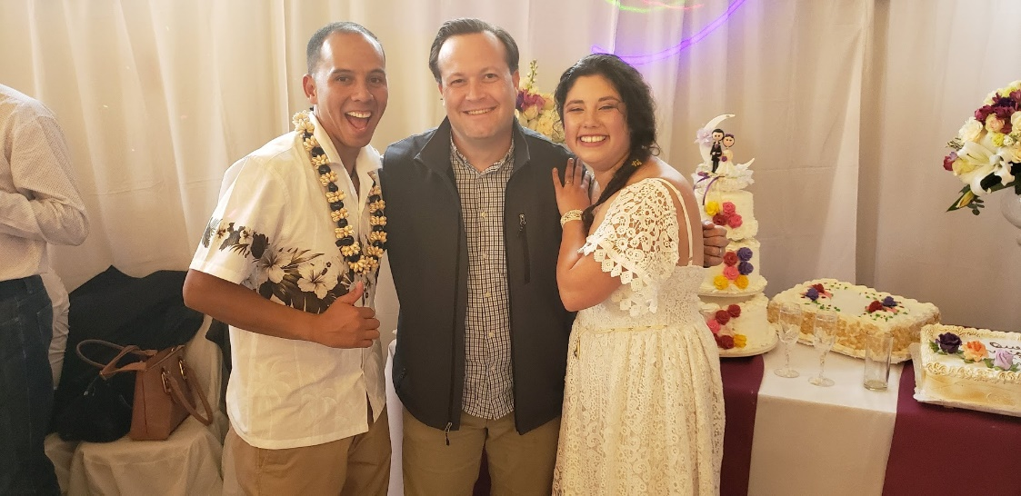
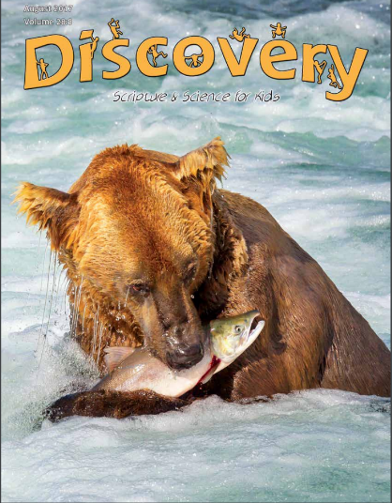


3,300 homes
EVERY month
Rotating Routes
Josh B. to Easter Island
House to House/Heart to Heart
Apologetics Press
Sr. High & Adult Mission Trip
$73,950
Tavaro Hanna (Bahamas)
Robert C. Lupo (Sneedville, TN)
Wayne Parker (Pacific)
Mauricio Yegros (Coral Springs)
Robert Martin (Pacific)
Joey Treat (Pacific)
Nnanna Aforji (Nigeria)
Tamuka Arunashe (Zimbabwe)

Slide 8
This will NOT be projected
If we give $91,450
  Bibles for Easter Island
    Population: 7,750
    Stores that sell Bibles: 0
    Josh has taken 500 Bibles in the last 4 years
  Special Requests for Mission Trips
    From college students and others
  One-Time Assistance (Special Gift) to Missionaries
    Hurt by Covid restrictions
    Some support has dropped

Slide 9
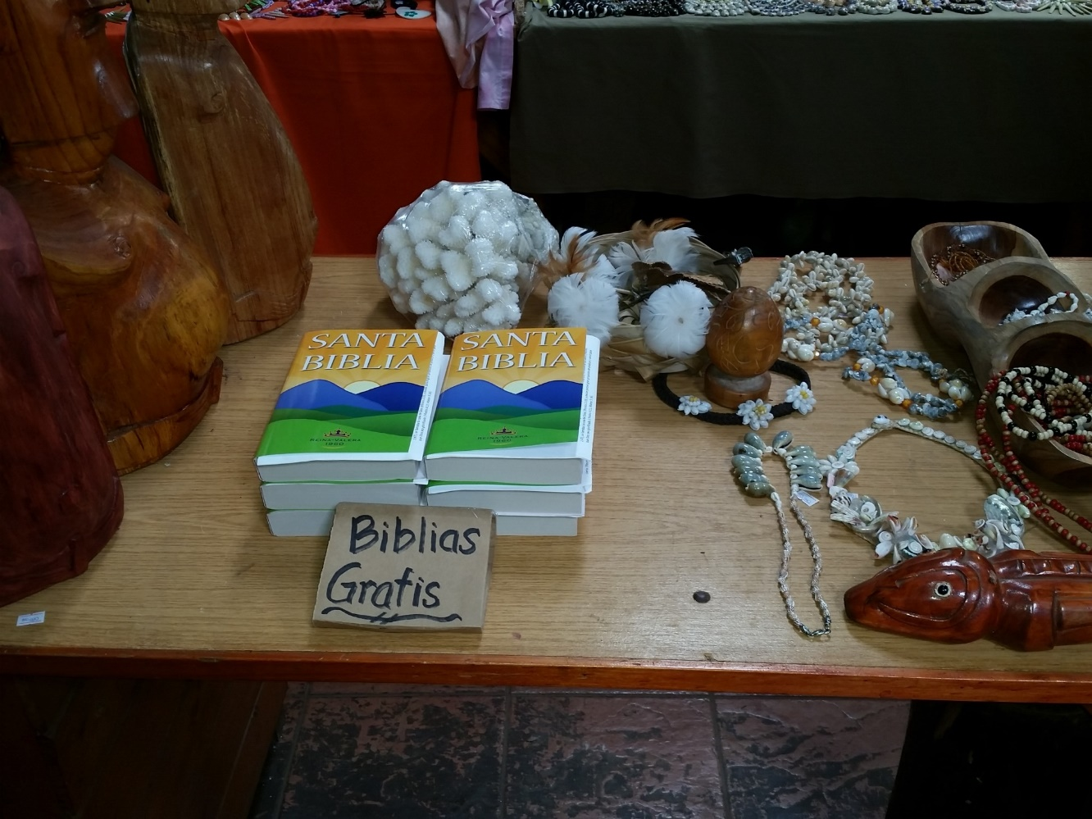
Easter Island
Population: 7,750
Stores that sell Bibles: 0
Bibles taken by Josh so far: 500
$91,450
Bibles for
Easter Island
Josh B. to Easter Island
House to House/Heart to Heart
Apologetics Press
Sr. High & Adult Mission Trip
$73,950
Tavaro Hanna (Bahamas)
Robert C. Lupo (Sneedville, TN)
Wayne Parker (Pacific)
Mauricio Yegros (Coral Springs)
Robert Martin (Pacific)
Joey Treat (Pacific)
Nnanna Aforji (Nigeria)
Tamuka Arunashe (Zimbabwe)

Slide 10
$91,450
Bibles for
Easter Island
Special Requests
for Mission Trips
Special Gift to Missionaries
Josh B. to Easter Island
House to House/Heart to Heart
Apologetics Press
Sr. High & Adult Mission Trip
$73,950
Tavaro Hanna (Bahamas)
Robert C. Lupo (Sneedville, TN)
Wayne Parker (Pacific)
Mauricio Yegros (Coral Springs)
Robert Martin (Pacific)
Joey Treat (Pacific)
Nnanna Aforji (Nigeria)
Tamuka Arunashe (Zimbabwe)

Slide 11
This will NOT be projected
If we give $111,950
  “In Search of the Lord’s Way” TV Program
    Provide some financial support in 2021
    Phil Sanders
    WGN on Sunday mornings at 7:00 a.m.
    Statistics: On the air since 1980

Slide 12
$111,950
“In Search of the
Lord’s Way” TV Program
$91,450
Bibles for
Easter Island
Special Requests
for Mission Trips
Special Gift to Missionaries
Josh B. to Easter Island
House to House/Heart to Heart
Apologetics Press
Sr. High & Adult Mission Trip
$73,950
Tavaro Hanna (Bahamas)
Robert C. Lupo (Sneedville, TN)
Wayne Parker (Pacific)
Mauricio Yegros (Coral Springs)
Robert Martin (Pacific)
Joey Treat (Pacific)
Nnanna Aforji (Nigeria)
Tamuka Arunashe (Zimbabwe)

Slide 13

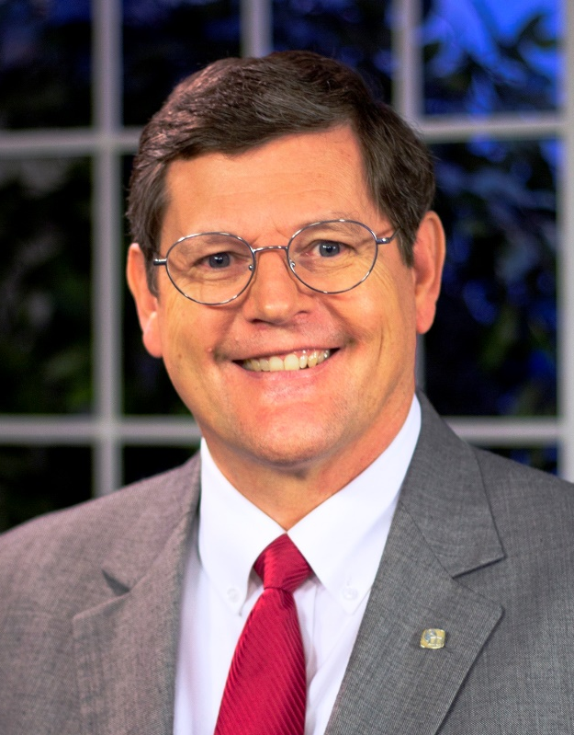

Sunday Mornings
at 7:00 a.m.
Reaching 100 million of 118 million homes in America every week
Phil Sanders

Slide 14

$125,950
Dominic Dos Santos (Trinidad)
$111,950
“In Search of the
Lord’s Way” TV Program
$91,450
Bibles for
Easter Island
Special Requests
for Mission Trips
Special Gift to Missionaries
Josh B. to Easter Island
House to House/Heart to Heart
Apologetics Press
Sr. High & Adult Mission Trip
$73,950
Tavaro Hanna (Bahamas)
Robert C. Lupo (Sneedville, TN)
Wayne Parker (Pacific)
Mauricio Yegros (Coral Springs)
Robert Martin (Pacific)
Joey Treat (Pacific)
Nnanna Aforji (Nigeria)
Tamuka Arunashe (Zimbabwe)

Slide 15
This will NOT be projected
If we give $125,950
  Dominic Dos Santos
    School has been in existence for 50 years
    They have trained hundreds of preachers
    They have students from all over the Caribbean, including some from Albania
    Dominic Dos Santos is the director of the school

Slide 16
$136,950
PIBC Teachers
$125,950
Dominic Dos Santos (Trinidad)
$111,950
“In Search of the
Lord’s Way” TV Program
$91,450
Bibles for
Easter Island
Special Requests
for Mission Trips
Special Gift to Missionaries
Josh B. to Easter Island
House to House/Heart to Heart
Apologetics Press
Sr. High & Adult Mission Trip
$73,950
Tavaro Hanna (Bahamas)
Robert C. Lupo (Sneedville, TN)
Wayne Parker (Pacific)
Mauricio Yegros (Coral Springs)
Robert Martin (Pacific)
Joey Treat (Pacific)
Nnanna Aforji (Nigeria)
Tamuka Arunashe (Zimbabwe)

Slide 17

Training Christians for 25 years
Taking the school directly to the students
Our part: Assisting with travel expenses of teachers

Slide 18
$136,950
PIBC Teachers
Trinidad SOP
$125,950
Dominic Dos Santos (Trinidad)
$111,950
“In Search of the
Lord’s Way” TV Program
$91,450
Bibles for
Easter Island
Special Requests
for Mission Trips
Special Gift to Missionaries
Josh B. to Easter Island
House to House/Heart to Heart
Apologetics Press
Sr. High & Adult Mission Trip
$73,950
Tavaro Hanna (Bahamas)
Robert C. Lupo (Sneedville, TN)
Wayne Parker (Pacific)
Mauricio Yegros (Coral Springs)
Robert Martin (Pacific)
Joey Treat (Pacific)
Nnanna Aforji (Nigeria)
Tamuka Arunashe (Zimbabwe)

Slide 19






Trinidad School of Preaching
Dominic Dos Santos
(Director)

Slide 20
This will NOT be projected
If we give $136,950
  PIBC Teachers
    25 years ago, Robert Martin started training for Christians in Pacific
    Taking the school directly to the students
    Our part: Assisting with travel expenses of teachers ($5,000/trip)
  One-time assistance for Trinidad School of Preaching
    School has been in existence for 50 years
    They have trained hundreds of preachers
    They have students from all over the Caribbean, including some from Albania
    Dominic Dos Santos is the director of the school

Slide 21
$+++,+++
+
+
+
$136,950
PIBC Teachers
Trinidad SOP
$125,950
Dominic Dos Santos (Trinidad)
$111,950
“In Search of the
Lord’s Way” TV Program
$91,450
Bibles for
Easter Island
Special Requests
for Mission Trips
Special Gift to Missionaries
Josh B. to Easter Island
House to House/Heart to Heart
Apologetics Press
Sr. High & Adult Mission Trip
$73,950
Tavaro Hanna (Bahamas)
Robert C. Lupo (Sneedville, TN)
Wayne Parker (Pacific)
Mauricio Yegros (Coral Springs)
Robert Martin (Pacific)
Joey Treat (Pacific)
Nnanna Aforji (Nigeria)
Tamuka Arunashe (Zimbabwe)

Slide 22




Working with congregations in Florida and around the United States
Assisting mission works on foreign soils
Planting congregations in due course
Josh Blackmer
Dan Jenkins

Slide 23


Robert Lupo
August 2021:
School of Preaching
Summer 2023:
New Evangelist

Slide 24
Mission Statement: Our mission is to labor with existing congregations and new works of the Lord’s church in evangelizing, edifying, and equipping the saints for greater service in domestic and foreign fields.
Evangelizing
  Gospel Meetings
  Door knocking/Canvasing
  Mission trips foreign and domestic
  Working with established congregations or mission points
  Establishing new works and congregations
Edifying
  Sending groups to domestic congregations
  Seminars
  Leadership workshops
Equipping
  Sending printed materials
  Preparing teachers
  Forming mission teams

Slide 25
$+++,+++
+
+
+
$136,950
PIBC Teachers
Trinidad SOP
$125,950
Palm Beach Lakes
World Missions
Dominic Dos Santos (Trinidad)
$111,950
Robert J. Lupo in
School of Preaching
“In Search of the
Lord’s Way” TV Program
$91,450
Bibles for
Easter Island
Special Requests
for Mission Trips
Special Gift to Missionaries
Josh B. to Easter Island
House to House/Heart to Heart
Apologetics Press
Sr. High & Adult Mission Trip
$73,950
Tavaro Hanna (Bahamas)
Robert C. Lupo (Sneedville, TN)
Wayne Parker (Pacific)
Mauricio Yegros (Coral Springs)
Robert Martin (Pacific)
Joey Treat (Pacific)
Nnanna Aforji (Nigeria)
Tamuka Arunashe (Zimbabwe)

Slide 27




Believe Jesus is God’s Son – John 8:24
Repent of your sins and turn to God – Acts 2:38
Confess your faith in Jesus Christ – Romans 10:9
Be immersed into Christ – Galatians 3:27
Live faithfully to Christ – Revelation 2:10

Slide 28
$+++,+++
+
+
+
$136,950
PIBC Teachers
Trinidad SOP
$125,950
Palm Beach Lakes
World Missions
Dominic Dos Santos (Trinidad)
$111,950
Robert J. Lupo in
School of Preaching
“In Search of the
Lord’s Way” TV Program
$91,450
Bibles for
Easter Island
Special Requests
for Mission Trips
Special Gift to Missionaries
Josh B. to Easter Island
House to House/Heart to Heart
Apologetics Press
Sr. High & Adult Mission Trip
$73,950
Tavaro Hanna (Bahamas)
Robert C. Lupo (Sneedville, TN)
Wayne Parker (Pacific)
Mauricio Yegros (Coral Springs)
Robert Martin (Pacific)
Joey Treat (Pacific)
Nnanna Aforji (Nigeria)
Tamuka Arunashe (Zimbabwe)

