Slide 2
Paul’s First Missionary Journey
Separated for the work (13:1-3)
Now there were at Antioch, in the church that was there, prophets and teachers: Barnabas, and Simeon who was called Niger, and Lucius of Cyrene, and Manaen who had been brought up with Herod the tetrarch, and Saul. While they were ministering to the Lord and fasting, the Holy Spirit said, "Set apart for Me Barnabas and Saul for the work to which I have called them." Then, when they had fasted and prayed and laid their hands on them, they sent them away.

Slide 3
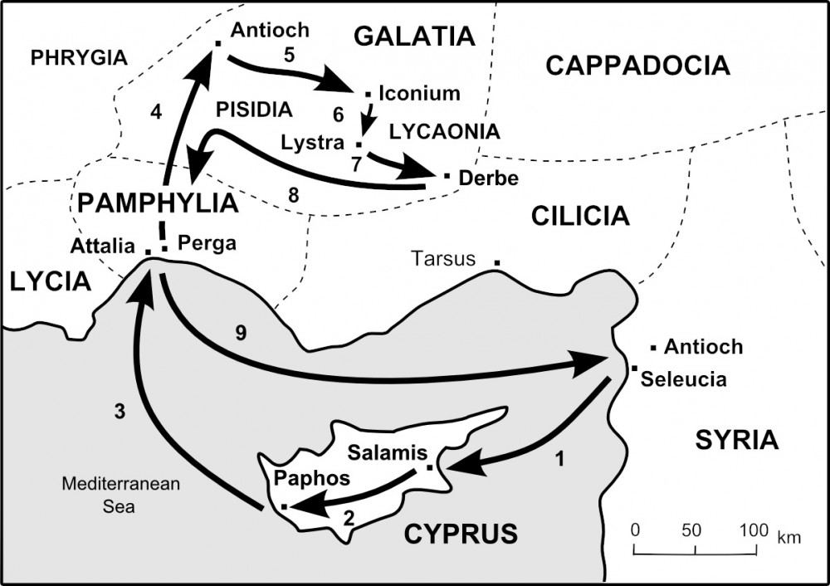
Paul’s First Missionary Journey
Events on the Island of Cyprus (13:4-12)
Sailed to Cyprus
Began preaching to Jews
Bar-Jesus/Elymas

Slide 4
Paul’s First Missionary Journey
Events at Antioch of Pisidia (13:13-52)
Travel to Antioch
Paul’s Sermon
The people received it
The leaders opposed it

Slide 5
Paul’s First Missionary Journey
Events at Iconium (14:1-7)
Taught in the synagogue
“Large number of people”
Divided city

Slide 6
Paul’s First Missionary Journey
Events at Lystra (14:8-20)
Miracle
People called them gods
Interference from Jews

Slide 7
Paul’s First Missionary Journey
Derbe and the Return (14:8-20)
Made many disciples
Returned to other cities
Encouraged the disciples
Preached as they returned
Recounted the events

