Slide 2
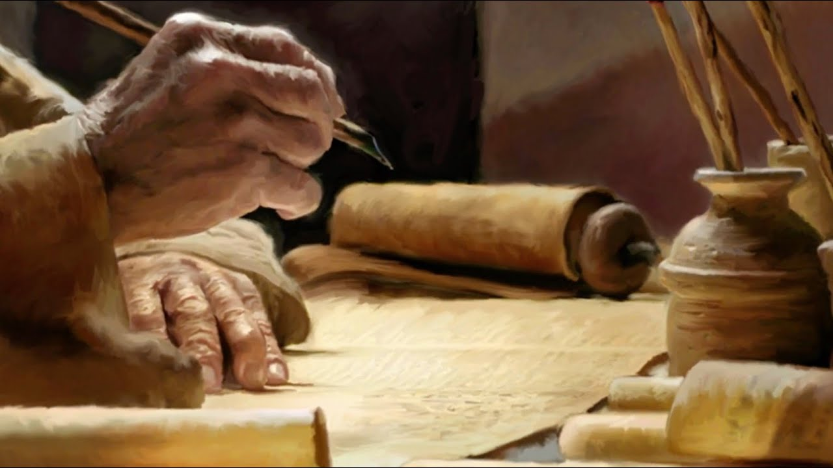
Ezekiel
The Watchman of Israel

Slide 3

Ezekiel: Outline
Judgement on Judah and Jerusalem (1-24)
Oracles against foreign nations (25-32)
Blessing for Judah and Jerusalem (33-48)

Slide 4
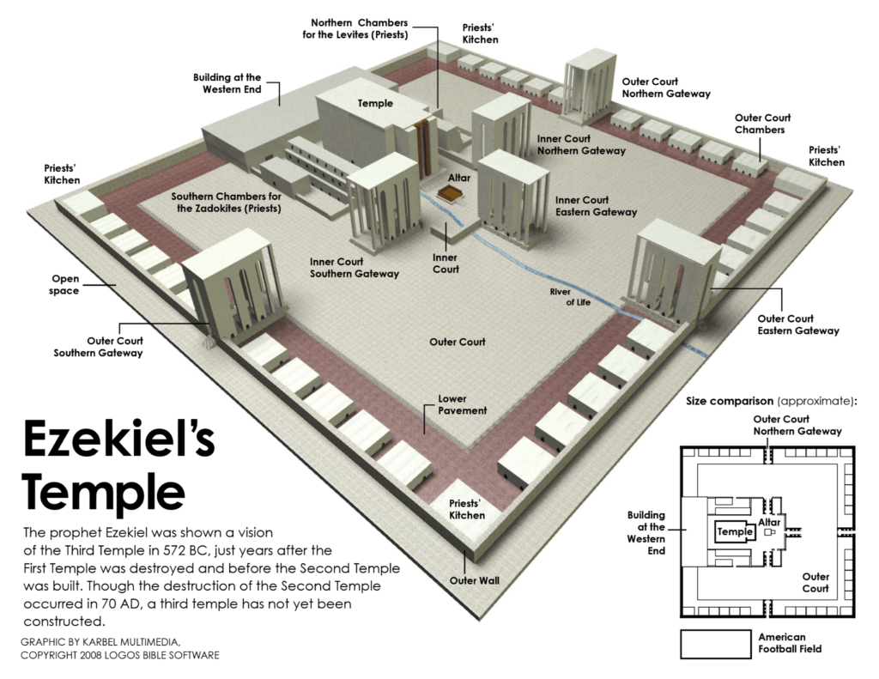

Slide 5
Blessing for Judah and Jerusalem (33-48)
Chapter 44
1-3: Message at the East Gate
4-14: Message at the North Gate
15-31: Ordinances Concerning the Sons of Zadok

Slide 6
Blessing for Judah and Jerusalem (33-48)
Chapter 45
1-6: Holy Land for the Levites
7-9: Land for the Princes
10-12: Just Balances
13-25: Providing the offerings

Slide 7
Blessing for Judah and Jerusalem (33-48)
Chapter 46
1-18: Prince’s Offerings
19-24: Places to Boil

Slide 8
Blessing for Judah and Jerusalem (33-48)
Chapter 47
1-12: Water from the Temple
13-23: Boundaries of the Land

Slide 9
Blessing for Judah and Jerusalem (33-48)
Chapter 48
1-9: Division of the Land
10-20: Portion for the Priests
21-22: Portion for the Prince
23-29: Portion for the Other Tribes
30-35: City Gates

Slide 10
