Slide 2
Ezekiel
The Watchman of Israel

Slide 3
Ezekiel: Outline
Judgement on Judah and Jerusalem (1-24)
Oracles against foreign nations (25-32)
Blessing for Judah and Jerusalem (33-48)

Slide 4
Blessing for Judah and Jerusalem (33-48)
Chapter 38
1-9: Prophecy Against Gog
10-13: Intent of Gog
14-23: Destruction of Gog

Slide 5
Blessing for Judah and Jerusalem (33-48)
Chapter 39
1-20: The Extent of the Destruction of Gog
21-24: They Will Know
25-29: Israel Will be Restored

Slide 6
Blessing for Judah and Jerusalem (33-48)
Chapter 40
1-4: The Man With the Measuring Rod
5-49: Measuring the Outer Temple

Slide 7
Blessing for Judah and Jerusalem (33-48)
Chapter 41
1-20: The Measurements of the Temple
21-26: The Wood Work of the Temple

Slide 8
Blessing for Judah and Jerusalem (33-48)
Chapter 42
1-14: Outer Court and Chambers
15-20: Final Dimensions

Slide 9
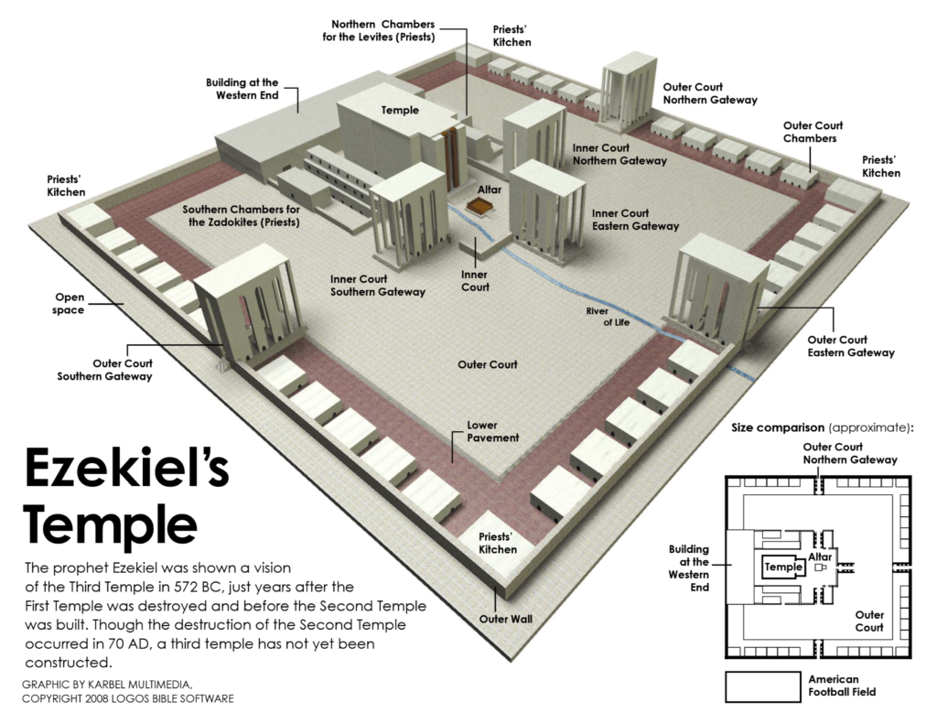

Slide 10
Blessing for Judah and Jerusalem (33-48)
Chapter 43
1-12: The Return of God’s Glory
13-17: Measurements of the Alter
18-27: Consecrating the Alter

