Slide 2
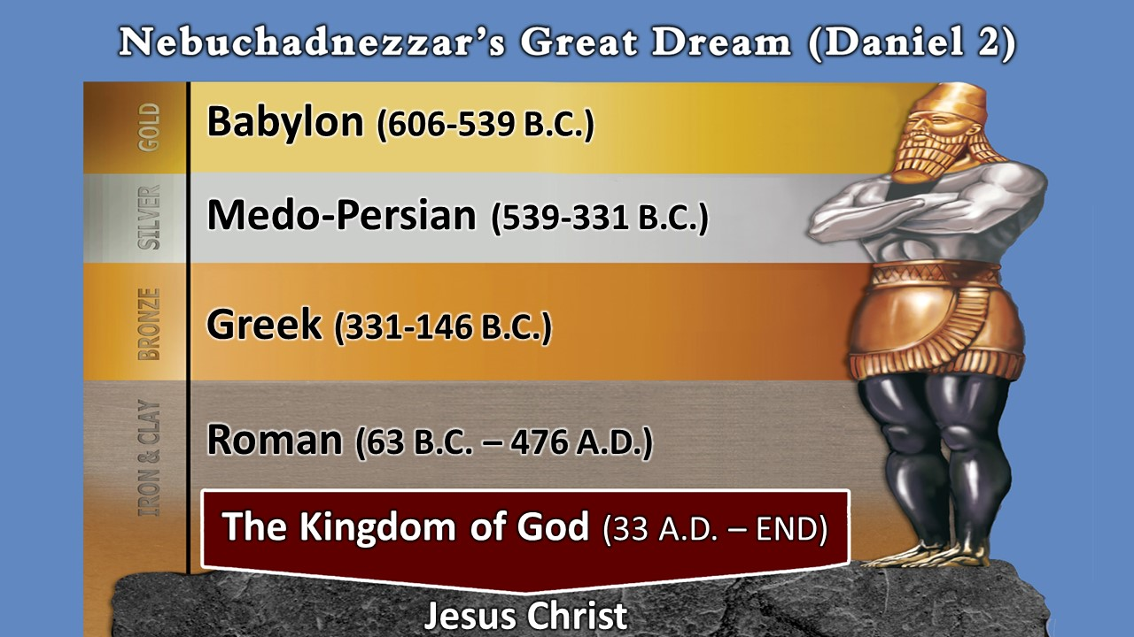

Slide 3
Nebuchadnezzar’s Golden Image (3:1-7)
    75 feet tall, 9 wide at the base
The Charge Against Daniel’s Three Friends (3:8-13)
    12(b) They do not worship the Golden Image
The Response (3:14-18)
    16 “We have no need to answer you” (Nebuchadnezzar)
The Sentencing (3:19-23)
    7 times hotter (verse 22) exceedingly hot
The Salvation of the Three Men (3:24-27)
    God protected them
The King’s Praise of God (3:28-30)
    Talk nice about God or I will kill you (Nebuchadnezzar)

