Slide 2
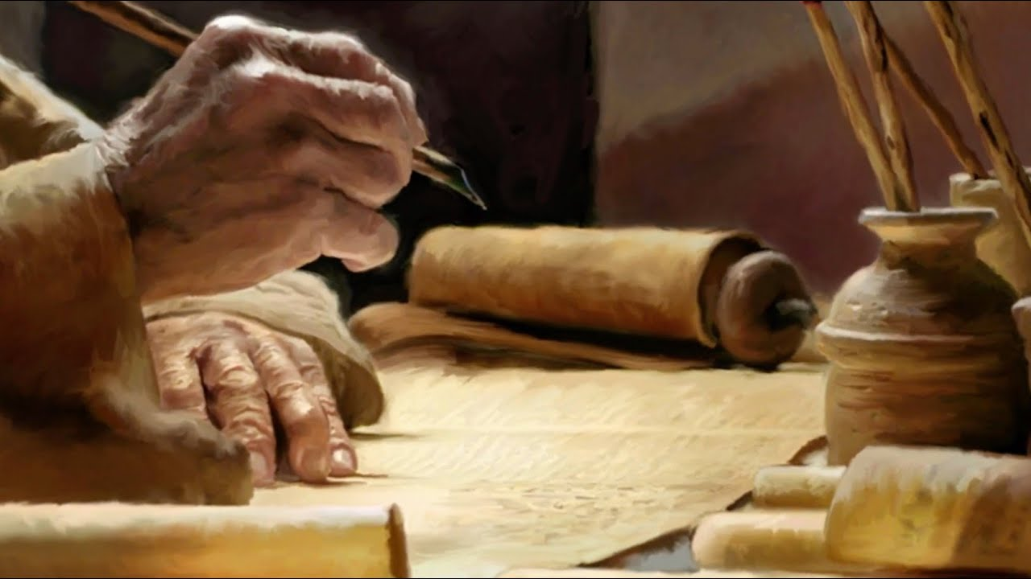
Ezekiel
The Watchman of Israel

Slide 3

Ezekiel: Outline
Judgement on Judah and Jerusalem (1-24)
Oracles against foreign nations (25-32)
Blessing for Judah and Jerusalem (33-48)

Slide 4
Blessing for Judah and Jerusalem (33-48)
Chapter 33
1-6: Duties of the Watchman
7-10: Ezekiel as a Watchman
11-20: True Righteousness
21-29: Jerusalem Falls and the Pride of the Remnant
30-33: Those that Listen to Ezekiel

Slide 5
Blessing for Judah and Jerusalem (33-48)
Chapter 34
1-10: Woe to the Shepherds of Israel
11-16: The Lord will Restore His Flock
17-22: The Lord will Judge His Flock
23-31: The Lord will Shepherd His Flock

Slide 6
Blessing for Judah and Jerusalem (33-48)
Chapter 35
1-15: Prophecy Against Edom

Slide 7
Blessing for Judah and Jerusalem (33-48)
Chapter 36
1-21: Message to the Land of Israel
22-38: For My Name’s Sake

Slide 8
Blessing for Judah and Jerusalem (33-48)
Chapter 37
1-14: Vision of Dry Bones
15-23: One Nation Under God
24-28: Davidic Covenant Remembered

