Slide 2
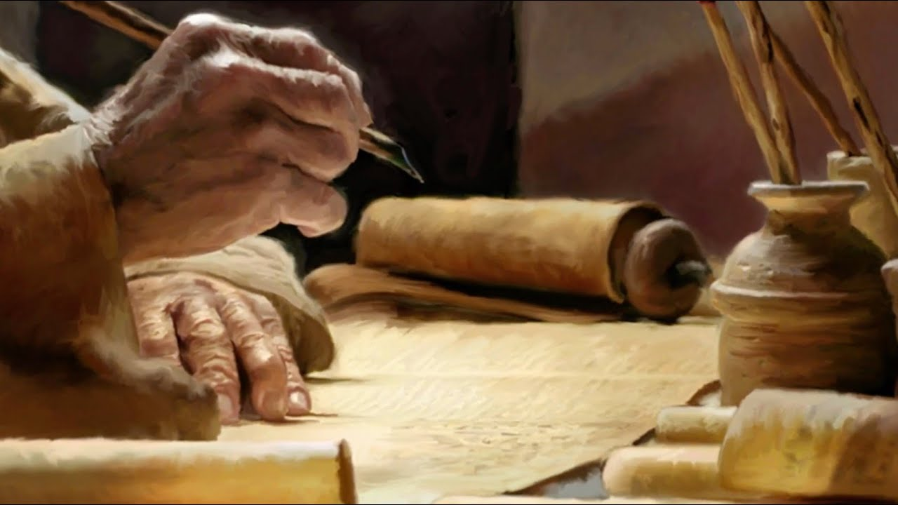
Ezekiel
The Watchman of Israel

Slide 3

Ezekiel: Outline
Judgement on Judah and Jerusalem (1-24)
Oracles against foreign nations (25-32)
Blessing for Judah and Jerusalem (33-48)

Slide 4
Oracles against foreign nations (25-32)
Chapter 25
1-7: Judgment Against Ammon
8-11: Judgement Against Moab
12-14: Judgement Against Edom
15-17: Judgement Against Philistia

Slide 5
Oracles against foreign nations (25-32)
Chapter 26
1-6: Sins of Tyre
7-14: Babylon Against Tyre
15-18: Princes of Tyre
19-21: People of Tyre

Slide 6
Oracles against foreign nations (25-32)
Chapter 27
1-11: Glory of Tyre
12-25: Wealth of Tyre
26-36: Lament of Surrounding Peoples

Slide 7
Oracles against foreign nations (25-32)
Chapter 28
1-10: Sins of the King of Tyre
11-19: Lament of the King of Tyre
20-24: Judgement of Sidon
25-26: Future Gathering of the House of Israel

Slide 8
Oracles against foreign nations (25-32)
Chapter 29
1-7: Judgement of Egypt
8-12: Desolation of Egypt
13-16: Egypt Brought Low
17-21: Babylon's Labor Against Tyre

Slide 9
Oracles against foreign nations (25-32)
Chapter 30
1-19: Lament Over Egypt
20-26: Victory of Babylon

Slide 10
Oracles against foreign nations (25-32)
Chapter 31
1-10: The Lofty Cedar Assyria
11-17: The Cedar Was Brought Down
18: Pharaoh is that Cedar

Slide 11
Oracles against foreign nations (25-32)
Chapter 32
1-16: Lament Over Pharaoh and Egypt
17-32: Fear in the Pit

