Slide 1
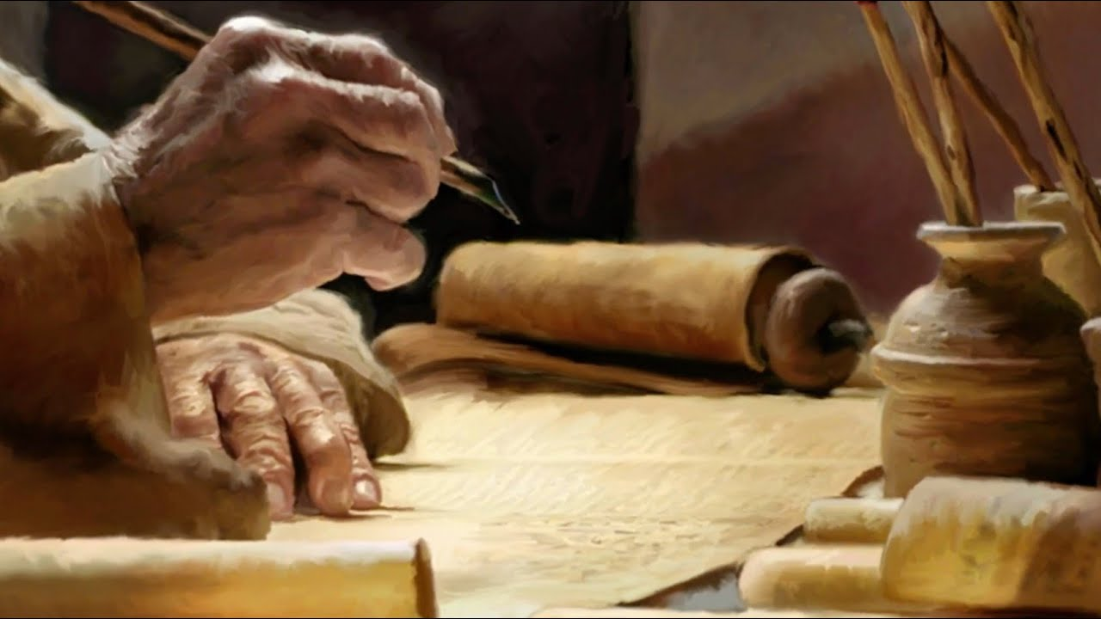
Ezekiel
The Watchman of Israel

Slide 2

Ezekiel: Outline
Judgement on Judah and Jerusalem (1-24)
Oracles against foreign nations (25-32)
Blessing for Judah and Jerusalem (33-48)

Slide 3
Judgement on Judah and Jerusalem (1-24)
Chapter 20
1-26: Sins of the Fathers
27-32: Thus Says the Lord God
33-44: Promise of restoration
45-49: Pronouncement against the Negev

Slide 4
Judgement on Judah and Jerusalem (1-24)
Chapter 21
1-17: The Sword of the Lord
18-28: The Path of the Sword

Slide 5
Judgement on Judah and Jerusalem (1-24)
Chapter 22
1-16: Sins of Jerusalem
17-22: Israel as Dross
23-31: No One to Stand in the Gap

Slide 6
Judgement on Judah and Jerusalem (1-24)
Chapter 23
1-10: Sins of Oholah
11-35: Sins of Oholibah
36-49: Further Judgment on the Sisters

Slide 7
Judgement on Judah and Jerusalem (1-24)
Chapter 24
1-14: The Babylonian Siege of Jerusalem
15-27: Death of Ezekiel’s Wife as a Sign

