Slide 1



Slide 2

We are surrounded by lies & dishonesty – cannot trust anything we’re told!
Christians must put away falsehood from us (4:25)
Christians must speak truth (4:25)
Christians must respect others and be honest (4:25)
NO EXCEPTIONS: It is never ok to lie!

Slide 3

We are surrounded by hateful words (4:29), hateful attitudes (4:31) and hateful actions (4:28, 31)
Christians must control their anger (4:26)
Christians must resist giving the devil an opportunity (4:27)
Christians must use edifying and grace-giving words (4:29)
Christians must have a compassionate attitude toward others (4:32)
Christians must lovingly serve the needs of others (4:28; 5:1-2)
Christians must practice the Golden Rule (Luke 6:31)
NO EXCEPTIONS: It is never ok to hate someone!

Slide 4

We are surrounded by sharp contention, division and polarization, pitting one group against another
Christians must remember that “God in Christ has forgiven you” (4:32)
Christians must focus on the “offering and sacrifice” of Christ (5:2)
The blood of Christ brings “near” those who are “far off” (2:13)
The blood of Christ breaks “down” “dividing walls” (2:14)
The blood of Christ “makes peace” where there is enmity (2:15)
The blood of Christ “reconciles” enemies “in one body” (2:16, 19-22)
The blood of Christ gives “access to the Father” equally to all (2:18)
The good news about Jesus Christ “draws all” together to Him (John 12:32)
NO EXCEPTIONS: No other power exists to solve all division problems!

Slide 5

We are surrounded by increasing “immorality” and “disobedience” (5:3-6)
Sin is not “fitting for saints” – we must avoid it and be thankful to avoid it (5:3-4)
Sin has no place “in the kingdom of Christ” – we must not participate (5:7, 11, 12)
Christians must “be the light” in the midst of darkness – be a holy people (5:8)
We must use the light (by teaching it and living it) to expose darkness (5:11-13)
We must be more concerned about what is pleasing to the Lord than to the world or to a political party (5:10)

Slide 6
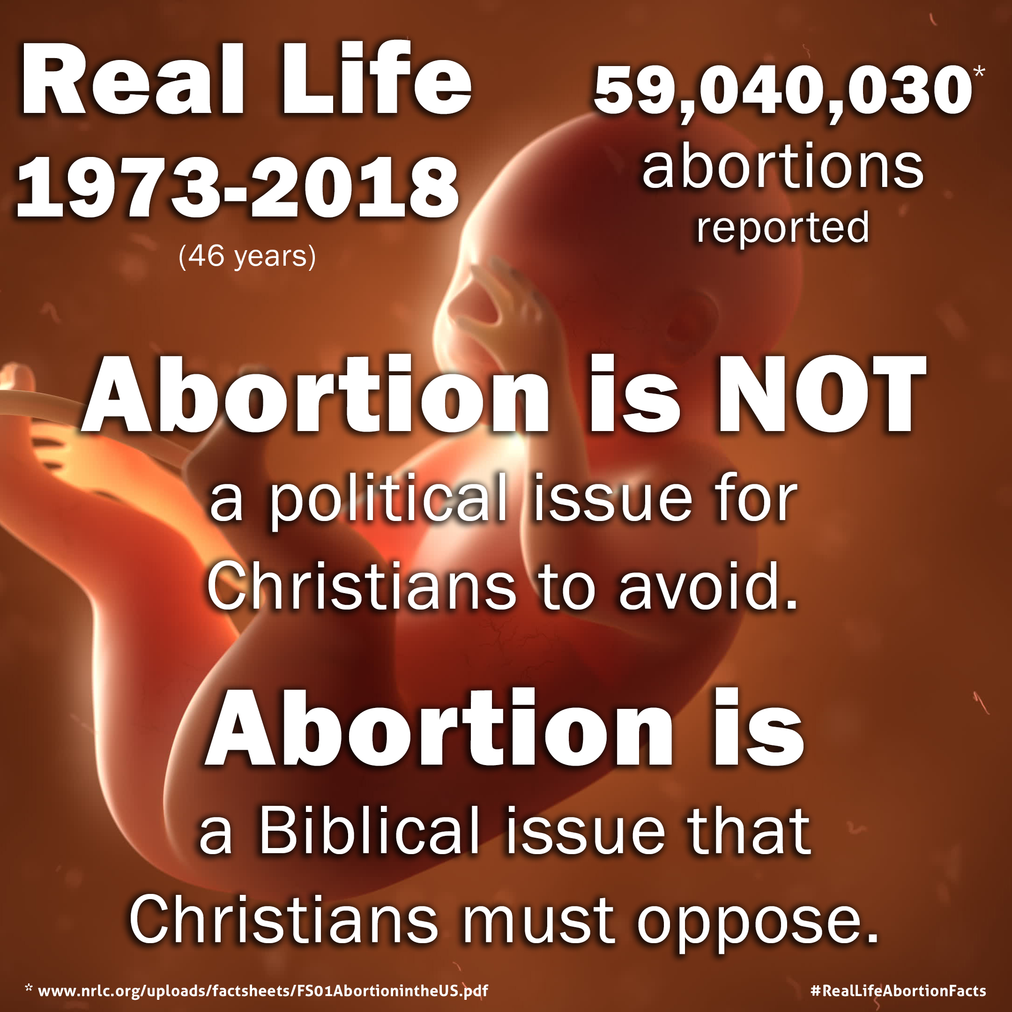
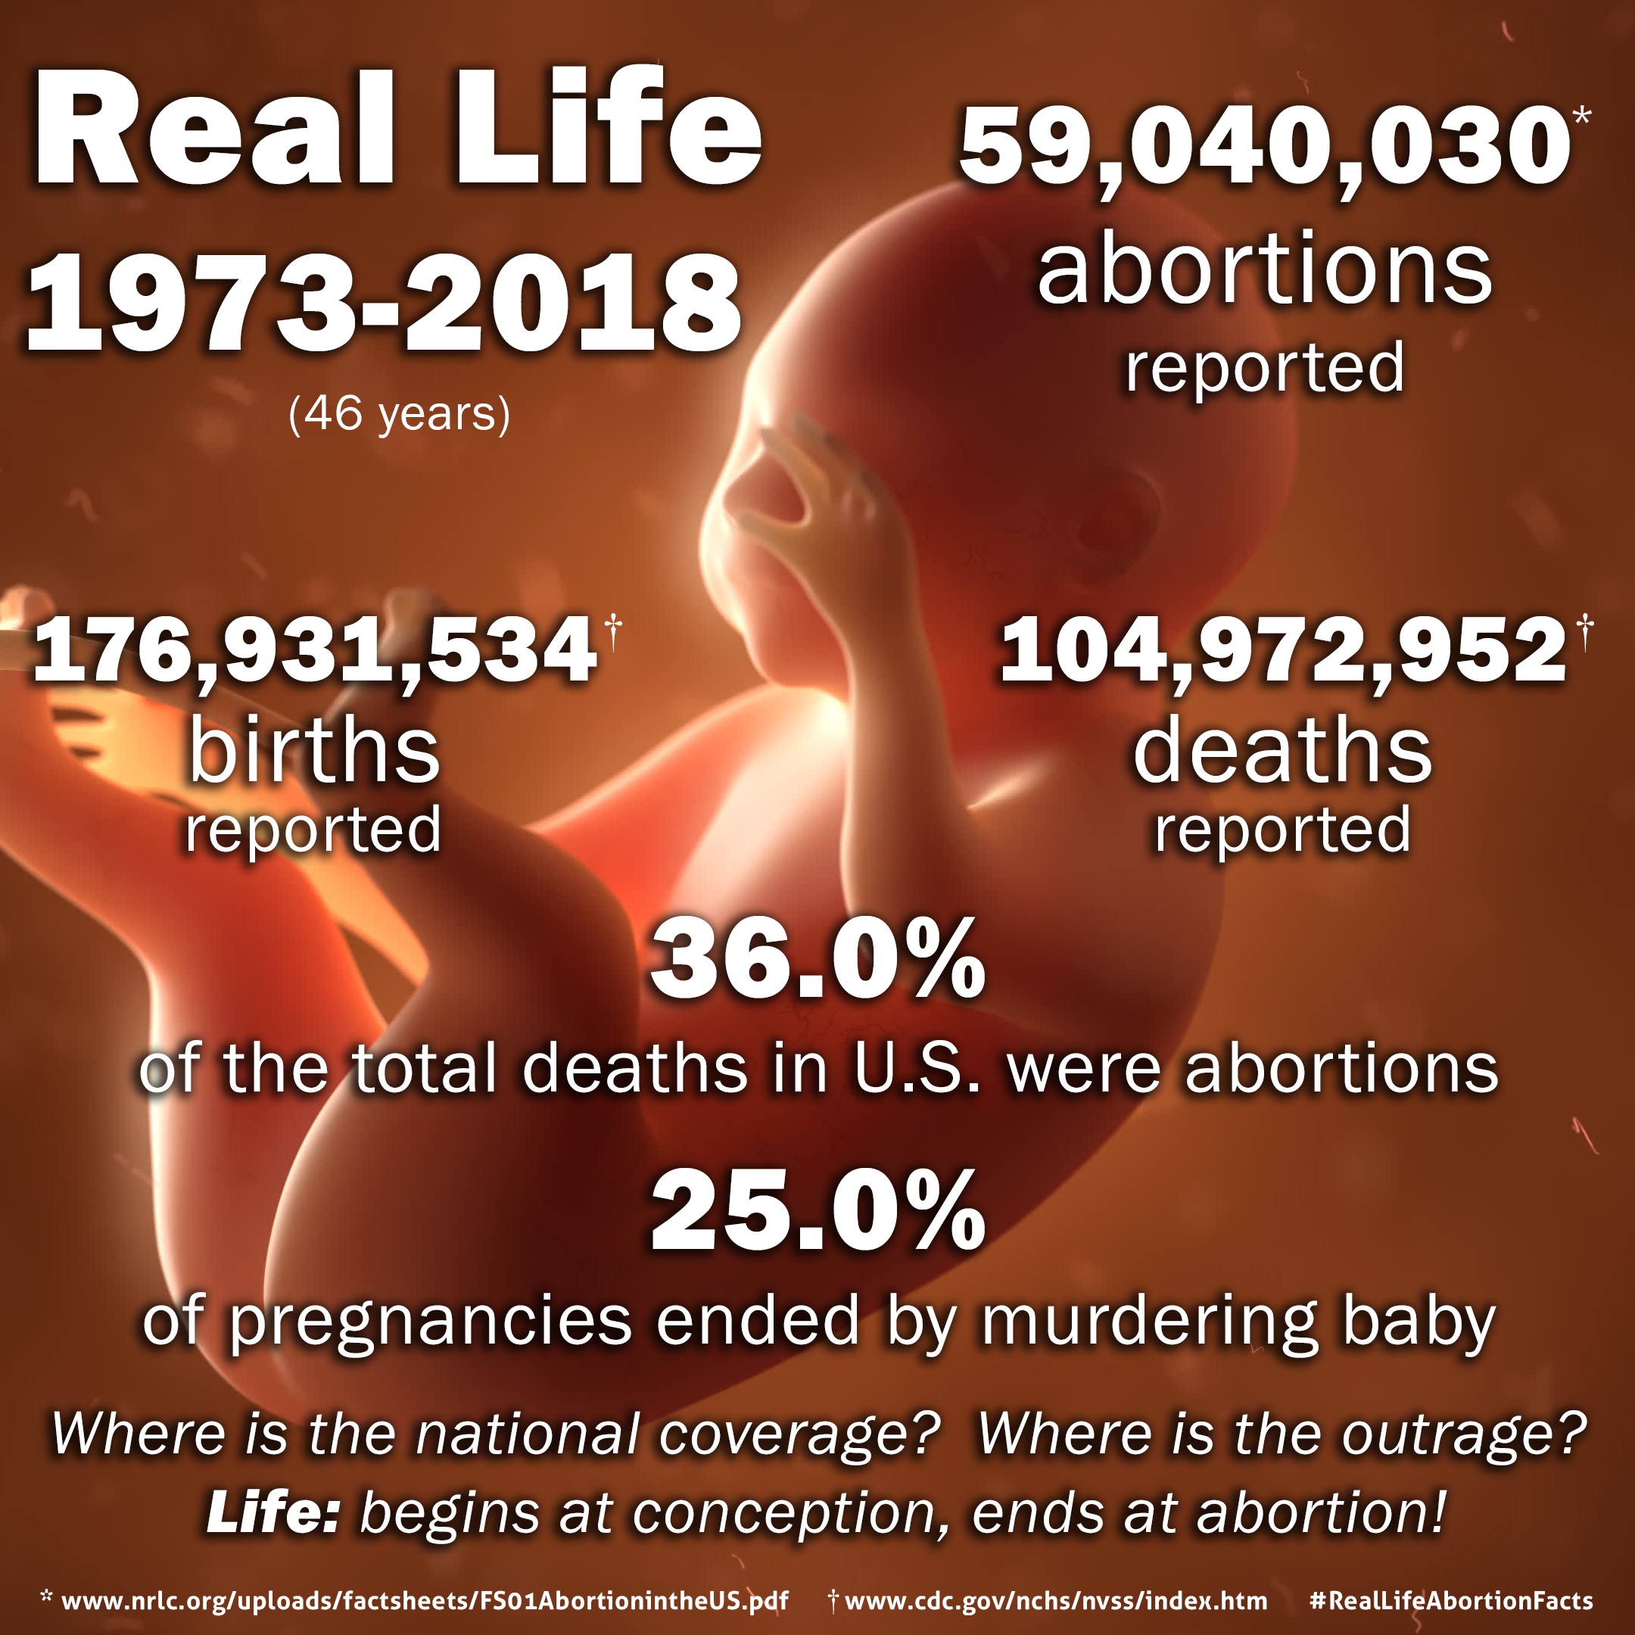
Between 1973 and 2018:
  36% of the deaths in the U.S. were abortions
  25% of pregnancies ended in abortion
Murdering babies is not just “some issue,” it is a horrendously sinful act that Christians cannot tolerate (Prov. 6:16-17)
When political policy intersects with Biblical truth, the Christian must be guided by, stand for, promote and defend Biblical truth…even seeking to influence political policy through adherence to Biblical truth (Acts 5:29)
#RealLifeAbortionFacts

Slide 7
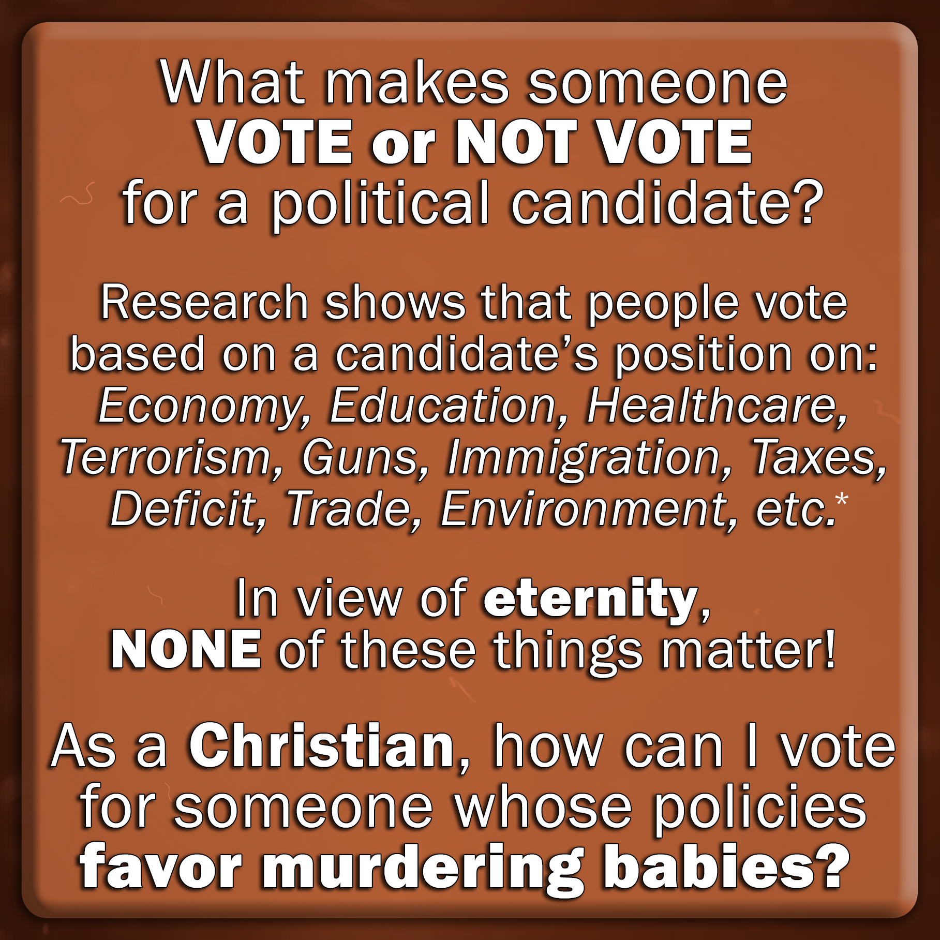
Between 1973 and 2018:
  36% of the deaths in the U.S. were abortions
  25% of pregnancies ended in abortion
Murdering babies is not just “some issue,” it is a horrendously sinful act that Christians cannot tolerate (Prov. 6:16-17)
When political policy intersects with Biblical truth, the Christian must be guided by, stand for, promote and defend Biblical truth…even seeking to influence political policy through adherence to Biblical truth (Acts 5:29)
#RealLifeAbortionFacts

Slide 8
We are surrounded by increasing “immorality” and “disobedience” (5:3-6)
Sin is not “fitting for saints” – we must avoid it and be thankful to avoid it (5:3-4)
Sin has no place “in the kingdom of Christ” – we must not participate (5:7, 11, 12)
Christians must “be the light” in the midst of darkness – be a holy people (5:8)
We must use the light (by teaching it and living it) to expose darkness (5:11-13)
We must be more concerned about what is pleasing to the Lord than to the world or to a political party (5:10)
NO EXCEPTIONS: It is never ok to look like the world!
It is always right to look like Christ!

Slide 9


Slide 10

Believe Jesus is God’s Son – John 8:24
Repent of your sins and turn to God – 2 Peter 3:9
Confess your faith in Jesus Christ – Romans 10:10
Be immersed into Christ – Galatians 3:27
  God will forgive all of your sins – Acts 2:38
  God will add you to His church – Acts 2:47
  God will enroll you in heaven – Hebrews 12:23
Follow Christ faithfully – 1 Corinthians 15:58
  If you’ve strayed, repent and turn away from your sins – Acts 8:22
  If you’ve strayed, confess your sins and ask for forgiveness – 1 John 1:9

