Slide 1
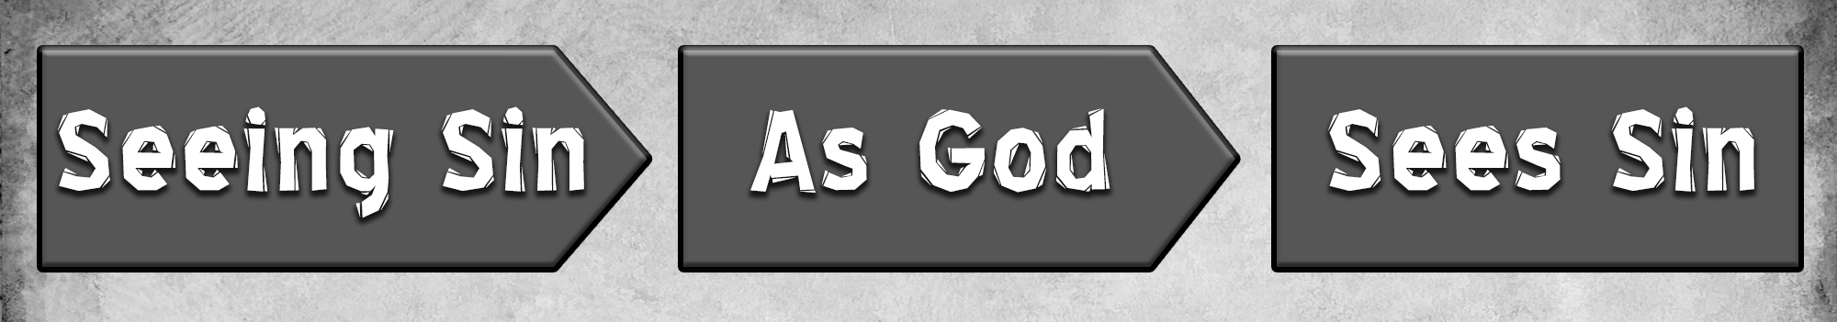


Slide 2
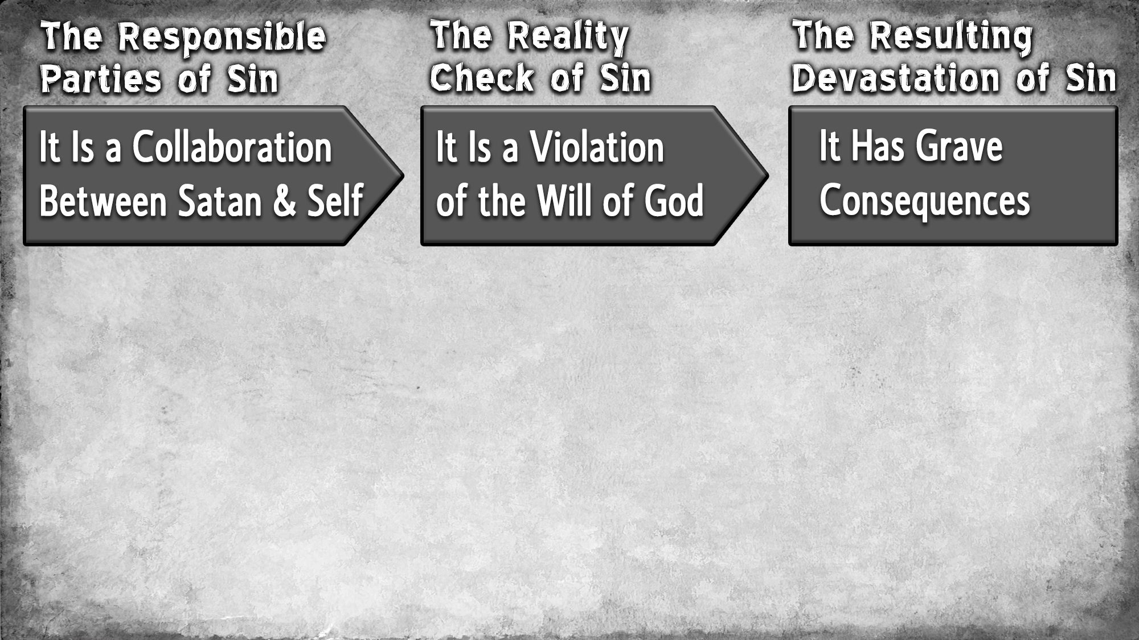
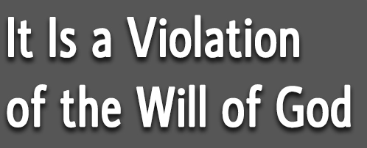
Sin is an act against God Himself (Psa. 51:4; Gen. 39:9)
Sin is an act against the very nature of God (Hab. 1:13; Isa. 6:3; 1 Jn. 1:5)
Sin is an act in violation of God’s will (Jer. 44:23; 1 John 3:4)
Sin grieves, displeases & angers God (Heb. 3:17; Num. 32:10-15; Gen. 6:6)

Slide 3
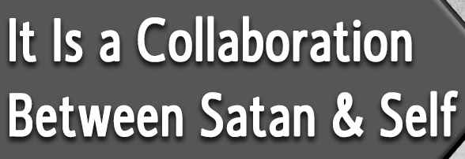
Sin is the result of Satan’s deceptions (1 John 3:8; 2 Cor. 11:3; Heb. 3:13)
Sin is the result of yielding to Satan’s influence (Acts 5:3-4)
Sin is the result of selfish desires (Jas. 1:14-16; 1 John 2:16)
Sin is the result of personal choice (1 John 3:4; Ezek. 18:20)

Slide 4
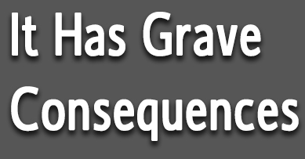
Right now, sin enslaves (John 8:34; Rom. 7:23-25; 2 Pet. 2:19)
Right now, sin separates (Isa. 59:1-2; Rom. 6:23; Jas. 4:4)
Right now, sin blots out (Ex. 32:33; Rev. 3:5)
Right now & in eternity, sin must be punished (Gal. 6:7; Ex. 32:23; Ro. 1:32)
In eternity, sin brings about eternal destruction (2 Th. 1:8-9; Matt. 25:46)
In eternity, sin brings about separation from God (Lk. 13:27-28; 2 Th. 1:9)

Slide 5

Jesus came to “destroy the works of the devil” (1 John 3:8)
Jesus came to “take away our sins” (1 John 3:5)
Jesus sacrificed Himself to “put away sin” (Heb. 9:26, 22)
Jesus shed His blood to “wash us from our sins” (Rev. 1:5; Mt. 26:28; Col. 1:14)
Jesus’ saving blood is only accessible through baptism (Rom. 6:3, 6-7, 17-18)
Jesus’ saving blood is only accessible to those “in Christ” (Eph. 1:7)
Jesus’ saving blood only remains accessible through faithful living (1 John 1:7)

Slide 6
Believe Jesus is God’s Son – Acts 16:31
Repent of your sins and turn to God – Acts 3:19
Confess your faith in Jesus Christ – Romans 10:9
Be immersed into Christ – Acts 2:38
Walk faithfully with Him – 1 John 1:7

