Slide 1
His Presence in His Tabernacle
Psalm 46:1-7

Slide 2
The Text—Psalm 46:1-7
In Spirit and in Truth--Praying
1 God is our refuge and strength, A very present help in trouble.
2 Therefore we will not fear, Even though the earth be removed, And though the mountains be carried into the midst of the sea;
3 Though its waters roar and be troubled, Though the mountains shake with its swelling. Selah
4 There is a river whose streams shall make glad the city of God, The holy place of the tabernacle of the Most High.
5 God is in the midst of her, she shall not be moved; God shall help her, just at the break of dawn.
6 The nations raged, the kingdoms were moved; He uttered His voice, the earth melted.
7 The LORD of hosts is with us; The God of Jacob is our refuge. Selah

Slide 3
Before Looking at the Text—Psalm 46:1-7
In Spirit and in Truth--Praying
Providence in David’s Life
Providence in Hezekiah’s Day
Providence in the Church today—look at the text

Slide 4
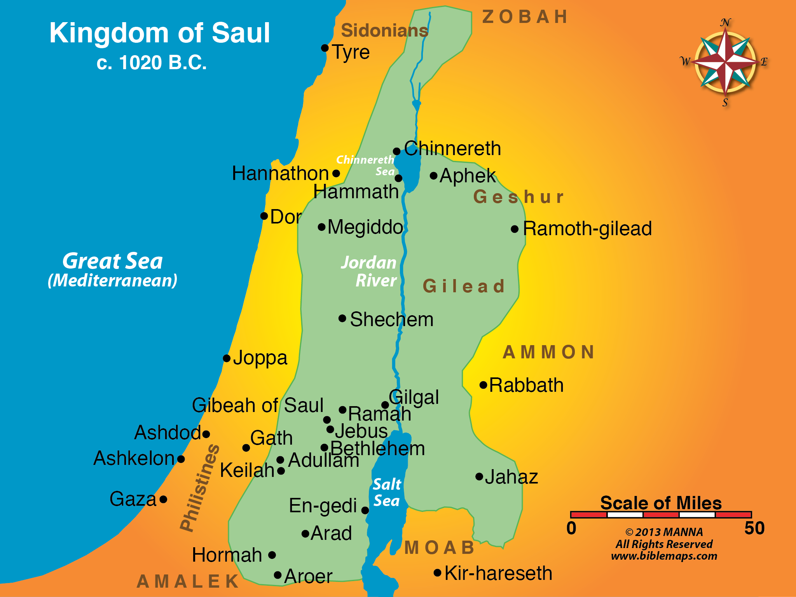
Kingdom of Saul—During Young David’s Life
In Spirit and in Truth--Praying
Life of David
Goliath
Saul’s “general”
Saul’s enemy
Saul’s army seeks his life
This part of his life is background of many psalms

Slide 5
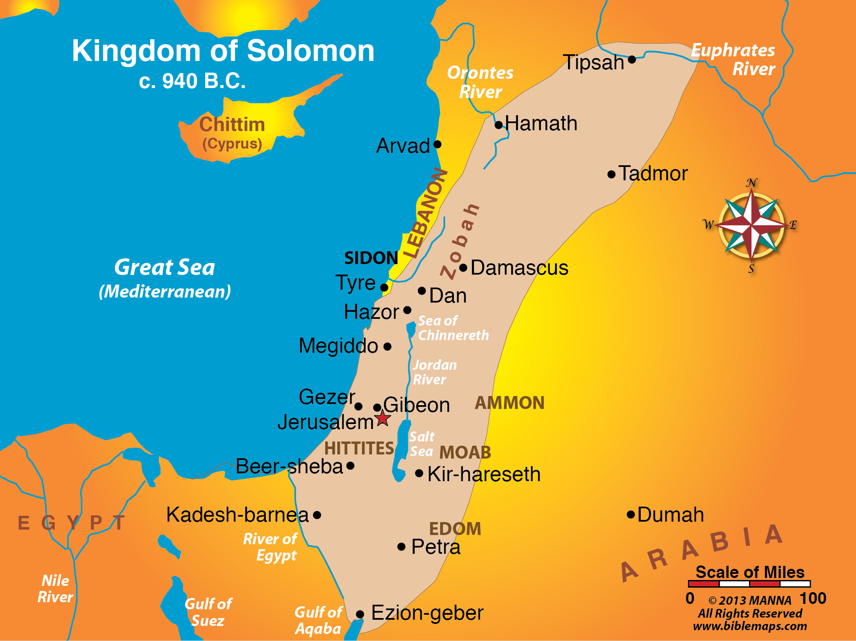
Expansion of Kingdom by David & Solomon
In Spirit and in Truth--Praying
David’s Kingdom
Saul slain by Philistines
David’s kingdom expands
Borders expanded even more by Solomon
From Euphrates to River of Egypt

Slide 6
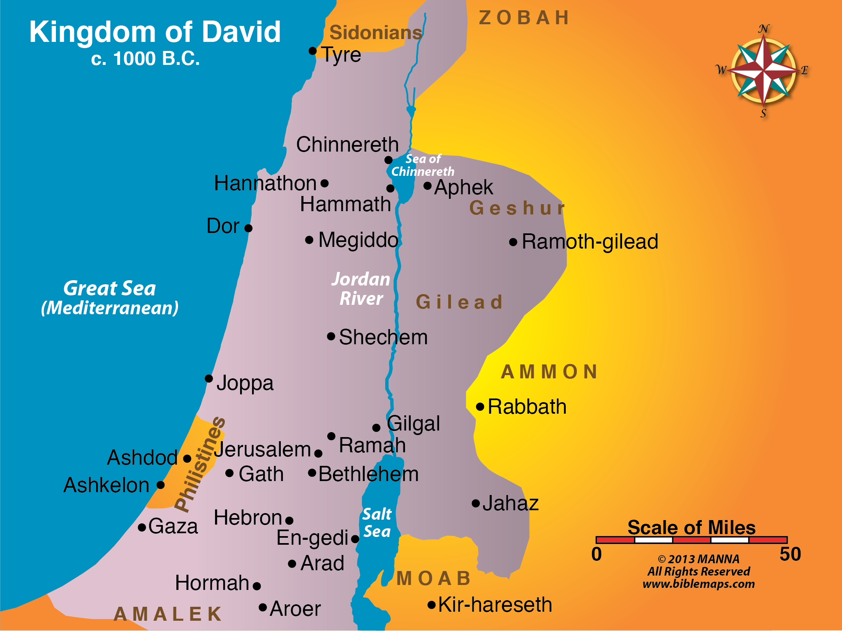
Kingdom of David—God’s Providence
In Spirit and in Truth--Praying

Slide 7
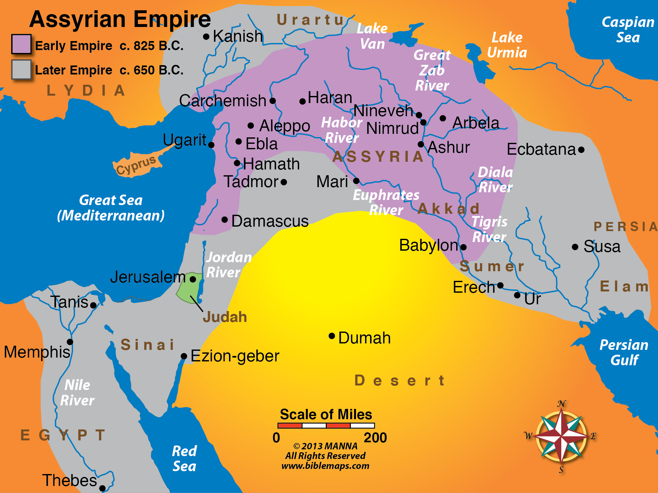
Kingdom of Assyria During Hezekiah’s Reign
In Spirit and in Truth--Praying
Assyrian Growth
Solomon’s death, kingdom divided
Northern Kingdom, Israel falls in 722 B.C.
Jerusalem under siege in days of Hezekiah’s reign
God delivers the holy city, Jerusalem

Slide 8
The Text—Psalm 46:1-7
In Spirit and in Truth--Praying
1 God is our refuge and strength, A very present help in trouble.
2 Therefore we will not fear, Even though the earth be removed, And though the mountains be carried into the midst of the sea;
3 Though its waters roar and be troubled, Though the mountains shake with its swelling. Selah
4 There is a river whose streams shall make glad the city of God, The holy place of the tabernacle of the Most High.
5 God is in the midst of her, she shall not be moved; God shall help her, just at the break of dawn.
6 The nations raged, the kingdoms were moved; He uttered His voice, the earth melted.
7 The LORD of hosts is with us; The God of Jacob is our refuge. Selah

Slide 9
God Is In The Midst of Us—His Tabernacle/Temple
In Spirit and in Truth--Praying
16 Do you not know that you are the temple of God and that the Spirit of God dwells in you?
17 If anyone defiles the temple of God, God will destroy him. For the temple of God is holy, which temple you are.
1 Cor. 3:16-17

Slide 10
God Is In The Midst of Us—His Tabernacle/Temple
In Spirit and in Truth--Praying
16 Do you not know that you are the temple of God and that the Spirit of God dwells in you?
17 If anyone defiles the temple of God, God will destroy him. For the temple of God is holy, which temple you are.
1 Cor. 3:16-17
5 Let your conduct be without covetousness; be content with such things as you have. For He Himself has said, "I will never leave you nor forsake you."
6 So we may boldly say: "The Lord is my helper; I will not fear. What can man do to me“
Hebrews 13:5-6

Slide 11
Christ Is In The Midst of Us—His Tabernacle/Temple
In Spirit and in Truth--Praying
18 And Jesus came and spoke to them, saying, "All authority has been given to Me in heaven and on earth.
19 Go therefore and make disciples of all the nations, baptizing them in the name of the Father and of the Son and of the Holy Spirit,
Mat 28:20 teaching them to observe all things that I have commanded you; and lo, I am with you always, even to the end of the age." Amen. Matt. 28:18-20

Slide 12
Christ Is In The Midst of Us—His Tabernacle/Temple
In Spirit and in Truth--Praying
18 And Jesus came and spoke to them, saying, "All authority has been given to Me in heaven and on earth.
19 Go therefore and make disciples of all the nations, baptizing them in the name of the Father and of the Son and of the Holy Spirit,
Mat 28:20 teaching them to observe all things that I have commanded you; and lo, I am with you always, even to the end of the age." Amen. Matt. 28:18-20
11 For both He who sanctifies and those who are being sanctified are all of one, for which reason He is not ashamed to call them brethren,
12 saying: "I will declare Your name to My brethren; in the midst of the assembly I will sing praise to You.“
Heb. 2:11-12

Slide 13
Blessings Because He Is In Our Midst
In Spirit and in Truth--Praying
Fellowship with God
7 But if we walk in the light as He is in the light, we have fellowship with one another, and the blood of Jesus Christ His Son cleanses us from all sin.
1 John 1:7

Slide 14
Blessings Because He Is In Our Midst
In Spirit and in Truth--Praying
Fellowship with God
Eternal salvation, forgiveness redemption
3 Blessed be the God and Father of our Lord Jesus Christ, who has blessed us with every spiritual blessing in the heavenly places in Christ,
4 just as He chose us in Him before the foundation of the world, that we should be holy and without blame before Him in love,
5 having predestined us to adoption as sons by Jesus Christ to Himself, according to the good pleasure of His will,
6 to the praise of the glory of His grace, by which He made us accepted in the Beloved.
7 In Him we have redemption through His blood, the forgiveness of sins, according to the riches of His grace.
Eph. 1:3-7

Slide 15
Blessings Because He Is In Our Midst
In Spirit and in Truth--Praying
Fellowship with God
Eternal salvation, forgiveness redemption
Victory over sin and Satan
4 For whatever is born of God overcomes the world. And this is the victory that has overcome the world—our faith.
5 Who is he who overcomes the world, but he who believes that Jesus is the Son of God?
1 John 5:4-5

Slide 16
Blessings Because He Is In Our Midst
In Spirit and in Truth--Praying
Fellowship with God
Eternal salvation, forgiveness redemption
Victory over sin and Satan
31 What then shall we say to these things? If God is for us, who can be against us?
32 He who did not spare His own Son, but delivered Him up for us all, how shall He not with Him also freely give us all things? . . .
35 Who shall separate us from the love of Christ? Shall tribulation, or distress, or persecution, or famine, or nakedness, or peril, or sword? . . .
37 Yet in all these things we are more than conquerors through Him who loved us.
38 For I am persuaded that neither death nor life, nor angels nor principalities nor powers, nor things present nor things to come,
39 nor height nor depth, nor any other created thing, shall be able to separate us from the love of God which is in Christ Jesus our Lord. Rom. 8:31-39

Slide 17
Blessings Because He Is In Our Midst
In Spirit and in Truth--Praying
Fellowship with God
Eternal salvation, forgiveness redemption
Victory over sin and Satan
Security and providence
27 My sheep hear My voice, and I know them, and they follow Me.
28 And I give them eternal life, and they shall never perish; neither shall anyone snatch them out of My hand.
29 My Father, who has given them to Me, is greater than all; and no one is able to snatch them out of My Father's hand.
John 10:27-29

Slide 18
Blessings Because He Is In Our Midst
In Spirit and in Truth--Praying
Fellowship with God
Eternal salvation, forgiveness redemption
Victory over sin and Satan
Security and providence
26 There is no one like the God of Jeshurun, Who rides the heavens to help you, And in His excellency on the clouds.
27 The eternal God is your refuge, And underneath are the everlasting arms; He will thrust out the enemy from before you, And will say, Destroy!
28 Then Israel shall dwell in safety, The fountain of Jacob alone, In a land of grain and new wine; His heavens shall also drop dew.
29 Happy are you, O Israel! Who is like you, a people saved by the LORD, The shield of your help And the sword of your majesty! Your enemies shall submit to you, And you shall tread down their high places. Deut. 33:26-29

Slide 19
Getting God in Your Midst
Believe Heb. 11:6
Repent Acts 17:30
Confess Faith in Him Rom. 10:9
Be Baptized Into Him Gal. 3:27
You are Now a Member of His Flock—His Glorious Church
Now be faithful until you die Rev. 2:10

Slide 20
Becoming a Servant in the Church
Believe Heb. 11:6
Repent Acts 17:30
Confess Faith in Him Rom. 10:9
Be Baptized Into Him Gal. 3:27
You are Now a Member of His Flock—His Glorious Church
Now be faithful until you die Rev. 2:10

