Slide 2

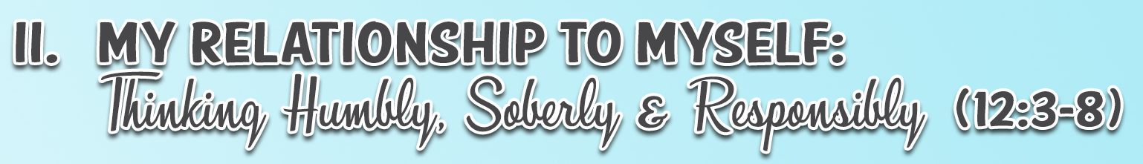
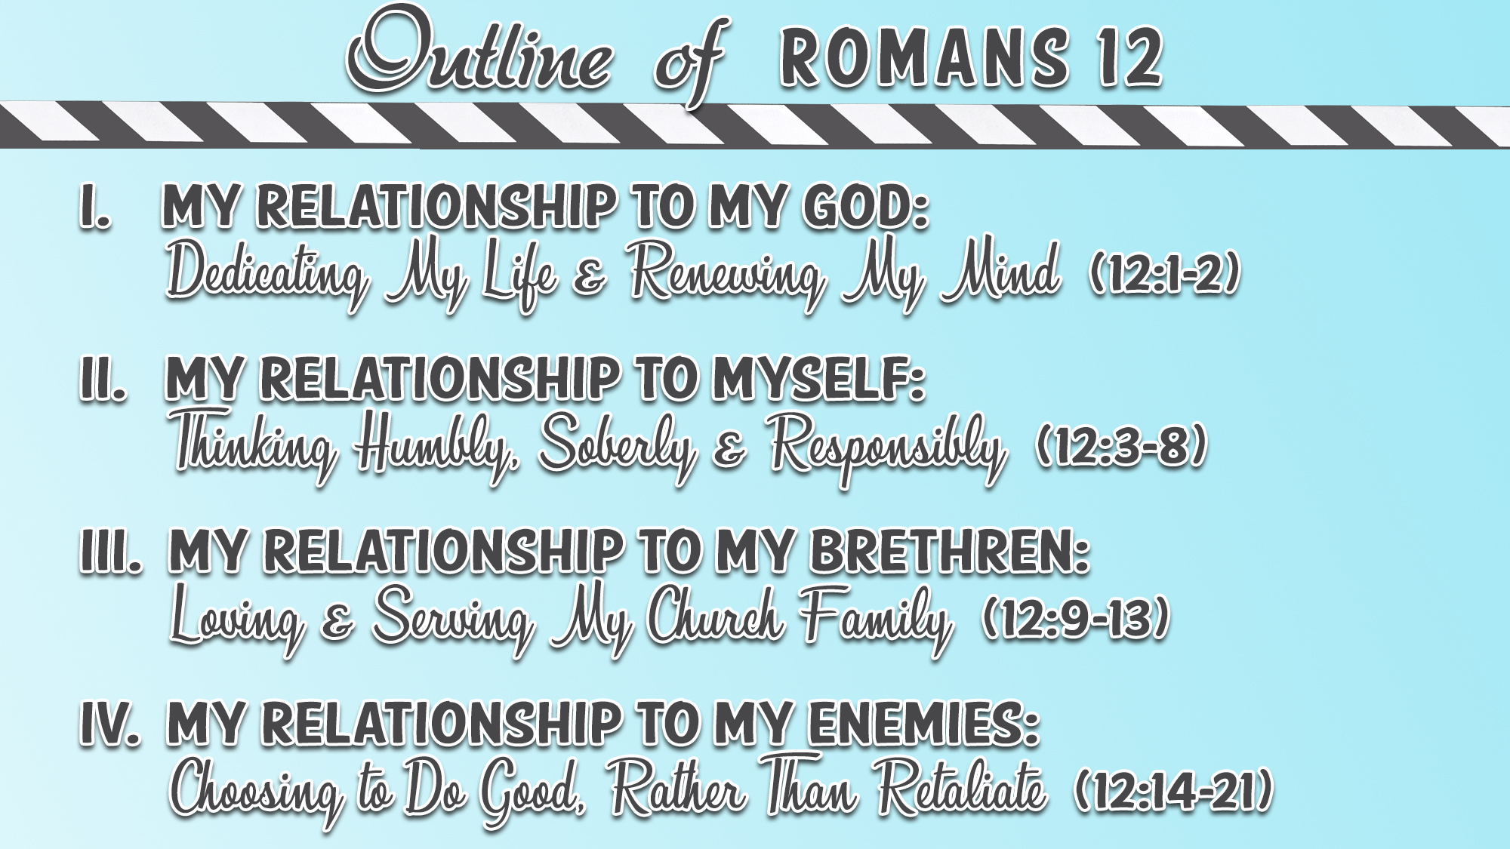

Slide 3
Choose to Do Good (12:14-16)
Bless those who persecute you (12:14)
Bless and do not curse (12:14)
Rejoice with those who rejoice (12:15)
Weep with those who weep (12:15)
Be of the same mind toward one another (12:16)
Do not set your mind on high things (12:16)
Associate with the humble (12:16)
Do not be wise in your own opinion (12:16)

Slide 4
Choose to Not Retaliate (12:17-21)
Never pay back evil for evil to anyone (12:17)
Have regard for good things in the sight of all men (12:17)
Live peaceably with all men (12:18)
Never take your own revenge (12:19)
Leave room for the wrath of God (12:19)

Slide 5
Choose to Not Retaliate (12:17-21)
Serve your enemy (12:20)
  Our proper response to mistreatment from our enemies involves “so doing” acts of kindness (quoting from Prov. 25:21-22)
    Present tense verb emphasizes habitual action
  Rather than retaliate, we are told to monitor the needs of our enemy
    If hungry, feed him
      Greek means “to feed with morsels, as nurses feed crumbs to a baby; supply with food in general”
    If thirsty, give him drink
    God does not call us to do the unreasonable or the unattainable

Slide 6
Choose to Not Retaliate (12:17-21)
Serve your enemy (12:20)
  By serving our enemies, good can result
    This is in addition to any good that can and will result for us personally (Luke 6:27-38)
    Serving our enemy will “heap burning coals of fire on his head”
      The Greek word for “burning coals” is “anthrax” – English word “anthracite” comes from this
      The use of the term signifies “retribution by kindness”
  Pain inflicted by burning coals was a symbol of shame and remorse experienced by the enemy who is rebuked by kindness
    Intended to heal, not hurt; to win, not to alienate; to shame into repentance

Slide 7
Choose to Not Retaliate (12:17-21)
Serve your enemy (12:20)
  Two positive alternatives to revenge:
    Leave any necessary punishment to God (12:19)
    Get busy in serving our enemy’s needs, genuinely seeking his highest good (12:20)
  When we are hurt by others, consciously decide to love them anyway (12:14-21)

Slide 8
Choose to Not Retaliate (12:17-21)
Overcome evil with good (12:20)
  Two present imperatives in this verse, emphasizing a regular life choice
  A stark alternative is set out in this verse – no neutrality, no middle way
  “Do not be overcome by evil”
    The Greek word involves being conquered (present tense verb)
    Stop being overcome by evil would include:
      Cursing those who persecute us (12:14)
      Repaying evil for evil (12:17)
      Taking revenge (12:19)
    All of these are evil responses to evil

Slide 9
Choose to Not Retaliate (12:17-21)
Overcome evil with good (12:20)
  “Overcome evil with good”
    Present tense emphasizes “keep on overcoming and conquering the evil thing”
    If we refuse to retaliate, we can instead practice positive counterparts to revenge:
      Bless our persecutors (12:14)
      Be seen focusing on and doing good (12:17)
      Strive to be active in peacemaking and peacekeeping (12:18)
      Leave all retaliation and punishment to God (12:19)
      Love and serve our enemy (12:20)
    All of these are good responses to evil
  Let us seek to repay good for evil, rather than repay evil for evil (Prov. 17:13)

